Slide 1
ATP Synthesis
The ATP Synthase Enzyme
Notes:
Welcome to part 1 of our lecture on ATP Synthesis in the Mitochondria. Here we will explore the structure and function of this ATP Synthase Enzyme

Slide 2
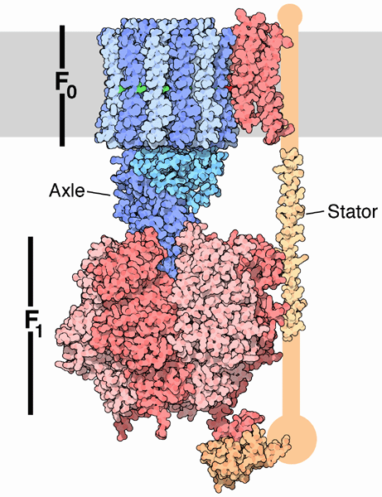
Rotary Motors
Intermembrane
Space
Matrix
Is composed of two rotary motors that uses the proton motive force to make ATP
Image from : Goodsell, D. (2012) Molecule of the Month, Protein Database
Notes:
ATP synthase is one of the wonders of the molecular world. ATP synthase is an enzyme, a molecular motor, an ion pump, and another molecular motor all wrapped together in one amazing nanoscale machine. It plays an indispensable role in our cells, building most of the ATP that powers our cellular processes. ATP synthesis is composed of two rotary motors, each powered by a different fuel. The motor at the top, termed F0, an electric motor. It is embedded in a membrane (shown schematically as a gray stripe here), and is powered by the flow of hydrogen ions across the membrane. As the protons flow through the motor, they turn a circular rotor (shown in blue). This rotor is connected to the second motor, termed F1. The F1 motor is a chemical motor, powered by ATP. The two motors are connected together by a stator, shown on the right.
Text from : Goodsell, D. (2012) Molecule of the Month, Protein Database

Slide 3
Motor to Generator
Intermembrane
Space
Each motor can drive the other
If F₀ is allowing the flow of H+ to the matrix – F₁ is activated and produces ATP
If F₁ is active, the Hydrolysis of ATP to ADP and Pi, is used to make the F₀ domain pump protons into the intermembrane space
Matrix
Image from : Goodsell, D. (2012) Molecule of the Month, Protein Database
Notes:
So why have two motors connected together? The trick is that one motor can force the other motor to turn, and in this way, change the motor into a generator. This is what happens in our cells: the F0 motor uses the power from a proton gradient to force the F1 motor to generate ATP. In our cells, food is broken down and used to pump hydrogen ions across the mitochondrial membrane. The F0 portion of ATP synthase allows these ions to flow back, turning the rotor in the process. As the rotor turns, it turns the axle and the F1 motor becomes a generator, creating ATP as the F0 domain turns. Remarkably, cells build similar molecular machines, such as the vacuolar ATPase, that work in reverse, using an ATP-driven motor to pump protons across a membrane.
Text from : Goodsell, D. (2012) Molecule of the Month, Protein Database

Slide 4
Parts List
Intermembrane
Space
‘a’ subunit linker between the
stator (b subunits) and the H+
transporters (c subunits)
‘a’ subunit feeds H+ into the c subunits
10 H+ transporters (c subunits)
Stator – b subunits (part of the electric generator that is stationary)
δ subunit attaches the α and β subunits to the stator
c
c
c
c
Inner
membrane
F₀
c
a
ε
Matrix
γ
b
b
β
α
β
F₁
δ
α
β
α
Notes:
The F0 domain and the stator are given English letter designations for each of the subunits. The ‘b’ subunit of the ATP Synthase is known as the stator, or the portion of the protein motor that does not move. It also connects the both the F0 and F1 domains, through linker subunits. The ‘a’ subunit is an important subunit that links the stator with the ‘c’-subunits and it is also critical for helping the c-subunits adopt the correct conformation for harvesting H+ from the intermitochondrial space and then changing shape to release them into the matrix. We will visualize this process more fully over the next several slides, but before we get there, let’s talk about structure of the F1 domain.

Slide 5
Parts List
Intermembrane
Space
c
c
c
c
Inner
membrane
The α subunits can bind ATP and Pi, but are not catalytic
The β subunits are the catalytic domains that produce ATP
F₀
c
a
ε
Matrix
γ
b
b
β
α
β
F₁
δ
α
β
α
Notes:
The stator attaches to the F1 domain through the delta subunit. Recall that the stator (subunit bb) is immobile. The F0 and F1 domains are also connected together by the gamma and epsilon subunits of the protein that functions like an axle that can be used to connect and rotate the F₀ motor domains. The alpha subunits are not catalytically active, but can bind to ATP or ADP and Mg2+. The beta subunits are the catalytically active subunits that produce the ATP from ADP + Pi. While the stator remains still, the F0 domain can spin in a counterclockwise direction due to the proton motive force. The axle subunits (gamma and epsilon) also spin in a counter clockwise direction and cause changes in the conformation of the beta subunits in the F1 domain that lead to the synthesis of ATP.

Slide 6
The Proton Motor
H⁺
H⁺
H⁺
H⁺
H⁺
H⁺
H⁺
H⁺
Intermembrane
Space (IMS)
H⁺
H⁺
H⁺
F₀
Inner
membrane
E⁻
a
The ‘a’ subunit helps load the c1 subunit with a proton (H+) from the IMS
c1
Matrix
b
b
β
α
β
F₁
δ
α
β
α
Notes:
In the first step within the F0 domain, the interaction of the c1 subunit with the ‘a’ subunit causes the conformational change of the c1 subunit that opens a half-channel that is open to the intermembrane space (IMS). A H+ flows in and coordinates with a negatively charged glutamate residue. The c-subunits rotate in a counterclockwise direction relative to the stationary stator and linker proteins (‘a’ and delta subunits)

Slide 7
The Proton Motor
H⁺
H⁺
H⁺
H⁺
H⁺
H⁺
H⁺
H⁺
Intermembrane
Space
H⁺
H⁺
Inner
membrane
H⁺
F₀
E⁻
a
Loading of the c-subunits causes the F₀ motor to move in the counterclockwise direction
c1
Matrix
b
b
β
α
β
F₁
δ
α
β
α
Notes:
The c subunits continue to rotate until they reach the other side of the ‘a’ subunit. Note that rotation of the c-subunits also moves the gamma axle subunit. Once the loaded c-subunit shifts away from the ‘a’ subunit, the half channel closes. Locking the proton inside the channel until it reaches the other side of the ‘a’ subunit.

Slide 8
The Proton Motor
H⁺
H⁺
H⁺
H⁺
H⁺
H⁺
H⁺
H⁺
Intermembrane
Space
H⁺
H⁺
H⁺
F₀
Inner
membrane
E⁻
a
Loading of the c-subunits causes the F₀ motor to move in the counterclockwise direction
c1
Matrix
b
b
β
α
β
F₁
δ
α
β
α
Notes:
It keeps rotating and…

Slide 9
The Proton Motor
H⁺
H⁺
H⁺
H⁺
H⁺
H⁺
H⁺
H⁺
Intermembrane
Space
H⁺
H⁺
Inner
membrane
H⁺
F₀
E⁻
a
Loading of the c-subunits causes the F₀ motor to move in the counterclockwise direction
c1
Matrix
b
b
β
α
β
F₁
δ
α
β
α
Notes:
Rotating…

Slide 10
The Proton Motor
H⁺
H⁺
H⁺
H⁺
H⁺
H⁺
H⁺
H⁺
Intermembrane
Space
H⁺
H⁺
Inner
membrane
H⁺
F₀
E⁻
a
Loading of the c-subunits causes the F₀ motor to move in the counterclockwise direction
c1
Matrix
H⁺
b
b
β
α
β
H⁺
F₁
δ
ADP + Pi
α
β
α
ATP
Notes:
Until the loaded c-subunit reaches the other side of the ‘a’ subunit, the c-subunit changes conformation to open up a half channel to the matrix side, causing the proton to flow out of the channel and into the matrix. This flow utilizes the proton motive force to drive the rotation of the F0 domain, which alters the catalytic activity of the beta subunits that leads the production and release of the ATP molecules from the synthase.

Slide 11
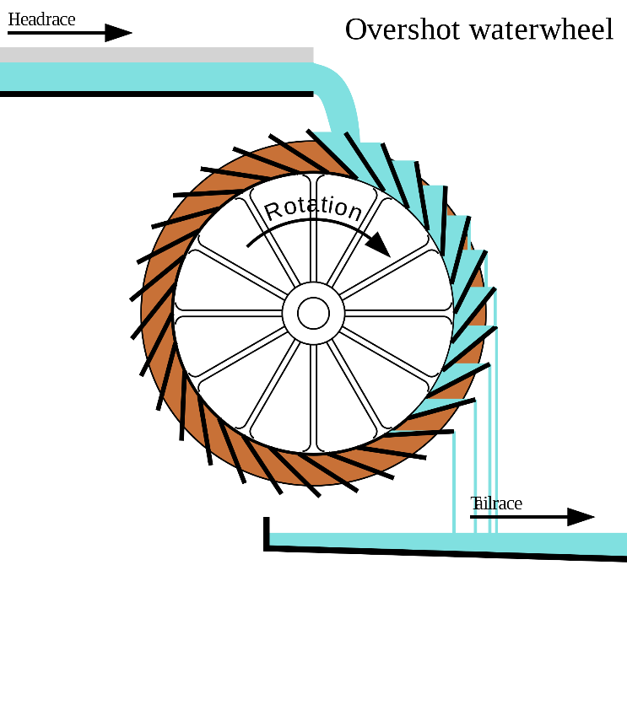
The Proton Motor
H⁺
H⁺
H⁺
H⁺
H⁺
H⁺
H⁺
Intermembrane
Space
H⁺
H⁺
H⁺
H⁺
H⁺
H⁺
H⁺
F₀
Inner
membrane
E⁻
E⁻
E⁻
E⁻
E⁻
a
c4
c3
c2
c1
C10
Matrix
H⁺
b
b
β
α
β
H⁺
F₁
δ
α
β
α
Water wheel image from Malcom.Boura
Notes:
Note that all of the c-subunits are active and working in concert with one another to drive the rotation of the c-subunit motor. It is a bit like a water wheel that uses the force of water to generate the movement of the rotational motor. So, you are essentially pouring in protons at the top, which generates movement of the c-subunits until the proton can be off loaded on the opposite side of the membrane. That subunit is now empty and can be filled again when the c-subunits shift positions, generating a rotational motor that is driven by the proton motive force. If the proton gradient is depleted, then the motor will shut off.

Slide 12
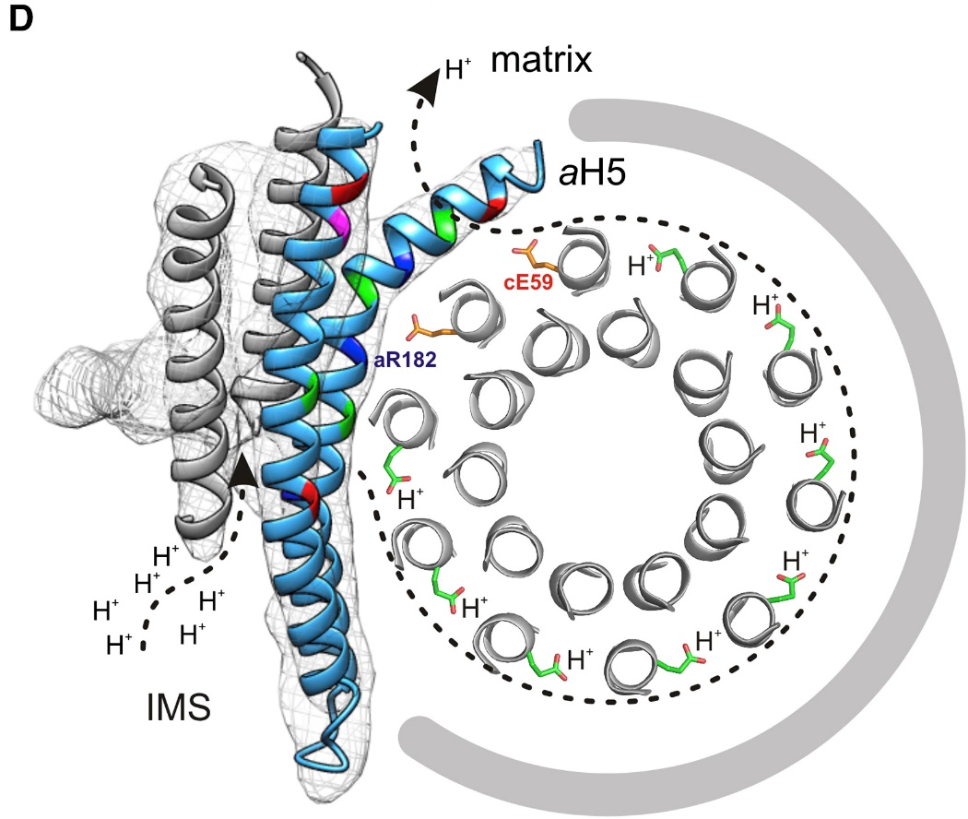

The ‘a’ subunit is more than a linker
feeds H+’s to the c subunits
Figure from : Hahn, A., et al (2016) Molecular Cell 63(3):445-456
Notes:
This image is the ATP Synthase from mitochondria in the yeast, Y. lipolytica. This figure shows the alignment of the ‘a’ subunit alpha helices in relation to the c-subunit proton (H+) transporters in the F0 domain. The figure on the left is a side view of the alpha helices with the Intermembrane space (IMS) on the bottom of the diagram and the matrix on the top. You can see that alpha helices 5 and 6 span the innermembrane of the mitochondria in a diagonal pattern. The c-subunits would be stacked like tall pillars in front of the ‘a’ subunit. The figure on the right is a cross sectional view looking down on the ‘a’ and ‘c’ subunits from the matrix side. The IMS would be extending into the plane of the paper on the opposite side. Ultimately, alpha helices 5 and 6 from subunit ‘a’ guide the protons into the c-subunits from the intermitochondrial space (IMS). Once the H+ are loaded into the c-subunits, the c-subunits will spin in a counterclockwise motion until the loaded c-subunit comes into contact with alpha helix 5 and 6 on the other side. Contact with the ‘a’ subunit causes the c-subunit to change shape, opening up the transporter to the matrix side and releasing the proton.

Slide 13
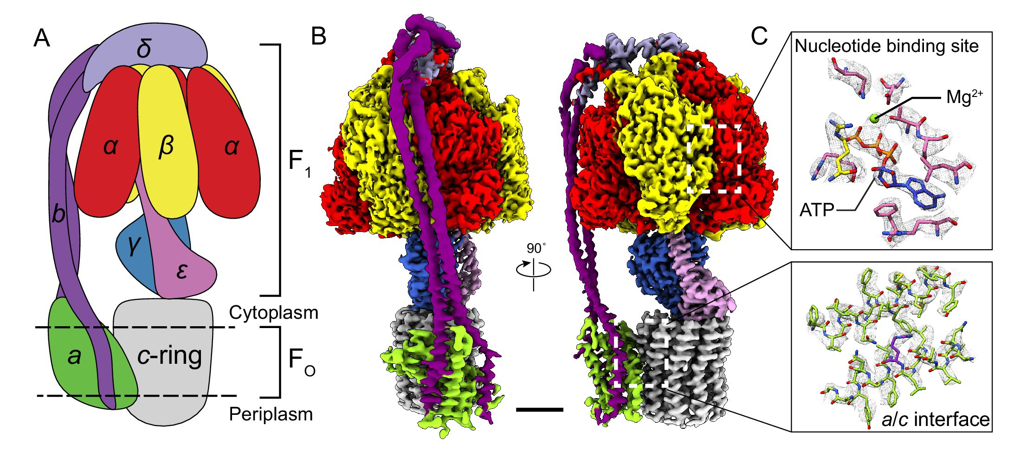
Bacterial ATP Synthase
Figure from : Guo, H. (2019) eLife 2019;8:e43128 doi: 10.7554/eLife.43128
Notes:
So what is going on inside the matrix? How does the proton motive force lead to the production of ATP? For this, we will look to the simpler structure of the bacterial ATP synthase. This structure is from a strain of Bacillus. Within this structure, you can see the familiar F₀ structure with the ‘a’ and ‘c’ subunits. Now we want to focus on the activities going on in the F₁ domain.

Slide 14
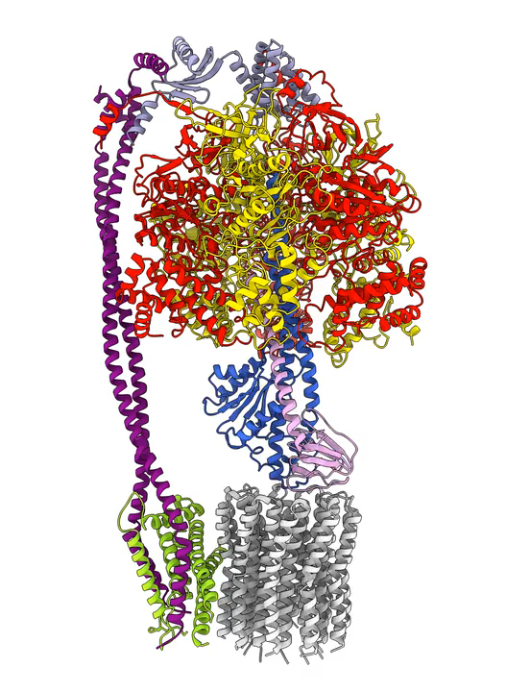
Proton flow causes motor movement
Figure from : Guo, H. (2019) eLife 2019;8:e43128 doi: 10.7554/eLife.43128
Notes:
This small video demonstrates how the turning of the c-subunits can mediate the turning of the alpha and beta subunits in the F1 domain through the axle structure of the gamma subunit

Slide 15
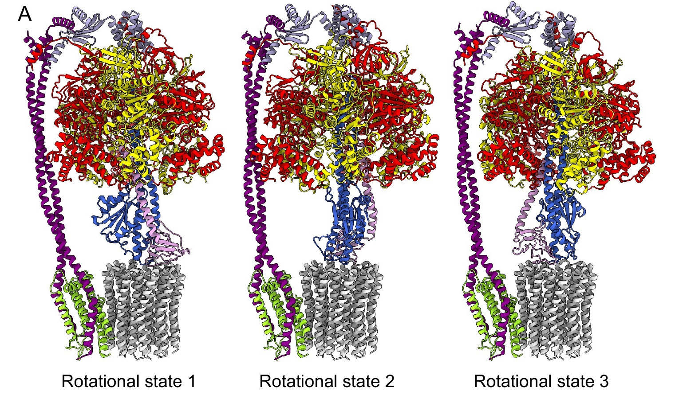
Rotation in F1 causes changes in protein conformation
Figure from : Guo, H. (2019) eLife 2019;8:e43128 doi: 10.7554/eLife.43128
Notes:
In the diagram, you can see how the rotation of the F0 subunit causes conformational changes in the yellow or beta subunit.

Slide 16
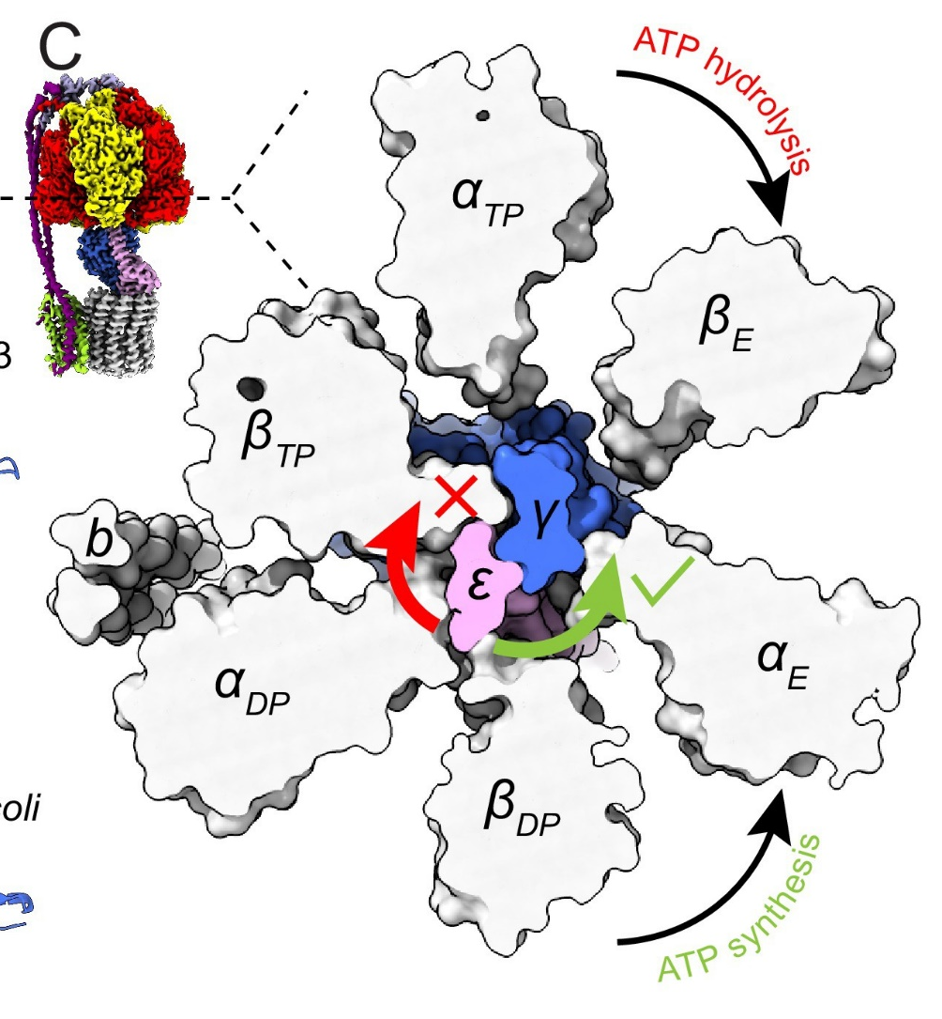
Closer Look at the F₁ Domain
Figure from : Guo, H. (2019) eLife 2019;8:e43128 doi: 10.7554/eLife.43128
Notes:
If you look at a cross section of the F1 Domain, one thing that becomes immediately apparent is that the conformation of the different beta subunits varies quite a bit. If you look at the beta-E domain, it has the most flexibility and space for movement in relation to both the axle proteins and the alpha subunits, whereas the beta-TP containing the newly formed ATP is the most constrained. Movement of the axel proteins (gamma and epsilon) in the counterclockwise direction will cause the position of the epsilon unit to shift in the direction of the beta-DP domain (which is bound to ADP + Pi). This will cause a conformational change in the beta-DP domain to the beta-TP conformation and induce that catalytic activity of that subunit to form ATP. The former beta domain that was in the TP conformation, shifts to the beta-E conformation and releases the ATP from the synthase. Interestingly, the ATP synthase protein CAN work in the opposite direction. If there is a lot of ATP around, ATP can be hydrolyzed by that ATP synthase causing the axle to rotate in the clockwise direction. This would, subsequently, turn the c-subunits in the clockwise direction as well and promote the movement of protons (H+) into the intermembrane space. This reverse mechanism is highly used in the vacuole of plants where an ATP Synthase homolog, is used to pump protons across the membrane at the expense of ATP.

Slide 17
Proton flow causes motor movement
Figure from : Guo, H. (2019) eLife 2019;8:e43128 doi: 10.7554/eLife.43128
Notes:
So now let’s go back to this video and watch in a little more detail. You will see that the c-subunits make a complete rotation. This is most easily seen by focusing on the pink episilon subunit in the axle portion of the synthase. While the axle rotates fully, the stator holds the F1 subunit in place so that it does not rotate. It does have flexibility and significantly changes shape, but you can see that the forward facing beta subunit shown in yellow still remains in the front while the c-subunits complete a full rotation. This allows the beta subunits to move through the different conformational states, first at beta-E (empty) where ADP and Pi are recruited to the subunit. This transitions to the beta-DP state, where the ADP and Pi are locked into the structure and cannot be removed. Further rotation of the axle causes the beta subunit to shift into the beta-TP state that mediates the catalytic activity of the subunit to form ATP. The ATP is then released from the molecule as it transitions from the beta TP state, back into the beta-E state.

Slide 18
Two Heads are Better than One
Image from : Goodsell, D. (2012) Molecule of the Month, Protein Database
Notes:
Cryoelectron microscopy has been used to determine the entire structure of ATP synthase. The resolution of these studies is not quite enough to see individual atoms, but it allows us to arrange all the subunits in their proper places. One of the surprises from this work is that the ATP synthase in our mitochondria forms a dimer, and the dimer is sharply bent. This is thought to help shape the extensively folded inner membrane of the mitochondrion. The structure shown here is from yeast mitochondria (PDB entry 6b8h). In a later lecture, we will discuss how ATP is transported out of the matrix of the mitochondria.
Text from : Goodsell, D. (2012) Molecule of the Month, Protein Database

