Slide 1
Apoptosis
And Other Regulated Pathways of
Cell Death
Notes:
Welcome to lecture on Apoptosis. Here we will learn about the two major pathways of programmed cell death through apoptosis.

Slide 2
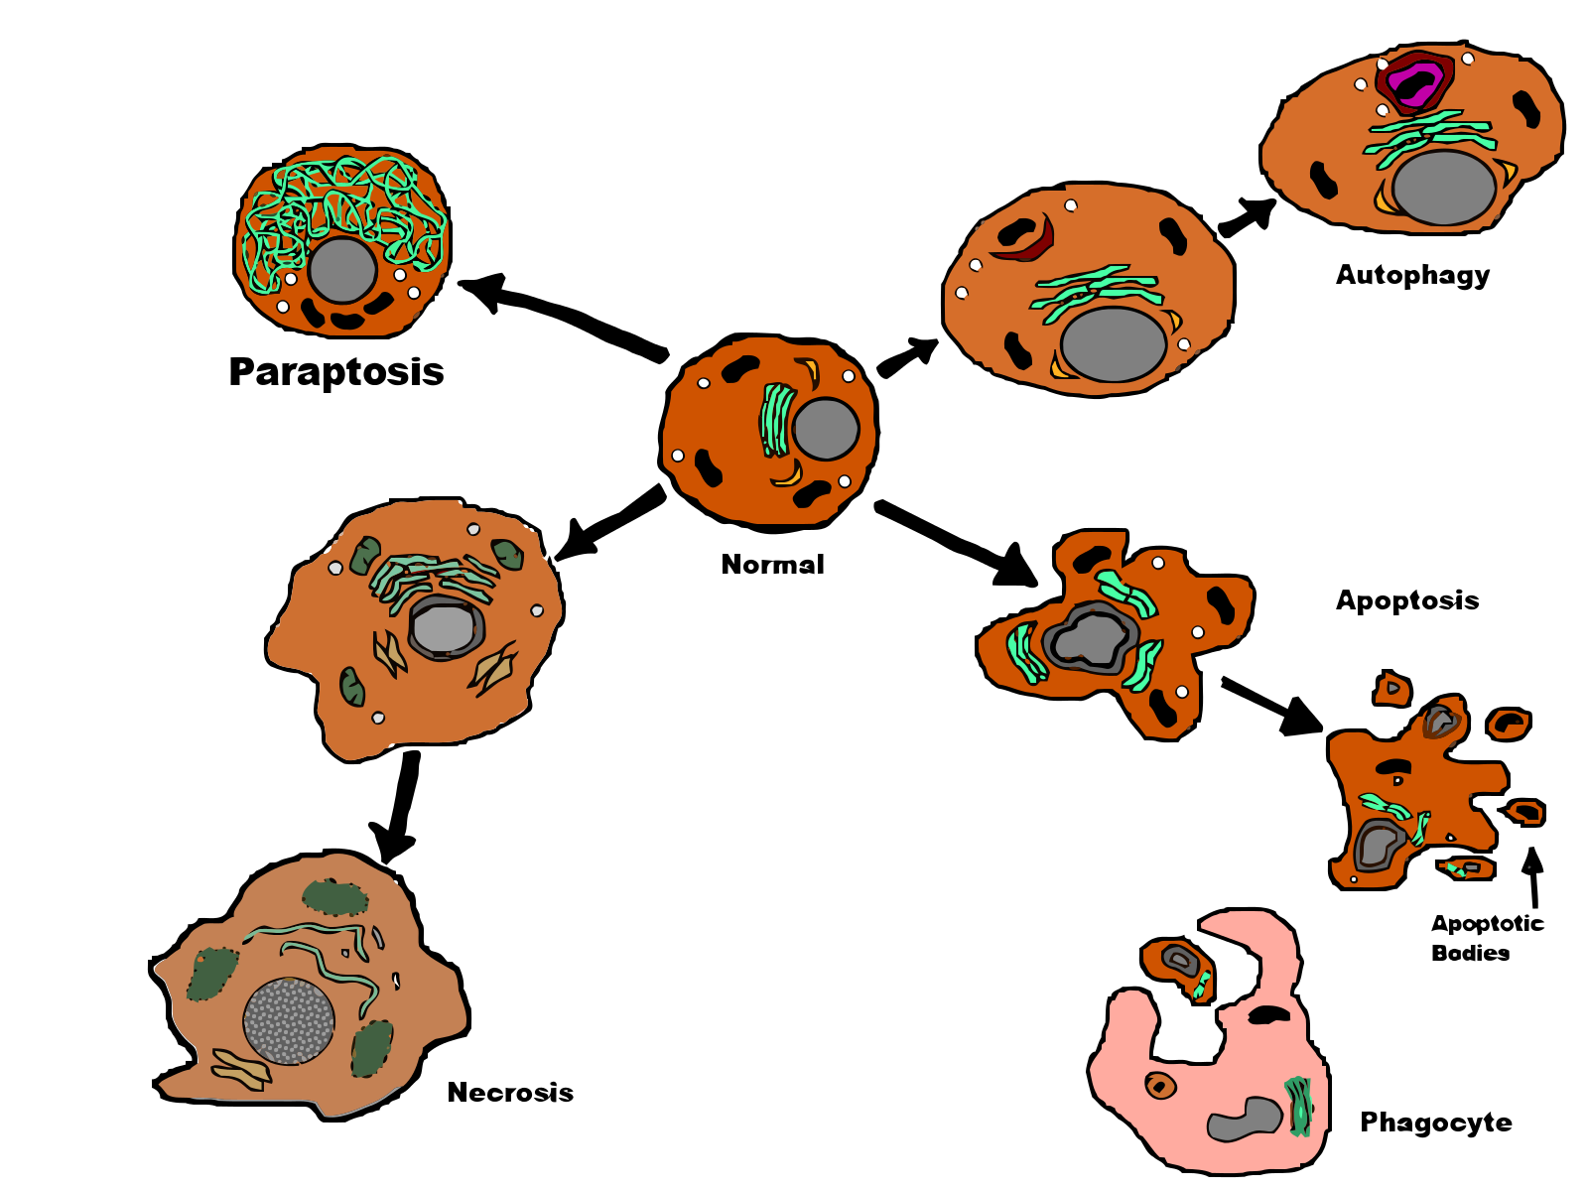
Main Types of Cell Death
Necrotic (catastrophic)
Apoptotic (programmed)
Notes:
There are two main types of cell death, apoptosis and necrosis. Apoptosis is usually part of a regulated process, and has been called ‘programmed cell death’ or ‘cell suicide’. It is a carefully regulated event, requiring energy from the dying cell, usually resulting in cell shrinkage and fragmentation. Phagocytosis of the resultant apoptotic bodies ensures there is no associated inflammation and bystander tissue damage. Necrosis typically results from a significant cellular injury. Cells swell and burst, releasing intracellular contents in an uncontrolled manner. This causes inflammation and tissue damage.

Slide 3
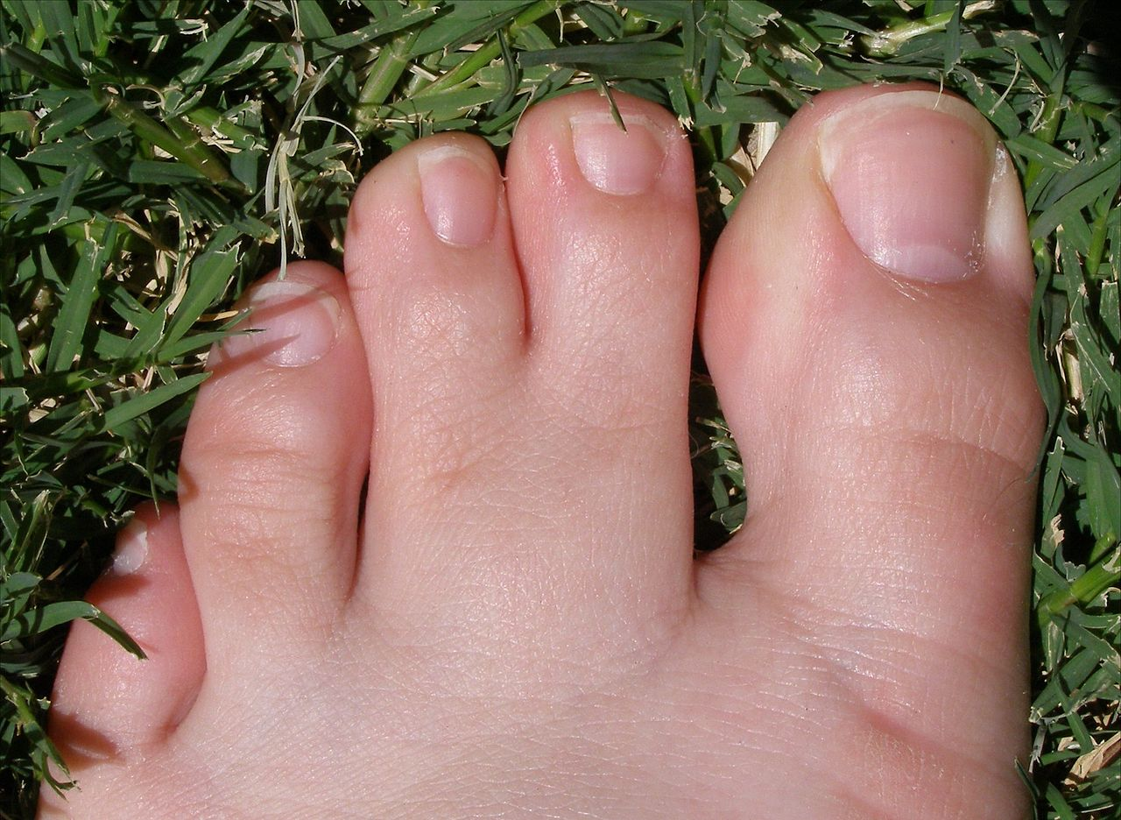
Why Programmed Cell Death?
Image from: pschemp
Notes:
Apoptosis is used for many purposes. During the development of embryos, organs are shaped by building oversized structures and then pruning back the cells that aren't needed. For instance, during development of the nervous system, half of the neurons die, leaving the proper neural wiring. If you have watched a tadpole lose its tail, you have also seen apoptosis in action. When you are an adult, apoptosis continues its work as obsolete cells die and are replaced by new cells, particularly in organs with high turnover such as the bone marrow and intestines. Apoptosis protects us from cells damaged by radiation or infected by viruses--when detected, these rogue cells are told promptly to commit suicide. Apoptosis is also one of our major defenses against cancer, and deadly cancer cells often have mutations that disable their own apoptosis machinery. This image shows the effect of lack of programmed cell death (specifically apoptosis) on the toes of a human. A mutation caused the middle two toes to remain connected. So in development, much of who we are and who we become is because of what was purposefully lost and removed. As we have seen many times throughout this term, evolution continues to be this convoluted path that adds one structure, to only remove it later in the final product.

Slide 4
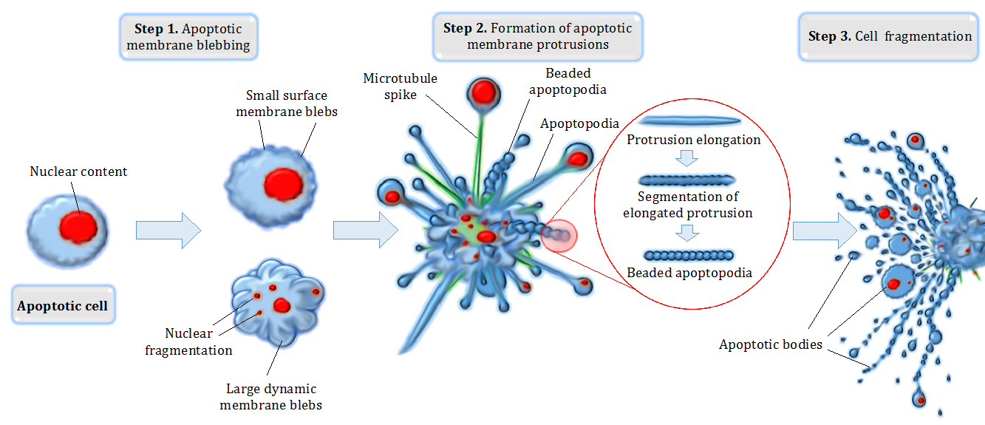
Morphology of Apoptosis
Image from: Aaron Smith, Michael AF Parkes, Georgia K Atkin-Smith, Rochelle Tixeira, Ivan KH Poon
Notes:
Blebbing is one of the defined features of apoptosis. During apoptosis (programmed cell death), the cell's cytoskeleton breaks up and causes the membrane to bulge outward. These bulges may separate from the cell, taking a portion of cytoplasm with them, to become known as apoptotic blebs. Phagocytic cells eventually consume these fragments and the components are recycled.
Two types of blebs are recognized in apoptosis. Initially, small surface blebs are formed. During later stages, larger so-called dynamic blebs may appear, which may carry larger organelle fragments such as larger parts of the fragmented apoptotic cell nucleus.
Wikipedia contributors. (2019, October 9). Bleb (cell biology). In Wikipedia, The Free Encyclopedia. Retrieved 06:02, February 22, 2020, from https://en.wikipedia.org/w/index.php?title=Bleb_(cell_biology)&oldid=920436337

Slide 5
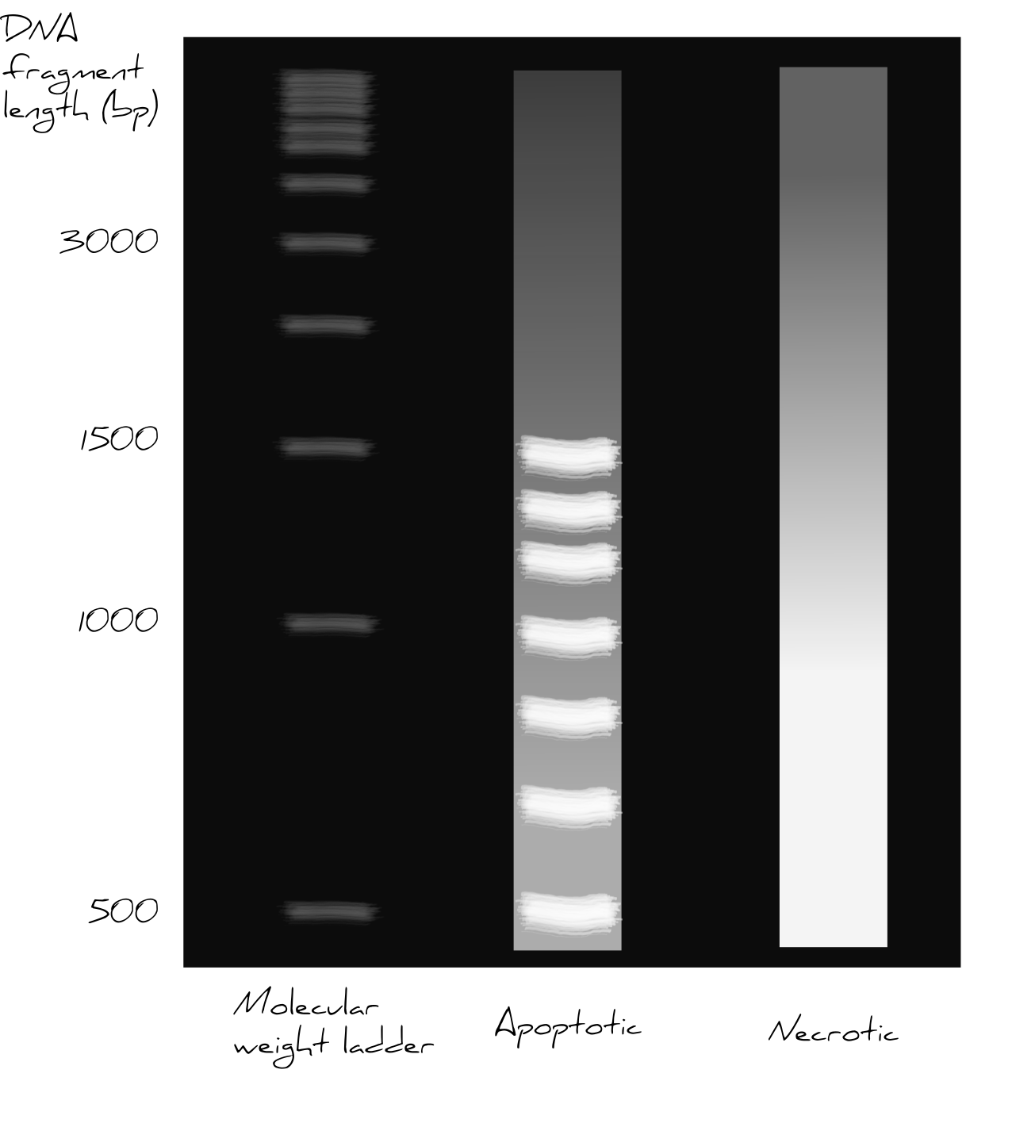
Morphology of Apoptosis
DNA is cleaved in a uniform manner during apoptosis
Figure from: Tim Kendall, University of Edinburgh, on Pathologia
Notes:
Another key feature of the apoptotic cascade is that the DNA of apoptotic cells is cleaved in a uniform manner between histones to create a ‘ladder’ when separated on an agarose gel. In contrast, the DNA is cleaved haphazardly during necrosis, producing a ‘smear’. Overall, apoptosis is an orderly process of cellular destruction.

Slide 6
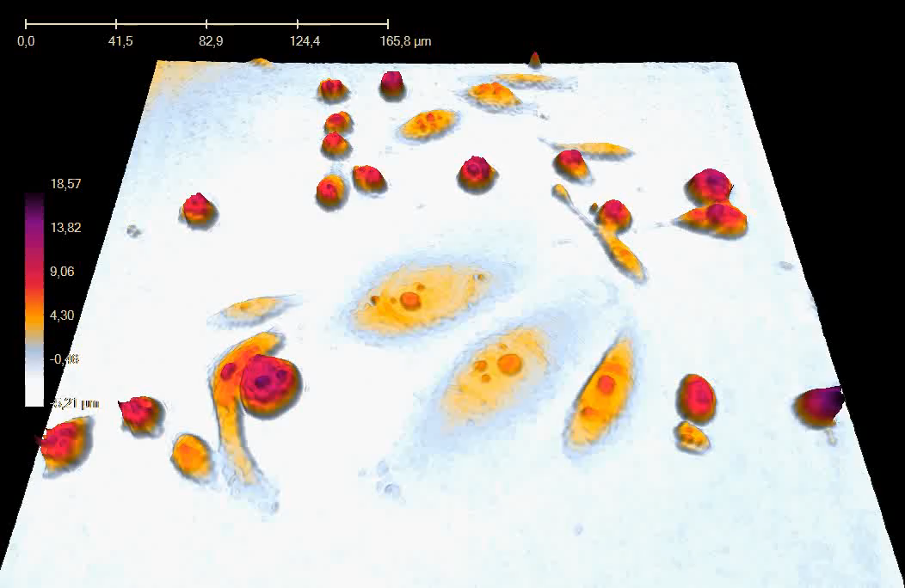
The Morphology of Apoptosis
Video from Birgit Janicke , Phase Holographic Imaging AB (PHIAB), Lund, Sweden displayed on Cell Image Library
Notes:
A time-lapse series using digital holographic microscopy presented as a movie. The movie shows living human prostate cancer cells (DU 145) induced to undergo of apoptosis following treatment with etoposide. The images were created by Phase Holographic Imaging AB (PHIAB), Lund, Sweden.

Slide 7
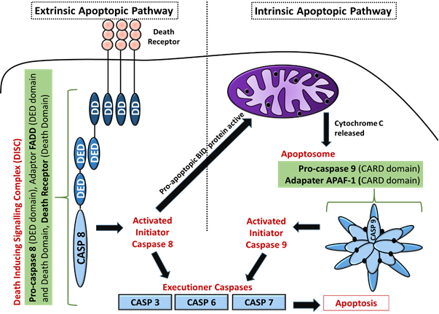
The Two Pathways of Apoptosis
Intrinsic
Extrinsic
Figure from: Tsgupta. , Pathologia
Notes:
There are two major apoptotic signaling pathways: the extrinsic pathway and the mitochondria (intrinsic) pathway. In the Mitochondrial pathway a cell receives signals from all elements of the extracellular environment – other cells, extracellular matrix and soluble factors. Under homeostatic conditions, these signals lead to the balance of intracellular protein Bcl-2 family members favoring ‘pro-survival’ factors, and the maintenance of intact mitochondrial membranes. If these ‘survival’ signals are withdrawn, the Bcl-2 family member balance shifts and pro-apoptotic family members become dominant. This leads to release of Cytochrome c from the mitochondria, leading to activation of caspase 9 and then the final common pathway mediated by effector caspases.
In the Extrinsic (death-receptor mediated) pathway death receptors are activated. Many cells have cell surface receptors that contain intracellular ‘death domains’ for example the Fas receptor. Binding of an appropriate ligand with the receptor, for example, FasL, can lead to activation of the effector pathway by a route independent of mitochondrial factors. Receptor ligation activates signalling through a death-associated signaling complex (DISC). The DISC is a complex of the ligand, receptor, and associated signalling proteins such as FAS-associated death domain protein (FADD), and leads to the activation of caspase 8 and the final common executioner pathway.

Slide 8
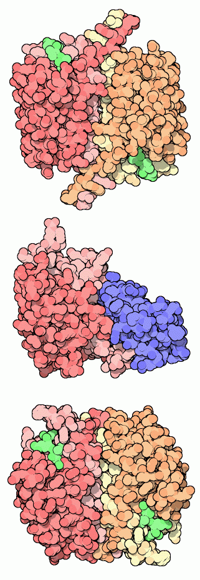
The Caspase Family
Caspase 1
(shown here with small inhibitors bound in green)
Caspase 9
(shown with inhibitor
XAIP-BIR3 in blue)
Caspase 3
(shown here with small inhibitors bound in green)
Image from : Goodsell, D. (2012) Molecule of the Month, Protein Database
Notes:
Caspases are the executioners of apoptosis. Once activated by gatekeeper molecules such as apoptosomes, they chop up strategic proteins in the cell. The name refers to two properties of these enzymes. First, they are cysteine proteases that use the sulfur atom in cysteine to perform the cleavage reaction (The C in caspases). Second, they cut proteins next to aspartate amino acids in their chains (the ASP is Caspases.) They do not cut indiscriminately--instead, they are designed to make exactly the right cuts needed to disassemble the cell in an orderly manner. Almost a dozen caspases have been discovered in human cells, each with a slightly different task. Caspase-1 (also known as interleukin-1beta-converting enzyme) was the first one discovered. It is not involved directly in apoptosis, but instead processes a cell signaling molecule in white blood cells. Caspase-9 is an initiator caspase--one that begins the process of apoptosis. It receives the message to begin work, becomes activated, and then makes a cut in the effector caspases, such as caspase-3. The effector caspases are also known as the Executioners within the apoptotic pathway that mediate the disassembly of the cell.
Text modified from : Goodsell, D. (2012) Molecule of the Month, Protein Database

Slide 9
The Caspase Family
Programmed Cell Death | Type of Caspase | Enzyme
Apoptosis | Initiator | Caspase 2
 |  | Caspase 8
 |  | Caspase 9
 |  | Caspase 10
 | Executioner | Caspase 3
 |  | Caspase 6
 |  | Caspase 7
Table from: Wikipedia
Notes:
Here is a table of some of the common caspase enzymes involved in the apoptotic cascade. Caspase 9 is predominantly involved with the intrinsic apoptotic cascade whereas caspase 2 and 8 are predominantly extrinsic initiators.

Slide 10
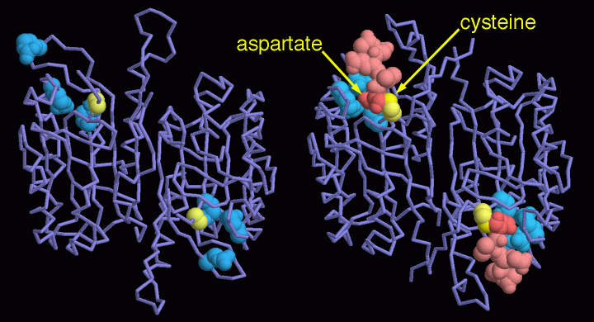
Caspases are Zymogens
Image from : Goodsell, D. (2012) Molecule of the Month, Protein Database
Notes:
As you might imagine, caspases are dangerous enzymes to have around, so they are created in the form of inactive proenzymes or zymogen. The structure on the left, PDB entry 1k88 , shows one example: procaspase-7. The active site contains a reactive cysteine, shown in yellow, and three basic amino acids (two arginines and a glutamate, shown in blue) that recognize the aspartate in the protein that is cleaved. As you can see, the procaspase is floppy and these four key amino acids are not assembled into a tight active site. When the caspase is activated, by making a few strategic cuts in the protein chain, the active site can form the proper conformation. The structure on the right, PDB entry 1f1j , shows active caspase-7 with a short protein chain bound in the active site. The structure catches the enzyme in the middle of its reaction. The cysteine is bound to the target protein chain, and the aspartate is nestled inside the three basic amino acids.
Text from : Goodsell, D. (2012) Molecule of the Month, Protein Database

Slide 11
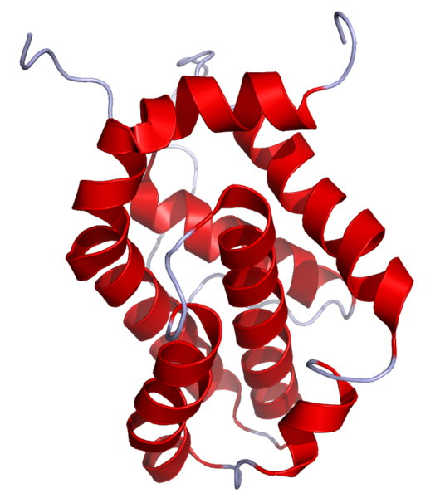
Bcl-2 and The Intrinsic Pathway
Image from: Ramin Herati
Notes:
The mitochondrial (intrinsic) pathway is regulated by Bcl-2 family of proteins. The Bcl-2 Family consists of over 25 related proteins that share Bcl-2 homology (BH) domains. The Bcl-2 family proteins consists of members that either promote or inhibit apoptosis. The intrinsic apoptotic pathway can be activated by internal cellular damage and stress, including treatment with DNA damaging agents, such as the cancer drug etoposide (shown in the previous video to cause the apoptosis of prostate cancer cells). They control apoptosis by governing the process of mitochondrial outer membrane permeabilization (MOMP), which is a key step in the intrinsic pathway of apoptosis. Bcl-2 family proteins have a general structure that consists of a hydrophobic α-helix surrounded by amphipathic α-helices. Some members of the family have transmembrane domains at their c-terminus which primarily function to localize them to the mitochondrion.

Slide 12
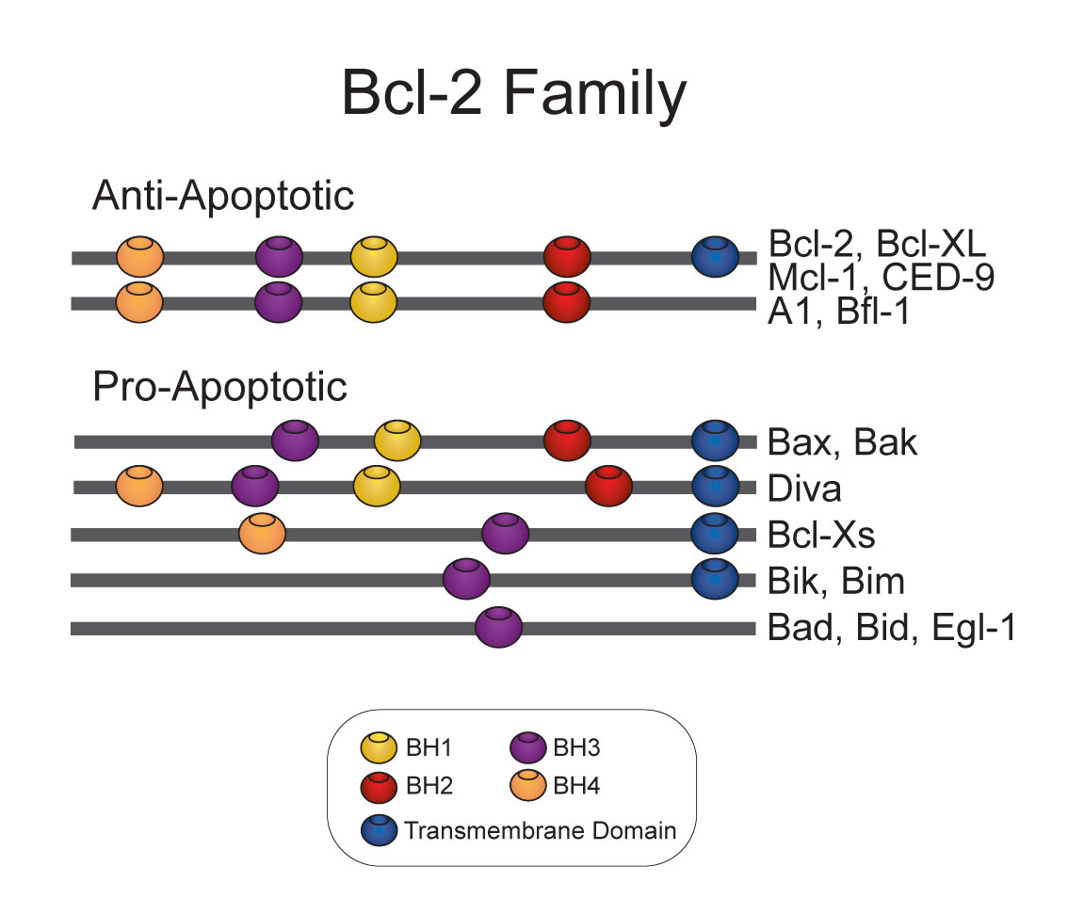
Image from: Kosigrim
Notes:
As noted on the previous slide, the members of the Bcl-2 family share one or more of the four characteristic domains of homology entitled the Bcl-2 homology (BH) domains (named BH1, BH2, BH3 and BH4) (see figure). The BH domains are known to be crucial for function. The anti-apoptotic Bcl-2 proteins, such as Bcl-2 and Bcl-xL, tend to conserve all four BH domains. The BH domains also serve to subdivide the pro-apoptotic Bcl-2 proteins into those with several BH domains (e.g. Bax and Bak) or those proteins that have only the BH3 domain

Slide 13
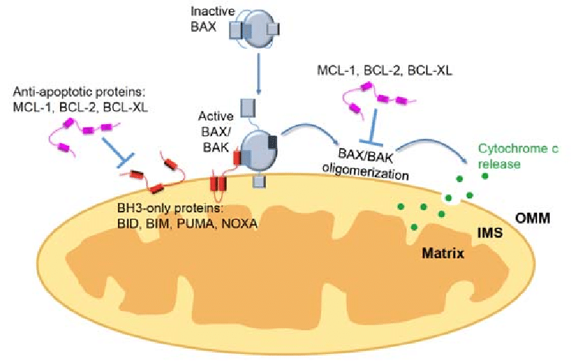
MOMP
Mitochondrial Outer Membrane Permeability
Figure from : Rasmussen, M.L., et al (2018) Genes 9(2):109
Notes:
After apoptotic stimuli, BH3-only proteins activate BCL-2-associated X protein (BAX) and Bcl-2 homologous antagonist/killer (BAK), which undergo a conformational change and insert into the mitochondrial outer membrane (OMM). BAK/BAX oligomerize and form pores, releasing cytochrome c from the intermembrane space (IMS) into the cytosol. When cells are not undergoing apoptosis, the antiapoptotic BCL-2 members prevent mitochondrial outer membrane permeabilization (MOMP) by sequestering the BH3-only proteins or by inhibiting BAK/BAX oligomerization Notes: BCL-XL: B-cell lymphoma extra-large; MCL-1: myeloid cell leukemia 1; BID: BH3-interacting domain death agonist; BIM: BCL-2 interacting mediator of cell death; PUMA: p53-upregulated modulator of apoptosis

Slide 14
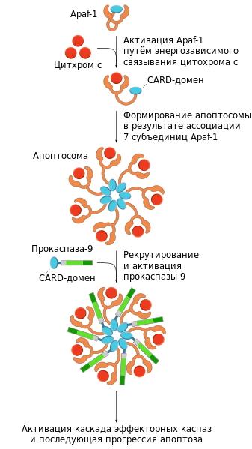
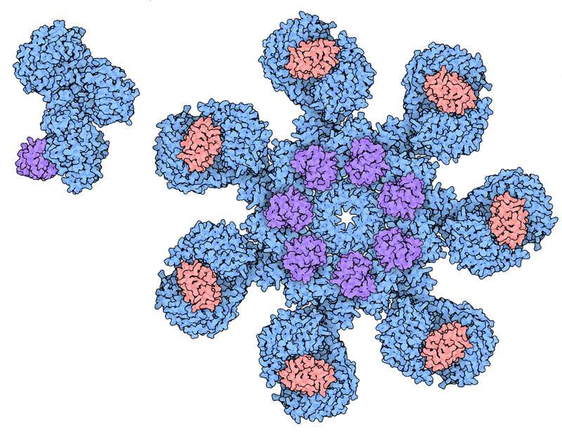
Assembly of the Apoptosome
Apaf-1
Cytochrome c
Binding with Apaf-1
Cytochrome c
CARD-domain
Early Assembly of the Apoptosome
Apoptosome
Image from : Goodsell, D. (2012) Molecule of the Month, Protein Database
Figure modified from: Brat Ural
Notes:
The release of Cytochrome c from the mitochondria (shown in red) causes the assembly of a structure known as the apoptosome. In the cytosol, Cytochrome c binds to the protein Apaf-1 (shown in blue and purple), causing it to assemble into a seven-fold ring. The caspases are then activated by binding to a ring of CARD domains (purple on the left and blue on the right) on the assembled apoptosome.

Slide 15
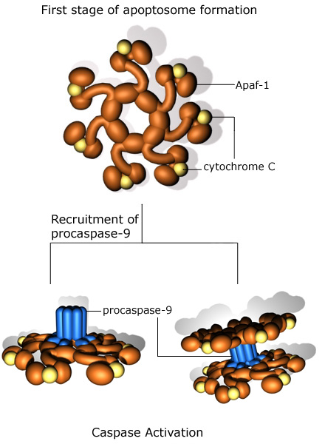
Assembly of the Apoptosome
Procaspase-9
Procaspase-9
Binds to the apoptosome
CARD-domain
Caspase-9 is activated and causes the cleavage and activation of executioner caspases that begin the disassembly process
Caspase Activation
Figure from : Phil Dash, Nitric Oxide Research Group
– University of Reading
Figure modified from: Brat Ural
Notes:
Apoptosome assembly is completed by the association and activation of procaspase-9. Procaspase-9 has a card domain that allows assembly with the apoptosome and recruits the binding of second apoptosome wheel unit. This results in the cleavage and activation of caspase-9. Active Caspase-9 cleaves and activates the downstream effector caspases responsible for disassembly of the cellular components.

Slide 16
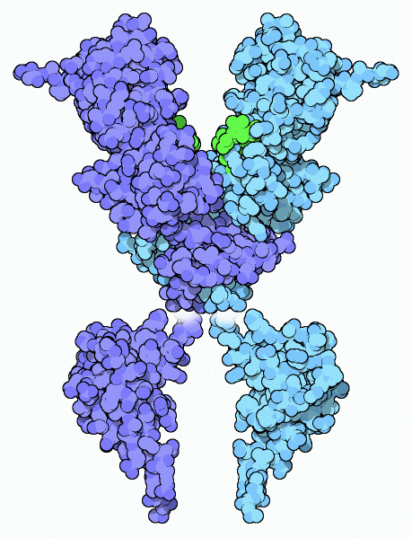
Helpers in Apoptosis
DNA nucleases are activated during the apoptotic cascade
Image from : Goodsell, D. (2012) Molecule of the Month, Protein Database
Notes:
Caspases are designed to break proteins into bite-sized pieces, but the cell needs help to break down its other molecules. Cells also have a number of caspase-activated proteins to do this work. The one shown here, from PDB entry 1v0d and 1c9f , is caspase-activated deoxyribonuclease. During apoptosis, caspases break up an inhibitory protein that binds to the two large domains at the bottom, creating the active form. DNA slides into the large groove at the top and the active site amino acids, shown here in green, clip it into small pieces.
Text modified from : Goodsell, D. (2012) Molecule of the Month, Protein Database

Slide 17
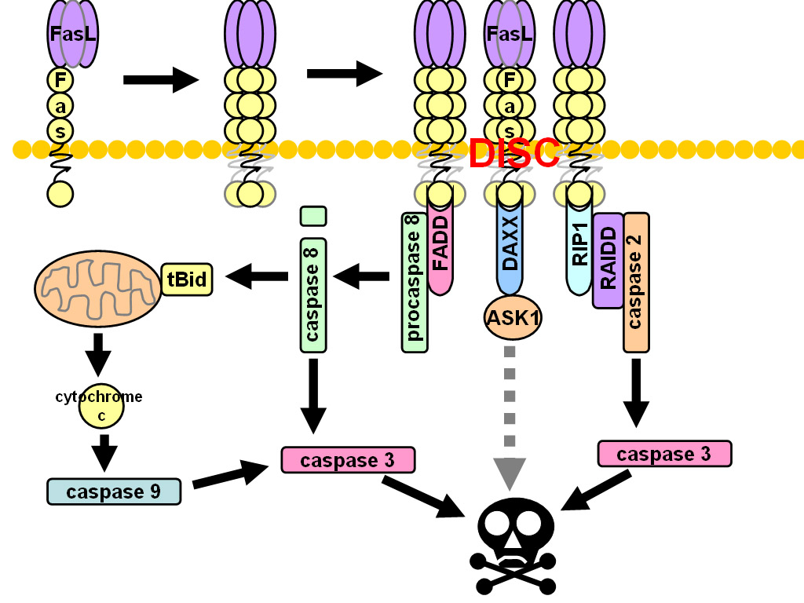
Extrinsic Apoptotic Pathway
Image by: Subclavian
Notes:
The extrinsic apoptotic pathway is initiated by external ligands that bind with protein death receptors on the surface of the cell, such as Fas and Tumor Necrosis Factor Receptor (TNFR). Once the receptor is bound, Fas oligimerizes to form the death-inducing signaling complex (DISC). Formation of the DISC complex leads to the cleavage and activation of procaspase 2 and procaspase 8. Activated caspase 2 and caspase 8 can mobilize effector caspases directly and can also activate the mitochondrial apoptotic cascade as well.

Slide 18
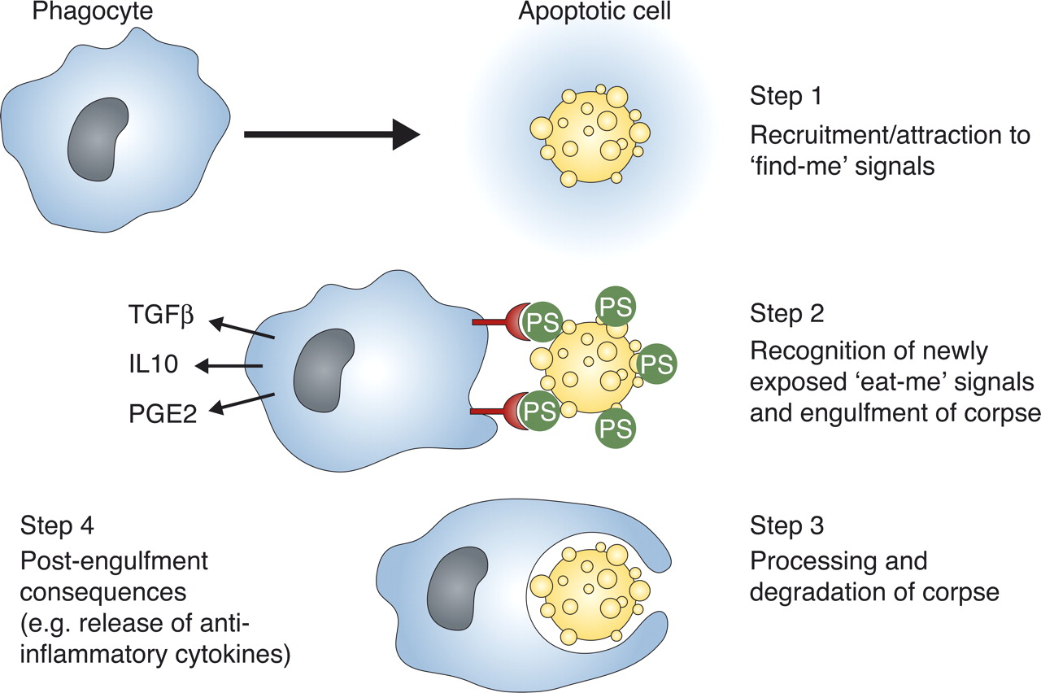
Cleaning up the Mess
Figure from: Ravichandran, Pathologia
Notes:
Apoptosis does not lead to inflammation in surrounding tissue, meaning there is no ‘bystander’ tissue damage. To achieve this, cells undergoing apoptosis release soluble factors (e.g. nucleotides ATP and UTP, chemokine CX3CL1) that recruit phagocytes. Recruited phagocytes recognise apoptotic cells by the presence of ‘eat me’ molecules such as phosphatidylserine present on their surface. The phagocyte responds to these signals by engulfing the apoptotic cell or body. Degradation of the engulfed component completes the process.

