Slide 1
Autophagy
Cellular Degradation and Recycling
Notes:
Welcome to our lecture on Autophagy. Here we will learn about the three major types of autophagy processes.

Slide 2
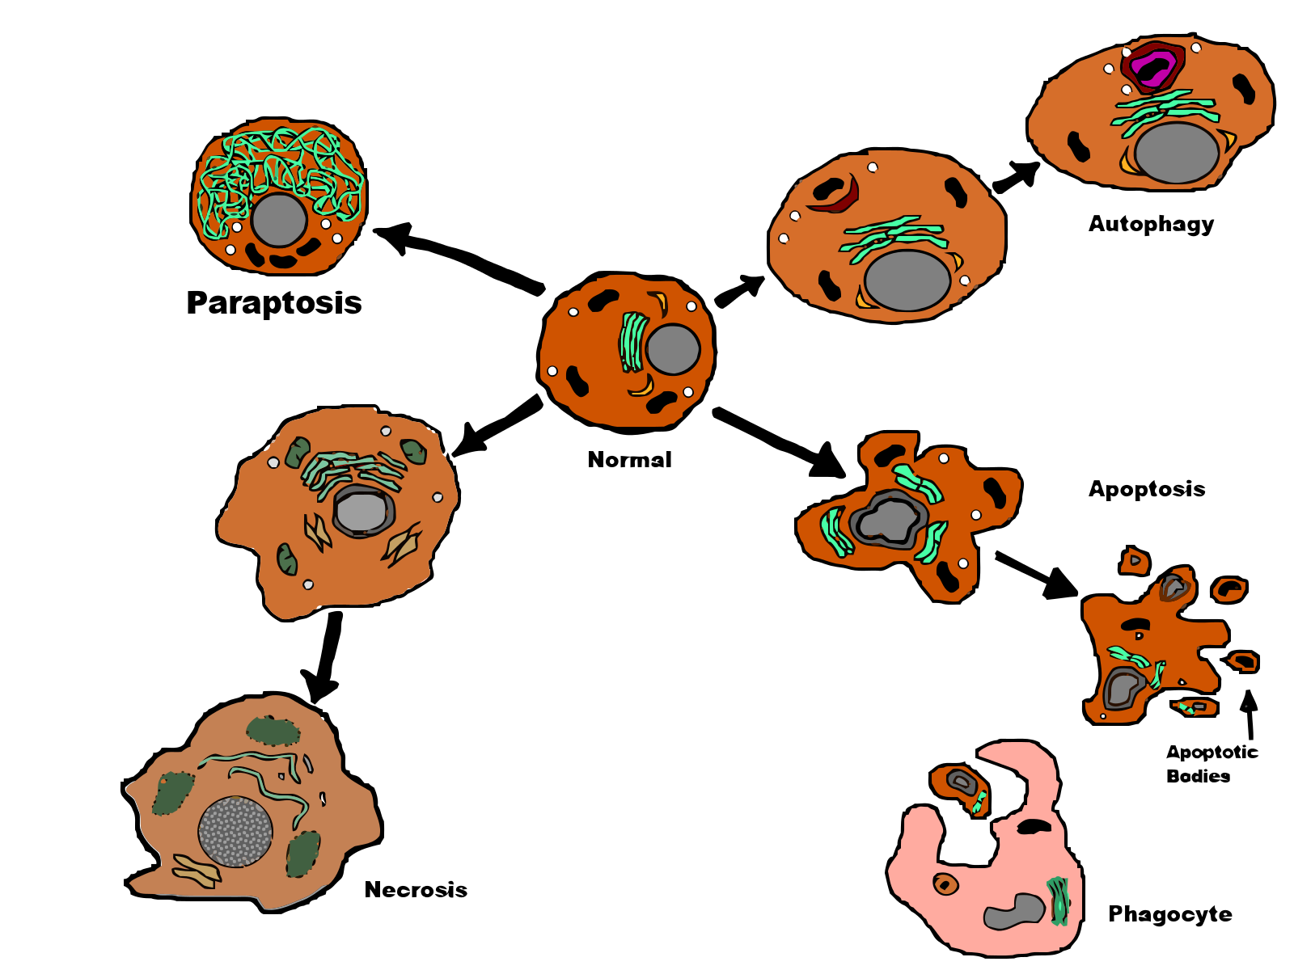
What happens when Cells are Damaged
Cellular Repair
Autophagy
Programmed Cell Death
Apoptosis
Catastrophic Cell Death
Necrosis
Figure modified from: Jhayes21
Notes:
In the last lecture on Reactive Oxygen Species, we talked about one method that cells can become damaged. So how do cells respond to damage and stress? If the stress and damage are not too bad, cellular repair pathways can be activated. We talked a lot last term about mechanisms of DNA damage and DNA repair processes. In this section, we will focus on the process of cellular cleaning and recycling, known as autophagy. If damage is too much for the cell to recover from, but maybe it is not enough to cause outright necrosis or catastrophic cell death, it may be targeted for programmed cells death. This is a safety mechanism for multicellular organisms, to help ensure that damaged cells do not alter or hinder normal cellular function within the organism. Apoptosis is one example of programmed cell death that we will focus on in the next lecture.

Slide 3
Autophagy
Auto-Phagy literally means ‘self-eating’.
Process of cellular recycling
Notes:
Autophagy or Auto-Phagy literally means ‘self-eating’. It is a mechanism of the cell that removes unnecessary or dysfunctional components. It allows the orderly degradation and recycling of cellular components. Autophagy can be a selective or non-selective lysosomal degradative process and is activated by stresses such as starvation. In selective autophagy, cargo is recognized by specific receptors to enable their specific identification, sequestration, and degradation by the autophagosome, whereas in non-specific autophagy, all materials are degraded by the same lysozome in a non-specific manner

Slide 4
Autophagy
Macroautophagy
Microautophagy
Chaperone-mediated autophagy
Notes:
There are three major types of autophagy: macroautophagy, microautophagy, and chaperone-mediated autophagy. Regardless of the type, autophagy acts as a cleaning mechanism by removing or degrading unnecessary materials from the cell (e.g., proteins, organelles, and microbes) and retaining or maintaining materials (biochemicals, metabolites, and organelles) required for survival, function, and development.

Slide 5
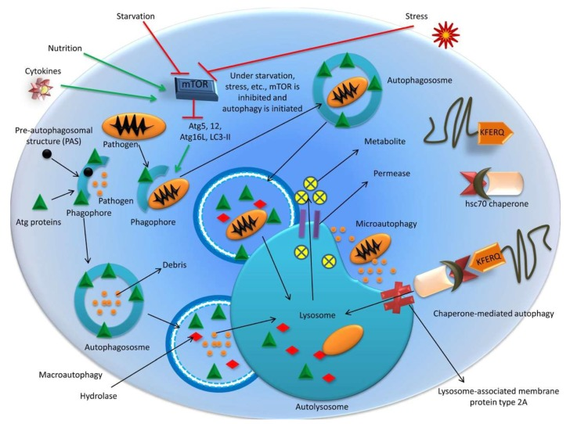
Different Types of Autophagy
Figure from: Khandia, R., et al. (2019) Cells 8(7):674
Notes:
Here is an overview figure of the three different types of autophagy. In the top part of the diagram Macroautophagy is depicted, where an autophagosome is activated to engulf an invading pathogen. The resulting autophagosome then fuses with the lysozome to complete the degradation pathway. Microautophagy is shown here, where small pools of cellular particles are engulfed directly into the lysozome. We won’t discuss this process further. Chaperone Mediated Autophagy (CMA) occurs when a chaperone binds to a damaged target within the cells and targets it for degradation in the lysosome.

Slide 6
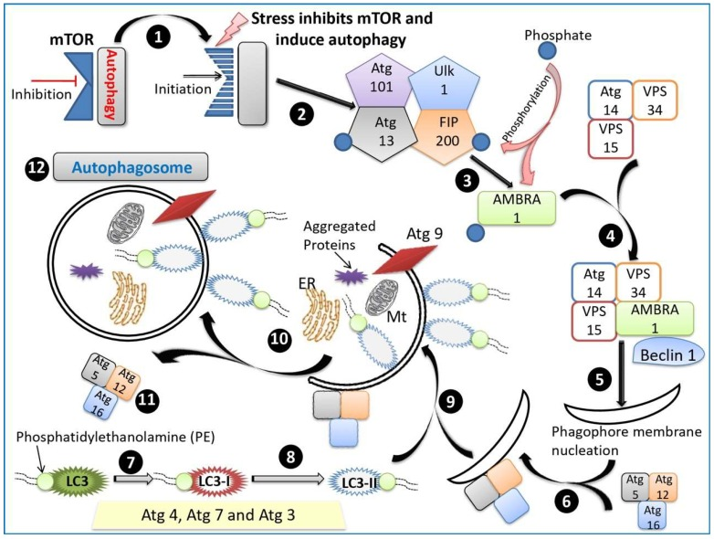
Macroautophagy
Figure from: Khandia, R., et al. (2019) Cells 8(7):674
Notes:
Macroautophagy is the major pathway which engulfs large portions of cytoplasm and cellular contents (e.g., long-lived proteins, aggregated proteins, damaged organelles, and intracellular pathogens) into a double-membraned vacuole called the autophagosome, which fuses with lysosomes to form an autolysosome, degrades the autolysosomal contents, and recycles macromolecules for reuse. The formation of an autophagosome is an involved process. (Step 1) Autophagy is normally inhibited by the mTOR protein (mammalian Target Of Rapamycin). mTOR is a protein kinase that regulates cellular response to growth factors, nutrient levels, and stress levels. It is part of the PI3K/Akt pathway that we learned about during our Insulin signaling cascade. Thus, during times of plenty, mTOR activity keeps the autophagy pathway silent. (Step 2) Various kinds of stress (hypoxia, oxidative stress, pathogen infection, endoplasmic reticulum stress or nutrient starvation conditions) inhibit the mTOR proteins, and the process of autophagy is initiated. (Steps 3 – 11) Depict the signaling cascade and assembly process of the autophagosome. You do not need to remember the individual steps within this pathway, but you should be familiar with mTOR. (Step 12) shows the completed assembly of the autophagosome containing aggregated proteins and damaged organelles. The LC3-II-PE complex is induced during starvation and helps within the assembly process. It is currently used as a marker for starvation-induced autophagy processes

Slide 7
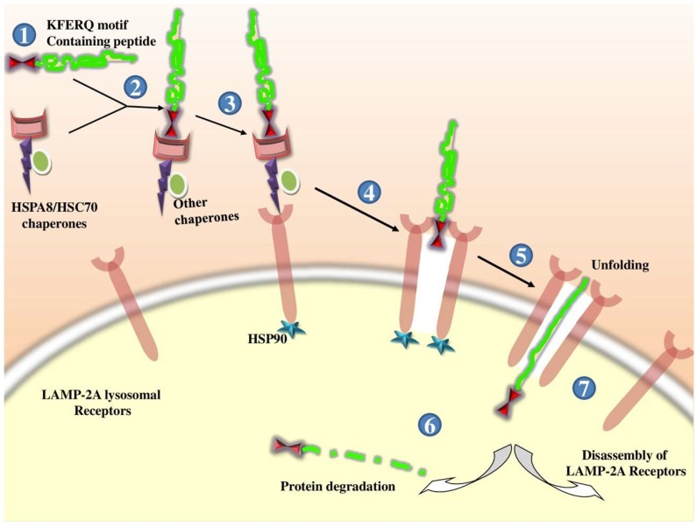
Chaperone-Mediated Autophagy
Figure from: Khandia, R., et al. (2019) Cells 8(7):674
Notes:
CMA is induced by physiological stresses such as prolonged starvation and involves the heat shock cognate protein (HSC70; 71-kDa, also known as HSPA8). The heatshock chaperone recognizes KFERQ motifs in target proteins and targets them for degradation in the lysosome. Note that about 30% of cytosolic proteins have these target degradation sequences that become exposed when the protein is damaged or misfolded. The CMA pathway delivers target proteins
across lysosomal membranes into the lysosomal lumen by interacting with lysosome-associated membrane protein type 2A (LAMP-2A) Hence, CMA differs from microautophagy and macroautophagy, as it does not require vesicular tracking.

Slide 8
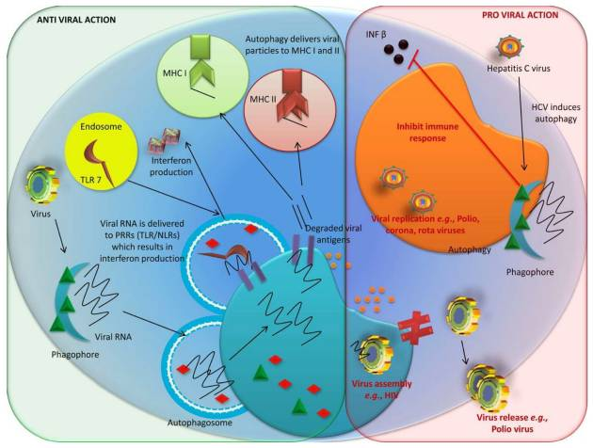
Figure from: Khandia, R., et al. (2019) Cells 8(7):674
Notes:
The processes of autophagy can be important during viral attacks where it can have anti-viral activities. Autophagy helps to clear viral pathogens during infection via various molecular mechanisms, regulates immune responses, and prevents harmful overactivation and inflammation. However, some viruses have evolved to dysregulate this system and cause the autophagy process to favor viral efficacy. Proviral autophagy plays an important role in the accelerated replication and pathogenesis of coronaviruses, the poliovirus, the hepatitis C virus (HCV) and Influenza A, to name a few. For example, during poliovirus (PV) infection, vesicle acidification, which can mature autophagosomes, has been shown to induce the maturation of virions into infectious particles. HCV, on the other hand, can derail the autophagy process causing it to impair the innate immune response of the host. In addition to viral pathology, dysregulation of normal autophagy processes can enhance tumor formation and progression during cancer, and can contribute to other disease states such as obesity and diabetes. In the next section, we will take a look at programmed cell death or apoptosis.

