Slide 1
Biochemical Energy Generation and Utilization
Part 3: Cellular Energy and Concentration Gradients
Notes:
Welcome to part 3 in our Biochemical Energy Generation and Utilization section. In this section we will discuss the importance of another major source of energy within the body, concentration gradients.

Slide 2
Importance of Concentration Gradients
Neuron Signaling – Action Potential (Ca²⁺/Na⁺/K⁺)
Secondary Active Transport Processes – Glucose transport in small intestine
Muscle Contraction – Ca²⁺ influx
ATP Production in Mitochondria – H⁺ gradient in the intermembrane space
Notes:
We have already seen the importance of chemical gradients in the processes of neuronal signaling and muscle contraction.

Slide 3
Importance of Concentration Gradients
Neuron Signaling – Action Potential (Ca²⁺/Na⁺/K⁺)
Secondary Active Transport Processes – Glucose transport in small intestine
Muscle Contraction – Ca²⁺ influx
ATP Production in Mitochondria – H⁺ gradient in the intermembrane space
Notes:
In this section, we will focus on two other functions of chemical concentration gradients, starting with their use in secondary active transport processes.

Slide 4
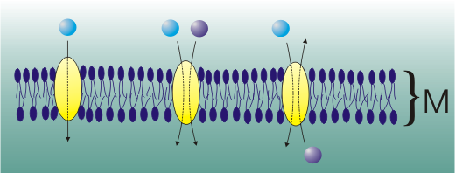
Types of Membrane Transporters
Uniporter
Symporter
Antiporter
Image by Zoph
Notes:
To begin, it is important to understand the different types of transport proteins embedded within the membrane. These include uniporters that only transfer one substance across the membrane. The voltage-gated Na+ and K+ channels used in the generation of neuronal action potentials are a good example of this type of transporter. We have also seen an antiporter example with the Na+/K+ ATPase that transports two different molecules in opposite directions across the membrane. The final class of membrane transporters are called symporters and they transport two molecules across the membrane in the same direction. We will see examples of all three types of transporters in this section.

Slide 5
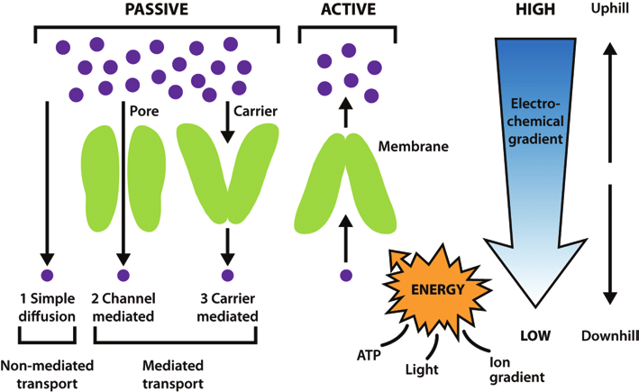
Passive vs Active Transport
Image by Watson, H. (2015) Essays in Biochemistry 59:43-69
Notes:
Note that protein transporters can be of two types. They can be channel proteins that open up a pore and allow the passage of molecules to go through them, or they can be carrier proteins which bind to the target molecules and change shape to pass them to the other side of the membrane. The transport of molecules across the membrane can either be passive, moving down the concentration gradient of the substance and not requiring energy input or it can be active, moving the substance against its concentration gradient and requiring energy input.

Slide 6
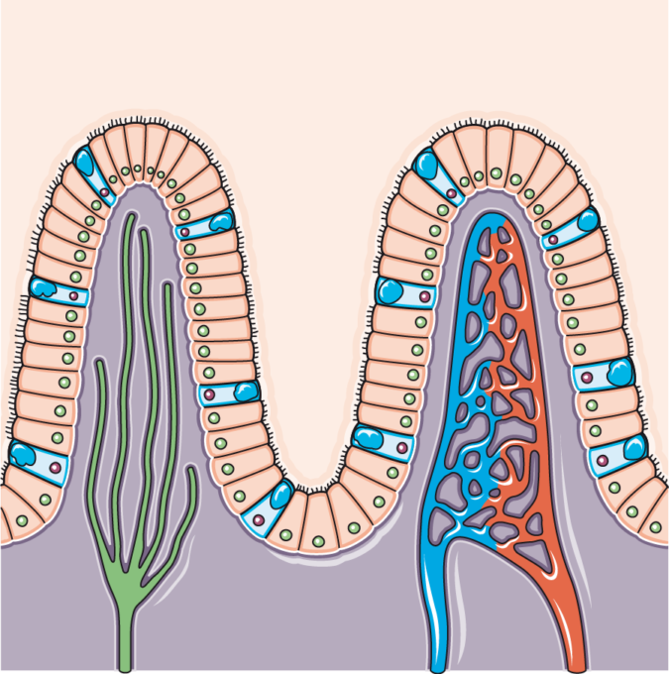
Glucose Uptake by Intestinal Cells
Intestinal Lumen
Pancreatic amylase
Intestinal Epithelium
Microvilli – Brush Border
Lymphatic System
Capillary bed
Connective Tissue and Smooth Muscle
Image modified from Smart Servier Medical Art
Notes:
Here we will use glucose uptake by intestinal cells as an example of these processes. The intestinal epithelial cells form a single columnar layer protecting the inside of the body from the dietary substances passing through the intestinal lumen. They overlay the connective tissue and smooth muscle and also contain access to both the blood stream and lymphatic systems.

Slide 7
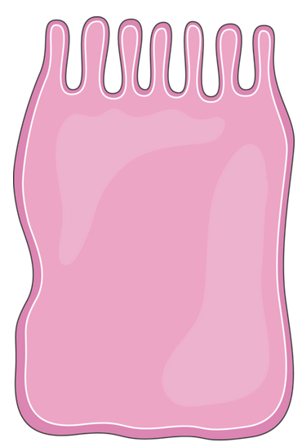
Glucose Uptake by Intestinal Cells
Apical Membrane
Intestinal Epithelium
Basal Membrane
Tight Junctions
Connective Tissue
Smooth Muscle
Bloodstream
Lymphatic System
Intestinal Lumen
Image modified from Smart Servier Medical Art
Notes:
A closer look at the epithelial cells shows that they have tight junctions connecting them together. This prevents the movement of molecules from the intestinal lumen in between the epithelial cells to the basement layer of connective tissue. Molecules that are taken up through the diet must pass through the epithelial cells directly and be transported to the blood stream or lymphatic system on the other side. To aid in this process, the luminal side of the epithelial cells (called the apical membrane) contain microvilli that increase the surface area of the cell and provide a ‘sticky’ landing area for substances from the diet.

Slide 8
Glucose Uptake by Intestinal Cells
Apical Membrane
Intestinal Epithelium
Basal Membrane
SGLT1
Na+/Glucose Symporter
Intestinal Lumen
Tight Junctions
Glucose
Starch
Na⁺
Na⁺
Na⁺
Na⁺
Pancreatic amylase
Na⁺
Na⁺
SGLT1 is an example of sodium-driven secondary active transport
Image modified from Smart Servier Medical Art
Notes:
Sodium-glucose Symporter is a transmembrane protein and is an example of sodium-driven Secondary active transport that occurs in the epithelial cells of the small intestines. The sodium-glucose symporter is found on the apical membrane of the epithelal cells, or the side facing the intestinal lumen. The sodium and glucose bind to the symporter and are simultaneously both co-transported into the epithelial cells.

Slide 9
Glucose Uptake by Intestinal Cells
Apical Membrane
Intestinal Epithelium
Basal Membrane
SGLT1
Na+/Glucose Symporter
Intestinal Lumen
Tight Junctions
Glucose
Starch
Na⁺
Na⁺
Na⁺
ADP
Na⁺
Pancreatic amylase
Na⁺
ATP
3Na⁺
Na⁺
2K⁺
Na+/K+ ATPase
SGLT1 is an example of sodium-driven secondary active transport
Image modified from Smart Servier Medical Art
Notes:
The sodium driven-glucose symporter uses the potential free energy stored in the sodium electrochemical gradient (low sodium concentration inside the epithelial cells) established by Sodium-Potassium ATPase pump that is embedded in the basal membrane of the epithelial cells. Therefore, the sodium influx from the lumen to the epithelial cell is coupled with glucose transport. This is known as secondary active transport.

Slide 10
Glucose Uptake by Intestinal Cells
Apical Membrane
Intestinal Epithelium
Basal Membrane
SGLT1
Na+/Glucose Symporter
Intestinal Lumen
Tight Junctions
Glucose
GLUT2 uniporter
Starch
Na⁺
Na⁺
Na⁺
ADP
To Bloodstream
Na⁺
Pancreatic amylase
Na⁺
ATP
3Na⁺
Na⁺
2K⁺
Na+/K+ ATPase
SGLT1 is an example of sodium-driven secondary active transport
Image modified from Smart Servier Medical Art
Notes:
The GLUT2 uniporter is found on the basal membrane of the intestinal cell, or the side facing the underlying connective tissue and vascular system. GLUT2 transports glucose from the intestinal lumen through the epithelial cell and into the bloodstream.

Slide 11
Importance of Concentration Gradients
Neuron Signaling – Action Potential (Ca²⁺/Na⁺/K⁺)
Secondary Active Transport Processes – Glucose transport in small intestine
Muscle Contraction – Ca²⁺ influx
ATP Production in Mitochondria – H⁺ gradient in the intermembrane space
Notes:
Concentration gradients also provide the energy required for the production of ATP in the mitochondria

Slide 12
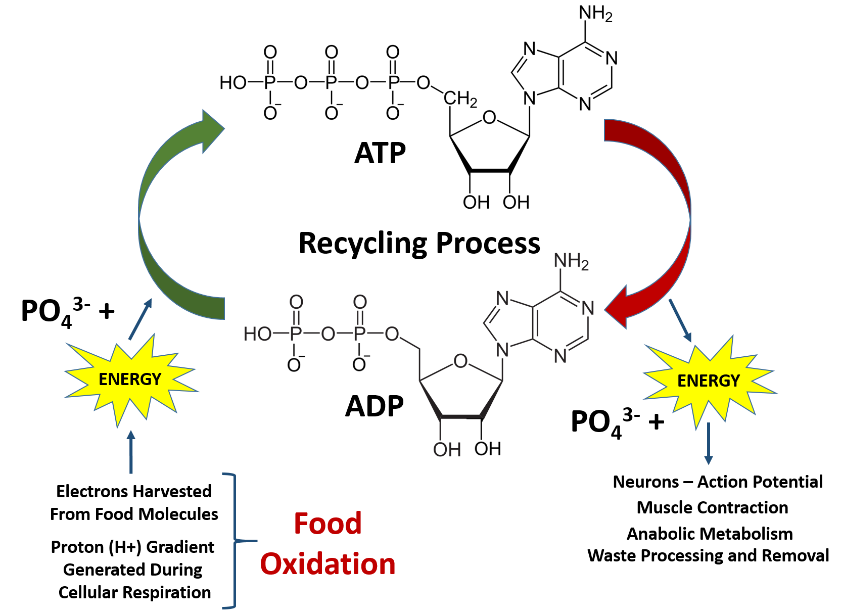
ATP Recycling Process
Notes:
As we have seen, ATP is the main energy source within the body. Cleavage of the high energy phosphate bonds releases large amounts of energy that are used for neuron function, muscle contraction, and the other metabolic processes that we have been examining within in the body. In fact, we essentially use our own body weight in ATP every day! How is that even possible when only a small fraction of our body weight is made up of the ATP molecule? ATP must be continually recycled from the lower energy ADP form back into the high energy ATP form. So much energy is needed to run the human body that each ATP molecule must be recycled an average of 500-750 times per day!

Slide 13
How Much ATP is there?
Thought question 1: If there is 0.1 mol of ATP in the body at any one time, how many molecules of ATP are present in the human body? If each of these molecules is recycled 750 times (on a particularly active day), how many chemical reactions take place just to regenerate this energy source?
Thought question 2: If there is 0.1 mol of ATP in the body at any one time and the molar mass of ATP 507.181 g/mol, what is the mass in grams of ATP present in the body?
Notes:
Take a few minutes to answer these questions…

Slide 14
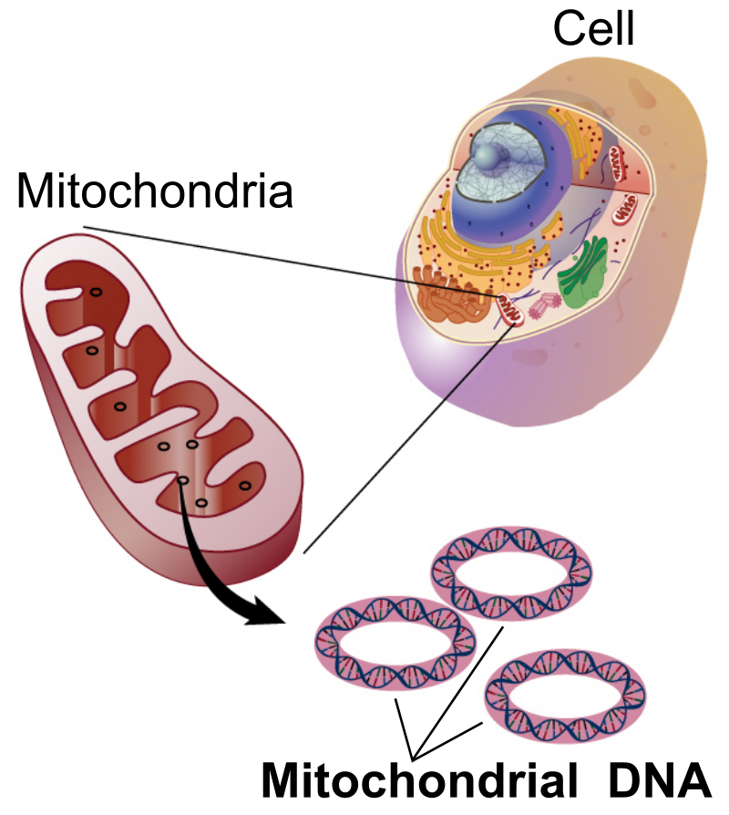
The Magical Mitochondria
Matrix
Intermembrane
Space
Outermembrane
Innermembrane
Figure by: National Human Genome Research Institute
Notes:
Mitochondria are unique organelles in that they are thought to originate from bacterial symbionts. They contain their own circular DNA and a double membrane. The innermembrane thought to have originated from the original bacterial plasma membrane, and the outermembrane thought to have originated from the plasma membrane of the eukaryotic cell that originally engulfed it. This creates two spaces within the mitochondria, the most internal space, called the matrix, and the space housed between the two membranes, termed the intermembrane space.

Slide 15
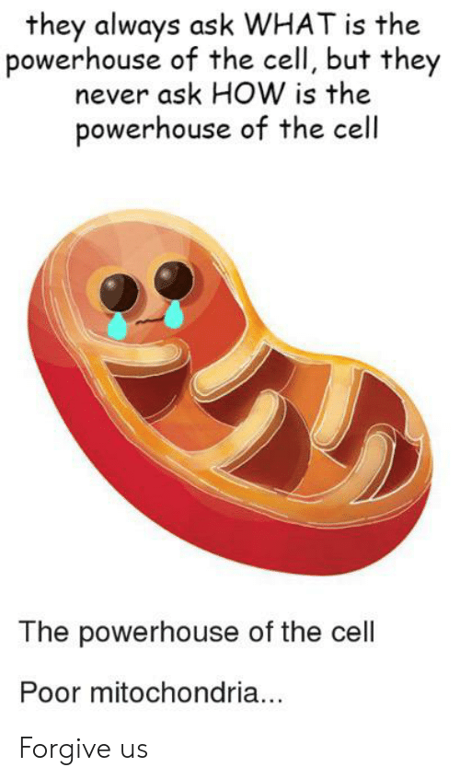
ATP is recycled in Mitochondria
Figure by: Meme
Notes:
The mitochondria are commonly known as the powerhouse of the cell, as this is the primary site where ADP is recycled into ATP. This regeneration process is called oxidative phosphorylation. The term oxidative is used because the food molecules are fully oxidized to carbon dioxide (CO₂) during the process to release energy. The electrons (and subsequent protons too) are used as an energy source to regenerate the ATP molecule. ATP is regenerated through the Phosphorylation process of adding a phosphate group to a molecule. In this case, the energy that is harvested from the oxidation of the food molecules, hence the term ‘oxidative phosphorylation’.

Slide 16
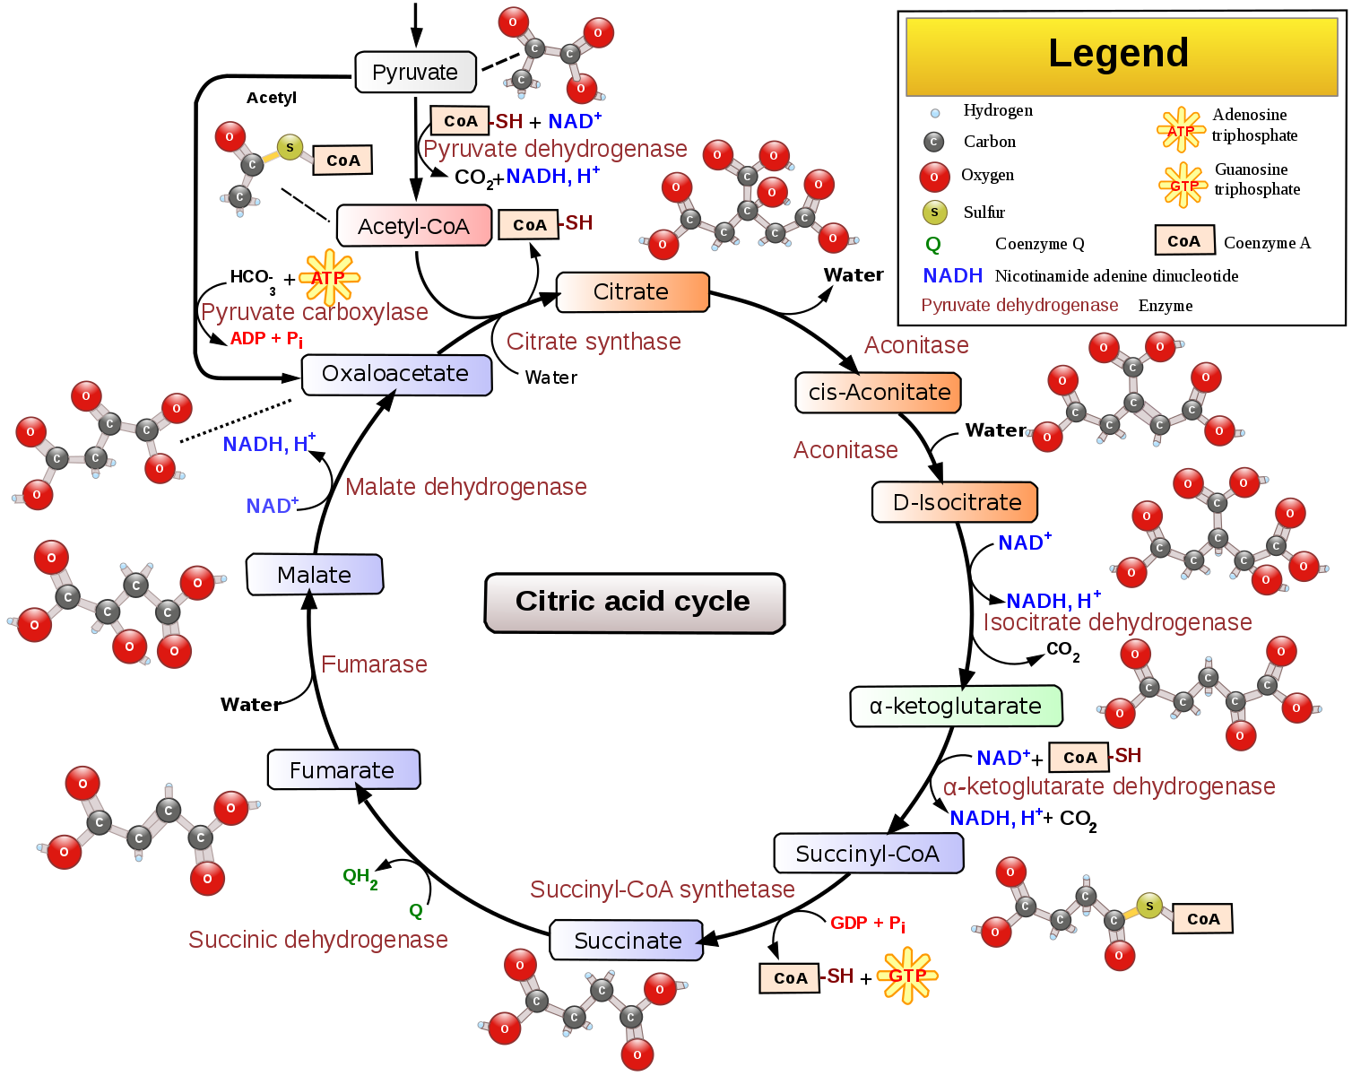
Figure by: Narayanese, WikiUserPedia, YassineMrabet, TotoBaggins
Notes:
Most of the oxidation reactions in the breakdown of food molecules take place in the interior of the mitochondria, called the matrix. The electrons (e-) and protons (H+) are harvested in this process through the metabolic reactions of the Citric Acid Cycle (or Kreb Cycle). They are transported by carrier molecules to the innermembrane of the mitochondria.

Slide 17


Energy Carriers
e⁻
H⁺
H⁺
H⁺
H⁺
e⁻
e⁻
Inner-
Membrane
Kreb
Cycle
e⁻
e⁻
e⁻
H⁺
e⁻
H⁺
e⁻
Figures by: PNG Arts and Plaistow Public Library
Notes:
Energy carriers are organic molecules that can undergo redox reactions to shuttle electrons (and protons) from the matrix of the mitochondria (where they are harvested in the reactions of the Kreb Cycle) to the innermembrane of the mitochondria, where the energy is used to phosphorylate the ADP molecule back into ATP. There are three major energy carrier molecules within the body (NADH, FADH₂ and NADPH). Both NADH and FADH₂ are utilized in mitochondrial oxidative phosphorylation. Later, we will see that NADPH is essential for similar photophosphorylation processes in the chloroplasts of plants.

Slide 18
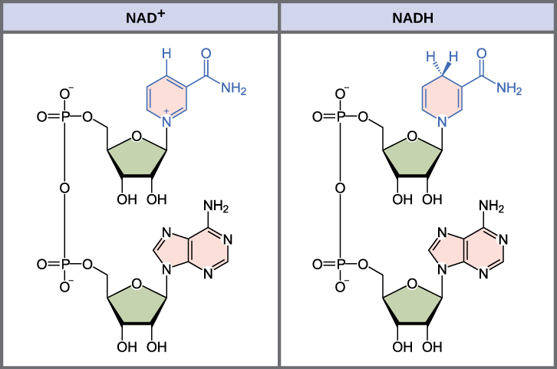
Energy Carriers – NAD⁺/NADH
Figure by: eCampus Ontario Pressbooks
Notes:
Nicotinamide Adenine Dinucleotide (or NAD+) can exist in either an oxidized (NAD+) or reduced (NADH) state, allowing it to easily shuttle electrons from one location to another. NAD+ can accept two electrons and one proton to form NADH. Note that NAD+/NADH is a loose-binding cofactor that can bind with an enzyme and then be released to travel to another location.

Slide 19
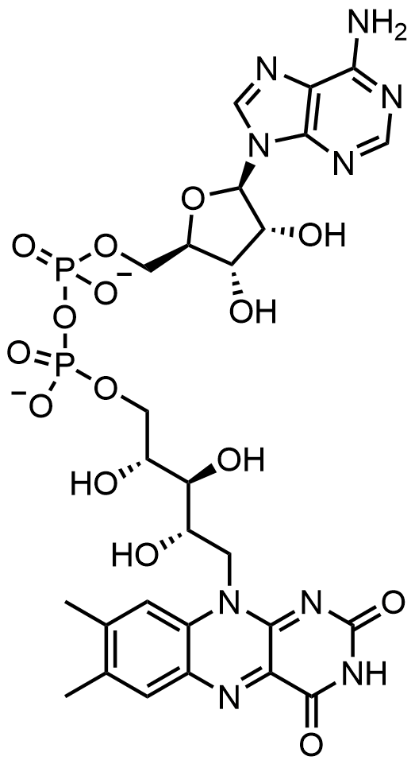
Energy Carriers
– FAD/FADH₂
FAD - Oxidized
Figure by: UMcrc14
Notes:
The Flavin Adenine Dinucleotide, contains a Flavin functional group that can accept two electrons and two protons

Slide 20
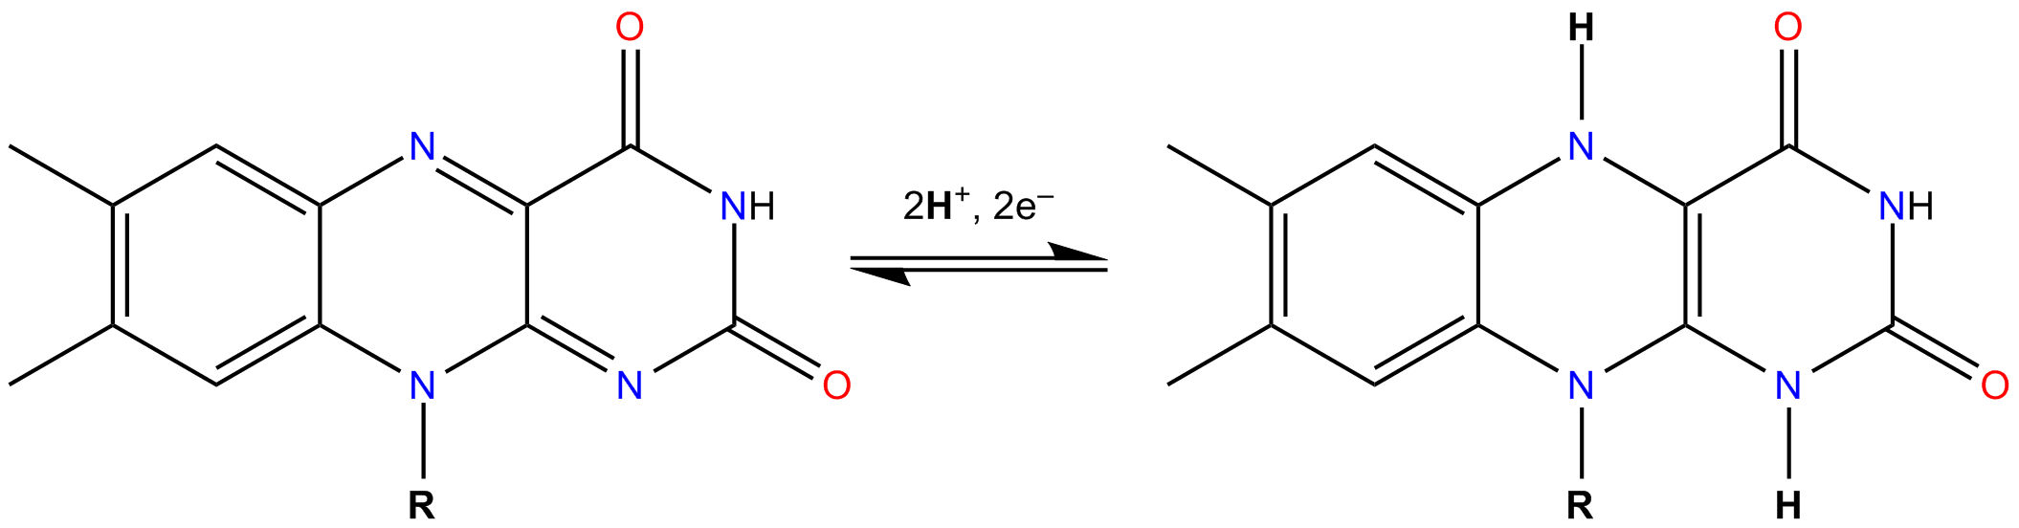
Energy Carriers – FAD/FADH
Oxidized
Reduced
Figure by: DMacks
Notes:
The oxidized form is FAD and the reduced form is FADH_{2 .}In contrast with NAD+/NADH, the FAD/FADH₂ cofactor is usually a tight binding prosthetic group within enzymes and cannot readily dissociate from the system. Thus, electrons/protons flowing through this system must move internally within the protein.

Slide 21
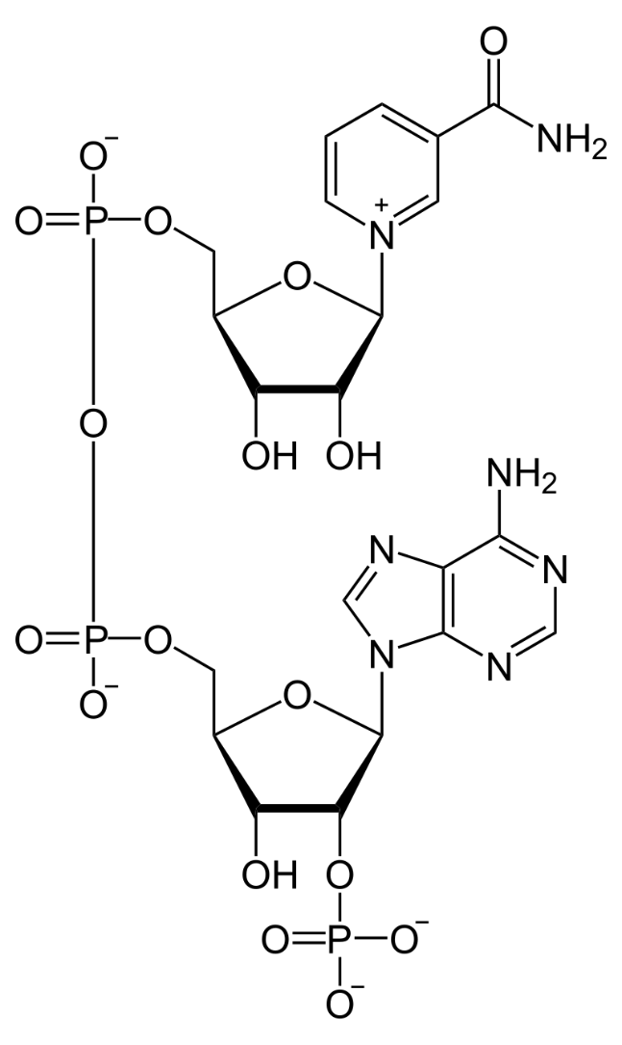
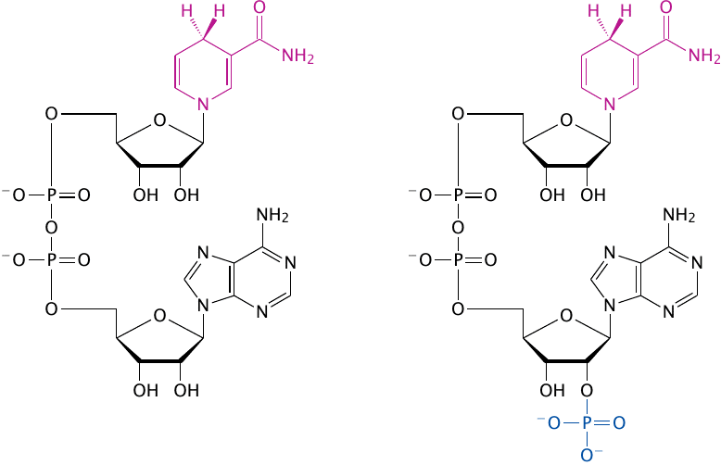
Energy Carriers – NADP⁺/NADPH
Oxidized
Reduced
Figure modified from: Neurotiker
Notes:
NADP+/NADPH is very similar to NAD+/NADH, but contains and extra phosphate group.

Slide 22
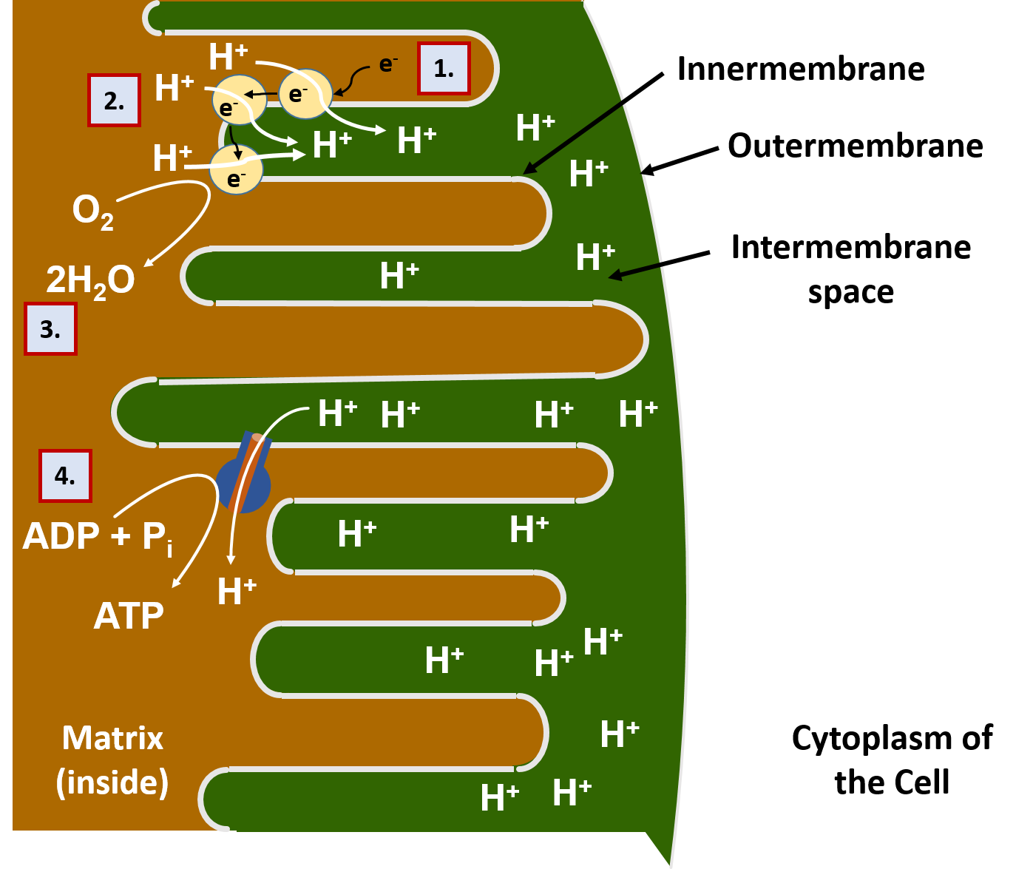
Proton Gradient and Energy
This Figure was adapted from: Geraldine Adele Lewis
Notes:
Once the energy carriers reach the innermembrane, the electrons are delivered to a series of proton pump proteins. Using the energy of the electrons, the proton pumps move H+ against their concentration gradient into the intermembrane space of the mitochondria. Recall that the intermembrane space is the area between the two membranes of the mitochondria (the innermembrane and the outermembrane). As the intermembrane space becomes full of protons, this creates a gradient potential. You can think of a gradient potential in a similar way that humans will use the power of water in a dam to generate electricity. The dammed water holds potential energy when there is high water in the dam. When the dam is opened in a controlled way to allow water to flow out, the power of the dammed water moving from an area of high concentration to an area of low concentration is used to turn turbines that can generate electricity. Similarly, in the mitochondria, the protons that are concentrated in the intermembrane space also have potential energy. Energy from this proton gradient is used to produce ATP through a proton channel protein called the ATP synthase. When the ATP synthase is bound to ADP and a phosphate ion (PO₄³⁻), the channel opens allowing the flow of H+ ions to move through the channel. The movement of the H+ ions through the protein causes the protein to turn like a cog wheel or a turbine. This turning process enables ADP and PO₄³⁻ to be joined together forming ATP. The electrons that have been used to generate the proton gradient end up reducing molecular oxygen (O₂) into water (H₂O). The oxygen supplied for this process is the oxygen that we breath in through our lungs. Thus, the oxidative phosphorylation process is also known as cellular respiration. We will spend the next few weeks learning how carbohydrates are metabolized and contribute to this energy process.

