Slide 1
Carbohydrates – Part 2
Monosaccharide Cyclization
Notes:
Welcome to part 2 in our carbohydrate series. In this section, we will cover monosaccharide cyclization.

Slide 2
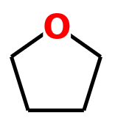
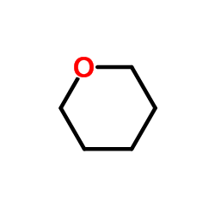
Sugar Cyclization
5 and 6 carbon sugars tend to cyclize SPONTANEOUSLY in solution forming either a furan ring or a pyran ring structure
Furan Ring
Pyran Ring
Notes:
Monosaccharides that are 5 or 6 carbons in length have the right bond angles to spontaneously form either a furan or pyran ring structure. Note that one of the hydroxyl oxygens is included as a member of the ring structure.

Slide 3
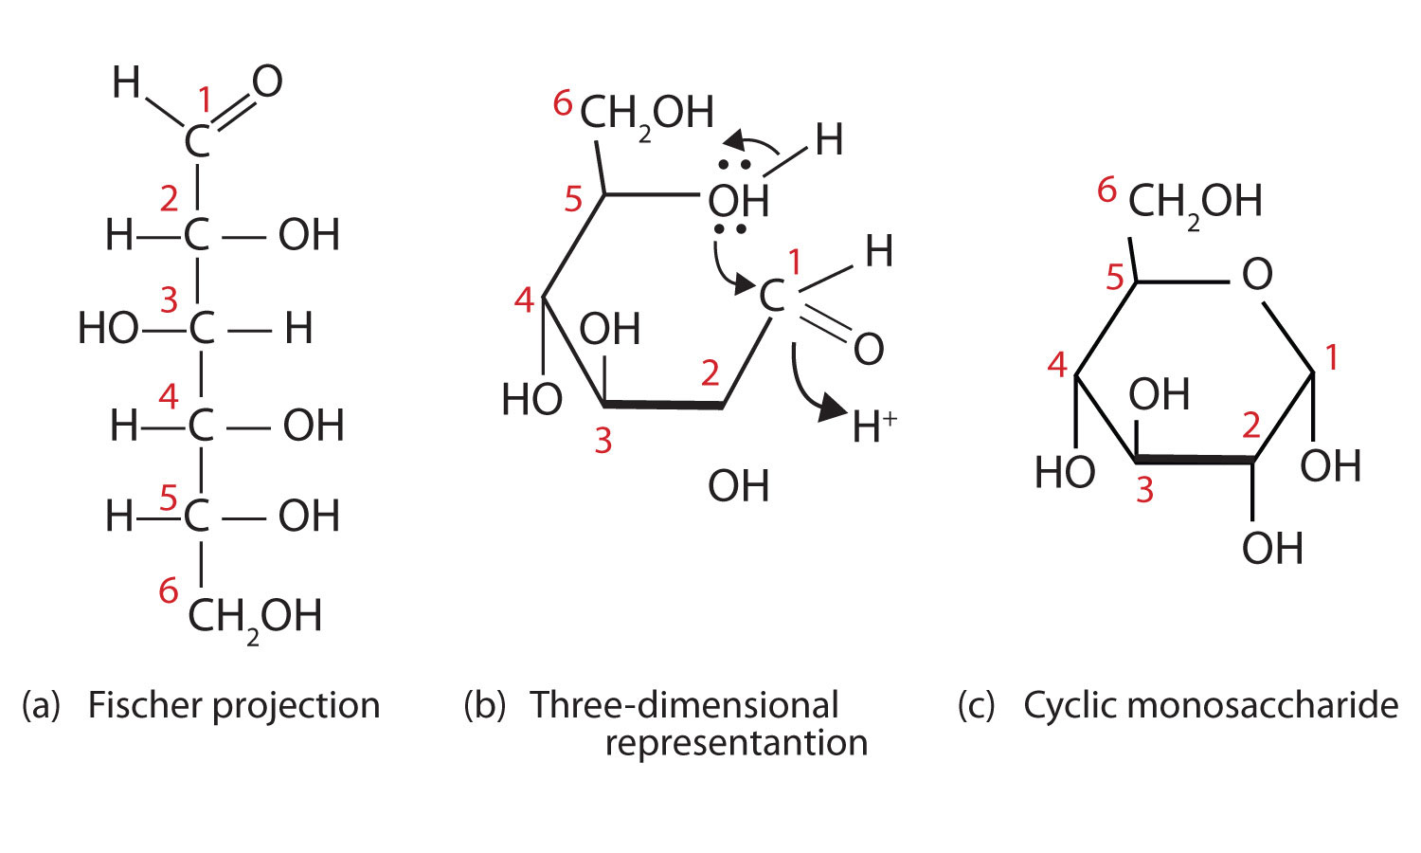
Cyclization of Glucose
Spontaneous and Reversible
Haworth Projection
Image Modified from: Ball, D.W., Hill, H.W., and Scott, R.J. (2012)
Notes:
This slide shows the cyclization of glucose. For this ring cyclization, the oxygen on carbon-5 attacks carbon-1 that contains the aldehyde functional group. As the covalent bond between the oxygen of C-5 forms with C-1, the double bond of the aldehyde breaks and forms a new bond with a proton that is free floating in the environment of the cell or solution. In the closed cyclic form, this forms a new hydroxyl group and adds in a new stererocenter in the sugar.

Slide 4
Cyclization of Glucose
Right in Fischer Projection is Down in Haworth Projection
Haworth Projection
Image Modified from: Ball, D.W., Hill, H.W., and Scott, R.J. (2012)
Notes:
When converting a Fischer projection into the cyclic ring structure, it is important to keep track of carbon numbers. This will help you correctly place the hydroxyl groups in the correct conformation. Note that in the Fischer projection that the hydroxyls on the right hand side are in the down conformation in the cyclic Haworth projection. Hydroxyls on the left of the Fischer projection are in the up conformation on the ring structure. In this ring closure, the new hydroxyl formed at C-1 is in the down position (although it could have also closed in the up conformation). This is the new stereocenter that is formed during cyclization. The remaining stereocenters should remain the same as in the Fischer projection. The carbon-2 hydroxyl is on the right in the Fischer projection and is in the down conformation on the ring. Carbon-3 on the left, and up on the ring, Carbon-4 on the right and down on the ring. The oxygen from Carbon-5 is now in the ring structure. Thus, when we look at the Fischer projection, you must think to rotate the position of the –OH on carbon-5 so that it is in line with the main chain. This will place that oxygen in line to be in the ring structure, and shifts the CH₂OH group at position 6 to the left hand side in the Fischer projection. Since CH₂OH ends up on the left hand side of the Fischer projection, it has to be up in the Haworth projection.

Slide 5
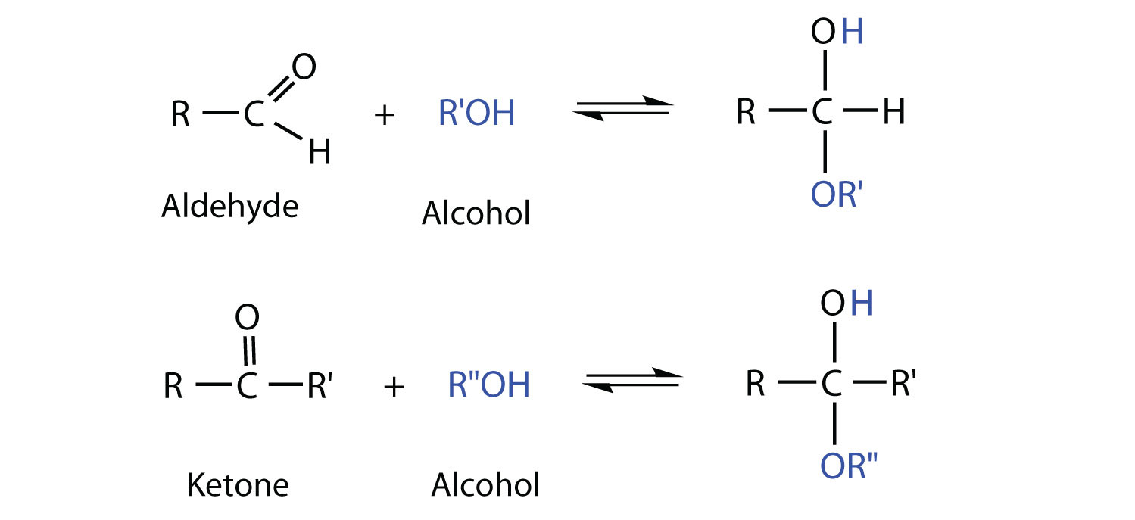
Basics of Sugar Cyclization
Hemiacetal
Hemiketal
Image Modified from: Ball, D.W., Hill, H.W., and Scott, R.J. (2012)
Notes:
The cyclization reaction is one that you have learned previously in organic chemistry. It is essentially the reaction of an alcohol with an aldehyde to form a hemiacetal, or in the case of a ketose, the reaction of a ketone with an alcohol to form a hemiketal

Slide 6
Aldose Cyclizations form Hemiacetals
Hemiacetal
Image Modified from: Ball, D.W., Hill, H.W., and Scott, R.J. (2012)
Notes:
If we look at the closed ring structure of glucose again, we can identify the hemiacetal that has formed during the reaction of the carbon-5 alcohol with the carbon-1 aldehyde.

Slide 7
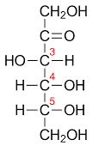
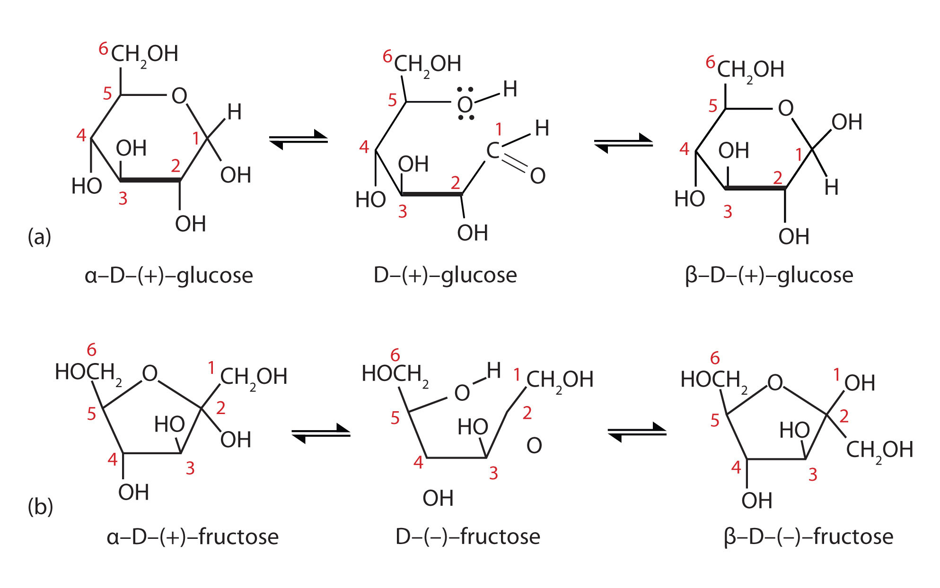
Ketose Cyclizations form Hemiketals
Hemiketal
Image Modified from: Ball, D.W., Hill, H.W., and Scott, R.J. (2012)
Notes:
Ketose cyclization is similar, the alcohol group of carbon-5 reacts with the ketone group at carbon-2 to form the hemiketal. In this case the new –OH group that is formed from the ketone is shown in the up conformation on the ring. It could also be formed in the down conformation.

Slide 8
Cyclization = New Stereocenter = Anomers
Anomeric Carbon
Anomeric Carbon
Image Modified from: Ball, D.W., Hill, H.W., and Scott, R.J. (2012)
Notes:
Thus, cyclization results in the formation of a new stereocenter at the ring closure position. These new isomers are called anomers (or anomeric pairs). And the carbon that previously contained the aldehyde or ketone structure is called the anomeric carbon. In the case of glucose, this is the C-1 carbon. You can always easily find the anomeric carbon of a cyclic sugar molecule, as it will be the only one bonded to two different oxygen atoms. All of the other carbons are only bonded to one oxygen.

Slide 9
Cyclization = New Stereocenter = Anomers
α-Conformation
The 1 and 6 positions are in the trans conformation above and below the ring
β-Conformation
The 1 and 6 positions are in the cis conformation on the same side of the ring
Image Modified from: Ball, D.W., Hill, H.W., and Scott, R.J. (2012)
Notes:
During ring cyclization, two potential isomers can form, either the alpha conformation or the beta conformation. In the alpha configuration, the functional groups extending from the carbons attached to the ring oxygen (the –OH of carbon-1 and the CH₂OH group extending off of carbon-5) are in the trans conformation extending above and below the ring structure. In the beta conformation, these positions are in the cis conformation, on the same side of the ring structure. The formation of the anomers does not change the name of the sugar. It is still D-glucose. We now need to add in the cyclic nature of the molecule and the designation of the new anomer (alpha or beta) into the name.

Slide 10
Naming Uncyclized and Cyclized Sugars
α-D-Glucopyranose
β-D-Glucopyranose
D-Glucose
Image Modified from: Ball, D.W., Hill, H.W., and Scott, R.J. (2012)
Notes:
To designate a six-membered ring structure, drop the –se from glucose and replace it with pyranose. Add in the alpha or beta designations at the beginning of the name. D-glucose forming the cyclized structure with the new –OH in the down conformation becomes alpha-D-glucopyranose. Likewise, the anomer in the cis conformation become beta-D-glucopyranose.

Slide 11
Naming Uncyclized and Cyclized Sugars
β-D-Fructofuranose
D-Fructose
Image Modified from: Ball, D.W., Hill, H.W., and Scott, R.J. (2012)
Notes:
Cyclization of fructose can form either the 6-membered ring or the 5-membered ring. The beta form of the 5-membered ring is shown here. Beta-D-fructofuranose is the sweetest form of D-fructose.

Slide 12
The Many forms of Fructose
β-D-Fructofuranose
α-D-Fructofuranose
α-D-Fructopyranose
β-D-Fructopyranose
D-Fructose
Can you cyclize fructose into these different forms?
Image Modified from: Ball, D.W., Hill, H.W., and Scott, R.J. (2012)
Notes:
Come back to this slide and practice cyclizing D-fructose into these four different conformations.

Slide 13
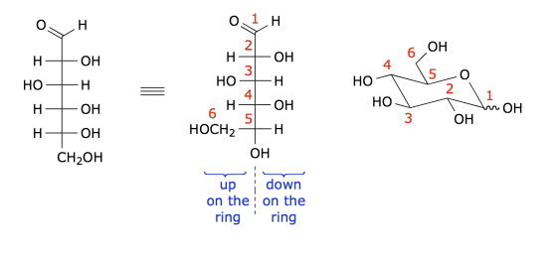
Converting to Chair Conformation
Notes:
In reality, cyclized sugars for the most part, prefer to be in the chair conformation (sometimes they can be in the boat conformation as well). Thus, it is useful to be able to recognize the stereocenters in the chair conformation. Recall that in the Fischer projection, right is down on the ring and left is up on the ring. In the chair conformation, look at the bond angles at the different positions of the sugars that indicate down or up on the ring structure. The squiggly line at C-1 indicates that ring closure could create either new anomer, the alpha in the down (or trans) conformation or the beta in the up (or cis) conformation.

Slide 14
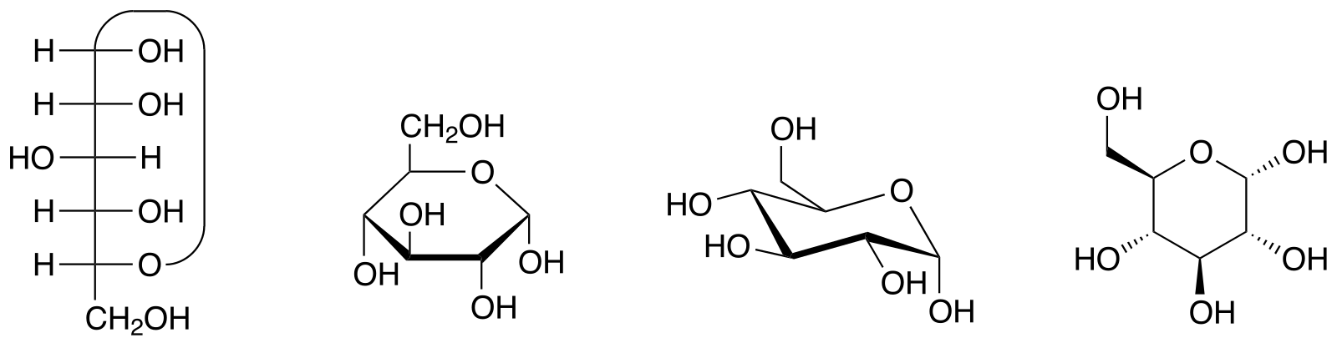
Different Views of α-D-glucopyranose
Fischer Projection
Haworth Projection
Chair Conformation
Line Angle Conformation
Image modified from: Yikrazuul
Notes:
Take some time to learn the different ways to view sugar monomers. You will be required to form the cyclized sugar if given the Fischer projection. You should be able to form any of the cyclic presentations shown here: the Haworth, Chair, or Line Angle conformations.

Slide 15
Section Review
Cyclization of Monosaccharides
Formation of hemiacetal or hemiketal
Anomeric carbon
Types of anomers
Anomer naming
Notes:
Overall in this section, you learned about the cyclization of monosaccharides. You should be able to cyclize a linear sugar into the ring conformation, recognize the formation of the hemiacetal or hemiketal structures, identify the anomeric carbon positions, distinquish between the alpha and beta anomers, and perform anomer naming if given the linear name of the sugar.

