Slide 1
Carbohydrates – Part 3
Monosaccharide Isomerases
Notes:
Welcome to part 3 in our carbohydrate series. In this presentation, we will discuss monosaccharide isomerase enzymes.

Slide 2
Isomerases Interconvert Aldoses and Ketoses
Class of Enzymes:
Isomerases - an enzyme that catalyzes the conversion of a specified compound to an isomer.
Notes:
Isomerases are the class of enzymes that catalyze the conversion of a specified compound to an isomer of that same compound.

Slide 3
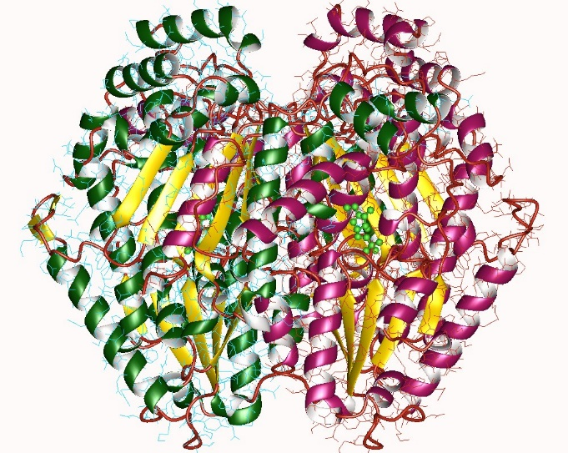
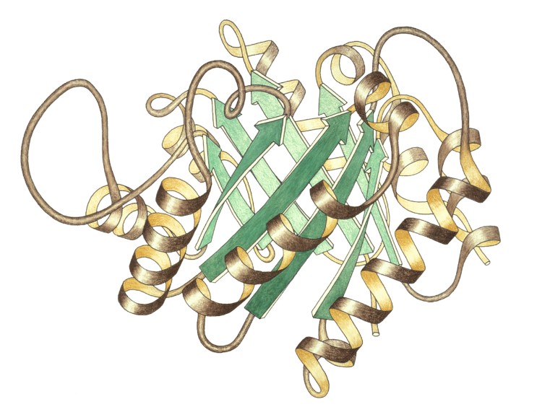
Two Important Sugar Isomerases
Can interconvert Aldoses to Ketoses
Two important ones are:
Phosphoglucose Isomerase (aka
Glucose 6-phosphate Isomerase)
Triosephosphate isomerase
Images by: Jeffrey, C.J., Lee, J.H., Chang, K.Z., Patel, V. and Jane Richardson
Notes:
There are two important sugar isomerases that you will need to know for glucose metabolism. The first is Phosphoglucose Isomerase (which is also known as Glucose 6-phosphate Isomerase) and the second is Triosephosphate Isomerase.

Slide 4
Phosphoglucose Isomerase (PGI)
Glucose 6-phosphate
(Aldose)
Fructose 6-phosphate
(Ketose)
Triosephosphate Isomerase (TPI)
Dihydroxyacetone
phosphate (DHAP)
(Ketose)
Glyceraldehyde
3-phosphate (GAP)
(Aldose)
Notes:
These sugar isomerases convert the sugars between their aldose/ketose pairs. For phosphoglucose isomerase, it is converting the aldose, glucose 6-phosphate into the ketose, fructose 6-phosphate. Similarly, triosephosphate isomerase converts the ketose, dihydroxyacetone phosphate (DHAP) into the aldose, Glyceraldehyde 3-phosphate (GAP). Notice that these are phosphorylated forms of some of the sugars that you are required to site recognize! It is a good time to practice recognizing their structure.

Slide 5
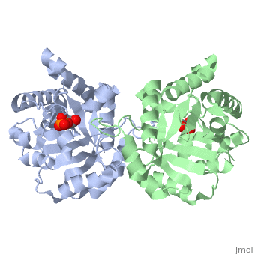
Triose Phosphate Isomerase (TPI)
is a dimeric enzyme
catalyzes the conversion of dihydroxyacetone phosphate (DHAP) to D-glyceraldehyde-3-phosphate (GAP)
Is an essential process in the glycolytic pathway
Deficiency can lead to accumulation of DHAP and result in chronic haemolytic anaemia
May have a role in Alzheimer’s Disease
Image from Protopedia
Notes:
Let’s look first at Triose Phosphate Isomerase. This dimeric enzyme catalyzes the conversion of DHAP to GAP. It is an essential enzyme during the breakdown of glucose through glycolysis. Mutations that block the activity of this enzyme can result in chronic haemolytic anaemia. The enzyme has also been linked to Alzheimer’s disease.

Slide 6
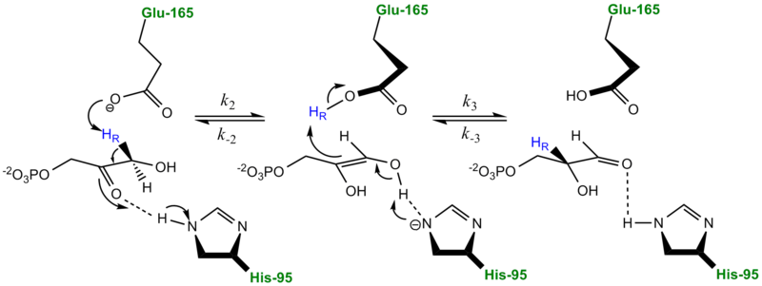
Reaction Mechanism of TPI
Classic Mechanism proposed by Knowles and coworkers involves the formation of an enediol intermediate
1
2
3
1
3
2
3
2
1
DHAP
-enediol
GAP
Image modified form User:Gregg Snider
Notes:
The reaction mechanism of TPI involves the formation of an enediol intermediate. This is the classic mechanism proposed by Knowles and coworkers. In this reaction, a histidine residue from TPI hydroden bonds with the ketone functional group from DHAP. At the same time, a glutamic acid abstracts a proton from carbon-3. The electrons from this bond, fold in creating the carbon-carbon double bond and force the ketone oxygen to abstract the hydrogen from His-95. This forms the enediol intermediate. An ‘enediol’ as the name implies is a carbon-carbon double bond (the –ene), where each carbon of the double bond is also bonded with an alcohol functional group (the di-ol) The enediol is unstable and the pi-bond electrons abstract the hydrogen from the glutamate residue forming a C-H bond at carbon-2. The aldehyde forms at carbon-3 and the histidine recovers its proton. GAP is then released from the enzyme active site.

Slide 7
Reaction Mechanism of PGI
Glucose
6-phosphate
Step 1: Glucose 6-Phosphate binds to enzyme and a Basic Residue (K or H) acts as an acid and catalyzes the opening of the ring
Notes:
The reaction mechanism for PGI is very similar to TPI, however the cyclic form of the glucose monomer needs to be linearized before the reaction can occur. Thus the glycosidic bond is disrupted by the interaction of Glucose 6-phsopahte with a basic residue (B) in the active site. This allows an electrophile E to abstract a proton from carbon-2.

Slide 8
Reaction Mechanism of PGI
-enediol
intermediate
Step 2: A conserved Glu (E) residue abstracts the acidic proton from C2 forming a cis-enediol intermediate.
Notes:
The electrons from this bond fold inward and create a carbon-carbon double bond. This forces the aldehyde oxygen to abstract a hydrogen from a basic residue in the active site or from the surrounding solution forming the hydroxyl. This formed the enediol intermediate.

Slide 9
Reaction Mechanism of PGI
Step 3: The conserved Glu (E) Residue donates the proton back to the C1 position.
Notes:
The enediol is unstable. The pi-bonded electrons attack the electrophile and abstract the hydrogen forming a carbon-hydrogen bond at carbon-1. The ketone functional group is then formed at carbon-2 with the release of the proton to the environment. Ring closure ensues with the reaction of the carbon-5 alcohol with the ketone function group at carbon-2 forming the hemiketal.

Slide 10
Reaction Mechanism of PGI
Fructose
6-phosphate
Step 4: The basic residue (K or H) abstracts the proton from the ring oxygen, resulting in ring closure and the formation of the product.
Notes:
This completes the rearrangement of Glucose 6-phosphate to form Fructose 6-phosphate.

Slide 11
Summary
Sugar Phosphate Isomerases
Interconvert aldose-ketose pairs, through a proposed
-enediol intermediate
Perform important required steps in the glycolytic pathway
Can lead to disease states if deficient or inappropriately modified
Notes:
In summary, you have learned that the sugar phosphate isomerases (GPI and TPI) interconvert aldose-ketose pairs through a proposed enediol intermediate. These are both important reactions that are required for glycolysis. Impairment of either of these enzyme functions can lead to disease states.

