Slide 1
Carbohydrates – Part 4
Disaccharide, Oligosaccharide, and Polysaccharide Structure
Notes:
Welcome to Part 4 of our carbohydrate series. In this presentation, we will focus on the structure of disaccharides, oligosaccharides and polysaccharides.

Slide 2
Types of Sugar Polymers
Disaccharides – Two monosaccharides linked together with a glycosidic bond
Oligosaccharides – a few sugars (3 – 15) linked together with glycosidic bonds
Polysaccharides – many sugars linked together with glycosidic bonds
Notes:
Disaccharides are defined as two monosaccharides linked together through a glycosidic bond. Oligosaccharides have a few sugars, typically 3 – 15 linked together with glycosidic bonds, while polysaccharides tend to have many monosaccharides linked together by glycosidic bonds.

Slide 3
Glycosidic Bonds
Monosaccharides can be joined together to form larger polymers through glycosidic bonds.
Glycosidic bond formation occurs through dehydration synthesis, joining the two sugars at the anomeric carbon position of the first sugar and a hydroxyl of another sugar molecule.
Notes:
Glycosidic bonds form through a dehydration reaction and have water as a byproduct. In this reaction, an alcohol oxygen from one sugar attacks the anomeric carbon of a neighboring sugar. The hydroxyl group on the anomeric carbon serves as a good leaving group and forms the –OH component of the water molecule that will be formed in the reaction. The second hydrogen is removed from the incoming alcohol, resulting in the formation of the glycosidic bond. Glycosidic bond formation does NOT happen spontaneously. It requires the action of an enzyme (not shown in this diagram).

Slide 4
Glycosidic Bonds
Acetal (Cannot Ring Open)
Hemiacetal (Can Ring Open)
The Hemiacetal can still behave as a reducing sugar.
Glycosidic Bond at α1 → 4 Position
Notes:
The glycosidic bond is shown in red (click) It is called an acetal when formed from an aldose at the anomeric carbon position, or a ketal when formed from the anomeric position of a ketose. The diagram above shows the acetal. In the acetal, the anomeric carbon is also bonded to a hydrogen atom. It would be a ketal, if this were replaced by a carbon containing group such as CH₂OH. The acetal ring (and the ketal ring) are no longer able to ring open and linearize (click). The hemiacetal on the second sugar, however, is still free to ring open and linearize. (click) Thus, the hemiacetal can still behave as a reducing sugar.

Slide 5
Disaccharides of D-Glucose
1
4
Two α-D-glucopyranose monomers linked at α1 → 4 position = Maltose
Two β-D-glucopyranose monomers linked at β1 → 4 position = Cellobiose
Notes:
Two alpha D-glucopyranose molecules can come together through an alpha 1→4 linkage and form the disaccharide maltose. Similarly, two beta D-glucopyranose molecules can also come together in a beta 1→4 linkage to form a disaccharide. However, you will notice that the sugar positions of the sugar alcohol groups do not favor bond formation. To enable them to come together, the second beta-D-glucopyranose needs to be flipped over. (click-click). The sugars can then form the glycosidic bond and retain the correct stereochemistry (click).

Slide 6
Disaccharides of D-Glucose
Sweet
1
4
Two α-D-glucopyranose monomers linked at α1 → 4 position = Maltose
Fibrous
Two β-D-glucopyranose monomers linked at β1 → 4 position = Cellobiose
Notes:
This forms the beta 1→4 glucopyranose disaccharide called Cellobiose. Structurally, it is much different from the maltose shown above. This gives the two molecules very different properties. (click) Maltose is sweet to the taste and serves as a good energy source for us, whereas cellobiose is fibrous and difficult to digest.

Slide 7
Formation of Sucrose
1 → 2 linkage with α-D-glucopyranose and β-D-fructofuranose
Notes:
Different sugars can also come together to form glycosidic linkages. The formation of sucrose occurs between the alpha anomeric carbon of alpha D-glucopyranose, with the beta anomeric position of beta D-fructofuranose. This is an alpha (1→2) linkage. The full name of the disaccharide resulting is alpha-D-glucopyranose-1→2)-beta-D-fructofuranose. With the two sugars written as above, we are unable to link them together and maintain correct stereochemical angles. Thus, we must flip the fructose over like a pankcake. (click)

Slide 8
Formation of Sucrose
1 → 2 linkage with α-D-glucopyranose and β-D-fructofuranose
α-D-glucopyranose (1 → 2) β-D-fructofuranose = Sucrose
Notes:
Now the beta hydroxyl is on the correct side, but it is still too high to link with the alpha position of the glucose. We can remedy this by shifting the position of the fructose down (click). Sucrose, common table sugar, can then be formed (click)

Slide 9
Formation of Lactose
β-D-Galactose (1 → 4) D-Glucopyranose
Notes:
Similarly, lactose is formed by combining beta-D-galactopyranose with D-glucopyranose, through a beta 1→4 linkage. To align the sugars, we can shift the glucose up so that the 4’ hydroxyl group is aligned to join with the beta anomeric position of galactose. (click-click). This allows the formation of lactose, the common sugar found in the milk of mammals. These are the four common disaccharides that you should be familiar with (Maltose, Cellobiose, Sucrose, and Lactose).

Slide 10
Oligosaccharides
Range from 3 to 15 sugar residues
Are not commonly found free floating in cells, but are instead attached to lipids or proteins, especially those bound in the plasma membrane
We will come back to talk more in depth about oligosaccharides in part 5 of the carbohydrate series
Communication, Signaling, and Identification
Notes:
Oligosaccharides are commonly formed with 3 – 15 sugar residues and are usually not free floating sugars within the body. Oligosaccharides are often linked with proteins or lipid structures where they are involved with cell signaling, cell-cell communication, and cellular identification. We will come back in the next section and discuss oligosaccharide functions in more depth.

Slide 11
Polysaccharides
Starch
Amylose
Amylopectin
Glycogen
Cellulose
Food and Energy
Structure, Support, Cushion
Notes:
There are three major polysaccharides that you should be familiar with: (1) Starch, which consists of a mixture of amylose and amylopectin, and is the common carbohydrate storage form found in plants, (2) Glycogen which is the common carbohydrate storage form of animals, and (3) Cellulose which is a polysaccharide used as the basis for structural support and cushioning in plants, animals and fungi.

Slide 12
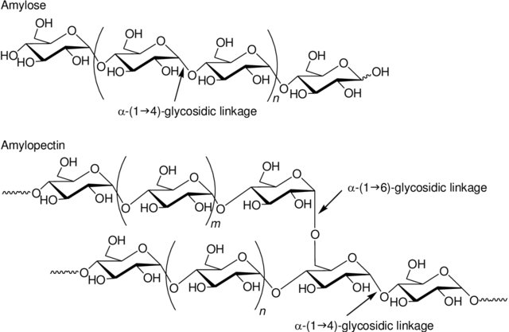
Amylose
The simplest polysaccharide, comprised of α-D-glucopyranose units joined with α1 →4 linkages
Image from Kadokawa
Notes:
The simplest polysaccharide is amylose. It consists of repeating alpha 1→4 linkages between alpha-D-glucopyranose residues. Approximately 20-30% of starch is made up of amylose.

Slide 13
Amylopectin
Contains α-D-glucopyranose units joined with α1 →4 linkages, and also has branches at the α1 →6 position about every 30 – 50 residues
Image from Kadokawa
Notes:
Amylopectin is a little bit more complex. It has the same core structure as the amylose, but it also has alpha 1→6 branching. This means that in addition to the alpha 1→4 glycosidic bonds, that there are also alpha 1→6 glycosidic bonds that can occur between alpha D-glucopyranose residues. In amylopectin, these branch points occur about every 30-50 residues. Amylopectin makes up approximately 70-80% of starch stored in plant materials.

Slide 14
Glycogen
Contains α-D-glucopyranose units joined with α1 →4 linkages, and also has branches at the α1 →6 position about every 12-15 residues
Glycogen
Image from Kadokawa
Notes:
Glycogen, the primary carbohydrate storage form in animals, is very similar to amylopectin. It has both the alpha 1→4 main chain and the alpha 1→6 branching. However, the alpha 1→6 branching occurs more frequently about every 12 – 15 residues. Why is this important?

Slide 15
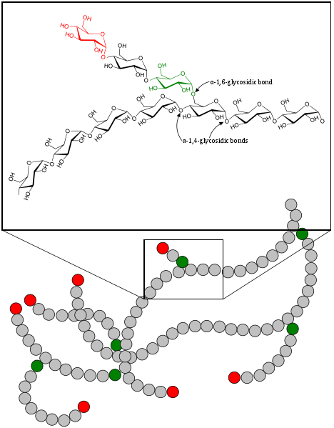
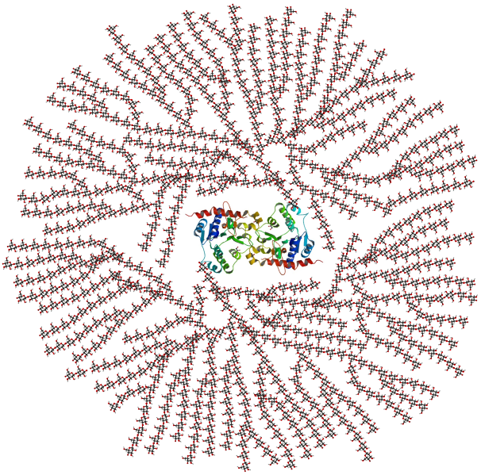
Glycogen Polymers
Image from Mikael Häggström
Image from GKFX
Notes:
You can look to the larger structure of glycogen for the answer. By having a lot of branch points, the glycogen molecule also has a lot of ends to it. This is important because glucose that is released from glycogen as a source of energy, is cleaved off one at a time from the end of the molecule. If there was only one end, it would be very inefficient for animals to generate enough energy to support muscle contraction and movement. Plants can get away with only having one end of the molecule on their amylose molecules, because they don’t have to run away from predators, chase down food, or walk for miles to search for it. Thus, in animals, it is much more helpful to be able to release hundreds of glucose monomers from each glycogen granule all at the same time.

Slide 16
Glycogen Polymers
Highly branching
Have many ends (fast access to glucose)
May have 30,000 glucose units in a granule
The polymer is attached to a central protein called glycogenin
10% of the mass of Liver cells is glycogen
2% of the mass of skeletal muscle is glycogen
Image from Mikael Häggström
Notes:
What else do you notice about the glycogen structure? Yes! It is attached to a protein core structure. This protein is called glycogenin and attaches to the reducing end of glucose (ie the anomeric position). Thus, all of the ends of the glycogen molecule are the non-reducing ends (ie the carbon 4 hydroxyl is showing). Also note just how big glycogen is: up to 30,000 glucose residues! Oh my…that is large enough to see these granules using microscopy. Also note that up to 10 % of the liver biomass is glycogen and approximately 2% of skeletal muscle biomass is glycogen.

Slide 17
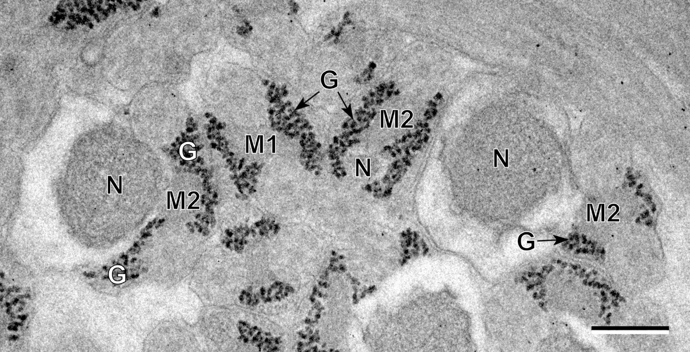
Glycogen in Spermatozoa
From a flatworm
Image from Miquel, et al (2013)
Notes:
In this slide you can visualize some of those very large glycogen granules. They are housed on the tails of the spermatozoa of the flatworm. Here is the outline of the head of the spermatozoa that is barely visible. The dark staining granules are glycogen. They are attached to the flagella of the spermatozoa to help power movement during fertilization. It’s like they are carrying their own gasoline!

Slide 18
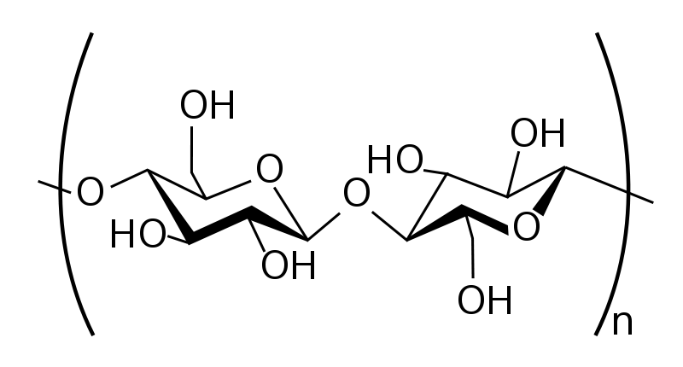
Cellulose
Units of β-D-glucopyranose linked with β1 →4 linkages
Image from Slashme
Notes:
Cellulose is the other major polysaccharide that you should be familiar with. Similar to the disaccharide cellobiose, this polymer consists of beta 1→4 linkages between glucose residues. This means that every other glucose has to be flipped upside down to join with the growing chain.

Slide 19
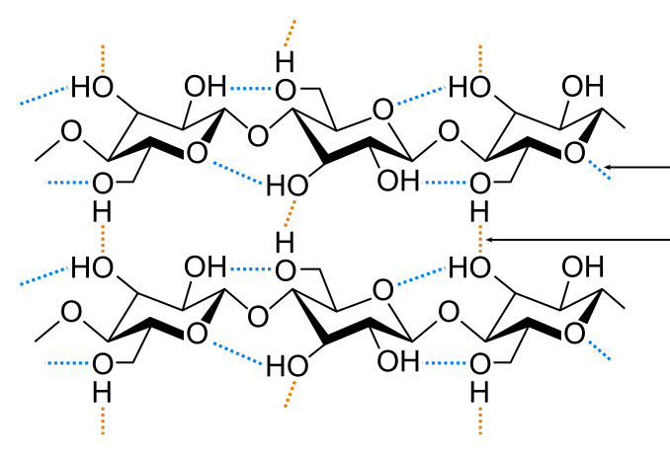
Cellulose Structure
Allows for strong Hydrogen Bond interactions
Intramolecular
Hydrogen Bonding
Intermolecular
Hydrogen Bonding
Image modified from Laghi.I
Notes:
This creates unique intramolecular (shown in blue) and intermolecular (shown in red) hydrogen bonding. Hydrogen bonding in the cellulose macromolecule enables it to be incredibly strong and fibrous. Carbohydrates form some of the strongest structural supports in the biological kingdom.

Slide 20
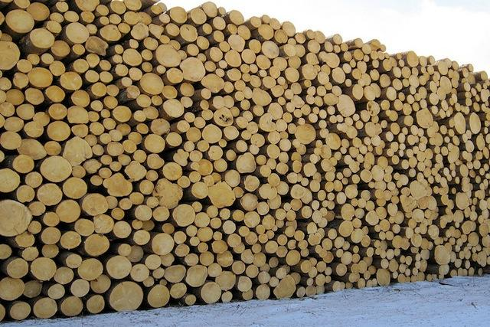
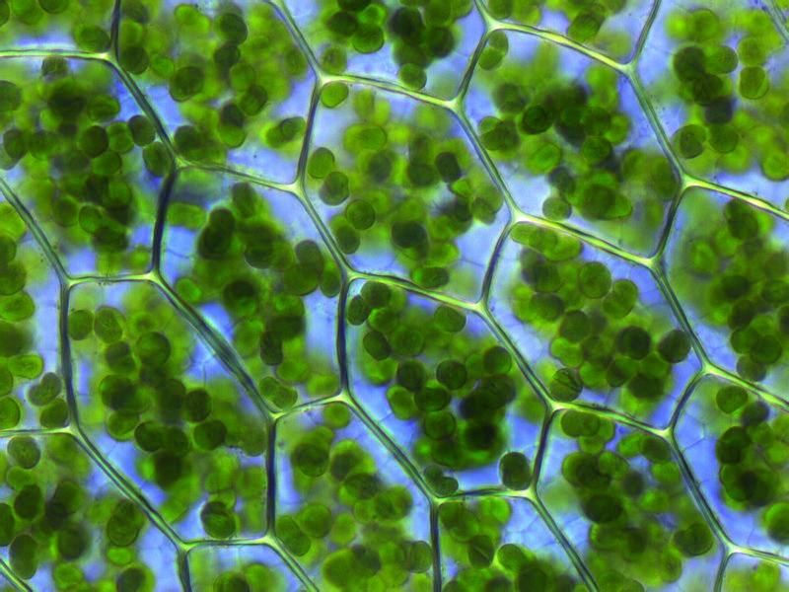
Cellulose
Primary structure of fibrous and woody plants
Forms the strong cell wall structure
Image from Katherna, Flickr Creative Commons
Image from Fabelfroh
Notes:
It is the core structure of fibrous and woody plants, forming the strong cell walls. We will visit this polymer again in the next section in a slightly modified form and see some of the structural support roles it plays in animals.

Slide 21
Summary
Formation of the glycosidic bond through dehydration synthesis
Important disaccharides (Maltose, Cellobiose, Sucrose, and Lactose)
Oligosaccharide functions
Polysaccharide structure and function (Amylose, Amylopectin, Glycogen, and Cellulose)
Review these concepts
Notes:
In summary, you have learned how to form glycosidic bonds through dehydration synthesis. You should be able to put two monosaccharides together at defined bond linkages or break them back apart via hydrolysis. You should be able to identify the four important disaccharides (Maltose, Cellobiose, Lactose, and Sucrose). You should also be able to describe the major functions of oligosaccharides. Finally, you should be familiar with the polysaccharide structures and functions of Starch (consisting of Amylose and Amylopectin), Glycogen, and Cellulose.

