Slide 1
Carbohydrates – Part 5
Sugar Derivatives and Functions
Notes:
Welcome to part 5 of our carbohydrate series. In this presentation, we will discuss common sugar derivatives and their functions.

Slide 2
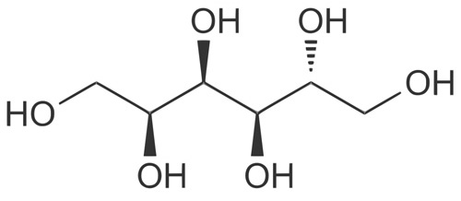
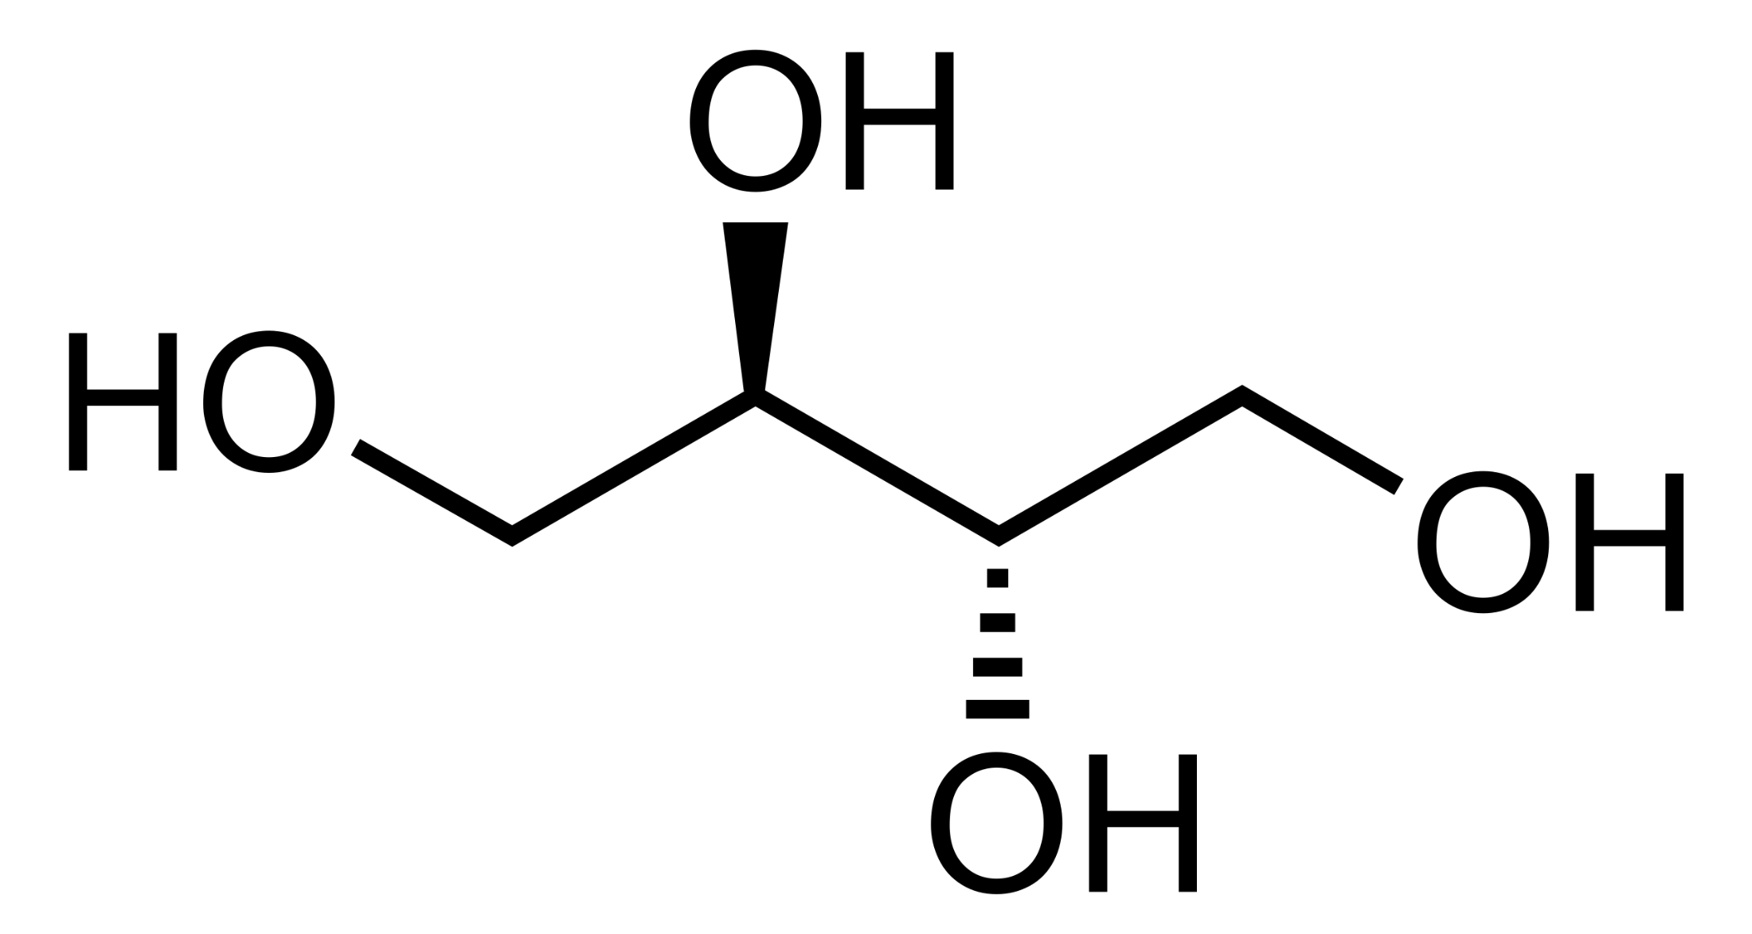
Monosaccharide Derivatives
Monosaccharides can commonly be converted to sugar alcohols and sugar acids
Erythritol – sugar alcohol
(60-70% as sweet as sucrose,
But contributes far fewer calories when eaten)
Sorbitol – sugar alcohol
(found naturally in fruits, it is also used as an artificial sweetener. It is metabolized more slowly than glucose)
Notes:
A common alteration that occur with monosaccharides involve the reduction of the aldehyde or ketone functional group into an alcohol, creating a sugar alcohol as shown here with erythritol and sorbitol. Sugar alcohols can be found as natural components of fruits and are typically not absorbed well by the small intestine. They are also metabolized more slowly than glucose, thus, they have been used as artificial sweeteners.

Slide 3
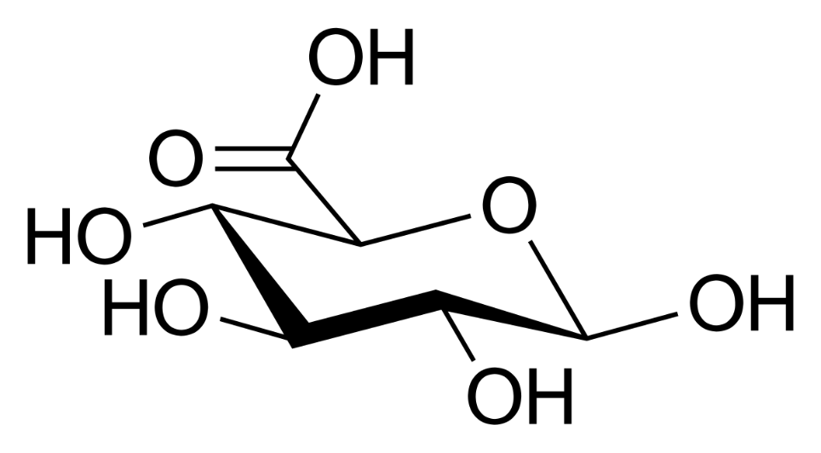
Monosaccharide Acids
Glucuronidation
Modifies organic molecules by adding glucuronic acid
Often involved in drug metabolism
Increases polarity of organic molecules for excretion
Phase II metabolism
Glucuronic Acid
(originally found in urine, but also in many gums, such as gum Arabic, xantham, and Kombucha Tea, commonly incorporated into glycoprotiens)
Notes:
Monosaccharides can also be modified into acids. Glucuronic acid is one of the most important sugar acids in humans. It is commonly involved in the detoxification and removal of foreign substances from the body. In the liver, detoxification reactions add glucuronic acid to drug compounds and other organic substances injested from the diet. This increases their polarity and prepares them for excretion from the body. The process is called glucuronidation and it is an important part of phase II metabolism.

Slide 4
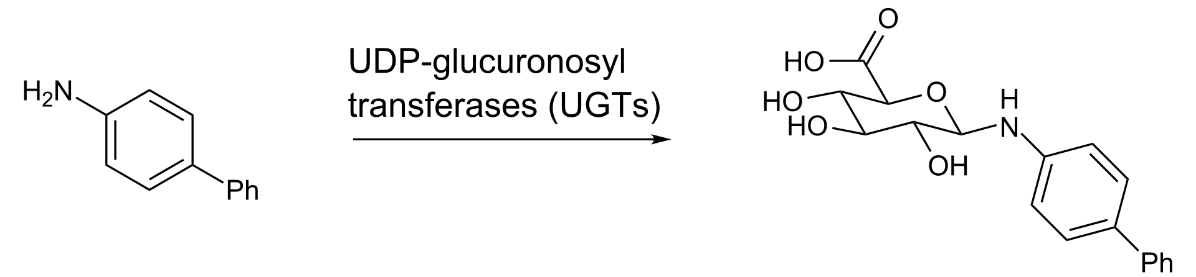
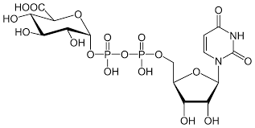
Glucuronidation
UDP-glucuronosyl Transferases (UGTs)
Superfamily of enzymes – can modify more than 350 different compounds in humans
The glucuronic acid
is activated by the addition of UDP
prior to the incorporation into the
organic substrate
Image from Edgar181
Notes:
Glucuronidation reactions are mediated by a family of enzymes called UDP-glucuronosyl transferases (UGTs). These constitute a superfamily of enzymes with the ability to modify over 350 different compounds in humans, including drugs like Acetaminophen and Morphine. Note that glucuronic acid must by activated by the addition of UDP prior to being added to the final substrate. We will see this type of activation is required for other sugar metabolic pathways such as glycogen synthesis as well.

Slide 5
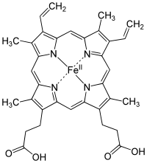
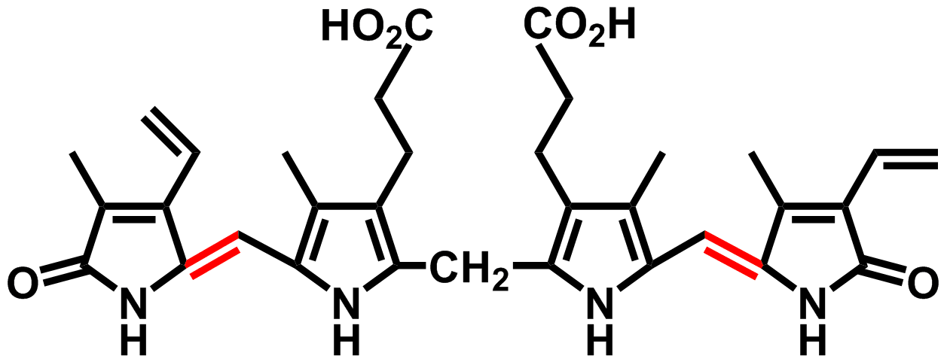
Bilirubin
Heme
Bilirubin
Is a breakdown product of heme cofactor during the destruction of aged or abnormal red blood cells
It is excreted in urine, feces, and bile, and is the cause of the yellow color in bruises, jaundice, and urine. Further breakdown products such as stercobilin cause the brown coloration of feces.
Image from Stefcho2
Notes:
The metabolism of bilirubin is another example that utilizes the glucuronidation pathway. Bilirubin is a breakdown product of the heme cofactor of hemoglobin. It accumulates during the breakdown of old or damaged red blood cells.

Slide 6
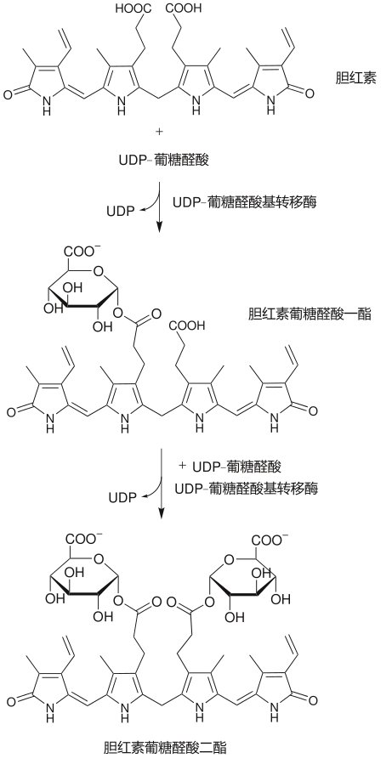
Glucuronidation of Bilirubin
Bilirubin
+ UDP-glucuronic acid
UDP-glucuronosyl Transferases (UGTs)
Are utilized during bilirubin metabolism and secretion
A deficiency in the glucuronosyltransferase for bilirubin can cause disease states with symptoms of unconjugated hyperbilirubinemia.
UGT Enzyme
Bilirubin glucuronide
+ UDP-glucuronic acid
UGT Enzyme
Image modified from Choij
Bilirubin diglucuronide
Notes:
Glucuronidation of bilirubin is required for excretion primarily through the urine and feces. Deficiency in the glucuronidation pathway leads to the accumulation of bilirubin in a condition known as unconjugated hyperbilirubinemia.

Slide 7
Bilirubin Accumulation
Hyperbilirubinemia could be caused by
increased bilirubin production
decreased uptake into the liver cells
impaired conjugation (defect in UGT enzyme)
interference with the secretion of conjugated bilirubin.
Notes:
Causes of this accumulation could be from many factors including reduced conjugation with glucuronic acid that impairs excretion.

Slide 8
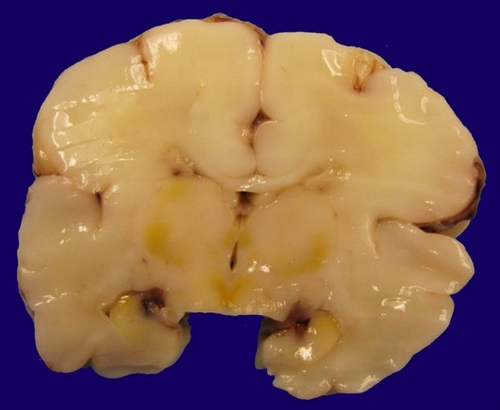
Crigler Najjar Syndrome
Serious Disease that often causes neonatal death
Less than 10% activity of bilirubin UGT enzyme
Unconjugated bilirubin accumumates in blood and brain
Image from Hamza, A. (2019)
Notes:
Babies born with Crigler Najjar Syndrome have less than 10% activity of the UGT enzyme required for bilirubin metabolism. This results in the accumulation of bilirubin in brain tissue, as the nonpolar compound can cross the blood-brain barrier. Death usually occurs in infancy.

Slide 9
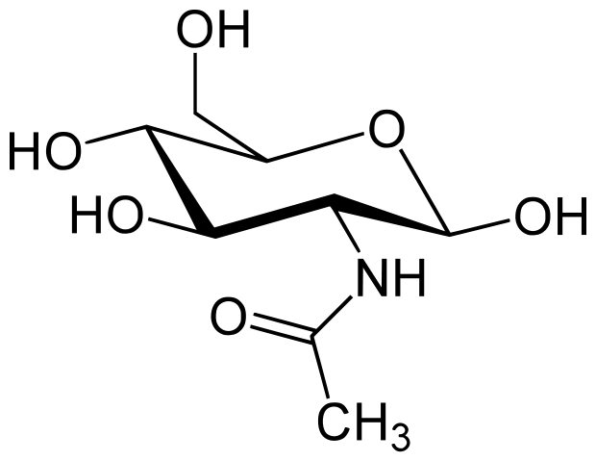
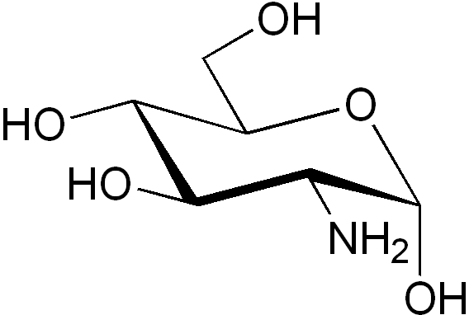
Monosaccharide Amination and Acetylation
Glucosamine
N-Acetylglucosamine
Glucosamine is one of the most common monosaccharides and is found predominantly in cartilage. It is also associated with oligosaccharides and other polysaccharide structures.
N-Acetylglucosamine is also quite common and is incorporated into oligosaccharide and polysaccharide structures
Notes:
Monosaccharides may also be altered via amination and acetylation. Common metabolites include glucosamine, with amination occurring at position 2 of D-glucose. Acetylation of the amine position produces N-Acetylglucosamine. These are common metabolites within the body and are found predominantly in joints, where they provide cushioning and support. Glucosamine and other polysaccharides built from N-acetylglucosamine are commonly taken as dietary supplements for osteoarthritis and joint pain. Yearly sales of these supplements routinely generate millions of dollars with the anticipation that sales could reach $1.5 billion by 2026.

Slide 10
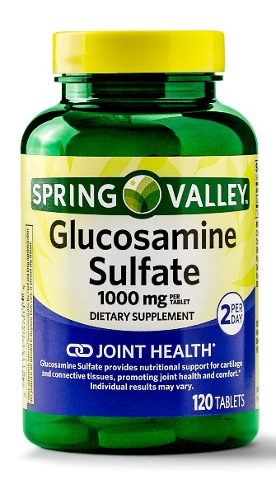
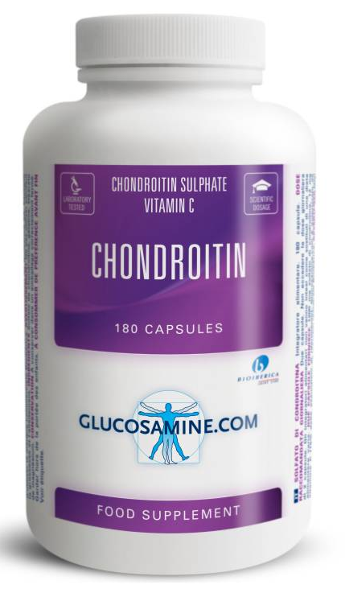
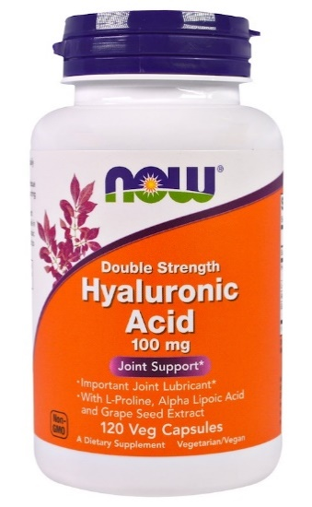
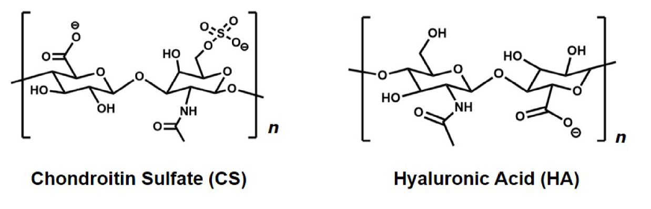
Chondroitin Sulfate and Hyaluronic Acid
Glucosamine, Chondroitin and Hyaluronic Acid cushion and protect joints
Sold as dietary supplements to alleviate osteoarthritis
Image from Tabet, A. et al (2018)
Notes:
These supplements include the polymers, Chondroitin Sulfate which has a repeating disaccharide core unit made up of beta-D-glucuronic acid and N-acetylgalactosamine sulfate, and Hyaluronic Acid composed of beta-D-glucuronic acid and N-acetylglucosamine. Note that the core structural linkages are in the beta conformation, like cellulose. Fibrous, structural support carbohydrates usually have beta linkages, while energy storage/food molecules have alpha-linkages. Note that chondroitin and hyaluronic acid have many positions for hydrogen bonding and tend to swell and hold water. This water retention is thought to contribute significantly to their joint cushioning abilities. Hyaluronic Acid is also used in many skin care products, as it has the ability to hold 1,000 times its weight in water. Thus it serves as a great moisturizer.

Slide 11
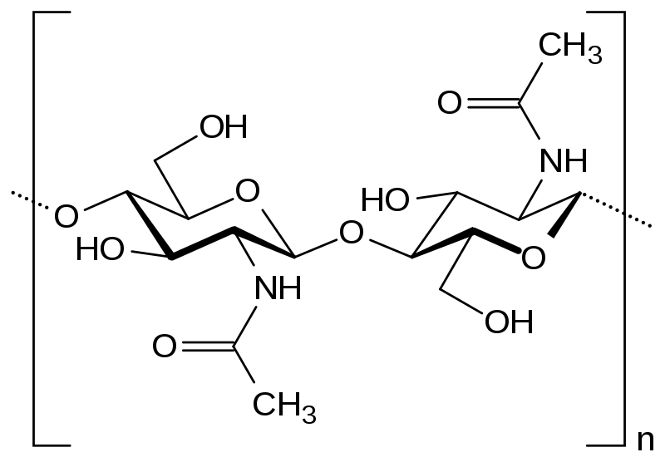
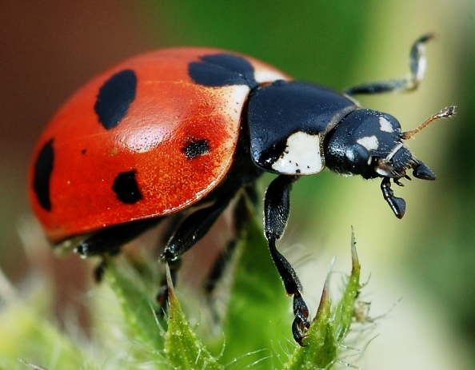
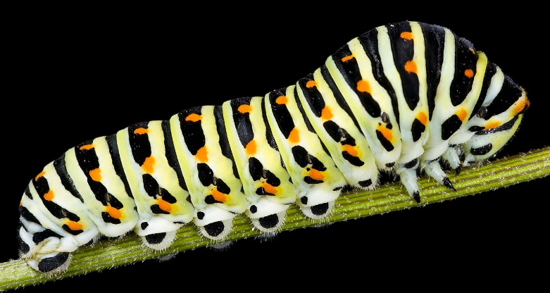
Chitin Polymer
Large polymer with repeating disaccharide unit shown (N-acetylglucosamine β1 →4 N-acetylglucosamine)
Forms the exoskeleton of insects. Pure form is leathery, encrusted form with calcium carbonate is much harder.
Encrutsted
Pure
Image from Didier Descouens
Image from Gilles San Martin
Notes:
Chitin is another structural support molecule that is common to the insect world. It is a sugar polymer composed of repeating beta-N-acetylglucosamine (1→4) N-acetylglucosamine disaccharide units. Chitin forms the exoskeleton of insect. In its pure form it forms a leathery texture like that found in the skin of a caterpillar. Combined with calcium carbonate, it forms and encrusted chitin that is very hard, and is used in the shells of many beetles and other insects.

Slide 12
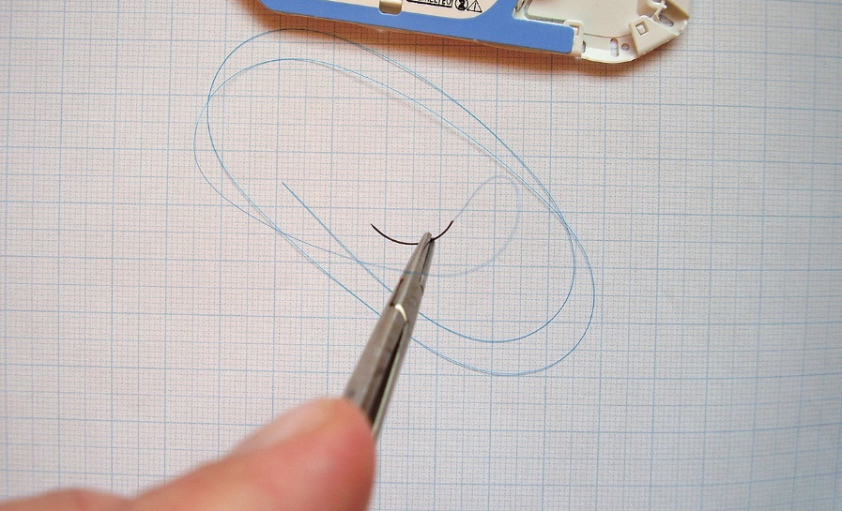
Chitin Polymer
Used in medicine to make self-dissolving stiches
Increases immune response and speeds healing
Image from Werneuchen
Notes:
Within the medical field, we use the chitin polymer (or a synthetically modified version of it) to make self-dissolving thread used for stitches. In addition to dissolving over time, this material attracts the immune response of the host and helps to speed the healing of wounds.

Slide 13
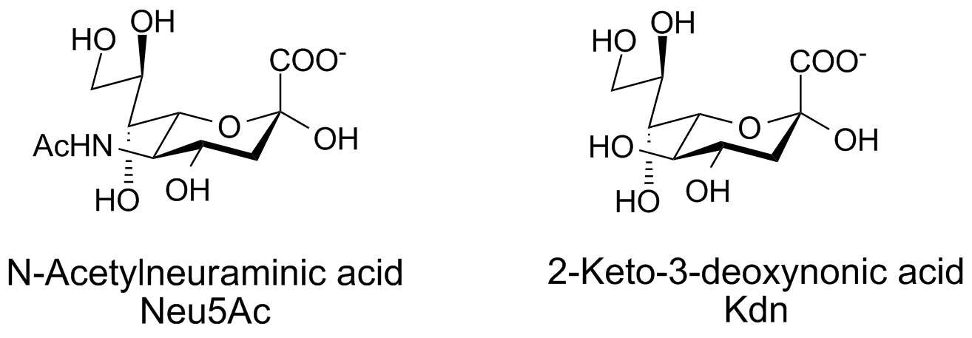
Monosaccharide Acids
Sialic Acids
Sialic Acids include 43 sugar derivatives, 2 common derivatives are shown above
Commonly found as components of oligosaccharide chains in glycolipids and glycoproteins
These residues impart a negative charge to glycoproteins
Image from Glycoform
Notes:
Sialic acid derivatives of monosaccharides are also common, with 43 different derivatives. Two of the most common ones, N-acetylneuraminic acid and 2-keto-3-deoxynonic acid are shown. These types of residues are commonly found in glycolipids and glycoproteins where they impart a negative charge to those molecules.

Slide 14
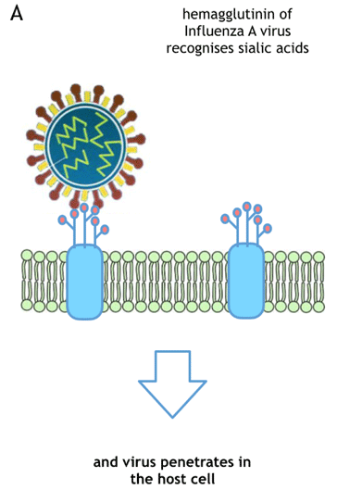
Influenza Virus
Influenza contains two major proteins on the surface of the viral coat that aid with infection and replication.
Hemagglutinin – required for infection
Neuraminidase – required for release of replicated viruses from infected cell
Image from Antonova, E., et al (2018) F1000Research 7:206
Notes:
Sialic acid recognition sequences can also be exploited by infectious agents such as the influenza virus to gain entry into their host targets. Two proteins on the surface of the influenza virus interact with sialic acid residues on the host cell to help the virus infect the cell, and then once propagated, help the virus release itself from the infected cell to continue the infectious cycle. These are the hemagglutinin and neuraminidase proteins. The hemagglutinin protein recognized sialic acid residues of glycoproteins in the upper respiratory tract to mediate cellular infection.

Slide 15
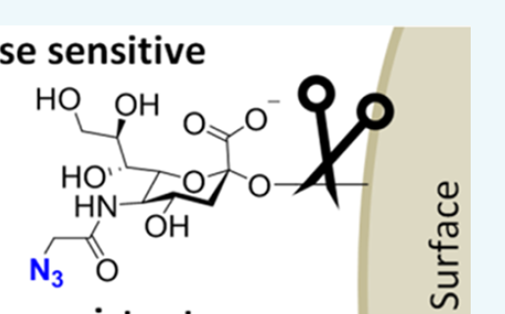
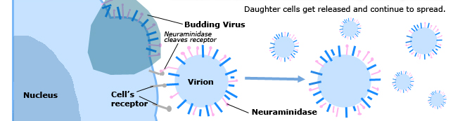
Neuraminidase
Neuraminidase
Enzyme
Cleaves the Neu5AC Sialic Acid residue from the surface of the cell, allowing the budding virus particle to be released.
Cell
Image from Heise, T., et al (2017) Bioconjugate Chem 28:1811 - 1815
Image from Can005
Notes:
Once the virus has infected the cell, it replicates and prepares new viruses to continue the infectious cycle. The virus directs the host cell to express the viral coat proteins in the plasma membrane of the host cell. The viral genome is then replicated, packaged, and associates with the regions of the plasma membrane containing the viral proteins. New virus then bud off from the host cell. For these new buds to be released as new viral particles, the action of the influenza neuraminidase enzyme is required. The neuraminidase cleaves a sialic acid residue from the cell surface, freeing the newly budded virus from the cell. Inhibition of this enzyme blocks the creation of new infectious particles and is a drug target for influenza treatments, such as oseltamivir.

Slide 16
Proteoglycans vs Glycoproteins
 | Proteoglycans | Glycoproteins
Structure | Protein covalently attached to one or more glycosaminoglycan chain | Oligosaccharide chains covalently attached to proteins
Location | Connective Tissue | Cell Surface
Function | Combine with collagen to form cartilage, modulation of cellular development | Cell-to-cell recognition, signaling, communication
Carbohydrate Content | 50-60% | 10-15%
Charge | Negatively Charged | Charge varies
Significance | Water associated with proteoglycans helps provide the cushion function of cartilage. | Carbohydrate modifications are essential for proper protein function. Changes in carbohydrate patterns are common in cancer.
Notes:
Protein-sugar complexes can be divided into two major classes: the proteoglycans and the glycoproteins. Thus far, we have mainly discussed glycoproteins and their role in cell-cell communication and identification. Glycoproteins are 85-90% protein and only 10 – 15% carbohydrate whereas, proteoglycans have much larger sugar component (roughly 50 – 60% of the polymer is carbohydrate). Proteoglycans tend to be negatively charged due to the incorporation of sugar acids, whereas glycoproteins have more charge influence from the protein core structure and can vary in charge potential. Proteoglycans are found predominantly within connective tissue where they combine with collagen to form cartilage. The ability of proteoglycans to become extensively hydrated aid in their cushioning function within joints. Glycoproteins, on the other hand, are typically embedded in the plasma membrane where they serve as receptors, signaling molecules and channels to aid cell-cell communication, recognition and signaling.

Slide 17
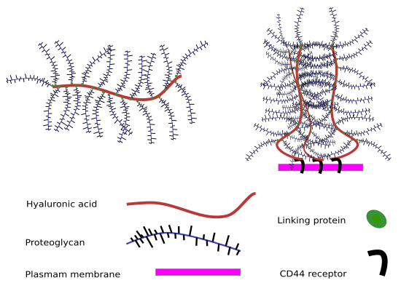
Aggregation of Hyaluronic Acid with Proteoglycans
Image from The Atlas of Plant and Animal Histology
Notes:
Hyaluronic acid commonly forms complex aggregates with proteoglycans in cartilage. Typically, these complexes are held together with intramolecular forces such as hydrogen bonding and dipole-dipole interactions, rather than covalently being attached to the protein components.

Slide 18
Glycoproteins
Oligosaccharides are attached to proteins through specific amino acid linkages:
N-linked attachment
O-linked attachment
Notes:
Glycoproteins, on the other hand, are proteins that are covalently linked with their oligosaccharide components. The linkages occur via nitrogen or oxygen mediated bond formation.

Slide 19
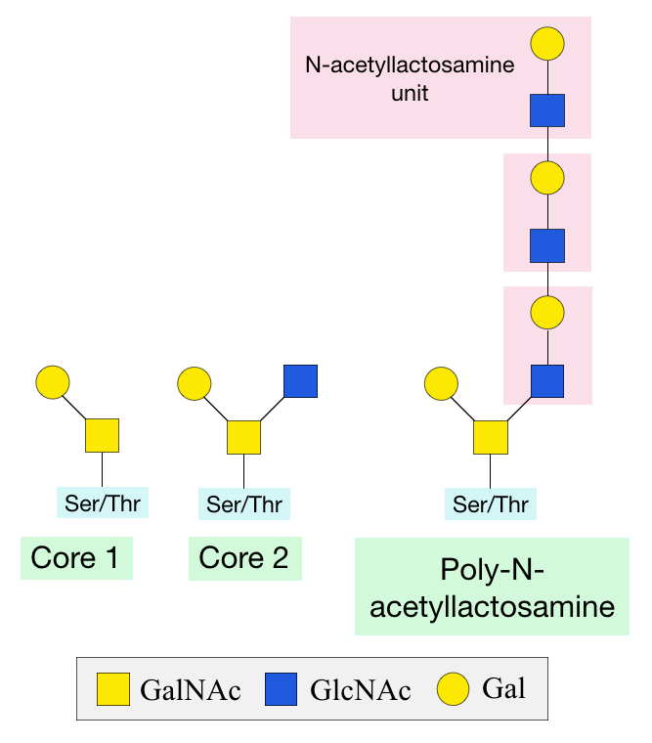
O-linked Glycosylation
Predominantly at Ser and Thr alcohol groups.
Process occurs mainly in the Golgi
Has many functions:
  trafficking of cells in the immune system,
  recognition of foreign material,
  controlling cell metabolism,
  changing protein stability, and
  regulating protein activity.
Image from Waffein
Notes:
O-linked glycosylation occurs mainly at Ser and Thr alcohol functional groups. Glycoproteins are typically translated into the rough endoplasmic reticulum where they can be processed and packaged for transport to the plasma membrane. Enroute to the plasma membrane, the oligosaccharide component of the glycoprotein is post-translationally linked to the protein core structure within the golgi apparatus. The oligosaccharide component of the protein can have many different functions. It can traffic cells to their final destination, be a required component of cell-cell recognition, help control cellular metabolism, or change physical attributes of the protein, such as stability or reactivity.

Slide 20
O-linked Glycosylation
O-glycosylation is universal in all domains of life
Changes in O-glycosylation are important in disease states such as cancer, Alzheimer’s disease, and diabetes.
Image from Waffein
Notes:
O-linked glycosylation occurs widely throughout the major domains of life, from bacteria to higher order plants and animals. Changes or alterations in glycosylation patterns often result in disease states such as cancer, diabetes and Alzheimer’s disease. This underscores the importance of glycosylation in protein function and activity.

Slide 21
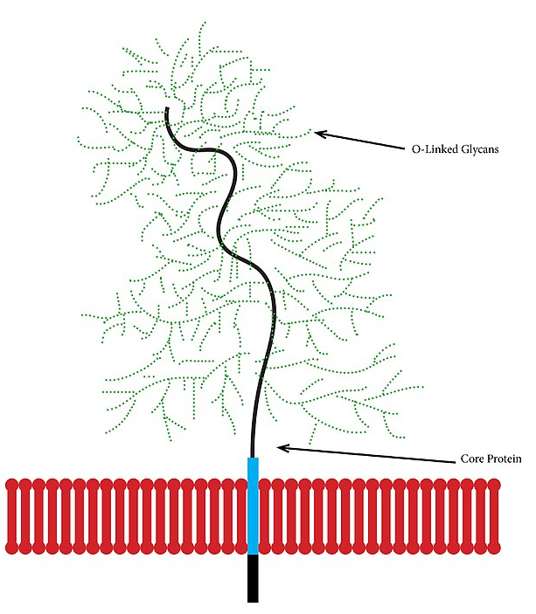
Mucins
are a group of heavily O-glycosylated proteins that line the gastrointestinal and respiratory tracts to protect these regions from infection
Changes in mucins are important in numerous diseases, including cancer and inflammatory bowel disease.
Image from Jcastr07
Notes:
An example of a protein class that is heavily modified by O-linked glycosylation are the mucins. The mucins are a primary component of mucus and may be embedded in the plasma membrane of epithelial cells that line the gastrointestinal and respiratory tract, as well as other ducts, glands and locations that secrete mucus. The mucins can also be secreted as free floating proteins into the extracellular matrix within these locations. Due to their carbohydrate component, they can be heavily hydrated creating a gel-like surface that protects and lubricates epithelial cell surfaces that are exposed to the external environment. They also aid in the protection of these regions from infection by trapping bacteria, viruses and other microbes within the viscous mucus layer. Alterations in mucin structure have been linked to disease states such as inflammatory bowel disease and cancer.

Slide 22
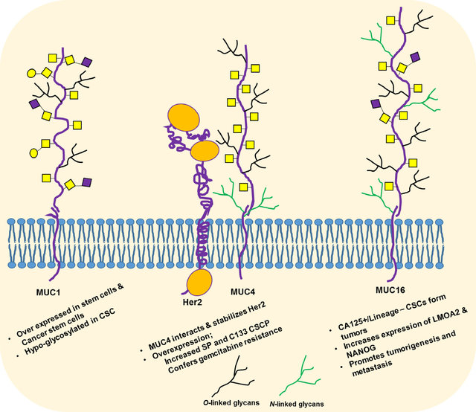
Mucin Overexpression and Cancer
Image from Barkeer, S., et al (2018) Neoplasia 20(8):813-825
Notes:
For example, mucins have been found to be overexpressed in many tumor types. In these situations, overexpressed proteins are often under glycosylated. Overexpression can also lead to the stabilization/activation of other signaling pathways such as the Her2-mediated growth stimulatory pathway. Overexpression of other mucins may play a role metastasis or the spread of tumor cells from one location to another.

Slide 23
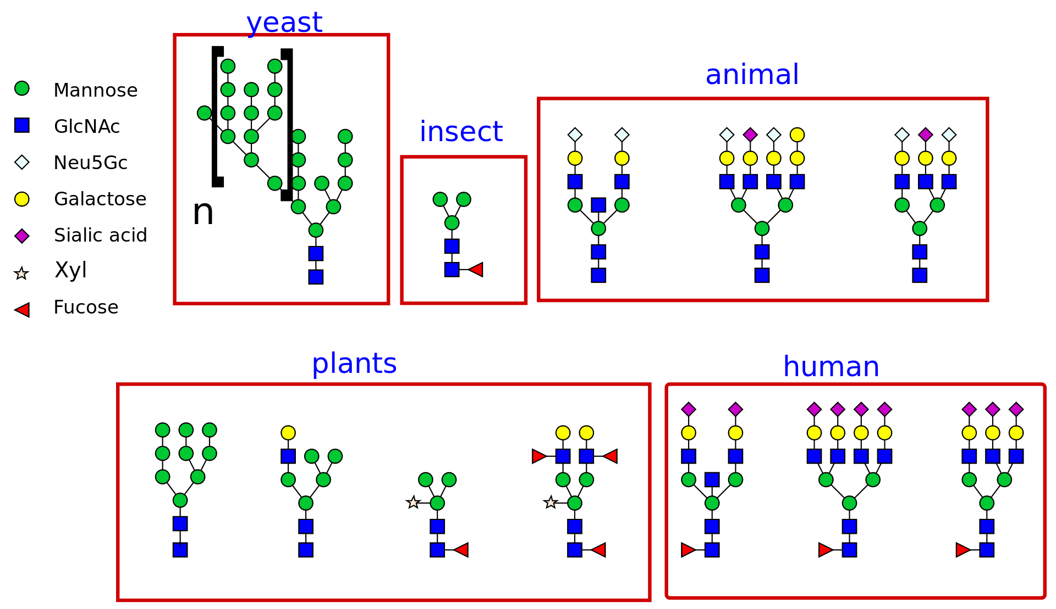
N-linked Glycosylation
Attached to Asn residues
Image from Dna 621
Notes:
In addition to O-linked oligosaccharides, sugars can be ligated to proteins via amine functional groups as well. This commonly occurs on asparagine residues within the protein core.

Slide 24
N-linked Glycosylation
Note that a pentasaccharide core is common to all N-linked oligosaccharides.
Pentasaccharide
core
Image from Dna 621
Notes:
The pentasacharide core, containing two N-acetylglucosamine and 3 mannose residues shown in this diagram, is required for N-linked glycosylation to occur. In contrast to O-linked glycosylation, N-linked glycosylation occurs in eukaryotes as well as the archaea domain, but very rarely in eubacteria.

Slide 25
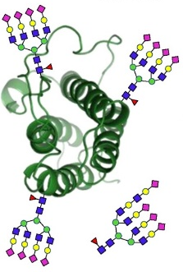
Erythropoetin (EPO)
EPO is a glycoprotein hormone that stimulates red blood cell (RBC) production
Recombinant Human EPO is prescribed to treat anemia caused by chronic kidney disease or chemotherapy
It is also abused by athletes to enhance RBC capacity
Image from Cowper, B., et al (2018) J. Pharm Biomed Analysis 153:214-220
Notes:
An example of a protein that has N-linked glycosylation is the Erythropoetin protein (EPO). This glycoprotein serves as a hormone that stimulates red blood cell production. It is commonly prescribed to treat anemia caused by kidney disease or cancer chemotherapy. It is also abused by athletes requiring endurance training.

Slide 26
Erythropoetin (EPO)
EPO contains three N-glycosylations and one O-glycosylation
Glycosylation increases the half life of the hormone in plasma and is also required for biological activity in vivo.
Image from Cowper, B., et al (2018) J. Pharm Biomed Analysis 153:214-220
Notes:
EPO has three N-linked glycosylations and one O-linked glycosylation that contribute to its function. Glycosylation increased the half-life of the protein in plasma and is also required for the biological activity of the hormone.

Slide 27
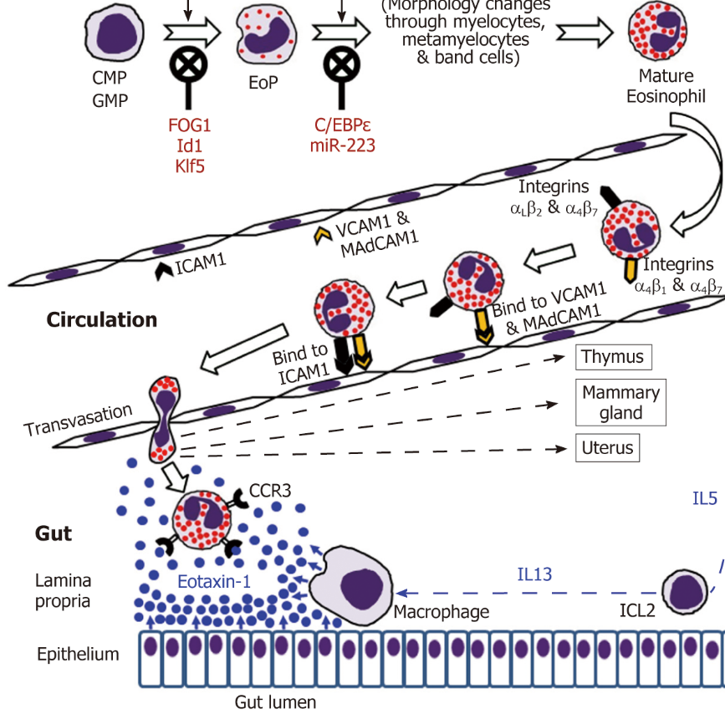
Immune System Function
N-linked glycans on an immune cell's surface will help dictate that migration pattern of the cell,
e.g. immune cells that migrate to the gut lumen have specific glycosylations that favor homing to that site
Image from Loktionov, A. (2019) World J Gastroenterol. 25(27):3503-3526
Notes:
N-linked glycosylation also plays a role in the trafficking of immune cells . Immune cells floating through the blood stream adhere to signal proteins on the endothelial lining. For example, immune cells that migrate to the gut lumen have specific glycosylation patterns that favor homing to that location.

Slide 28
Cell Adhesion Molecules (CAMs)
CAMs are typically single-pass transmembrane receptors with three domains
  Intracellular domain that interacts with cytoskeleton
  A Transmembrane domain
  An Extracellular domain that is involved with binding to other cells or the extracellular matrix (ECM)
  Families include:
    Integrins
    Cadherins
    Selectins
Notes:
Cellular adhesion is also facilitated by protein glycosylation. One class of glycoproteins involved in this process are the Cell Adhesion Molecules (CAMs). These are typically single-pass transmembrane proteins that contain an intracellular domain that interacts with the cytoskeleton of the cell, and an extracellular domain involved with binding to the extracellular matrix components or neighboring cells. The major different families of this protein class are the integrins, the cadherins, and the selectins.

Slide 29
Galectins and Integrins
Galectins are small proteins that act as ligands for transmembrane proteins, such as the Integrins.
Binding of Galectins causes the Integrins to move laterally in the plasma membrane and dimerize
This can lead to an array of cellular functions. For example, Gal-3 has been shown to effect
  cellular proliferation
  phagocytosis, endocytosis and atherosclerosis
  processes regulating cell adhesion
Notes:
We will focus on a subset of integrins that bind to a small family of ligands known as the galectins. The binding of galectins with their associated integrins cause the integrins to move laterally within the plasma membrane until they dimerize with another galectin-bound integrin. This can then activate an array of cellular responses, including cellular proliferation, phagocytosis, endocytosis, and cellular adhesion. These can influence disease states, such as coronary artery disease, by increasing atherosclerotic lesions.

Slide 30
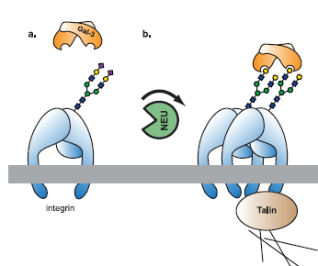
Gal-3 and β1-Integrin Activation
Gal-3 cannot bind to β1-Integrin unless the neuramidase enzyme (NEU) cleaves a sialic acid residue from the Integrin glycosyl-group
Gal-3 binds as a homodimer to β1-Integrin causing lateral movement of integrin within the membrane until it can dimerize with another β1-Integrin receptor
Image from Yang, E.H., et al (2017) PLOS ONE DOI.org/10.1371
Notes:
This slide shows the activation of beta-1-integrin by the gal-3 ligand. Note that the gal-3 ligand cannot bind with the integrin unless a neuraminidase enzyme cleaves the sialic acid residue from the integrin glycosyl functional group. Gal-3 binding can then lead to the dimerization of the integrin receptor and further activation of downstream pathways.

Slide 31
Summary
Monosaccharides can be structurally modified to sugar alcohols, acids, and amines, as well as undergo acetylation
These altered sugars can form disaccharide and polysaccharide structures with unique biological activities
Sugar groups can be incorporated into proteins and lipids to form biologically active structures.
In addition to storing energy, molecules containing sugars act as:
  Regulatory hormones
  Signaling receptors
  Cell adhesion and migration factors
  Cell recognition tags
  Structural support and cushioning
Notes:
Overall, in this section, you have been exposed to some of the unique chemical modifications that sugars can undergo in vivo and how these altered sugars can be combined to form oligosaccharide and polysaccharide structures with diverse functions. You have also learned about the integration of carbohydrate structures into proteins and lipids, with a focus on glycoproteins, and proteoglycans. We will come back and talk further about glycolipids when we introduce lipid structures more fully in a later chapter. It is clear that carbohydrates play a diverse and important role in cellular function, supplying energy resources, as well as contributing to cell-cell communication, signaling, identification and trafficking, and structural support and cushioning.

