Slide 1
Ethanol
Production and Metabolism
Notes:
Welcome to lecture on Ethanol production and metabolism.

Slide 2
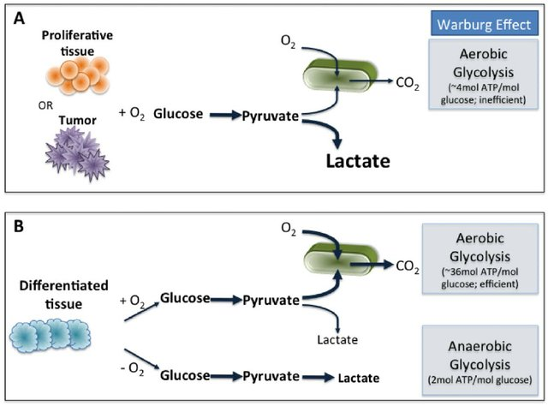
Overview of Glycolysis
or in yeast…alcoholic fermentation
Ethanol
Figure modified from Kim, Y. et al (2011) PLoS ONE 6(12):e28293
Notes:
In the previous lecture, we discussed the anaerobic metabolic pathway in animals that leads to the production of lactate. Yeast and other fungi can switch to anaerobic growth and produce ethanol as a byproduct. The production of alcoholic beverages through this fermentation process is quite popular. We will look into the mechanism that yeast use to convert pyruvate into ethanol, and also take a look at how alcohol is metabolized once we consume it.

Slide 3
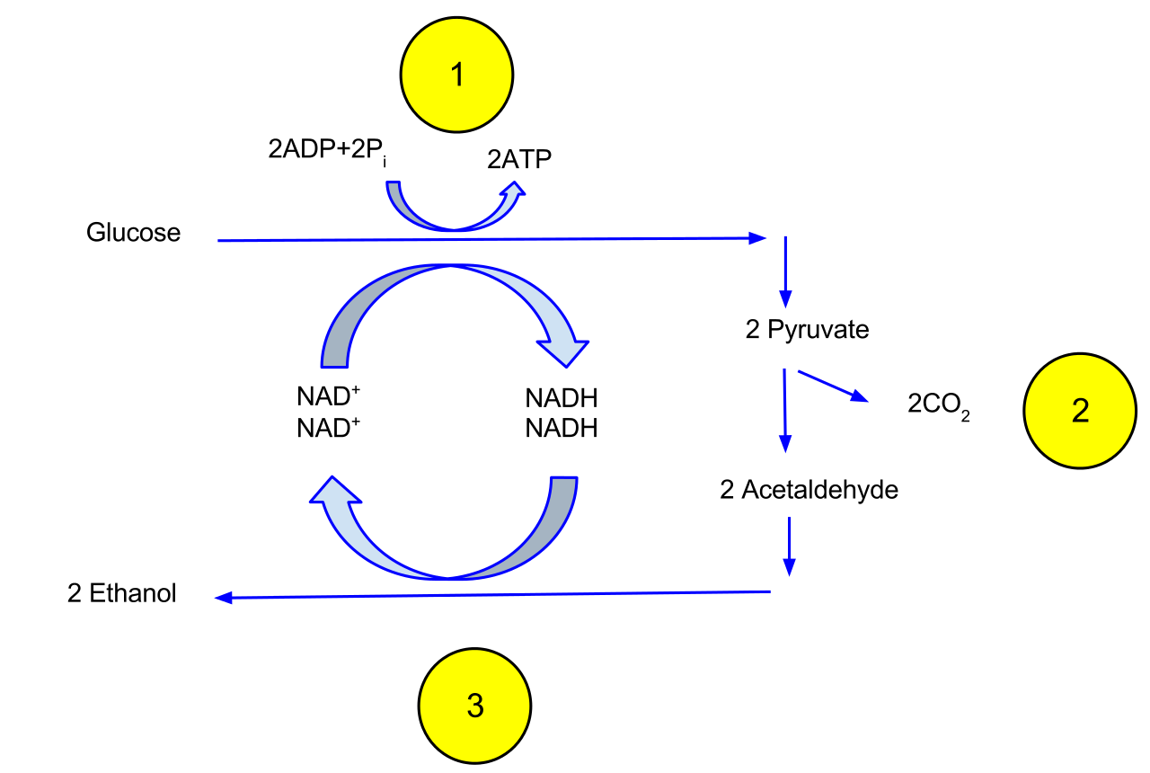
Re-oxidation of NADH
Figure from Davidcarmack
Notes:
As in the process of converting pyruvate into lactate, the purpose of ethanol fermentation is the oxidation of NADH to NAD+, to renew this electron carrier for use in the glycolytic pathway. In ethanol fermentation, (Step 1) one glucose molecule breaks down into two pyruvates. The energy from this exothermic reaction is used to create 2 ATP and 2 NADH. (Step 2) The two pyruvates are then broken down into two acetaldehydes and give off two CO2 as a byproduct. (Step 3) The two acetaldehydes are then converted to two ethanol by using the electrons from NADH, converting NADH back into NAD+.

Slide 4
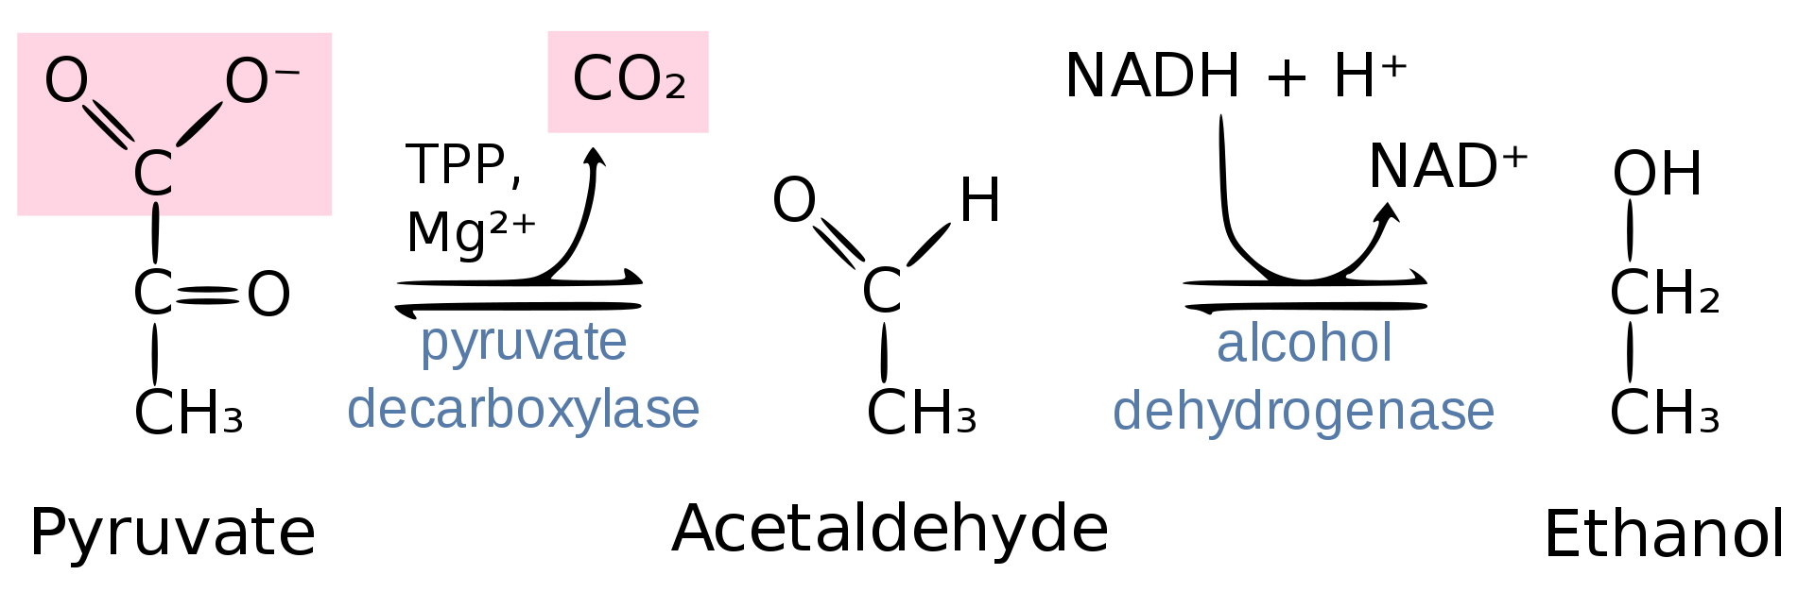
Figure from Thomas Baldwin
Notes:
Two major enzymes are involved during this conversion. First, pyruvate is decarboxylated by pyruvate decarboxylase (an enzyme that requires thymine pyrophosphate and Mg2+ as cofactors) producing the acetaldehyde intermediate. Acetaldehyde is then reduced into ethanol by the enzyme, alcohol dehydrogenase. The alcohol dehydrogenase step uses NADH as the electron donor (reducing agent) during the reaction.

Slide 5
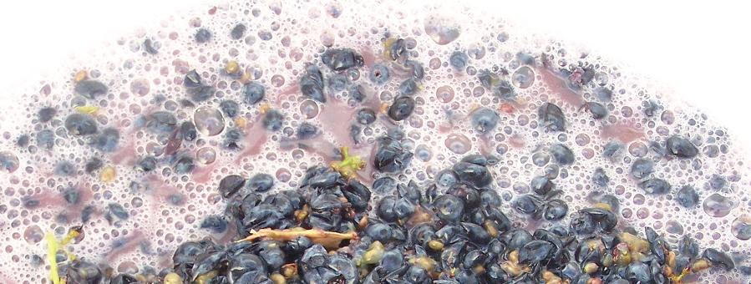
Grape Fermenation During Wine Production
Figure from Agne27
Notes:
Take a look at the second video posted for this set of lectures to learn more about the in depth chemical processes used to make wine.

Slide 6
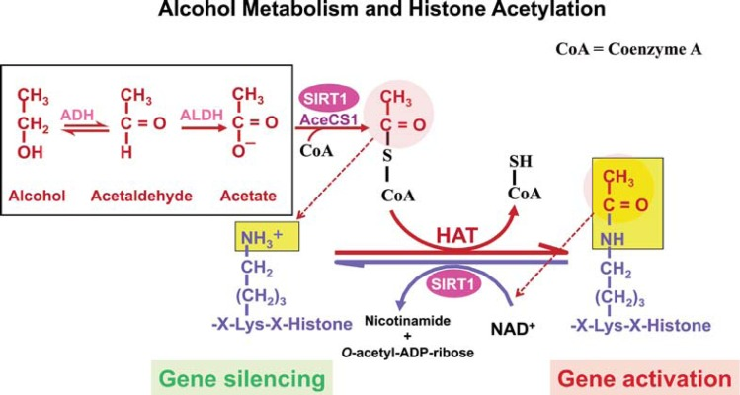
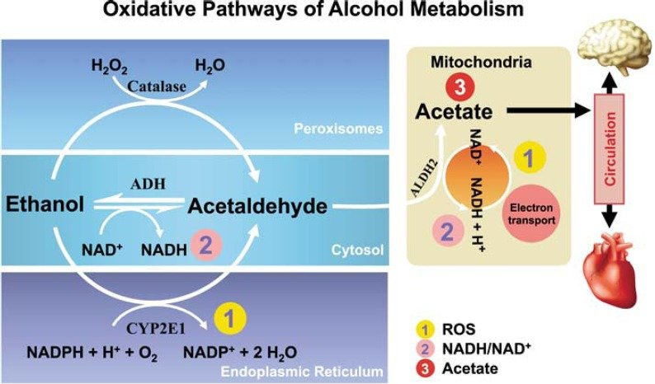
Normal Alcohol Metabolism
ADH
Cytosol
Figure modified from Zakhari, S. (2013) Alcohol Research: Current Reviews 35(1):6-16
Notes:
Once we consume alcohol, it is oxidatively metabolized primarily in the liver. Cytosolic Alcohol Dehydrogenase (ADH) and mitochondrial Acetaldehyde Dehydrogenase 2 (ALDH2) are the main enzymes involved in this metabolic pathway, first converting ethanol to acetaldehyde and then acetaldehyde to acetate. Liver mitochondria have a limited capacity to use the acetate in the Kreb cycle because the enzyme needed to convert acetate to acetyl-CoA (acetyl-CoA synthase 2) is almost absent in the liver, but is abundant in the heart and skeletal muscles. Thus, most of the acetate resulting from ethanol metabolism escapes the liver into the blood circulation and is eventually metabolized to CO₂ by way of the Kreb cycle in cells with mitochondria that contain enzymes to convert acetate to acetyl CoA, such as heart, skeletal muscle, and brain.

Slide 7
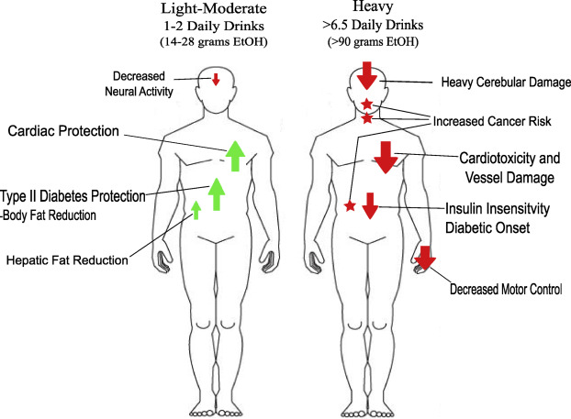
Alcohol and Hormesis
Figure from Adamson, S.S., et al (2017) Translational Medicine of Aging 1:18-23.
Notes:
Like many substances, the consumption of alcohol can be both beneficial and detrimental, it depends on the quantity and frequency of consumption. This is known as a hormetic response. At low doses (up to 2 daily drinks for men and 1 daily drink for women) the consumption of alcohol can be cardioprotective. At higher consumption rates this protective effect is lost and the detrimental effects of alcohol consumption become apparent and include cardiotoxicity, liver damage, and increased cancer risk. Not to mention the debilitation that can accompany addiction.

Slide 8
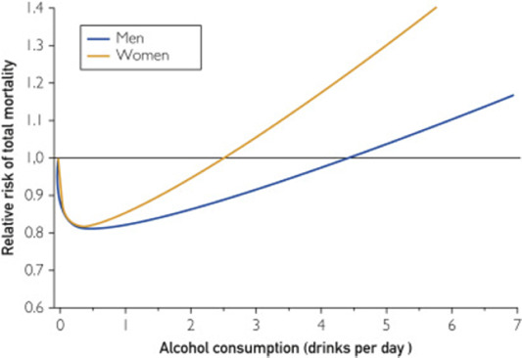
Risk of Mortality and Alcohol Consumption
Figure from Adamson, S.S., et al (2017) Translational Medicine of Aging 1:18-23.
Notes:
These graphs exemplify the hormetic nature of alcohol consumption. Maintaining ethanol consumption between one and two daily drinks will significantly reduce overall risk of mortality. However, mortality risk skyrockets at high ethanol consumption

Slide 9
Moderate Alcohol Use
reduces the risk of a new diagnosis of coronary artery disease by 29%
reduces the risk of dying from any cardiovascular disease by 25%
reduces the risk of dying from a heart attack or coronary artery disease by 25%
reduces the risk of dying from any cause by 13%
reduces the risk of having an ischemic (clot-caused) stroke by 8%
increases the risk of dying from a stroke by 6%
increases the risk of having a hemorrhagic (bleeding) stroke by 14%.
Notes:
Moderate alcohol use of no more than 2 drinks per day for men, and no more than 1 drink per day for women can reduce the risk of coronary artery disease by 29%, and reduce the risk of dying from any cardiovascular disease by 25%. These statistics are significant. Do note that at these levels that there is an increased risk of dying from hemorrhagic stroke.

Slide 10
Excessive Alcohol Use…
The CDC estimates that excessive alcohol use contributes to almost 80,000 deaths a year in the United States. These come from motor vehicle accidents and violence, liver disease and hemorrhagic stroke, and 50 other causes.
40% of deaths from liver disease are caused by alcohol
Notes:
Increased alcohol consumption, however, can have dire effects on health and can lead to unwanted addiction. The Centers for Disease Control estimates that alcohol abuse leads to approximately 80,000 deaths annually in the United States and that up to 40% of deaths related to liver disease are caused by alcohol abuse.

Slide 11
Defining Alcohol Consumption
Low-risk drinking. For men, this is no more than four drinks in a single day and no more than 14 drinks in a week; for women, no more than three drinks in a single day and no more than seven drinks in a week. (About 57% of Americans who drink alcohol fall into this category.)
Increased-risk drinking is drinking more than either the single-day limit or the weekly limit (29% of drinkers).
Highest-risk drinking is drinking more than the single-day limit and the weekly limit (14% of drinkers).
Notes:
Harvard Medical School has evaluated thousands of studies and has tried to come up with a method for alcohol risk assessment. They categorize low-risk drinking behavior for men as no more than four drinks in a single day or 14 drinks in a week, and no more than 3 drinks in a single day or a total of 7 drinks in a single week for women. Women have lower drinking tolerance due to their smaller sizes, but also due to metabolic differences. Women have less ADH and typically higher fat levels which disperse and retain ethanol longer. Addiction and damage to the liver tends to occur more quickly in women as well. Harvard ranks people at increased risk if their drinking is above either the single day or the weekly limit (which is estimated at 29% of drinkers). High risk drinkers break both the daily and weekly limits (estimated at 14% of drinkers)

Slide 12

Binge or Chronic Drinking
Ethanol
Acetaldehyde
Acetate
Figure modified from Zakhari, S. (2013) Alcohol Research: Current Reviews 35(1):6-16
Notes:
During ethanol metabolism, when circulating ethanol is in the millimolar range, acetaldehyde is in the micromolar range, and acetate is in the millimolar range. When heavy drinking or chronic drinking occurs the Acetaldehyde Dehydrogenase enzyme cannot keep up with the Alcohol Dehydrogenase enzyme and the pool of Acetaldehyde increases. This aldehyde has many toxic effects within biological systems.

Slide 13
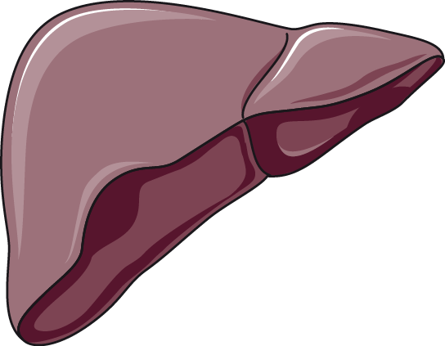
Acetaldehyde Toxicity
Can lead to double stranded DNA breaks
Acetaldehyde-Protein Adducts cause Immune Response and may lead to more liver damage through autoimmune response
Forms Protein Adducts
(Microtubulin Adducts cause hepatocyte swelling; alters enzyme function)
Acetaldehyde
Acetaldehyde Favors Lipid Peroxidation
Mitochondrial Function is Altered
Figure modified from Servier Medical Art
Notes:
The Acetaldehyde can form adducts with proteins. For example, acetaldehyde adducts on cytoskeletal components such as microtubulin, lead to the swelling of hepatocytes (liver cells). If secreted from the cell, these protein adducts can also be recognized as foreign by the immune system and cause an autoimmune response causing further inflammation and damage to the liver. Acetaldehyde also causes oxidative damage to lipids and DNA and can alter mitochondrial function. Overall, the liver is stressed and unhappy when too much ethanol is consumed.

Slide 14
Effects of Chronic Alcohol Use
Epigenetic Modifications
Alters DNA Methylation and Histone Acetylation Patterns
Alters the ratio of NADH:NAD+
Alters carbohydrate metabolism
Promotes the formation of Reactive Oxygen Species
Lipid and protein oxidation
DNA Damage – Double strand breaks
Contributes to Cellular Apoptosis
Organ Damage: Fatty Liver and Liver Cirrhosis
Increased Risk of Cancer
Notes:
Heavy chronic drinking can also lead to epigenetic modifications that alter protein expression patterns within the cell. Due to the oxidation of alcohol to acetate, the metabolism of alcohol also leads to an increase in the NADH: NAD+ ratio altering carbohydrate metabolism. Heavy ethanol consumption promotes the formation of reactive oxygen species and can also promote apoptosis. These later two topics will be discussed in more detail in the next set of lectures. Overall, heavy drinking is extremely hard on liver function. It can lead progressively from the formation of a fatty liver to liver cirrhosis and increased risk of liver cancer. The risk for several other types of cancer is also heightened with heavy alcohol use.

Slide 15
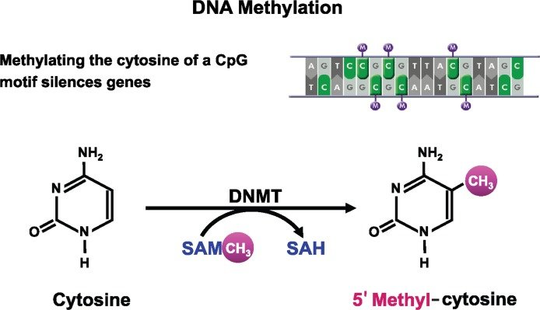
DNA Methylation
SAH
Chronic Heavy
Alcohol Use
Figure modified from Zakhari, S. (2013) Alcohol Research: Current Reviews 35(1):6-16
Notes:
This is a schematic representation of DNA methylation, which converts cytosine to 5′methyl-cytosine via the actions of DNA methyltransferase (DNMT). DNA methylation typically occurs at cytosines that are followed by a guanine (i.e., CpG motifs). Within the liver, chronic heavy drinking reduces pools of S-adenosylmethionine (SAM) while increasing homocysteine and S-adenosylhomocysteine (SAH). SAH further inhibits DNA methyltransferases (DNMTs) by negative feedback inhibition, ultimately resulting in global hypomethylation of DNA. This hypomethylation leads to the inappropriate expression of many genes especially within the liver tissue.

Slide 16
Oxidative Pathways of Alcohol Metabolism
Figure from Zakhari, S. (2013) Alcohol Research: Current Reviews 35(1):6-16
Notes:
Two genes that are upregulated due to this hypomethylation express the Catalase enzyme and the p450 oxidoreductase enzyme, CYP2E1. Both of these enzymes are involved in oxidative pathways of alcohol metabolism that produce the toxic acetaldehyde intermediate. Expression of both of these proteins become more prevalent in chronic alcohol consumption or when blood alcohol levels are high, as in cases of binge or heavy drinking. The activity of these enzymes can also lead to the formation of reactive oxygen species that contribute to global cellular damage (lipid peroxidation, DNA damage, protein damage, etc).

Slide 17
Histone Acetylation
Figure from Zakhari, S. (2013) Alcohol Research: Current Reviews 35(1):6-16
Notes:
Gene regulation in other areas of the body are also affected in response to chronic heavy alcohol consumption. This is due to the production of acetate during the metabolic pathway of alcohol that is released from the liver into the bloodstream. In other areas of the body, acetate is converted to acetyl-CoA by the enzyme Acetyl-coenzyme A (acetyl-CoA) synthetase (AceCS). AceCS is activated by Sirtuin 1, also known as NAD-dependent protein deacetylase (SIRT1). Acetyl-CoA is used by histone acetyltransferase (HAT) to acetylate the lysine residues in histone proteins. Recall from last term that histone acetylation causes these proteins to release the bound DNA, allowing regions to be opened up for transcription. Thus, higher levels of acetate promote histone acetylation and increased gene expression.
Note in the diagram shown, that SIRT1 also deaceytlates histones, resulting in gene silencing. Thus, SIRT1 is a sensor that balances gene activation and silencing in the cell based on the cell’s energy status. Alcohol metabolism results in acetate formation, which is used in extrahepatic tissues to produce acetyl-CoA, upregulating histone acetylation within those tissues. NOTES: AceCS1 = Acetyl-CoA synthase 1; ADH = alcohol dehydrogenase; ALDH = Aldehyde dehydrogenase.

Slide 18
Heavy Alcohol Use
Increase in NADH/NAD+ Ratio
In the Liver, the increase in cytosolic NADH favors the formation of lactate resulting in lactic acidosis
This can cause Alcoholic hypoglycemia
Hyperuricemia can arise as ketone bodies and lactate can compete in the tubules of the kidney with the excretion of urea.
Hypertriglyceridemia occurs as heavy alcohol consumption increases triglyceride concentration and results in fatty liver
Notes:
Both ADH and ALDH utilize the cofactor nicotinamide adenine dinucleotide (NAD⁺), which is reduced to NADH; as a consequence, during ethanol oxidation the ratio NADH/NAD⁺ is significantly increased, altering the cellular redox state and triggering a number of adverse effects, related to alcohol consumption. Glycolysis and the Kreb Cycle are downregulated due to low NAD+ levels. This results in lower pyruvate levels, lower conversion of pyruvate to acetyl-coA and also causes a decrease in gluconeogenesis (ie there is not enough pyruvate to drive glucose production). Thus, the pyruvate that does form favors anaerobic conversion to lactate and can result in lactic acidosis or lowering of the blood pH levels. Low rates of gluconeogenesis can also contribute to hypoglycemia that can be seen during binge drinking.
Hyperuricemia or an increase in blood levels of uric acid can also occur due, in part, to increased production of ketone bodies and lactic acid. Both the ketone bodies and lactate can compete with uric acid for excretion into the urine within the kidney. The uric acid gets retained and heightens blood levels.

Slide 19
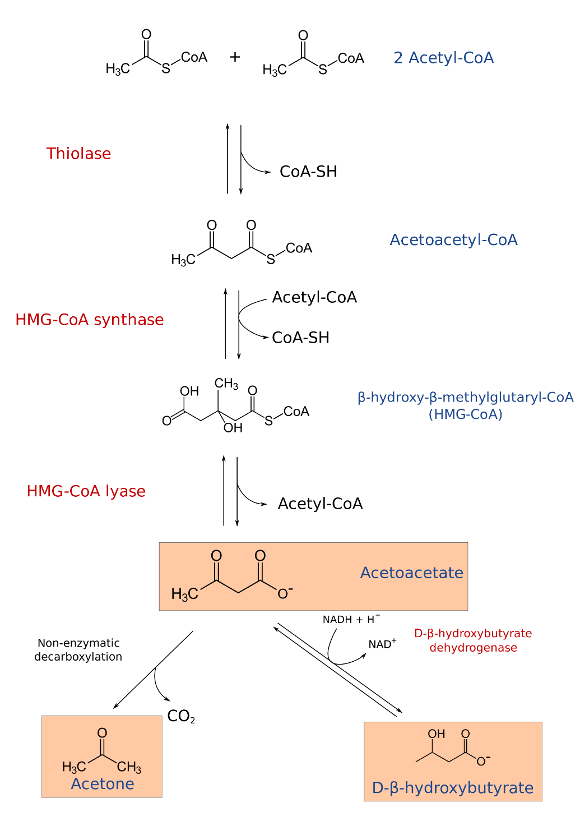
Ketone Bodies
Normally form during starvation from breakdown of fatty acids
Provides energy to the brain, heart, and skeletal muscles.
Accumulation in the blood can cause ketoacidosis
Heavy alcohol use induces ketogenesis
Figure from Sav vas
Notes:
Ketone bodies typically form during periods of starvation when carbohydrate stores have been depleted. When the liver can no longer efficiently maintain blood glucose levels, it will breakdown fatty acids into ketone bodies and secrete these into the bloodstream. Ketone bodies, such as acetoacetate, acetone and D-beta-hydroxybutarate (which isn’t a real ketone, but is still referred to as a ketone body) are released into the bloodstream to compensate for the reduced glucose levels. Brain, heart and skeletal muscle tissue can utilize ketone bodies as an energy source and this is good short term solution to starvation. However, the formation of lactate and ketone bodies can severely reduce blood pH levels and induce a life-threatening state known as ketoacidosis. In addition to starvation, heavy alcohol consumption can induce ketogenesis inappropriately.

Slide 20
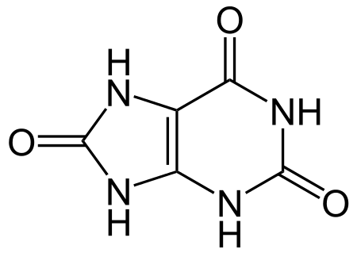
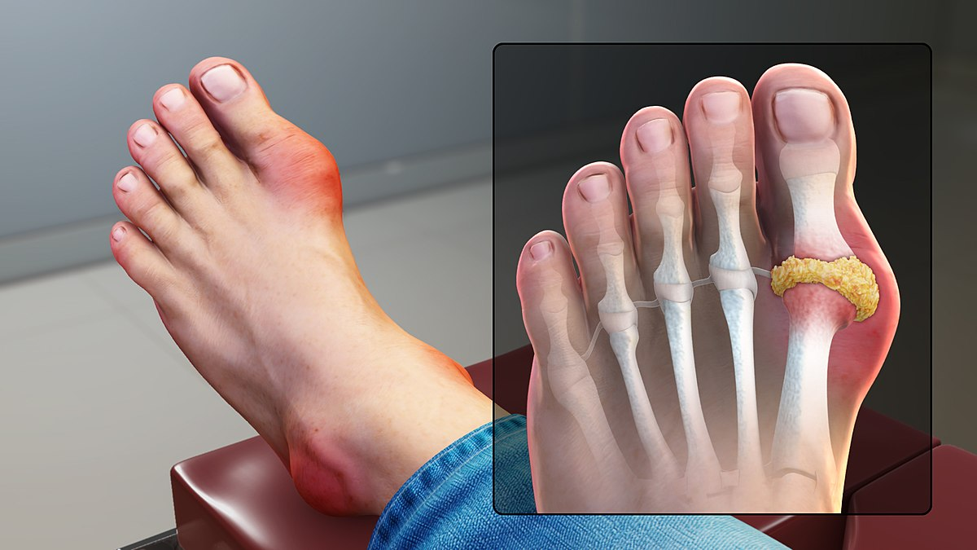
Hyperuricemia
High uric acid in blood
Ethanol decreases excretion of uric acid by:
Competition with excretion of ketone bodies
Dehydration, resulting in lower urine output
Uric Acid
High uric acid in blood
Can lead to Gout (crystallization of uric acid in joints, tendons and surrounding tissues)
Image from www.scientificanimations.com
Notes:
As noted before, high levels of lactate and ketone bodies within the bloodstream can result in dehydration and reduced excretion of uric acid, leading to hyperuricemia. Over time, high uric acid levels can cause uric acid to precipitate, especially in joints where it causes painful gout flare ups.

Slide 21
Alcohol Use and Cancer
Increases the Risk for Cancers of the:
Mouth
Throat (Pharynx)
Voice Box (Larynx)
Esophagus
Liver
Colon and Rectum
Breast
May also increase risk for pancreas and stomach
Notes:
According to the American Cancer Society excessive alcohol use can increase the risk for several different forms of cancer.
Cancers of the mouth, throat, voice box, and esophagus: Alcohol use clearly raises the risk of these cancers. Drinking and smoking together raises the risk of these cancers even more than drinking or smoking alone. This might be because alcohol can help harmful chemicals in tobacco get inside the cells that line the mouth, throat and esophagus. Alcohol may also limit how these cells can repair damage to their DNA caused by the chemicals in tobacco.
Liver cancer: Long-term alcohol use has been linked to an increased risk of liver cancer. Regular, heavy alcohol use can damage the liver, leading to inflammation and scarring. This might raise the risk of liver cancer.
Colon and rectal cancer: Alcohol use has been linked with a higher risk of cancers of the colon and rectum. The evidence for this is generally stronger in men than in women, but studies have found the link in both sexes.
Breast cancer: Even a few drinks a week is linked with an increased risk of breast cancer in women. This risk may be especially high in women who do not get enough folate (a B vitamin) in their diet or through supplements. Alcohol can also raise estrogen levels in the body, which may explain some of the increased risk. Cutting back on alcohol may be an important way for many women to lower their risk of breast cancer.

Slide 22
How does Alcohol increase Cancer Risk?
Damage to body tissues (potentially through oxidative damage, acetaldehyde, and ethanol itself!)
Effects on other harmful chemicals
Effects on absorption of folate or other nutrients
Effects on estrogen or other hormones
Effects on body weight
Notes:
Alcohol may help other harmful chemicals, such as those in tobacco smoke, enter the cells lining the upper digestive tract more easily. This might explain why the combination of smoking and drinking is much more likely to cause cancers in the mouth or throat than smoking or drinking alone. In other cases, alcohol may slow the body’s ability to break down and get rid of some harmful chemicals.
Alcohol might affect the body’s ability to absorb some nutrients, such as folate (vitamin B12). Folate is a vitamin needed as a cofactor for enzymes involved in amino acid biosynthesis. Absorption of nutrients can be even worse in heavy drinkers, who often have low levels of folate. These low levels may play a role in the risk of some cancers, such as breast and colorectal cancer.
Alcohol can raise the levels of estrogen, a hormone important in the growth and development of breast tissue. This could affect a woman’s risk of breast cancer.
Too much alcohol can add extra calories to the diet, which can contribute to weight gain in some people. Being overweight or obese is known to increase the risks of many types of cancer.
Along with these effects, alcohol may contribute to cancer growth in other, unknown ways.

Slide 23
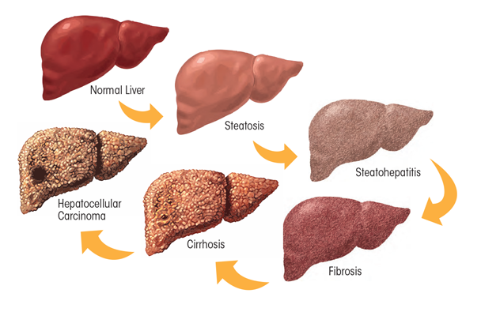
Heavy Chronic Drinking
Figure from Osna, N.A. et al (2017) Alcohol Research: Current Reviews 38(2)
Notes:
Heavy ethanol consumption produces a wide spectrum of hepatic lesions. Fatty liver (i.e., steatosis) is the earliest, most common response that develops in more than 90 percent of problem drinkers who consume 4 to 5 standard drinks per day. With continued drinking, alcoholic liver disease can proceed to liver inflammation (i.e., steatohepatitis), fibrosis, cirrhosis, and even liver cancer (i.e., hepatocellular carcinoma).Heavy drinking can also damage other organs, such as the pancreas and the brain, and can raise blood pressure. It also increases the risk of heart disease and stroke. In pregnant women, alcohol use, especially heavy drinking, may lead to birth defects or other problems with the fetus.

Slide 24
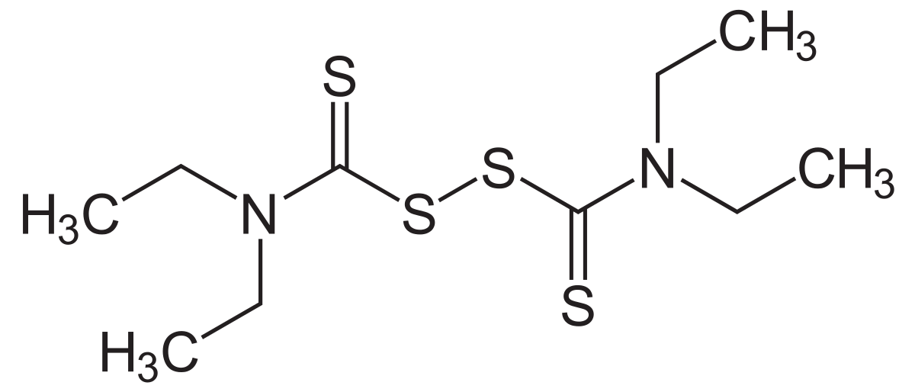
Disulfiram in fighting Alcoholism
Blocks the activity of mitochondrial ALDH-2, preventing the oxidation of Acetaldehyde to Acetate
Notes:
In 1951, the FDA approved disulfiram for the treatment of alcoholism in the US. Initially, the drug was prescribed in very high doses, often as high as 3,000 mg per day. The high doses led to reports of severe reactions with alcohol, some which were fatal. It is an inhibitor of the ALDH-2, which will lead to an even higher increase in acetaldehyde concentration if alcohol is consumed. Thus, alcoholics that are taking this drug to try and quite drinking need to maintain sobriety. If they drink while taking this drug, they will become very ill due to the accumulation of acetaldehyde. Overall, the use of this drug supports abstinence, which is often hard to realistically achieve.
At one time, researchers thought that prior to prescribing disulfiram to people, they should have the experience of mixing the drug with alcohol in a supervised setting. Researchers felt it was important for the individuals to have full knowledge of what would happen if they mixed disulfiram and alcohol. This practice is no longer used, but it is essential that every person is educated on the reactions of combining alcohol with disulfiram before a prescription is written.

Slide 25
Effects of Chronic Alcohol Use
Epigenetic Modifications
Alters DNA Methylation and Histone Acetylation Patterns
Alters the ratio of NADH:NAD+
Alters carbohydrate metabolism
Promotes the formation of Reactive Oxygen Species
Lipid and protein oxidation
DNA Damage – Double strand breaks
Contributes to Cellular Apoptosis
Organ Damage: Fatty Liver and Liver Cirrhosis
Increased Risk of Cancer
Notes:
Now that we have explored the metabolism of alcohol and the deleterious effects it can have when abused, we will now turn our attention to reactive oxygen species and the processes of autophagy, and cellular apoptosis

