Slide 1
Gluconeogenesis
Part 1: Overview and Pyruvate Carboxylase Activity
Notes:
Welcome to part one of our lecture series on Gluconeogensis. This tutorial will cover the four novel enzymatic reactions that can reverse the process of glycolysis and generate glucose from non-carbohydrate precursors

Slide 2
Gluconeogenesis
Is the production of glucose from non-carbohydrate precursors
It is expensive! Costs a lot of ATP to make glucose
Only done by the body during long term fasting or starvation
Brain relies on ~120 g glucose/day
The liver can make glucose, release it into the blood stream and feed the brain and/or muscle tissue
Notes:
The production of glucose from non-carbohydrate precursors is an energetically expensive process for mammalian systems. It is only engaged during long term fasting or starvation, and is only engaged in a small subset of tissues. Specifically the liver is the predominant location for gluconeogenesis, although the kidneys can also produce small amounts. During long term fasting or starvation, glycogen stores within the liver are depleted, causing the liver to no longer be able to homeostatically regulate blood glucose levels from this source. This is when gluconeogenesis kicks into gear. The liver will expend large quantities of energy from fat to produce glucose and release it into the blood stream. In this way, the brain and skeletal muscles can be supplied with quick energy. Recall that glucose is the primary energy source for brain tissue, as lipids do not cross the blood-brain barrier.

Slide 3
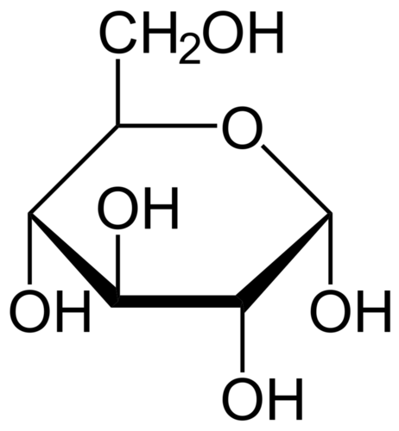
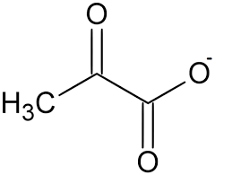
Gluconeogenesis
Pyruvate → → → Glucose
→ → →
Notes:
Chemically, gluconeogenesis is the process of converting pyruvate (or a few other precursors) into glucose. Seven of the ten enzymatic steps from the glycolytic pathway are used in this process. Three steps of the glycolytic pathway are irreversible. Thus, gluconeogenesis must use novel enzymes to mediate these reaction steps.

Slide 4
Glucogenic Molecules
Pyruvate
Lactate
Glycerol
Alanine
Notes:
The other major non-carbohydrate precursors used to make glucose are lactate, glycerol and alanine. After you learn the primary pathway of gluconeogenesis from pyruvate, we will explore how these other precursors enter into the pathway.

Slide 5
Gluconeogenesis
Uses many of the same enzymes as glycolysis, but in the reverse direction
The irreversible steps in glycolysis are:
  Hexokinase Step
  Phosphofructokinase-1 Step
  Pyruvate Kinase Step
  The Three Regulatory Steps!!
Notes:
The three irreversible steps of glycolysis are also the three key regulatory steps within the pathway: The hexokinase step, the phosphofructokinase-1 step, and the pyruvate kinase step.

Slide 6
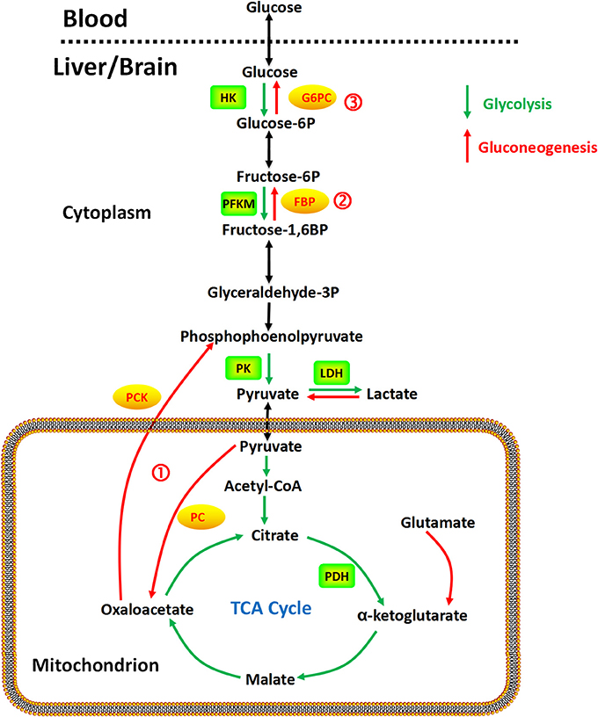
Gluconeogenesis Overview
Three Steps
Four Enzymes
Figure from: Yip, J, et al (2017) Front. Pharmacol. 10.3389
Notes:
In this overview, the glycolytic pathway is outlined in green. The key regulatory steps that cannot be reversed during the gluconeogenic pathway shown in red, include the pyruvate kinase step. To reconvert pyruvate back into phosphoenolpyruvate, pyruvate must first be transported into the matrix of the mitochondria where in can be converted into the 4 carbon molecule, oxaloacetate. Oxoloacetate can then be transported (a bit laboriously) back into the cytosol where it can be converted into the 3 carbon molecule, phosphoenolpyruvate. If you count transporting the oxaloacetate out of the mitochondria, three enzymes are required for this process! Two novel enzymes are also required to convert fructose 1,6-bisposphate back into fructose 6-phosphate, and glucose 6-phosphate back into free glucose. (Note that you have already learned about this last step in our section on glycogen metabolism! Yay!) That means there are only four new enzymatic steps to learn.

Slide 7
Gluconeogenesis Overview
Step 1
  Pyruvate to Phosphenolpyruvate
Figure from: Yip, J, et al (2017) Front. Pharmacol. 10.3389
Notes:
The most complicated part of gluconeogenesis is converting pyruvate back into phosphoenolpyruvate. So let us take a look at this process in a little more detail. This process takes the action of three enzymes, pyruvate carboxylase (PC) located in the mitochondrial matrix, aspartate aminotransferase (AAT), located in the matrix and the cytosol, and the phosphoenolpyruvate carboxykinase (PCK) located in the cytosol. Oxaloacetate and aspartate are intermediate compounds formed in the process.

Slide 8
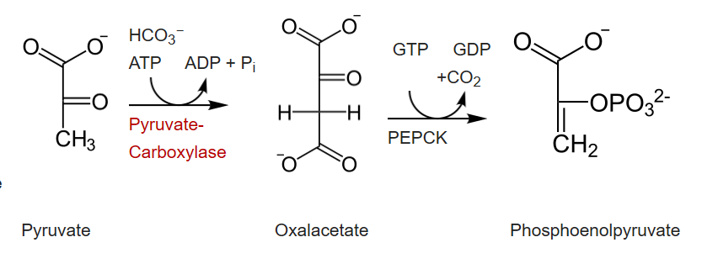
Pyruvate to Phosphoenolpyruvate
Here you can see some of the energy intensive steps required during gluconeogenesis.
Figure modified from: Principles of Biochemistry (2019) Wikibooks
Notes:
To convert pyruvate back to phosphoenopyruvate, you will need to use 1 molecule of ATP and 1 molecule of GTP in the process. This reaction series will have to happen twice for each glucose molecule that will be made.

Slide 9
Pyruvate Carboxylase Enzyme
Converts Pyruvate to Oxaloacetate
Requires a Biotin Cofactor
Has two enzymatic reactions
  Carbon Fixation
  Carbon Transfer
Figure modified from: Principles of Biochemistry (2019) Wikibooks
Notes:
The Pyruvate Carboxylase enzyme is required for the first step. This enzyme converts pyruvate into oxaloacetate. Note that oxaloacetate is a normal intermediate formed in the Kreb Cycle. Thus, you will see this compound again. The Pyruvate Carboxylase enzyme requires biotin as a cofactor and has two major enzymatic functions: 1) The first is carbon fixation, from carbon dioxide, and the 2) is carbon transferase activity, placing the carbon dioxide that has been fixed, onto the molecule of pyruvate to create oxaloacetate.

Slide 10
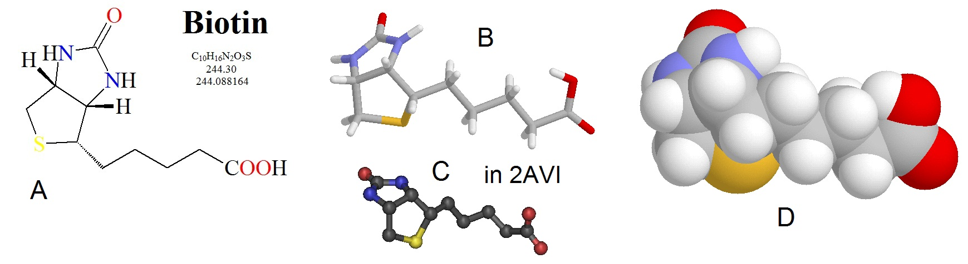
Biotin Cofactor
Image from: Biosynthesis
Notes:
Biotin is a water soluble vitamin (known as D-biotin or vitamin B7) and is a cofactor in many enzymatic reactions, especially those involving carboxylation (or carbon fixation reactions). It is part of the vitamin B2 complex and is an essential vitamin for mammals. Deficiency results in dermatitis, loss of hair, and neurologic symptoms. Different structural models for biotin are shown here.

Slide 11
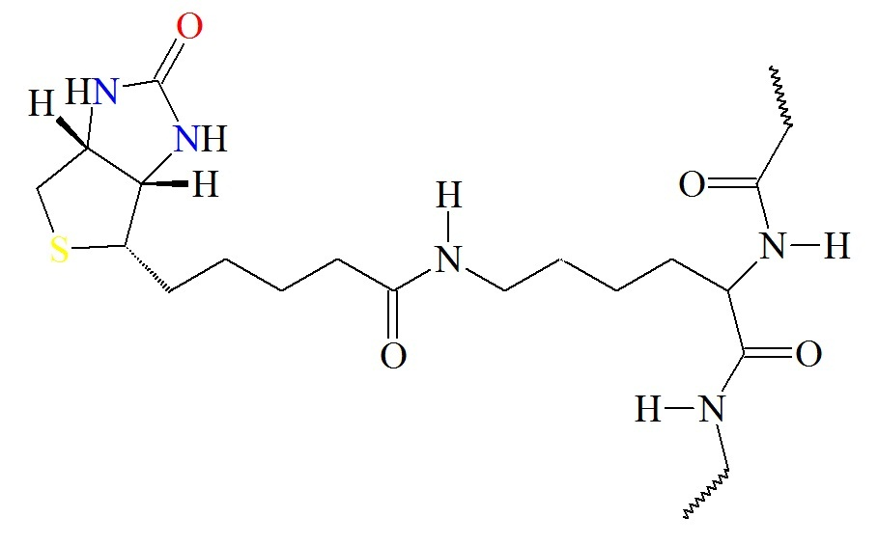
Biotin attaches to Lysine
Forms an amide linkage with the Enzyme
Image from: Biosynthesis
Notes:
The biotin cofactor forms an amide linkage with the pyruvate carboxylase enzyme at a lysine residue. This creates a flexible linker region within the pyruvate carboxylase that is capable of dipping the biotin cofactor into the different catalytic domains of the enzyme to obtain the biological activity of the protein. Attaching the biotin to the enzyme, requires the energy of ATP.

Slide 12
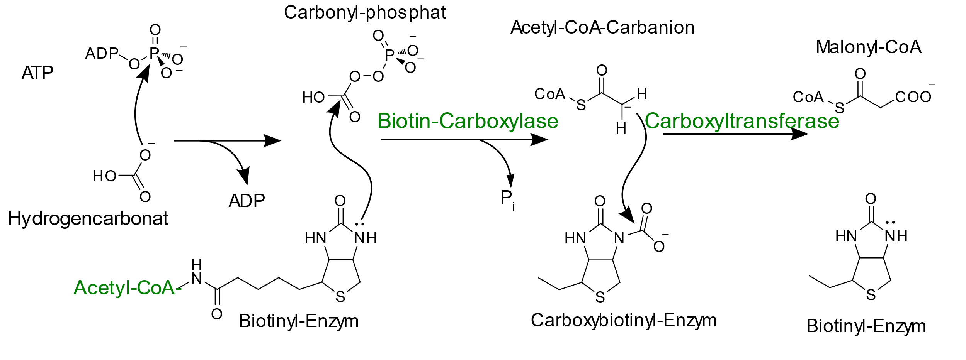
Biotin Carboxylase Activity
Carbonyl-Phosphate
ATP
+
Bicarbonate
Carboxybiotinyl-Enzyme
Complex
Biotin Carboxyl Carrier Protein
Biotinyl-Enzyme
Complex
1. Carbon Fixation Step
Image modified from: Boris, TM
Notes:
To mediate the formation of oxaloacetate from pyruvate, the pyruvate carboxylase (PC) enzyme has two major catalytic properties. First, PC needs to fix carbon dioxide (or bicarbonate when in solution) to the biotin cofactor. The enzyme reaction in the first part of the mechanism is the biotin carboxylase activity and it requires the energy of ATP. Here you can see that an oxygen from bicarbonate mediated nucleophilic attack on the outer phosphate group of the ATP molecule forming the carbonyl-phosphate intermediate + ADP. The Biotin cofactor that is bound to the enzyme is then able to mediate nucleophilic attack on the carbon of the carbonyl-phosphate intermediate. This forms the Carboxybiotinyl-Enzyme complex and releases the inorganic phosphate group harvested from the ATP molecule. The biotin is now loaded for the second enzymatic reaction.

Slide 13
Pyruvate Carboxyltransferase Activity
Step 2: Formation of a pyruvate carbanion intermediate
Enzyme
Enzyme
Enzyme
Pyruvate
Pyruvate Carbanion
Image modified from: Boris, TM
Notes:
The carboxyltransferase activity is housed in a separate domain of the enzyme and requires the formation of a carbanion intermediate to occur on the pyruvate molecule to make it reactive enough to cause the addition of the carboxyl group. A base from the enzyme eliminates a proton from the C3 position of pyruvate causing the formation of an ene-ol reaction intermediate. As the electrons on the oxygen from the pyruvate molecule reform the carbonyl group, the electrons from the carbon-carbon double bond shift onto the carbon, creating a reactive carbanion intermediate.

Slide 14
Pyruvate Carboxyltransferase Activity
Image modified from: Boris, TM
Enzyme
Pyruvate Carbanion
Oxaloacetate
Enzyme
BCCP
Biotinyl-Enzyme
Complex
Carboxybiotinyl-Enzyme
Complex
Step 3: Formation oxaloacetate and restoration of biotin
Notes:
At this point, the carboxybiotinyl complex swings into the Carboxytransferase domain, providing the carboxyl group that will be incorporated into pyruvate. The carbanion intermediate mediates a nucleophilic attack onto the carboxyl carbon from the BCCP complex, and carbon dioxide is transferred to the pyruvate, creating oxaloacetate. The biotin cofactor is restored by the donation of the proton from the basic residue in the enzyme. This also restores the Pyruvate Carboxylase enzyme for another round of activity.

Slide 15
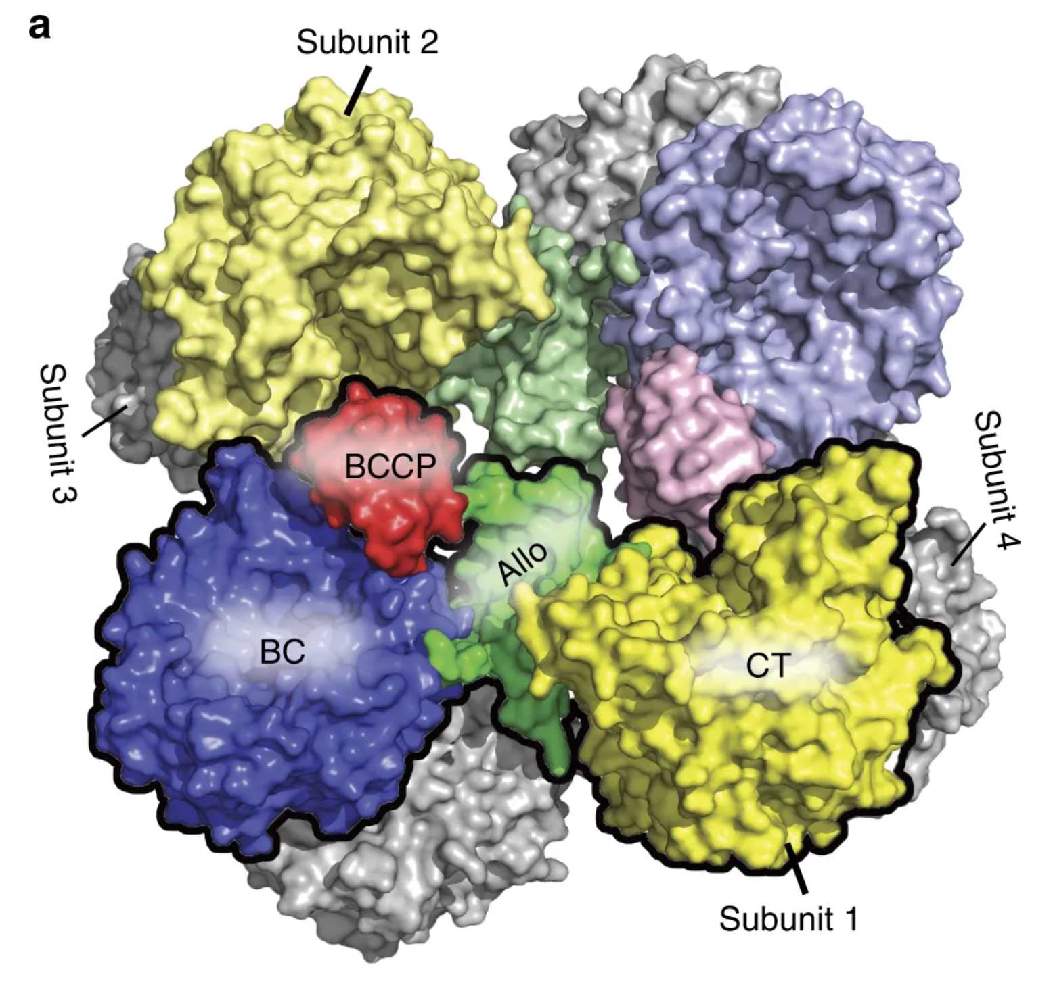
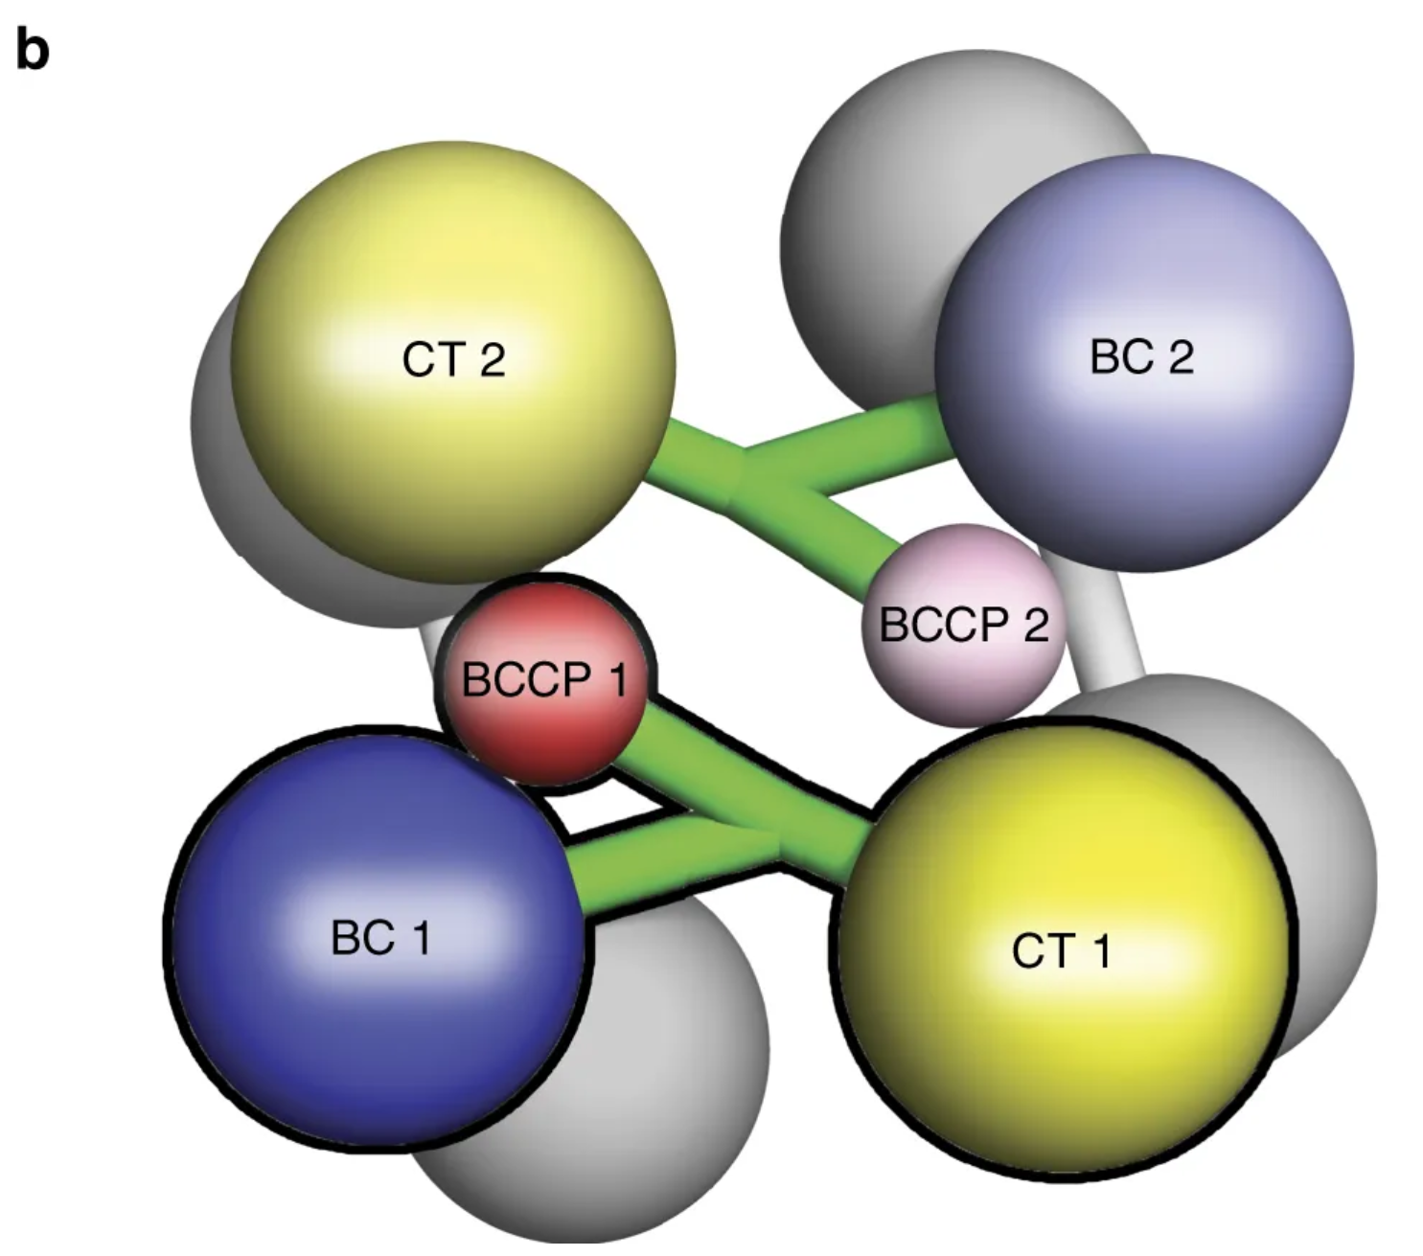
Pyruvate Carboxylase
Is a tetrameric protein
Figure modified from: Liu, Y., et al (2018) Nat Commun 9:1384
Notes:
To make things even more complicated, the overall structure of the Pyruvate Carboxylase is a tetramer that contains four functional protein subunits. Two subunits are shown in color, with the other two indicated in gray at the back of the structure. Each subunit contains a biotin carboxylase (BC) domain shown in blue, a carboxyltransferase (CT) domain shown in yellow, and the biotin-carboxyl carrier protein (BCCP) domain shown in red and green.

Slide 16
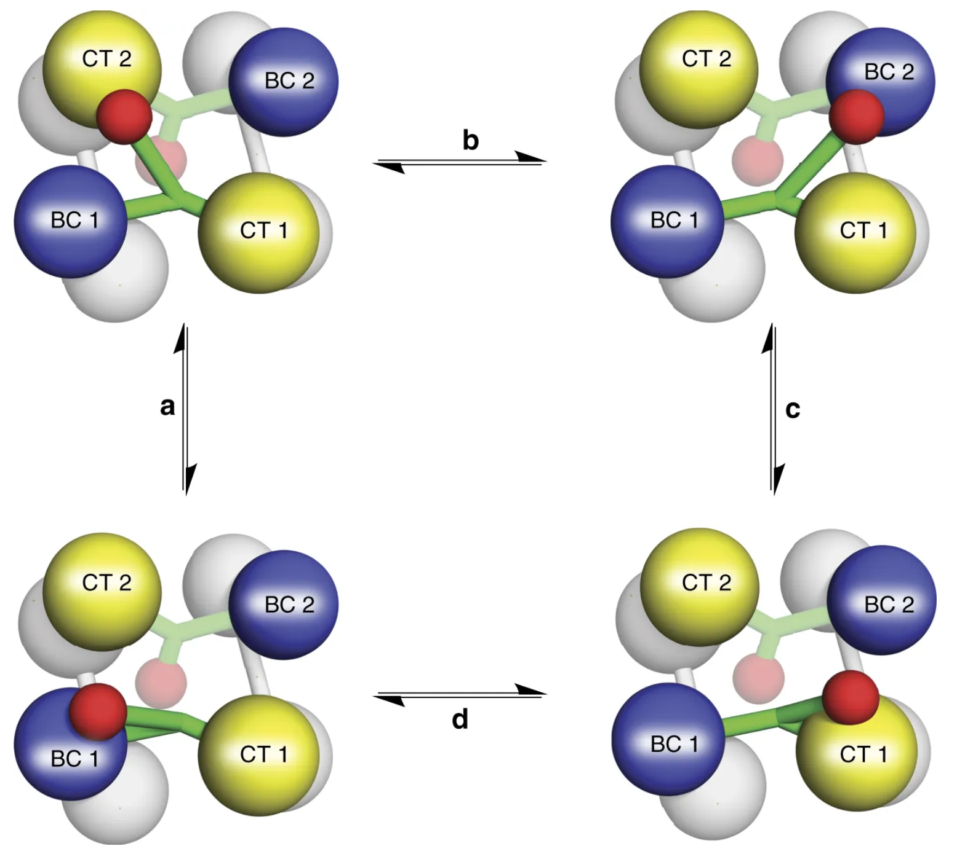
Pyruvate Carboxylase Mechanism
Figure modified from: Liu, Y., et al (2018) Nat Commun 9:1384
Notes:
The Biotin-Carboxyl Carrier Protein Domain (BCCP) is a flexible arm of the protein structure that can swing from one catalytic domain to the other during the reaction process. As shown in the diagram, the BCCP domain of subunit 1 will be fixed with carbon dioxide at the biotin carboxylase domain from subunit 1 (BC1). The BCCP will then translocate to the carboxyltransferase domain from subunit 2 (CT2) where it will create one molecule of oxaloacetate and reset the biotin cofactor. The BCCP will then swing into the BC2 domain where carbon fixation will occur. BCCP then shifts to the CT1 domain where it creates a second oxaloacetate molecule and resets the biotin. While this is going on with the BCCP from subunit 1, the other BCCP arms from subunits 2, 3, and 4 are also active. Thus, one full sequence of the enzyme activity will produce 8 molecules of oxaloacetate.

Slide 17
Pyruvate Carboxylase
Is an allosteric protein
  Acetyl-CoA is an activator
  ADP in an inhibitor
Figure modified from: Liu, Y., et al (2018) Nat Commun 9:1384
Notes:
In looking at the space filling diagram of Pyruvate Carboxylase, the central region of the protein that extends to the BCCP domain is also an allosteric region of the protein. When Pyruvate enters into the Kreb Cycle, it is first converted to Acetyl-CoA. If abundant Pyruvate is present, then ample supply of Acetyl-CoA will also be available, indicating a high energy load for the cell. Acetyl-CoA, can bind with Pyruvate Carboxylase and act as an activator of the protein, stimulating the production of oxaloacetate. ADP, on the other hand, is a low energy indicator and an inhibitor of the enzyme. In the next section, we will discover how the oxaloacetate finds its way into the cytoplasm.

Slide 18
Sugar Phosphate Reactions
Glucose
P_{i}
ATP
Hexokinase
Glucose
6-phosphatase
ADP
Glucose 6-phosphate
H₂O
ATP
Fructose 6-phosphate
P_{i}
PFK-1
FBPase-1
ADP
H₂O
Fructose 1,6-bisphosphate
Kinases (Transferases)
Hydrolases
Glycolysis
Gluconeogenesis
Notes:
The final two novel reactions in the gluconeogenic pathway are both hydrolase reactions involving the hydrolysis of the phosphate group from the sugar. This is notable, as it does not produce energy, the way the reverse kinase reactions do in the second half of the glycolytic pathway. Thus, there is no substrate level phosphorylation that occurs in the gluconeogenic pathway.

Slide 19
Energy Demands of Gluconeogenesis
6 moles of ATP equivalents required to make 1 mole of Glucose
2 ATP + 2 Pyruvate → 2 Oxaloacetate + 2 ADP
2 GTP + Oxaloacetate → 2 Phosphoenolpyruvate + 2 GDP
2 ATP + 2 (3-Phosphoglycerate) → 2 (1,3-Bisphosphoglycerate) + 2 ADP
2 NADH + 2 (1,3 Bisphosphoglycerate) → 2 Glyceraldehyde 3-P + 2 NAD⁺
Over 3 times as much energy required to make glucose from pyruvate than you generate breaking glucose down into pyruvate
Notes:
Overall, there are approximately 6 molar equivalents of ATP required to make 1 mole of glucose. Over 3 times as much energy is consumed during glucose formation than is generated from glycolysis during the breakdown of glucose. Per glucose molecule made, 2 ATP are used in the Pyruvate Carboxylase step, 2 GTP are used in the Phosphoenolpyruvate Carboxykinase step, and 2 ATP are used in the kinase reaction to create 1,3-bisphosphoglycerate from 3-phosphoglycerate. There is also the loss of 2 moles of NADH during the reverse reaction to create Glyceraldehyde 3-phosphate from 1,3-Bisphosphoglycerate, which reduces energy potential through oxidative phosphorylation in the mitochondria. Plus there are energy costs to changing the metabolite pools in the matrix of the mitochondria and for transporting molecules across the mitochondrial membrane that we have not considered here. With that, we will now leave our discussions of glycolysis and gluconeogenesis. In the next lecture series, we will move into the matrix of the mitochondria and focus on the Kreb Cycle and Electron Transport Chain.

