Slide 1
Gluconeogenesis
Part 3: PEPCK and the Production of Glucose
Notes:
Welcome to part 3 in our lecture series on Gluconeogensis. This tutorial will cover the final three enzymatic reactions that differ in gluconeogenesis.

Slide 2
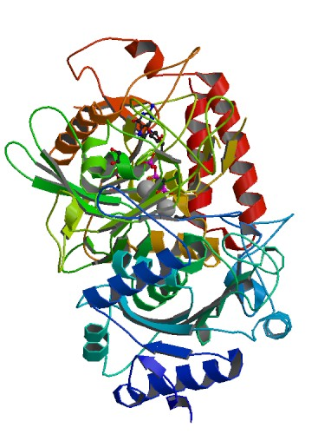
Phosphoenolpyruvate Carboxykinase
Is a lyase
Exists in two isoforms (a cytoplasmic and mitochrondrial form)
Cytosolic form predominantly used for gluconeogenesis
But phosphoenolpyruvate CAN be transported across the inner mitochondrial membrane
Figure from: ProteinBoxBot
Notes:
Phosphoenolpyruvate carboxykinase is classified as a lyase enzyme and exists in two isozymes, a cytoplasmic PEPCK and a mitochondrial PEPCK. The cytoplasmic form is the one that is predominantly used in the gluconeogenic pathway. However, small amounts of PEP can be transported across the mitochondrial membrane.

Slide 3
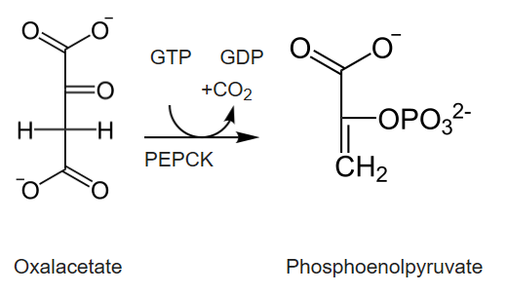
Phosphoenolpyruvate Carboxykinase
Figure modified from: Principles of Biochemistry (2019) Wikibooks
Notes:
The reaction mediated by PEPCK is the conversion of oxaloacetate to phosphoenolpyruvate using GTP as the phosphate donor. The enzyme also releases carbon dioxide.

Slide 4
PEPCK Regulation
Transcriptional Level
Increased expression with increased cAMP levels, increased glucocorticoids, and increased thyroid hormone.
Decreased expression in response to insulin signaling
Allosteric Level
High levels of ADP (low energy load) decreases PEPCK activity
Notes:
Cytoplasmic PEPCK is largely regulated at the transcriptional level where increases in gene expression are seen in response to elevated cAMP levels, increased glucocorticoids, and increased thyroid hormone levels. Decreased gene expression was caused by insulin signaling. ADP also acts as an allosteric effector of the protein, causing it to have lower activity.

Slide 5
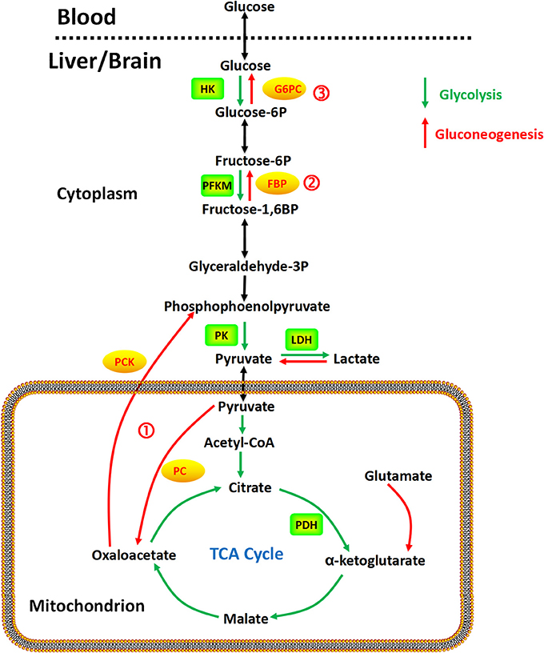
Gluconeogenesis Overview
Last two unique enzymes of gluconeogenesis are phosphatases.
Figure from: Yip, J, et al (2017) Front. Pharmacol. 10.3389
Notes:
The last two unique enzymes of the gluconeogenic pathway are both phosphatase enzymes. Fructose 1,6-bisphosphatase converts fructose 1,6-bisphosphate to fructose 6-phosphate, and glucose 6-phosphatase, converts glucose 6-phosphate to free glucose.

Slide 6
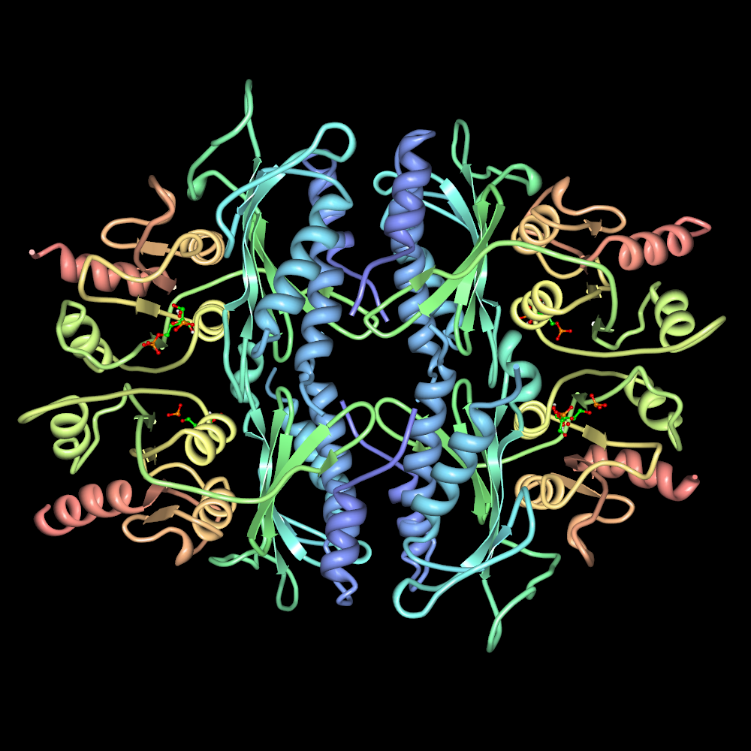
Fructose 1,6 Bisphosphatase
Converts Fructose 1,6-bisphosphate to fructose 6-phsopahte
Requires Mg²⁺ or Mn²⁺ for activity
Competitively inhibited by fructose 2,6-bisphosphate
Allosterically regulated
Inhibited by AMP (low energy load)
Figure from: Jslipscomb
Notes:
Fructose 1,6-bisphosphatase requires a metal cofactor and is competitively and allosterically regulated. Fructose 2,6-bisphosphate and low energy load (AMP and ADP) inhibit the enzyme.

Slide 7

Glucose 6-Phosphatase Enzyme
P
Glucose
6-phosphate
To the blood
P
Cytoplasm
T1
SP
T2
T3
G-6-Pase
Lumen of the ER
P
P
Notes:
lThe dephosphorylation of glucose, as we learned previously in our glycogen metabolism lectures, only occurs appreciably in liver cells, as this is the primary location for the regulation of blood glucose levels. This serves as the final step in the gluconeogenic pathway. Glucose 6-phosphate is transported from the cytoplasm into the lumen of the endoplasmic reticulum (ER) through transporter 1 (T1). The glucose 6-phosphatase (G-6-Pase) then cleaves the phosphate from the substrate, releasing inorganic phosphate (P) and glucose (red molecule). The inorganic phosphate is then transported back into the cytoplasm through transporter 2 (T2) and glucose is transported through Transporter 3 (T3). Free glucose is then transported back into the bloodstream through a glucose (GLUT) transporter (not shown).

Slide 8
Sugar Phosphate Reactions
Glucose
P_{i}
ATP
Hexokinase
Glucose
6-phosphatase
ADP
Glucose 6-phosphate
H₂O
ATP
Fructose 6-phosphate
P_{i}
PFK-1
FBPase-1
ADP
H₂O
Fructose 1,6-bisphosphate
Kinases (Transferases)
Hydrolases
Glycolysis
Gluconeogenesis
Notes:
The final two novel reactions in the gluconeogenic pathway are both hydrolase reactions involving the hydrolysis of the phosphate group from the sugar. This is notable, as it does not produce energy, the way the reverse kinase reactions do in the second half of the glycolytic pathway. Thus, there is no substrate level phosphorylation that occurs in the gluconeogenic pathway.

Slide 9
Energy Demands of Gluconeogenesis
6 moles of ATP equivalents required to make 1 mole of Glucose
2 ATP + 2 Pyruvate → 2 Oxaloacetate + 2 ADP
2 GTP + Oxaloacetate → 2 Phosphoenolpyruvate + 2 GDP
2 ATP + 2 (3-Phosphoglycerate) → 2 (1,3-Bisphosphoglycerate) + 2 ADP
2 NADH + 2 (1,3 Bisphosphoglycerate) → 2 Glyceraldehyde 3-P + 2 NAD⁺
Over 3 times as much energy required to make glucose from pyruvate than you generate breaking glucose down into pyruvate
Notes:
Overall, there are approximately 6 molar equivalents of ATP required to make 1 mole of glucose. Over 3 times as much energy is consumed during glucose formation than is generated from glycolysis during the breakdown of glucose. Per glucose molecule made, 2 ATP are used in the Pyruvate Carboxylase step, 2 GTP are used in the Phosphoenolpyruvate Carboxykinase step, and 2 ATP are used in the kinase reaction to create 1,3-bisphosphoglycerate from 3-phosphoglycerate. There is also the loss of 2 moles of NADH during the reverse reaction to create Glyceraldehyde 3-phosphate from 1,3-Bisphosphoglycerate, which reduces energy potential through oxidative phosphorylation in the mitochondria. Plus there are energy costs to changing the metabolite pools in the matrix of the mitochondria and for transporting molecules across the mitochondrial membrane that we have not considered here. With that, we will now leave our discussions of glycolysis and gluconeogenesis. In the next lecture series, we will move into the matrix of the mitochondria and focus on the Kreb Cycle and Electron Transport Chain.

