Slide 1
Glycogen Biosynthesis and Metabolism – Part 1
Insulin Signaling and Glycogen Synthesis
Notes:
Welcome to part 1 in our Glycogen Biosynthesis and Metabolism lecture series. In this section, we will discuss Insulin signaling and Glycogen Synthesis.

Slide 2
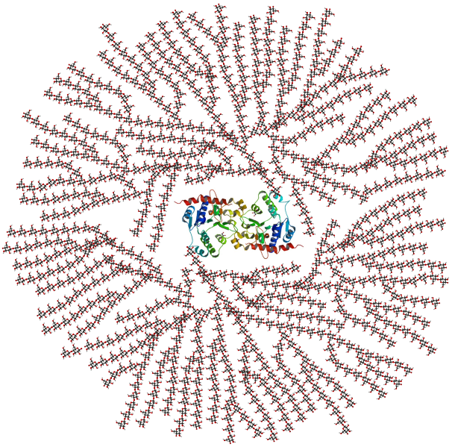
Glycogen
Primary energy storage carbohydrate in animals
Primary backbone has α1 → 4 linkages and secondary α1 →6 linkages
Creates many ends of the molecule allowing for the fast release of glucose for energy conversion
Notes:
Recall that glycogen is a large polymer of glucose residues connected in the main chain by a1→4 linkages and with branching side chains about every 12 – 15 residues at the a1→6 position. The reducing ends of the carbohydrate (two for each polymer) are connected to the glycogenin dimeric protein. With the branching nature of the polymer, many non-reducing ends of the molecule are present, allowing easy access and fast release of glucose for energy utilization.

Slide 3
Glycogen
10% of the mass of the liver is glycogen
2% of the mass of skeletal muscle is glycogen
The polymer is attached to a central protein called glycogenin
May have as many as 30,000 glucose monomers per molecule
Notes:
Most of the body’s pools of glycogen are stored in the liver, with 10% of the liver biomass in glycogen granules, and in the skeletal muscle, with glycogen comprising 2% of the biomass of the muscle. Each glycogen polymer may have upwards of 30,000 glucose residues, making the glycogen polymer visible using standard microscopic techniques. Storage of glycogen within muscle tissue is used by the muscle cells as a source of energy to fuel muscle contraction. In the liver, the purpose of glycogen storage is different. Glycogen stored at this location is used to maintain the homeostatic balance of blood glucose levels. The liver is the primary organ that can actively transport glucose into the bloodstream. Our only other major source of glucose within the blood is from our diet.

Slide 4
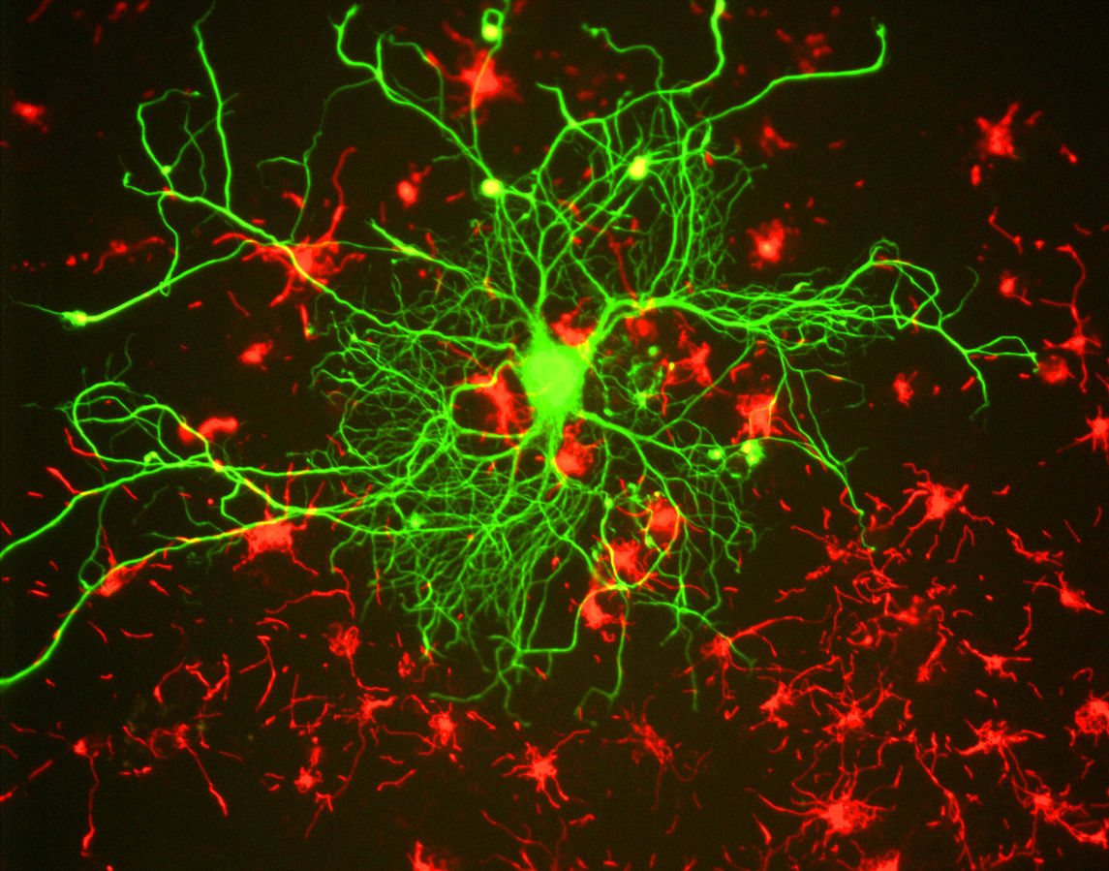
Blood Glucose Homeostasis
Is critical for brain function
Image from GerryShaw
Notes:
The brain has a huge energy demand, but nearly zero storage of key energy molecules required for ATP production. Furthermore glucose and ketone bodies are the only energy sources that can pass the blood brain barrier and be utilized by the brain for ATP production. Note that ketone bodies are only produced during starvation, or disease states such as diabetes, and are not a regular source of energy for the brain. Thus glucose is critical for brain function. Nearly 10% of the whole body’s energy is used for nerve impulse transmission by the brain. If blood flow to the brain carrying critical oxygen and glucose is impeded, people will lose consciousness within approximately 20 seconds! And brain death/permanent damage occurs within 4 minutes of blood flow cessation. This exemplifies the importance of the liver in maintaining blood glucose levels, as well as the importance of oxygen maintenance.

Slide 5
Why is the storage of glucose useful?
Glycogen
Glucose 1-phosphate
Glucose 6-phosphate
GLYCOLYSIS
PENTOSE
PHOSPHATE
PATHWAY
Most cells (esp.
Muscle and Brain)
Liver
Most cells
Pyruvate
Ribose + NADPH
Anaerobic
Aerobic
Glucose
Lactate
CO₂ and H₂O
To Blood Stream
Notes:
Glycogen in the liver or muscle can be broken down into glucose 1-phosphate. This can be interconverted to glucose 6-phosphate which is then readily used in many cellular processes. The process of glycolysis (or the breakdown of glucose into pyruvate) occurs in all cells and produces a small amount of ATP in the process. Further processing of pyruvate can occur anaerobically (or in the absence of oxygen) to produce lactate, or the process can continue to occur in the aerobic pathway to complete oxidation to carbon dioxide and water in the Kreb cycle. Note that oxygen from breathing is used to create the water within this step. This fuels the process of oxidative phosphorylation within the mitochondria and produces large quantities of ATP (36 molecules/glucose). Within the liver, glucose can be freed from glycogen and released back into the blood stream to maintain homeostatic levels. Glucose 6-phosphate can also be utilized as a precursor for other major macromolecules such as ribose and deoxyribose, as well as the hexosamine compounds commonly found cushioning joints or attached to proteins of the plasma membrane.

Slide 6
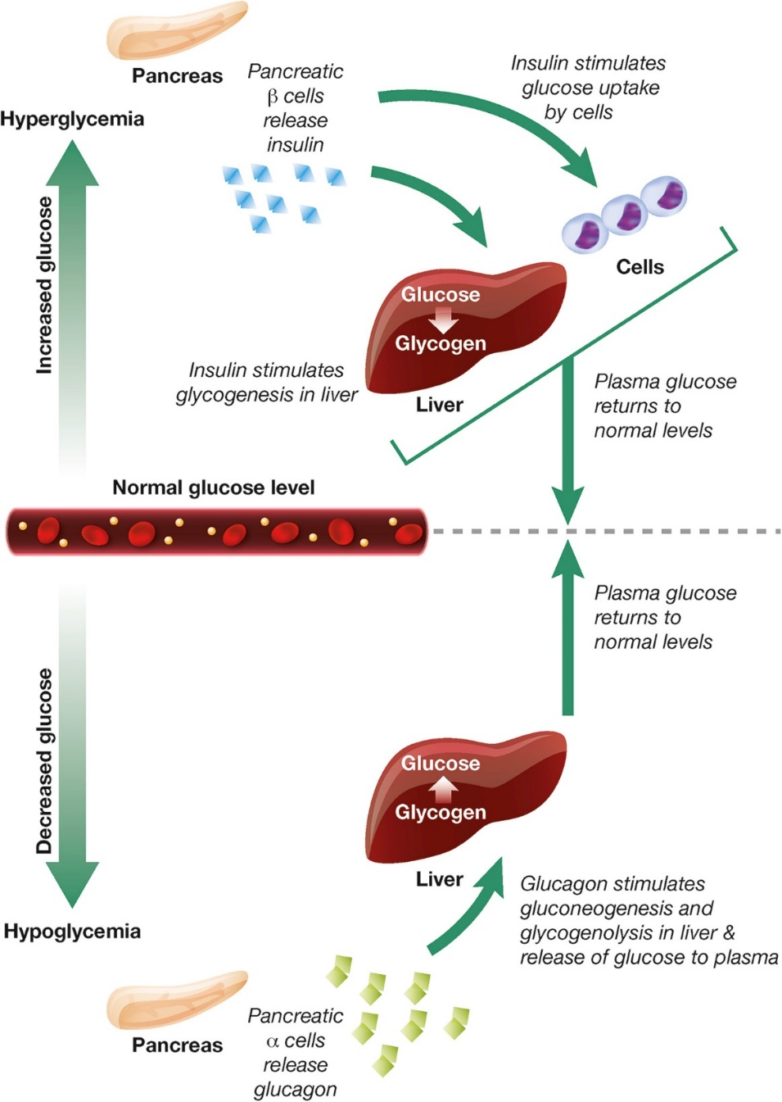
Liver and Pancreas
Maintain Glucose Homeostasis in the Blood
Insulin is secreted by the pancreas in response to high blood glucose levels
Glucagon is secreted by the pancreas in response to low blood glucose levels
Image from Hædersdal, S., et al (2018) Mayo Clinic Proceedings 93(2):217-239
Notes:
In healthy individuals hormone signaling is critical to maintain blood glucose homeostasis. Within this system, the hormones glucagon and insulin work together to maintain normal plasma glucose levels. During hyperglycemia, pancreatic beta (β) cells release insulin, which stimulates glucose uptake by energy-consuming cells and the formation of glycogen in the liver. During hypoglycemia, pancreatic alpha (α) cells release glucagon, which stimulates gluconeogenesis and glycogenolysis in the liver and the release of glucose to the plasma.

Slide 7

Image from Hædersdal, S., et al (2018) Mayo Clinic Proceedings 93(2):217-239
Notes:
The first area we will focus our attention on, will be the mechanism utilized by insulin to reduce blood glucose levels.

Slide 8
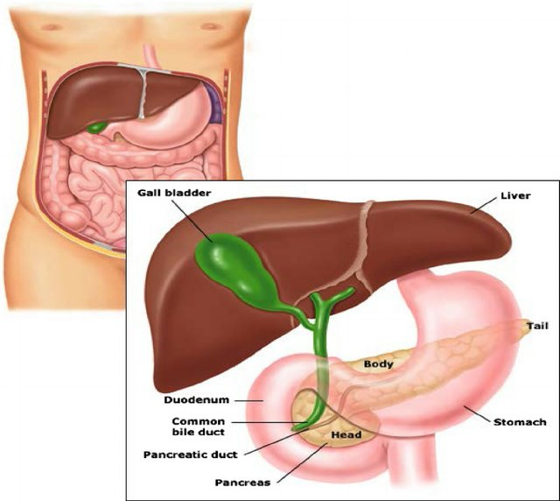
Anatomy of liver and pancreas
Image from Akinlade, A., et al (2014) Int. Archives of Med 7(50):28
Notes:
This is the structure of the pancreas and its anatomical relationship with the liver and the stomach. The pancreas is the sensor organ that detects blood glucose levels. It is responsible for signaling to the liver to either remove or release glucose in response to changing levels. Notably, the pancreas also produces most of the digestive enzymes utilized by the body, including proteases, amylases, and lipases. We will return to this activity of the pancreas during later lectures.

Slide 9
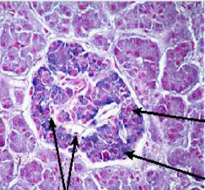
Pancreatic Islets
Islets are distinguished from the surrounding tissue by a continuous connective tissue capsule and extensive vascularity
Glucagon-secreting α-cells stain red
Insulin-secreting β-cells stain blue
Capillaries
Image from Akinlade, A., et al (2014) Int. Archives of Med 7(50):28
Notes:
Right now, let’s focus on the pancreatic islet cells. They are responsible for the production of glucagon and insulin. The islets are distinguished from the surrounding tissue by a continuous connective tissue capsule and extensive vascularity. In this diagram, the islet cells that secrete glucagon (known as αλπηα cells) are stained in red, while the beta cells that produce insulin are stained in blue.

Slide 10
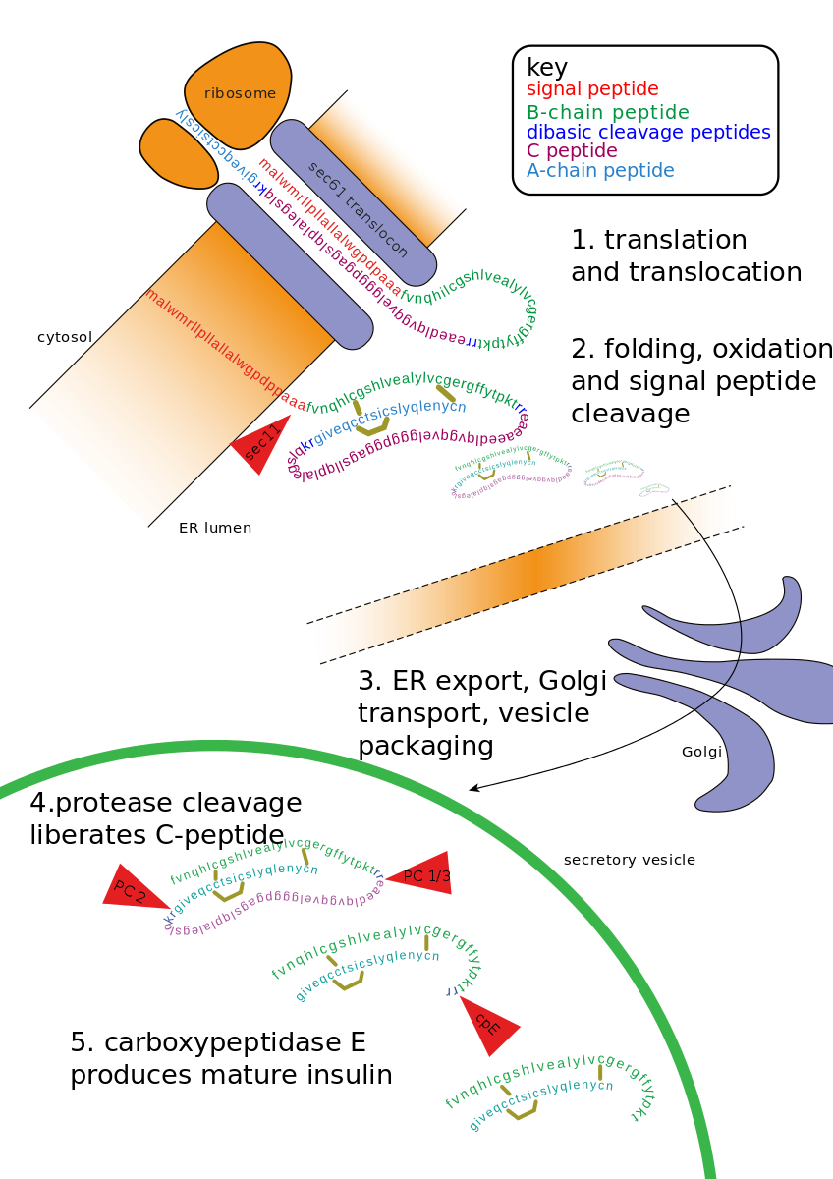
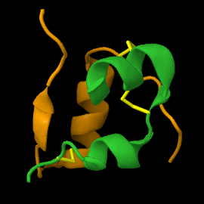
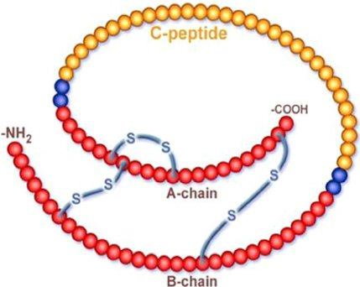
Insulin Processing in Pancreas
Insulin Peptide
Image from Theislikerice
Proinsulin
Image from Akinlade, A., et al (2014) Int. Archives of Med 7(50):28
Image from Fred the Oyster
Notes:
Insulin is a peptide hormone composed of 51 amino acids. It is produced as a longer propeptide, called proinsulin, that needs to be processed by protein cleavage and folding to obtain proper structure. The peptide is first translated on ribosomes linked to the rough endoplasmic reticulum (ER), where a signal peptide docks the peptide to the ER membrane. The proinsulin is folded and the signal peptide cleaved. It is transported to the golgi where it is further packaged into secretory vesicles. Within the secretory vesicles, the proinsulin is cleaved to release the C-peptide. The A and B peptides are held together by disulfide bridges and form the active insulin component.

Slide 11
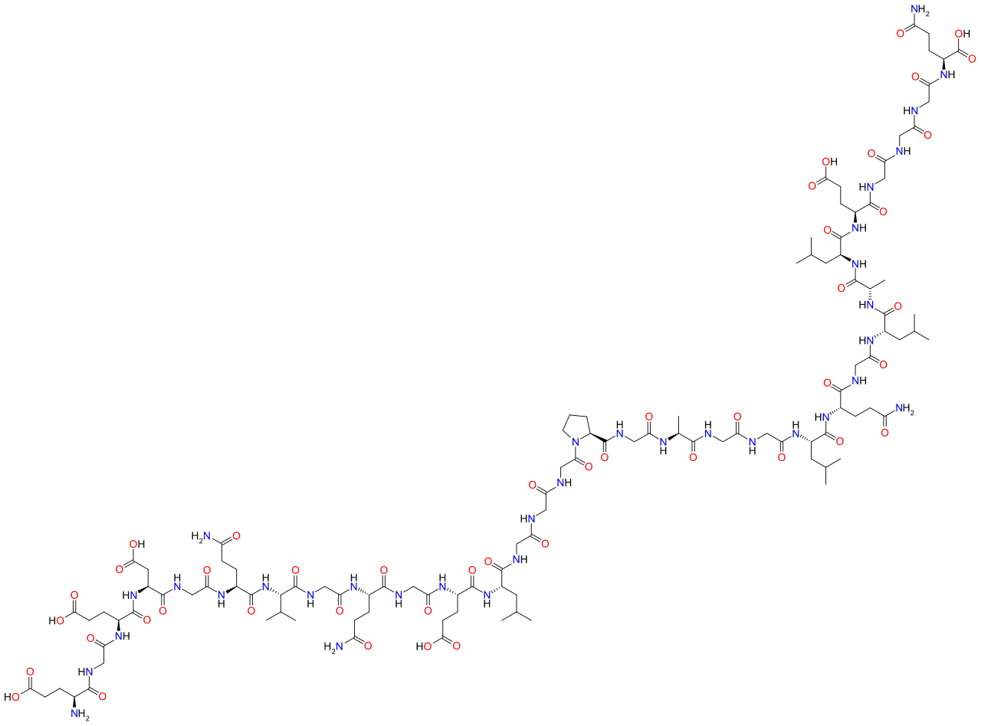
C-peptide
Bioactive
Equimolar to Insulin
Used diagnostically
Image from JaGa
Notes:
The C-peptide is a bioactive peptide secreted at the same time and in equimolar amounts to the insulin hormone. It also has a longer half life than insulin and is excreted by the kidneys into the urine, making detection easy. Furthermore, it allows for the detection of patient produced insulin, even if they are receiving insulin injections. Thus, C-peptide detection is often utilized to help distinguish between patients with type 1 diabetes from patients with type 2 diabetes (or Maturity onset diabetes). Details about the different forms of diabetes will be discussed in greater detail in a later lecture.

Slide 12
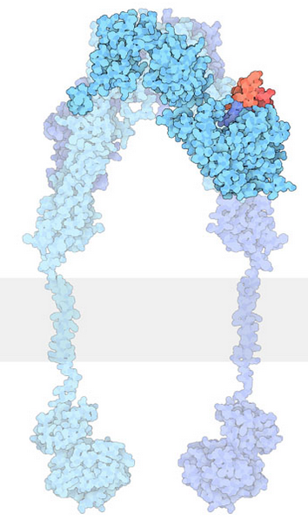
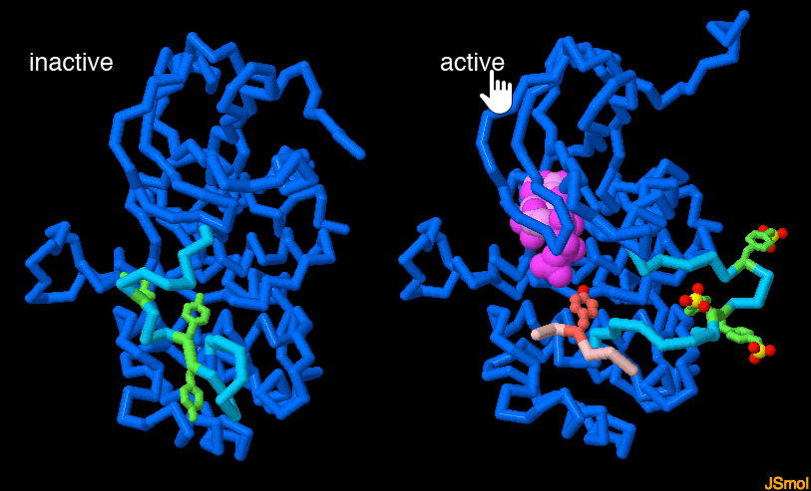
Insulin Receptor
Tyrosine Kinase that autophorphorylates and phosphorylates other target proteins
Images from Goodsell, D., et al (2015) RCSB PDB-101 ‘Molecule of the Month’
Notes:
Once insulin is released from the pancreas, it travels throughout the body and binds with cellular targets that contain the insulin receptor. The Insulin Receptor is a tyrosine kinase receptor that dimerizes upon insulin binding. Insulin receptors are located on most cell types throughout the body causing pleiotropic effects during insulin response. Primary targets of insulin action are the liver, where it promotes the uptake of glucose and the production of the glycogen storage molecule, as well as skeletal muscle and fat. The tyrosine kinase portion of the receptor located on the internal side of the plasma membrane is a dynamic protein with many moving parts. The active site binds to ATP (shown in hot pink) and uses it to phosphorylate its downstream targets. In the inactive state (shown on the left), a mobile loop (in bright turquoise) binds in the active site, blocking its action. When the receptor is activated, several tyrosines (green) on this loop are phosphorylated, causing it to swing out of the active site, allowing ATP (hot pink) to enter (shown on the right). Other signaling proteins (a small peptide from one is shown in light pink) then bind and are phosphorylated on their tyrosine amino acids (shown in green).

Slide 13
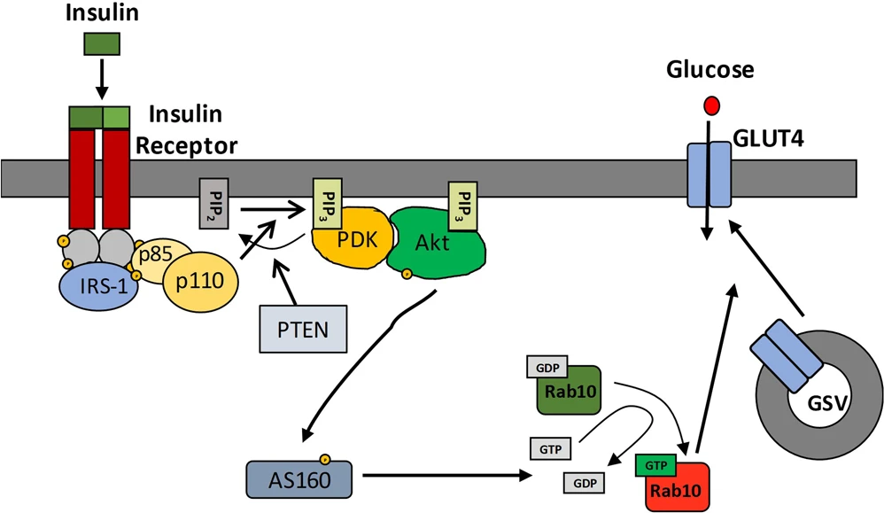
Insulin and Glucose Uptake
Result 1: Increased Glucose Uptake from Bloodstream into Liver and other body Cells (reducing blood glucose levels)
P
P
P
P
P
P
AS160
P
P
Rab10
P
GDP
AS160
P
P
P
P
Rab10
GTP
Image from Carmichael, R.E., et al (2019) Scientific Reports 9:6477
Notes:
The insulin receptor is a receptor tyrosine kinase, which undergoes dimerization and autophosphorylation of Tyr residues upon insulin binding. The phosphorylated receptor recruits and phosphorylates the insulin receptor substrate 1 (IRS-1) on tyrosine residues, which then recruits dimeric Phosphoinositol (PI)3-kinase (p85/p110 in the diagram above) and phosphorylates the p85 regulatory subunit. The PI3 kinase catalyses the phosphorylation of phosphatidylinositol bisphosphate (PIP₂) within the plasma membrane to form phosphoinositol, 3,4,5-triphosphate (PIP₃). PIP3 then recruits PIP3-dependent kinase (PDK) which phosphorylates and activates Akt. Once activated, Akt dissociates from the membrane into the cytosol where one of its downstream targets is AS160. AS160 is a GTPase that normally binds with Rab10 (a G-protein) causing the cleavage of GTP to GDP. Thus, AS160 downregulates the activity of Rab10. In the phosphorylated state, AS160 cannot bind or inhibit Rab10, enabling Rab10 to release GDP and bind with a molecule of GTP. In the activated state, Rab10 helps promote the fusion of GLUT4-containing secretory vesicles (GSVs) secretory vesicles with the plasma membrane. The GSVs house copies of the glucose transporter protein, GLUT4. Fusion of the GSVs with the plasma membrane allows for increased surface expression of GLUT4 and upregulation of glucose import into the cell. Having GLUT4 proteins stored within secretory vesicles makes it available more readily than having to activate gene transcription pathways and production of the protein. This allows a faster response to help lower blood glucose levels. The result is increased glucose uptake from the bloodstream into liver cells and other cellular targets, reducing blood glucose levels.

Slide 14
PIP2 to PIP3 Phosphorylation
Extracellular
Plasma
Membrane
Intracellular
P
p85
P
p110
+
ATP
Phosphotidylinositol-
4,5-bisphosphate (PIP2)
Phosphotidylinositol-
3,4,5-triphosphate (PIP3)
Notes:
Here is a deeper look at some of the initial activation steps in the insulin signaling pathway. This step shows the phosphorylation of Phosphoinositol 4,5-bisphosphate (PIP2) to Phosphotidylinositol 3,4,5-triphosphate (PIP3). PIP2 is a common phospholipid within the lipid bilayer structure. In future lectures, we will see the utilization of this phospholipid in other signaling pathways as well.

Slide 15
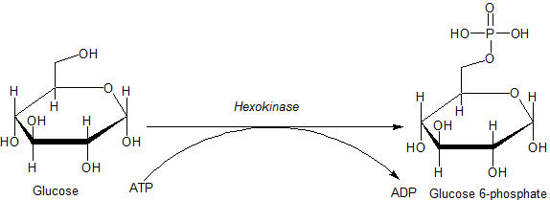
Glucose 6-phosphate
When glucose enters the cell it is rapidly converted to glucose 6-phosphate which traps it inside the cell
Image from Jmun7616
Notes:
Once glucose enters a cell, it is rapidly converted to glucose 6-phosphate via the enzyme hexokinase. We will revisit this enzyme in more detail in our section on glycolysis. Importantly, phosphorylation traps the glucose inside the cell and does not allow it to be redistributed back into the blood stream. This helps to maintain the homeostasis of glucose within the bloodstream. In addition, glucose 6-phosphate is the first step in many pathways utilizing glucose, including energy utilization and the formation of building blocks such as ribose and deoxyribose used in RNA and DNA synthesis.

Slide 16
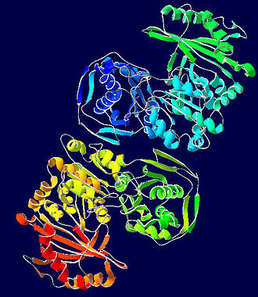
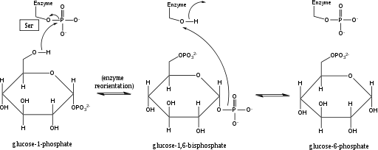
Phosphoglucomutase
Converts reversibly between glucose 6-phosphate and glucose 1-phosphate
Image from Wikimedia Commons and Jag123
Notes:
Another important enzyme in glucose metabolism is phosphoglucomutase. This enzyme falls into the isomerase class of enzymes and is able to effectively transfer the phosphate group from the 6- to the 1-position. This reaction is fully reversible, as shown above. Within this mechanism, a serine residue of the enzyme is covalently linked to a phosphate group. In the reaction shown, the 6’-Oxygen of glucose attacks the phosphate attached to serine in the enzyme active site. The ser-OH acts as a good leaving group. This creates a glucose bisphosphate intermediate. As the reaction proceeds, the ser-Oxygen attacks the phosphate group at the alternate position restoring the phosphorylated serine residue of the enzyme and releasing the glucose-phosphate isomer. For glycogen biosynthesis glucose 1-phosphate will be required.

Slide 17
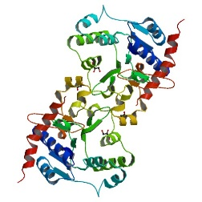
Insulin and Glucose Uptake
Result 2: Glucose entering skeletal muscle or liver is converted to glycogen for storage
P
GSK-3
INACTIVE
GSK-3
Glycogen
Synthase
ACTIVE
P
ACTIVE
P
Glycogen
Synthase
Glycogen
PP1
INACTIVE
Image modified from Carmichael, R.E., et al (2019) Scientific Reports 9:6477
Notes:
In the previous slide, we saw that insulin signaling increases the number of GLUT4 transporters in the plasma membrane causing an increased uptake of glucose into the cell. Within liver and muscle tissue, if the glucose is not required for energy or other metabolic intermediates, it is then converted to glycogen for storage. The major enzyme required for glycogen synthesis is also activated via insulin signaling. In addition to phosphorylating the AS160 protein, Activated Akt also phosphorylates the Glycogen Synthase Kinase enzyme (GSK-3) which inactivates this protein. This causes protein phosphorylase 1 (PP1) to dephosphorylate the Glycogen Synthase enzyme shifting it into a more active state, causing glycogen synthesis to commence. So we have just talked about two pathways activated during cellular response to insulin signaling, and I am sure that you are feeling a bit overwhelmed with the complexity. However, biological processes are incredibly complex and signaling pathways have multiple pleiotropic downstream effects. For insulin signaling, we have only touched the tip of the iceberg, as evidenced in the next slide.

Slide 18
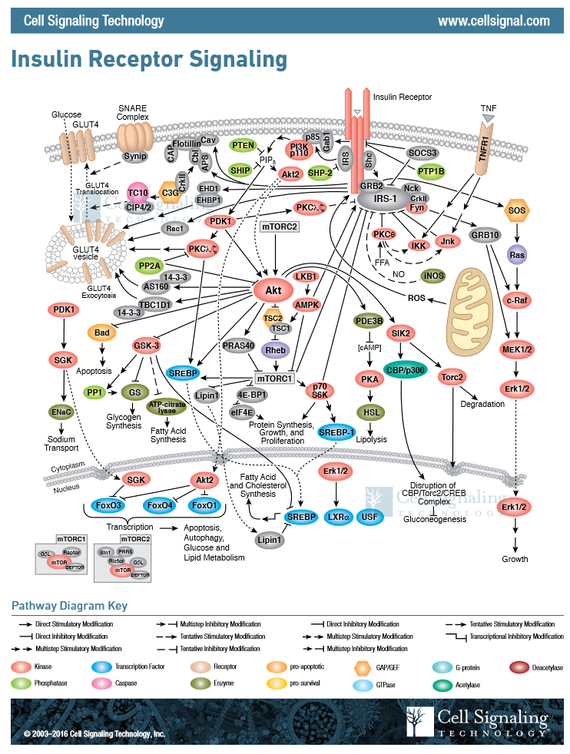
Insulin
The complexity of Insulin signaling pathways
Image by Cell Signaling Technology
Notes:
This diagram created by cell signaling technology tries to capture a more complete picture of insulin signaling. Now this IS overwhelming! We will keep our simplified version for the test, but keep this in the back of your mind. Life is no where near as simple as your upper division biochemistry textbooks make it out to be! If we take a closer look at this pathway, we can find the two paths that we were looking at above. First the activation of the PI3 kinase by the IRS protein, which then converts PIP2 to PIP3. PIP3 is required for activation of PDK, which in turn phosphorylates Akt. As you can see, Akt has many downstream targets. Two of which, we talked about. The AS160 pathway that leads to the upregulation of GLUT4 transporters in the plasma membrane. Note that this is not the only pathway activated by insulin that initiates this response. At least four other pathways are also increasing translocation of the GSVs to the plasma membrane. Thus, signaling pathways often contain redundancies. The second pathway that we discussed was the GSK-3 inactivation by Akt. This leads to the dephosphorylation and activation of the Glycogen Synthase enzyme. Note that phosphorylation and inactivation of PP1 is also blocked during this signaling cascade, increasing the dephosphorylation of Glycogen Synthase by PP1.

