Slide 1
Glycogen Biosynthesis and Metabolism – Part 2
Glycogenesis
Notes:
Welcome to part 2 of our lecture series in Glycogen Biosynthesis and Metabolism. In this next section we will take a closer look at the enzymes required for Glycogenesis (or the synthesis of glycogen)

Slide 2
Glycogenesis
The process of forming glycogen is called ‘Glycogenesis’
It requires a series of enzymes:
  Hexokinase
  Phosphoglucomutase
  UDP-glucose Pyrophosphorylase
  Glycogen Synthase
  Glycogenin
  Glycogen Branching Enzyme
Notes:
The process of glycogenesis requires the activity of several enzymes. Some of these, we have already discussed including the hexokinase that phosphorylates the 6-OH of glucose and the phosphoglucomutase that converts glucose-6-phosphate to the glucose-1-phosphate isomer. In this section, we will discuss the remaining four enzymes and their role in glycogen biosynthesis.

Slide 3
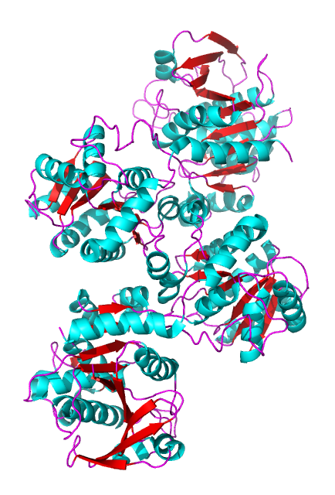
Glycogen Synthase (GS)
Is the key regulatory enzyme of glycogen synthesis
Regulated by allosteric modifiers
  Binding of Glucose 6-phosphate increases the activity GS
Regulated by covalent modification
  Phosphorylation by GSK-3 leads to inactivation of the enzyme
  Phosphorylation by another enzyme, Protein Kinase A, also leads to inactivation (PKA is activated by glucagon signaling)
Image from WilsonNR
Notes:
The key enzyme required is glycogen synthase (GS). This enzyme is the key regulatory step in the process, and we have already seen how insulin signaling upregulates the activity of this enzyme by inhibiting phosphorylation by GSK-3. Other effectors include the allosteric binding of glucose-6-phosphate, which also increases the activity of the GS. In a later section, we will also see that the hormone glucagon can also regulate the activity of the GS through protein kinase A (PKA). In this situation, glycogen synthesis is downregulated and glycogen breakdown is amplified.

Slide 4
Glycogen Synthase (GS)
Is responsible for nearly all of the α1 → 4 glucose linkages found in glycogen
It requires a primer of at least four glucose residues before it can begin adding glucose residues to the growing chain.
Image from WilsonNR
Notes:
Within glycogenesis the GS is responsible for building the majority of the main alpha 1→4 chain linkages. The GS does require a primer of 4 -6 glucose residues linked together by alpha 1→4 bonds to begin synthesis. GS also CANNOT create the alpha 1→6 branches inherent to the core structure of glycogen.

Slide 5
Glycogen Synthase Reaction
Glycogen Synthase attaches glucose from a glucose-UDP monomer to the nacent glycogen chain at the non-reducing end of the molecule
Glycogen_{(n)} + UDP-glucose → Glycogen_{(n+1)} + UDP
Notes:
To build the glycogen main chain, GS uses the glycogen primer + a glucose that has been activated through binding to a molecule of uridine diphosphate (UDP) at the 1-position for its substrates. Upon completion of the linkage 1 position of the incoming UDP-glucose is bonded with the 4-position of the nascent glycogen molecule releasing the UDP as a leaving group.

Slide 6
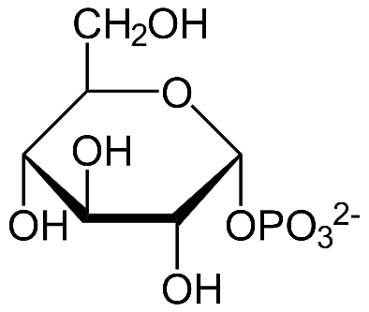
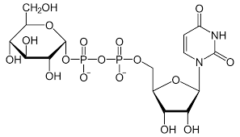
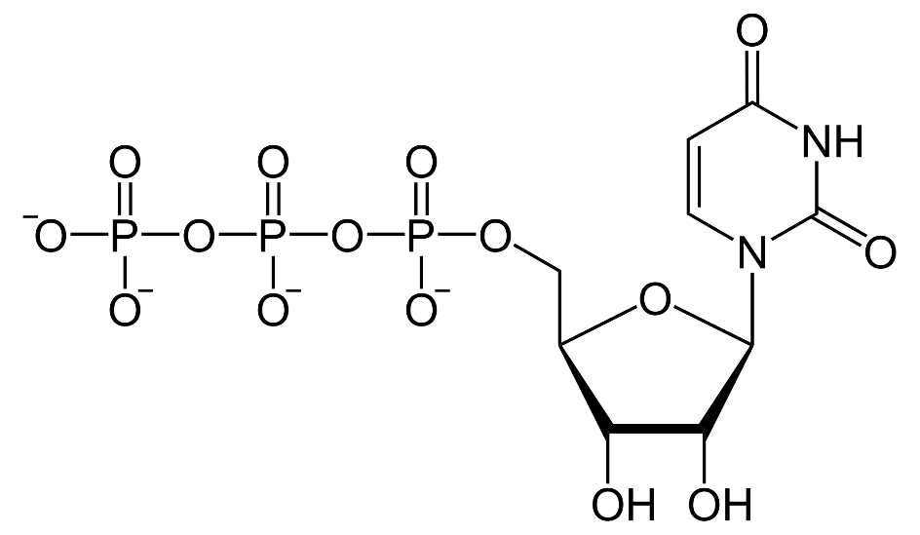
UDP-Glucose Pyrophosphorylase
Catalyzes the formation of UDP-Glucose from UTP and Glucose 1-phosphate
+
+
P_{i}
Notes:
Formation of the UDP-glucose is mediated by the UDP-glucose pyrophosphorylase. This enzyme utilizes glucose 1-phosphate and UTP as substrates to generate UDP-glucose and release inorganic phosphate.

Slide 7
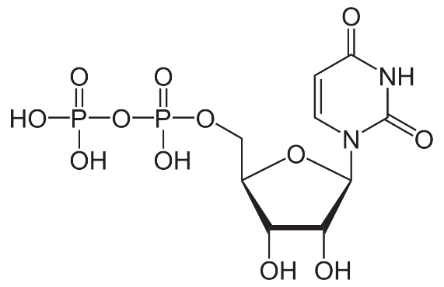
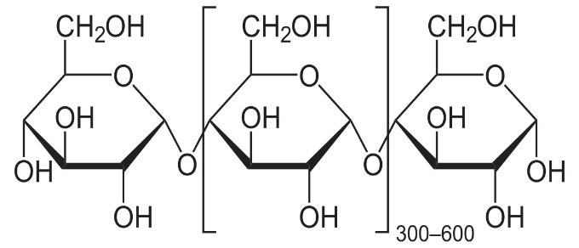
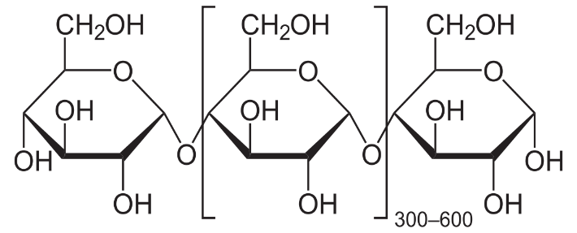
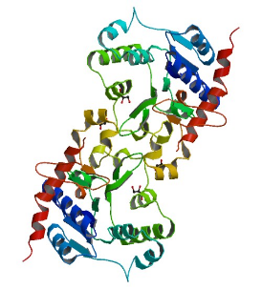

Glycogen Synthase
UDP-Glucose
UDP
+
+
(n)
(n+1)
Glycogen main chain
Glycogen main chain + 1
Notes:
UDP-glucose is then utilized by GS to extend the main chain of glycogen by one glucose residue. In this reaction, the 4’-OH group of the glycogen main chain attacks the anomeric carbon of UDP-glucose. The UDP functional group serves as a good leaving group following the formation of the alpha 1→4 bond.

Slide 8
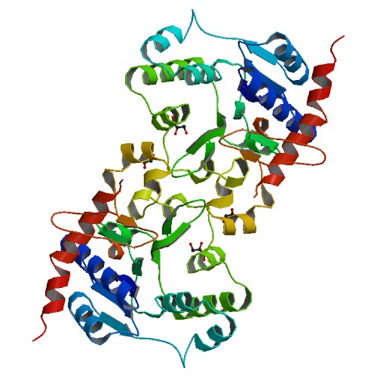
Glycogenin
Small protein that acts as a glycogen synthase primer
It achieves this by catalyzing the addition of glucose to itself at Tyr-194.
Once sufficient residues have been added, glycogen synthase takes over extending the chain.
Glycogenin remains covalently attached to the reducing end of the glycogen molecule.
Image from Mikael Häggström
Notes:
In a previous slide, we mentioned that GS requires a glycogen primer of 4 – 6 glucose residues to begin adding new residues to. This primer is provided by the small docking protein, Glycogenin. This protein is a homodimer that self-catalyzes glycosylation at amino acid Tyr-194. In this reaction the –OH group of Tyr mediates nucleophilic attack on the anomeric carbon of UDP-glucose. Thus, glycogenin is tethered to the reducing end of the glycogen molecule.

Slide 9
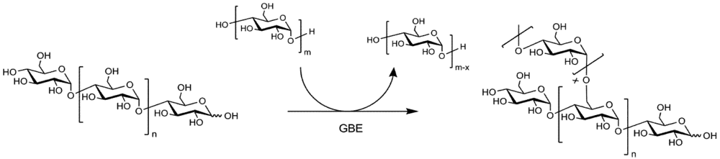
Glycogen Branching Enzyme
The Glycogen Branching Enzyme (GBE) will clip a portion of glucose residues linked together by α1→4 glycosidic bonds, and attach the fragment to the 6 position of the growing glycogen chain
This occurs about every 12 – 15 residues
Glycogen Synthase continues to extend the branch with α1 →4 residues
Notes:
The final enzyme, the glycogen branching enzyme (GBE), catalyses the hydrolytic cleavage of an α(1→4) glycosidic linkage and subsequent inter- or intra-chain transfer of the non-reducing terminal fragment to the C6 hydroxyl position of an α-glucan (see the figure above). In this example an inter-chain transfer is occurring. At the top of the scheme, above the arrow, you can see that the GBE enzyme transiently removes X-number of glucose residues (usually around 7) from one linear glycogen chain and then attaches it as an alpha 1→6 branch to the other chain. In this process an additional non-reducing end is created which can act as primer site for Glycogen Phosphorylase (the main enzyme that breaks down glycogen). Thus, glucose residues can be released very quickly when needed.

Slide 10
Summary of Glycogenesis
1.
Glucose
4.
3.
UDP-Glucose
Pyrophosphorylase
Glucose
1-PO₄³⁻
Glucose
Hexokinase
P
UDP
P
2.
Glucose
6-PO₄³⁻
Phosphoglucomutase
Notes:
Overall, a summary of glycogenesis begins when glucose enters the cell through the GLUT4 transporter (or similar family member). Hexokinase phosphorylates the glucose and traps it in the cell. Phosphoglucomutase then converts glucose 6-phosphate into glucose 1-phosphate. This substrate is utilized by UDP-glucose pyrophosphorylase to generate UDP-glucose.

Slide 11
Summary of Glycogenesis
6.
Glucose
Glucose
UDP
(n)
+
+
5.
UDP
(n)
Notes:
Glycogen synthase (GS) uses UDP-glucose as a glucose donor to extend the alpha 1→4 chain of glycogen with more glucosyl residues. Note that a primer of at least 4 glucose residues must be attached to glycogenin to serve as a substrate for GS.

Slide 12
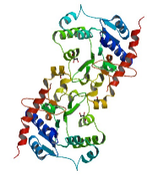
Summary of Glycogenesis
7.
Notes:
Finally, the branching enzyme transfers chains of alpha 1→4 glucose residues (~7) to the same or to a different glycogen residue to create an alpha 1→6 linkage. This occurs approximately every 12 to 16 residues.

