Slide 1
Glycogen Biosynthesis and Metabolism – Part 3
Glucagon Signaling in the Liver
Notes:
Welcome to part 3 in our lecture series about Glycogen Biosynthesis and Metabolism. In the previous sections, we’ve discussed insulin signaling and the process of building glycogen (glycogenesis) in detail. Now let’s take a look at the other side of the homeostatic balance….glucagon signaling.

Slide 2
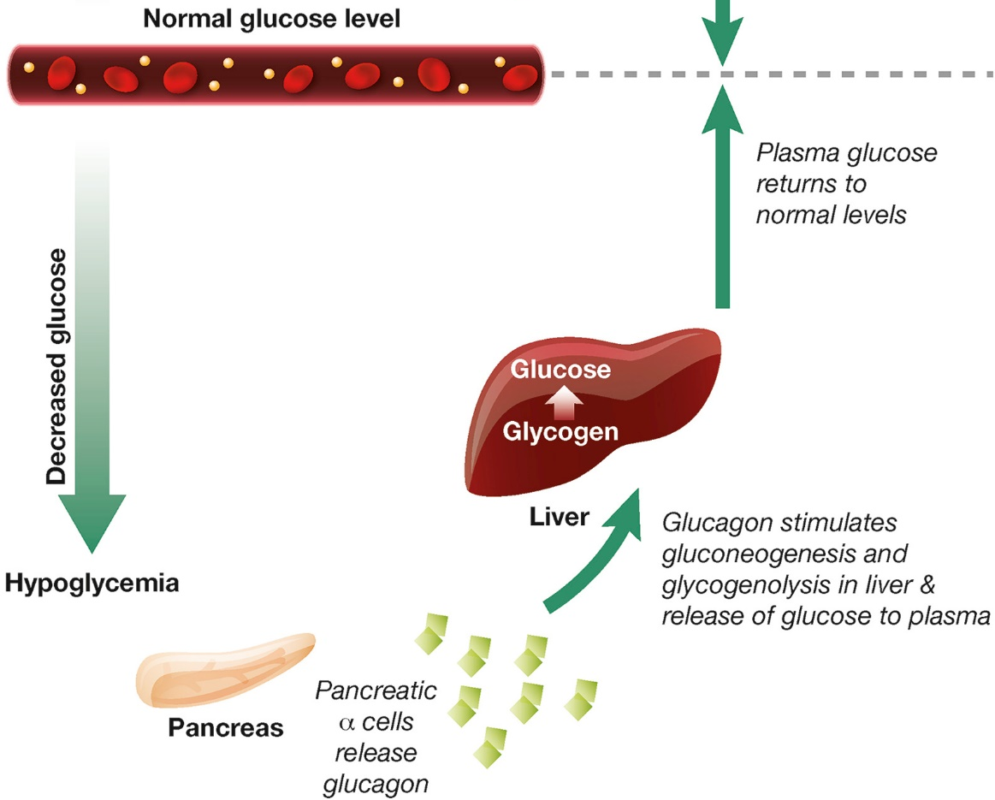
Image from Hædersdal, S., et al (2018) Mayo Clinic Proceedings 93(2):217-239
Notes:
During hypoglycemia (or low blood glucose levels), pancreatic alpha (α) cells release the hormone peptide, glucagon, which stimulates gluconeogenesis (the formation of glucose) and glycogenolysis (the breakdown of glycogen) in the liver, resulting in the release of glucose to the plasma, and the raising of blood glucose levels.

Slide 3
Glucagon Signaling
Primary target sites:
  Liver – Purpose to release glucose into the bloodstream
    Downregulates Glycogenesis
    Downregulates Glycolysis (breakdown of glucose/hexoses to make energy)
    Upregulates Glycogenolysis (breakdown of glycogen into glucose monomers)
    Upregulates Gluconeogenesis (biosynthesis of glucose from organic precursors)
    Upregulates Lipolysis and Ketogenesis
  Adipose Tissue (in rats, but maybe not in humans??)
    Fatty Acid release
Notes:
Let’s review a few terms before we begin. In the last section we were introduced to glycogenesis, or the synthesis of glycogen. We saw that this pathway was activated during insulin signaling. In glucagon signaling, this pathway is inhibited and the opposite pathway, glycogenolysis (glycogen breakdown) is activated. Glucagon signaling in the liver also downregulates glycolysis (the utilization of glucose for energy production), as the liver is trying to use glucose to maintain blood glucose levels. It doesn’t utilize it for its own energy needs during this time. Instead, lipids can be used by liver cells to generate ATP energy, and in fact, glucagon signaling increases Lipolysis or the breakdown of lipids. Finally, glucagon also upregulates the process of gluconeogenesis or the generation of glucose from non-sugar metabolites. We will address the mechanisms of glycolysis and gluconeogenesis in a later chapter. Here we will only take a cursory look at these pathways, and will focus more on the process of glycogenolysis.

Slide 4

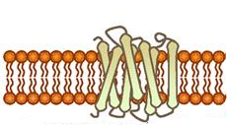

Glucagon Signaling in Liver Cells
Glucagon Hormone
Glucagon Receptor (7TM)
GDP
GTP
Figure modified from Yan, A., et al (2016) In J Biol Sci 12(12):1544-1554 and Truthortruth
Notes:
Glucagon signaling begins when the hormone binds with its receptor on liver cells. (click) Glucagon receptors are not widespread within the body, like insulin receptors have evolved. Since the purpose of this hormone is to cause the release of glucose back into the blood stream, this process is highly controlled and only the liver can deliver glucose back into the blood stream to maintain homeostasis. Thus, other target tissues such as skeletal muscle do not need to have these receptors expressed and are not sensitive to glucagon signaling.

Slide 5
Glucagon Signaling in Liver Cells
7TM = G-protein coupled receptor (GPCR)
GDP
γ
β
α
G-protein
GTP
Figure modified from Yan, A., et al (2016) In J Biol Sci 12(12):1544-1554 and Truthortruth
Notes:
The glucagon receptor is a G-protein-coupled receptor and is also referred to as a 7TM receptor (as it contains 7 transmembrane domains that span the plasma membrane). This family of receptors is widespread throughout the body and responsible for many of the pharmaceutical mechanisms of action seen in our treatment of different disease conditions. With regards to this pathway, once glucagon binds to the receptor, the receptor moves laterally in the plasma membrane and binds with a G-protein that is stationed as a peripheral protein to the plasma membrane. (click) The G-protein contains three major domains, the alpha, the beta, and the gamma domain. The alpha domain is capable of binding to the GDP/GTP cofactor. When the G-protein is inactive, all three subunits stay together and the alpha subunit remains inactive and bound to GDP.

Slide 6
Glucagon Signaling in Liver Cells
7TM = G-protein coupled receptor (GPCR)
GDP
GTP
Figure modified from Yan, A., et al (2016) In J Biol Sci 12(12):1544-1554 and Truthortruth

Slide 7
Glucagon Signaling in Liver Cells
GTP
GDP
Figure modified from Yan, A., et al (2016) In J Biol Sci 12(12):1544-1554 and Truthortruth
Notes:
When the G-protein associates with an activated receptor, the alpha subunit exchanges GTP for the bound GDP cofactor and the gamma and beta subunits dissocate

Slide 8
Glucagon Signaling in Liver Cells
Adenylyl Cyclase
GTP
GDP
ATP
Figure modified from Yan, A., et al (2016) In J Biol Sci 12(12):1544-1554 and Truthortruth
Notes:
The activated alpha subunit moves laterally on the periphery of the plasma membrane until it contacts the adenylyl cyclase enzyme (also called adenylate cyclase)

Slide 9
Glucagon Signaling in Liver Cells
Adenylyl Cyclase
GTP
ATP
GDP
Figure modified from Yan, A., et al (2016) In J Biol Sci 12(12):1544-1554 and Truthortruth
Notes:
This activates the adenylyl cyclase that converts ATP into cyclic AMP (cAMP)

Slide 10
Glucagon Signaling in Liver Cells
Adenylyl Cyclase
cAMP
cAMP
GDP
cAMP
GTP
cAMP
Figure modified from Yan, A., et al (2016) In J Biol Sci 12(12):1544-1554 and Truthortruth
Notes:
cAMP production is an amplification step within this pathway. That means that more cAMP is produced that G-proteins are activated. After a period of time, a G-protein hydrolase will cause the hydrolysis of the GTP to GDP and inactivate the G-protein.

Slide 11
Glucagon Signaling in Liver Cells
GDP
cAMP
cAMP
cAMP
cAMP
Figure modified from Yan, A., et al (2016) In J Biol Sci 12(12):1544-1554 and Truthortruth
Notes:
At this point, the G-protein will associate with the gamma and beta subunits reforming its inactive state. Another glucagon signaling event will be required to reactivate the process. The cyclic AMP produced in the process serves as a second messenger in the process and activates a myriad of downstream targets. We will focus on two targets.

Slide 12
Glucagon Signaling in Liver Cells
GDP
cAMP
Protein Kinase A
(PKA)
cAMP
Figure modified from Yan, A., et al (2016) In J Biol Sci 12(12):1544-1554 and Truthortruth
Notes:
The first is Protein Kinase A, it becomes activated upon binding with cAMP

Slide 13
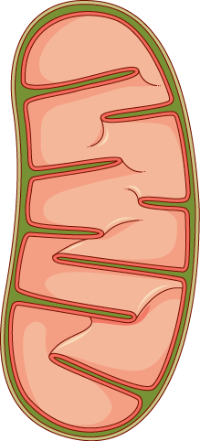

Glucagon Signaling in Liver Cells
GDP
cAMP
PKA
Protein Kinase A
(PKA)
Nucleus
cAMP
CREB
Figure modified from Yan, A., et al (2016) In J Biol Sci 12(12):1544-1554 and Servier Medical Art
Mitochondria
Notes:
The second is target is a cAMP Response Element-Binding Protein (CREB).

Slide 14
Glucagon Signaling in Liver Cells
GDP
cAMP
PKA
Protein Kinase A
(PKA)
Nucleus
cAMP
cAMP
CREB
Figure modified from Yan, A., et al (2016) In J Biol Sci 12(12):1544-1554 and Servier Medical Art
Mitochondria
Notes:
The CREB protein is also activated when bound to the cAMP molecule. This causes the CREB protein to translocate from the cytosol into the mitochondria and into the nucleus.

Slide 15
Glucagon Signaling in Liver Cells
GDP
cAMP
PKA
Protein Kinase A
(PKA)
Nucleus
Upregulation of Genes
Involved in Gluconeogenesis
cAMP
cAMP
CREB
Figure modified from Yan, A., et al (2016) In J Biol Sci 12(12):1544-1554 and Servier Medical Art
Mitochondria
Notes:
In both of these locations, the activated CREB binds to specific response element sequences in the DNA and activates the transcription of genes that are involved in gluconeogenesis. We will discuss these genes and their encoded proteins in more detail in a later chapter. What is important to note now, is that glucagon signaling in the liver results in the upregulation of glucose production de novo from non-carbohydrate precursors. This is NOT a favored pathway in the body. It is expensive energetically for the liver to manufacture glucose. In fact, more expensive in the cost of ATP than can be produced from the newly formed molecule. However, organs like the brain can only utilize free glucose as an energy resource. Thus, the liver will engage in this energy deficit to build glucose for use by the brain and other cellular targets. The liver is quite a selfless organ.

Slide 16
Glucagon Signaling in Liver Cells
GDP
cAMP
PKA
Protein Kinase A
(PKA)
Glycolysis
Glycogenesis
Glycogenolysis
Figure modified from Yan, A., et al (2016) In J Biol Sci 12(12):1544-1554 and Servier Medical Art
Notes:
Glucagon signaling also leads to the downregulation of glycolysis (which we will cover later) and glycogenesis (which we will cover now!) It also leads to an increase in glycogenolysis, or the breakdown of glycogen (which we will also look at in more depth).

Slide 17
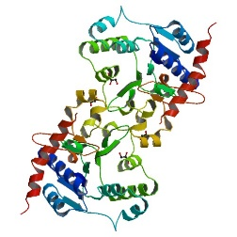
Downregulation of Glycogenesis
GDP
cAMP
PKA
Glycogen
Synthase
P
Glycogen
Synthase
P
INACTIVE
ACTIVE
PP1
Glycogen
Figure modified from Yan, A., et al (2016) In J Biol Sci 12(12):1544-1554 and Servier Medical Art
Notes:
As seen in the previous section, glycogen synthase (GS) is the primary enzyme regulated in the biosynthesis of glycogen. And GS is active in the dephosphorylated state. Thus, one actions of PKA is to phosphorylate the GS enzyme causing it to shift into its inactive conformation and blocking glycogenesis

Slide 18
Downregulation of Glycogenesis
GDP
Glycogen
Synthase
P
Glycogen
Synthase
P
INACTIVE
ACTIVE
PP1
Glycogen
INACTIVE
cAMP
P
PP1
PKA
P
Figure modified from Yan, A., et al (2016) In J Biol Sci 12(12):1544-1554 and Servier Medical Art
Notes:
In addition, activated PKA also phosphorylates the protein phosphatase 1 enzyme leading to the inactivation of the phosphatase. This helps to maintain the GS in the phosphorylated, inactive state.

Slide 19
Inhibition of Protein Phosphatase Type 1
Glycogen
PP1
ATP
ADP
cAMP
PKA
Glycogen
P
P
LESS ACTIVE
I
PP1
ATP
ADP
P
INACTIVE
I
PP1
P
Notes:
The inhibition of PP1, is a little bit more complicated than indicated on the previous slide. PP1 contains a regulatory domain and a catalytic domain. Normally the regulatory domain of PP1 binds with glycogen, keeping the molecule close to the location where GS will be present. Thus, when GS is near its substrate in can also bind with PP1 and be dephosphorylated into its active state. This is more efficient that having to diffuse around the cell trying to find the PP1 randomly. When PKA phosphorylates the regulatory domain of PP1, it dissociates from the catalytic domain, causing the catalytic domain to float away from the glycogen molecule. This makes PP1 less efficient at dephosphorylating GS because it is harder for the molecules to randomly come into contact with one another. Thus, PP1 is less active. PKA reduces this activity even further, by phosphorylating an allosteric inhibitor (I) of PP1. In the phosphorylated state, I can bind to PP1 fully inactivating the phosphatase. Both phosphorylation events need to be reversed to regain full PP1 activity.

Slide 20
Downregulation of Glycogenesis
Protein Kinase A (PKA) phosphorylates:
Glycogen Synthase and downregulates its activity
Protein Phosphatase Type 1, causing the catalytic domain to dissociate from the regulatory domain = less active PP1
An inhibitor of PP1 that binds to the catalytic domain that enables the binding of the inhibitor to the catalytic domain of PP1, effectively inhibiting activity of this phosphatase
Notes:
In summary, glucagon signaling in the liver downregulated glycogenesis through the activation of PKA. PKA phosphorylated GS directly, inactivating the enzyme, and maintains it in the inactive state by also inhibiting the PP1 responsible for dephosphorylating GS.

