Slide 1
Glycogen Biosynthesis and Metabolism – Part 5
Regulation of Glycogenolysis
Notes:
Welcome back to part 5 of Glycogen Biosynthesis and Metabolism. Today we will focus on the regulation of glycogenolysis in response to glucagon and epinephrine signaling.

Slide 2
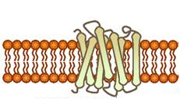

Regulation of Glycogenolysis in Liver Cells
GDP
cAMP
PKA
Protein Kinase A
(PKA)
Glycolysis
Glycogenesis
Glycogenolysis
Figure modified from Yan, A., et al (2016) In J Biol Sci 12(12):1544-1554 and Servier Medical Art
Notes:
In this section, we will discuss the regulation of glycogenolysis and the ways in which regulation in the liver and in skeletal muscle differ.

Slide 3
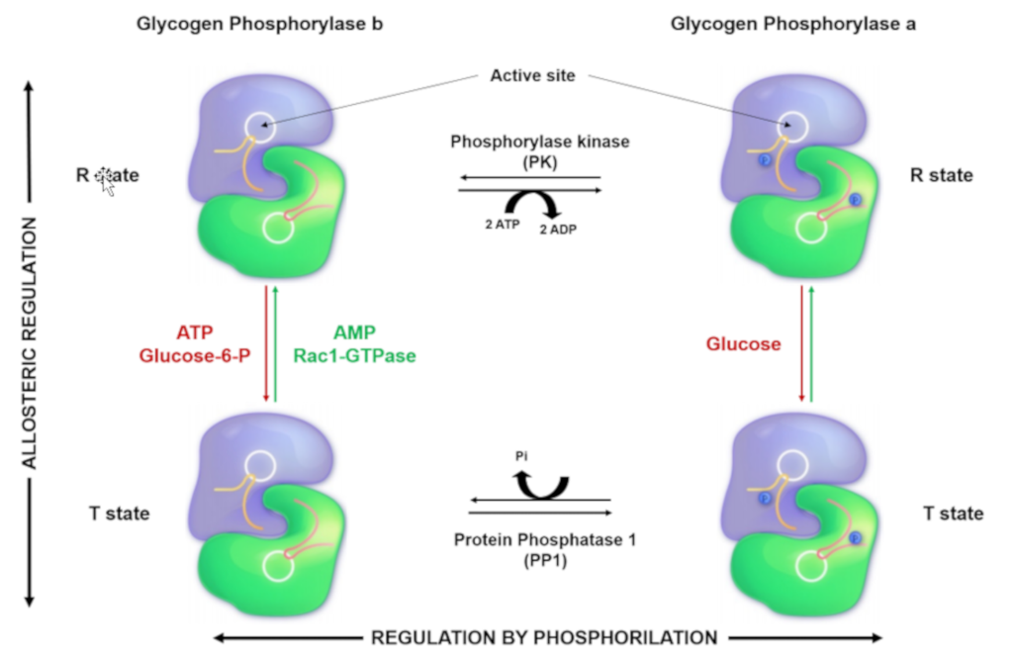
Glucagon Signaling in Liver Cells
GDP
cAMP
PKA
P
Phosphorylase
Kinase
P
Phosphorylase
Kinase
P
P
P
P
Glycogen Phosphorylase
Glycogen Phosphorylase
(more active)
Figure modified from Yan, A., et al (2016) In J Biol Sci 12(12):1544-1554 and
Llavero, F., et al (2019) Int. J. Mol. Sci. 20(23):5919
Notes:
Recall that glucagon stimulation activates protein kinase A (PKA) through the Adenylate Cyclase signaling pathway. This in turn phosphorylates Phosphorylase Kinase, which is upstream of Glycogen Phosphorylase. The subsequent phosphorylation of Glycogen Phosphorylase leads to increased activity of the protein and the breakdown of glycogen. In the next few slides we will focus on the activities of the phosphorylase kinase.

Slide 4
Phosphorylase Kinase
Is a Tetramer that is regulated by phosphorylation by PKA and by binding with Ca²⁺
Calcium can be released in cellular targets due to nerve impulses, muscle contraction, or through hormone signaling.
Maximal activity is achieved when both phosphorylation and Ca²⁺ are present
Notes:
The phosphorylase kinase enzyme is a heterotetramer that is primarily regulated by phosphorylation through the PKA pathway as shown in the previous slide. However, this enzyme is also regulated by the allosteric binding of calcium ions. Calcium may be present within cellular targets due to nerve impulse firing, muscle contraction, or through hormone signaling. The presence of calcium in the cell generally indicates that there is high energy demand on the cell at that time, and that energy production is needed. Thus, calcium binding to the phosphorylase kinase is a positive effector of the enzyme and upregulates activity. Maximal activity of the enzyme is achieved through combined phosphorylation and calcium binding. Thus, phosphorylase kinase can exist in 4 different states of activity as shown in the next slide.

Slide 5
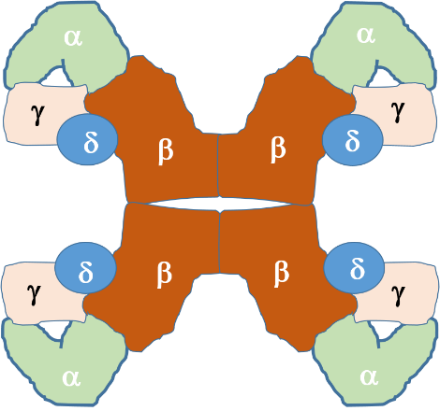
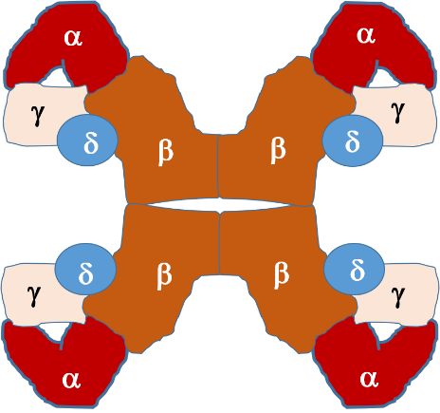
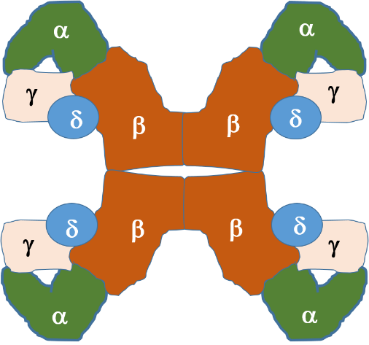
Phosphorylase Kinase
Partially Active
ADP
P
P
Ca²⁺
ATP
P
P
ATP
ADP
Ca²⁺
P
P
Ca²⁺
Ca²⁺
Ca²⁺
P
P
Ca²⁺
Inactive
Ca²⁺
Ca²⁺
ADP
Fully Active
Ca²⁺
Ca²⁺
Ca²⁺
ATP
Partially Active
Notes:
In the left hand diagram, phosphorylase kinase (PK) is in the inactive state, with the kinase-containing alpha domains shown in red. The upper diagram shows the activation of PK through phosphorylation by Protein Kinase A during hormone signaling. This leads to a partially active enzyme. Similarly, calcium binding, shown in the lower diagram, also results in a partially active enzyme. Calcium plays a particularly important role in the activation of this enzyme in skeletal muscle. The process of muscle contraction causes the release of high levels of calcium into the cytoplasm. Thus, the presence of calcium within the cytoplasm of muscle cells indicates high energy demand, as the muscle is being called into action. This activates PK and stimulates the breakdown of glycogen within muscle tissue to help meet energy demands. Maximal activity is obtained with both calcium binding and phosphorylation.

Slide 6
Regulation of Glycogenolysis is different in Liver and Skeletal Muscle (other tissues)
Activated by different hormones
  Liver activated by both Glucagon and Epinephrine
  Skeletal Muscle activated by Epinephrine
Have different Isozymes of Glycogen Phosphorylase
Image modified from Ascherer730
Notes:
Overall, the regulation of glycogenolysis in liver and skeletal muscle differs. First, the G-protein coupled pathway is activated by different hormones. Liver tissue is responsive to Glucagon stimulation, as well as stimulation through the Epinephrine hormone signaling pathway. Glycogenolysis in skeletal muscle tissue, on the other hand, is only activated by the Epinephrine signaling pathway, but not by glucagon. This is because the liver is the only organ responsible for regulating blood glucose levels. Thus, pancreatic signaling due to low blood glucose levels only targets glycogenolysis within the liver tissue. Both systems are responsive to Epinephrine, which is described in more detail in the next two slides.

Slide 7
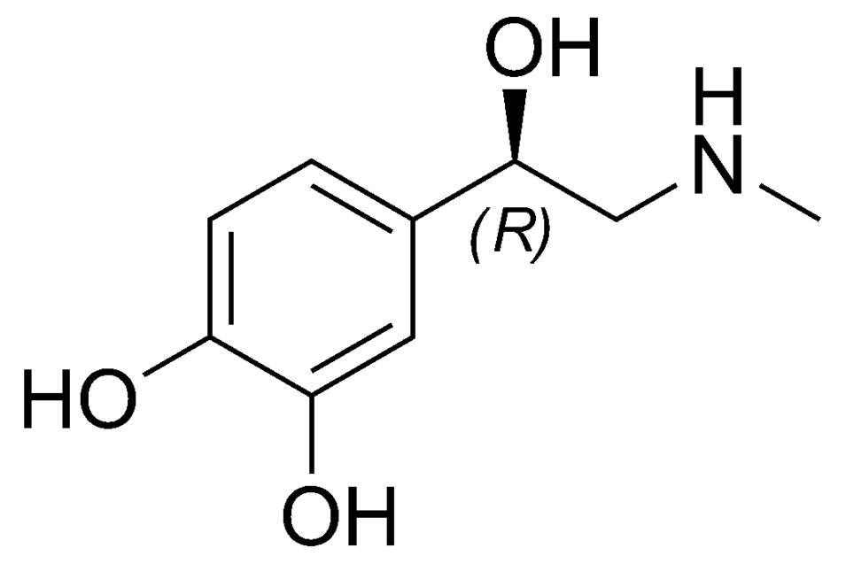

Epinephrine
Also called Adrenaline
Secreted during flight or fight response or during strenuous exercise
Pleiotropic Physiological Responses
  Increases glycogenolysis in liver and skeletal muscle
  Increases lipidolysis in adipose tissue
  Relaxation of smooth muscles in lungs and respiratory track
  Increase in cardiac contractility
  Constrict blood flow to the skin
  Contract smooth muscles of skin (hair raises/goosebumps)
Notes:
Epinephrine is a small amino acid-derived hormone (can you guess the amino acid?? Yes it is Tyrosine!!). It is also called adrenaline, as it is secreted from the adrenal glands located just above the kidneys, during the flight or fight response. It is also secreted during heavy or sustained exercise. Epinephrine has pleiotropic responses in the body, which include the activation of glycogenolysis in the liver and skeletal muscles. Epinephrine also promotes fat breakdown in adipose tissue, which releases this energy reserve into the blood stream for utilization by muscle tissue. It also causes the relaxation of smooth muscles in the lungs and respiratory track enabling better oxygen absorption. Cardiac contractility is also increased to increase blood flow to skeletal muscles. This supports the generation of ATP from glucose and fatty acids for sustained muscle utilization. It also reduces blood flow to the skin and causes the contraction of smooth muscles in the skin causing goosebumps.

Slide 8
Comparison of Glucagon and Epinephrine Signaling in Liver and Skeletal Muscle
Glucagon
Epinephrine
Glucagon Receptor
(G-protein coupled receptor)
Epinephrine Receptor
(G-protein coupled receptor)
G-protein
Adenylate Cyclase
PKA
Pleiotropic Effects
Notes:
Within the liver and skeletal muscle, the epinephrine signaling pathway overlaps with the glucagon signaling pathway seen in the liver. The epinephrine receptor is also a G-protein coupled receptor related to the glucagon receptor. However, it is specific for epinephrine and cannot bind with glucagon. It does activate the same G-protein pathway leading to Protein Kinase A activation. The body is very efficient at reusing machinery in different parts of the body, in this case, it does so under different regulatory parameters.

Slide 9
Regulation of Glycogenolysis is different in Liver and Skeletal Muscle (other tissues)
Activated by different hormones
  Liver activated by both Glucagon and Epinephrine
  Skeletal Muscle activated by Epinephrine
Have different Isozymes of Glycogen Phosphorylase that are regulated by a combination of:
  Allosteric Effectors
  Reversible Phosphorylation
Image modified from Ascherer730
Notes:
The Glycogen Phosphoyrlase enzymes are also encoded by different genes within the Liver and Skeletal Muscle. These are known as ISOZYMES. Isozymes have the same biological function, but since they are expressed from different genes, they have different enzyme kinetics and they are regulated in different and unique ways within each tissue.

Slide 10
Glycogen Phosphorylase (Both Isozymes)
Glycogen Phosphorylase exists in two major conformations:
a-form (phosphorylated)
b-form (dephosphorylated)
The state of the protein can also be either Relaxed (more flexible) or Tense (less flexible).
The Relaxed (R-state) is active and is favored by the a-form The Tense (T-state) is inactive and is favored by the b-form
Image modified from Ascherer730
Notes:
The liver and skeletal muscle forms of Glycogen Phosphorylase share approximately 90% sequence identity. Both isozymes can exist in two major conformations, the a-form and the b-form. The protein adopts the a-form when it is phosphorylated at a serine residue by phosphorylase kinase. The Glycogen Phosphorylase enzyme can also be in two different states, the relaxed, flexible state which is the active form of the enzyme, and the tense or rigid state that is inactive. When the protein is in the a-conformation, it favors the relaxed and active state of the protein. Therefore, phosphorylation of Glycogen Phosphorylase leads to an increase in the activity of the enzyme. This is depicted in the following diagram.

Slide 11
Glycogen Phosphorylase Enzymes
b-form
a-form
R-state
(active)
P
P
T-state
(inactive)
P
P
Image modified from Llavero, F., et al (2019) Int. J. Mol. Sci. 20(23):5919
Notes:
As shown here, both isozymes of Glycogen Phosphorylase are responsive to phosphorylation by phosphorylase kinase. Phorsphorylation of Glycogen Phosphorylase causes it to shift from the b-form to the a-form of the protein. The a-form of the protein favors the relaxed, active state of the protein, whereas the b-form of the protein favors the tense and inactive state of the protein.

Slide 12
Glycogen Phosphorylase
ISOZYMES are also regulated by Allosteric Effectors
Liver
Glucose is a negative regulator
Skeletal Muscle
Glucose 6-phosphate is a negative regulator
ATP is a negative regulator
AMP is a positive regulator
Image modified from Ascherer730
Notes:
The different isozymes of the Glycogen Phosphorylase enzyme are also regulated by different, tissue-specific allosteric effectors. Within the liver, glucose is a negative regulator of Glycogen Phosporylase, which makes sense, as the role of this pathway in liver tissue is to promote the release of glucose into the blood stream. The presence of free glucose in the cytoplasm of the liver, would indicate either the fed-state when blood glucose levels are high, or that high levels of glycogenolysis have released substantial glucose. Within liver tissue, the presence of free glucose will cause the a-form of Glycogen Phosphorylase to shift to the Tense state, reducing the activity of the enzyme. This is shown in the following diagram.

Slide 13
Liver Glycogen Phosphorylase
a-form
Glucose
R-state
(active)
P
P
Glucose blocks the activity of Liver Glycogen Phosphorylase, even in the presence of phosphyrlation!
T-state
(inactive)
P
P
Image modified from Llavero, F., et al (2019) Int. J. Mol. Sci. 20(23):5919
Notes:
As shown here, when the liver isoform of Glycogen Phosphorylase is in the a-form (phosphorylated). It can be shifted into the Tense state in the presence of high levels of free glucose. This blocks the glycogen binding site of the enzyme, essentially serving as a competitive inhibitor of the enzyme

Slide 14
Glycogen Phosphorylase
ISOZYMES are also regulated by Allosteric Effectors
Liver
Glucose is a negative regulator
Skeletal Muscle
Glucose 6-phosphate is a negative regulator
ATP is a negative regulator
AMP is a positive regulator
Image modified from Ascherer730
Notes:
Skeletal muscle glycogen phosphorylase (or Myophosphorylase, as it is sometimes called), is more responsive to allosteric effectors that indicate the energy state of the cell. This makes sense, as the main purpose of glycogen breakdown in muscle tissue is to fuel the energy demand for the muscle tissue. Thus, the energy housed in glucose will be used to produce ATP within these cells. The presence of either Glucose 6-phosphate or ATP within skeletal muscle indicates high levels of energy are present. Thus, glycogen breakdown will be inhibited. The presence of AMP, on the other hand, indicates a low energy state and is an activator of Glycogen Phosphorylase. This is shown in the following set of diagrams.

Slide 15
Glycogen Phosphorylase
P
Glucose
6-phosphate
b-form
a-form
P
P
R-state
(active)
P
P
P
P
NEGATIVE
REGULATOR
P
P
T-state
(inactive)
P
P
P
P
Image modified from Llavero, F., et al (2019) Int. J. Mol. Sci. 20(23):5919
Notes:
As shown here, Muscle Glycogen Phosphorylase is negatively regulated by the presence of high levels of Glucose 6-phosphate. Regardless of form (a or b) the enzyme is shifted into the Tense state.

Slide 16
Glycogen Phosphorylase
P
P
P
ATP
b-form
a-form
P
P
P
P
P
P
R-state
(active)
P
P
P
P
P
P
P
P
NEGATIVE
REGULATOR
P
P
P
P
P
P
T-state
(inactive)
P
P
P
P
P
P
P
P
Image modified from Llavero, F., et al (2019) Int. J. Mol. Sci. 20(23):5919
Notes:
A similar phenomena occurs in the presence of high levels of ATP. Again showing the inhibition of the enzyme in the presence of high levels of energy.

Slide 17
Glycogen Phosphorylase
P
AMP
b-form
a-form
P
P
R-state
(active)
P
P
P
P
POSITIVE
REGULATOR
P
P
T-state
(inactive)
P
P
P
P
Image modified from Llavero, F., et al (2019) Int. J. Mol. Sci. 20(23):5919
Notes:
However, in the presence of low energy indicators, such as AMP, the glycogen phosphorylase enzyme is activated, even in the absence of phosphorylation. Thus, when AMP is bound, the b-form of glycogen phosphorylase is converted into the relaxed and active state.

Slide 18
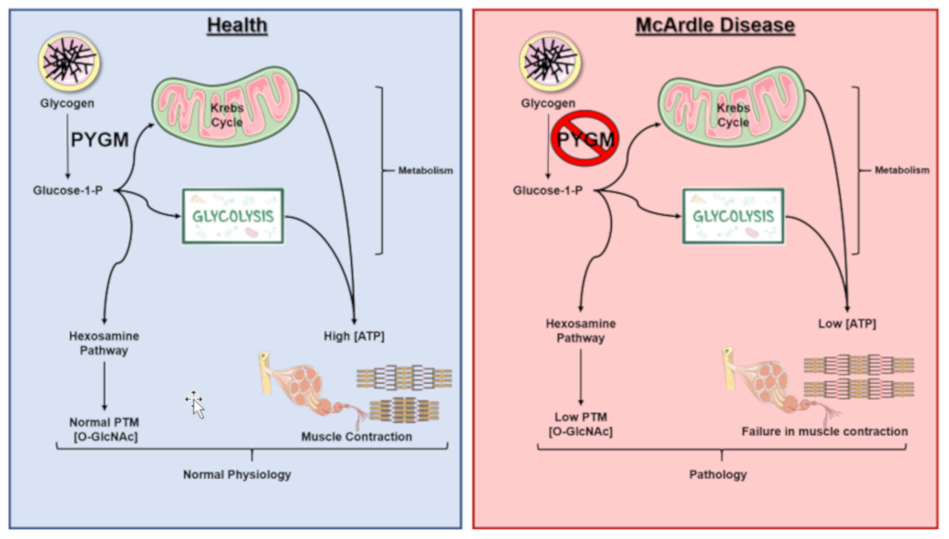
McArdle’s Disease
Image from Llavero, F., et al (2019) Int. J. Mol. Sci. 20(23):5919
Notes:
McArdle disease, also referred to as myophosphorylase deficiency or type V glycogen storage disease, is a recessive inherited disorder characterized by an inability to metabolize glycogen due to the absence of a functional myophosphorylase (PYGM). The normal functional pathway is shown in blue, on the left, while the mutant pathway is shown on the right in red. Patients with this disease lack sufficient glucose-1-phosphate (G1P) monomers needed for glycolysis and the hexosamine biosynthetic pathway (HBP). This results in lower ATP and, consequently, lower muscle contraction, as well as in lower post-translational modifications by O-GlcNAcylation in comparison to normal conditions. This is especially pronounced during extended or heavy workouts, where people with McArdle’s Disease will sustain painful cramping of their muscle tissue during workouts, can have dark red/brown urine, and can easily tire during activity. Some patients also note a second wind phenomena occur during workouts as the body shifts from carbohydrates to lipids as a primary energy source. The dark red/brown color in the urine happens if muscle tissue is damaged during the workout. The damaged muscle releases the protein myoglobin into the bloodstream. This is filtered out by the kidneys and excreted in the urine, causing the color change. Severe uncontrolled disease can cause life threating kidney problems.

Slide 19
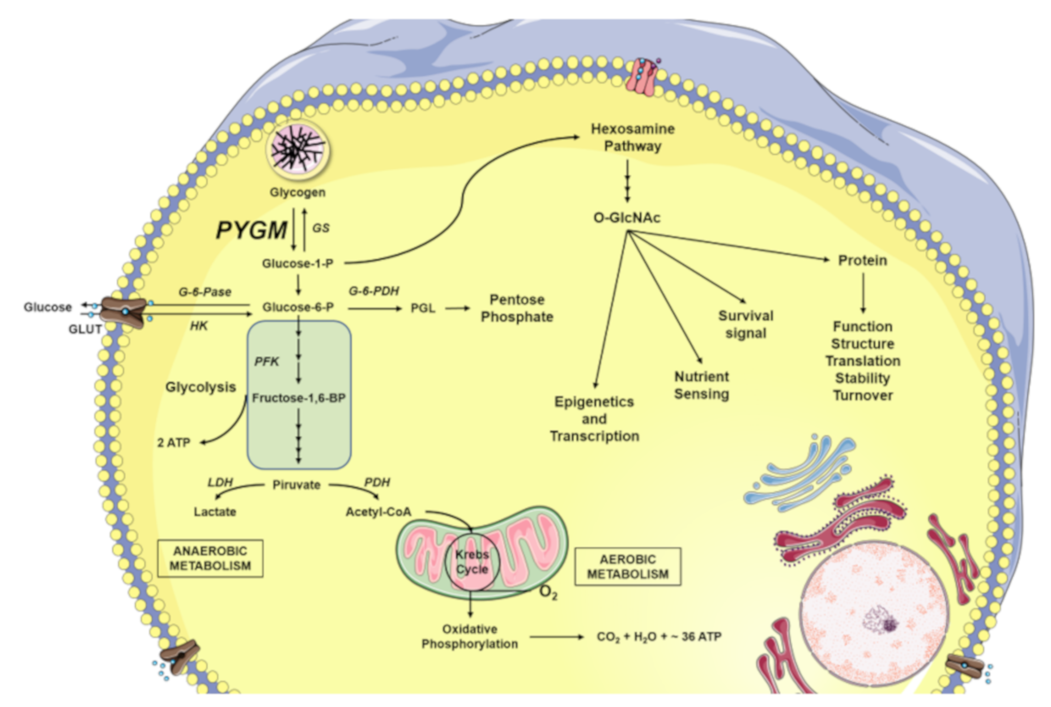
Summary of Glucose Metabolism in Muscle
Image from Llavero, F., et al (2019) Int. J. Mol. Sci. 20(23):5919
Notes:
Here is a summary of glucose metabolism in muscle and other tissues. Both glucose-1-phosphate (G1P) released from the intracellular glycogen stores by glycogen phosphorylase (GP), as well as the glucose introduced into the cell through glucose transporters (GLUT) are converted to glucose-6-phosphate (G6P) by phosphoglucomutase (PGM) and hexokinase (HK), respectively. The G6P can be directed to different destinations. One of them is the pentose phosphate pathway for the formation of nucleic acid building blocks (ribose and deoxyribose). Another destination is in the formation of energy (ATP). Here G6P enters the metabolic pathway of glycolysis. The glycolytic reactions will culminate in the production of pyruvate and adenosine triphosphate (ATP). Pyruvate can be fermented in lactate by the catalysis of the lactate dehydrogenase (LDH), as happens during anaerobic muscle exercise. On the other hand, pyruvate can be used to obtain ATP through full oxidation in the Kreb Cycle. In total, oxidative phosphorylation produces 36 molecules of ATP, 6 molecules of carbon dioxide (CO₂), and 6 molecules of water (H₂O) from 1 glucose molecule. Whereas, glycolysis alone, only produces two net ATP molecules per glucose. Glucose, moreover, in addition to being the fuel of the cell’s energy metabolism, is also used by the cellular machinery as a vitally important substrate for the production of key intermediaries of the hexosamine biosynthetic pathway (HBP) forming O-GlcNAc, β-linked N-acetylglucosamine . And finally, in times of plenty, glucose will by utilized by glycogen synthase (GS) to make glycogen.

