Slide 1
Glycolysis
Part 3 - Regulation of Phosphofructokinase-1
Notes:
Welcome to part 3 of our Glycolysis series. In this section, we will focus on one of the major regulatory steps in the glycolytic pathway, the conversion of fructose-6-phosphate to fructose-1,6-bisphosphate by the enzyme Phosphofructokinase-1.

Slide 2
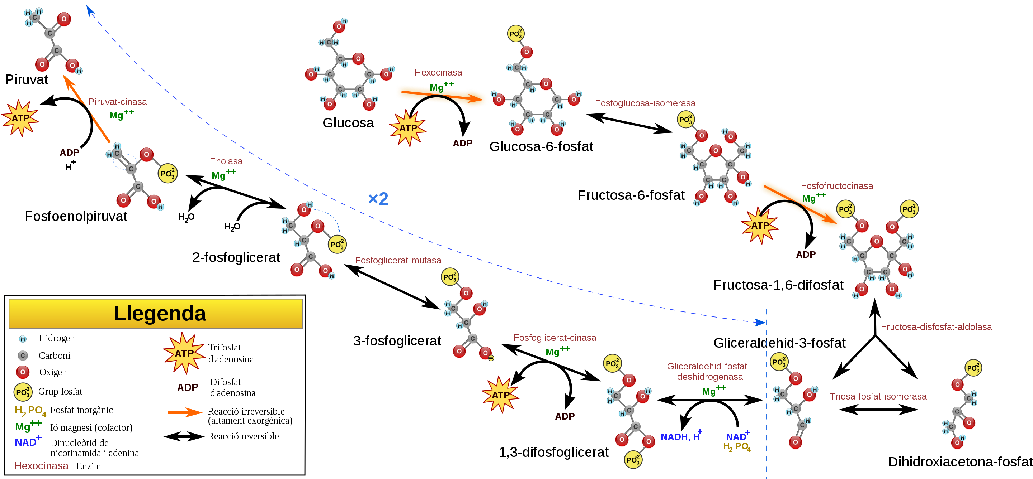




Glycolysis – Step 2
2
3
4
1
2
Fructose Bisposophate Aldolase
Phosphoglucose
Isomerase
Dihydroxyacetone
Phosphate
Hexokinase
Mg²⁺
Phosphoglucose Isomerase
Phosphofructo-
kinase
Mg²⁺
5
Triose Phosphate Isomerase
Glucose
Glucose-6-phosphate
Fructose-6-phosphate
Fructose-1,6-bisphosphate
Glyceraldehyde 3-phosphate
Glucose-6-phosphate
Fructose-6-phosphate
Figure modified from YassineMrabet
Notes:
We have already covered the reaction mechanism of the phosphoglucose isomerase enzyme in an earlier lecture on carbohydrate structure. Please refer back to this video tutorial for details about the isomerase mechanism.

Slide 3
Glycolysis – Step 3
3
3
4
1
2
Fructose Bisposophate Aldolase
Phosphofructo-
kinase
Mg²⁺
Dihydroxyacetone
Phosphate
Hexokinase
Mg²⁺
Phosphoglucose Isomerase
Phosphofructokinase-1
Mg²⁺
5
Triose Phosphate Isomerase
Glucose
Glucose-6-phosphate
Fructose-6-phosphate
Fructose-1,6-bisphosphate
Fructose-
1,6-bisphosphate
Glyceraldehyde 3-phosphate
Fructose-6-phosphate
Figure modified from YassineMrabet
Notes:
In this section, we really want to focus on the third step in the glycolytic pathway, the conversion of fructose-6-phosphate to fructose-1,6-bisphosphate by the enzyme Phosphofructokinase-1 (PFK-1). It is interesting to note that ALL of the major enzymes regulated in glycolysis are kinases. The last lecture focused on the role of the hexokinase isozymes in regulating glycolysis in different tissues within the body. This lecture will focus on PFK-1, and our final lecture on glycolysis will cover the third major regulatory element in the glycolytic path, the metabolic step requiring the action of the pyruvate kinase. So there are three major regulatory elements for glycolysis: the Hexokinase step, the PFK-1 step, and the Pyruvate Kinase step.

Slide 4
Phosphofructokinase-1 (PFK-1)
First unique and irreversible reaction of glycolysis
Fructose-1,6-bisphosphate is committed to going through the glycolytic pathway
PFK-1 is the most important control component in the glycolytic pathway
Notes:
The PFK-1 reaction is the first irreversible reaction of glycolysis. It also represents the committed step within the pathway. The phosphorylation of fructose-6-phosphate (F6P) to fructose-1,6-bisphosphate (F1,6BP) commits the F1,6BP to continuing through the glycolytic pathway. It cannot be utilized for any other purpose at that point. F6P, on the other hand, could be converted back into glucose-6-phosphate and used form many different purposes (ie glycogen synthesis, nucleotide synthesis, or hexosamine synthesis). Because of the committed nature of this step, PFK-1 is one of the most important control points in the glycolytic pathway.

Slide 5
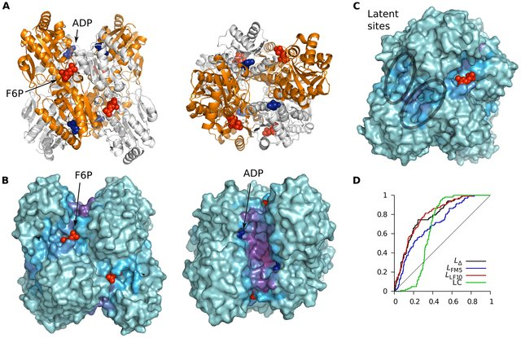
PFK-1 is an Allosteric Enzyme
Activators
ADP/AMP
Fructose-2,6-Bisphosphate
Inhibitors
ATP
Citrate
Figure modified from Mitternacht, S., and Berezovsky, I.N. (2011)
Notes:
The PFK-1 enzyme is composed of a tetramer that can contain different combinations of three types of subunits: muscle (M), liver (L), and platelet (P). The composition of the PFK1 tetramer differs according to the tissue type it is present in. For example, mature muscle expresses only the M isozyme, therefore, the muscle PFK1 is composed solely of homotetramers of M4. The liver and kidneys express predominantly the L isoform. In erythrocytes, both M and L subunits randomly tetramerize to form M4, L4 and the three hybrid forms of the enzyme (ML3, M2L2, M3L). As a result, the kinetic and regulatory properties of the various isoenzymes pools are dependent on subunit composition. Tissue-specific changes in PFK activity and isoenzymic content contribute significantly to the diversities of glycolytic and gluconeogenic rates which have been observed for different tissues
PFK1 is an allosteric enzyme and has a structure similar to that of hemoglobin in so far as it is a dimer of a dimer. One half of each dimer contains the ATP binding site, shown in dark blue, whereas the other half the substrate (fructose-6-phosphate or (F6P)) binding site, shown in red, as well as a separate allosteric binding site, that is occupied by ADP above. All isoforms of PFK-1 are activated by the allosteric binding of ADP or AMP. This indicates a low energy state within the cell and the need for glycolysis and energy generation. Allosteric inhibitors include high levels of ATP and Citrate. Note that ATP is a substrate of this enzyme and has the normal substrate binding site indicated in dark blue above. When there is enough ATP present that it can also bind allosterically to the enzyme, it will act as an inhibitor. Citrate (the first molecule in the the Kreb Cycle (Citric Acid Cycle), can also act as an allosteric inhibitor of PFK-1. High levels of citrate indicate high energy load within the cell and that no more pyruvate is needed to generate energy through oxidative phosphorylation. We are also going to see that Fructose 2,6-bisphosphate is predominantly a regulator of PFK-1 in Liver Cells, where it serves as an activator.

Slide 6
Opposing Pathways in the Liver
Glycolysis
Gluconeogenesis
(Breaking down glucose)
(Making new glucose)
glucose
Glycogenesis
Glycogenolysis
(Making new glycogen)
(breaking down glycogen)
Figure modified from Yan, A., et al (2016) In J Biol Sci 12(12):1544-1554 and Servier Medical Art
Notes:
But before we discuss the formation and use of Fructose 2,6-bisphosphate and its role in the regulation of PFK-1, let’s review opposing glucose utilization/production pathways within the liver. Two opposing pathways within the liver are glycolysis (the breakdown of glucose) and gluconeogenesis (the formation of glucose). It would be unproductive to have both of these pathways operating at the same time. Thus, if one pathway is needed, then the other one needs to be turned off. We previously saw this same type of control for glycogenesis (the formation of glycogen) and glycogenolysis (the breakdown of glycogen). When one of these pathways is upregulated, the other needs to be downregulated.

Slide 7
Opposing Pathways in the Liver
Resting State = Goldilocks Amount of Glucose
Glycolysis
Gluconeogenesis
X
(Breaking down glucose)
(Making new glucose)
glucose
Glycogenesis
Glycogenolysis
(Making new glycogen)
(breaking down glycogen)
Figure modified from Yan, A., et al (2016) In J Biol Sci 12(12):1544-1554 and Servier Medical Art
Notes:
In the resting state of the liver, when blood glucose levels are in the homeostatic range, gluconeogenesis will be shut off, as it is very expensive to make glucose and the liver will only invest in making glucose if blood glucose levels fall critically low (ie extreme exercise or long term fasting). In the resting state, the liver will use the glycolytic pathways to supply normal levels of ATP energy for the maintenance of housekeeping processes. Glycogenesis and glycogenolysis will be in balance or equilibrium as needed to augment the supply of glucose entering the system from the blood stream.

Slide 8
Opposing Pathways in the Liver
Glucagon Signaling
Glycolysis
Gluconeogenesis
X
(Breaking down glucose)
(Making new glucose)
Blood stream
X
glucose
Glycogenesis
Glycogenolysis
(Making new glycogen)
(breaking down glycogen)
Figure modified from Yan, A., et al (2016) In J Biol Sci 12(12):1544-1554 and Servier Medical Art
Notes:
If glucose in the blood drops below homeostatic levels, the pancreas will release glucagon and begin this hormone signaling pathway that causes the liver to release glucose into the blood stream. Thus, glucagon signaling leads to the downregulation of glycolysis and glycogenesis, so it can shunt glucose pools to the blood stream. It also leads to an increase in glycogenolysis, or the breakdown of glycogen. If the demand is high for glucose in the blood stream, liver cells will also turn on the gluconeogenesis pathway and make glucose new from non-carbohydrate precursors. This is an energy intensive pathway. The major site of gluconeogenesis is the liver, with a small amount also taking place in the kidney. Little gluconeogenesis takes place in the brain, skeletal muscle, or heart muscle. It just does not make energetic sense to do that! It costs more energy for cells to make glucose than they can get from breaking it down in oxidative phosphorylation. This cost can be dealt with by doing it in the liver and then releasing it into the blood stream to fuel activities in the brain, heart and skeletal muscles.

Slide 9
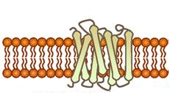


Glucagon Signaling in Liver Cells
GDP
cAMP
CREB
Glycolysis
cAMP
PKA
Protein Kinase A
(PKA)
Glycogenesis
Gluconeogenesis
Glycogenolysis
Figure modified from Yan, A., et al (2016) In J Biol Sci 12(12):1544-1554 and Servier Medical Art
Notes:
So do to this, glucagon stimulates that lovely signaling pathway that you are all now familiar with! It activates the G-protein coupled receptor which in turn activates the downstream G-protein. Adenylate Cyclase is activated and produces the second messenger, cAMP. cAMP binds with the CREB protein and activates the transcription of proteins involved in gluconeogenesis. cAMP also binds with Protein Kinase A and upregulates the activity of glycogen phosphorylase resulting in the breakdown of glycogen. It also downregulates the activity of glycogen synthase to inhibit glycogenesis. In this section, we will also see how PKA activation will downregulate the glycolytic pathway as well.

Slide 10
Glucagon Signaling in Liver Cells
GTP
cAMP
CREB
Glycolysis
cAMP
PKA
Protein Kinase A
(PKA)
Glycogenesis
Gluconeogenesis
Glycogenolysis
Figure modified from Yan, A., et al (2016) In J Biol Sci 12(12):1544-1554 and Servier Medical Art
Notes:
The activated G-protein stimulates Adenylate cyclase to produce cAMP. cAMP then binds with protein kinase A (PKA) and the cAMP Response Element-Binding Protein (CREB). Activated CREB will bind with DNA in the nucleus and mitochondria and upregulate the expression of genes involved with gluconeogenesis. Protein kinase A will phosphorylate downstream targets that downregulate glycolysis and glycogenesis, while upregulating glycogenolysis (again, to free up glucose and return it to the blood stream.

Slide 11
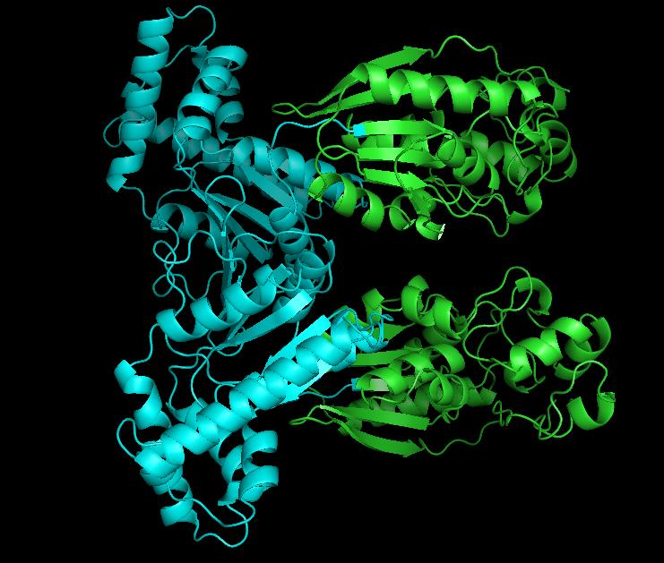
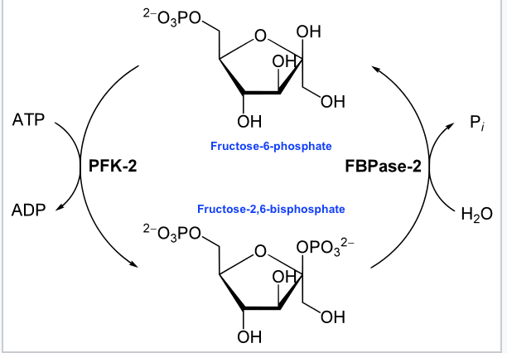
PFK-2/FBPase-2 Enzyme
Activity controlled by Phosphorylation
P
(active)
(active)
PFK-2 Activity
FBPase Activity
Bifunctional Enzyme
Images from Kedrosolan and Hyunsuky
Notes:
Regulation of the glycolytic pathway in response to this signaling occurs through the regulation of the PFK-2/FBPase-2 Enzyme. Activity of this enzyme is controlled through the PKA signaling cascade. This enzyme is responsible for phosphorylating fructose 6-phosphate to the fructose 2,6 bisphosphate form. Note that this bisphosphate form of fructose is DIFFERENT!! than the bisphosphate form utilized in the glycolytic pathway. The glycolytic pathway requires fructose-1,6-bisphosphate that is formed from the PFK-1 enzyme (or Step 3 of the glycolytic pathway). This is a separate enzyme altogether and not involved directly in the glycolytic pathway. However, we noted in the past slide that fructose-2,6-bispohphate can serve as an allosteric activator of the PFK-1 enzyme. The PFK-2/FBPase-2 Enzyme is a dual purpose enzyme. Half of the protein has kinase activity and can phosphorylate fructose-6-phosphate to fructose-2,6-bisphosphate. The other half of the enzyme contains a phosphatase that can cleave off the phosphate group from the 2-position and restore fructose-6-phosphate. Note that both activities are not functional at the same time! The enzyme activity is determined by phosphorylation state. When the protein is dephosphorylated, the PFK-2 enzyme is active leading to the production of fructose-2,6-bisphosphate. This molecule can then bind with PFK-1 in the glycolytic pathway and increase its activity. If the protein is phosphorylated by PKA during glucagon signaling, the FBPase is activated and the kinase activity is inhibited. This leads to the dephosphorylation of fructose at the 2-position and the release of fructose-6-phosphate.

Slide 12
PFK-1 Allosteric Regulation
Fructose-2,6-bisphosphate binds to PFK-1 at latent allosteric locations and positively upregulates its activity
3
Phosphofructokinase-1
Mg²⁺
Fructose-
1,6-bisphosphate
Fructose-6-phosphate
F26BP from Kedrosolan
PFK-1 modified from Mitternacht, S., and Berezovsky, I.N. (2011)
Notes:
As shown in the last slide the PFK-2/FBPase-2 Enzyme is responsible for phosphorylating fructose 6-phosphate to the fructose 2,6 bisphosphate form. Note that this bisphosphate form of fructose is DIFFERENT!! than the bisphosphate form utilized in the glycolytic pathway. The glycolytic pathway requires fructose-1,6-bisphosphate that is formed from the PFK-1 enzyme (or Step 3 of the glycolytic pathway). If there is a lot of fructose-6-phosphate around…ie you just drank high fructose corn syrup in your sugary energy drink….it can support both the formation of fructose 1,6-bisphosphate by PFK-1, and the production of fructose-2,6-bisphosphate by PFK-2. Fructose-2,6-bisphosphate will then bind with PFK-1 and super charge it for converting F6P into fructose-1,6-bisphosphate.

Slide 13
Opposing Pathways in the Liver
Glucagon Signaling
Glycolysis
Gluconeogenesis
X
(Breaking down glucose)
(Making new glucose)
Blood stream
X
glucose
Glycogenesis
Glycogenolysis
(Making new glycogen)
(breaking down glycogen)
Figure modified from Yan, A., et al (2016) In J Biol Sci 12(12):1544-1554 and Servier Medical Art
Notes:
However, during glucagon signaling, you need to shut down this fast track upregulation of PFK-1 by fructose-2,6-bisphosphate and turn down the glycolytic pathway. To do this, Protein Kinase A will phosphorylate the PFK-2/FBPase-2 enzyme and alter its activity. The kinase activity is inhibited and the phosphorylase activity is turned on.

Slide 14
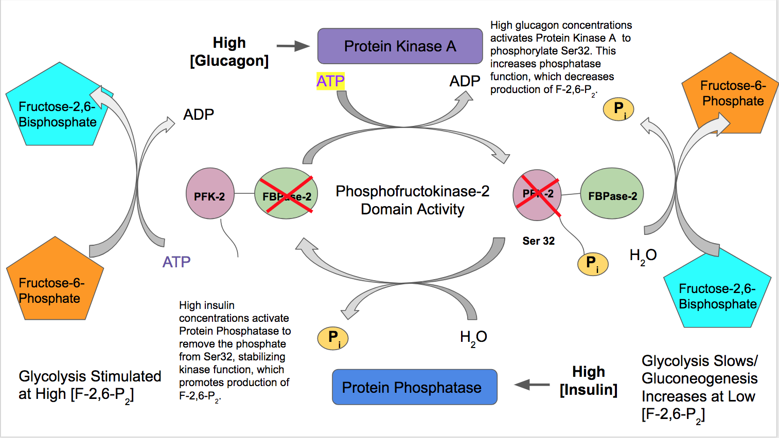
Regulation in Liver Cells
Image from Kedrosolan
Notes:
This slide gives a summary of this control pathways. In the presence of glucagon, PKA will phosphorylate the PFK-2/FBPase-2 enzyme causing the kinase activity to be switched off and the phosphatase activity to be switched on. Dephosphorylation of fructose-2,6-bisphosphate recovers fructose-6-phosphate (F6P). F6P can then go through the reverse isomerase reaction and recover glucose-6-phosphate (G6P). G6P will then be transported to the rER where it will be dephosphorylated and then free glucose can be released back into the blood.

Slide 15
Opposing Pathways in the Liver
Glucagon Signaling
Glycolysis
Gluconeogenesis
X
(Breaking down glucose)
(Making new glucose)
Blood stream
X
glucose
Glycogenesis
Glycogenolysis
(Making new glycogen)
(breaking down glycogen)
Figure modified from Yan, A., et al (2016) In J Biol Sci 12(12):1544-1554 and Servier Medical Art
Notes:
Ultimately, the result of glucagon signaling is the downregulation of glycolysis (note that it is downregulated – not silenced).

Slide 16
Regulation in Liver Cells
Image from Kedrosolan
Notes:
The opposite holds true for insulin signaling. High insulin concentrations result in the activation of protein phosphatase and the dephosphorylation of the PFK-2/FBPase-2 enzyme. In the dephosphorylated state, PFK-2 activity is high and the FBPase-2 activity is low, which will stimulate PFK-1 and the glycolytic pathway. Who knew that life would be so complicated!

