Slide 1
Glycolysis
Part 4 - Enzymatic Activity of Glyceraldehyde 3-Phosphate Dehydrogenase
Notes:
Welcome to part 4 in our Glycolysis series. In this section, we will focus on the enzymatic activities of the Glyceraldehyde 3-Phosphate Dehydrogenase

Slide 2
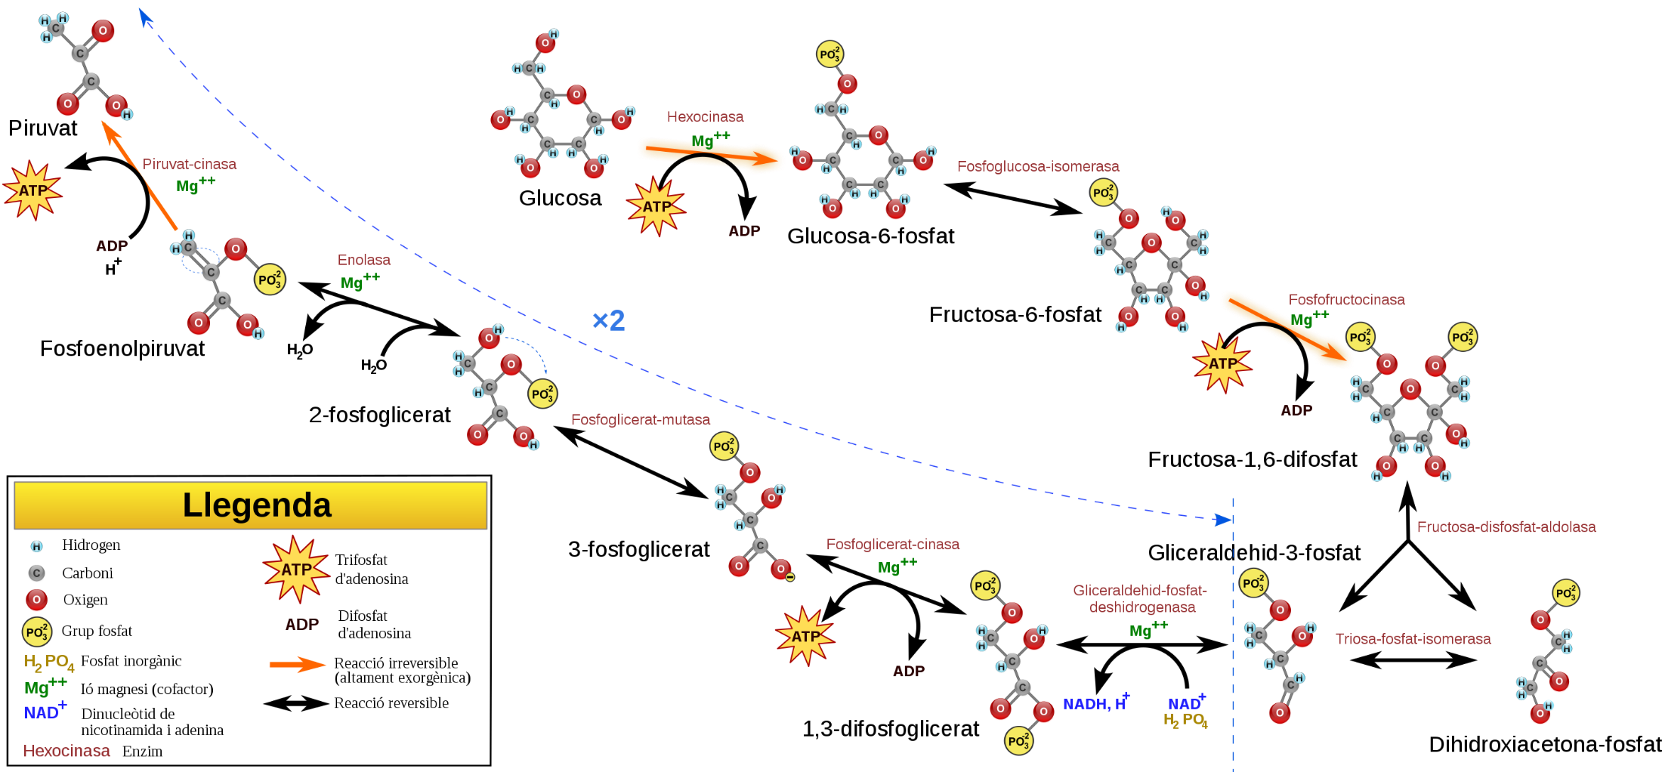



Glycolysis – Step 4
Dihydroxyacetone
phosphate
4
3
4
Fructose Bisphosphate
Aldolase
1
2
Fructose Bisposophate Aldolase
Phosphofructo-
kinase
Mg²⁺
Dihydroxyacetone
Phosphate
Hexokinase
Mg²⁺
Phosphoglucose Isomerase
5
Triose Phosphate Isomerase
Glucose
Glucose-6-phosphate
Fructose-6-phosphate
Fructose-1,6-bisphosphate
Fructose-
1,6-bisphosphate
Glyceraldehyde 3-phosphate
Glyceraldehyde
3-phosphate
Figure modified from YassineMrabet
Notes:
So we left glycolysis in our last section, just after the PFK-1 enzyme produced Fructose-1,6-bisphosphate. In step 4 of glycolysis the fructose-1,6-bisphosphate is cleaved by aldolase to yield 1 molecule of dihydroxyacetone and 1 molecule of glyceraldehyde 3-phosphate.

Slide 3
Glycolysis – Step 5
5
3
4
1
2
Triose Phosphate
Isomerase
Fructose Bisposophate Aldolase
Phosphofructo-
kinase
Mg²⁺
Dihydroxyacetone
Phosphate
Hexokinase
Mg²⁺
Phosphoglucose Isomerase
5
Triose Phosphate Isomerase
Glucose
Glucose-6-phosphate
Fructose-6-phosphate
Fructose-1,6-bisphosphate
Glyceraldehyde
3-phosphate
Glyceraldehyde 3-phosphate
Dihydroxyacetone
phosphate
Figure modified from YassineMrabet
Notes:
This is followed by the conversion of dihydroxyacetone phosphate to glyceraldehyde 3-phosphate by the action of the triose phosphate isomerase.

Slide 4


Second Half of Glycolysis – Energy Generating
6
Glyceraldehyde 3-phosphate
Glyceraldehyde
3-Phosphate
Dehydrogenase
NAD⁺
Pi
6
Glyceraldehyde
3-phosphate Dehydrogenase
10
NADH
+ H⁺
9
8
7
Pyruvate
Kinase
Mg²⁺
Phosphoglycerate Mutase
Enolase
Phosphoglycerate Kinase
Mg²⁺
NAD⁺
Pi
NADH
+ H⁺
Pyruvate
Phosphoenol-
Pyruvate
2-Phosphoglycerate
3-Phosphoglycerate
Glyceraldehyde
3-phosphate
1,3-Bisphosphoglycerate
1,3-Bisphosphoglycerate
Figure modified from YassineMrabet
Notes:
The next reaction step is the first one where we have seen the utilization of an energy carrier molecule to harvest electrons from our food molecules. The Glyceralde 3-Phosphate (G3P) Dehydrogenase is an oxidoreductase enzyme that oxidizes the glyceraldehyde 3-phosphate and reduces the NAD⁺ carrier to NADH and a H⁺ . The name De-Hydrogen-Ase, implies the removal of hydrogen (and its electron) from the molecule, which is observed at the C-1 position. Also observed is the incorporation of a phosphate group at the C-1 position.

Slide 5
Glyceraldehyde 3-Phosphate Dehydrogenase
Mediates two important reactions:
First the oxidation of the aldehyde to the carboxylic acid (this generates the NADH carrier and the enzyme is named for this reaction)
Second, a dehydration reaction occurs with inorganic phosphate to form the 1,3-bisphosphoglycerate
This enzyme can be classified as an oxidoreductase AND as a hydrolase!
Notes:
Thus, the G3P-Dehydrogenase enzyme mediates two important reactions. In the first, the aldehyde at position C-1 is oxidized to the carboxylic acid, generating the reduced form the electron carrier NADH. A second dehydration reaction occurs with inorganic phosphate to for the 1,3-bisphosphoglycerate. Therefore, this enzyme can be classified as two different types of enzymes, as the dehydrogenase (or oxidoreductase) in the first step and as a hydrolase in the second step. For the purposes of glycolysis, the formation of the NADH is the important component of the reaction from an energy-generating standpoint. Thus, the enzyme was named for its ability to mediate this step of the reaction.

Slide 6
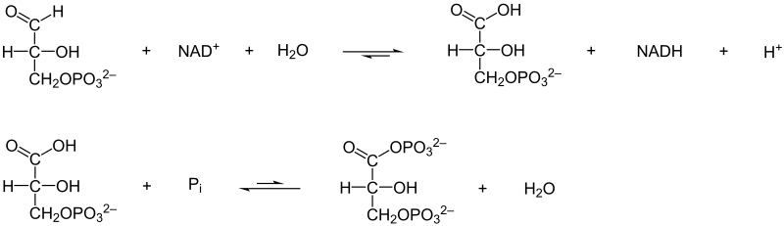
Glyceraldehyde 3-Phosphate Dehydrogenase
Oxidation
+ NAD⁺ + H₂O
+ NADH + H⁺
Dehydration
+ P_{i}
+ H₂O
Notes:
Here are the two major reaction steps, the oxidation step shown in the upper panel is favored and has a negative delta G value (therefore it is spontaneous). However, the dehydration reaction in the second step is not favored and requires and input of energy to go in the forward direction. The enzyme is able to couple these reactions together and use the excess energy from the oxidation reaction to complete the dehydration step in the second part. It does this by forming a thioester covalent intermediate with the enzyme during the reaction mechanism. Let’s take a look at this in a little bit more detail.

Slide 7

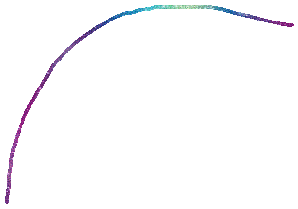

Glyceraldehyde 3-Phosphate Dehydrogenase
H-S
S
B:
H-
NAD⁺
B:
NAD⁺
Notes:
An active site cysteine residue mediates an attack on the glyceraldehyde 3-phosphate at the C-1 position. The reaction is stabilized by a basic residue in the active site (most likely histidine). The formation of the carbonyl double bond, as the electrons from the oxygen flow back into the glyceraldehyde 3-phosphate causes the oxidation of the molecule with the loss of the electrons and hydrogen from the C-1 position. The electrons are transferred to the NAD⁺ electron carrier molecule forming NADH

Slide 8





Glyceraldehyde 3-Phosphate Dehydrogenase
S
NAD⁺
H
S
B:
H
+ P_{i}
B:
+ PO₄³⁻
NADH
NAD⁺
Notes:
NADH leaves the active site of the enzyme and is replaced with another oxidized form of NAD+. Inorganic phosphate also enters the active site of the enzyme with the incoming NAD+. One of the oxygens from the phosphate mediates nucleophilic attack on the carbonyl carbon, forming a covalent bond. The thiol group serves as a leaving group,

Slide 9
Glyceraldehyde 3-Phosphate Dehydrogenase
H-S
B:
1,3-Bisphosphoglycerate
Notes:
restoring the active site of the enzyme and releasing the product 1,3-bisphosphoglycerate.

Slide 10
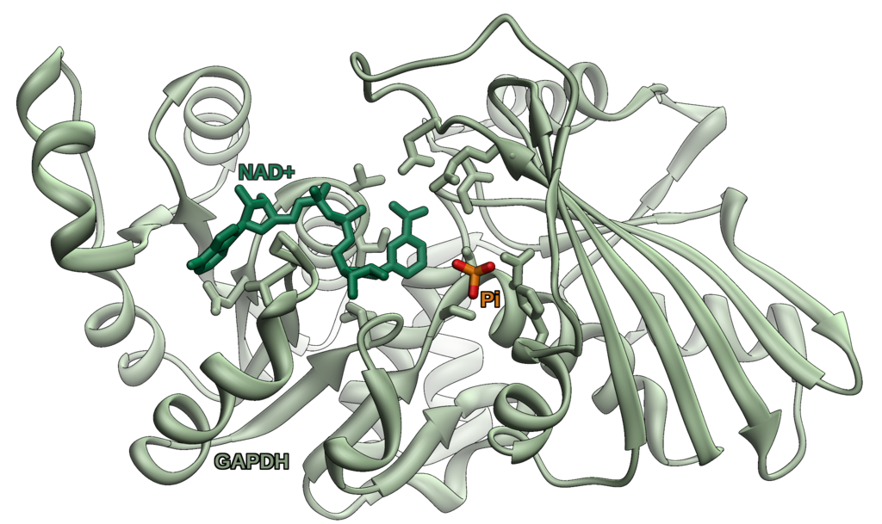
Glyceraldehyde 3-Phosphate Dehydrogenase
Figure from Vossman
Notes:
In summary, the G3P-Dehydrogenase enzyme mediates the oxidation and hydrolysis of G3P to 1,3-Bisphosophoglycerate. In the process the enzyme consumes one molecule of inorganic phosphate and produces the reduced form of the NAD-cofactor, which is NADH plus an extra H⁺ that is released by the inorganic phosphate during the dehydration part of the reaction. The NADH carrier will then be utilized under aerobic conditions in the electron transport chain to produce ATP through oxidative phosphorylation. For each glucose molecule, this reaction happens twice producing 2 NADH molecules.

