Slide 1
Glycolysis
The Fate of NADH
Notes:
We now return to the glycolytic process to explore the fate of NADH that is produced during this metabolic pathway.

Slide 2
NADH in Recycling in the Cytoplasm
Aerobic Pathway
Aspartate/Malate Shuttle
Glycerol 3-phosphate-DHAP Shuttle
Anaerobic Pathway
Lactate and the Cori Cycle
Ethanol production (in yeast)
Notes:
The glycolytic pathway yields a total of 2 ATP and 2 NADH molecules per Glucose processed. As we have learned, NADH can be utilized in the electron transport chain in the mitochondria to help generate the proton gradient required for the oxidative phosphorylation and ATP production. However, NADH cannot directly cross the innermitochondrial membrane and get into the matrix where NADH can be utilized. Thus, there are two primary ways that the electrons harvested during glycolysis can be transported into the matrix of the mitochondria. The first is via the Aspartate/Malate shuttle system that we learned about in gluconeogenesis. The second is the glycerol 3-phosphate – dihydroxyacetone (DHAP) Shuttle system. Alternatively, if aerobic respiration is not possible and NAD+ cannot be regenerated in the cytosol by these methods, pyruvate can be turned into lactate by lactate dehydrogenase and NADH can be recycled to NAD+ via this pathway.

Slide 3
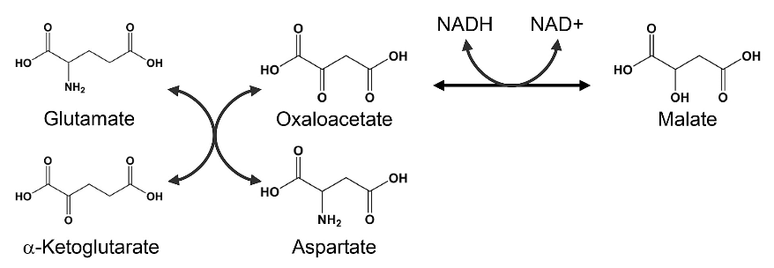
Malate – Aspartate Shuttle System
Malate Dehydrogenase
Aspartate Aminotransferase
Figure modified from: Son, H.F. and Kim, J-J. (2016) PLoS One 10.1371
Notes:
Recall that the Malate-Aspartate Shuttle System is dependent on the functioning of two enzymatic processes. The first is the aspartate aminotransferase that can utilize glutamate as an amine donor to generate aspartate from oxaloacetate. Alpha-ketoglutarate is also formed in this process. Depending on substrate concentrations and other regulatory mechanisms, this enzyme can also work in the reverse reaction to produce glutamate and oxaloacetate. In a different reaction using Malate Dehydrogenase, oxaloacetate can be reduced to form malate using a molecule of NADH as the electron donor. When this happens in the cytosol, NADH can be recycled to NAD+ and the resulting malate can be transported into the matrix of the mitochondria. Once in the mitochondria, malate can undergo oxidation in the last step of the Kreb Cycle and produce oxaloacetate and one molecule of NADH, which can then be used by complex I in the Electron Transport Chain.

Slide 4

Malate – Aspartate Shuttle System
Aspartate Aminotransferase
Oxaloacetate
Glutamate
Malate Dehydrogenase
Malate
α-ketoglutarate
NADH
Aspartate
NAD⁺
IM Space
Matrix
Aspartate
Glutamate
Malate
α-ketoglutarate
Malate Dehydrogenase
Oxaloacetate
NAD⁺
Aspartate Aminotransferase
NADH
Notes:
Here is the schematic of that shuttle process. Essentially oxaloacetate is converted to aspartate, where it is transported to the cytosol. Once in the cytosol it is converted back to oxaloacetate and can then be reduced to malate, using cytosolic NADH as the electron donor. The electrons are then carried back into the matrix of the mitochondria on the malate molecule where they re-enter the Kreb Cycle.

Slide 5
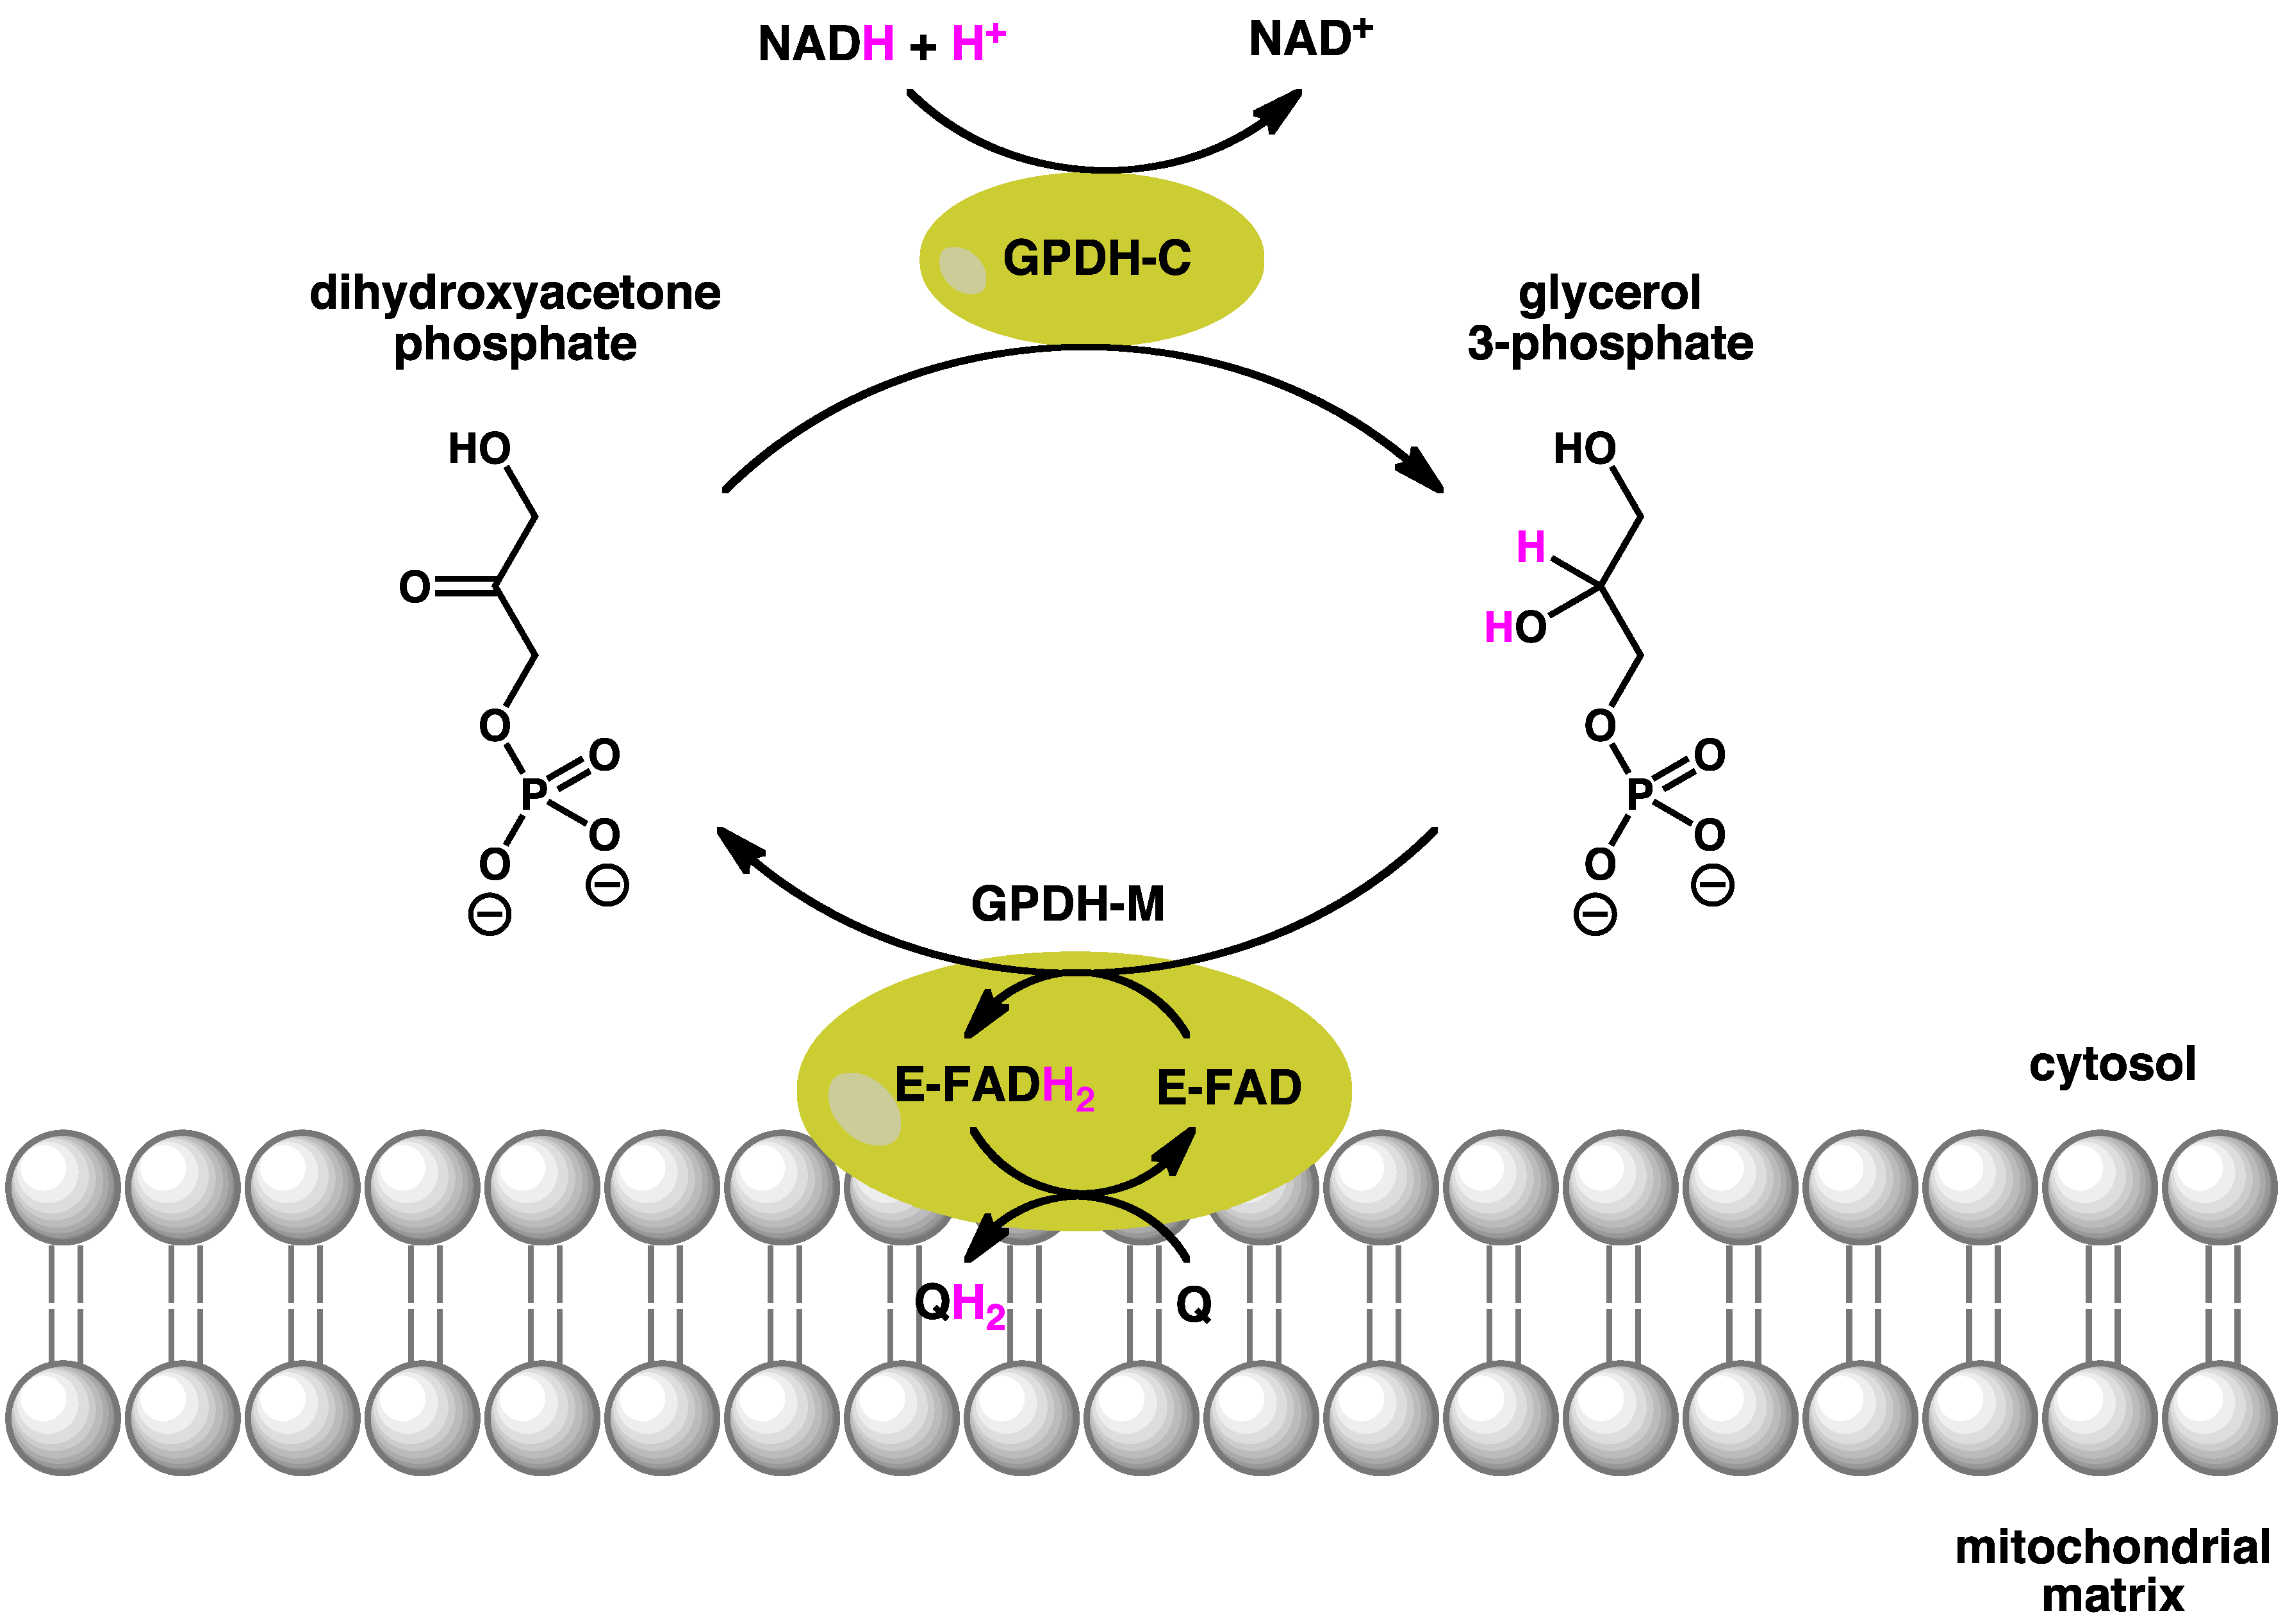
Glycerol-3 Phosphate – DHAP Shuttle
Figure from Boghog2
Notes:
Alternatively, depending on the concentration of metabolic intermediates, the glycerol-3 phosphate – DHAP shuttle may be employed to reoxidize NADH in the cytoplasm. In this shuttle, cytoplasmic glycerol 3-phosphate dehydrogenase, reduces dihydroxyacetone (DHAP) to glycerol 3-phosphate using the NADH generated in glycolysis as the electron donor. This restores the NAD+ pool for continued use in glycolysis. The glycerol 3-phosphate can then be oxidized back to DHAP using a glycerol 3-phosphate dehydrogenase enzyme that is bound as a peripheral membrane protein in the innermembrane of the mitochondria. The electrons from the glycerol are then transferred to FAD forming FADH2 and restoring the DHAP pool. Similar to the succinate dehydrogenase enzyme, the FADH2 produced in this reaction can be transferred to a conenzyme Q electron shuttle in the innermembrane and enter the electron transport chain.

Slide 6
Summary of Aerobic Pathway of NADH Oxidation
Malate – Aspartate Shuttle Preserves the NADH
NADH worth ~3 ATP in this process
Glycerol 3 Phosphate – DHAP Shuttle converts NADH to FADH for entry into the Electron Transport Chain.
NADH worth ~1.8 ATP in this process
Notes:
In summary, if the malate-aspartate shuttle is used, the energy of the NADH is conserved in the process and can be used to produce approximately 2.5 - 3 ATP. If the glycerol 3 phosphate – DHAP shuttle is used, NADH is converted to FADH2 to enter into the electron transport chain and will only be worth approximately 1.5 ATP

Slide 7
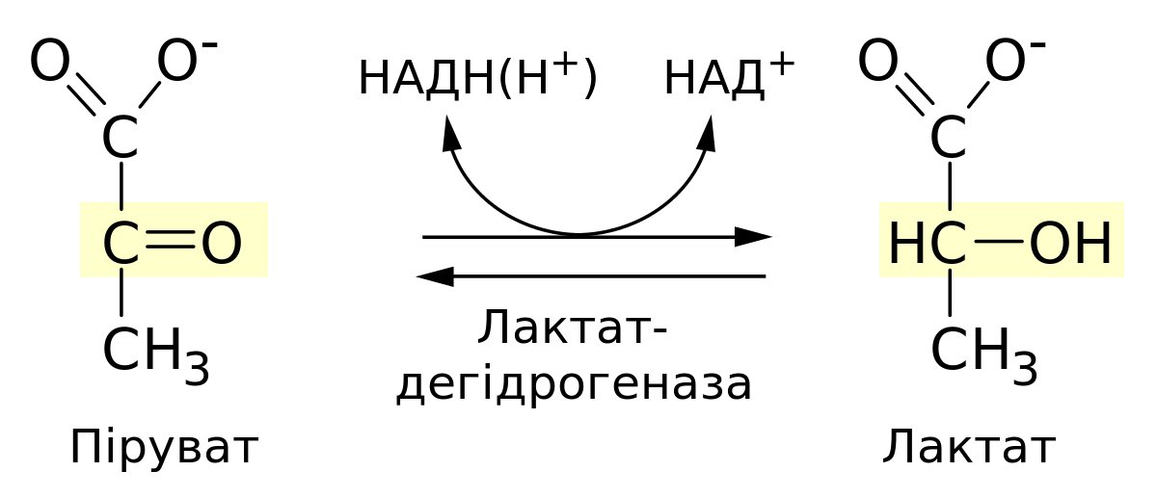
Anaerobic Metabolism in Animals
NADH/H+
NAD+
Lactate
Dehydrogenase
Pyruvate
Lactate
Figure modified from Zlir’a
Notes:
In animals, muscle tissue can withstand short bursts of anaerobic metabolism. Under these circumstances, the tissue is not getting enough oxygen to produce ATP aerobically (ie you may be running away from a lion and not be able to breath fast enough to keep up with muscle tissue demand!) In this case, only glycolysis is available to produce more ATP. And even though only 2 ATP are produced per glucose, it is better than none! In this case, the NADH produced in the second half of glycolysis needs to be reoxidized back to NAD+ to keep running the glycolytic pathway. To do this, the enzyme lactate dehydrogenase reduces pyruvate to lactate and recovers the needed NAD+.

Slide 8
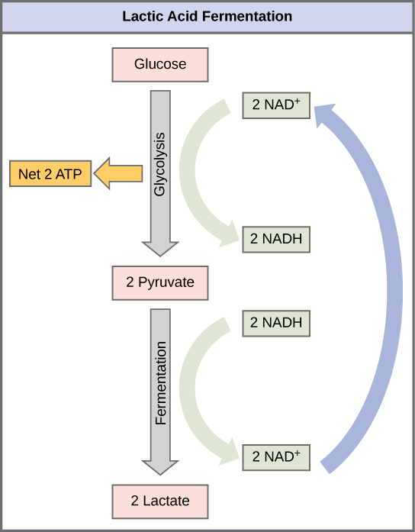
Formation of lactate allows recycling of NADH to NAD+ in the cytoplasm
Figure from Boundless Biology, LumenCandella
Notes:
This is shown here in this diagram, where NAD+ is recycled in the process.

Slide 9
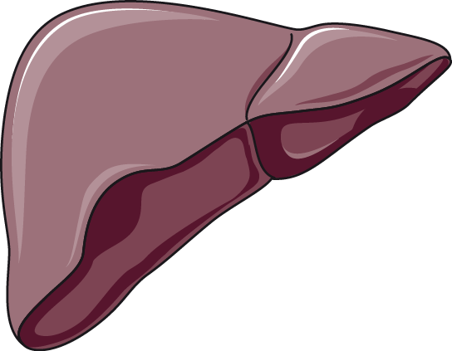
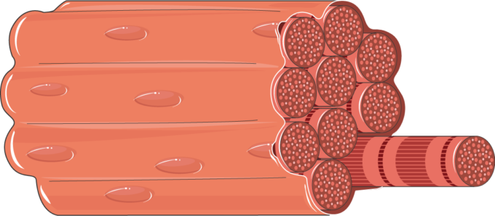
The Cori Cycle
To Bloodstream
Glucose
Glucose
Pyruvate
To Muscle
NADH
NAD⁺
2 ATP
Pyruvate
To Liver
NADH
NAD⁺
Lactate
To Bloodstream
Figure modified from Servier Medical Art
Notes:
If anaerobic respiration occurs within a muscle tissue, the muscle will need to off load the lactate into the bloodstream so that it can keep recycling the NADH to NAD+. The lactate is then taken up by the liver, where it can be converted back to pyruvate and can be utilized in the gluconeogenic pathway, if needed. This is known as the Cori Cycle.

