Slide 1
Lipids
Steroids
Notes:
Welcome to our lecture series on Lipids. Here we will learn about the basic structure and function of steroid lipids in biological systems.

Slide 2
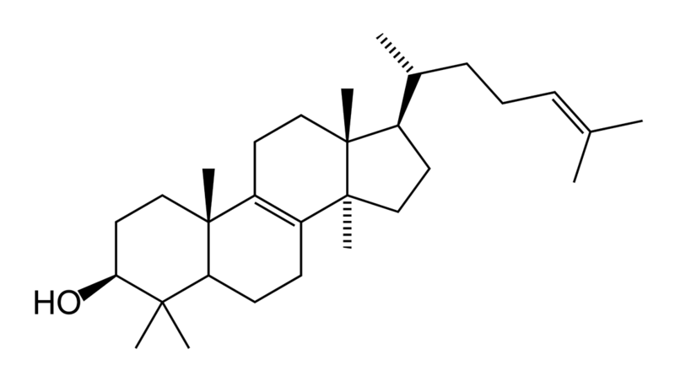
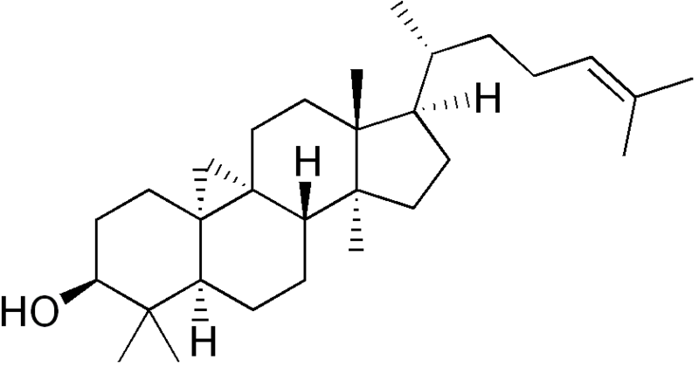
Steroids
A steroid is a terpenoid lipid
Steroids vary by the functional groups
Hundreds of types
lanosterol (animals and fungi)
cycloartenol (plants).
Lanosterol
Cycloartenol
Notes:
A steroid is a terpenoid lipid characterized by a carbon skeleton with four fused rings, generally arranged in a 6-6-6-5 fashion. Steroids vary by the functional groups attached to these rings and the oxidation state of the rings. Hundreds of distinct steroids are found in plants, animals, and fungi. All steroids are made in cells either from the sterol lanosterol in animals and fungi, or the sterol cycloartenol in plants.

Slide 3
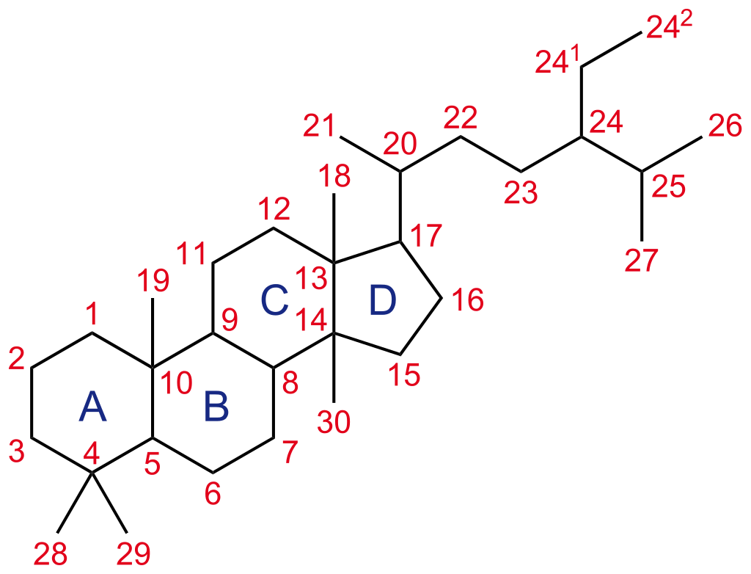
Steroid Numbering System
Structure from: NEUROtiker
Notes:
This is the structure of cholestane, a steroid with 27 carbon atoms. Its core ring system (ABCD), composed of 17 carbon atoms, is shown with IUPAC-approved ring lettering and atom numbering. You do not need to memorize the ring numbering. It is here as a reference.
Structure from: NEUROtiker

Slide 4
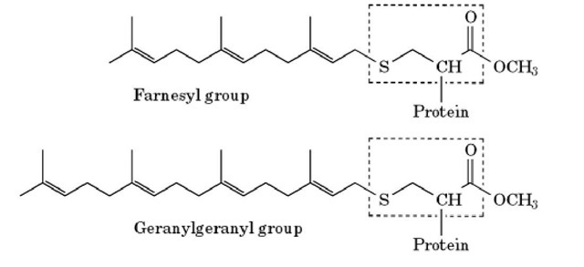
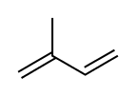
Terpenes and Terpenoids
Isoprene Unit
Notes:
Steriods are considered to be terpenoids due to the building blocks and modifications required for their biosynthesis. Terpenes are one of the largest classes of natural products. Their building block is the 5-carbon isoprene unit, which are assembled to each other in thousands of different ways to yield unique products. In the phospholipid section, you were introduced to the farnesyl and genranylgeranyl hydrocarbon tails that are added onto peripheral membrane proteins to help tether them to the plasma membrane. Both of these hydrocarbons are examples of terpenes. Terpenoids are compounds related to terpenes, which may include some oxygen functionality or some rearrangements of the original terpene bonds.

Slide 5
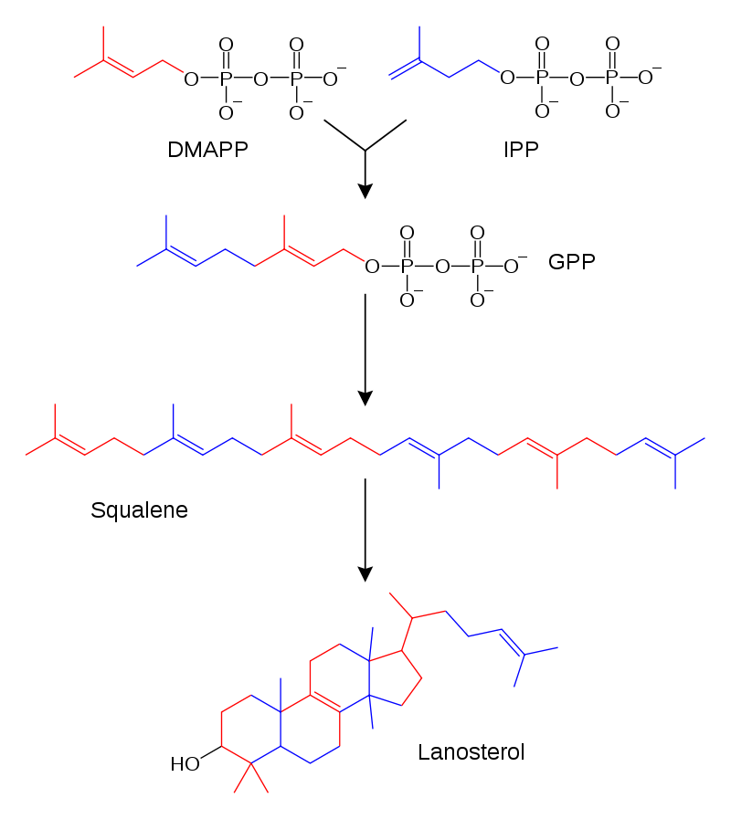
Figure from: Fvasconcellos, original by Tim Vickers
Notes:
As terpenoids, steroids are built from the 5-carbon isoprene units. In the first step, the isoprene building blocks are activated to the diphosphate intermediates, dimethylallyl pyrpophosphate (DMAPP) and isopentenyl pyrophosphate (IPP). The IPP unit is then transferred to the DMAPP forming geranyl pyrophosphate (GPP)

Slide 6
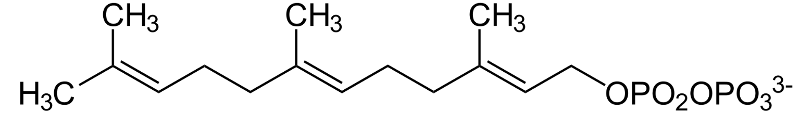
+
GPP
FPP
Figure modified from: Fvasconcellos, original by Tim Vickers
Notes:
Another isoprene unit, from IPP is transferred to the geranyl pyrophosphate (GPP) to yield the 15 carbon intermediate farnesyl pyrophosphate (FPP).

Slide 7
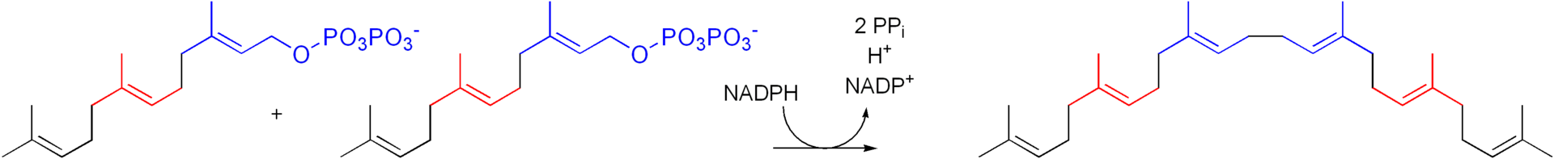
FPP
FPP
NADPH
Squalene
Synthase
NADP⁺ + H⁺ + 2PP_{i}
Squalene
Figure modified from: Jag123
Notes:
Two farnesyl pyrophosphates are then joined by squalene synthase to yield the 30 carbon precursor, squalene.

Slide 8
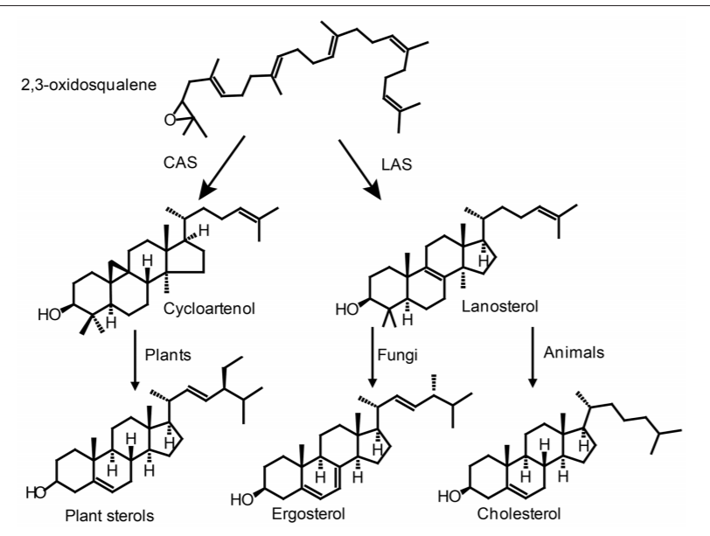
Figure from: Jäpelt, R., and Jakobsen, J. (2013) Fron. Plant Sci 4:136
Notes:
Squalene is then oxidized to an expoxide and undergoes cyclization reactions producing the A, B, C, and D steroid ring structures. Within plants, cycloartenol is formed and serves as the core steroid structure that all others are produced from. In fungi and animals, 2,3-oxidosqualene is cyclized to lanosterol. Fungi convert this to ergosterol and animals to cholesterol. In animals, cholesterol then serves as the backbone for the synthesis of other steroids.

Slide 9
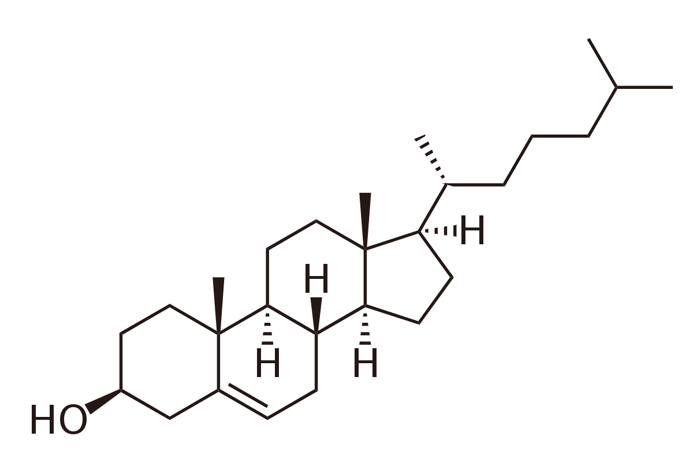
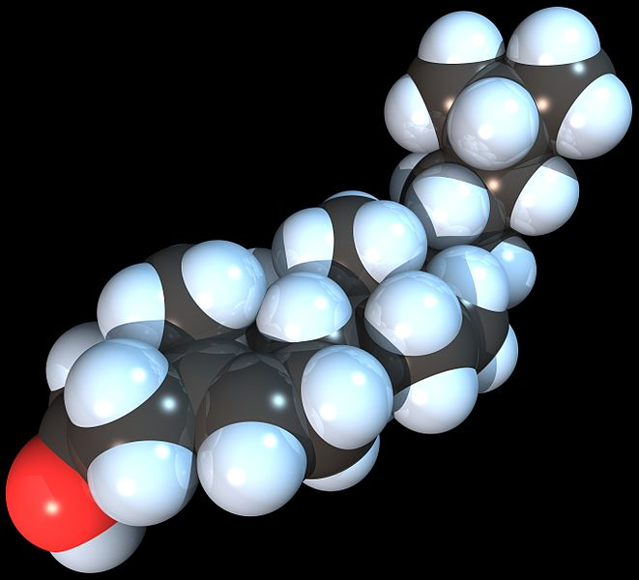
Cholesterol
Figure from: Boris, TM
Figure from: RedAndr
Notes:
Cholesterol is the most abundant steroid in animals. It is also classified as a sterol, due to the hydroxyl located at the C-3 position. The hydroxyl makes cholesterol weakly amphipathic. The ring structure makes cholesterol very rigid and when it is inserted into the plasma membrane, it increases the melting temperature of that structure. Cholesterol is synthesized in the liver or taken up in the diet. As a sterol is a highly hydrophobic substance, its transport between organelles requires transport carriers. Both vesicular (membrane-based) and non-vesicular (protein-based) transport are involved in intracellular transport of sterols. Chylomicron structures, which we will discuss in further detail, are used to transport cholesterol between cells.

Slide 10
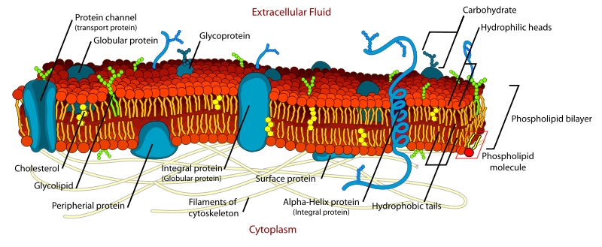
Phospholipid Bilayer
Figure from: Mariana Ruiz edited by Alokprasad84
Notes:
Cholesterol is also part of the plasmsa membrane. The content of cholesterol present in the plasma membrane helps to determine the rigidity and flexibility of the membrane. Specifically the planar nature of cholesterol and the inflexibility of the ring structures cause cholesterol to increase plasma membrane rigidity and give higher melting temperatures. The placement of cholesterol within the membrane is not uniform. Higher levels of cholesterol are found in lipid raft regions and can be associated with increased risk for disease states or disease aggressiveness

Slide 11
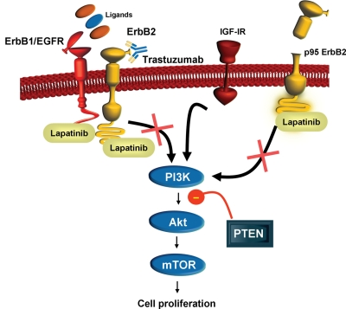
Tyrosine Kinase Expression and Breast Cancer
Figure from: Vogel, C., et al. (2010) Jap J Clin Onco 40(11):999-1013
Notes:
During the development of breast cancer, a common protein that becomes mutated or overexpressed is the tyrosine kinase receptor, ErbB2. During cancer this protein becomes unregulated and turned on all the time causing the activation of growth stimulatory signaling pathways. Note that we have seen some of these common players before in the insulin signaling cascade. This dysregulation leads to uninhibited growth of the tumor. The therapeutic drug Trastuzumab is a monoclonal antibody designed to target ErbB2. Lapatinib is another treatment option. It is a tyrosine kinase inhibitor that blocks the signaling pathway of ErbB2.

Slide 12
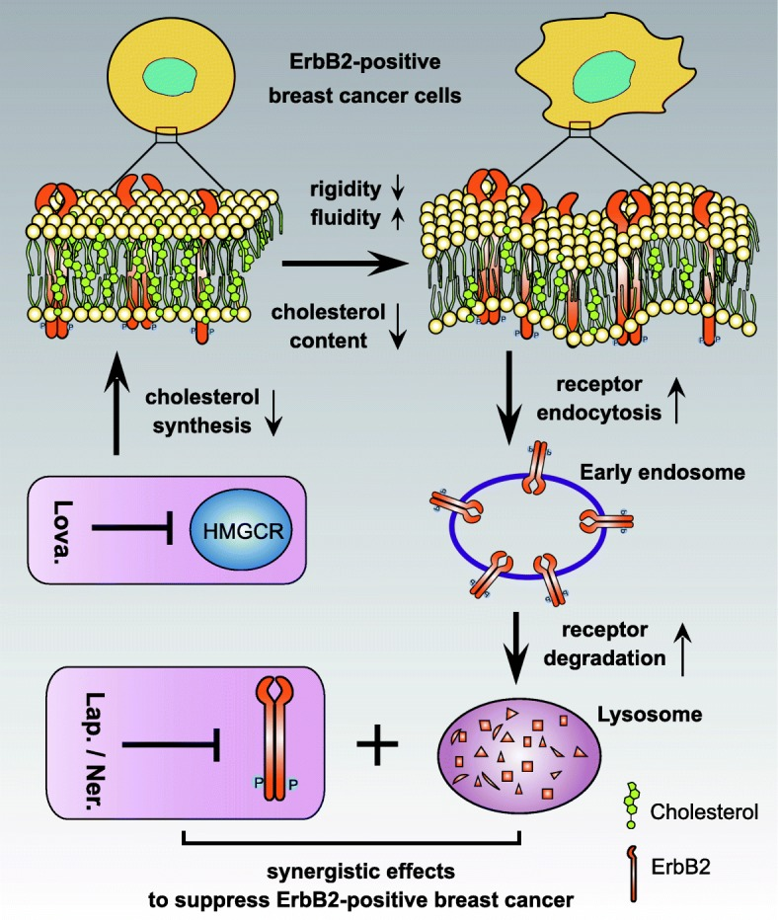
Cancer Signaling and Cholesterol
Figure from: Zhang, J., et al. (2019) Cell Commun Signal 17:15
Notes:
So how does all of this relate back to cholesterol levels within the plasma membrane?

Slide 13
Cancer Signaling and Cholesterol
Figure from: Zhang, J., et al. (2019) Cell Commun Signal 17:15
Notes:
Within ErbB2 positive breast cancer, the ErbB2 is overexpressed and found in lipid raft areas with heightened levels of cholesterol present. These lipid rafts areas are very rigid. Researchers have speculated that the rigidity of the lipid rafts within this system contribute to the aggressiveness and ability of the tumor to develop resistance to treatment.

Slide 14
Cancer Signaling and Cholesterol
Figure from: Zhang, J., et al. (2019) Cell Commun Signal 17:15
Notes:
One strategy during treatment is to try and hit the tumor with multiple agents to cause the catastrophic or apoptotic death of the tumor cells. In this experiment, the researchers wanted to determine if there were any synergistic effects by treating the tumor cells with a combination of Lapatinib (The tyrosine kinase inhibitor) and Lovastatin (a cholesterol lowering drug). Lovastatin works by inhibiting the HMG-CoA Reductase enzyme (HMGCR) required for the synthesis of cholesterol in the liver. Lapatinib inhibits the tyrosine kinases.

Slide 15
Cancer Signaling and Cholesterol
Figure from: Zhang, J., et al. (2019) Cell Commun Signal 17:15
Notes:
Researchers in this study used a mouse xenograft model, where human breast cancer cells were implanted in the mice. The mice were then either treated with Lapatinib alone, Lapatinib + Lovastatin, or left untreated. In this model system, dual treatment was found to reduce cholesterol levels in the membrane, increase membrane fluidity, and increase the rates of ErbB2 receptor endocytosis and degradation. In the xenograft model, this correlated with reduced tumor size following treatment. Thus, while cholesterol does not directly mediate cell signaling functions, it can indirectly affect the activity of protein receptors and cellular processes such as endocytosis.

Slide 16
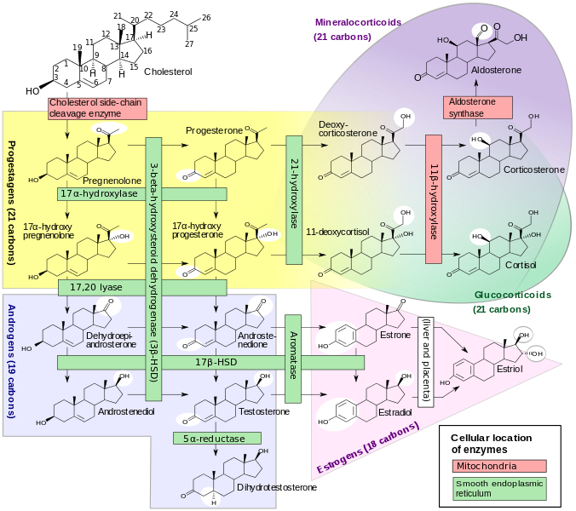
Steroidogenesis
Figure from: David Richfield (User:Slashme) and Mikael Häggström.
Notes:
The role of cholesterol in the body is not limited to its functions in the plasma membrane. Cholesterol is also the precursor for the development of all other steroids within the body. Many of those steroids serve as hormones and are involved in cellular communication and signaling pathways.

Slide 17
Steroidogenesis
Figure from: David Richfield (User:Slashme) and Mikael Häggström.
Notes:
The first part of the steroidogenesis pathway involves the biosynthesis of progesterone, 17-αλπηα-hydroxy pregnenolone, and 17-αλπηα-hydroxy progesterone. These can serve as hormone signaling molecules directly or by being further converted into the androgens, glucocorticoids, mineralcorticoids, and estrogens

Slide 18
Steroidogenesis
Figure from: David Richfield (User:Slashme) and Mikael Häggström.
Notes:
The glucocorticoids are involved in the flight or fight stress response within the body. In response to stress, cortisol is released from the adrenal glands located above the kidneys. It has pleiotropic effects on the body. For example, it activates glycogenolysis and gluconeogenesis processes in the liver as well as lipolysis in adipose tissue. The net effect is to increase glucose concentrations in the blood. Cortisol also prevents the release of substances that cause inflammation. If present chronically, it can weaken the immune system and reduce bone formation leading to osteoporosis. There are a myriad of other effects associated with cortisol, that would take the rest of this term to fully tease apart, so we will leave it there. In addition to the glucocorticoids, metabolism of progesterone can also lead to the production of the mineralcorticoids, such as aldosterone. Aldosterone is essential for sodium conservation in the kidney.

Slide 19
Steroidogenesis
Figure from: David Richfield (User:Slashme) and Mikael Häggström.
Notes:
Pregnenolone and progesterone metabolism also lead to the production of the androgens and estrogens. These are necessary for normal sexual development and play a role in healthy aging and longevity.

Slide 20
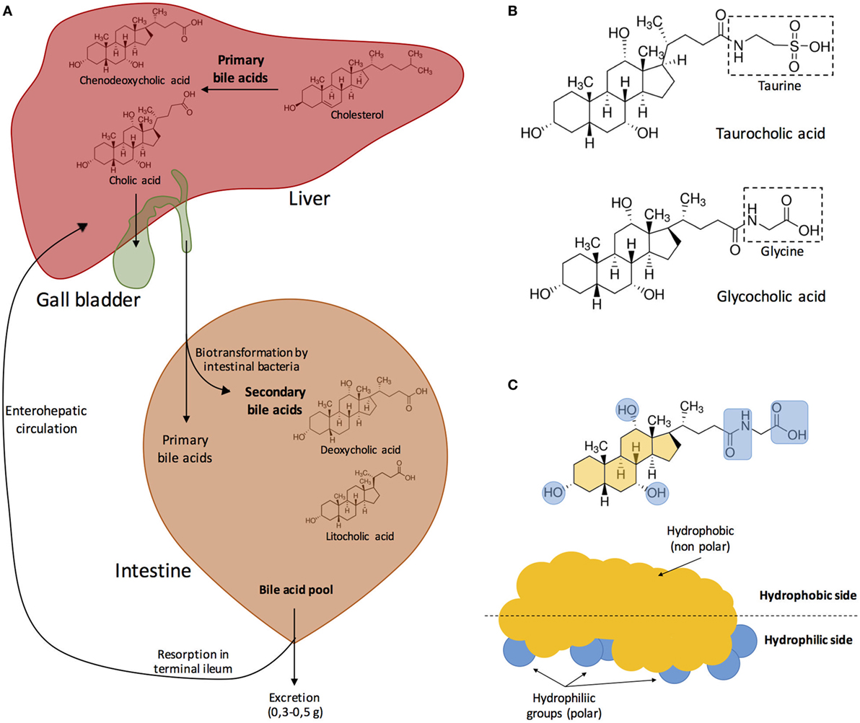
Bile Acids/Salts
Figure from: Urdaneta, V. and Casadesus, J. (2017) Front. Med. 4:163
Notes:
Cholesterol is also the precursor for the synthesis of bile acids. Bile acids are transformed to bile salts with their association with sodium or potassium ions.

Slide 21
Figure from: Urdaneta, V. and Casadesus, J. (2017) Front. Med. 4:163
Notes:
Bile acids are synthesized in the liver and then transferred to the gall bladder for storage. From there they are released into the small intestine where they aid in the metabolism of lipids consumed in the diet.

Slide 22
Figure from: Urdaneta, V. and Casadesus, J. (2017) Front. Med. 4:163
Notes:
Once in the small intestine, microbes can transform bile acids into secondary bile acids. The pool of bile acids/salts can then be used for digestion, or transported and reabsorbed through the enterohepatic circulation, or excreted.

Slide 23
Figure from: Urdaneta, V. and Casadesus, J. (2017) Front. Med. 4:163
Notes:
Bile acids can be further modified by the addition of taurine or glycine.

Slide 24
Figure from: Urdaneta, V. and Casadesus, J. (2017) Front. Med. 4:163
Notes:
Overall, these modifications make the bile salts more amphipathic. In the core structure, the hydrophilic portions of the molecules are localized to one face whereas the hydrophobic portions are facing the other side. The hydrophobic portions are shown in yellow and hydrophilic portions in blue.

Slide 25
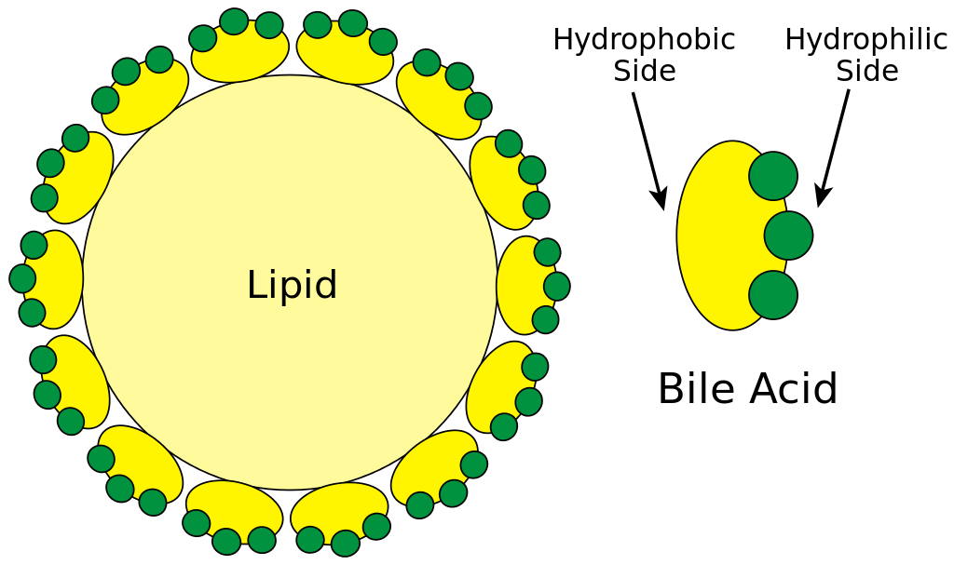
Bile Acids Emulsify Lipids
Figure from: Frank Boumphrey, MD
Notes:
The amphipathic nature of the bile salts enables them to aid in lipid digestion. Bile salts can surround the hydrophobic lipid core, shielding it from the hydrophilic water environment.

Slide 26

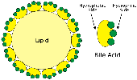
Bile Acids Emulsify Lipids
TAGS from Diet
Figure modified from: Frank Boumphrey, MD
Notes:
This allows the bile acids/salts to emulsify the lipids consumed in the diet, so that they are suspended in small droplets of the fat within the small intestine. This creates higher surface area of the fat, so that lipase enzymes can more efficiently break them down. In the next section, we wil look more closely at the process of lipid digestion.

