Slide 1
Lipids
Digestion and Transportation
Notes:
Welcome to our lecture series on Lipids. Here we will learn about lipid digestion in the small intestine and the transport of triacylglycerides and cholesterol within the blood stream.

Slide 2
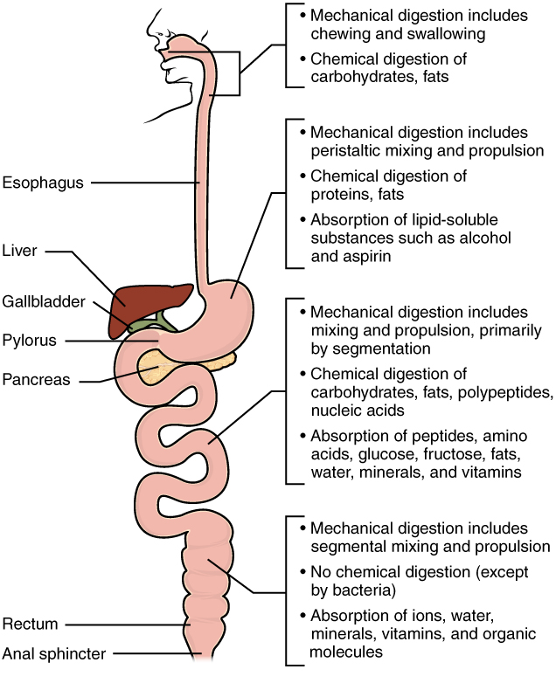
Digestion
Mechanical
Chemical
Figure from: Anatomy and Physiology by Rice University
Notes:
Digestion of food has two major components: Mechanical digestion and chemical digestion. Mechanical digestion includes processes such as chewing, peristaltic mixing, emulsification of fats, and any process that physically breaks down the food molecule into smaller pieces. Chemical digestion on the other hand, results into the chemical alteration or breakdown of the food molecule into smaller pieces. Usually for macromolecules, it involves breaking down the macromolecule into the individual building blocks. For example, amino acids from proteins, sugars from carbohydrates, nucleic acids into nucleotides, and fats into fatty acids and glycerol. Digestion begins in the mouth and continues as food travels through the small intestine. Most absorption occurs in the small intestine.

Slide 3
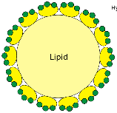
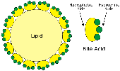
Bile Acids Emulsify Lipids
TAGS from Diet
Figure modified from: Frank Boumphrey, MD
Notes:
Recall from our last section that bile acids/salts are used to emulsify fats (or mechanically break them down into smaller suspended particles). This occurs in the small intestine.

Slide 4
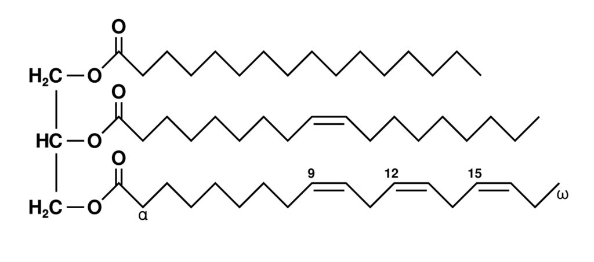
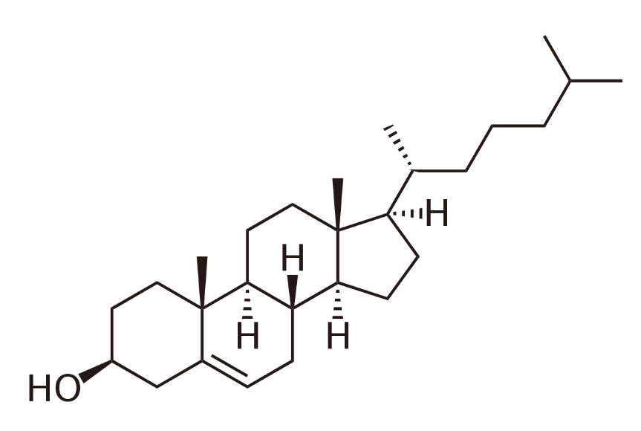
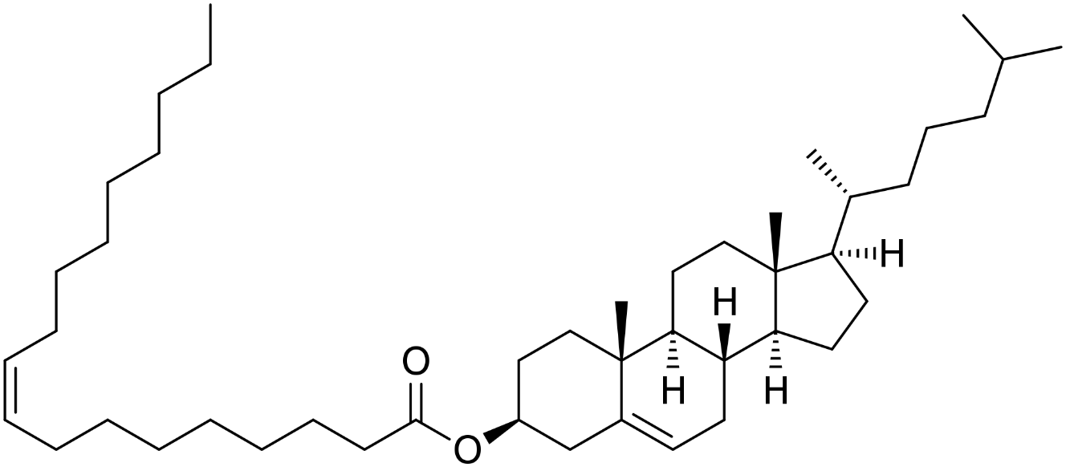
Dietary lipids
Triacylglycerides (TAGS)
Cholesterol
Figure from: Boris, TM
Structure by: Wolfgang Schaefer
Cholesterol
Esters
Figure from: Edgar181
Notes:
The primary lipids consumed in the diet are triacylglycerides, cholesterol, and cholesterol esters, which contain a long chain fatty acid attached to the alcohol functional group.

Slide 5
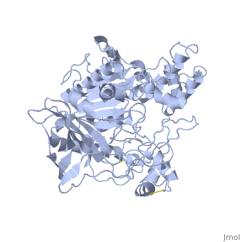
Chemical Digestion of Lipids
Types of Lipases
Pancreatic Lipases
Bile Salt-stimulated Lipase (BSSL)
Hormone-sensitive Lipase (LIPE)
Monoacylglycerol Lipase (MAGL)
Image from: Protopedia
Notes:
Lipase enzymes are required to chemically breakdown triacylglycerides into fatty acids and glycerol. They are hydrolase enzymes using the addition of water across the ester bond to release the alcohol and carboxylic acid functional groups. Here we will focus on the activity of the pancreatic lipase.

Slide 6
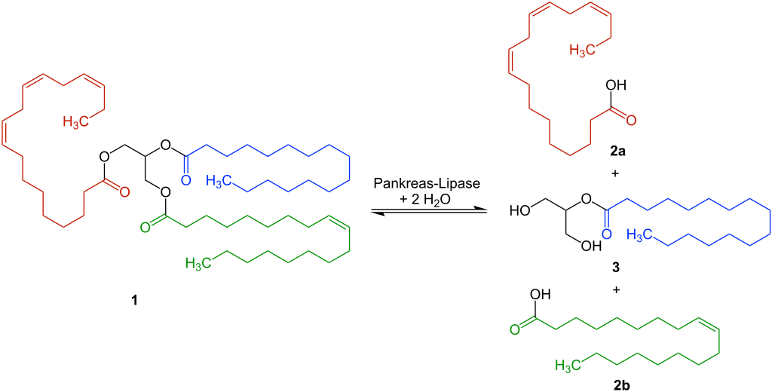
Hydrolysis by Pancreatic Lipase
Pancreatic Lipase
+ H₂O
Figure modified from: Ju
Notes:
Triacylglyceride hydrolysis is mediated by lipase enzymes in vivo. Different lipases will cleave TAGs into different products. Some will release all 3 fatty acids and some, like the Pancreatic Lipase, will only release the outer 2 and will leave the fatty acid on the 2-position attached as a monoacylglyceride.

Slide 7



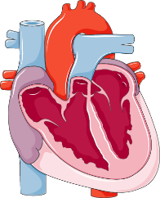
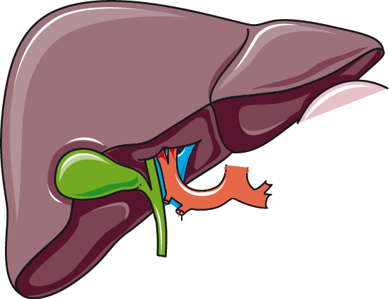
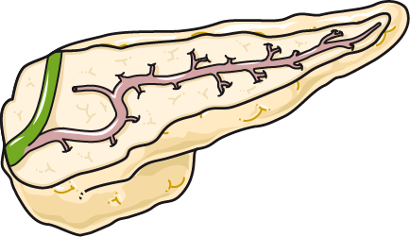




Lipid Digestion and Transportation
Remnant Recycling/Clearance
Skeletal and Heart Muscle
Adipocytes
Liver
Gall Bladder
Pancreas
Lymph System
Lipases + Bile Acids
Chylomicrons
Blood Stream
Lipids from food
Colon
Excretion
Small Intestine
Emulsified Fat Droplets
Images from Smart Servier Medical Art
Notes:
When food is eaten, it travels to the small intestine where much of the major macromolecules are digested to their building block components and absorbed by the intestinal epithelial cells, known as enterocytes. Triacylglycerides (TAGs) from dietary fat are first emulsified by bile salts produced in the liver and delivered through the bile duct along with digestive enzymes produced in the pancreas. Pancreatic lipases then breakdown the TAGs into 2 fatty acids and a monacylglyceride, as shown in the previous slide. The lipid products must then be absorbed by the enterocytes.
Reference: (PDF) Triglyceride-rich lipoproteins as a causal factor for cardiovascular disease. Available from: https://www.researchgate.net/publication/302555822_Triglyceride-rich_lipoproteins_as_a_causal_factor_for_cardiovascular_disease [accessed Mar 05 2020].

Slide 8
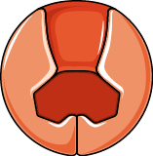
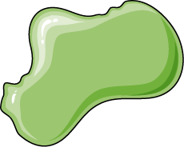





Lipid Tranport Across the Membrane
MAG
FFA
+ H₂O
Intestinal lumen
Lipase
Cytoplasm
Other Flippases?
Diffusion?
CD36
FATP
FABP
FABP
FABP
FABP
FABP
1
TAG Assembly
Chylomicron Formation
TF
2
3
Gene Expression
ER
β-oxidation
Nucleus
Mitochondria
Figure modified from Yan, A., et al (2016) In J Biol Sci 12(12):1544-1554 , Truthortruth, and Smart Servier Medical Art
Notes:
Here is a close up of the plasma membrane of the enterocyte. The intestinal lumen is at the top and the cytoplasmic side below. Lipases in the intestinal lumen breakdown Triacylglycerides (TAGs) into 2 Free Fatty Acids (FFAs) and a monoacylglyceride (MAG). These hydrolysis products are taken up by enterocytes through multiple mechanisms. The CD36 transmembrane protein and Fatty Acid Transport Proteins (FATP) have been shown to be involved with lipid transport across the plasma membrane. However, knockout studies have shown that uptake is reduced, but not completely inhibited, suggesting that other processes, such as diffusion or flippase-mediated diffusion also contribute to lipid uptake. CD36 has also been shown to be involved with dietary cholesterol uptake. Once inside the enterocyte, FFAs are bound and chaperoned by Fatty Acid Binding Proteins (FABPs). FABPs are a family of protein chaperones that have varied functions in trafficking lipids within the cell.

Slide 9
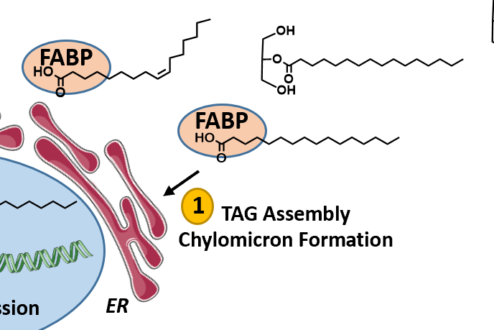
Lipid Tranport Across the Membrane
MAG
FFA
+ H₂O
Intestinal lumen
Lipase
Cytoplasm
Other Flippases?
Diffusion?
CD36
FATP
FABP
FABP
FABP
FABP
FABP
1
TAG Assembly
Chylomicron Formation
TF
2
3
Gene Expression
ER
β-oxidation
Nucleus
Mitochondria
Figure modified from Yan, A., et al (2016) In J Biol Sci 12(12):1544-1554 , Truthortruth, and Smart Servier Medical Art
Notes:
Once inside the enterocyte and bound with FABPs, FFAs and MAGs have three major fates. First they can be reassembled into TAGs. Cholesterol is also converted to cholesterol esters. This occurs within the endoplasmic reticulum (ER). Inside the ER, the reassembled lipids are packaged in a particle structure called a chylomicron that consists of a single phospholipid layer with cholesterol and apolipoproteins. Chylomicrons are then released into the lymphatic system, travel to the blood stream, and deliver TAGs and cholesterol to downstream targets such as skeletal muscle and adipose tissue.

Slide 10
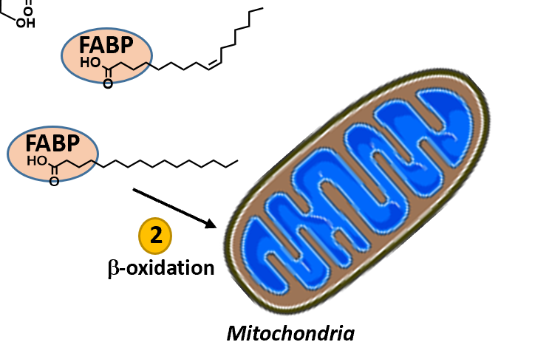
Lipid Tranport Across the Membrane
MAG
FFA
+ H₂O
Intestinal lumen
Lipase
Cytoplasm
Other Flippases?
Diffusion?
CD36
FATP
FABP
FABP
FABP
FABP
FABP
1
TAG Assembly
Chylomicron Formation
TF
2
3
Gene Expression
ER
β-oxidation
Nucleus
Mitochondria
Figure modified from Yan, A., et al (2016) In J Biol Sci 12(12):1544-1554 , Truthortruth, and Smart Servier Medical Art
Notes:
Second, FFAs can travel to the mitochondria where they can be broken down in the process of beta-oxidation to acetyl-CoA. This energy can then be used in the kreb cycle and electron transport chain to produce ATP.

Slide 11
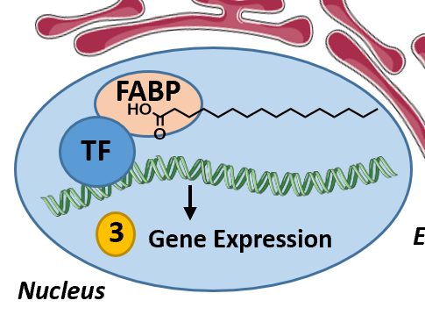
Lipid Tranport Across the Membrane
MAG
FFA
+ H₂O
Intestinal lumen
Lipase
Cytoplasm
Other Flippases?
Diffusion?
CD36
FATP
FABP
FABP
FABP
FABP
FABP
1
TAG Assembly
Chylomicron Formation
TF
2
3
Gene Expression
ER
β-oxidation
Nucleus
Mitochondria
Figure modified from Yan, A., et al (2016) In J Biol Sci 12(12):1544-1554 , Truthortruth, and Smart Servier Medical Art
Notes:
FABP/FFA complexes can also bind with transcription factors (TF) and mediate gene expression. These TFs increase the expression of genes involved in the oxidation and metabolism of lipids.

Slide 12
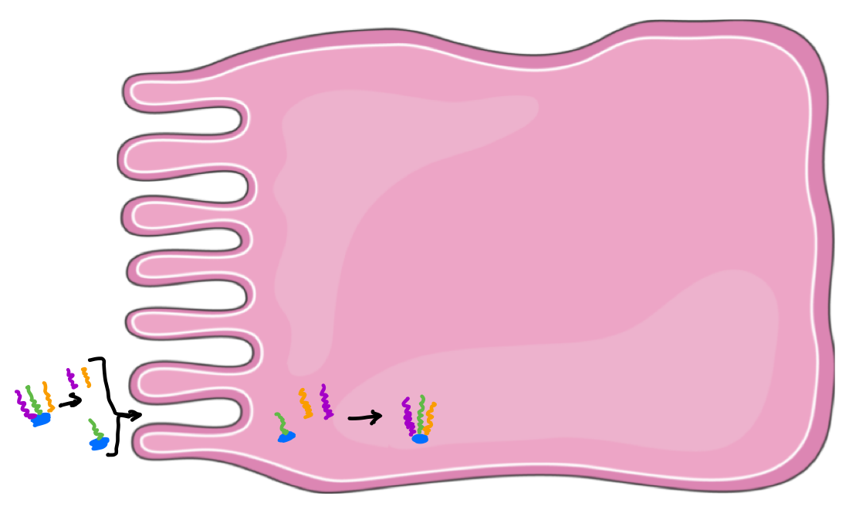

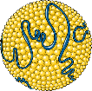

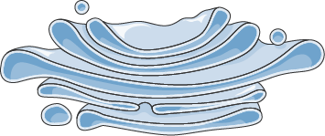
Lipid Packaging and Transport
To Lymph System
Apo-B48
Secretory
Vesicle
ER
Golgi
Figure modified from:
Smart Servier Medical Art
Notes:
Within enterocytes, FFAs and MAGs can travel to the endoplasmic reticulum where they are reassembled into TAGs. Dietary cholesterol is similarly converted to cholesterol esters. In the ER they are packaged into chylomicron structures which consist of a single phospholipid monolayer, cholesterol, and proteins known as apolipoproteins. One of the main apolipoproteins incorporated into chylomicrons is called Apo-B48. TAGs and cholesterol esters are carried inside of the chylomicron. Once packaged, the chylomicrons are carried in secretory vesicles to the plasma membrane where they are released on the basolateral side of the enterocyte into the lymph system.

Slide 13
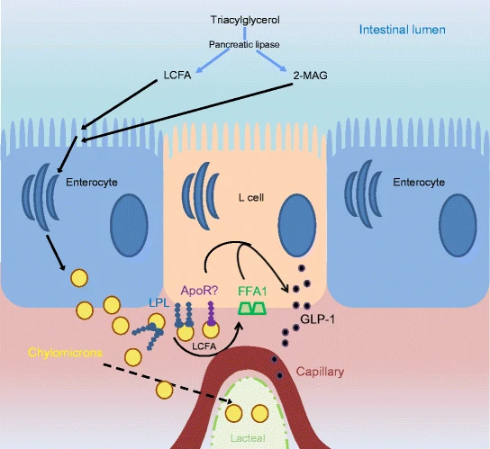
Chylomicron Release Causes Hormone Signaling
Enteroendocrine
Cell
Figure modified from Psichas, A., et al. (2017) Diabetologia 60:2475-2485
Notes:
Lipids are a potent stimulus for the secretion of the peptide hormones, glucagon-like peptide (GLP)-1 and glucose-dependent insulinotropic peptide (GIP) from the basolateral-side of the intestinal epithelial cells. Within the epithelial cells are specialized enteroendocrine cells that can sense lipid concentration. This model proposes a pathway for the release of these gut hormones through the sensing of chylomicron release from neighboring enterocytes possibly by direct chylomicron binding, or by the hydrolysis of TAGs carried by the chylomicrons to release free fatty acids (FFAs). FFAs can then activate G-protein coupled receptors, such as FFA1 and lead to the release of GLP-1 and GIP. These hormone peptides promote beta-cell proliferation in the pancreas and stimulate the glucose-dependent secretion of insulin. They are also thought to initiate feelings of satiety or fullness. GLP-1 agonists, such as Trulicity, have been shown to reduce blood glucose levels and are currently being marketed to patients with type 2 diabetes.

Slide 14
Lipid Digestion and Transportation
Remnant Recycling/Clearance
Skeletal and Heart Muscle
Adipocytes
Liver
Gall Bladder
Pancreas
Lymph System
Lipases + Bile Acids
Chylomicrons
Blood Stream
Lipids from food
Colon
Excretion
Small Intestine
Emulsified Fat Droplets
Images from Smart Servier Medical Art
Notes:
80%–95% of the chylomicron load are TAGs. Newly synthesized chylomicrons are then exported through the lymphatic system before entering the circulation, where they acquire other apolipoprotein components, such as apoC-II, apoC-III, and apoE. TAGs and cholesterol esters carried in the chylomicrons are delivered to target tissues such as skeletal and heart muscle, as well as adipose tissue. Remnant chylomicron particles are then taken up and recycled by hepatocytes in the liver.
(16) (PDF) Triglyceride-rich lipoproteins as a causal factor for cardiovascular disease. Available from: https://www.researchgate.net/publication/302555822_Triglyceride-rich_lipoproteins_as_a_causal_factor_for_cardiovascular_disease [accessed Mar 05 2020].

Slide 15
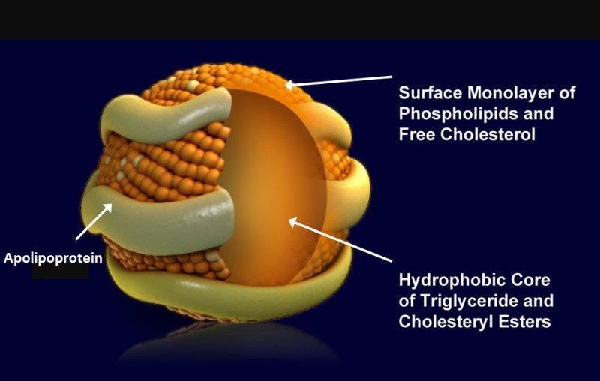
Lipoprotein Particles
Figure from: Feinglold, K.R. and Grunfeld, C. (2018) Entotext
Notes:
Chylomicrons are part of a larger family of molecules known as lipoproteins. All lipoproteins have a central hydrophobic core of non-polar lipids, primarily cholesterol esters and triglycerides. This hydrophobic core is surrounded by a hydrophilic membrane consisting of phospholipids, free cholesterol, and apolipoproteins. Lipoproteins resemble lipid micels in that they have a hydrophobic core and only contain a single phospholipid monolayer.

Slide 16
TAG and Cholesterol Structures
Triacylglycerides (TAGS)
Cholesterol
Figure from: Boris, TM
Structure by: Wolfgang Schaefer
Cholesterol
Esters
Figure from: Edgar181
Notes:
Cholesterol esters and TAGs are the primary lipids transported by lipoprotein particles.

Slide 17
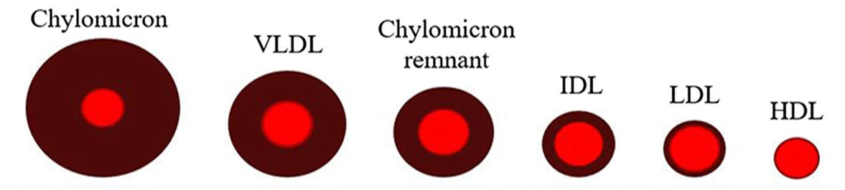
Lipoprotein particles
ULDL
Figure modified from: Su, X., et al. (2019) Lipids in Health and Disease 18:134
Notes:
There are five major types of lipoprotein, classified based on their density (hence their size) from ultra-low-density lipoproteins (the ULDL = chylomicrons) to very-low-density lipoprotein (VLDL), intermediate-density lipoproteins (IDL), low density liporpoteins (LDL) and high-density lipoproteins (HDL). Chylomicrons (CM) are the largest in diameter with the lowest density and the highest TAG content. Chylomicron remnants are in between VLDL and IDL in density. Cholesterol is transported by all lipoproteins and is particularly concentrated in HDL and LDL particles, noted by the red component.
(16) (PDF) Triglyceride-rich lipoproteins as a causal factor for cardiovascular disease. Available from: https://www.researchgate.net/publication/302555822_Triglyceride-rich_lipoproteins_as_a_causal_factor_for_cardiovascular_disease [accessed Mar 05 2020].

Slide 18
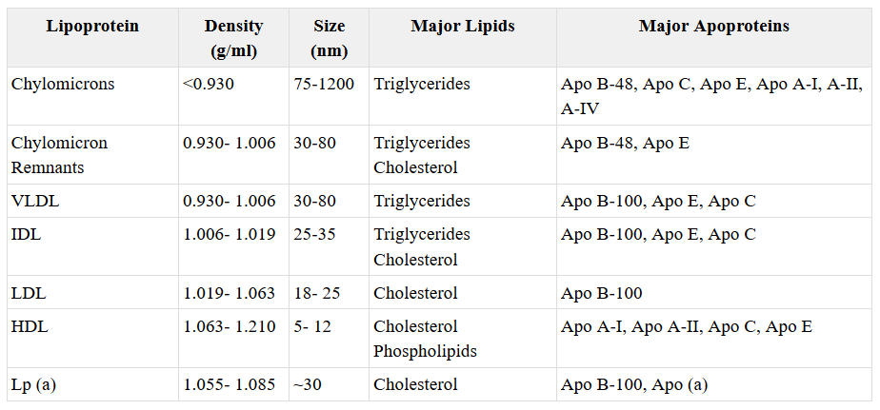
Lipoprotein Particles
Table from: Feinglold, K.R. and Grunfeld, C. (2018) Entotext
Notes:
Each class of lipoprotein particle contains unique apolipoproteins that can be used along with their density to identify them.

Slide 19
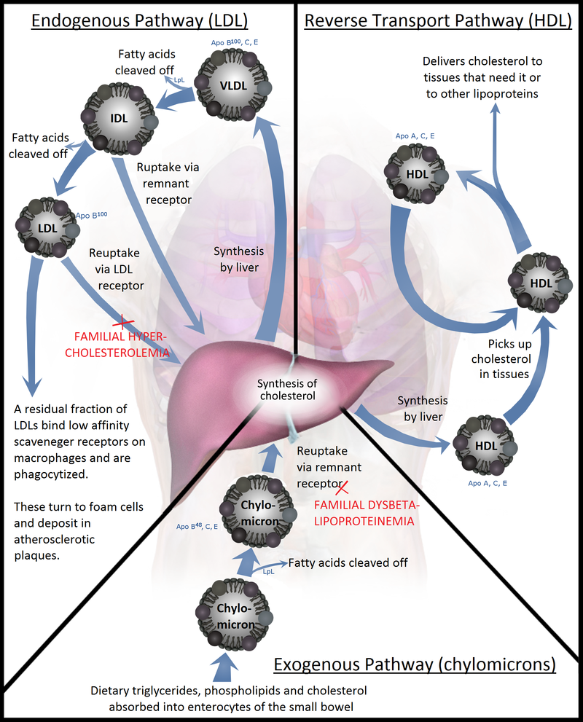
Figure from: Npatchett
Notes:
This diagram shows the major functions of the lipoprotein particles. Note that only the chylomicrons, that are produced by the enterocytes, introduce exogenous lipids from the diet into the system. Other biological lipids are synthesized in the liver and packaged into the other types of lipoprotein particles for delivery. VLDL particles are triacylglyceride-rich and primarily function to deliver TAGs to peripheral tissues. As VLDLs deliver TAGs their density is increased and they become IDLs. IDLs are thus, enriched in cholesterol content and are considered to be pro-atherogenic (or contribute to the process of atherosclerosis or hardening of the arteries). As IDLs deliver more of their TAG load to peripheral tissues they are further converted into LDLs. LDLs are further enriched in cholesterol content and in fact, LDLs carry the majority of cholesterol that is in the circulation. HDLs are the smallest lipoprotein particle and play a key role in reverse cholesterol transport from the peripheral tissues back to the liver where it can be recycled.

Slide 20
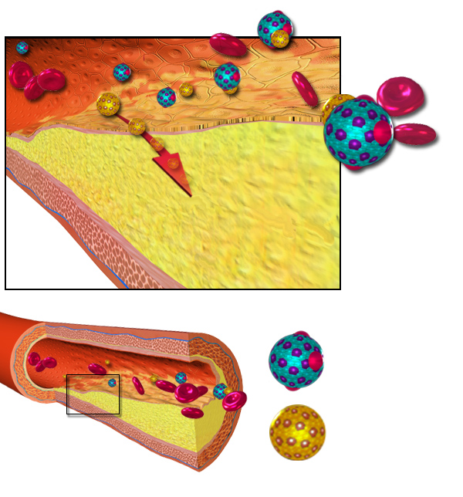
HDL vs LDL and Atherosclerosis
HDL
Atherosclerotic Plaque
LDL
Figure modified from: BruceBlaus
Notes:
An abundance of small dense LDL particles are seen in association with hypertriglyceridemia, low HDL levels, obesity, type 2 diabetes (i.e. patients with the metabolic syndrome) and infectious and inflammatory states. These small dense LDL particles are considered to be more pro-atherogenic than large LDL particles for a number of reasons. Small dense LDL particles have a decreased affinity for the LDL receptor resulting in a prolonged retention time in the circulation. Additionally, they more easily enter the arterial wall and bind more avidly to intra-arterial proteoglycans, which traps them in the arterial wall. Finally, small dense LDL particles are more susceptible to oxidation, which could result in an enhanced uptake by macrophages.
HDL particles remove cholesterol from circulation and are thought to be anti-atherogenic. In addition, HDL particles have anti-oxidant, anti-inflammatory, anti-thrombotic, and anti-apoptotic properties, which may also contribute to their ability to inhibit atherosclerosis.
Text modified from: Feinglold, K.R. and Grunfeld, C. (2018) Entotext

Slide 21
Healthy Lipid Profile
Test | Desired Level
Total Cholesterol | Under 200 mg/dL
LDL (bad) cholesterol | Under 100 mg/dL
HDL (good) cholesterol | Over 60 mg/dL
Triglycerides | Under 150 mg/dL
C-Reactive Protein (CRP) – standard test | Under 10 mg/L
C-Reactive Protein (hs-CRP) – high sensitivity | Under 2 mg/L (low risk for cardiovascular event)
Notes:
A healthy lipid profile is one where total cholesterol levels are under 200 mg/dL of blood plasma. LDL should optimally be below 100 mg/dL and HDL above 60 mg/dL. Total triglycerides should be under 150 mg/dL. Although it is not a lipid, the C-reactive protein is gaining more attention as another marker of cardiovascular health. In the high sensitivity test for this protein, optimal levels should be under 2 mg/L or 0.2 mg/dL

Slide 22
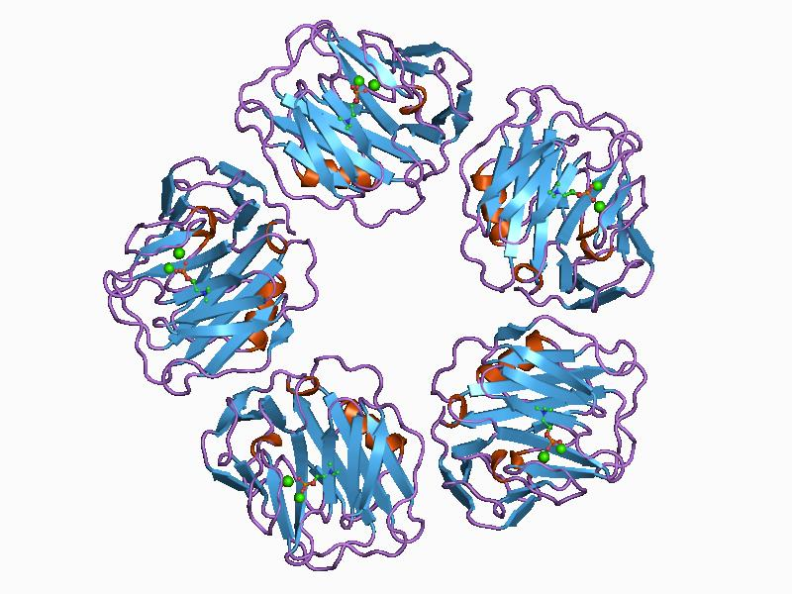
C-Reactive Protein
Figure by: Awahar Swaminathan and MSD staff at the European Bioinformatics Institute
Notes:
C-reactive protein (CRP) is a ring-shaped, pentameric protein found in blood plasma, whose circulating concentrations rise in response to inflammation. It is produced by the liver and binds to lysophosphatidylcholine expressed on the surface of dead or dying cells (and some types of bacteria) in order to activate the complement system and increase immune response. CRP concentrations between 2 and 10 mg/L are considered as metabolic inflammation: or states that lead to atherosclerosis and type II diabetes mellitus. In the next section, we will take a closer look at adipose tissue and see how fatty acids are released into the blood stream as an energy resource.

