Slide 1
Lipids
Beta-Oxidation of Odd Chain
and Very Long Fatty Acids
Notes:
Welcome to our lecture series on Lipids. Here we will learn about the beta-oxidation of odd chain fatty acids and other unique fats.

Slide 2
Odd Chain Fatty Acids
HCO₃⁻
P_{i}
+
ADP
+
ATP
Propionyl-CoA
Carboxylase
Methylmalonyl-CoA
Epimerase
Propionyl-CoA
D-Methylmalonyl-CoA
Methylmalonyl-CoA
Mutase
Succinyl-CoA
L-Methylmalonyl-CoA
Notes:
Odd chain fatty acids undergo standard beta oxidation until there are three carbons remaining. At this point, three additional enzymes are required to convert this intermediate to succinyl-CoA, which can then enter the Kreb Cycle. Propionyl-CoA is first converted to D-methylmalonyl-CoA by the Propionyl-CoA Carboxylase. Similar to other carboxylases we’ve investigated this term, this enzyme uses biotin as a cofactor and requires the hydrolysis of ATP to incorporate carbon dioxide (as bicarbonate) into the molecule. The next two enzymes are isomerases that rearrange the intermediates to succinyl-CoA.

Slide 3
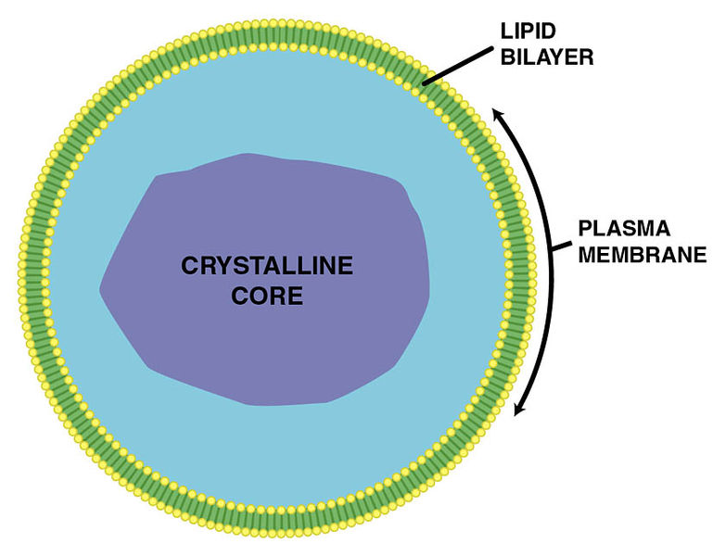
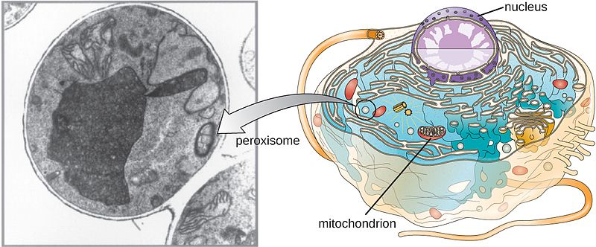
Very Long Chain Fatty Acids
β-Oxidation of very long chain fatty acids occurs in peroxisomes
Figures by: Anthony Atkielski and CNX OpenStax
Notes:
Very long chain fatty acids and other unique and branched fatty acids are processed within peroxisomes. Peroxisomes are oxidative organelles. They are involved in the catabolism of very long chain fatty acids, branched chain fatty acids, bile acid intermediates (in the liver), D-amino acids, and polyamines. Within the mechanism of many of these reactions the enzymes in the peroxisome cause the reduction of reactive oxygen species – specifically into hydrogen peroxide. To deal with this reactive species, catalase enzymes are also present within the peroxisome. In animal cells, the long fatty acids are converted to medium chain fatty acids, which are subsequently shuttled to mitochondria where they eventually are broken down to carbon dioxide and water. Peroxisomes also play a role in the production of bile acids important for the absorption of fats and fat-soluble vitamins, such as vitamins A and K.
Text adapted from: Wikipedia contributors. (2020, February 19). Peroxisome. In Wikipedia, The Free Encyclopedia. Retrieved 03:06, March 13, 2020, from https://en.wikipedia.org/w/index.php?title=Peroxisome&oldid=941629442

Slide 4
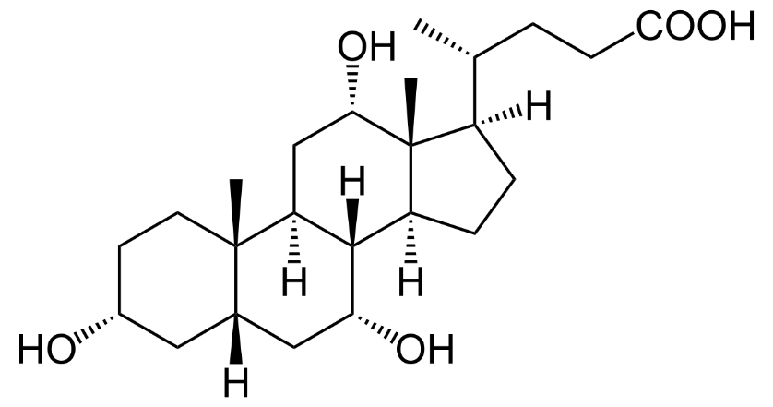
Unique Functions of Peroxisomes
Plasmalogens
LCFAs
Phytanic Acid
Bile acid with Cholic acid group
All Cis-4,7,10,13,16,19-Docosahexaenoic Acid
Notes:
There are a number of specific metabolic pathways that occur exclusively in mammalian peroxisomes. These include: the α-oxidation of phytanic acid (which is a digestive product released from chlorophyll), the β-oxidation of very long-chain and polyunsaturated fatty acids, conjugation of cholic acid as part of bile acid synthesis, and the biosynthesis of plasmalogens. Plasmalogens are unique glycerophospholipids that contain a vinyl ether group instead of a standard fatty acid. They make up about 15% of the phospholipids within the plasma membrane.

Slide 5
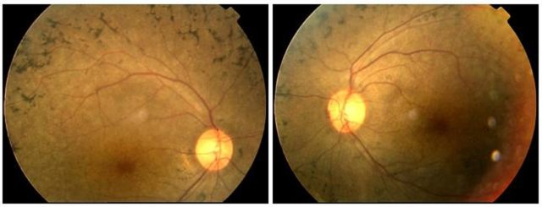
Refsum’s Disease
Retinitis Pigmentosa – shows changes of fundi, including lumps of pigment
Image by: Li, C., et al (2010) Molecular Vision 16:454-461
Notes:
Refsum’s disease is a genetic disorder causing the inability to degrade phytanic acid through the alpha oxidation pathway in peroxisomes. The accumulation of phytanic acid can cause numerous symptoms, including vision loss through a condition called retinitis pigmentosa. The first sign of vision loss is usually loss of night vision, which usually becomes symptomatic in childhood. It can lead to blindness. Refsum’s disease can also lead to a reduced sense of smell or anosmia. Most people with Refsum’s disease have these two symptoms. Other common symptoms that develop in some Refsum’s cases include muscle wasting, loss of coordination and balance (ataxia), hearing loss, and sometimes life threatening heart problems. Treatment is to eat a phytanic acid-restricted diet. Phytanic acid is mainly derived from consuming meat from ruminant animals. These animals have microorganisms that can release phytanic acid during chlorophyll breakdown. Humans usually cannot derive significant amounts of phytanic acid from consuming chlorophyll from plant materials in the diet. In the next section we will learn about the formation of ketoacids and the role that they play during starvation or in the development of diabetes.

