Slide 1
Lipids
Ketone Bodies, Cholesterol, and Diabetes
Notes:
Welcome to our lecture series on Lipids. Here we will learn about the synthesis of ketones in the liver and some of the related pathways. We will also discuss potential health benefits and consequences of these molecules.

Slide 2
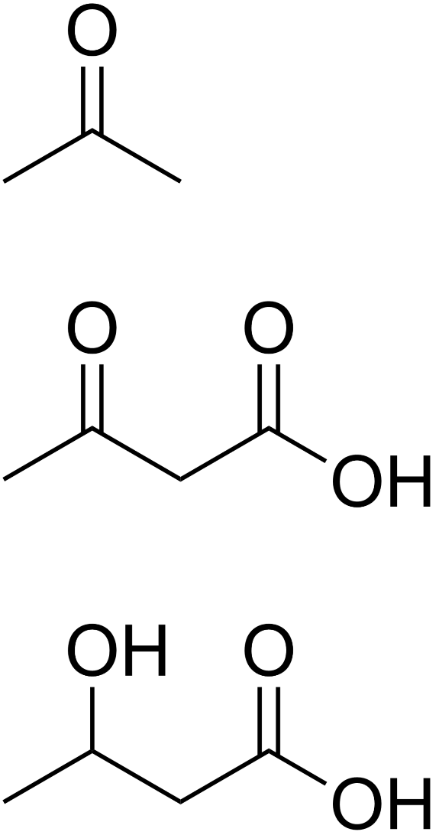
Ketone Bodies and Ketosis
Acetone
Acetoacetate
β-Hydroxybutyrate
Notes:
Ketosis is a metabolic state characterized by elevated levels of ketone bodies in the blood or urine. Physiologic ketosis is a normal response to low glucose availability, such as low-carbohydrate diets or fasting, that provides an additional energy source for the brain in the form of ketones. In physiologic ketosis, ketones in the blood are elevated above baseline levels, but the body's acid-base homeostasis is maintained. The two main ketones formed are acetone and acetoacetate. beta-hydroxybutyrate is also considered a ketone body (even though it is the alcohol or reduced form of acetoacetate).

Slide 3
Ketone Body and Cholesterol Biosynthesis
Acetyl-CoA
Acetyl-CoA
β-Ketothiolase
Acetoacetyl-CoA
Acetyl-CoA
HMG-CoA
Synthase
3-Hydroxy-
3-Methylglutaryl-CoA
(HMG-CoA)
HMG-CoA
Lyase
Many
Enzymatic
Steps
4 Enzymatic
Steps
Cholesterol
Isoprene Pyrophosphate
Acetyl-CoA
Acetoacetate
Notes:
Ketone bodies are synthesized along a similar pathway that cholesterol uses. Two acetyl-CoA molecules can be joined together by the beta-ketothiolase enzyme to generate acetoacetyl-CoA. Acetoacetyl-CoA is then converted to 3-hydroxy-3-methylglutaryl-CoA (HMG-CoA). HMG-CoA lyase converts HMG-CoA to Acetoacetate (a ketone body) and Acetyl-CoA is also recovered. Alternatively, HMG-CoA is also a precursor for the biosynthesis of isoprene pyrophosphate, the key building block for cholesterol biosynthesis.

Slide 4
Ketone Body and Cholesterol Biosynthesis
Acetyl-CoA
Acetyl-CoA
β-Ketothiolase
Acetoacetyl-CoA
Acetyl-CoA
HMG-CoA
Synthase
3-Hydroxy-
3-Methylglutaryl-CoA
(HMG-CoA)
Statin Drugs
HMG-CoA
Reductase
HMG-CoA
Lyase
Many
Enzymatic
Steps
4 Enzymatic
Steps
Cholesterol
Isoprene Pyrophosphate
Acetyl-CoA
Acetoacetate
Notes:
Within this pathway, the HMG-CoA Reductase enzyme would mediate the next step in isoprene biosynthesis. Notably this is the primary target of the statin drugs used to lower cholesterol and maintain heart health.

Slide 5
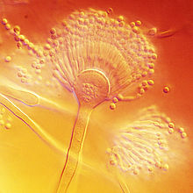
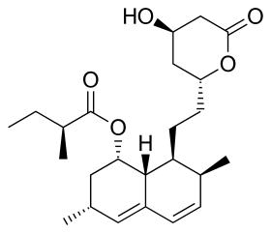
HMG-CoA Reductase Inhibitors
3-Hydroxy-3-Methylglutaryl-CoA
(HMG-CoA)
2 NADPH
HMG-CoA
Reductase
Aspergillus terreus
2 NADP⁺
+
CoASH
Statin Drugs
Lovastatin
Aspergillis photo from: Medmyco
Notes:
Lovastatin was the first statin drug to enter the market in 1987. It is a natural product isolated from the fungi, Aspergillus terreus. Since that time, many statin drugs have made it to market and over 100,000 people have participated in controlled trials with statin drugs. Most of these have been men (~85%), due in large part to the propensity for men to develop cardiovascular diseases earlier. They make up most of the heart patients. Studies have found that statin use results in a 25 – 40% reduction in male cardiac events and deaths. The use of statins for women has largely been extrapolated from studies with men. However, meta-analysis of combined data suggest that statins reduce the risk of cardiovascular events in women that already have heart disease and that women with heart disease are 26% less likely to die of a heart attack when taking statins. Statins may also reduce the risk for breast cancer, reduce gallstone formation and slow cognitive decline. Adverse effects from statin use are relatively low, but can include myalgia (muscle pain) and liver toxicity with long term use.

Slide 6
Ketone Bodies
β-hydroxybutyrate
Dehydrogenase
NAD⁺
HMG-CoA
Lyase
NADH
+ H⁺
β-Hydroxybutyrate
Acetyl-CoA
Acetoacetate
HMG-CoA
Spontaneous
Degradation
+ CO₂
Acetone
Notes:
As we noted, HMG-CoA can also be converted into acetoacetate and subsequently the other two major ketone bodies. Ketone bodies are produced by the liver when carbohydrates are in short supply, usually during fasting or starvation conditions. The liver cannot directly use ketone bodies as an energy resource, so they excrete them into the blood stream, where they mainly support the functioning of the brain, heart and skeletal muscles. These tissue systems can convert ketone bodies back into acetyl-CoA and utilize them as an energy source.

Slide 7

Ketogenic Diet Extends Life in Mice
Image by: Rasbak
Notes:
A study by Lopez-Dominguez showed that a low carbohydrate, ketogenic diet extends longevity in adult male mice. It improved motor function, memory and muscle mass during aging while also decreasing tumor formation. Biochemically, the researchers noted an increase in protein acetylation in the liver and skeletal muscle, although what role this played in the biological effects observed have yet to be determined.
https://doi.org/10.1016/j.cmet.2017.08.005

Slide 8
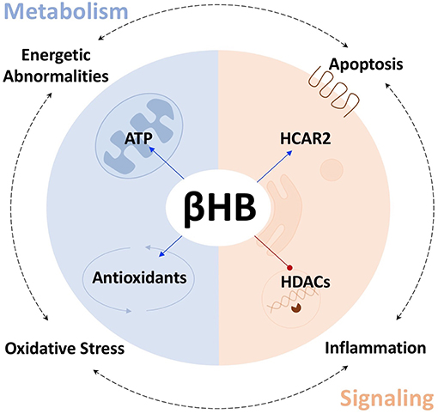
D-β-Hydroxybutyrate and Neural Health
Figure from: Norwitz, N.G., et al. (2019) Front. Nutr. 10.3389
Notes:
Beta-Hydroxybutyrate is gaining attention in neuronal health and may provide a new treatment avenue for disease states such as Parkinson’s Disease. It has been shown that lifestyle interventions that induce endogenous D-β-hydroxybutyrate production, such as caloric restriction and ketogenic diets, can increase healthspan and lifespan in animal models and potentially reduce the risk of age-related neurodegenerative diseases such as Alzheimer’s and Parkinson’s Disease. With regards to Parkinson’s Disease, beta-hydroxybutyrate has been shown to help reduce the death of dopaminergic neurons and help alleviate symptoms in mouse models. Biochemically, D-β-hydroxybutyrate has been shown to reduce overall cellular oxidative stress and increase the energetic performance of mitochondria, as well as regulate processes such as inflammation and apoptosis.

Slide 9
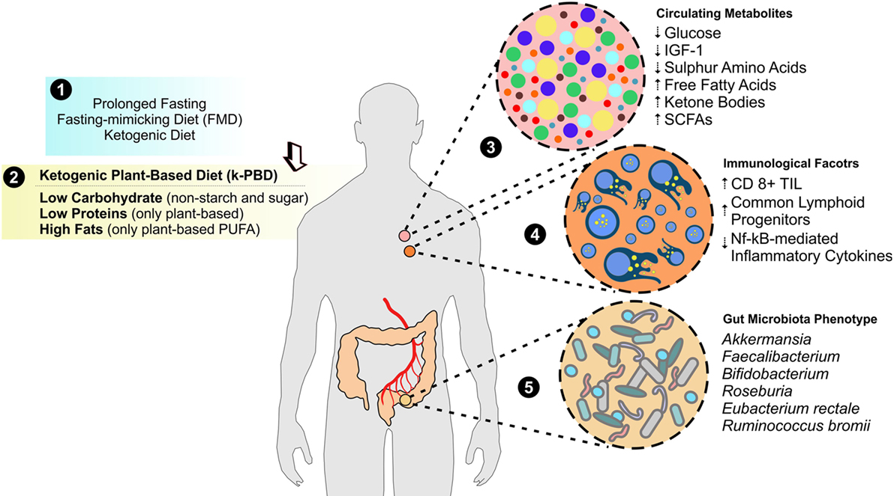
Fasting improves Cancer Treatment
Figure from: Letteiri-Barbato, D. and Aquilano, K. (2018) Front. Oncol:10.3389
Notes:
A number of studies have now shown that fasting and other diets that promote ketogenesis are effective adjuvants during cancer therapy. Adjuvants are modalities that improve the effectiveness of a treatment but in and of themselves to not display the desired effect. There are multiple effects of fasting that include reduced circulating glucose levels, reduced sulfur containing amino acids, and increased free fatty acids, ketone bodies, and short chain fatty acids. This alters gut microbiota and many systems within the body, such as inflammatory response. Overall, it is thought to create a hostile environment to cancer cells causing an increase in cell death when treated with chemotherapeutic agents. All and all, ketogenesis and fasting hold a lot of promise for increasing our healthspan.

Slide 10
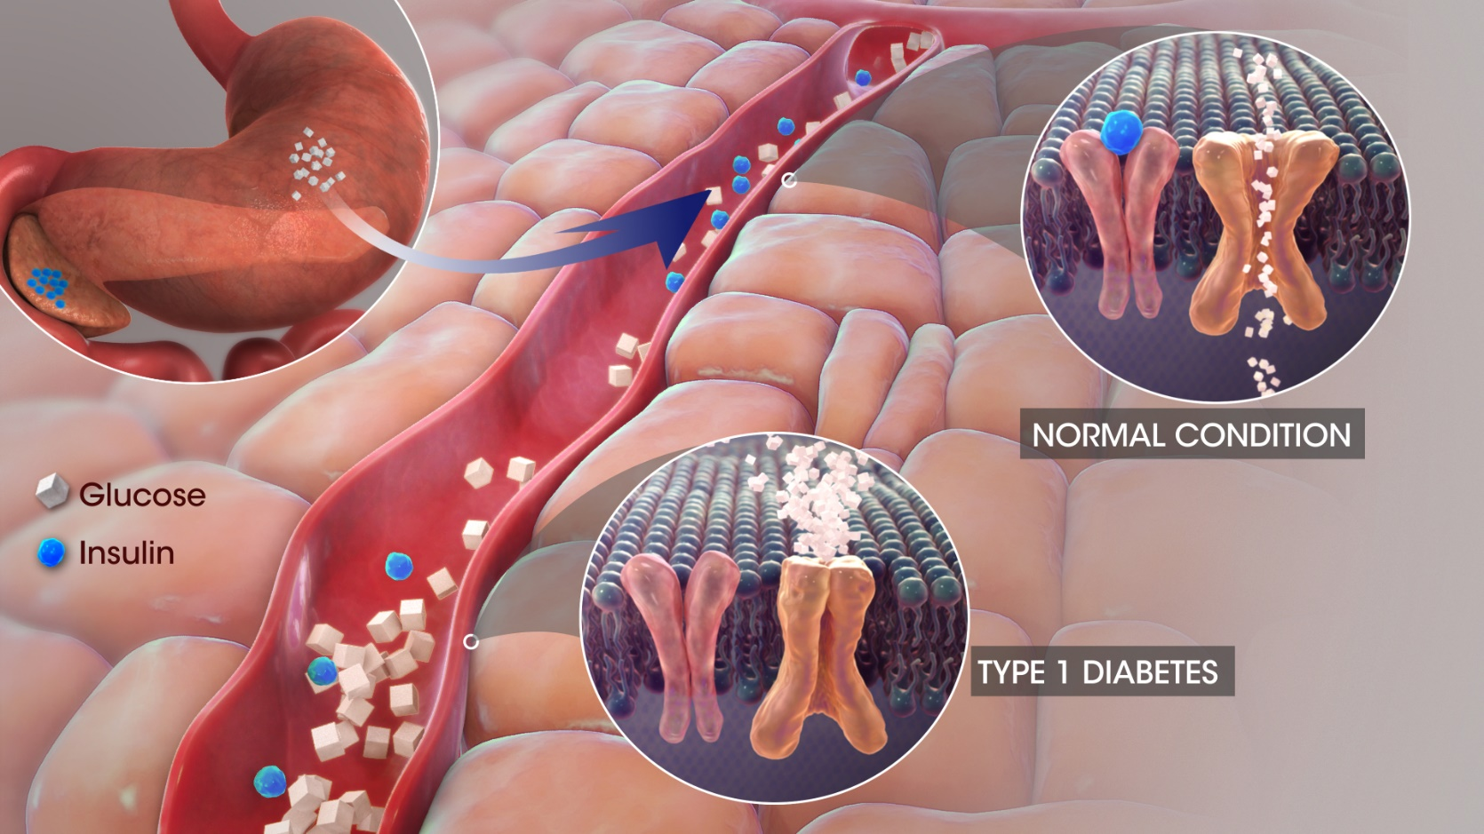
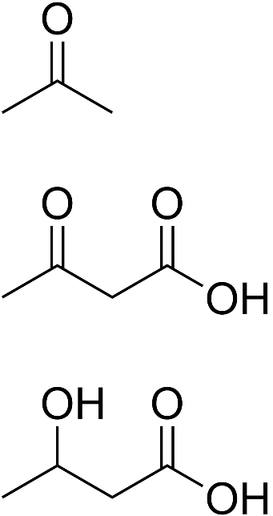
Diabetic Ketoacidosis
Acetone
Acetoacetate
β-Hydroxybutyrate
Image by: Scientific Animations
Notes:
The news about ketones in the blood is not all good. Under certain conditions, they can cause a dangerous drop in blood pH levels known as ketoacidosis. This occurs mainly in patients with Type I Diabetes. In Type I Diabetes there is insufficient insulin being produced by the pancreas. Because cells aren’t receiving signaling to take up glucose, blood levels of glucose rise, and cellular energy demands are not met. This causes an increase in glucagon release by the pancreas, as energy demand by the body is still high. Glucagon signaling increases cellular processes in the liver, such as glycogenolysis, gluconeogenesis, and ketogenesis. Fatty acid release from adipose tissue is also increased. Increased ketone bodies in the bloodstream causes a dangerous drop in blood pH, as these acetoacetate and beta-hydroxybutyrate are also acidic. Note that ketoacidosis only mildly occurs during intermittent fasting conditions, as the concentrations of ketones produced (1 mmol/L) is not high enough to significantly lower blood pH levels. Starvation times of 20 – 30 days are required to reach peak ketoacidosis levels (8 – 10 mmol/L)

