Slide 1
Lipids
β-Oxidation and Energy
Notes:
Welcome to our lecture series on Lipids. Here we will learn about the process of beta oxidation and energy production.

Slide 2
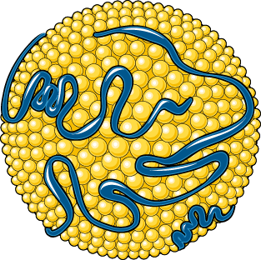
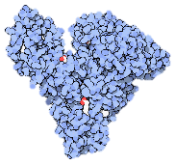


Lipid Utilization in Skeletal Muscle
Serum
Albumin
Lipoprotein
Extracellular
Cytoplasmic
CD36
FATP
ApoR
FABP
AMP + PPi
ATP
+ H₂O
FABP
Acyl-CoA
Synthetases
Lipases
FABP
+ CoASH
Figure modified from:
Yan, A., et al (2016) In J Biol Sci 12(12):1544-1554 and Servier Medical Art and Goodsell, D. (2012) Molecule of the Month, Protein Database
Notes:
When lipids are plentiful from uptake in the diet, or due to fatty acid release by adipose tissue, target cells, such as skeletal muscle will receive this energy payload. Free fatty acids are passed from serum albumin through transporters such as Fatty Acid Transporter Protein (FATP) and CD36. Lipoproteins can also bind with Apolipoprotein Receptors (ApoR) and release triacylglycerides (TAGs) into the cell. TAGs will then be broken down into free fatty acids (FFAs) and glycerol by lipase enzymes. FFAs will be chaperoned by Fatty Acid Binding Proteins (FABPs) within the cytosol. If energy levels are low in the cell, the fatty acids will be targeted to the mitochondria, where they can be oxidized and utilized in the Kreb cycle to produce ATP. The first step in this process is to transfer the fatty acids across the mitochondrial inner membrane. Thus, the fatty acids must first be activated to the Coenzyme A-associated form to begin this journey. Note that this in an energy utilizing step, where ATP is consumed in the process. This is similar to the first stage of glycolysis where there needs to be energy investment before there can be energy gain.

Slide 3
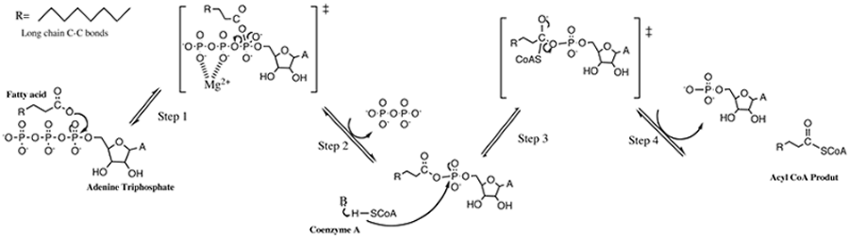
Fatty Acyl-CoA Synthetases
Part 1: The Fatty Acid is Activated by
covalent bond formation with ATP
Part 2: The adenylate is a good leaving group
and is replaced by CoASH
Fatty Acyl-CoA
Product
Fatty Acyl-Adenylate
Intermediate
Figure modified from: SeverinShockin
Notes:
Here is a more detailed mechanism of the Fatty Acyl-CoA Synthetase Enzymes. In the first step, the carbonyl oxygen from the fatty acid attacks the first phosphate position, creating the first transition state. Magnesium from the enzyme coordinates with the other two phosphate groups, and helps to mediate their dissociation. This creates the fatty acyl-adenylate intermediate. The adenylate serves as a good leaving group for the second half of the reaction where CoASH mediates attack on the carbonyl carbon of the acetate group. The adenylate (AMP) is kicked out and Fatty acyl-CoA is released as the product of the reaction.

Slide 4
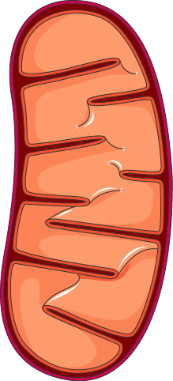
Lipid Utilization in Skeletal Muscle
Serum
Albumin
Lipoprotein
Extracellular
Cytoplasmic
CD36
FATP
ApoR
FABP
AMP + PPi
ATP
+ H₂O
FABP
Acyl-CoA
Synthetases
Lipases
FABP
+ CoASH
Figure modified from:
Yan, A., et al (2016) In J Biol Sci 12(12):1544-1554 and Servier Medical Art and Goodsell, D. (2012) Molecule of the Month, Protein Database
The CREB protein is also activated when bound to the cAMP molecule. This causes the CREB protein to translocate from the
Notes:
With the formation of the Fatty acyl-CoA, the fatty acid is now prepared to move into the mitochondrial matrix.

Slide 5
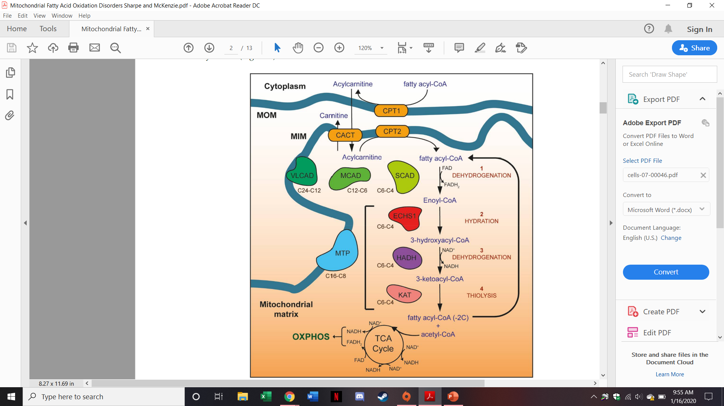
Overview of Mitochondrial Pathways
Figure from: Sharpe, A.J., and McKenzie, M. (2018) Cells 7(46)doi:10.3990
Notes:
Here is an overview of the mitochondrial pathways needed for the oxidation of fatty acids during energy utilization. The first step is to move the fatty acid from the cytoplasm into the matrix of the mitochondria. As we have seen for other molecules, this is usually not a straight forward process. Fatty acids are no different. They require these three proteins, embedded in the mitochondrial outer membrane (MOM) or the mitochondrial inner membrane (MIM) to mediate the transfer. We will look at this process in more detail in the next few slides. We will then focus on the beta-oxidation pathway, which is the catabolic pathway involved in oxidizing the fatty acids to generate acetyl-CoA and electron carrier molecules (NADH and FADH2). And you are already familiar with the third step, where acetyl-CoA is further oxidized in the Kreb Cycle (Tricarboxylic Acid or Citric Acid Cycle) to release carbon dioxide and more electron carriers.

Slide 6
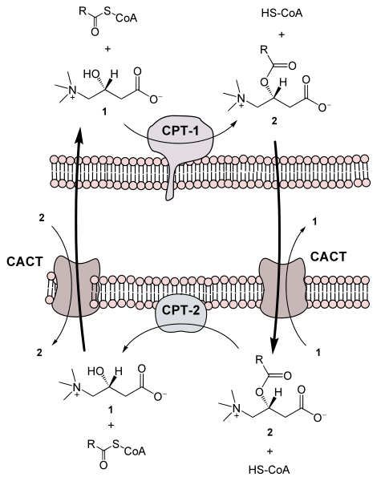
Carnitine Palmitoyl Transferases 1 and 2
Figure from: Yikrazuul
Notes:
L-carnitine is a derivative of the amino acid, lysine and was first isolated from meat in 1905, hence the name carnitine. In this reaction, the carnitine palmitoyl transferase-1 (CPT-1) enzyme enables the alcohol functional group on carnitine to attack on the carbonyl carbon of the fatty acyl-CoA. Coenzyme A then serves as a good leaving group for the carnitine reaction. The resulting product, fatty acyl-carnitine, is then transported into the matrix of the mitochondria through a translocase protein. Once in the matrix, the CPT-2 enzyme completes the reverse reaction and restores the fatty acyl-CoA and empty carnitine. Note that the translocase used in this reaction is an antiporter. Carnitine moves from the matrix into the cytoplasm when a fatty acyl-carnitine moves into the matrix of the mitochondria.

Slide 7
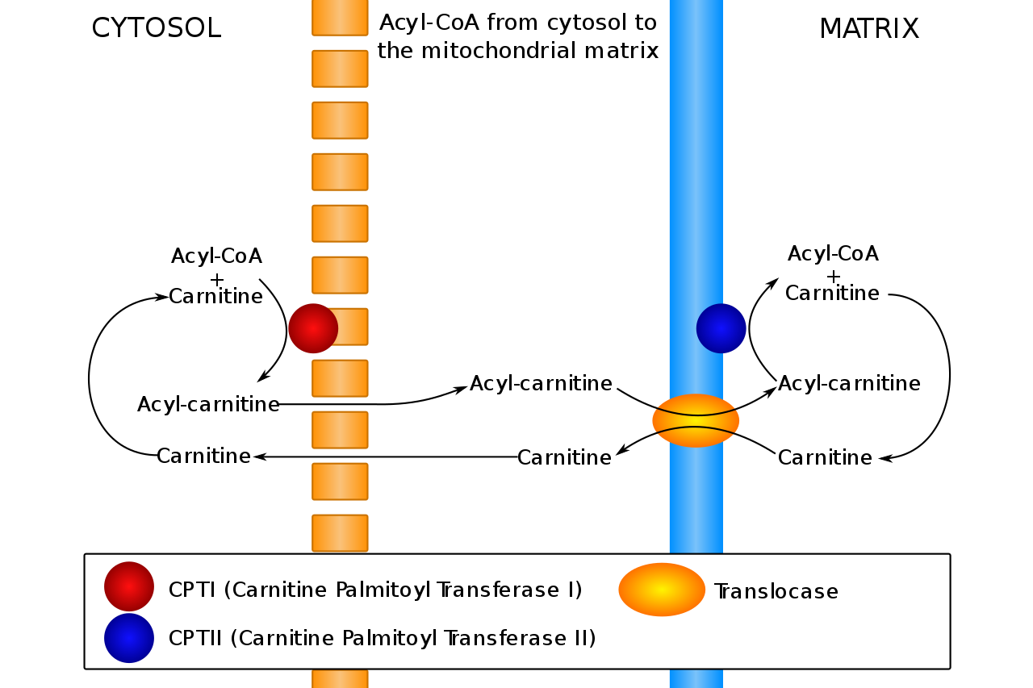
Carnitine Palmitoyl Transferases I & II
Figure from: Slagt vectorization
Notes:
This is another schematic summary of this transport process. The acyl-coA is converted to acyl-carnitine, which allows the movement of the molecule through the translocase antiporter into the matrix. Free carnitine moves into the cytoplasm at the same time. Once in the matrix, the acyl-carnitine is converted back to fatty acyl-CoA.

Slide 8
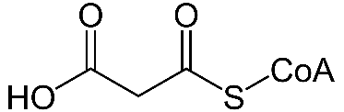
CPT-1 is the Rate Limiting Step in LCFA Oxidation
P
Acetyl-CoA
Carboxylase
AMP-Activated
Kinase
Malonyl-CoA
Acetyl-CoA
Carboxylase
Acetyl-CoA
Malonyl-CoA
Fatty Acid Biosynthesis
Figure from: Yikrazuul
Notes:
The Carnitine Palmitoyl Transferase I (CPT-1) is the rate limiting step for the beta-oxidation or breakdown of long chain fatty acids (LCFAs). It is inhibited by Malonyl-CoA. Malonyl-CoA is a 3-carbon unit that is formed as an intermediate during fatty acid biosynthesis. Thus, it is the opposite pathway of fatty acid oxidation, similar to what we saw with glucose during glycolysis and gluconeogenesis. The activation of fatty acid synthesis is dependent on two conditions. The first is that there are a lot of precursor molecules present (ie a lot of acetyl-coA). This will serve as substrate for making malonyl-CoA. The second condition is that there is plenty of energy present in the cell. If ATP levels are high and AMP levels are low, then fatty acid biosynthesis and the storage of energy molecules makes sense. If energy levels are low and a lot of AMP is present, the AMP-activated kinase will phosphorylate Acetyl-CoA Carboxylase and inhibit the production of malonyl-CoA. If malonyl-CoA levels are low, CPT-1 will remain active and fatty acids will be transported into the matrix where they will be used to produce ATP.

Slide 9
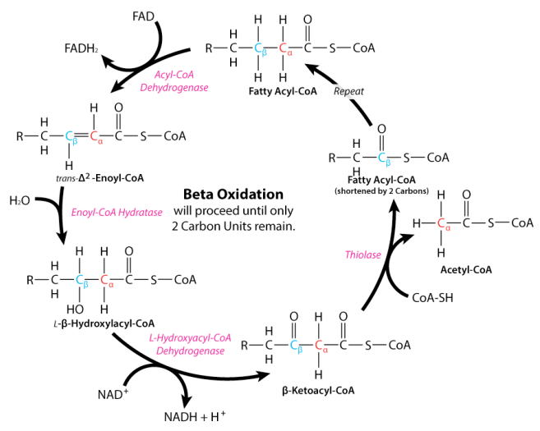
Overview of β-Oxidation
Notes:
This is an overview of the four major steps in the beta oxidation pathway. We will look at each of these individual steps in detail over the next few slides.

Slide 10
STEP 1: Acyl-CoA Dehydrogenase
Dehydrogenase Activity (Create FADH₂)
Lyase Activity between the alpha and beta positions
FADH₂
FAD
β
α
β
α
Trans Δ² Enoyl-CoA
Notes:
The first enzymatic step in the pathway is a dehydrogenation step that is mediated by an acyl-CoA dehydrogenase enzyme. This enzyme mediates the removal of two hydrogens and two electrons (one each from the alpha and beta carbon positions). Recall that the alpha carbon is located directly next to the carbonyl carbon, and that the beta position is located 2 carbons away from the carbonyl carbon. Within this mechanism, the two electrons and two protons removed from the fatty acid, reduce a molecule of FAD to FADH2. The remaining electrons previously shared in these bonds, fold inward and form the C=C double bond. This forms a Trans delta 2 enoyl-CoA intermediate. Thus, this reaction step is also a lyase reaction.

Slide 11
STEP 2: Enoyl-CoA Hydratase
Add water across the C=C double bond
The –OH is added to the beta position
β
α
H₂O
β
α
β-Hydroxy Acyl-CoA
Notes:
In STEP 2, water is added across the C=C double bond in a hydratase reaction. The hydroxyl group is added to the beta carbon position and the hydrogen to the alpha position, forming a beta-hydroxy acyl-CoA intermediate.

Slide 12
STEP 3: Hydroxyacyl-CoA Dehydrogenase
Dehydrogenase Activity (Create NADH + H⁺)
Formation of Ketone at the beta position
NADH
+ H⁺
NAD⁺
β-Ketoacyl-CoA
Notes:
The newly formed hydroxy group is further oxidized to a ketone during step 3. Two electrons and two hydrogens are removed from the hydroxy-carbon at the beta position and donated to the electron carrier, NAD+. This results in the formation of a ketone at the beta position forming the intermediate, beta-ketoacyl-CoA.

Slide 13
STEP 4: β-Ketothiolase
Cleaves off 2 carbon unit (Acetyl-CoA)
Formation of Acyl-CoA Ketone 2 carbon units shorter
CoASH
+
Notes:
In the final enzymatic step, the C-C bond between the alpha and beta carbons is cleaved by the addition of the CoASH. The H from the CoASH is incorporated into the newly formed acetyl-CoA product, and the CoA-S incorporated into remaining fatty acyl chain, forming a fatty acyl-CoA that is two carbons shorter that the original one. This process is repeated until the entire fatty acid has been oxidized to acetyl-CoA.

Slide 14
Overview of Mitochondrial Pathways
Figure from: Sharpe, A.J., and McKenzie, M. (2018) Cells 7(46)doi:10.3990
Notes:
Now let’s go back to our overview slide and take a look in a little more detail. The first step in the beta oxidation pathway is the dehydrogenation (or lyase) reaction.

Slide 15
Overview of Mitochondrial Pathways
Figure from: Sharpe, A.J., and McKenzie, M. (2018) Cells 7(46)doi:10.3990
Notes:
This can be completed in the mitochondria by one of three enzymes that depend on the nature of the fatty acid serving as the substrate. Very long chain fatty acids (greater than 12 carbons in length or most of the fatty acids incorporated into TAGs) will be dehydrogenated by the VLCAD (very long chain acyl dehydrogenase) enzyme. Medium long chain fatty acids (between 6 – 12 carbons in length) will be dehydrogenated by MCAD (medium chain acyl dehydrogenase) and short chain fatty acids (between 4 – 6 carbons in length) will be dehydrogenated by SCAD (short chain acyl dehydrogenase).

Slide 16
Overview of Mitochondrial Pathways
Figure from: Sharpe, A.J., and McKenzie, M. (2018) Cells 7(46)doi:10.3990
Notes:
The next three steps can be completed by three independent enzymes (ECHS1 – the enoyl-coA hydratase; HADH – the beta-hydroxy acyl dehydrogenase enzyme; and KAT – the beta-ketoacylthiolase enzyme) or by a single super enzyme that has all three of these activities, known as MTP (mitochondrial trifunctional protein). Similar to VLCAD, MTP is embedded in the innermembrane of the mitochondria and is used for long chain fatty acids, mostly between 8 – 16 carbons in length. Although deficiencies in this enzyme do result in accumulation of C18 carbons as well, suggesting that MTP also has activity on these fatty acids. The soluble, individual enzymes in this pathway are used for carbons between 4 and 6 carbons in length. Thus, as a fatty acid progresses through repeated cycles of beta oxidation, the machinery used to generate the acetyl-CoA units will switch to the soluble enzymes, once the length of the fatty acid has been sufficiently reduced.

Slide 17
Overview of Mitochondrial Pathways
Figure from: Sharpe, A.J., and McKenzie, M. (2018) Cells 7(46)doi:10.3990
Notes:
In the end, each round of beta-oxidation yields one acetyl-CoA that can enter the Kreb Cycle, and a fatty acyl-CoA that is two carbons shorter. In the next section, we will discuss how you can calculate the amount of ATP produced through the utilization of fatty acids.

