Slide 1
CH451 Biochemistry II
Review of Amino Acids and Chirality
Notes:
In this lecture, we will review the basic concepts of chirality within organic molecules as well as the structures of the 20 amino acids involved in protein synthesis

Slide 2
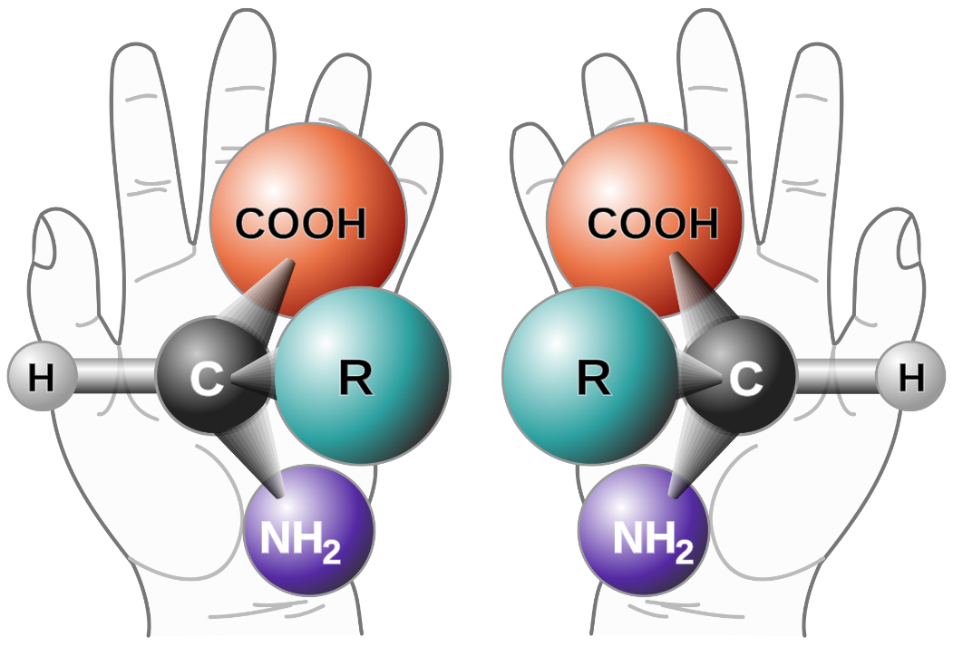
Chirality
Chiral and Achiral Molecules
A chiral molecule is one that is not superimposable with its mirror image.
Carbon becomes chiral when it has four different groups attached
Image By: πϵρήλιο
Notes:
Carbohydrates will be one of the first topics that we will cover during this term. The structures of this class of major macromolecule rely heavily on the formation of isomers and stereoisomers. Thus, we will begin by reviewing concepts of stereochemistry and chirality, using the familiar structures of amino acids in our example. This will give us an opportunity to review the 20 major amino acids used in protein biosynthesis, as they will also continue to be important in our discussions of metabolism. 19 of the 20 proteogenic amino acids are chiral in nature. This means that they are not superimposable with their mirror image and that they contain four different functional groups bonded to the carbon center. In the case of the amino acid, this includes the carboxylic acid functional group, the amine functional group, the various R-groups, and the hydrogen. Only glycine, which contains hydrogen as its R-group does not have chirality.

Slide 3
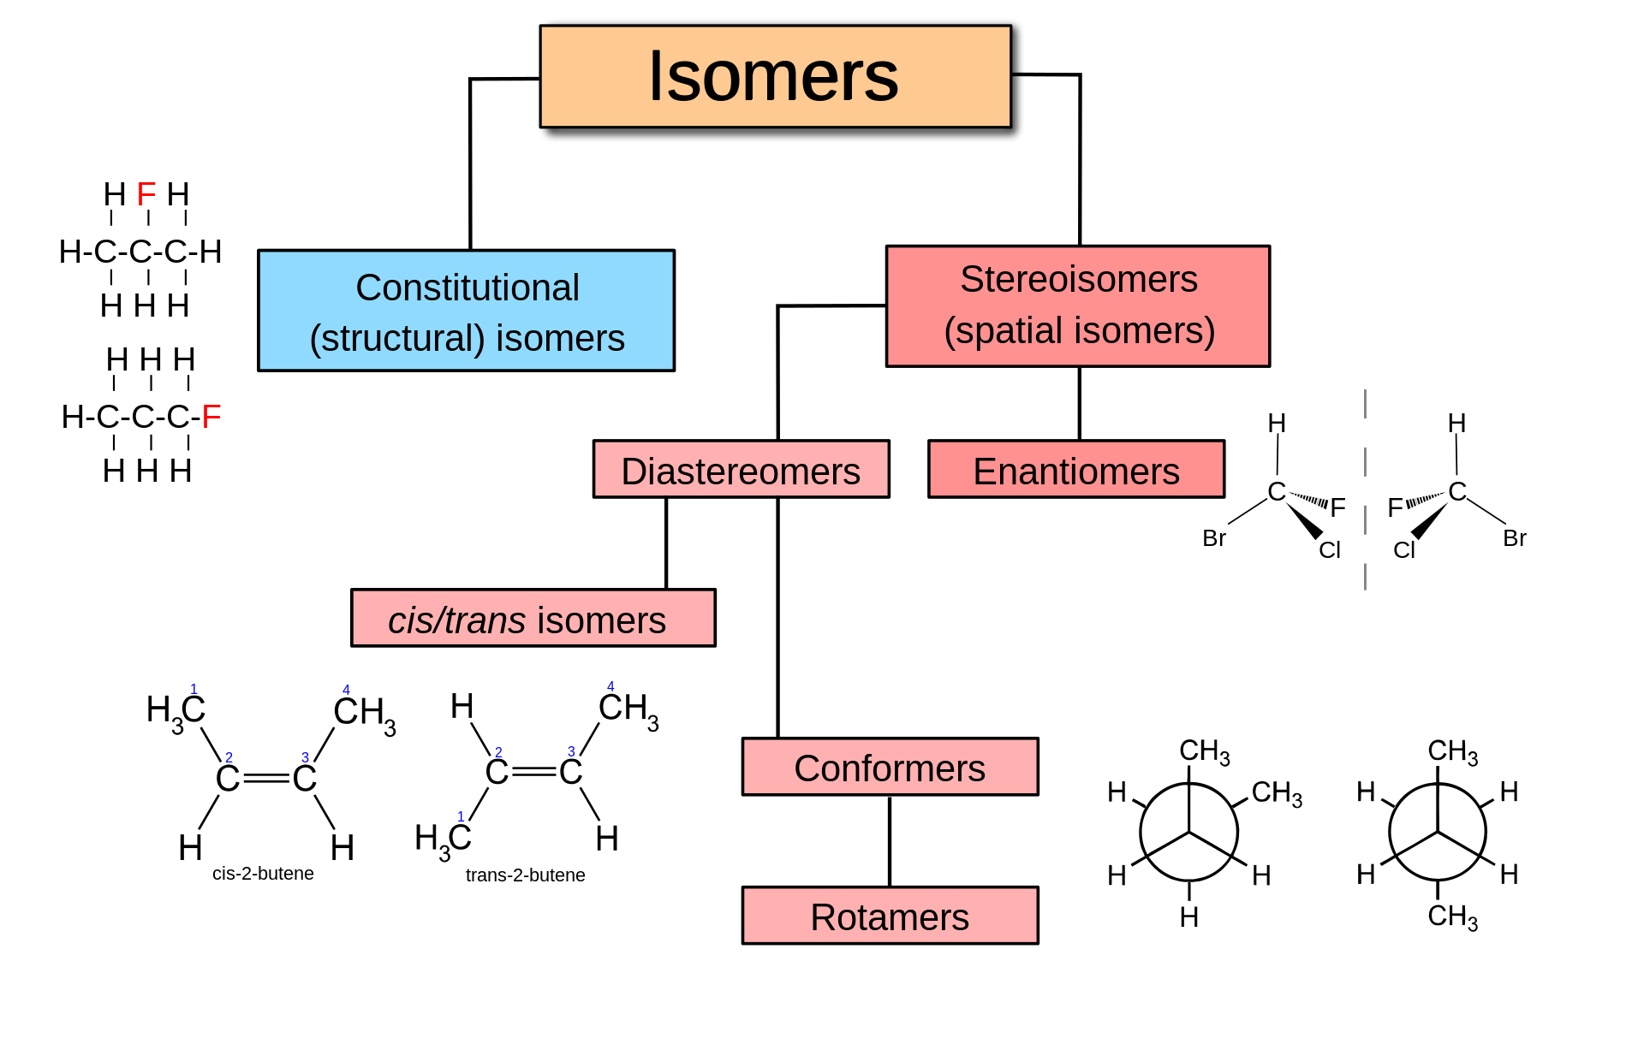
Image by: Vladsinger - Own work, CC BY-SA 3.0,
Notes:
This chirality that is inherent to many organic molecules, gives rise to a number of different types of isomers. Structural or Constitutional Isomers (shown on the left in blue) are the simplest type of isomer. They have the same molecular formula, but have different bonding patterns of the atoms within space. Stereoisomers, on the other hand, have the same molecular formula, and also have the same bonded order of atoms within the structure. Only the spatial arrangement of the bonded atoms differ in stereoisomers. Stereoisomers can be divided into two types: the diastereomers and the enantiomers. Diastereomers are stereoisomers that are not related through a reflective operation (ie. They are not mirror images of eachother). We will come back to this type of stereoisomer in more detail during our introduction to carbohydrates in the next section. Here we will focus a little more on the other type of stereoisomer, the enantiomer. Enantiomers are known as optical isomers and have mirror images that are not superimposable.

Slide 4
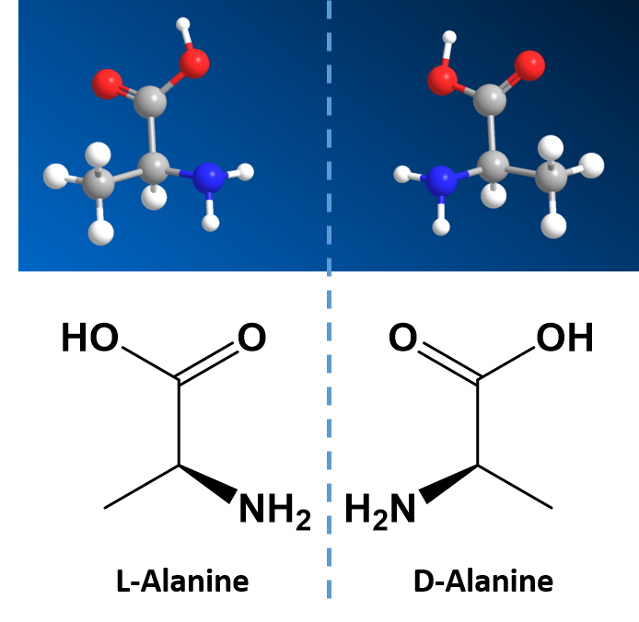
Enantiomers
Enantiomers are the mirror image versions of chiral molecules.
Same molecular formula
Same order of atoms bonded together
Same chemical and physical properties, EXCEPT…
Notes:
Enantiomers, as introduced in the last slide, are the mirror image versions of chiral molecules. They have the same molecular formula and the same connection of the atoms in space. The mirror image versions are NOT superimposable. However, they have physical properties that are nearly identical to one another, making it very difficult to tell them apart from one another or to separate from one another. Because of this nature, they are given a special stereoisomer name called enantiomers and in fact, the compounds themselves are given the same name!

Slide 5
Enantiomers
Enantiomers are the mirror image versions of chiral molecules.
EXCEPT the ability to rotate plain polarized light
Right-handed = Dextrorotary (D-)
Left-handed = levorotary (L-)
Notes:
These molecules do differ in the way that they rotate plain polarized light and the way that they react with and interact with biological molecules, such as receptors and enzymes. Molecules that rotate the light in the right-handed direction are called dextrorotary and are given a D- letter designation. Molecules that rotate light in the left-handed direction are called levorotary and are give an L- letter designation to distinguish one enantiomer from the other.

Slide 6
Enantiomers
In Nature:
Amino acids are predominantly in the L-conformation
Sugars are predominantly in the D-conformation
Notes:
Notably, amino acids formed in nature are predominantly in the L-conformation, while natural sugars occur in the D-conformation. The D- and L- forms of alanine are shown here.

Slide 7
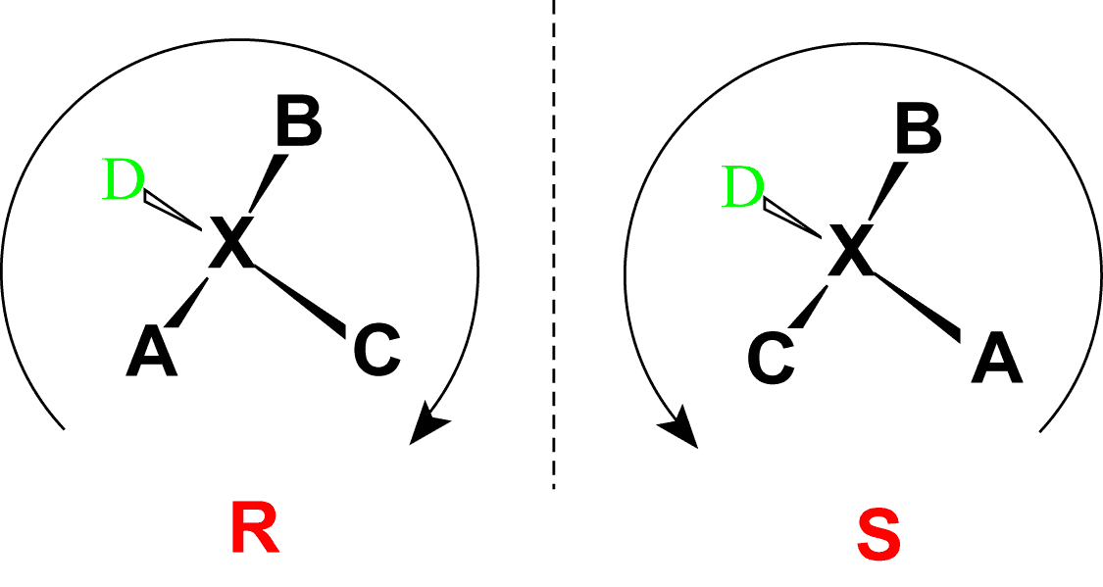
Absolute Stereoconfiguration
An Absolute Configuration refers to the spatial arrangement of the atoms of a chiral molecule and are given the stereodescription of:
R- referring to Rectus
S- referring to Sinister
Assigned using the Cahn-Ingold-Prelog Priority Rules
Notes:
Note that the D- and L-designations are specific terms used for the way a molecule rotates plain polarized light. It does not denote the absolute stereo configuration of a molecule. An absolute configuration refers to the spatial arrangement of the atoms of a chiral molecular entity (or group) and its stereochemical description are given the R- or S- designation, referring to Rectus, or Sinister, respectively. The absolute configurations for a chiral molecule (in pure form) are most often obtained by X-ray crystallography.

Slide 8
Cahn-Ingold-Prelog Priority Rules
Notes:
In the Cahn-Ingold-Prelog system for naming chiral centers, the groups attached to the chiral center are ranked according to their atomic number with the highest atomic number receiving the highest priority (A in the diagram above) and the lowest atomic number receiving the lowest priority (D in the diagram above). The lowest priority is then pointed away from the viewer to correctly orient the molecule for further evaluation. The path of priorities #1, #2, and #3 (corresponding to A, B and C above) are then traced. If the path is is in the clockwise direction, the chiral center is given the R-designation, whereas if the path is counterclockwise, it is given the S-designation.

Slide 9
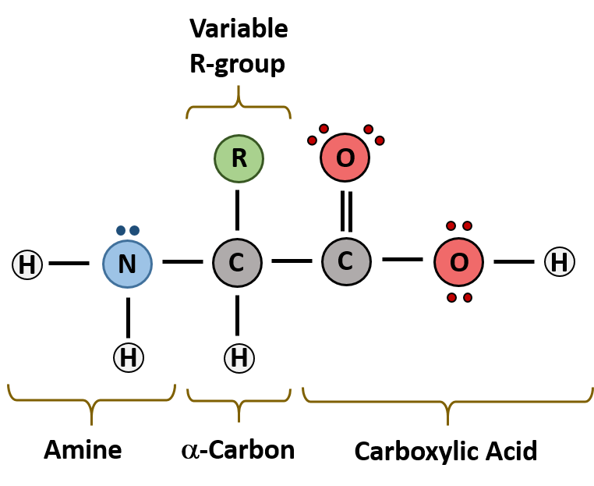
Alpha Amino Acids
Notes:
Note the core structure of alpha amino acids, which are incorporated into protein structures. There is the basic amine functional group attached to the alpha carbon, followed by the carboxylic acid functional group. The alpha carbon also contains one bond to a hydrogen atom and the other to the variable R-group that differs for each of the 20 different amino acids.

Slide 10
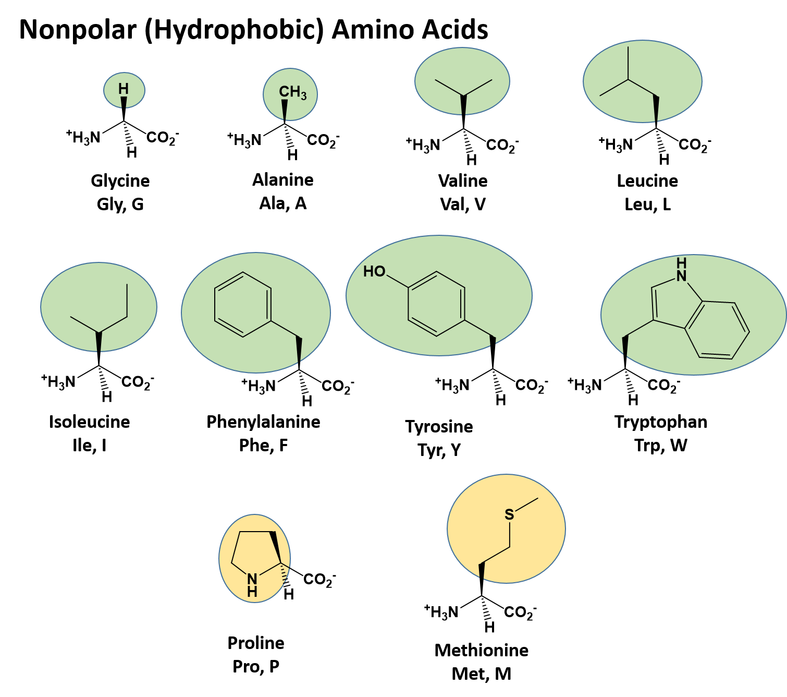
Notes:
These include the Nonpolar (Hydrophobic) Amino Acids. Within this class are the: (1) Aliphatic (straight and branched-chain) amino acids such as glycine, alanine, valine, leucine, and isoleucine, the (2) Aromatic amino acids, phenylalanine, tyrosine and tryptophan, and the (3) unique nonpolar amino acids, proline and methionine.

Slide 11
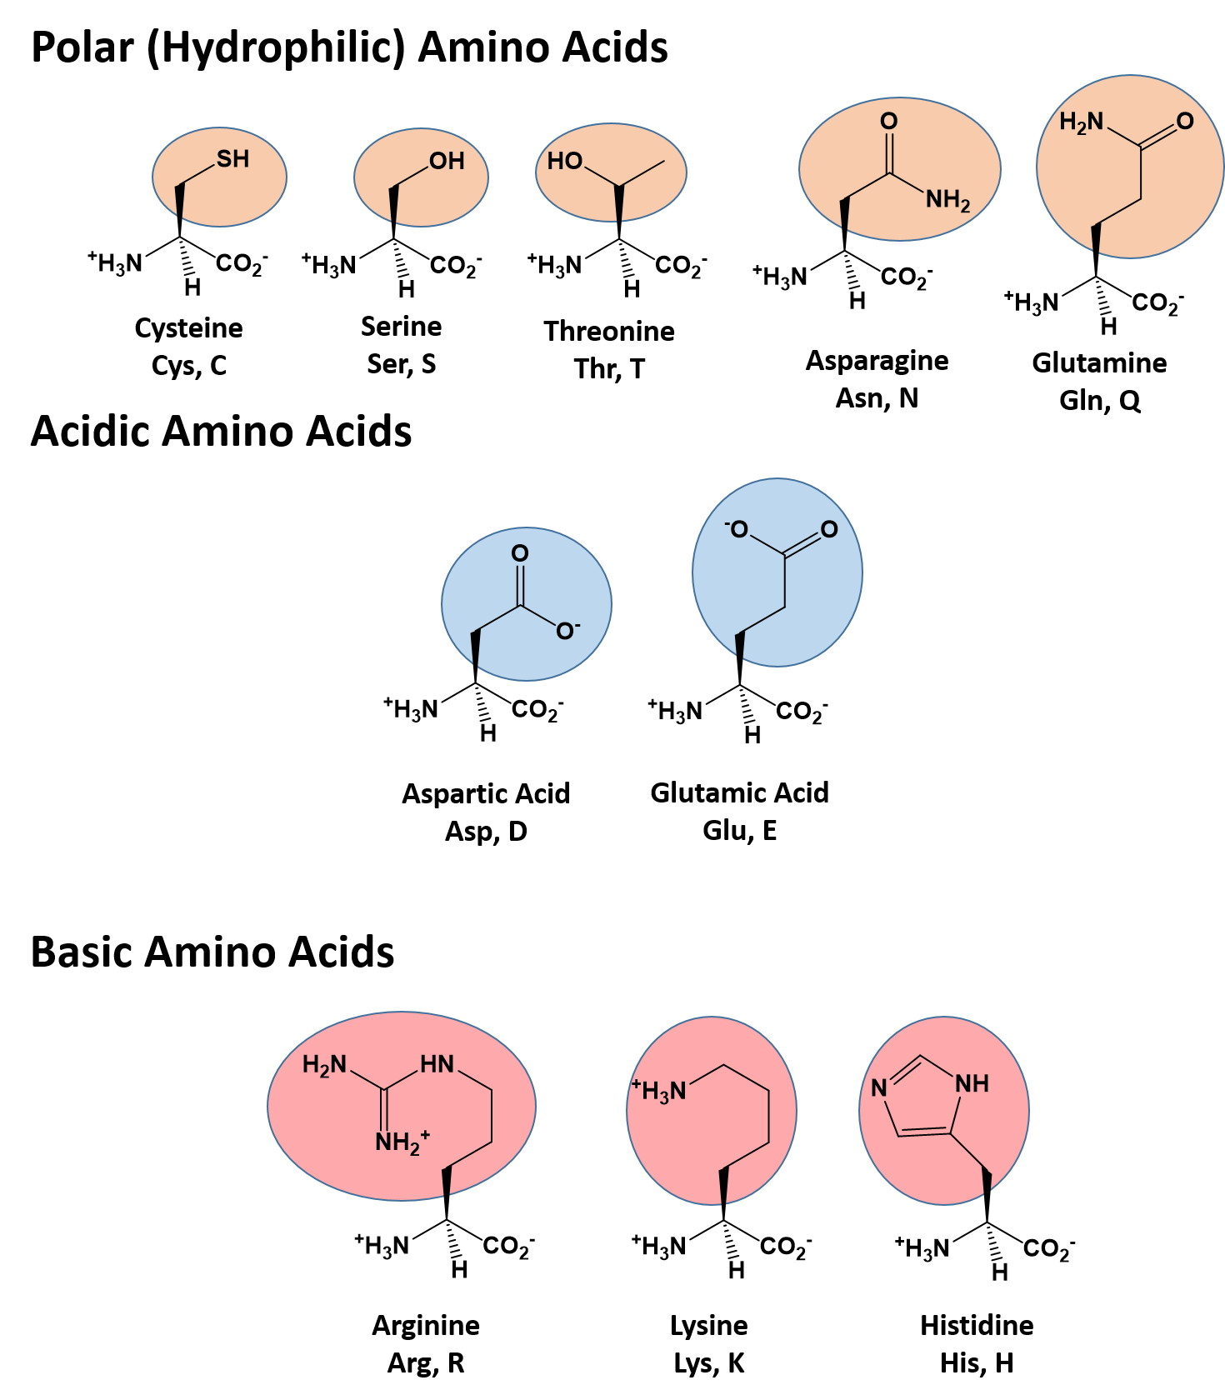
Notes:
And the Polar (Hydrophilic) Amino Acids. Within this class are the: (1) Polar uncharged amino acids such as cysteine, serine, threonine, asparagine, and glutamine, the (2) Acidic amino acids – aspartic acid and glutamic acid, and the (3) Basic amino acids, arginine, lysine and histidine.

Slide 12

Isomers and Stereochemistry
Carbohydrate and Lipid Function and Metabolism
Enzymatic Activity and Regulation
Receptor Activation and Biological Response Mechanisms
Notes:
In the next section, we will begin to explore how the stereochemistry of carbohydrates, lipids, and other small organic molecules regulate enzyme activity, receptor activation, and biological responses.

Slide 13
Enzyme Classes
Six Major Classes of Enzymes:
Oxidoreductases – Mediate Redox Reactions
Transferases – transfer a functional group from one
molecule to another
Hydrolases – mediate hydrolysis/dehydration reactions
Lyases – Add or remove groups to form double bonds
Isomerases – Mediate intramolecular rearrangements
Ligases – Join two substrates using the energy of ATP
hydrolysis
Notes:
So before we leave this section, let’s end with a brief review of the 6 major enzyme classes. You will be learning more about these types of reactions throughout the term, as they are used during the metabolism of carbohydrates and lipids. The first are oxidoreductases which function to add or remove electrons from substrates. And recall that both reactions need to occur. Electrons are removed from one molecule and donated to another. Oxidation and Reduction always occur together. Transferases are enzymes that mediate the transfer of one functional group from a donor to an acceptor molecule. Hydrolases mediate the breakdown of substances by the addition of water to the compound. They also mediate the opposite reaction, dehydration synthesis, where water is removed from two molecules to join them together. All of the major macromolecules are synthesized and broken down using dehydration synthesis or hydrolysis, respectively. Lyases add or remove double bonds. Isomerases cause intramolecular rearrangements. Thus, the molecular formula of the compound stays the same. The molecule is just converted into another isomer. And finally, ligases use the energy of ATP to join to molecules together. We saw a ligase involved in sealing the phosphate-sugar backbone of DNA. In the next section, we will begin learning about the structure, function and metabolism of carbohydrates.

