Slide 1
The Electron Transport Chain
Part 3: Complex III
Notes:
Welcome to part 3 of our lecture on the Electron Transport Chain.

Slide 2
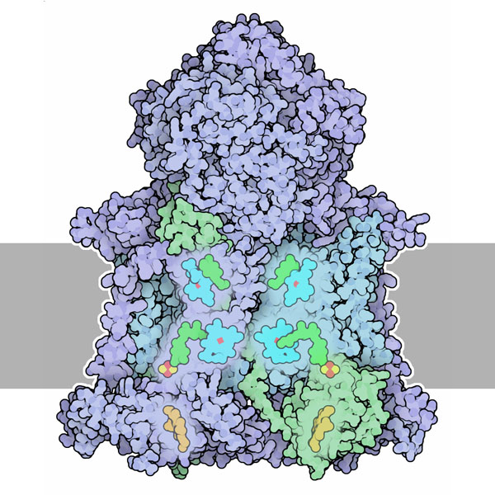
Complex III: Q/Cytochrome C Oxidoreductase
Receives QH₂
Transfers electrons to shuttle protein called Cytochrome C
Transfers 4 protons (H⁺) into the intermembrane space
Removes 2 more protons (H⁺) from the matrix
Image modified from : Goodsell, D. (2012) Molecule of the Month, Protein Database
Notes:
Complex III is the Q-Cytochrome C Oxidoreductase (also called Cytochrome bc1 for the heme cofactors that it binds) It is a dimeric protein. Each half is composed of 11 protein chains and a complex collection of cofactors, including several hemes and an iron-sulfur cluster. The role of Complex III in the electron transport chain is to transfer the electrons carried by Coenzyme Q from Complexes I and II, to a small shuttle protein known as Cytochrome C. In this process, it transfers 4 H+s to the intermembrane space and takes an additional 2 H+s from the matrix.

Slide 3
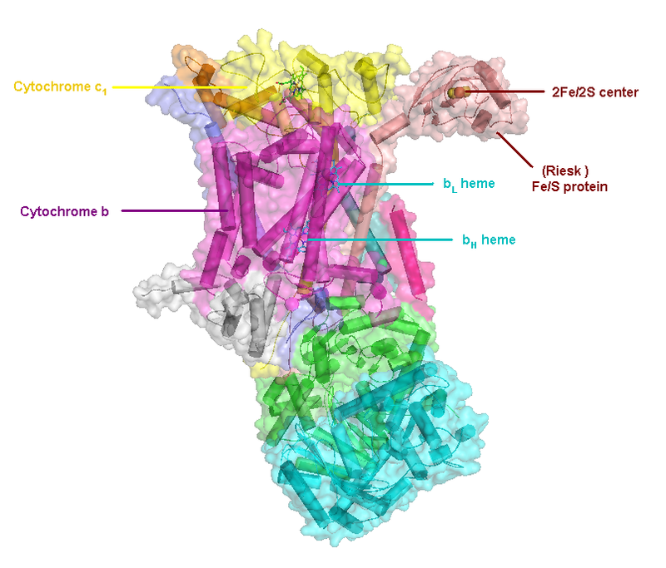
One Dimer of Complex III
Complex III has many cofactors and subunits:
Subunit Cytochrome c₁
Cofactor c1 heme
Subunit Cytochrome b
Cofactor b_{L} heme
Cofactor b_{H} heme
Rieski Subunit
Iron/Sulfur Complexes
e)
Image from Wikiwand
Notes:
Here is one half of the Complex III dimer with the cofactors used to transport electrons listed. Structures of several different forms have been determined. The 3D structures have revealed the location of the cofactors and two paths that electrons follow. Two of the major protein subunits are cytochromes (meaning that they bind with heme cofactors). The top subunit shown in yellow is called Cytochrome C1 because it binds to a heme group that adopts the C-conformation. The lower subunit is known as Cytochrome b, as it binds with two heme groups in the b-conformation. And a third important subunit is the Reiske subunit that binds the Fe/S complexes used in the transfer of electrons to the electron carrier Cytochrome C (which is a separate protein and should not be confused with the Cytochrome C1 subunit shown here). There are also two binding sites for Coenzyme Q, that will be discussed in more detail over the next few slides. Structural analysis has also uncovered many complex details, such as an unusual motion of the Reiske subunit holding the iron-sulfur cluster, and scientists are still working out how the entire process occurs without short-circuiting the cycle.

Slide 4
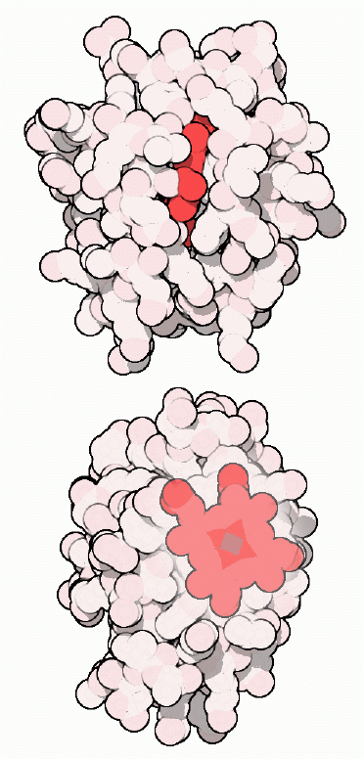
Cytochrome C
Peripheral Membrane Protein
Cytosolic Side
Electron Carrier between Complex III and IV
Also involved in Apoptosis
Image modified from : Goodsell, D. (2012) Molecule of the Month, Protein Database
Notes:
Cytochrome C, shown here, is a small, water soluble protein that associates as a peripheral membrane protein with the innermitochondrial membrane on the cytosolic side. Its main purpose is to carry or shuttle electrons between Complex III and Complex IV of the electron transport chain, but it is also involved in the process of apoptosis (which we will discuss later). To mediate its electron carrying function, Cytochrome C contains a heme group with an iron ion gripped tightly inside, colored red here. The iron ion readily accepts and releases a single electron. Thus, Cytochrome C can carry electrons from Complex III to Complex IV, one at a time. It also can only carry electrons. It cannot carry protons (H+) This is a problem as we have been transferring 2 electrons & 2 protons as a unit, up until this point! In this case, the electrons have to move through radical transfer instead of as a pair.

Slide 5
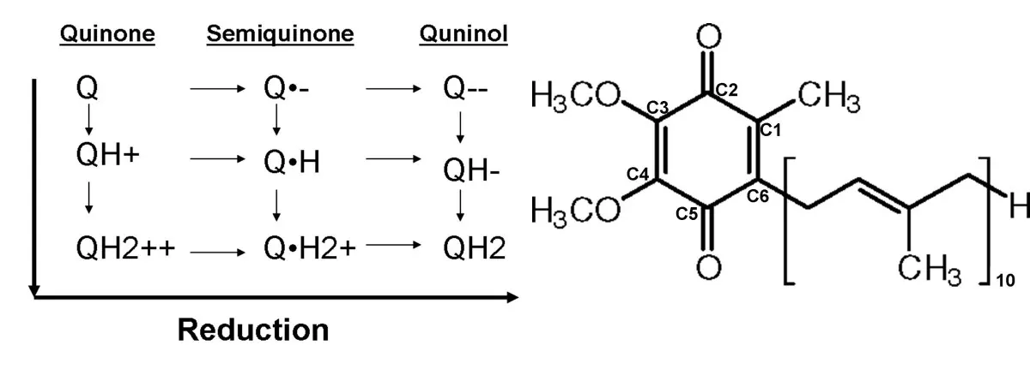
Coenzyme Q (Ubiquinone)
Can have 9 Redox States
Figure from Madeo, J., et al. (2013) Springer Plus 2: 139
Notes:
The Coenzyme Q is capable of existing in many different oxidation states, so radical transfer is possible, but it would be inefficient, and likely unsustainable, to only take one electron from QH2 and then release it back into the inner membrane pool of Coenzyme Q when housing a single electron and two protons. If the Q pool has a significant portion of the Q in this partially-filled radical state, it will NOT be able to pick up pairs of electrons from Complex I and Complex II. It also cannot be accepted by Complex III in this state. Thus, the energy from the electrons of our food molecules would be wasted, and our available Q-pool to accept electrons and protons from our food molecules would shrink with every round. Similar to all of the other electron carriers, oxidized Q must be recycled after every round of use, so that it can be reused in the cycle. So how does Complex III solve this electron transfer problem?

Slide 6
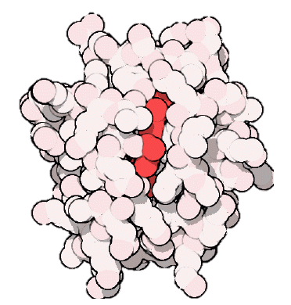
The Q Cycle: Part 1
Intermembrane Space
H+
H+
H+
H+
e-
e-
Q
e-
e-
e-
e-
Q
H+
Q
Q
H+
H+
H+
H+
e-
e-
Q
H+
Q
H+
Q
Q
Q
H+
Matrix
H+
H+
H+
H+
H+
Image modified from : Goodsell, D. (2012) Molecule of the Month, Protein Database
Notes:
It uses a process known as the Q-Cycle. In the first part of this Cycle. One fully reduced molecule of Coenzyme Q binds in a Q-site close to the cytosolic side of the membrane. This is followed by the binding of a completely oxidized Q molecule in a lower Q-site that is closer to the matrix of the mitochondria. A molecule of Cytochrome C then binds with the Complex

Slide 7
The Q Cycle: Part 1
H+
H+
H+
H+
e-
e-
Q
e-
e-
e-
e-
Q
Q
H+
Q
H+
H+
H+
H+
e-
e-
Q
H+
Q
H+
Q
Q
H+
Q
H+
H+
H+
H+
H+
Image modified from : Goodsell, D. (2012) Molecule of the Month, Protein Database
Notes:
Once these labile cofactors are bound to Complex III, the two protons attached to the Coenzyme Q are released into the intermembrane space. One electron is then transferred up to Cytochrome C, and the other electron is transferred down to partially reduce the lower Q molecule.

Slide 8
The Q Cycle: Part 1
H+
H+
H+
H+
H+
H+
e-
e-
e-
Q
Q
Q
e-
e-
Q
H+
H+
H+
e-
e-
Q
H+
Q
H+
Q
Q
H+
e-
Q
H+
H+
H+
H+
H+
Image modified from : Goodsell, D. (2012) Molecule of the Month, Protein Database
Notes:
At this point, the fully oxidized Coenzyme Q in the upper binding site floats out of the protein and back into the inner membrane pool of Coenzyme Q. The Cytochrome C that has been loaded with one electron leaves Complex III and travels to Complex IV to deliver the electron. The partially reduced Coenzyme Q stays bound to Complex III.

Slide 9
The Q-Cycle Part 2
H+
H+
H+
H+
H+
H+
e-
e-
Q
e-
e-
e-
e-
Q
H+
Q
Q
H+
H+
H+
H+
e-
e-
Q
H+
Q
H+
Q
Q
H+
Q
e-
H+
H+
H+
H+
H+
Image modified from : Goodsell, D. (2012) Molecule of the Month, Protein Database
Notes:
In part 2 of the Q-cycle, a second fully reduced Coenzyme Q molecule binds with Complex III. An oxidized Cytochrome C carrier protein also binds.

Slide 10
The Q-Cycle Part 2
H+
H+
H+
H+
H+
H+
e-
e-
Q
e-
e-
e-
e-
Q
Q
H+
Q
H+
H+
H+
H+
e-
e-
Q
H+
Q
H+
Q
Q
H+
Q
e-
H+
H+
H+
H+
H+
Image modified from : Goodsell, D. (2012) Molecule of the Month, Protein Database
Notes:
The two protons from the reduced Coenzyme Q are transferred to the intermembrane space. One electron is then shuttled to the Cytochrome C carrier, and the other transferred to the partially reduced Coenzyme Q.

Slide 11
The Q-Cycle Part 2
H+
H+
H+
H+
H+
H+
H+
H+
e-
e-
e-
Q
Q
Q
e-
e-
Q
H+
H+
H+
e-
e-
Q
H+
Q
H+
Q
Q
H+
e-
Q
e-
H+
H+
H+
H+
H+
Image modified from : Goodsell, D. (2012) Molecule of the Month, Protein Database
Notes:
The fully oxidized Coenzyme Q is then released back into the Q-pool and the reduced Cytochrome C carrier leaves for Complex IV. The fully reduced Coenzyme Q molecule in the lower binding site attracts two protons from the matrix of the mitochondria.

Slide 12
The Q-Cycle Part 2
H+
H+
H+
H+
H+
H+
H+
H+
e-
e-
Q
Q
Q
e-
e-
Q
H+
H+
H+
e-
e-
Q
H+
Q
H+
Q
Q
H+
H+
e-
Q
e-
H+
H+
H+
H+
Image modified from : Goodsell, D. (2012) Molecule of the Month, Protein Database
Notes:
This fully reduced form of Coenzyme Q is then released back into the Q-pool where it is then free to dock into the upper Q-binding site in Complex III and begin the cycle again.

Slide 13
Complex III: End Result for 1 NADH or 1 FADH
4 protons (H+) are transferred into the intermembrane space
2 more protons (H+) are removed from the matrix
2 molecules of Cytochrome C are reduced
2 molecules of Coenzyme Q are fully oxidized, but 1 molecule of Coenzyme Q is fully reduced (Net use of 1 QH₂)
Image modified from : Goodsell, D. (2012) Molecule of the Month, Protein Database
Notes:
The net energy coming in from 1 molecule of NADH at Complex I or FADH2 at Complex II, will cause Complex III to shift 4 protons into the intermembrane space and remove 2 additional protons from the matrix. It will also reduce two molecules of Cytochrome C and fully oxidize a total of 1 Coenzyme Q molecule, since the Q-cycle oxidizes 2 but then reduces 1 Coenzyme Q.

Slide 14
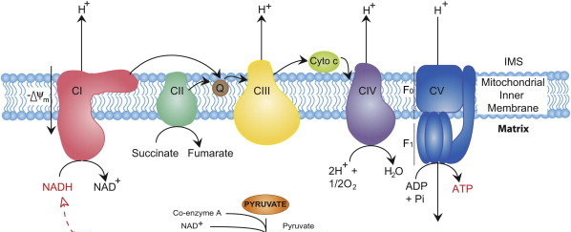
Summary of the Electron Transport Chain
4 H⁺
4 H⁺
2 H⁺
10 H⁺
3 ADP
+Pi
3 ATP
From Kreb Cycle
Notes:
This is a cartoon summary of the entire electron transport chain. Complex I harvesting electrons derived from NADH of the Kreb Cycle to produce 1 molecule of Coenzyme Q and pump 4 protons across the membrane. Complex II harvests the electrons from the succinate dehydrogenase reaction of the Kreb cycle and feeds them through FADH2 and other iron-sulfur clusters to generate 1 molecule of Coenzyme Q. The molecules of Coenzyme Q are used to reduce Cytochrome C at Complex III through the Q-Cycle. Complex III also pumps 4 protons per NADH or FADH2. Cytochrome C then transfers electrons to Complex IV that reduces molecular oxygen to water and pumps 2 more protons to the intermembrane space fore each NADH or FADH2 molecules consumed.

Slide 15
Proton Load for NADH and FADH₂
Electrons from 1 NADH = 10 protons (H+) pumped
10 protons = 3 ATP (inside the matrix of mitochondria)
Electrons from 1 FADH₂ = 6 protons (H+) pumped
6 protons = ~1.8 ATP (inside the matrix of mitochondria)
Notes:
Overall for 1 NADH molecule, 10 protons are pumped across the membrane resulting in one turn of the ATP Synthase protein and the generation of 3 ATP molecules (that are located in the matrix of the mitochondria) We will see there is an energy costs to move the ATP to the cytoplasm where it can be used more efficiently to do work, such as muscle contraction. FADH2, on the other hand, bypasses Complex I and does not itself pump protons. Thus, it is worth less currency when it comes to the production of ATP. 1 FADH2 is not capable on its own to generate one turn of the ATP Synthase enzyme. Thus, in estimation, each FADH2 is worth approximately 1.8 ATP molecules (although you have to make them 3 at a time!). In the next lecture, we will explore the structure and activity of the ATP Synthase enzyme and see how ATP is transported into the cytosol.

