Slide 1
The Kreb Cycle
Part 2: The Kreb Cycle Reactions
Notes:
Welcome to part two of our lecture series on the Kreb Cycle. This tutorial will go through the metabolic reactions of the Kreb Cycle in more detail.

Slide 2
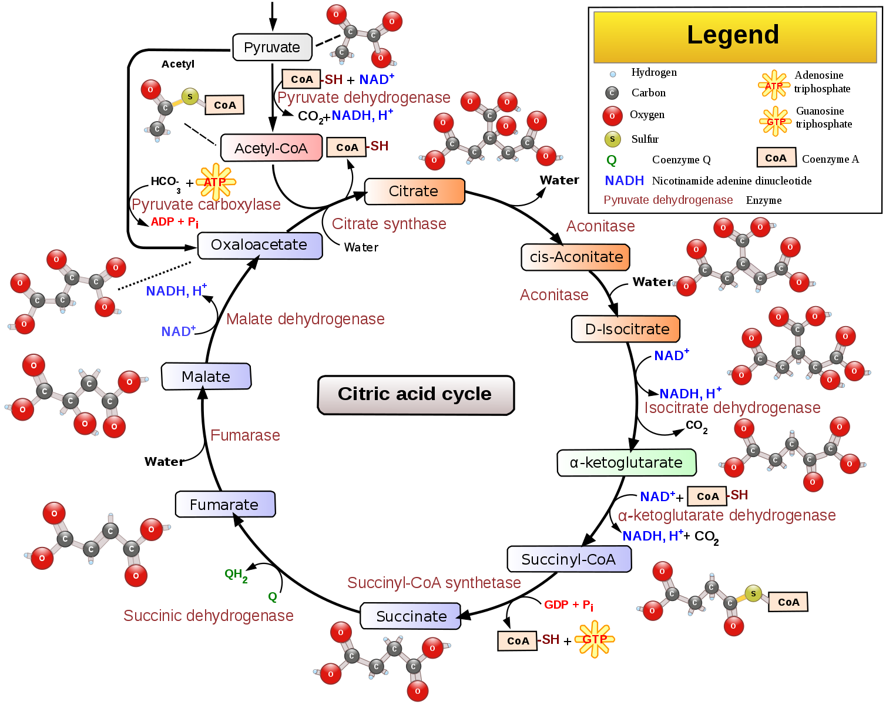
Kreb Cycle
Overview
Image from
Narayanese, WikiUserPedia,
YassineMrabet, TotoBaggins
Notes:
The Kreb Cycle has a total of 8 metabolic reactions involved in the full oxidation of our food molecules into carbon dioxide.

Slide 3
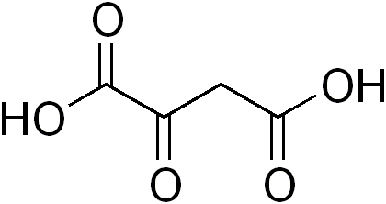
Kreb Cycle Reactions
8 major reactions occur in the Kreb Cycle.
It is a metabolic cycle because it regenerates the same metabolite at the end that you start with
OXALOACETATE
Notes:
The eight reactions of the citric acid cycle use a small molecule--oxaloacetate--as the starting place for the reaction cycle. The cycle starts by addition of an acetyl group to oxaloacetate, then, in eight steps, the acetyl group is completely broken apart, restoring the oxaloacetate molecule for another round. In a typically biological twist, it's not quite this simple. You might imagine that the enzymes could just pop off the two carbon atoms of the acetyl group, using the oxaloacetate as a convenient carrier. However, by carefully labeling particular carbon atoms in these molecules, scientists have found that things get shuffled around a bit, and two carbon atoms in the original oxaloacetate are the parts that are actually released as carbon dioxide. Then, at the end of the cycle, the original acetate atoms are shuffled around to recreate the oxaloacetate.

Slide 4
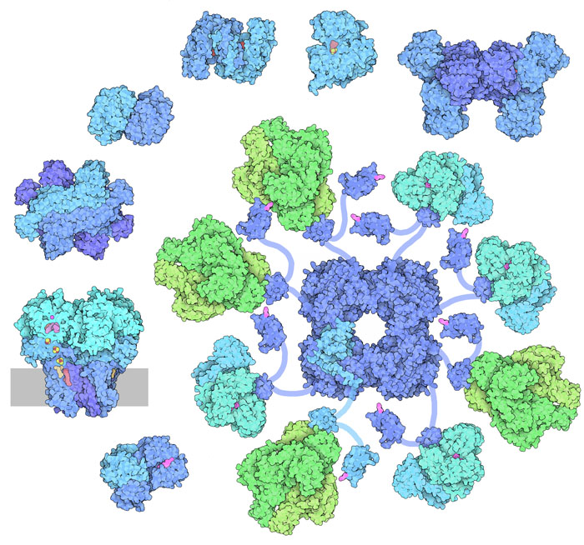
The Kreb Cycle Shown Enzymatically
Citrate Synthase
Aconitase
Malate
Dehydrogenase
Isocitrate
Dehydrogenase
Fumarase
Succinate
Dehydrogenase
α-ketoglutarate
Dehydrogenase
Succinyl-CoA
Synthetase
Image modified from : Goodsell, D. (2012) Molecule of the Month, Protein Database
Notes:
The citric acid cycle, also known as the Krebs cycle or the tricarboxylic acid cycle, is at the center of cellular metabolism, playing a starring role in both the process of energy production and biosynthesis. It finishes the sugar-breaking job started in glycolysis and fuels the production of ATP in the process. It is also a central hub in biosynthetic reactions, providing intermediates that are used to build amino acids and other molecules. The citric acid cycle enzymes, shown here, are found in all cells that use oxygen, and even in some cells that don’t. In addition, all of these enzymatic reactions take place in the matrix of the mitochondria, where they are tethered closely to the innermembrane, and in fact, the succinate dehydrogenase is actually a membrane bound protein and participates in the next stage of the process, the electron transport chain.

Slide 5
Reaction 1: Citrate Synthase
Citrate Synthase
Oxaloacetate + Acetyl-CoA
Citrate
Image from : Hbf878
Notes:
The first reaction in the citric acid cycle is the formation of citric acid (or citrate) from acetal-coA and oxaloacetate. CoASH is released in the process. Note that the two carboxylic acid groups shown in blue originate from oxaloacetate, while the acetate-derived carboxylic acid group and methyl carbon are shown in red. This will allow you to visualize what happens to these positions throughout the Kreb cycle reactions.

Slide 6
Reaction 2: Aconitase
Citrate
cis-Aconitate
Isocitrate
Aconitase
Notes:
Reaction 2, is the isomerization of citrate to isocitrate, and it is mediated by an enzyme named Aconitase. This is named for the cis-aconitate intermediate that forms during the reaction. In fact, on many Kreb Cycle diagrams, the cis-aconitate is also shown on the diagram. Thus, you must be careful when you are labeling a Kreb cycle diagram that this intermediate may be shown or it may not be shown.

Slide 7
Reaction 3: Isocitrate Dehydrogenase
Isocitrate Dehydrogenase
Isocitrate
α-Ketoglutarate
Dehydrogenase AND Decarboxylase Activity
Notes:
Within the citric acid cycle, isocitrate, produced from the isomerization of citrate, undergoes both oxidation and decarboxylation to form αλπηα-Ketoglutarate. CO2 is released and a molecule of NADH is formed in the process.

Slide 8
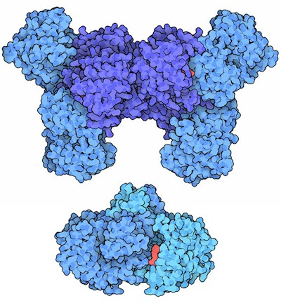
Isocitrate Dehydrogenase
Reaction Mechanism involves NAD⁺ and Mg²⁺ as cofactors
Image from : Goodsell, D. (2012) Molecule of the Month, Protein Database
Notes:
This is accomplished by the isocitrate dehydrogenase enzyme. Note that the enzyme is named for its oxidation role, not the decarboxylation step. Isocitrate dehydrogenase uses NAD+ and Mg2+ as cofactors within the reaction mechanism that is shown on the next few slides.

Slide 9
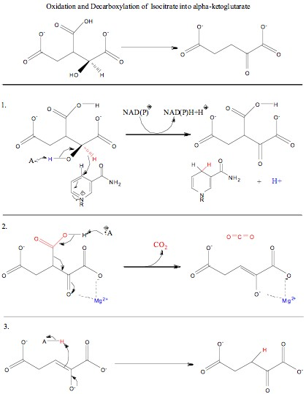
Isocitrate Dehydrogenase
NAD⁺ NADH/H⁺
Step 1: Dehydrogenase Activity
Image from : Haynathart
Notes:
Step 1 details the dehydrogenase activity of the enzyme. First, an acidic residue in the active site deprotonates the alcohol position of isocitrate. The electrons flow into the molecule generating the carbonyl functional group. This enables the extraction of the electrons and hydrogen from the C2 carbon position by the NAD+ cofactor. The proton is released into the environment by the acidic residue in the active site when NADH exits the active site.

Slide 10
Isocitrate Dehydrogenase
Step 2: Decarboxylase & Lyase Activity
Image from : Haynathart
Notes:
In step 2, the decarboxylation occurs. In this reaction mechanism, the Mg2+ cofactor stabilizes the carbonyl function group and the C1 carboxylic acid functional group. An acidic base within the active site drives the decarboxylation which forms an alkene intermediate. Again, the carbonyl oxygen is charge stabilized by interaction with the metal cofactor.

Slide 11
Isocitrate Dehydrogenase
Step 3: Ketone Formation
Image from : Haynathart
Notes:
As the carbonyl electrons fall back into the molecule forming the ketone functional group, tthe pi-bond between the C2 and C3 positions, abstracts a proton from an acidic residue in the active site to form alpha-ketoglutarate. Take a moment to compare this mechanism with that found in the Pyruvate Dehydrogenase Complex, and that of the Glyceraldehyde 3-Phosphate Dehydrogenase from the Glycolytic pathway. This exemplifies the many different ways dehydrogenase enzymes can work to oxidize biological molecules.

Slide 12
React 4: α-Ketoglutarate Dehydrogenase
α-Ketoglutarate Dehydrogenase
α-Ketoglutarate
Succinyl-CoA
Has a very similar mechanism to the PDH Complex
Notes:
The alpha-ketoglutarate dehydrogenase (KGDH) has a reaction mechanism that is very similar with pyruvate dehydrogenase (PDH) complex. It also liberates CO2 and a molecule of NADH and a proton, in the process of forming Succinyl-CoA.

Slide 13
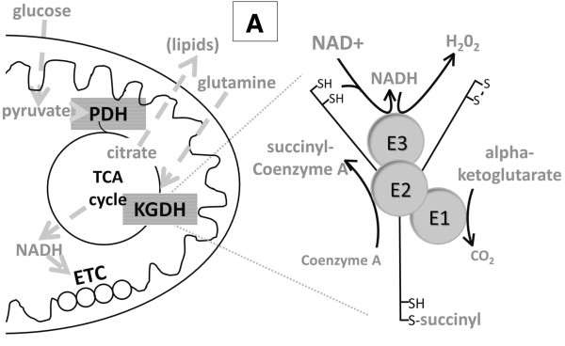




α-Ketoglutarate Dehydrogenase
H₂O (ETC)
glutamate
FADH₂
Lipoamide
HS
FAD
E3
SH
Succinyl-CoA
E2
E1
TPP
CoASH
Figure Modified from Stuart, et al (2014) Cancer and Metabolism 2:4
Notes:
Similar to the pyruvate dehydrogenase (PDH), the alpha-ketoglutarate dehydrogenase (KGDH) also uses CoASH as a substate, and TPP, Lipoamide, FAD, and NAD+ as cofactors. In this case TPP attacks the alpha ketoglutarate C2 carbonyl carbon, mediating the release of the CO2 that was originally from the acetate molecule. The remaining succinyl group is then transferred to the lipoamide cofactor. Partial reduction of the lipoamide from the alpha-ketoglutarate has also occurred at this step. On the E2 complex, the succinyl group is transferred to Coenzyme-A as a thioester and released from the enzyme. The lipoamide cofactor is fully reduced in the process. The lipoamide cofactor releases the electrons the bound FAD housed on the E3 subunit. This restores the oxidized state of lipoamide for a second round of enzymatic function. Finally, the electrons are moved from the FADH2 to the labile NAD+ cofactor where they can be transported to the electron transport chain.

Slide 14
Reaction 5: Succinyl-CoA Synthetase
Succinyl-CoA Synthetase
Succinyl-CoA
Succinate
Substrate-Level Phosphorylation
Notes:
The Succinyl-CoA synthetase is an enzyme that creates a molecule of GTP (ATP equivalent) through the phosphorylation of GDP. This process releases the Coenzyme A and forms a molecule of succinate.

Slide 15
Reaction 6: Succinate Dehydrogenase
Succinate Dehydrogenase
Succinate
Fumarate
Oxidoreductase and Lyase
Electron Transport Chain Protein
Notes:
Succinate dehydrogenase then mediates the oxidation of succinate to form fumarate through another novel dehydrogenase mechanism.

Slide 16
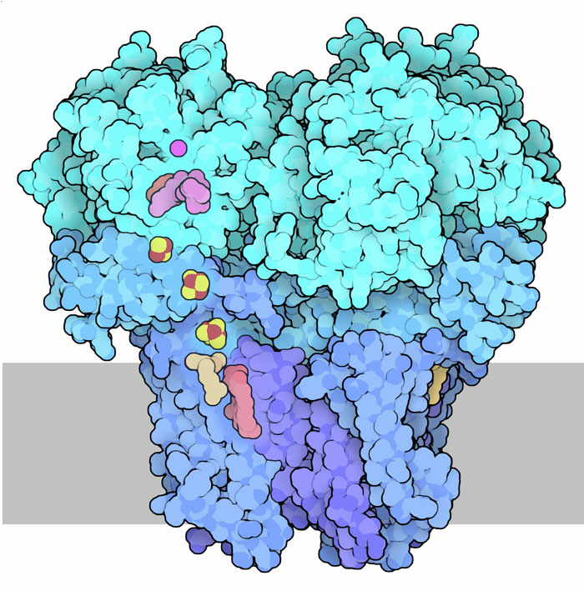
Succinate Dehydrogenase
Matrix
Intermembrane
Space
Image modified from : Goodsell, D. (2012) Molecule of the Month, Protein Database
Notes:
This step is performed by a protein complex that is bound in the membrane of the mitochondrion. It links this citric acid cycle task directly to the electron transport chain (ETC) and makes the transfer of electrons harvested from the food molecules streamlined. It first extracts hydrogen atoms from succinate, transferring them to the carrier FAD. The resulting product is fumarate. Interestingly, this protein is also Complex II in the electron transport chain, where it can directly transfer the electrons harvested from the succinate into the ETC. We will come back to this complex in the next section covering the ETC.

Slide 17
Reaction 7: Fumarase
Fumarase
Fumarate
Malate
Hydrolase
Notes:
In reaction 7, the lyase, known as fumarase, converts fumarate to malate. This enzyme is also a hydrolase, as water is incorporated into the final structure (shown in pink, here).

Slide 18
Reaction 8: Malate Dehydrogenase
Malate Dehydrogenase
Malate
Oxaloacetate
Notes:
The final reaction is one that we visited in the gluconeogenic pathway leading to the oxidation of malate to form oxaloacetate. One final energy carrier, NADH & H+, is formed.

Slide 19
Energy Yield in Kreb Cycle
Per Cycle
  3 NADH/H+
  1 FADH₂
  1 GTP (ATP equivalents)
Per Glucose = 2 Cycles (2 Acetyl-CoA molecules)
  6 NADH/H+
  2 FADH₂
  2 GTP (ATP equivalents)
Notes:
Overall the total energy yielded in one turn of the citric acid cycle are 3 molecules of NADH & H+, 1 FADH2, and 1 GTP. This is doubled for the energy potential in 1 glucose molecule as two molecules of acetyl-CoA will enter the Kreb cycle.

Slide 20
Regulation of the Kreb Cycle
Three Major Regulatory Steps
Pyruvate Dehydrogenase – The Gatekeeper of the Kreb
Cycle
Isocitrate Dehydrogenase
α-Ketoglutarate Dehydrogenase
Notes:
Regulation of this pathways is mediated primarily by three of the major dehydrogenase enzymes in the pathway. These include: Pyruvate dehydrogenase which serves as a gatekeeper prior to the beginning of the Kreb Cycle, followed by the next two dehydrogenase/carboxylase steps in the pathway, mediated by isocitrate dehydrogenase and alpha-ketoglutarate dehydrogenase. Essentially all of the steps were CO2 is released. All of these enzymes are highly regulated by the energy load of the cell.

Slide 21
Pyruvate Dehydrogenase Complex
Regulation of the PDH Complex
Allosteric Regulation
  High NADH = Inactivation
  High Acetyl-CoA = Inactivation
  High ATP = Inactivation
  High ADP = Activation
Phosphorylation
  PDH Kinases inactivate PDH
  PDH Phosphatases activate
Gatekeeper of the Kreb Cycle
Image from : Goodsell, D. (2012) Molecule of the Month, Protein Database
Notes:
For example, PDH is inactivated when high energy load is present in the cell. For example, if NADH or ATP levels are high, the enzyme will have low activity. Similarly it undergoes negative feedback inhibition with the acetyl-CoA product of the reaction. Phosphorylation also plays a role in PDH regulation. Energy-sentitive PDH kinases are active when the cell has high energy. This causes the phosphorylation and inactivation of the E1 subunit, blocking all activity of the enzyme. Alternatively, dephosphorylation activates PDH.

Slide 22
Isocitrate Dehydrogenase
Regulated Allosterically by Energy Load in the Cell
Low energy activates the pathway
  High ADP levels
High Energy shuts off the pathway
  High ATP
  High NADH
Image from : Goodsell, D. (2012) Molecule of the Month, Protein Database
Notes:
Similarly, Isocitrate Dehydrogenase is activated by low energy level states (ie high ADP levels) and inhibited when energy is plentiful (high ATP or high NADH).

Slide 23



α-Ketoglutarate Dehydrogenase
Regulated Allosterically by Energy Load in the Cell
Negative Feedback Inhibition
  Succinyl-CoA
High Energy shuts off the pathway
  High ATP
  High NADH
Image from : Goodsell, D. (2012) Molecule of the Month, Protein Database
Notes:
Following suit, the alpha-ketoglutarate enzyme undergoes negative feedback inhibition by an accumulation of the succinyl-CoA product levels. High levels of ATP and NADH are also inhibitory.

Slide 24
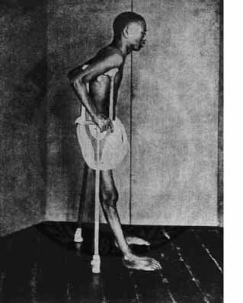
Beriberi
Lack of Vitamin B1
  Inefficient TPP
  Reduced capacity of PDH Complex and the α-ketoglutarate DH
Symptoms
  weight loss,
  emotional disturbances,
  impaired sensory perception,
  weakness and pain in the limbs,
  periods of irregular heart rate.
Image from : Brinerustle
Notes:
Note that vitamin deficiencies can cause disease states, such as Beriberi. A lack of vitamin B1 will lead to inefficient production of the TPP cofactor required for the PDH and KGDH complexes. Thus, these enzymatic systems to not function well to produce ATP. Patients will experience weight loss, emotional distubances, and other neurological and muscular symptoms.

Slide 25
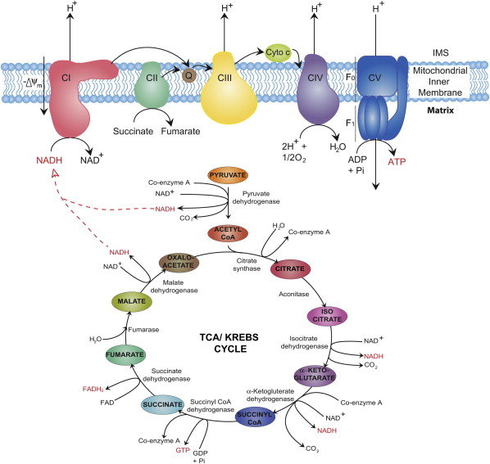
Figure from : Osellame, L, et al (2012) Best Pract. & Research Clin Endocrin. & Metab. 26:711-723
Notes:
In the next lecture, we will learn how the electrons harvested in the Kreb cycle are used to generate ATP through the electron transport chain.

