Slide 1
Lipids
Triacylglycerides
Notes:
Welcome to part 2 of our lecture series on Lipids. Here we will learn about the basic structure and reactions of triacylglycerides (TAGS).

Slide 2
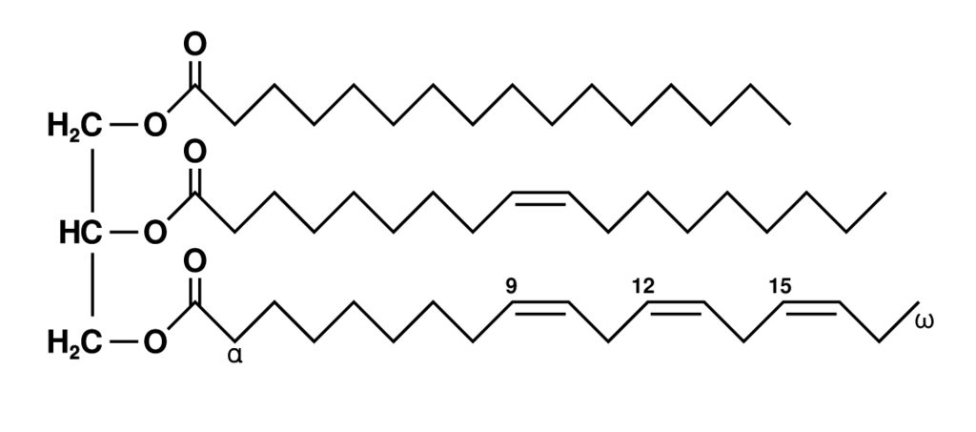
TAGS are Fats and Oils
Structure by: Wolfgang Schaefer
Notes:
Triacylglycerides (TAGs) are composed of 3 fatty acids and a glycerol backbone. They are also known as triacylglycerol or triglycerides.
The three fatty acids are usually different from one another on any single TAG and pools of fats/oils are typically mixtures of many different TAGs.

Slide 3
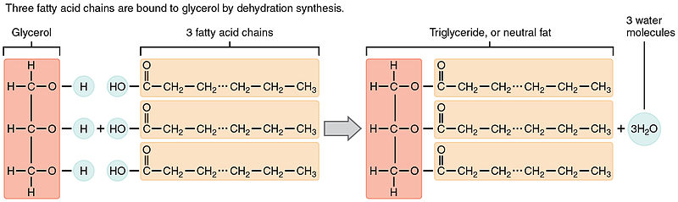
TAGS are built by Dehydration Synthesis
Alcohol + Carboxylic Acid = Ester
Figure by: Illustration from Anatomy & Physiology, Connexions Web site
Notes:
TAGS are formed by dehydration synthesis creating ester linkages from glycerol and three fatty acids. This is the basic reaction. The actual reaction in vivo is more complicated and involves several enzymatic steps

Slide 4
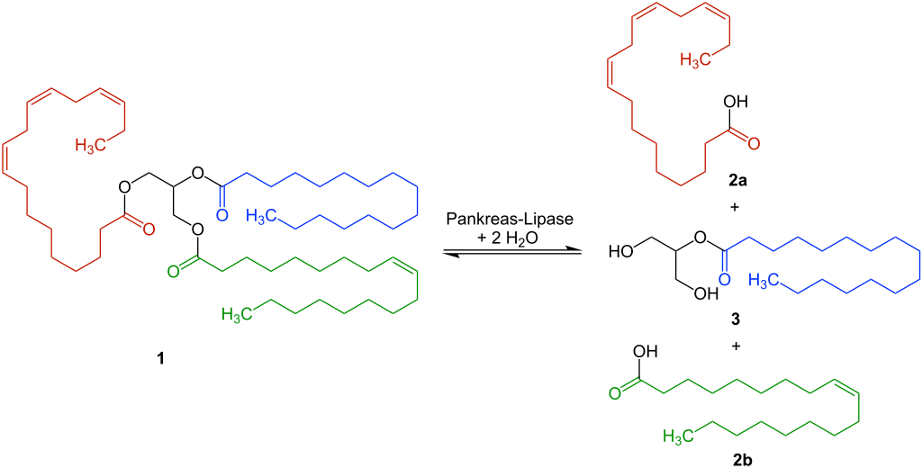
Hydrolysis by Pancreatic Lipase
Pancreatic Lipase
+ H₂O
Figure modified from: Ju
Notes:
The reverse reaction, hydrolysis is mediated by lipase enzymes in vivo. Different lipases will cleave TAGs into different products. Some will release all 3 fatty acids and some, like the Pancreatic Lipase, will only release the outer 2 and will leave the fatty acid on the 2-position attached as a monoacylglyceride.

Slide 5
General Properties of TAGs
Hydrophobic/Nonpolar
Most are mixtures
Melting points and Boiling points are not sharp
When shaken with water they emulsify
Colorless
Odorless
Notes:
TAGS are very nonpolar molecules that are typically mixtures. Thus, their melting points and boiling points are not usually sharp. When mixed with water and shaken, they will tend to emulsify. Pure fats and oils are colorless and odorless (color and odor is always a result of contaminants) – for example, bacteria found in butter give flavor and carotene gives color.

Slide 6
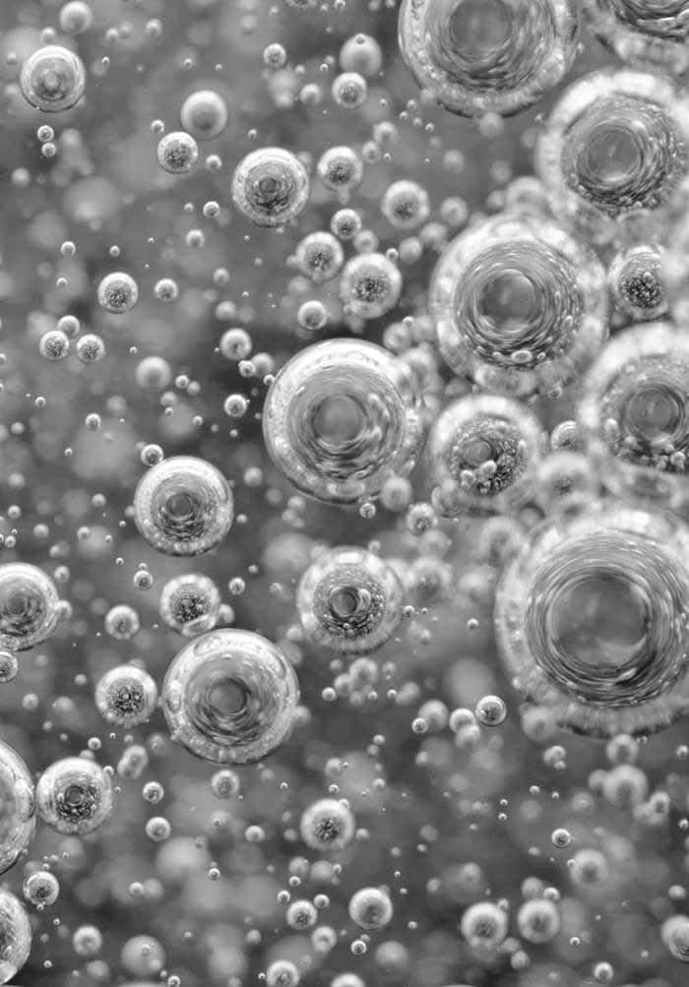
Emulsification
An emulsion is a mixture of two or more liquids that are normally immiscible
Image by: Koh, K.S., and Wong, V. L. (2019) IntechOpen
Notes:
To emulsify is to force two immiscible liquids to combine in a suspension—substances like oil and water, which cannot dissolve in each other to form a uniform, homogenous solution. Although oil and water can't mix, we can break oil down into teeny-tiny droplets that can remain suspended in the water. Thus, the definition of an emulsion is a mixture of two or more liquids that are normally immiscible.

Slide 7
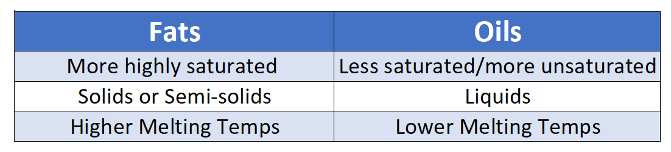
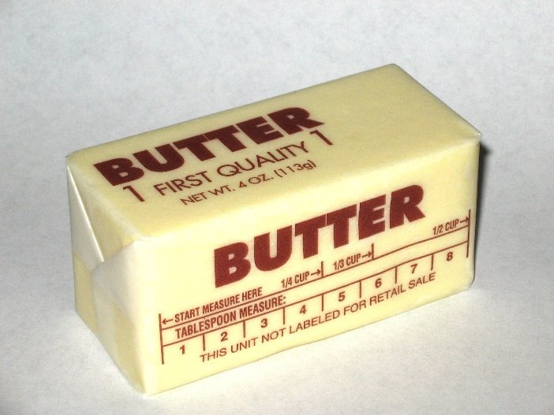
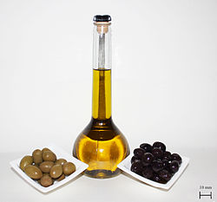
Fats vs. Oils
Picture by: Steve Karg
Picture by: Poyraz 72
Determined by degree of saturation/unsaturation
Notes:
TAGs are often referred to as Fats and Oils. Fats tend to be more highly saturated than oils and thus, have higher melting temperatures. They are typically solids at room temperature. Oils on the otherhand have lower melting temperatures and are typically liquids at room temperature.

Slide 8
Examples of Oils
Olive oil – from Oleo europa (olive tree)
Corn oil – from Zea mays
Peanut oil – from Arachis hypogaea
Cottonseed oil – from Gossypium
Sesame oil – from Sesamum indicum
Linseed oil – from Linum usitatissimum
Sunflower seed oil – from Helianthus annuus
Rapeseed oil – from Brassica rapa
Coconut oil – from Cocos nucifera
Notes:
Here are some examples of common oils

Slide 9
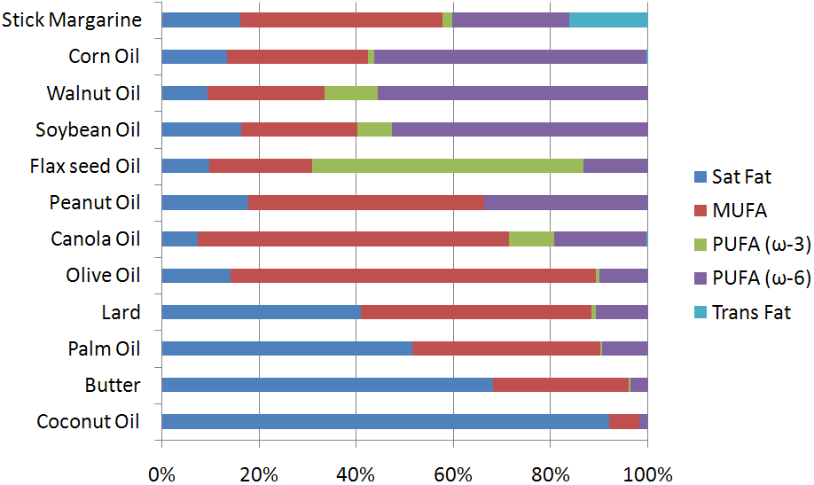
Food Sources of TAGs
Figure from: Lindshield, B. – Kansas State University Human Nutrition Flexbook
Notes:
This diagram gives you a sense of the mixtures of fatty acids found in different TAG sources. Note that coconut oil has a high degree of saturated fatty acids incorporated into the TAG structure. This increases the melting temperature of this oil causing it to be a solid at room temperature.

Slide 10
Non-drying, Semi-drying and Drying Oils
based on the ease of autoxidation and polymerization of oils (important in paints and varnishes)
the more unsaturation in the oil, the more likely the “drying” process
Non-drying oils:
Castor, olive, peanut, rapeseed oils
Semi-drying oils
Corn, sesame, cottonseed oils
Drying oils
Soybean, sunflower, hemp, linseed, tung, oiticica oils
Notes:
Oils can be non-drying, semi-drying, or drying. A non-drying oil is an oil which does not harden when it is exposed to air. This is as opposed to a to drying oil, which hardens (through polymerization) completely, or a semi-drying oil, which partially hardens. These properties are dependent on their degree of saturation. Typically, more highly saturated oils are non-drying in nature. The oil hardens through a chemical reaction in which the components crosslink (and hence, polymerize) by the action of oxygen

Slide 11
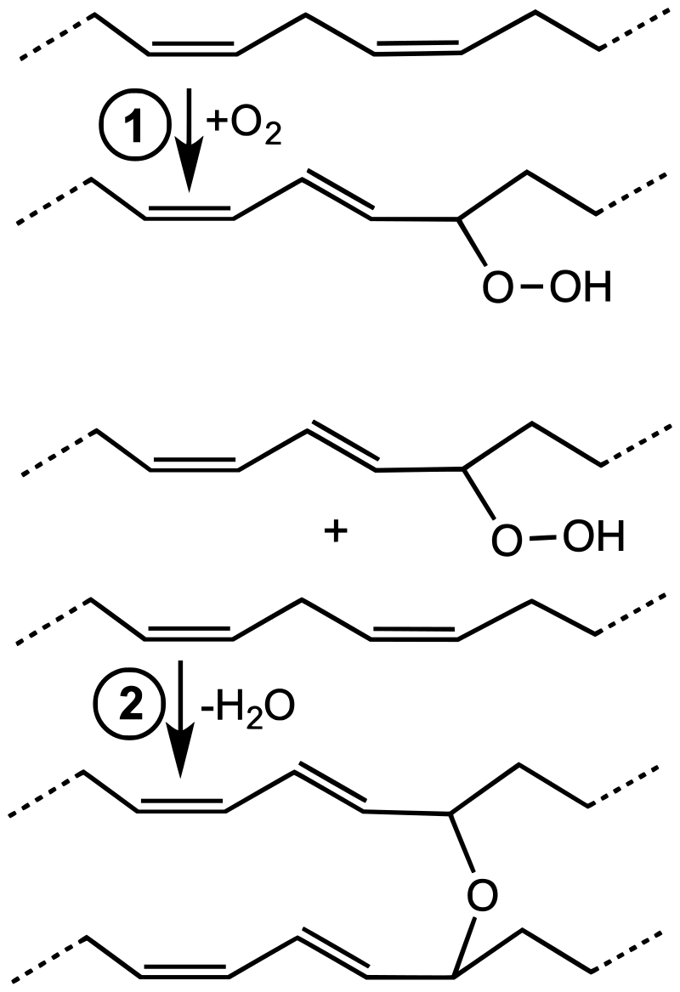
Polymerization of Drying Oils
Figure by: Smokefoot
Notes:
This diagram shows a simplified chemical reactions associated with cobalt-catalyzed drying process. In the first step, the diene undergoes autoxidation to give a hydroperoxide. In the second step, the hydroperoxide combines with another unsaturated side chain to generate a crosslink. This polymerization results in stable films that, while somewhat elastic, do not flow or deform readily. Drying oils are a key component of oil paint and some varnishes. Some commonly used drying oils include linseed oil, tung oil, poppy seed oil, perilla oil, and walnut oil.
Text from: Wikipedia contributors. (2020, February 21). Drying oil. In Wikipedia, The Free Encyclopedia. Retrieved 16:52, February 25, 2020, from https://en.wikipedia.org/w/index.php?title=Drying_oil&oldid=941972775

Slide 12
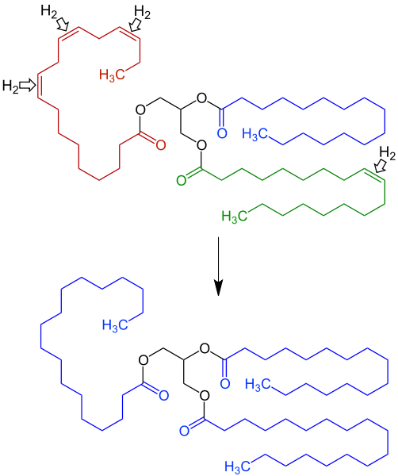
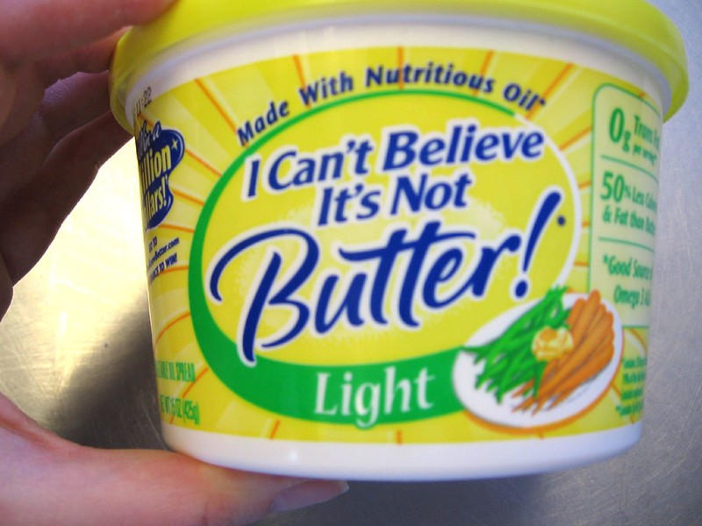
Hydrogen-ation
Unsaturated
Reduces the C=C double bonds with H₂
Saturated
Photo by: ilovebutter
Structure by: Ju
Notes:
Hydrogenation reactions involve the addition of H2 across a C=C double bond, effectively reducing or saturating the carbons at that position. Hydrogenation of TAGs leads to either saturated or partially saturated fats mixed with trans fatty acid byproducts. The purpose of hydrogenation is to make the oil/fat more stable to oxygen and temperature variation (increase shelf life) and to create a spreadable solid/semi-solid. Examples of hydrogenated fats include Crisco and margarine.

Slide 13
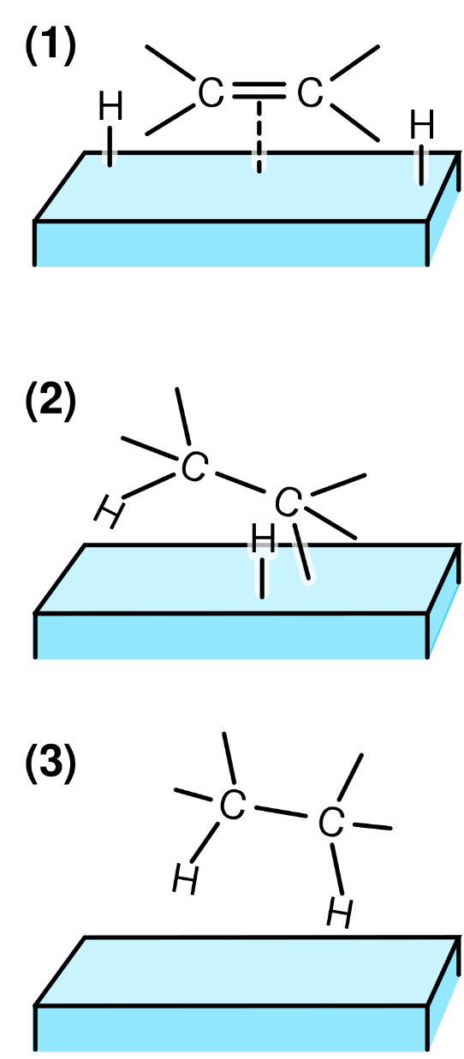
Hydrogenation
Reduces the C=C double bonds
Figure by: Michael Schmid
Notes:
Usually a metal catalyst, such as Ni or Pt are required for the hydrogenation process. Steps in the hydrogenation of a C=C double bond involve the following steps: (1) The reactants are adsorbed on the catalyst surface and H₂ dissociates. (2) A H atom bonds to one C atom. The other C atom is still attached to the surface. (3) A second C atom bonds to an H atom. The molecule is free to leave the surface.

Slide 14
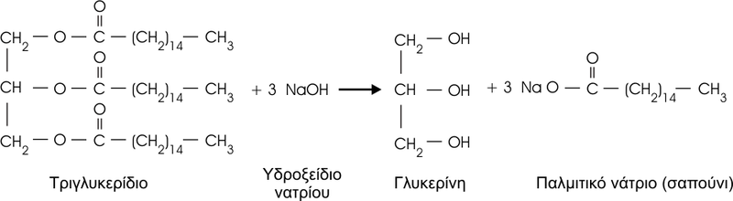
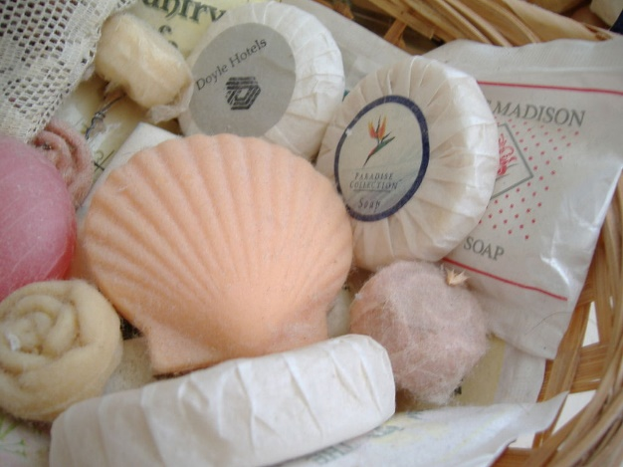
Saponification
Soap = Salt of the Fatty Acid
Figure modified from: Ttzavaras
Glycerol
Picture from: Phanton
Notes:
Hydrolysis of TAGs with a strong base will split the TAG into glycerol and the salts of fatty acids. The salts of fatty acids are “soaps”. Thus, this process is called Saponification.
Saponification using KOH instead of NaOH gives softer soaps.

Slide 15
TAGS as Energy
Structure by: Wolfgang Schaefer
Notes:
Triacylglycerides (TAGs) are the body’s main energy source and it is stored in fat tissue called, adipose tissue. In the following lectures, we will see how these molecules are transported, stored, and utilized as an energy resource in the Kreb cycle.

