Slide 1
Foundations of Biochemistry
Chapter 6: Enzyme Principles and Biotechnical Applications
Notes:
Overall, in Chapter 6 we will be learning some basic enzyme principles to get us started on our journey of Enzyme activity and regulation.

Slide 2
Major Topics
6.1 The Nature and Classification of Enzymes
6.2 Enzyme Names and Classification
6.3 Enzyme Structure and Substrate Binding
6.4 Enzymes and Reaction Equilibrium
6.5 Properties and Mechanisms of Enzyme Action
6.6 Enzymes are Affected by pH and Temperature
6.7 Enzymes are Sensitive to Inhibitors
6.8 Allosteric Regulators and the Control of Enzyme Activity
6.9 Origin, Purification, and Uses of Enzymes
6.10 Industrial Enzymology
Notes:
There are quite a few sections in this chapter, but as you will see, many are quite short!

Slide 3
Foundations of Biochemistry
Chapter 6.1 The Nature and Classification of Enzymes
Notes:
In this first section, we will cover the nature and classification of enzymes

Slide 4
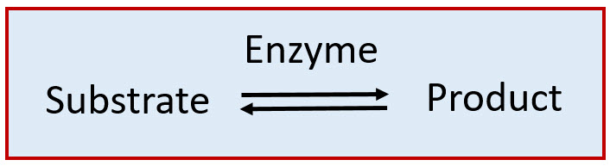
The Catalytic Constant
K_{cat} = turnover rate or frequency
Notes:
As catalysts, enzymes are only required in very low concentrations, and they speed up reactions without themselves being consumed during the reaction. We usually describe enzymes as being capable of catalyzing the conversion of substrate molecules into product molecules. And this property is described by the constant called Kcat or the turnover rate or frequency. This catalytic constant represents the number of substrate molecules that can be converted to product by a single enzyme molecule per unit time (usually per minute or per second).

Slide 5
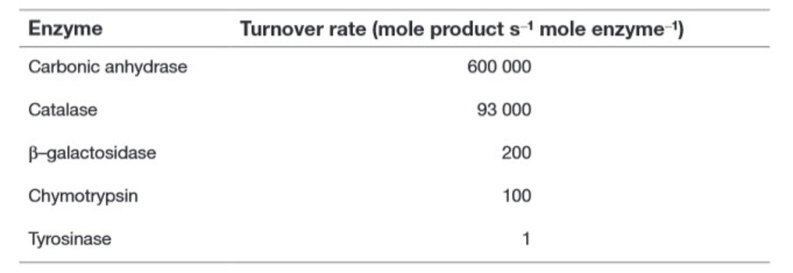
K_{cat}
Notes:
As well as being highly potent catalysts, enzymes also possess remarkable specificity in that they generally catalyze the conversion of only one type (or at most a range of similar types) of substrate molecule into product molecules. Some enzymes demonstrate group specificity. For example, alkaline phosphatase (an enzyme that is commonly encountered in first-year laboratory sessions on enzyme kinetics) can remove a phosphate group from a variety of substrates. Other enzymes demonstrate much higher specificity, which is described as absolute specificity. For example, glucose oxidase shows almost total specificity for its substrate, β-D-glucose, and virtually no activity with any other monosaccharides. Each enzyme has a specific catalytic rate for each substrate that it can catalyze

Slide 6
Foundations of Biochemistry
Chapter 6.2 Enzyme Names and Classification

Slide 7
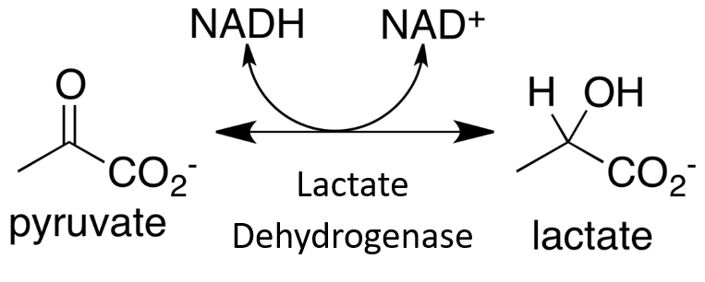
Naming Enzymes
‘-ase’
Notes:
Enzymes typically have common names (often called ‘trivial names’) which refer to the reaction that they catalyze, with the suffix ‘-ase’ (e.g. oxidase, dehydrogenase, carboxylase), although individual proteolytic enzymes generally have the suffix ‘-in’ (e.g. trypsin, chymotrypsin, papain). This is because these were some of the earliest enzymes discovered, and they were named before the ‘-ase’ enzyme classification system was put into place. In the early 1960s the Enzyme Commission came up with a layered enzyme classification system. In this system, each enzyme is given a specific number. For example, Lactate Dehydrogenase, shown here has the EC number 1.1.1.27. Each number refers to a classification level that gets more detailed and detailed at each step. Let’s use Lactate Dehydrogenase as an example. First, you may recognize from your experience with organic chemistry that lactate dehydrogenase is mediating a redox reaction. In this case the reduction reaction is shown in the forward direction and the oxidation reaction in the reverse. Recall that ketones can be reduced to secondary alcohols (and/or secondary alcohols can be oxidized to a ketone, in the reverse reaction). Note that Lactate Dehydrogenase can go either way depending on the circumstance…ie levels of product and reactant.

Slide 8
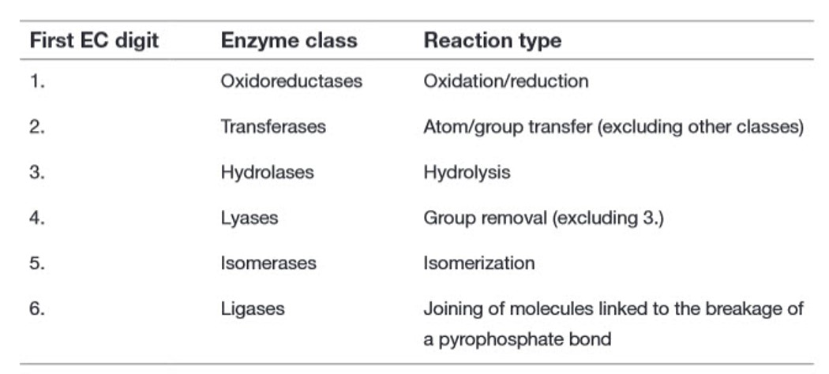
EC Primary Classification
Notes:
The first number in the system refers to the primary classification system. So if we look carefully, we can see that oxidoreductase enzymes are listed at #1, and the first digit in the Lactate Dehydrogenase E.C. number is 1.

Slide 9
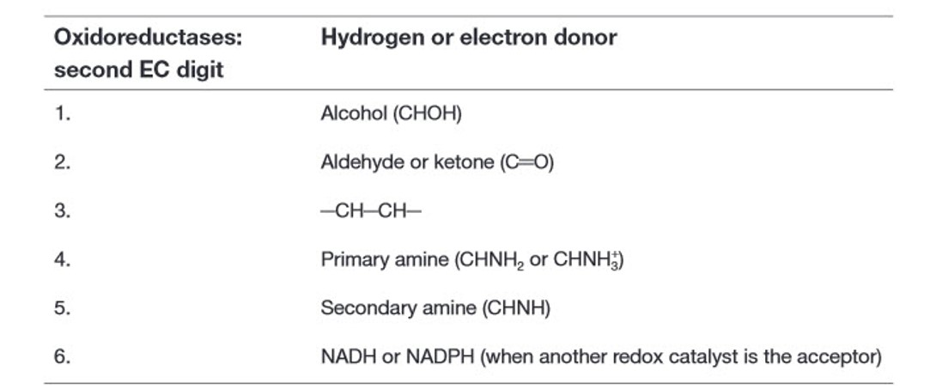
Second Level EC Number
Notes:
Each type of enzyme class then has sublevels that it is divided into, based on the types of substrates and reactants involved in the reactions. For oxidoreductase enzymes, the second level of classification corresponds with the electron donor molecule in the reaction. In the case of lactate dehydrogenase, this is the alcohol. As the oxidation reaction is shown in the reverse direction. So first, you would need to identify the oxidation reaction and then look to see what the reactant for the oxidation reaction is…Within the numbering system, alcohol is listed as #1. So the first two levels of classification for Lactate Dehydrogenase is 1.1

Slide 10
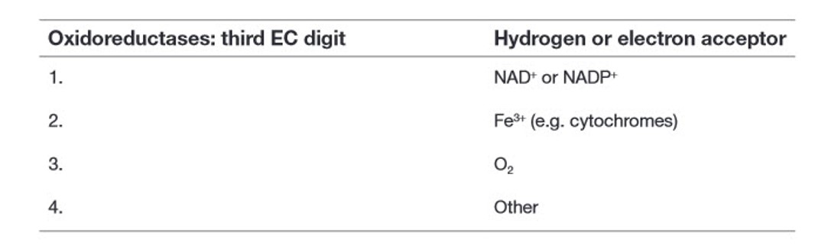
Third Level EC Number
Notes:
For oxidoreductase enzymes, the third level of classification refers to the electron acceptor in the oxidation reaction. In the case of Lactate Dehydrogenase, NAD+ is the electron acceptor. Recall that we noted previously that electrons and hydrogens usually move together in biological oxidation/reduction reactions. So if you follow the hydrogens, you are also following the electrons. If a molecule loses electrons (and the associated hydrogens) it becomes oxidized. If it gains electrons (and the associated hydrogens) it is reduced. If we look at the classification scheme for Lactate Dehydrogenase, we can see that the third position is also 1! So it is 1.1.1. The last digit for Lactate Dehydrogenase is 27, as it is the 27th enzyme to be characterized in this class. So its full classification is: 1.1.1.27. For this class, you will only need to be familiar with the first classification level.

Slide 11
EC Primary Classification
Notes:
We will systematically visit these different types of reactions throughout both this term and next term. You should be able to place an enzyme into it’s proper primary class. So on this list, you are already familiar now with two classes…the oxidoreductases that we just looked at, and the hydrolase reactions. Can you think of any dehydration/hydrolysis reactions that we have already looked at? Hopefully, you jumped up and down and shouted, yes! Protein synthesis…you can identify these reactions with the consumption or formation of water as one of the reactants or products, respectively. You’ve also heard about another one of these, although we didn’t look at the reaction in detail. The DNA Ligase enzyme that fuses the backbone of DNA together during those cloning reactions that we talked about. This enzyme also is active during DNA replication and falls in the ligase class of enzymes. Ligases join two things together to form one thing. This differs from the hydrolase enzymes in that water is not involved in the process. Ligases often use the energy of ATP hydrolysis to mediate the reaction.

Slide 12
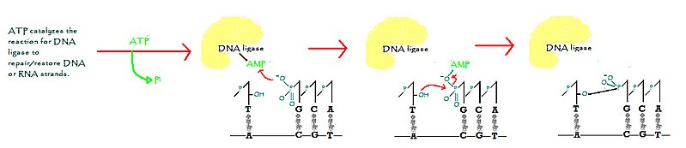
DNA Ligase
Image from: Swts0litude
Notes:
Here is the DNA Ligase reaction.

Slide 13
DNA Ligase
Image from: Swts0litude
Notes:
Here is the DNA Ligase reaction. In the first part of the reaction, ATP is cleaved and the monophosphate is attached covalently to the enzyme. An oxygen from the phosphate group of the broken link in the DNA backbone, can then mediate nucleophilic attack on the AMP bound to the enzyme, causing it to release from the enzyme and covalently join with the phosphate group.

Slide 14
DNA Ligase
Image from: Swts0litude
Notes:
In the second part of the reaction, the AMP bound to the phosphate group can then serve as a leaving group. In this part of the reaction, the alcohol oxygen from the 3’-hydroxyl group mediates nucleophilic attack on the phosphorous of the 5’ phosphate group. The AMP bond is cleaved, releasing AMP and the sugar-phosphate backbone is resealed.

Slide 15
EC Primary Classification
Notes:
Now we’ve looked at three classes…let’s see an example of a transferase

Slide 16
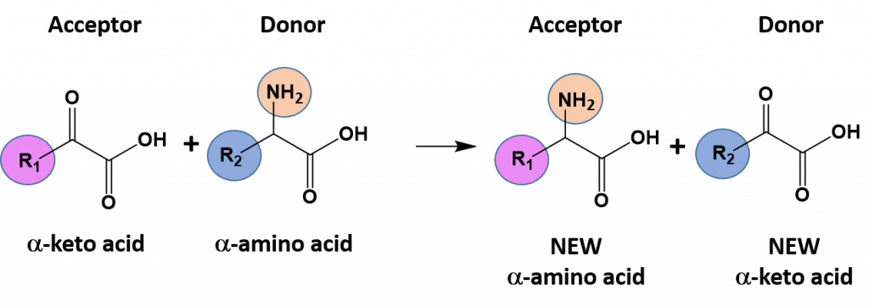
Transferases
Notes:
Transferases mediate group transfer reactions. In group transfer reactions, a functional group will be transferred from one molecule that serves as the donor molecule to another molecule that will be the acceptor molecule. The transfer of an amine functional group from one molecule to another is common example of this type of reaction and is shown here.

Slide 17
EC Primary Classification
Notes:
let’s see an example of an isomerase next…

Slide 18
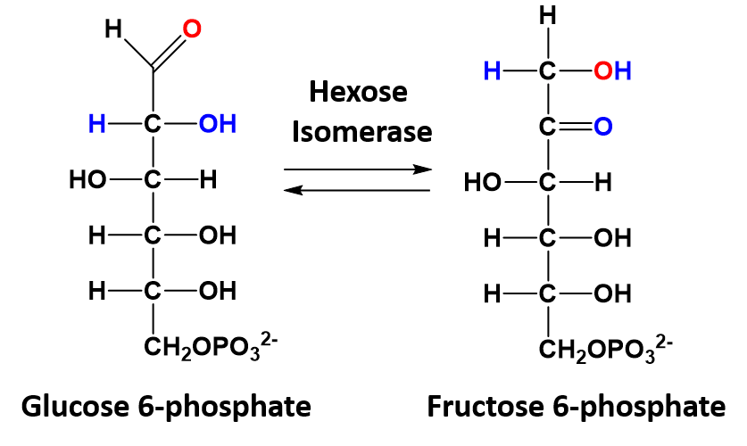
Isomerase Reactions
Notes:
In isomerization reactions a single molecule is rearranged such that it retains the same molecular formula but now has a different bonding order of the atoms forming a structural or stereoisomer. The conversion of glucose 6-phosphate to fructose 6-phosphate is a good example of an isomerization reaction

Slide 19
EC Primary Classification
Notes:
The last class we need to take a look at are the lyases.

Slide 20
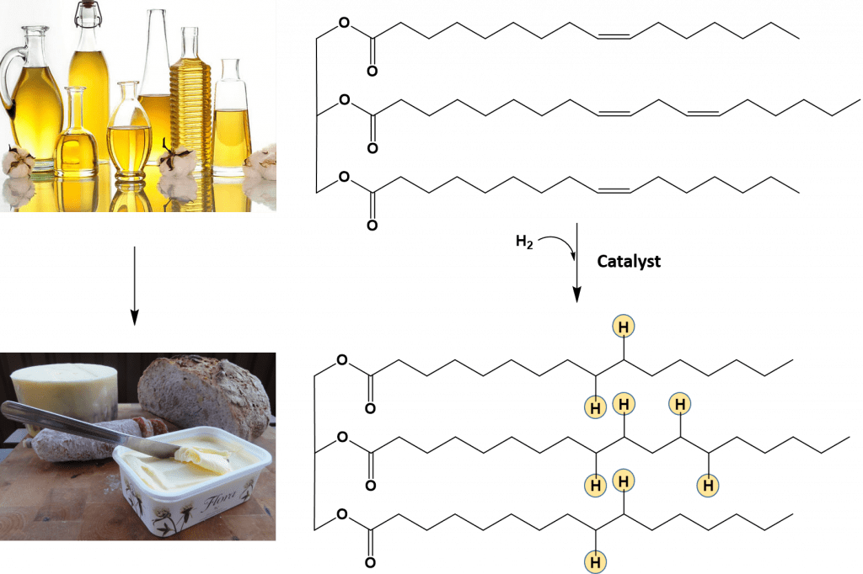
Lyase Reactions
Notes:
Lyase reactions mediate the formation and removal of carbon-carbon double bonds within a molecule. Now you may notice that when the double bond is removed, that new hydrogen atoms are added to the molecule…yes, if you were caught up thinking about our oxidoreductase story, you might be saying to yourself…hold up…are electrons also moving with those hydrogens? Is this also an oxidoreductase reaction? And you would be correct!! Yes, lyase reactions are also redox reactions.

Slide 21

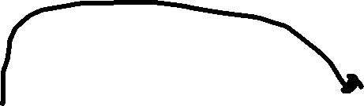
EC Primary Classification
Notes:
Even though lyase reactions are technically also oxidoreductase reactions, they have a special classification of their own. Class 4. This is mainly due to the type of redox reactions that are classified in EC 1. These tend to have the formula of: A + B = C + D; or two reactants form two products. Hydrolases and transferases also follow this reaction style. Lyase reactions differ, in that their major formula is: A = B + C where one molecule is converted to two or two into one in the reverse direction. Ligases also follow this type of formula. Isomerases follow the formula A = B or only 1 substrate and 1 product. Anyway, this difference in formula type is the main reason why lyases are classified as their own enzyme class, rather than with the other oxidoreductase enzymes.

Slide 22
Foundations of Biochemistry
Chapter 6.3 Enzyme Structure and Substrate Binding
Notes:
In this section, we will define some general features of enzymes.

Slide 23
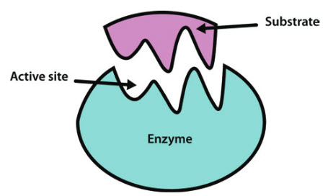
Enzyme-Substrate Binding
Notes:
Amino acid-based enzymes are globular proteins that range in size from less than 100 to more than 2,000 amino acid residues. These amino acids can be arranged as one or more polypeptide chains that are folded and bent to form a specific three-dimensional structure, incorporating a small area known as the active site, where the substrate actually binds. The active site may well involve only a small number (less than 10) of the constituent amino acids. It is the shape and charge properties of the active site that enable it to bind to a single type of substrate molecule, so that the enzyme is able to demonstrate considerable specificity in its catalytic activity.

Slide 24
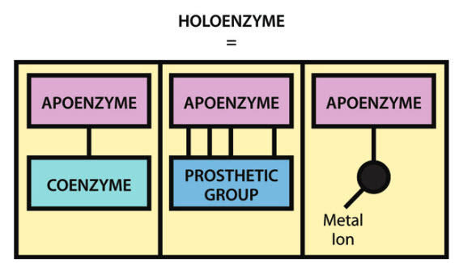


Notes:
Some enzymes require a cofactor to be functional. This can be a small organic molecule or a metal ion that helps mediate the reaction. Small organic molecules that can bind and be released from the enzyme are called coenzymes. If the small organic molecules bind really tightly to the enzyme they are called prosthetic groups. When the enzyme does not contain its cofactor, it is called an apoenzyme. With the cofactor it is called the holoenzyme.

Slide 25
Foundations of Biochemistry
Chapter 6.4 Enzymes and Reaction Equilibrium
Notes:
This section provides an introduction to the energetics of enzyme reactions.

Slide 26


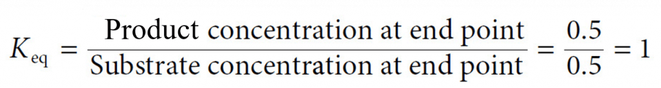
Enzyme and Reaction Rates
Notes:
Recall that enzymes enhance reaction rates, however, they do not change the equilibrium of the reaction or the spontaneity. These are determined by the intrinsic properties of the substrate and products. Recall that K equilibrium is determined by a ratio of the products over the substrates.

Slide 27

Enzymes for Complexes with their Substrates
Notes:
Enzymes form complexes with their substrates during the reaction. The ES complex makes the reaction more favorable. Once the reaction has occurred and the product is formed, the product dissociates from the enzyme.

Slide 28
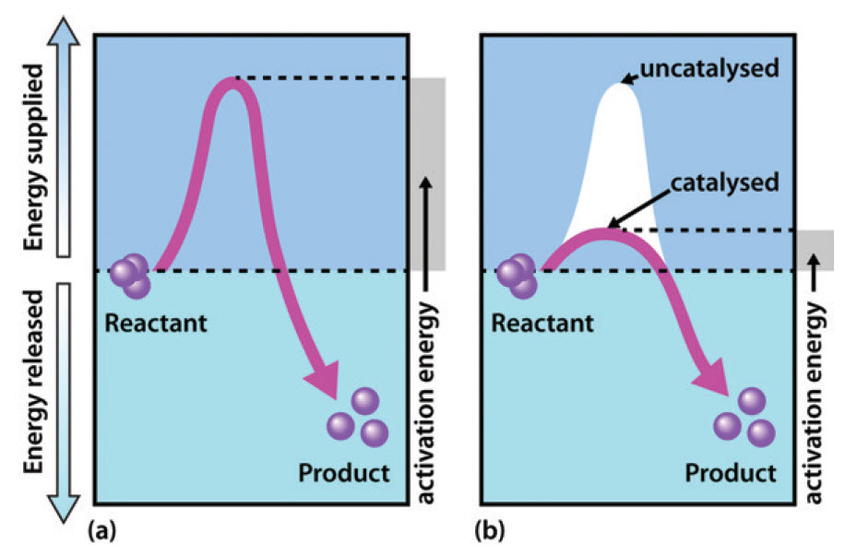
Enzymes reduce the Activation Energy Required for a Reaction
Notes:
In terms of energetics, reactions can be either exergonic (releasing energy) or endergonic (consuming energy). The reaction shown is exergonic (or the energy of the products is much lower than the energy of the reactants causing a release of energy during the reaction.
Enzymes will not affect the overall change in Gibbs Free Energy. What enzymes do, is reduce the activation energy required to start the reaction process. The second energy graph shows the reduction of the transition state energy when the enzyme is present. Ultimately, enzymes make the transition state of the reaction more likely to occur. Note, however, this cannot make an endergonic reaction exergonic. In the next section, we will begin to introduce enzyme kinetics.

