Slide 1
Chapter 7: Catalytic Mechanisms of Enzymes
7.1 Review of Organic Chemistry Concepts

Slide 2
Brief Review of Organic Principles
Definition of an Enzyme
Homolytic vs Heterolytic Bond Cleavage
Nucleophiles and Electrophiles
Electron Pushing
Acid Dissociation Constants (pKa)
Primary Enzyme Classifications

Slide 3
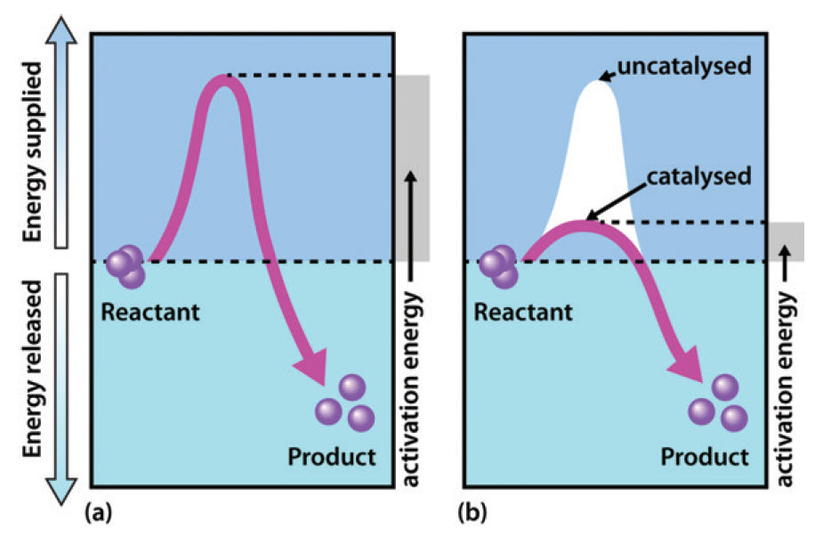
Enzymes
Are catalysts that speed up the rate of a chemical reaction, but are not themselves used up in the process of the reaction.
Notes:
Enzymes are catalysts that speed up the rate of a chemical reaction, but are not themselves used up in the process of the reaction. They act by lowering the activation energy required for the reaction to proceed in the forward direction and facilitating the formation of the transition state species. They do NOT alter the χηανγε ιν φρεε ενεργψ of the reaction and do NOT determine the spontaneity of a reaction.

Slide 4
Homolytic and Heterolytic Cleavage
+
Heterolytic Cleavage
Carbocation
Hydride Ion
+
Carbanion
Proton
Homolytic Cleavage
+
Radical Cleavage
Notes:
Covalent bonds consist of an electron pair shared between to atoms. During heterolytic bond cleavage, the bond pair is broken such that the electron pair remains with one of the atoms. In the case of a carbon-hydrogen bond, if the electrons remain with the hydrogen, this would form the hydride ion and the carbon would hold a positive charge and be a carbocation. If the electrons remain with the carbon, this forms the carbanion and the hydrogen is left as the proton. In homolytic bond cleavage the bond is broken so that the electron pair splits and one electron remains with the carbon and one with the hydrogen producing unstable radical intermediates. This occurs mostly during redox reactions.

Slide 5
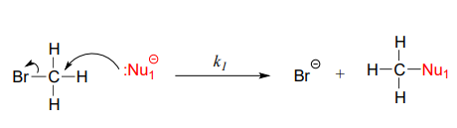
Nucleophiles and Electrophiles
Nucleophile
Electrophile
Figure modified from: Oregon Institute of Technology – Organic Chemistry, Libretexts
Notes:
A nucleophile is a chemical species that donates an electron pair to form a chemical bond in relation to a reaction. All molecules or ions with a free pair of electrons or at least one pi bond can act as nucleophiles. Because nucleophiles donate electrons, they are by definition Lewis bases. In the vast majority of the nucleophilic substitution reactions you will see in this and other organic chemistry texts, the electrophilic atom is a carbon which is bonded to an electronegative atom, usually oxygen, nitrogen, sulfur, or a halogen. The concept of electrophilicity is relatively simple: an electron-poor atom is an attractive target for something that is electron-rich, i.e. a nucleophile.

Slide 6
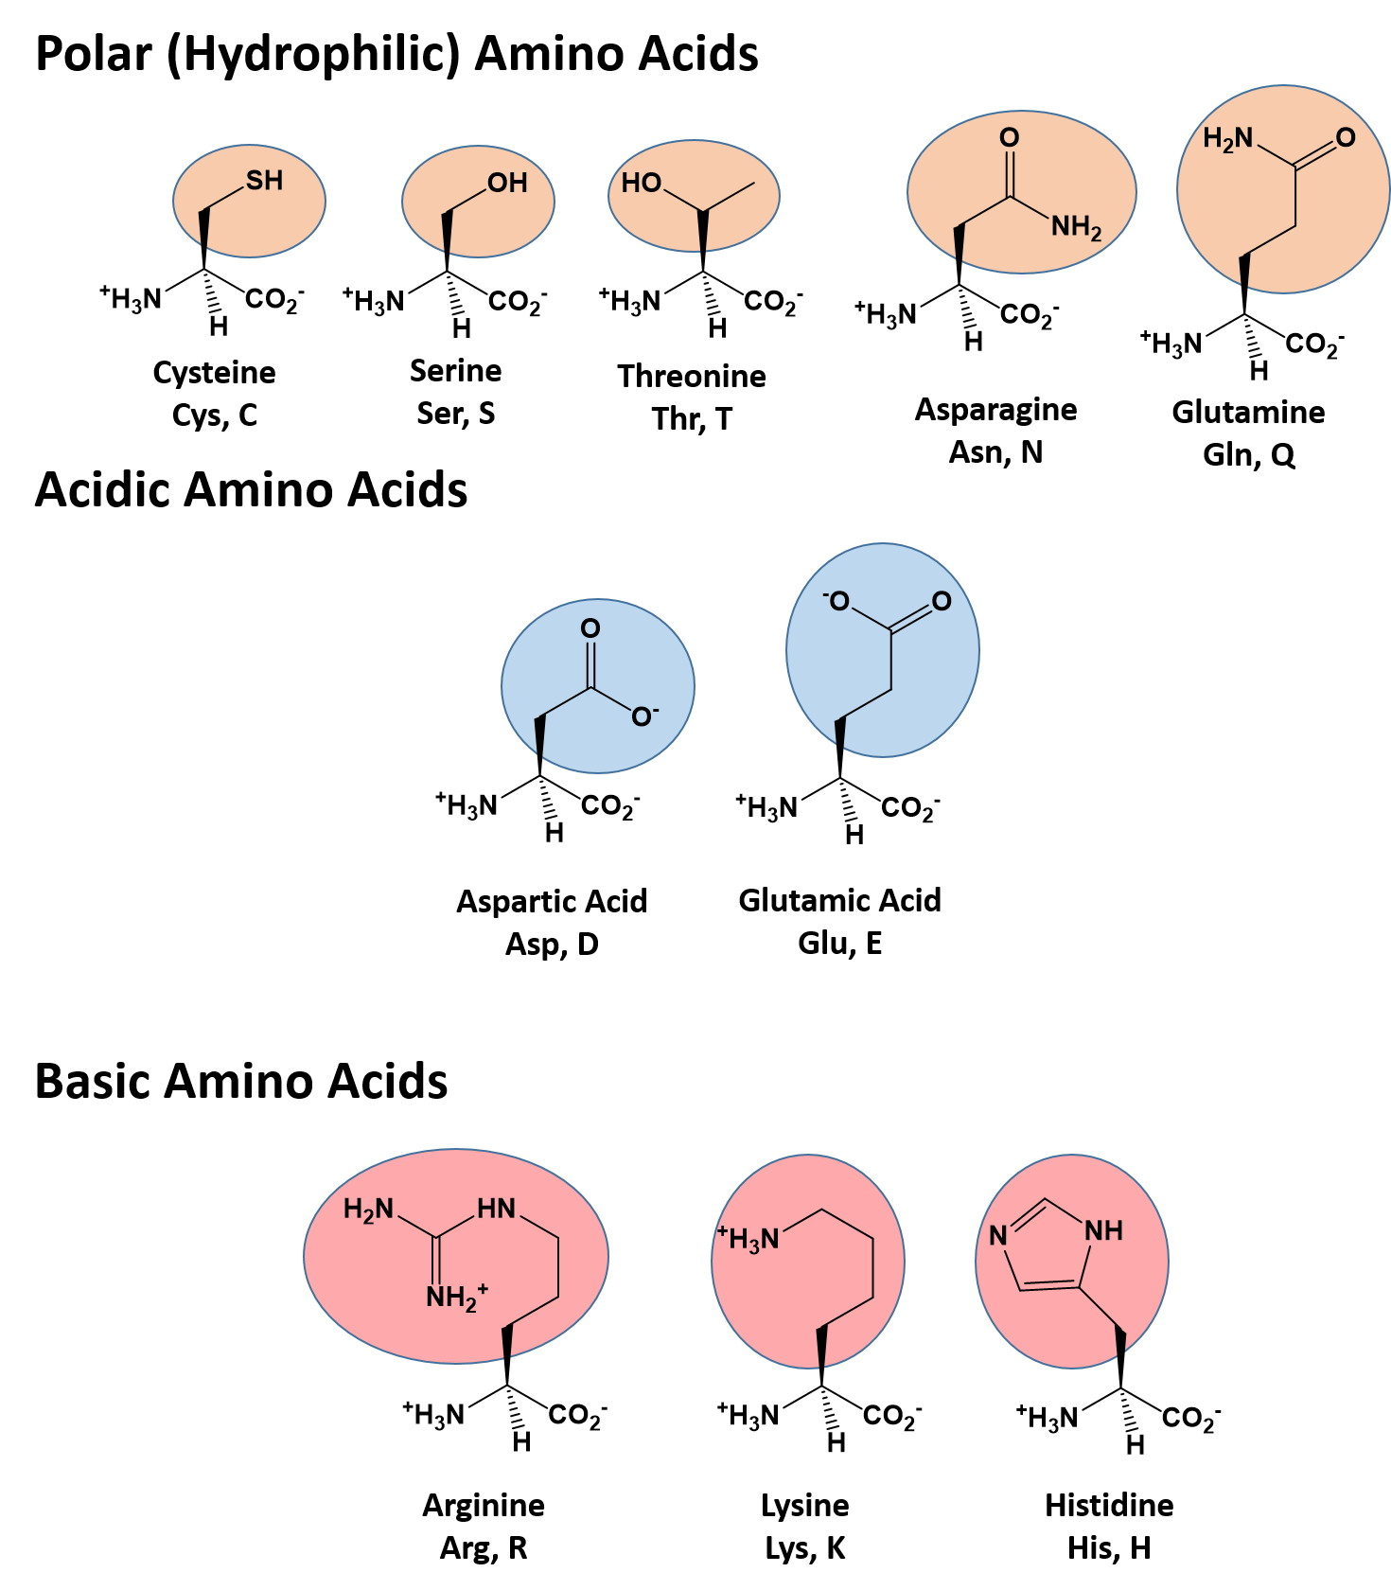
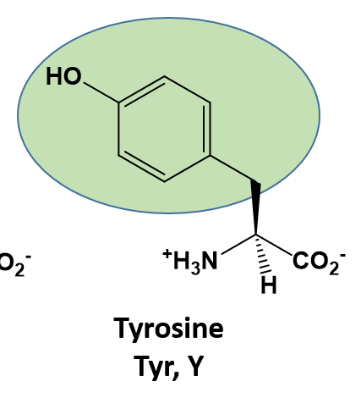
Nucleophiles and R-Groups
Notes:
the most common nucleophilic atoms are oxygen, nitrogen, and sulfur, and the most common nucleophilic compounds and functional groups are water/hydroxide ion, alcohols, phenols, amines, thiols, and sometimes carboxylates.

Slide 7
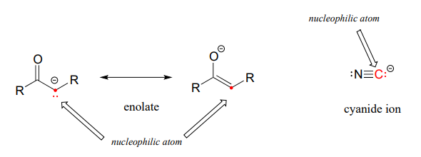
Carbons Atoms Can Also Act as Nucleophiles
Figure from: Oregon Institute of Technology – Organic Chemistry, Libretexts
Notes:
Carbon atoms can also act as nucleophiles, if they are next to an electron withdrawing group that can stabilize the charge state of the carbon atom. This can include the enolate, shown here, where either the carbon or the oxygen can act as the nucleophile.

Slide 8
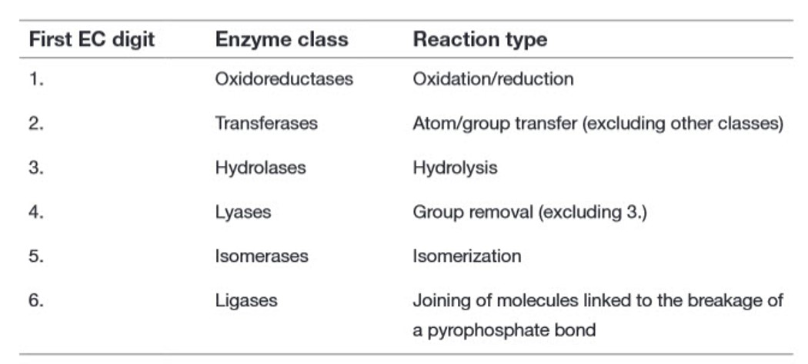
Main Classification of Enzyme Reactions
Notes:
In chapter six, we were introduced to the 6 main types of enzyme classes. We will continue to see examples of enzymes from these classes throughout this term and next term. So each time you see a new enzyme reaction, you should be thinking about how you should classify it!

Slide 9
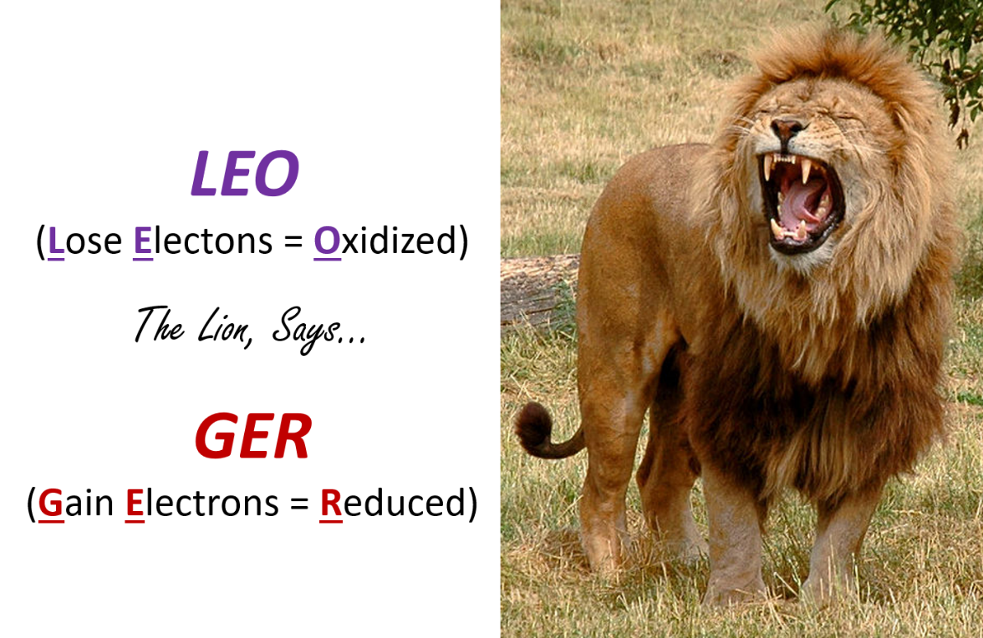
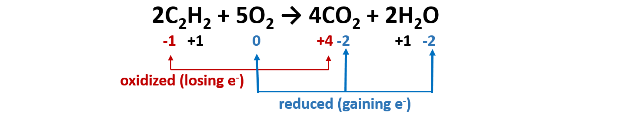
Oxidoreductases
Notes:
Recall that oxidation-reduction (redox) reaction are a type of chemical reaction that involves a transfer of electrons between two atoms or compounds. The substance that loses the electrons is said to be oxidized, while the substance that gains the electrons is said to be reduced. Redox reactions always have to occur together. If one molecule is oxidized, then another molecule has to be reduced. In biological systems, protons often move with the electrons during redox reactions, and can be used as a way to easily identify this reaction type.

Slide 10
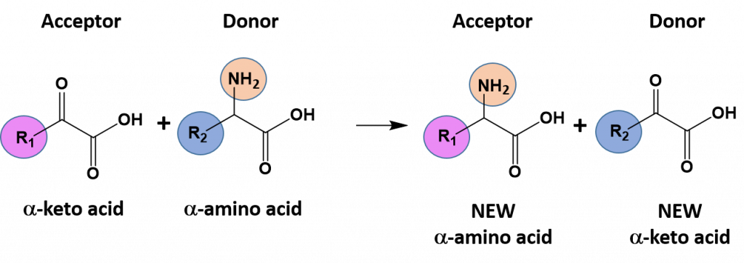
Transferases
Notes:
In group transfer reactions, a functional group will be transferred from one molecule that serves as the donor molecule to another molecule that will be the acceptor molecule. The transfer of an amine functional group from one molecule to another is common example of this type of reaction

Slide 11
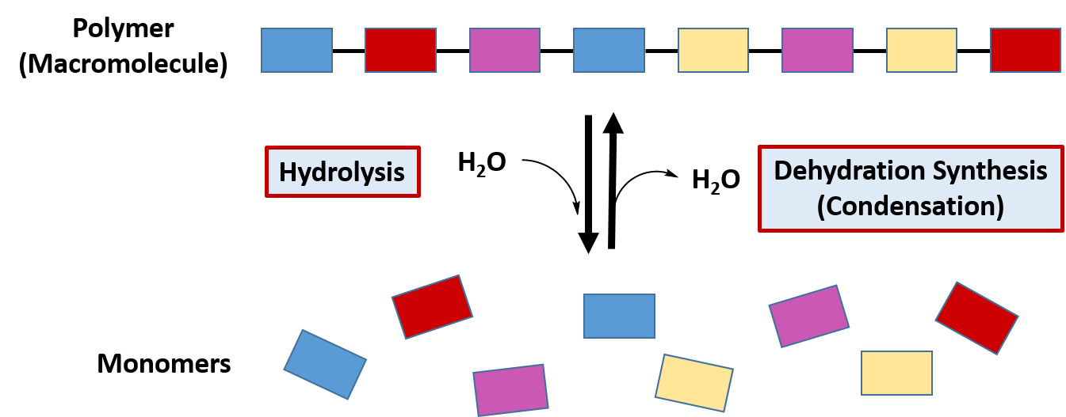
Hydrolases
Notes:
The classification of hydrolysis reactions include both the forward reactions that involve the addition of water to a molecule to break it apart or the reverse reaction involving the removal of water to join molecules together, termed dehydration synthesis (or condensation). Recall that the major macromolecules of the body are assembled using this reaction mechanism.

Slide 12
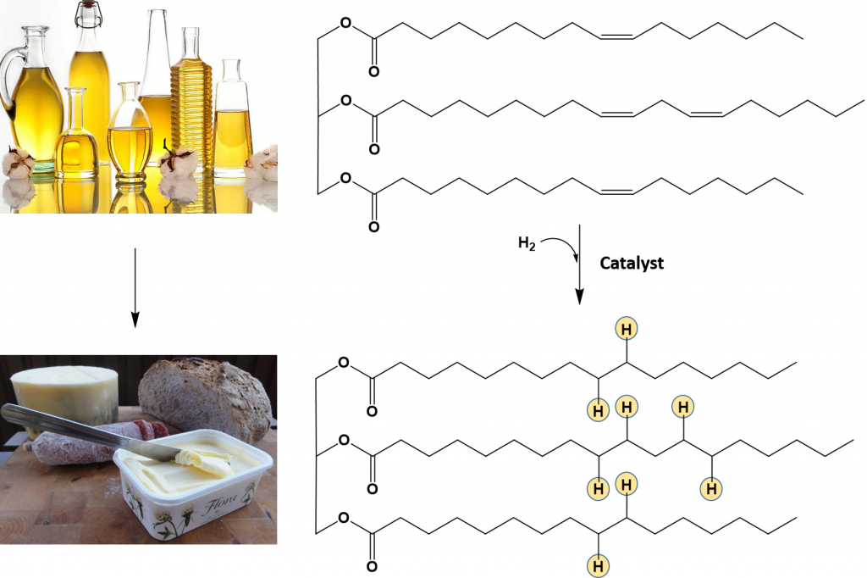
Lyases
Notes:
Reactions that mediate the formation and removal of carbon-carbon double bonds are also common in biological systems and are catalyzed by a class of enzymes called lyases.

Slide 13
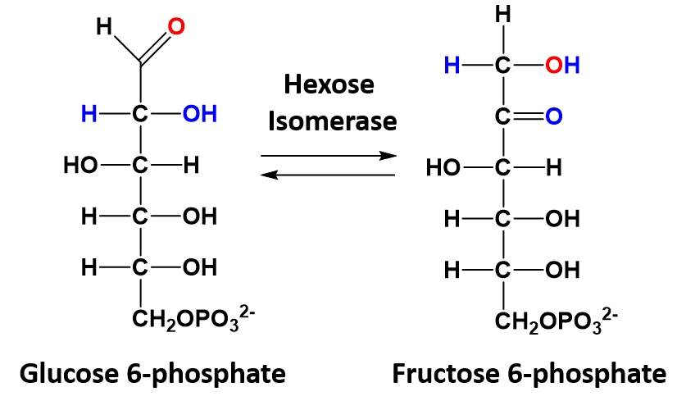
Isomerases
Notes:
In isomerization reactions a single molecule is rearranged such that it retains the same molecular formula but now has a different bonding order of the atoms forming a structural or stereoisomer. The conversion of glucose 6-phosphate to fructose 6-phosphate is a good example of an isomerization reaction and is shown

Slide 14
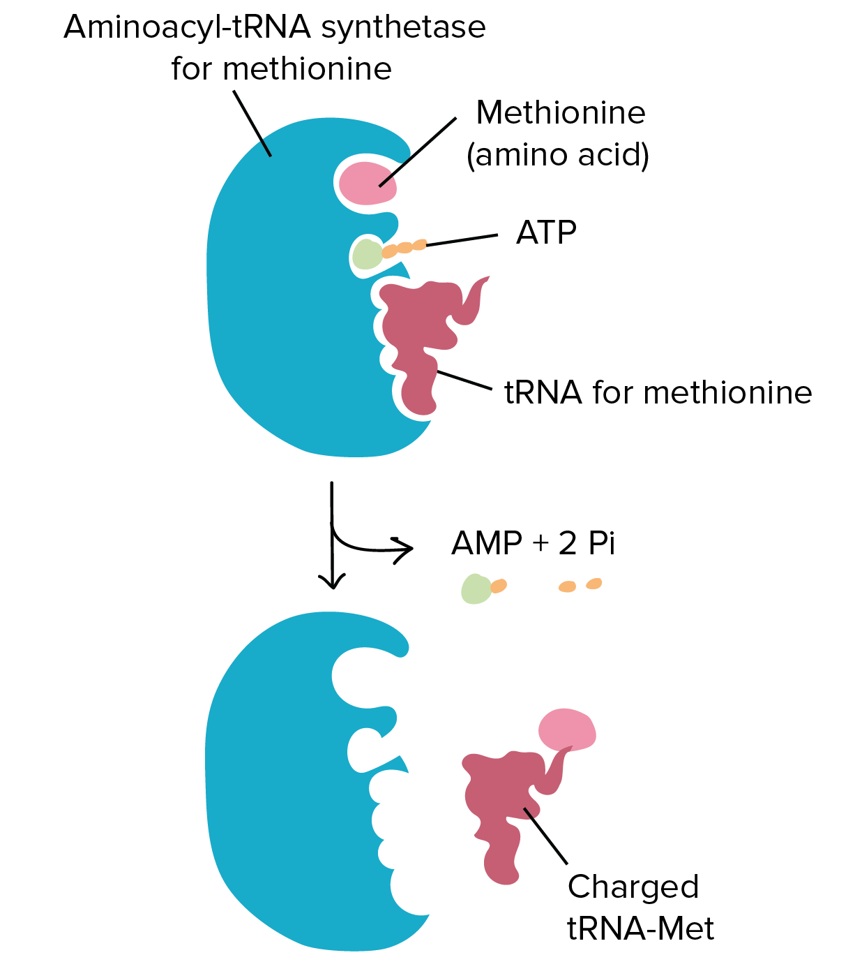
Ligases
Ligation reactions use the energy of ATP to join two molecules together
Figure provided by the Kahn Academy
Notes:
Ligation reactions use the energy of ATP to join two molecules together. An example of this kind of reaction is the joining of the amino acid with the transfer RNA (tRNA) molecule during protein synthesis. During protein synthesis the tRNA molecules bring each of the amino acids to the ribosome where they can be incorporated into the newly growing protein sequence. To do this, the tRNA molecules must first be attached to the appropriate amino acid. Specific enzymes are available called amino acyl – tRNA synthetases that mediate this reaction. The synthetase enzymes use the energy of ATP to covalently attach the amino acid to the tRNA molecule.

Slide 15
Chapter 7: Catalytic Mechanisms of Enzymes
7.2 and 7.3 Overview of Catalytic Mechanisms
Notes:
This section will focus on an introduction to the major catalytic strategies enzymes use to mediate their reactions and will focus on the serine protease, chymotrypsin, as an example of four of these strategies.

Slide 16
Types of Catalytic Mechanisms
Covalent Catalysis
Acid-Base Catalysis
Electrostatic Catalysis
Desolvation
Catalysis by Approximation
Strain Distortion
Cofactor Catalysis
Notes:
So there are seven major catalytic strategies that enzymes use to catalyze reactions. These are:

Slide 17
Chapter 7: Catalytic Mechanisms of Enzymes
Serine Proteases
Notes:
And our serine proteases, that will be our first enzymatic example, actually uses a combination of four of these strategies.

Slide 18
Types of Catalytic Mechanisms
Covalent Catalysis
Acid-Base Catalysis
Electrostatic Catalysis
Desolvation
Catalysis by Approximation
Strain Distortion
Cofactor Catalysis
Notes:
Serine proteases use a combination of covalent catalysis, acid-base catalysis, electrostatic interactions, and desolvation during its reaction mechanism.

Slide 19
Types of Catalytic Mechanisms
Covalent Catalysis
  involves the formation of a covalent bond between the enzyme and at least one of the substrates involved in the reaction.
Acid-Base Catalysis
  is involved in any reaction mechanism that requires the transfer of a proton from one molecule to another. It is very common to see this mechanism combined with Covalent Catalysis as many nucleophiles are activated by the removal of a proton, including alcohol, thiol, and amine functional groups.
Electrostatic Catalysis
  occurs when the enzyme active site stabilizes the transition state of the reaction by forming electrostatic interactions with the substrate. The electrostatic interactions can be ionic, ionic-dipole, dipole-dipole, or hydrophobic interactions. Hydrogen bonding is one of the most common electrostatic interactions formed in the active site.
Desolvation
  Enzyme active sites can become devoid of water and mimic the reaction characteristics of the gas phase. This can destabilize the polarized state of charged groups such as acids and bases. Thus, the neutral form of these types of residues becomes the favored state. This is due to significant alterations in the pKa of the active site residues within the nonpolar environment.
Notes:
So let’s define these in a little more detail before we look at a specific example.

Slide 20
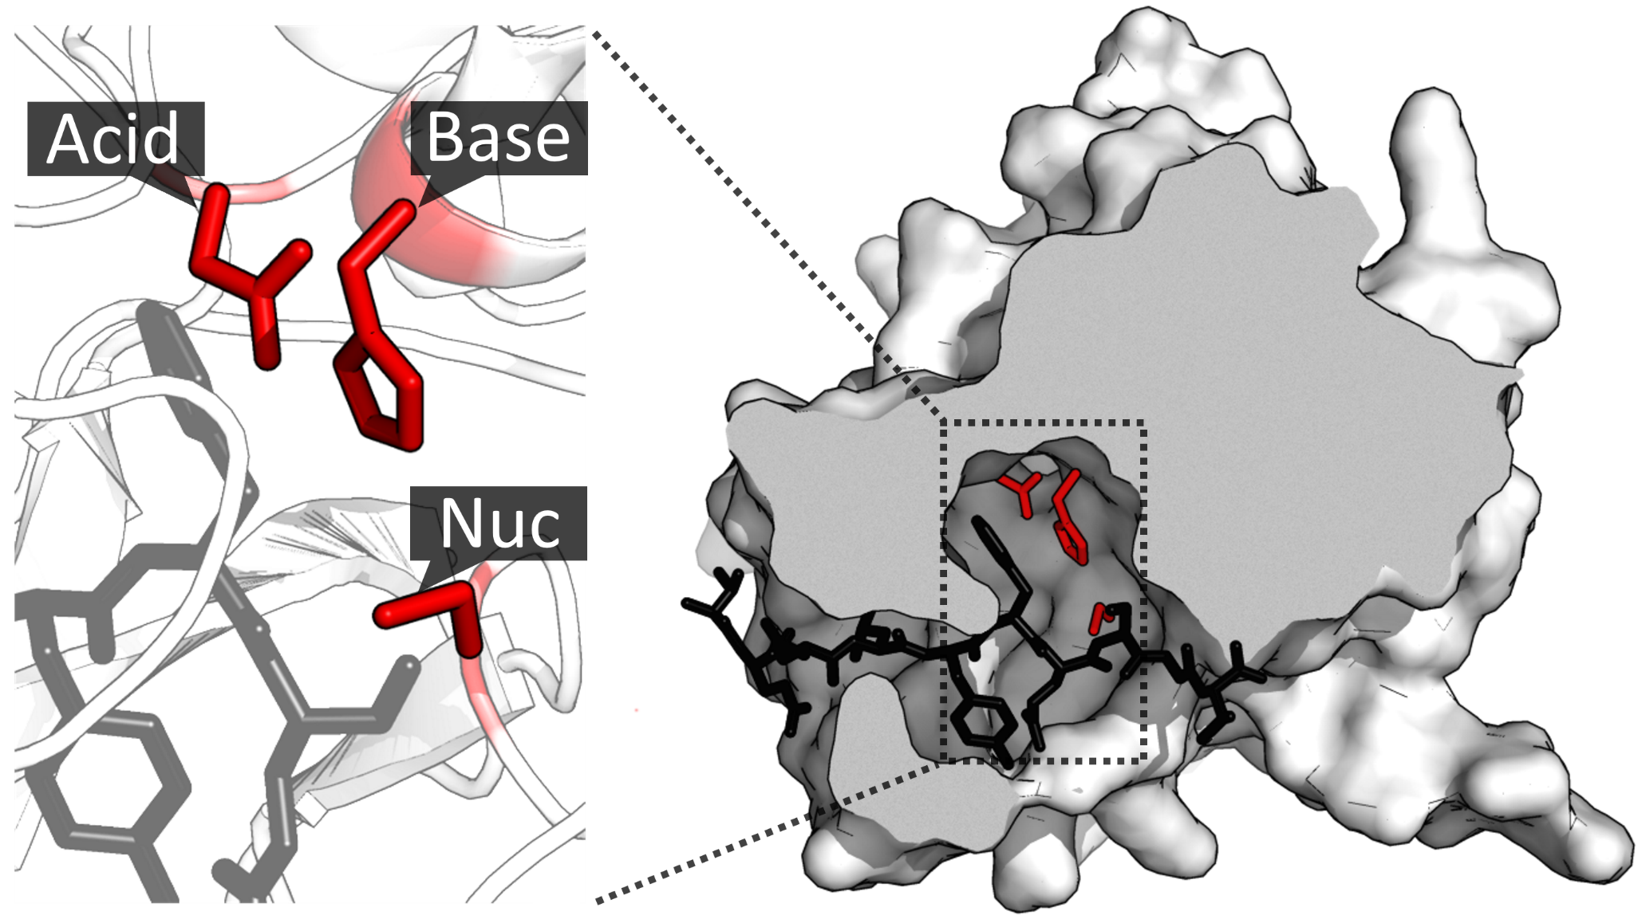
Serine Proteases
Notes:
The Serine Proteases are a family of enzymes that mediate the hydrolysis of proteins into smaller peptide units. We have already talked about the activity of two serine proteases, Trypsin and Chymotrypsin during our discussion of techniques used to study proteins. The active site of this family of proteins contains a catalytic triad that consists of an acid (Asp), a base (His), and a nucleophile (Ser). The serine residue is the position where the enzyme forms a covalent linkage with the substrate and is the reason that this protein class is named the Serine Proteases. We will learn about the detailed reaction mechanism of the Chymotrypsin Enzyme as an example.

Slide 21
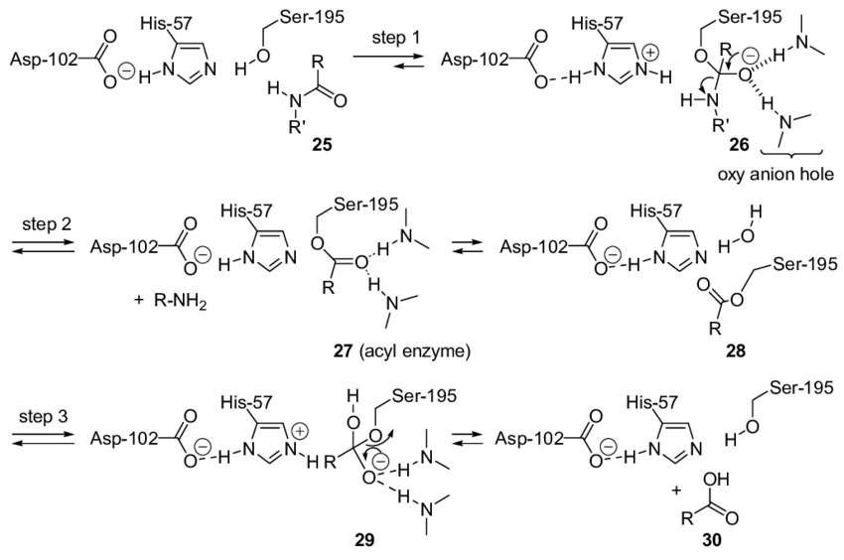
Chymotrypsin active site catalysis
Figure from: Vogel, P., et al (2016) Catalysts 6(9):128
Notes:
This diagram shows an overview of the chemistry that is occurring at the active site of the Chymotrypsin enzyme. Overall, the reaction starts with the peptide to be cleaved, entering the active site. The catalytic triad of the enzyme is shown here. The aspartic acid residue coordinates with the histidine residue, enabling the histidine residue to abstract a proton from the alcohol oxygen of the serine residue. This enables the serine oxygen to act as a nucleophile and attack the carbonyl carbon of the peptide bond. It forms this oxyanion intermediate structure that is the transition state of the reaction. This is stabilized by electrostatic interactions within a region of the protein known as the oxyanion hole. We will discuss this in more detail in the next few slides. As the electrons from the oxyanion rebound into the peptide, the peptide bond (the amide bond) is cleaved, releasing that half of the peptide from the enzyme. This part of the peptide leaves the active site allowing water to enter. The water mediates nucleophilic attack on the carbonyl carbon, recreating the oxyanion intermediate. As the electrons rebound this time, the serine residue acts as the leaving group, which restores the enzyme and forms the carboxylic acid of the cleavage product. The other half of the peptide is then free to diffuse out of the active site of the enzyme. The enzyme is then ready for another round of cleavage.

Slide 22
Chymotrypsin Active Site
Ser-195
Empty Chymotrypsin Active Site
His- 57
Asp-102
Notes:
Okay, so that is a lot for a single slide. Let’s slow down and look at this in a little more detal. Here is a model of the Chymotrypsin enzyme shown in blue, with the catalytic triad indicated in green. The histidine-57 residue and aspartic acid-102 residue participate in the acid-base dynamics, while the serine-195 serves as the active site nucleophile and forms a covalent intermediate with the protein substrate.

Slide 23
Chymotrypsin Active Site
Ser-195
Protein Substrate Enters
His- 57
Desolvation
Acid-Base Catalysis
Asp-102
Notes:
When the protein that will be cleaved enters the active site of the enzyme, the Asp-102 abstracts a proton from the His-57 residue in the acid-base component of the reaction mechanism. This step also utilized the mechanism of desolvation. When the protein to be cleaved enters into the active site, it takes up all the active site space and excludes water from the active site. This creates a dehydrated microenvironment which causes the pKa’s of the active site residues to shift, increasing the pKa of aspartic acid such that it will accept a proton from histidine residue rather than donate it. This enables the histidine-57 to abstract a proton from the Ser-195 residue and activate the alcohol oxygen as a nucleophile. The Ser-195 oxygen then attacks the carbonyl carbon of the amide (peptide) bond that will be cleaved.

Slide 24
Chymotrypsin Active Site
Oxyanion
Ser-195
His- 57
Asp-102
Notes:
The serine oxygen forms a covalent bond with protein substrate, causing the carbonyl oxygen of the substrate to become charged. This charged species is called an oxyanion. This stage begins the covalent catalysis component of the reaction mechanism and forms the transition state of the reaction.

Slide 25
Chymotrypsin Active Site
Oxyanion Hole
Ser-195
His- 57
Asp-102
Notes:
The oxyanion transition state is stabilized by electrostatic interactions (hydrogen bonding) with the backbone amine groups of the enzyme. This stabilization area on the enzyme is called the oxyanion hole. This represents the electrostatic interactions component of the reaction mechanism.

Slide 26
Chymotrypsin Active Site
Oxyanion Hole
Ser-195
His- 57
Asp-102
Notes:
From here, the electrons on the oxyanion rebound back down to reform the carbonyl functional group. This overloads the carbon atom with five bonds and causes the C-N bond to break. The electrons from the C-N bond take the proton from the Histidine residue.

Slide 27
Chymotrypsin Active Site
Oxyanion Hole
Ser-195
First Product Leaves the Active Site
His- 57
Asp-102
Notes:
The first product of the reaction can then leave the catalytic site of the enzyme. The carbonyl side of the protein is still covalently attached to the enzyme at the serine residue.

Slide 28
Chymotrypsin Active Site
Oxyanion Hole
Ser-195
Water Enters the Active Site
His- 57
Asp-102
Notes:
After the first product of the reaction leaves the catalytic site of the enzyme, this creates enough space that water can re-enter the active site.

Slide 29
Chymotrypsin Active Site
Oxyanion Hole
Ser-195
Water forms a covalent bond with the substrate
His- 57
Asp-102
Notes:
The water interacts electrostatically with the serine-195 and histidine-57 residues and is positioned such that the oxygen can act as a nucleophile and attack the carbonyl carbon of the substrate forming a covalent bond.

Slide 30
Chymotrypsin Active Site
Oxyanion Hole
Ser-195
Water forms a covalent bond with the substrate
His- 57
Asp-102
Notes:
The histidine residue bonds with the proton from the water molecule and the oxyanion intermediate reforms.

Slide 31
Chymotrypsin Active Site
Oxyanion Hole
Ser-195
Serine is reformed
His- 57
Asp-102
Notes:
The electrons from the oxyanion rebound to reform the carbonyl. This causes the bond between the carbonyl carbon and the serine oxygen to break. The electrons from this bond capture the proton from water and reform the serine residue and histidine-57 is restored.

Slide 32
Chymotrypsin Active Site
Oxyanion Hole
Ser-195
The second product can leave the active site
His- 57
Asp-102
Notes:
The second product leaves the active site of the enzyme. The enzyme active site is restored and ready for another round of catalysis. Thus, the serine protease catalytic mechanism utilized (1) Acid-Base Catalysis, (2) Desolvation, (3) Covalent Catalysis, and (4) Electrostatic Interactions to complete protein hydrolysis.

