Slide 1
Chapter 7: Catalytic Mechanisms of Enzymes
7.3 Protease Comparisons and NMP Kinases

Slide 2
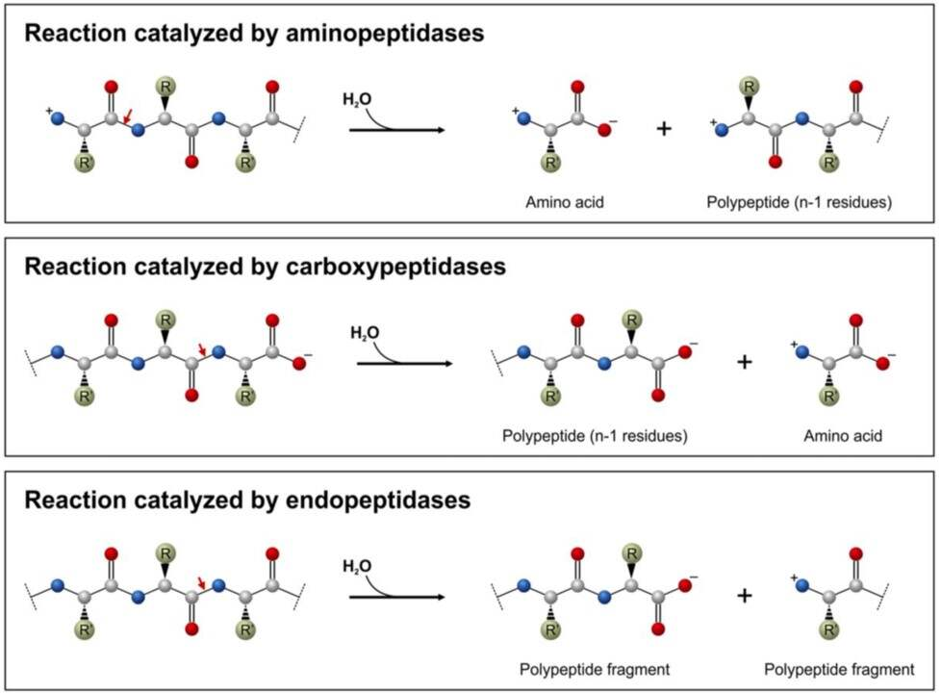
Notes:
In the last lecture, we took a look at the catalytic mechanism of the chymotrypsin protease enzyme. I just wanted to end that section discussing some comparisons between some of the major types of protease enzyme classes, including the aminopeptidases, which cleave off the amino terminal residue, the carboxypeptidases, which cleave off the carboxy-terminal residue, and the endopeptidases, like chymotrypsin, that cleaves proteins in the middle of the protein sequence creating peptide fragments.

Slide 3
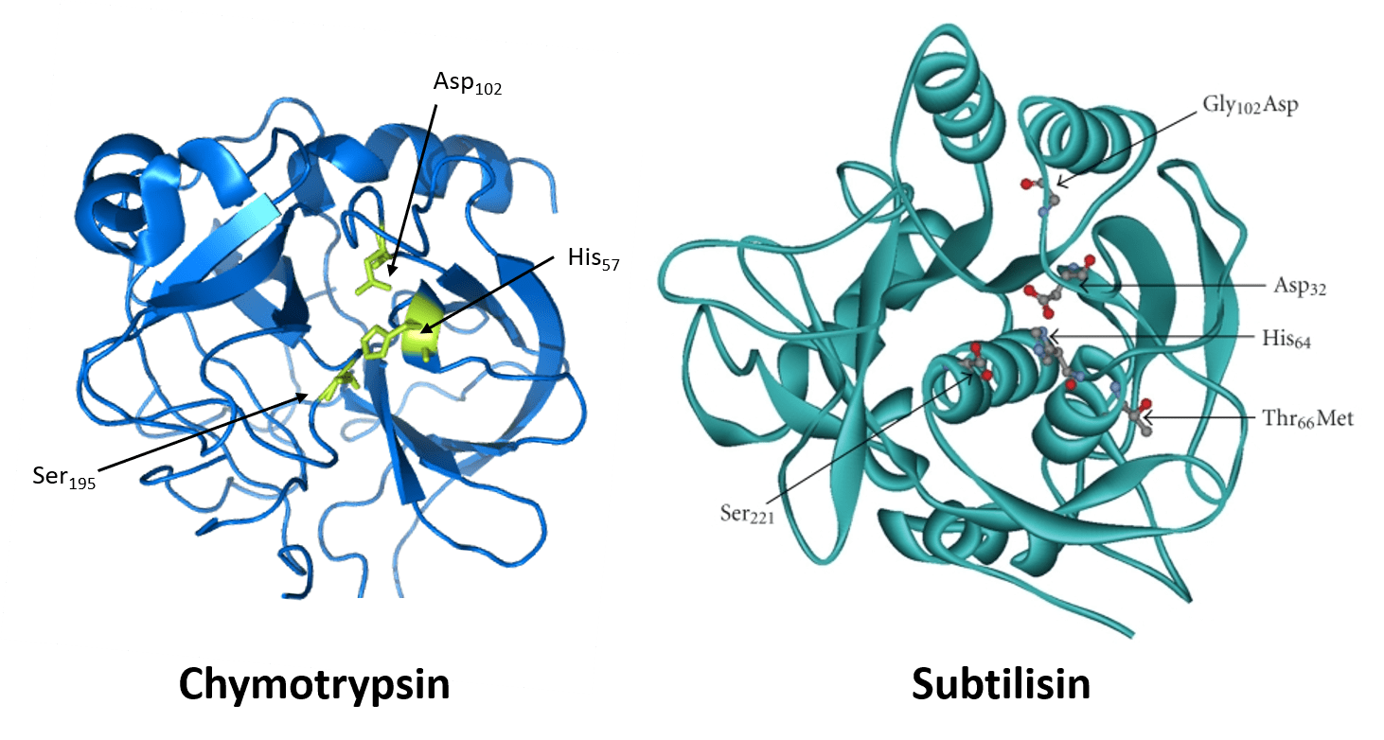
Serine Proteases
Notes:
As we saw in the last talk, chymotrypsin belongs to the serine protease class of endopeptidases, and contains a catalytic triad that is important in the reaction mechanism. Recall that Asp, His, and Ser all play critical roles within the catalytic mechanism. Interesting within this family, some members are true homologs arising through the same ancestral lineage. However, convergent evolution is also seen within the subclasses of serine proteases. For example, Chymotrypsin and subtilisin are both serine proteases and utilize the same catalytic triad (Ser-His-Asp). However, they do not share significant sequence homology and do not resemble one another in their 3-D shape. This underscores the importance of this mechanism within the active site of enzymes, that it has arisen multiple time during evolutionary history.

Slide 4
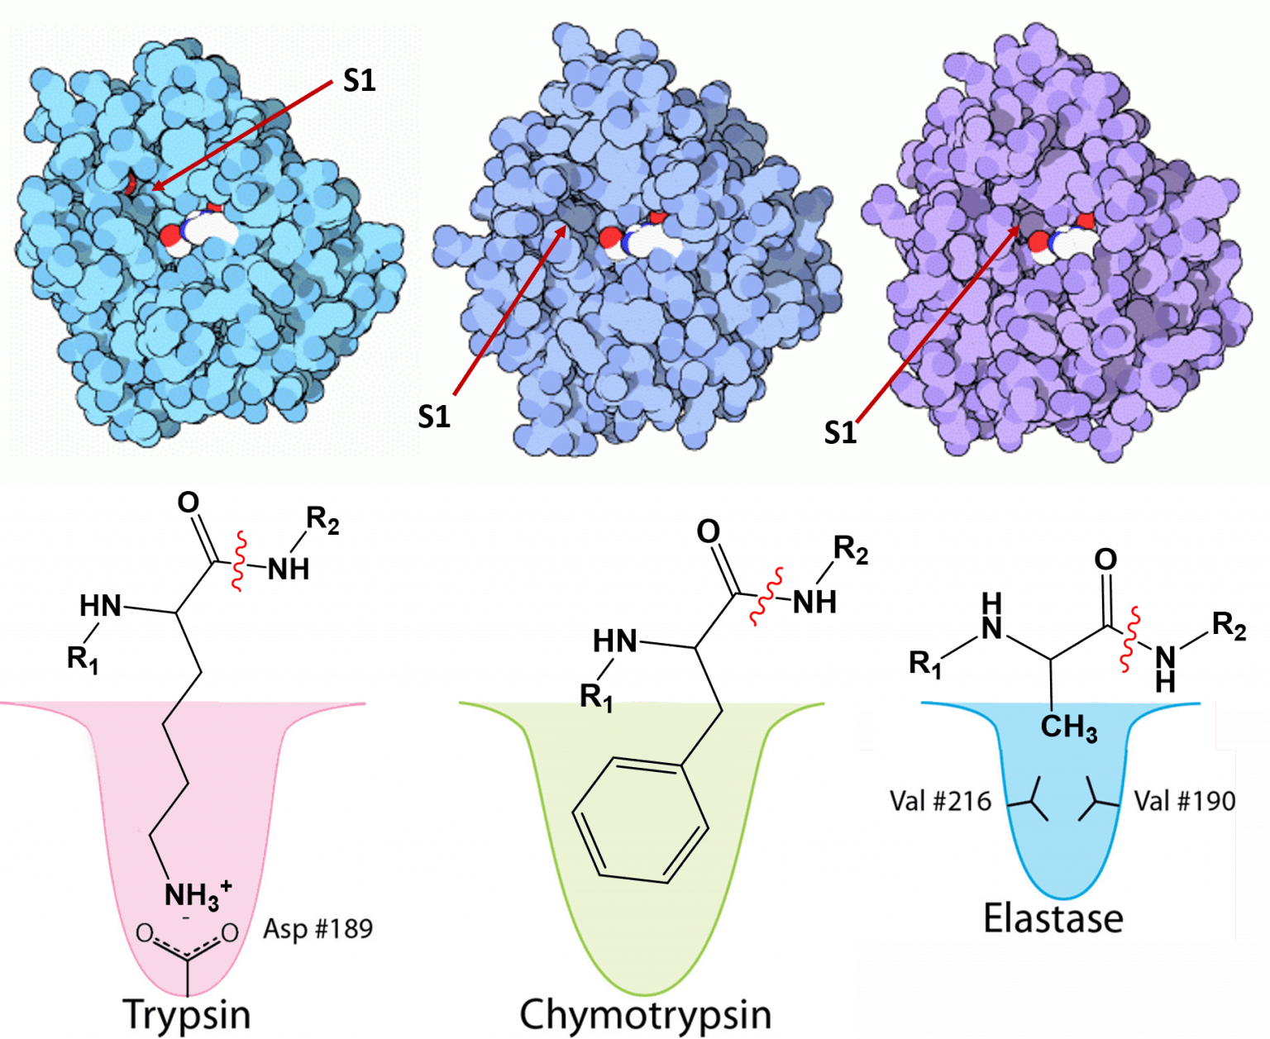
Trypsin, Chymotrypsin and Elastase
Notes:
Trypsin, Chymotrypsin, and Elastase, on the otherhand, are serine protease homologs that share high sequence homology and tertiary structures. However, they each have diverged in their ability to recognize protein substrates. You can see that while these enzymes have significant homology and have retained the catalytic triad, the substrate binding domain has evolved to recognize different R-groups to dock the substrate for subsequent cleavage. Trypsin recognizes basic amino acids and forms electrostatic interactions with the basic R-groups and an aspartic acid residue, while the substrate docking site for chymotrypsin contains small, nonpolar R-groups allowing for the binding of aromatic amino acids. Elastase on the otherhand, has a smaller binding site that contains larger aliphatic residues, limiting this docking site to smaller, hydrophobic R-groups, such as alanine. Overall, a lot of protein mechanics have been learned from the serine proteases.

Slide 5
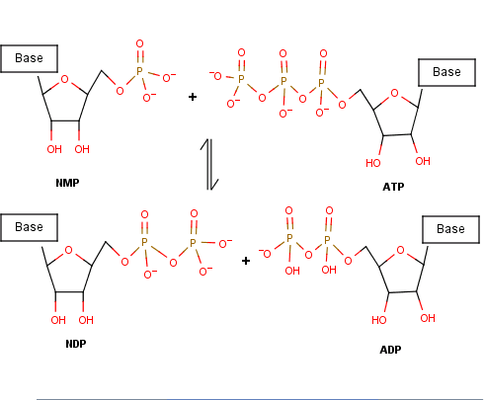
NMP Kinases
Figure from: Joyjiang
Notes:
Another enzyme class that we want to take a look at are the Nucleoside monophosphate kinases or simply NMP kinases. NMP kinases are enzymes that catalyze the transfer of a phosphoryl group from a nucleoside triphosphate (NTP) such as ATP onto a nucleoside monophosphate (NMP). So essentially the create two NDPs (one being the ADP molecule). The enzyme can also work in the opposite direction, depending on the concentration of nucleotide phosphate pools.

Slide 6
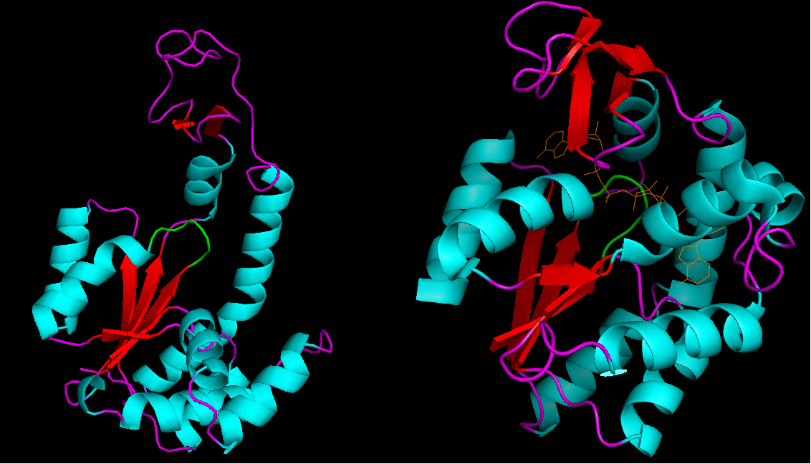
Adenylate Kinase
Figure from: Jilliaaaane
Notes:
Adenylate kinase (AK) an example NMP kinase, is shown here in both an open, unbound conformation (left) and with the lid domain closed around Ap5A, an inhibitor (right). The P-loop is shown here in green while Ap5A is orange.

Slide 7
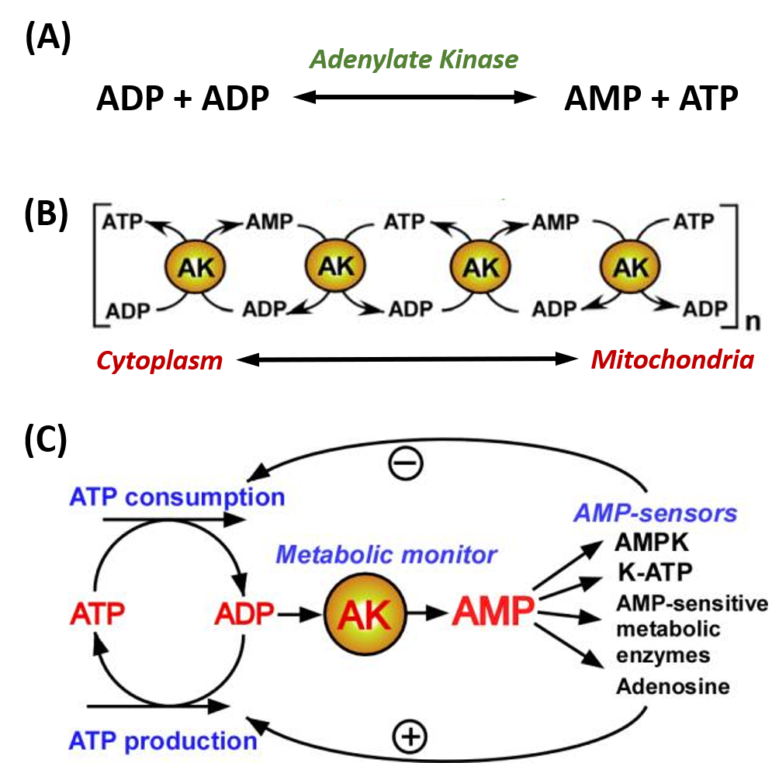
Notes:
By constantly monitoring phosphate nucleotide levels inside the cell, AK enzymes play an important role in cellular energy homeostasis. The basic chemical reaction mediated by this enzyme class is the conversion of 2 ADP molecules into 1 ATP and 1 AMP. The reverse reaction can also occur forming an equilibrium based on cellular concentrations of the varying phosphorylation states. AK enzymes can be involved in regulating nucleotide concentrations and serve as a relay system between cellular and mitochondrial pools of adenine nucleotides, as shown in Figure B. AK enzymes can also serve as a sensor for energy load within the cell and can lead to the activation of AMP-sensitive systems within the cell when energy levels are low . To date there have been nine human AK protein isoforms identified. While some of these are ubiquitous throughout the body, some are localized into specific tissues. For example, AK7 and AK8 are both only found in the cytosol of cells; and AK7 is found in skeletal muscle whereas AK8 is not. AK1, the most abundant cytosolic AK isozyme, has a Km about a thousand times higher than the Km of AK7 and 8, indicating a much weaker binding of AK1 to AMP. Sub-cellular localization of the AK enzymes is done by unique targeting sequences found in the protein. Each isoform also has different preference for NTP’s. Some will only use ATP, whereas others will accept GTP, UTP, and CTP as the phosphoryl carrier.

Slide 8
Types of Catalytic Mechanisms
Covalent Catalysis
Acid-Base Catalysis
Electrostatic Catalysis
Desolvation
Catalysis by Approximation
Strain Distortion
Cofactor Catalysis
Notes:
NMP Kinases use three strategies for mediating their chemical reactions. They use Electrostatic Interactions, Catalysis by Approximation, and Cofactor Catalysis

Slide 9
Types of Catalytic Mechanisms
Electrostatic Catalysis
  Occurs when the enzyme active site stabilizes the transition state of the reaction by forming electrostatic interactions with the substrate. The electrostatic interactions can be ionic, ionic-dipole, dipole-dipole, or hydrophobic interactions. Hydrogen bonding is one of the most common electrostatic interactions formed in the active site.
Catalysis by Approximation
  Occurs when the enzyme active site brings substrates within close proximity and a favorable orientation for a chemical reaction to take place.
Cofactor Catalysis
  Occurs when an enzyme uses a cofactor to facilitate the chemical reaction. This can be a metal ion or an organic molecule.
Notes:
Before we get into the details about the reaction mechanism, let’s define these strategic features.

Slide 10
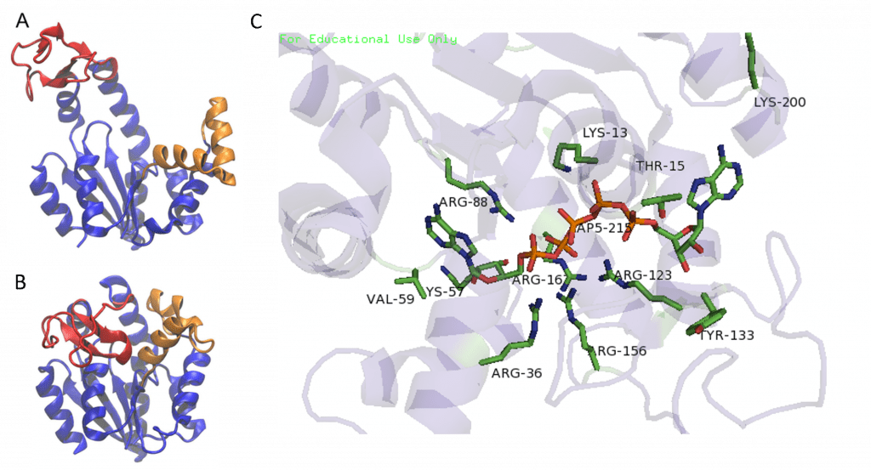
Adenylate Kinase Reaction
Notes:
Phosphoryl transfer during the AK reaction only occurs after the closing of an ‘open lid’ structure in the enzyme through the catalysis by approximation mechanism. This causes an exclusion of water molecules that brings the substrates in proximity to each other and effectively lowers the energy barrier for the nucleophilic attack by the γ-phosphoryl group of ATP on the α-phosphoryl of AMP. In the crystal structure of the AK enzyme from E. coli with inhibitor Ap5A, the Arg88 residue coordinate the Ap5A at the α-phosphate group through electrostatic interactions. It has been shown that the mutation of Arg88 to Gly (R88G) results in 99% loss of catalytic activity of this enzyme, suggesting that this residue is intimately involved in the phosphoryl transfer. A magnesium or manganese cofactor is also required, essential for increasing the electrophilicity of the phosphate on AMP, though this magnesium ion is only held in the active pocket by electrostatic interactions and dissociates easily.

Slide 11
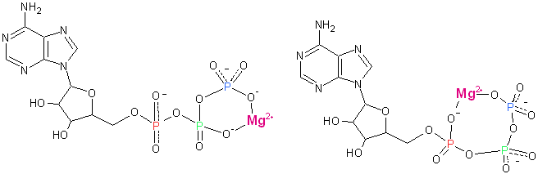
Metal Ion Cofactor for AK
Notes:
Another feature of NMP kinases, is that it interacts with the ATP substrate only after it forms a complex. ATP forms a complex with either a magnesium or manganese ion which provides more points for the substrate and enzyme to interact thus increasing the binding energy. There are isomeric forms to the metal ion-nucleotide complex depending on the interaction between the metal ion and the oxygen atoms attached to the phosphoryl groups.

Slide 12
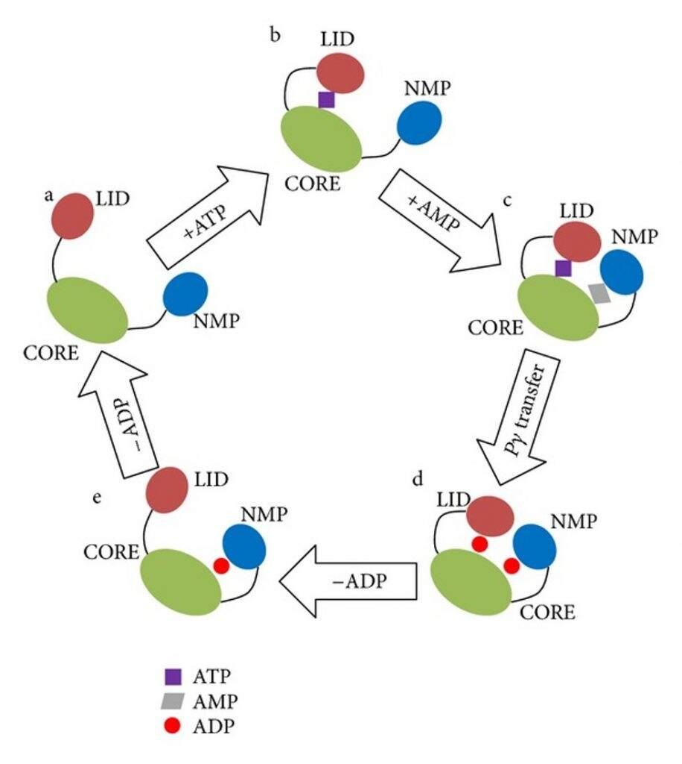
Notes:
Ultimately, the NMP and ATP have different binding locations on the enzyme. ATP interacts with a metal cofactor and binds with the lid side of the Adenylate kinase. The AMP will then bind with the NMP domain. Closure of the lid structure and stabilization through electrostatic interactions with the enzyme brings the two substrates in close proximity with one another and facilitates the chemical reaction that transfers one phosphoryl group from the ATP to the AMP molecule. Both molecules of ADP are then released from the enzyme.

Slide 13
Chapter 7: Catalytic Mechanisms of Enzymes
7.3 Restriction Endonucleases

Slide 14

Restriction Enzymes
EcoRI Cleavage Site
Notes:
Previously, we discussed the utility of bacterial restriction enzymes in molecular biology, especially with regards to cloning techniques. Recall that restriction enzymes recognize palindromic sequences within the DNA where they mediate cleavage. Some can cleave right down the middle of the binding site, while others, such as EcoRI will cleave in an offset manner, producing single-stranded sticky ends at the edge of the cut site.

Slide 15
Types of Catalytic Mechanisms
Strain Distortion
  Occurs when the enzyme active site stabilizes the transition state of the reaction by causing a bend or kink in the molecule that exaggerates the normal chemical bond angle, making it more likely to break.
Catalysis by Approximation
  Occurs when the enzyme active site brings substrates within close proximity and a favorable orientation for a chemical reaction to take place.
Cofactor Catalysis
  Occurs when an enzyme uses a cofactor to facilitate the chemical reaction. This can be a metal ion or an organic molecule.
Notes:
Typically restriction enzymes will mediate their reactions using a combination of Catalysis by Approximation, Strain Distortion and Cofactor Catalysis. We have already seen the use of Catalysis by Approximation and Cofactor Catalysis. Strain distortion, however, is another strategic way enzymes use to mediate reactions, where the enzyme active site…

Slide 16
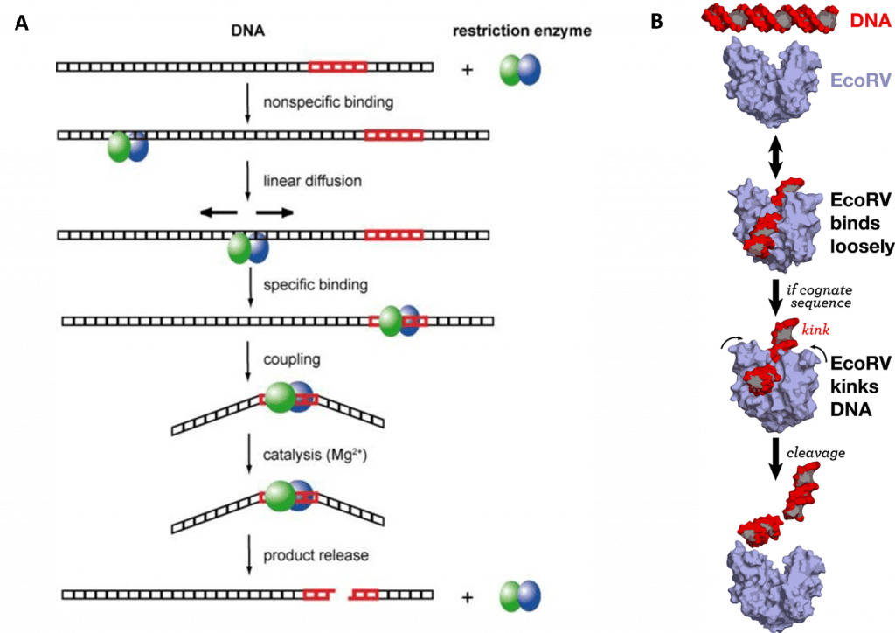
EcoRI Endonuclease
Notes:
Cleavage of the DNA molecule, as with the other major macromolecules, requires the addition of water. Thus, restriction endonucleases can be classified as hydrolase enzymes. Restriction endonucleases typically have two different modes that they use to bind with DNA. The first is a scanning mode, where the endonuclease will nonspecifically bind with the DNA molecule and slide along the sequence until it locates its sequence specific binding site. Once specific binding occurs, the strain distortion becomes apparent as the DNA is significantly bent leading to cleavage. A magnesium ion is required to help coordinate the water molecule during hydrolysis.

Slide 17
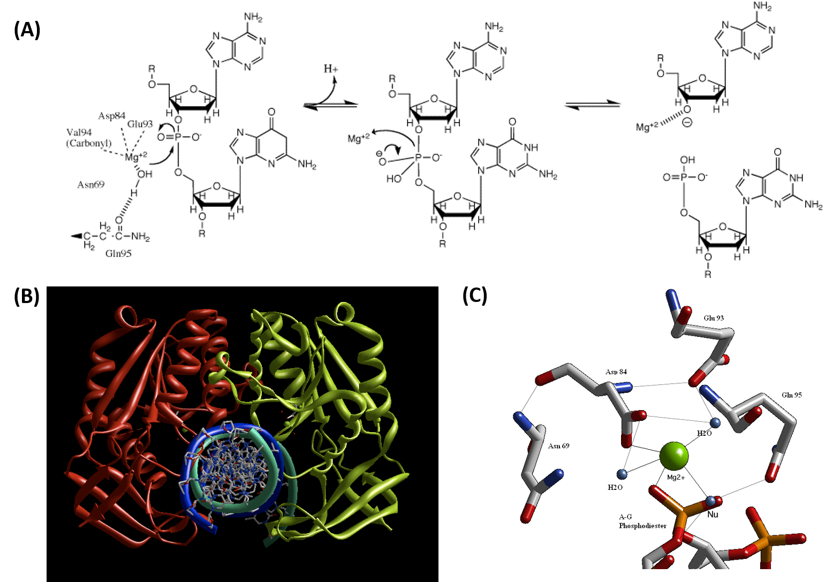
BglII Reaction Mechanism
Notes:
A similar restriction endonuclease, BglII provides a more detailed description of the enzymes reaction mechanism.

Slide 18
BglII Reaction Mechanism
Notes:
In the first part of the reaction, the Mg2+ ion helps to coordinate the water molecule, enabling it to act as a nucleophile at the 5’-phosphate site of the second G. Note that the cut site of BglII is AGATCT, and cleavate occurs between the first A and G residue, which is shown in the diagram here.

Slide 19
BglII Reaction Mechanism
Notes:
The electrons from the double bond are initially shifted to the oxygen. When they rebound back to reform the O=P double bond, the 5’-side of the DNA molecule is cleaved. This cleavage product is coordinated initially with the Mg2+ from the active site center and later replaced with a proton after the downstream DNA sequence leaves the active site.

Slide 20
BglII Reaction Mechanism
Notes:
This diagram shows the crystal structure of the BglII Dimer bound to the DNA molecule, shown in cross section in blue and green. The strain distortion can be seen here.

Slide 21
BglII Reaction Mechanism
Notes:
And this diagram very nicely shows the coordination of the active site water molecule by the Mg2+, placing it in close proximity with the phosphate target, demonstrating catalysis by approximation.

Slide 22
Chapter 7: Catalytic Mechanisms of Enzymes
7.3 RNA Enzymes (Ribozymes)
Notes:
The final reaction mechansisms, that we want to visit in chapter 7 are those most common to RNA enzymes or ribozymes.

Slide 23
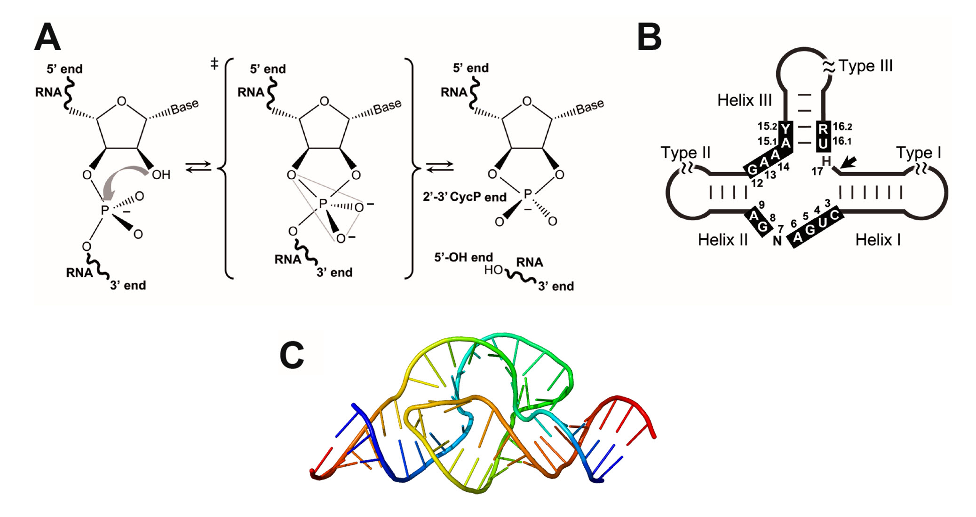
Ribozymes
Notes:
While most enzymatic functions are mediated by proteins, some key cellular processes are mediated by RNA enzyme, including the peptidyl transferase activity of the ribosome during protein synthesis. A less well known chemical reaction is mediate by the RNA ribozyme called the Hammerhead Ribozyme that is shown above. The Hammerhead Ribozyme is a small, self-cleaving molecule of RNA. In this case the single stranded RNA molecule forms this hammerhead structure that is shown in 2-dimensions in figure B and in a 3-D view in figure C.

Slide 24
Ribozymes
Notes:
This self cleavage process is then mediated using the 2’-OH of the 5’ sugar residue to mediate nucleophilic attack on the residue to the 3’-side. Nucleophilic attack leads the release of the 3’-side of the molecule as the leaving group. Essentially this is breaking this nucleotide apart into the phosphate which gets trapped on the 5’ side of the cleavage product, and the nucleoside that will be left in product below. This results in a cyclic cleavage product on the 5’-side, where the phosphate residue is bound at both the 2’ and 3’ positions of the terminal ribose within the sequence.

Slide 25
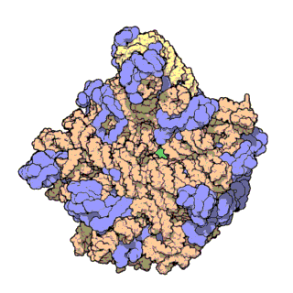
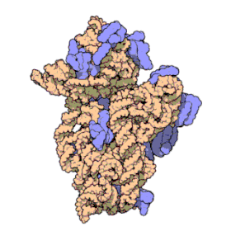
Ribosome
Notes:
The ribosome is a much more complex structure than the Hammerhead Ribozyme and represents a ribozyme of critical importance. Ribosomes consist of two major subunits, called the large and small subunits. These are complex structures that contain a mixture of ribosomal RNA (rRNA) molecules shown in peach and protein components shown in blue. The peptidyl transferase active site is shown in green on the large subunit, and is housed within the rRNA component of the molecule. This is where the peptide bond will form between amino acids during protein synthesis.

Slide 26
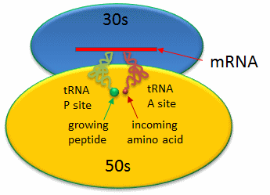
Notes:
This diagram gives a schematic representation of the ribosome small and large subunits coming together during peptide synthesis. The mRNA is docked on the small RNA subunit and transfer RNAs (tRNAs) act as a chaperone to bring the amino acids to the correct location where they dock onto the mRNA and are held in place by the large subunit of the ribosome. Dehydration synthesis occurs by the amino acids coming into close proximity on the large subunit.

Slide 27
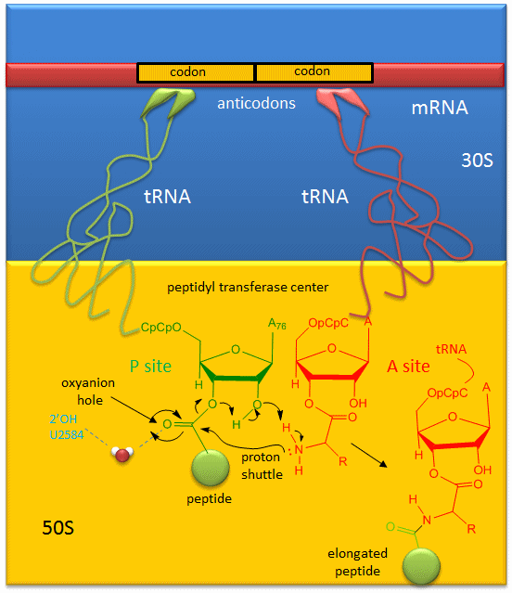
Proposed
Mechanism
Notes:
A likely mechanism for the formation of the amide bond between a growing peptide on the P-site tRNA and the amino acid on the A-site tRNA has been derived from crystal structures with bound substrates and transition state analogs. Catalysis does not involve any of the ribosomal proteins (not shown) since none is close enough to the peptidyl transferase center to provide amino acids that could participate in general acid/base catalysis. Hence the rRNA must acts as the enzyme. The most likely mechanism to stabilize the oxyanion transition state at the electrophilic carbon attack site is a precisely located water, which is positioned at the oxyanion hole by H-bonds to uracil 2584 on the rRNA. In this mechanism, the nucleophilic attack by the incoming amine at the carbonyl carbon of the nascent peptide is facilitated by a concerted proton shuffle. The rebounding electrons from the oxyanion intermediate cause the ribose of the tRNA to serve as a leaving group, where the oxygen at the 3’ position abstracts a proton from the 2’-OH position, which in turn abstracts a proton from the incoming amine functional group. In this mechanism, the substrate (Peptide-tRNA) assists its own cleavage in that the 2’OH is in position to initiate the protein shuttle mechanism. Thus, throughout chapter 7, we have seen many examples of all the major strategies that enzymes use to reduce the activation energy and stabilize transition states within the chemical reactions that they mediate. In chapter 8, we will gain a better understanding about how protein activity is regulated in vivo and when protein degradation occurs.

