Slide 1
Chapter 8: Protein Regulation and Degradation
8.1 Isozymes
Notes:
Welcome to Chapter 8. Here we will focus on mechanisms of protein regulation and degradation, beginning with Isozymes.

Slide 2
Isozymes
are enzymes that differ in amino acid sequence but catalyze the same chemical reaction.
Notes:
In many cases, isozymes are coded for by homologous genes that have been duplicated within the genome and have then diverged over time. However, they can also evolve from convergent evolution as well and be completely unrelated at the sequence level. In both cases, isozymes are expressed from different genes. They are NOT allelic variations of the same gene. Isozymes usually display different kinetic parameters (e.g. different K_{M} or K_{cat} values), or different regulatory properties. The existence of isozymes permits the fine-tuning of metabolism to meet the particular needs of a given tissue or developmental stage.

Slide 3
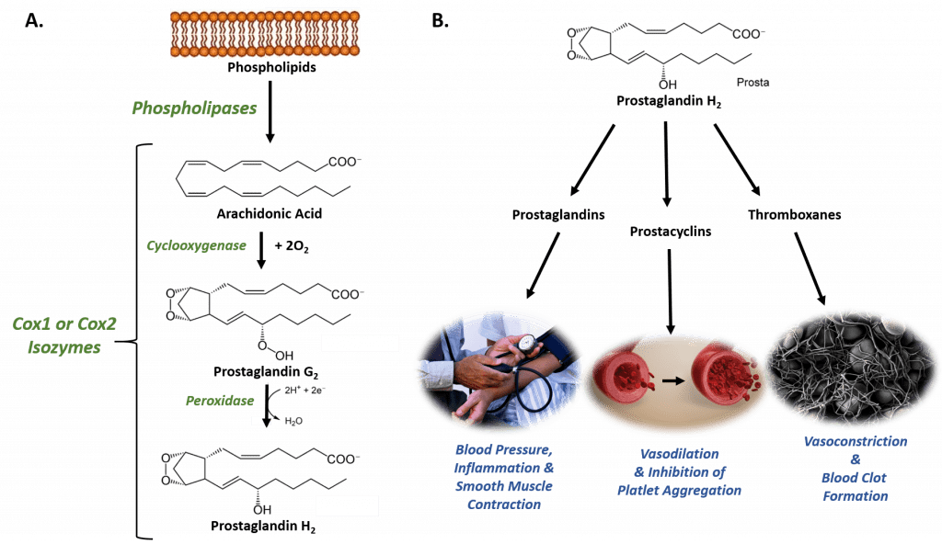
Example: Cyclooxygenase Enzymes (Cox1 and Cox2)
Notes:
Cyclooxygenase enzymes are bifunctional enzymes that mediate the cyclooxygenase and peroxidase reactions that convert arachidonic acid to Prostaglandin H2. The first reaction, the cyclooxygenase reaction is shown here. The prostaglandins (PG) are a group of physiologically active lipid compounds called eicosanoids having diverse hormone-like effects in animals. Prostaglandins have been found in almost every tissue in humans and other animals. They are derived enzymatically from the fatty acid arachidonic acid. Every prostaglandin contains 20 carbon atoms, including a 5-carbon ring. They are a subclass of eicosanoids (eicos means 20)

Slide 4
Example: Cyclooxygenase Enzymes (Cox1 and Cox2)
Notes:
In the second half of the reaction the peroxidase portion of the enzyme mediates the conversion of prostaglandin G2 into prostaglandin H2, or reduces the peroxide into an alcohol. Note that this is a redox enzyme. Prostaglandin H2 may be modified into other variations by additional enzymes.

Slide 5
Prostaglandins
Notes:
Prostaglandins are implicated in various physiological processes such as gastrointestinal cytoprotection, hemostasis and thrombosis, as well as renal hemodynamics. Through their role in vasodilation, prostaglandins are also involved in inflammation and can trigger the onset of a fever or the sensation of pain. They are synthesized in the walls of blood vessels and serve the physiological function of preventing needless clot formation, as well as regulating the contraction of smooth muscle tissue.

Slide 6
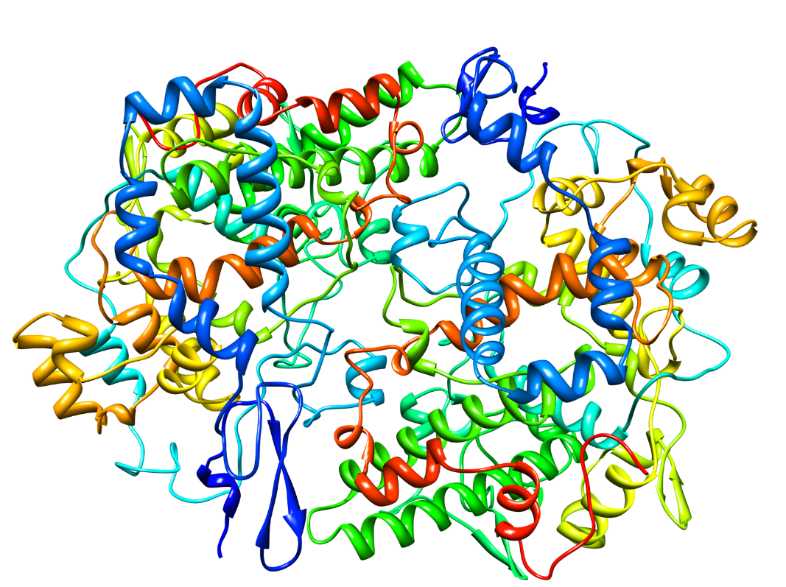
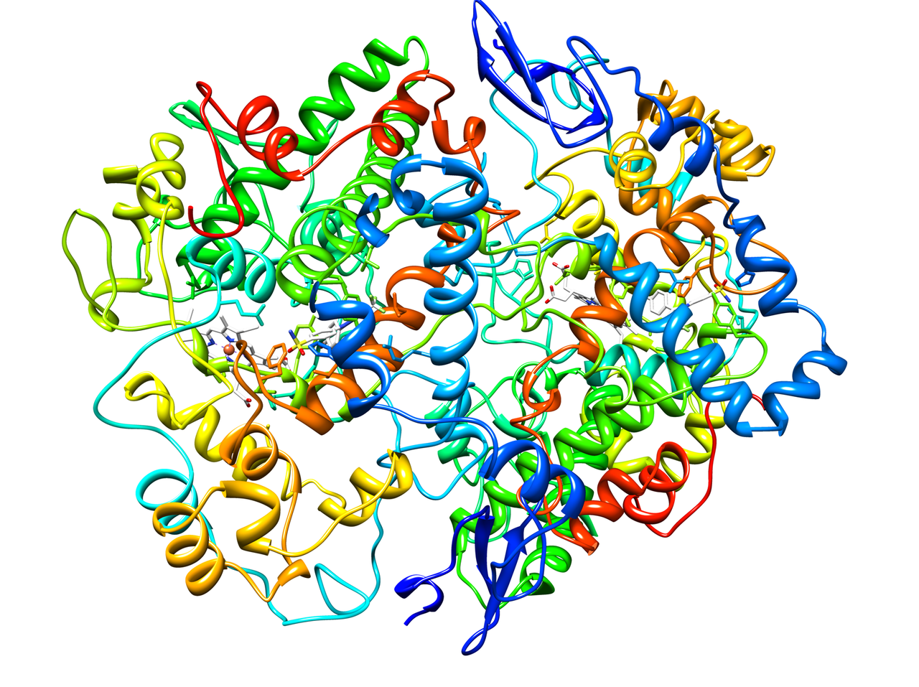
Cyclooxygenase Isozymes
Cox-1
Cox-2
Notes:
Due to their role in mediating inflammatory and fever response within the body, Cox-1 and Cox-2 enzymes are targets for Non-Steroidal Anti-Inflammatory drugs (NSAIDS), such as ibuprofen. The Cox-1 and Cox-2 enzymes share about 65% sequence homology and nearly identical catalytic sites. Both enzymes have three domains and both form dimers. They are often found attached to the membrane of the endoplasmic reticulum. The Cox-2 enzyme is predominantly responsible for inflammation and fever response in the body, whereas, Cox-1 is involved with regulation of the GI tract mucous production and smooth muscle contraction.

Slide 7
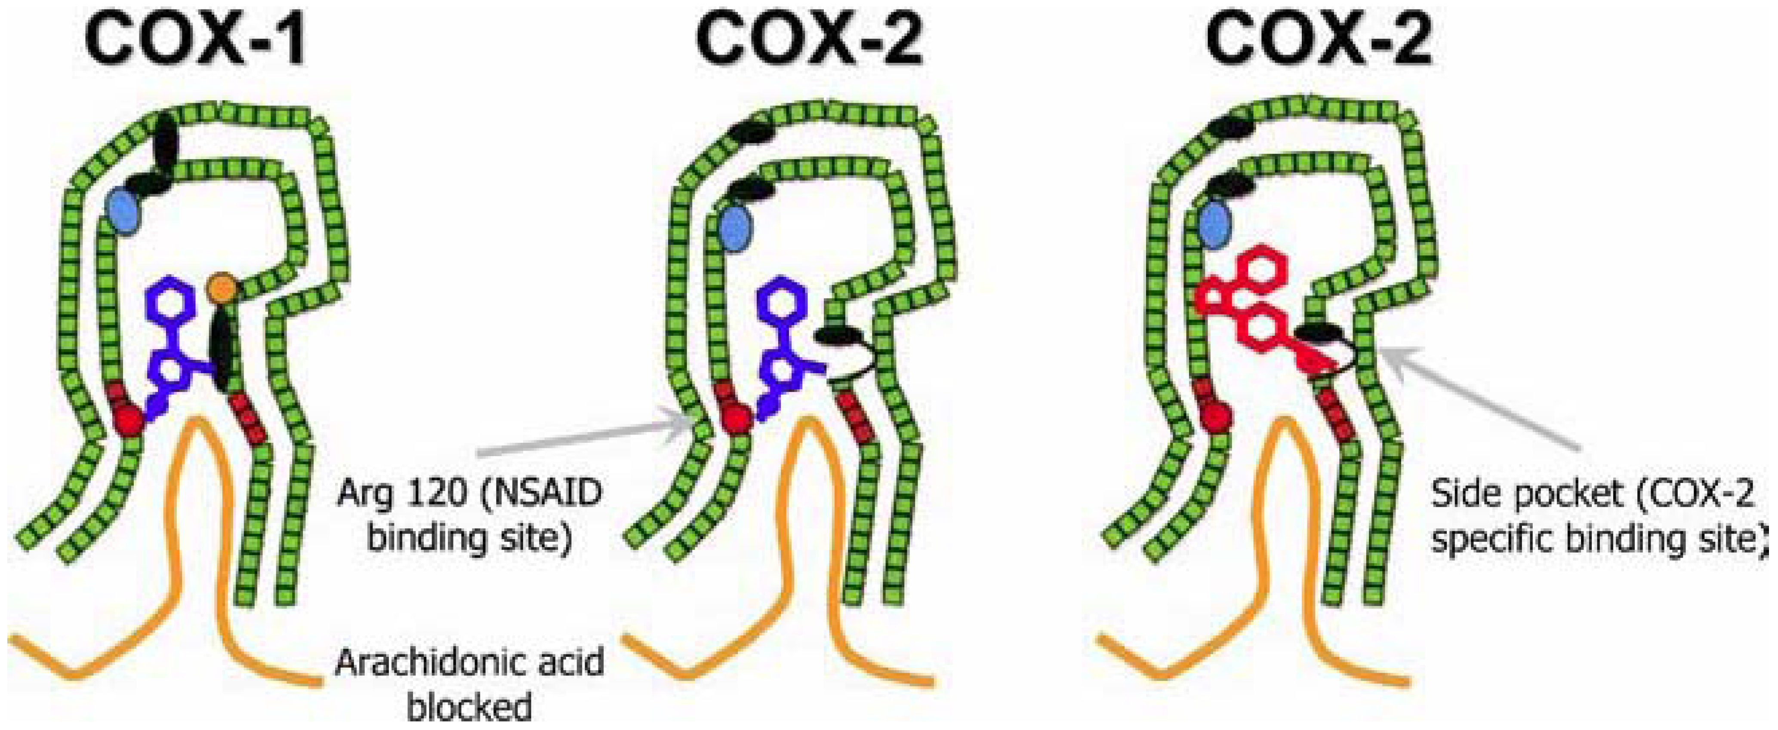
NSAIDS and Cox-1 and Cox-2
Notes:
Standard NSAIDs or first generation NSAIDS will bind to both Cox-1 and Cox-2, as shown in blue here, where the active site becomes blocked and will not allow the arachidonic acid access to the active site. Ibuprofen is an irreversible inhibitor. It covalently binds with the enzyme and blocks activity permanently. Cox-2 inhibition will prevent inflammation and pain, however, inhibition of Cox-1 can lead to gastrointestinal upset and if taken for long periods of time, can lead to the formation of ulcers, as the production of the protective mucosa is inhibited.

Slide 8
NSAIDS and Cox-1 and Cox-2
Notes:
Next generation NSAIDS are Cox-2 specific inhibitors. There was a lot of fanfare over this class of inhibitors in the beginning, as they were hoped to reduce the gastrointestinal effects without compromising the reduction in inflammation and pain. However, they have ended up having some unintended cardiovascular side effects not seen with the standard NSAID classes.

Slide 9
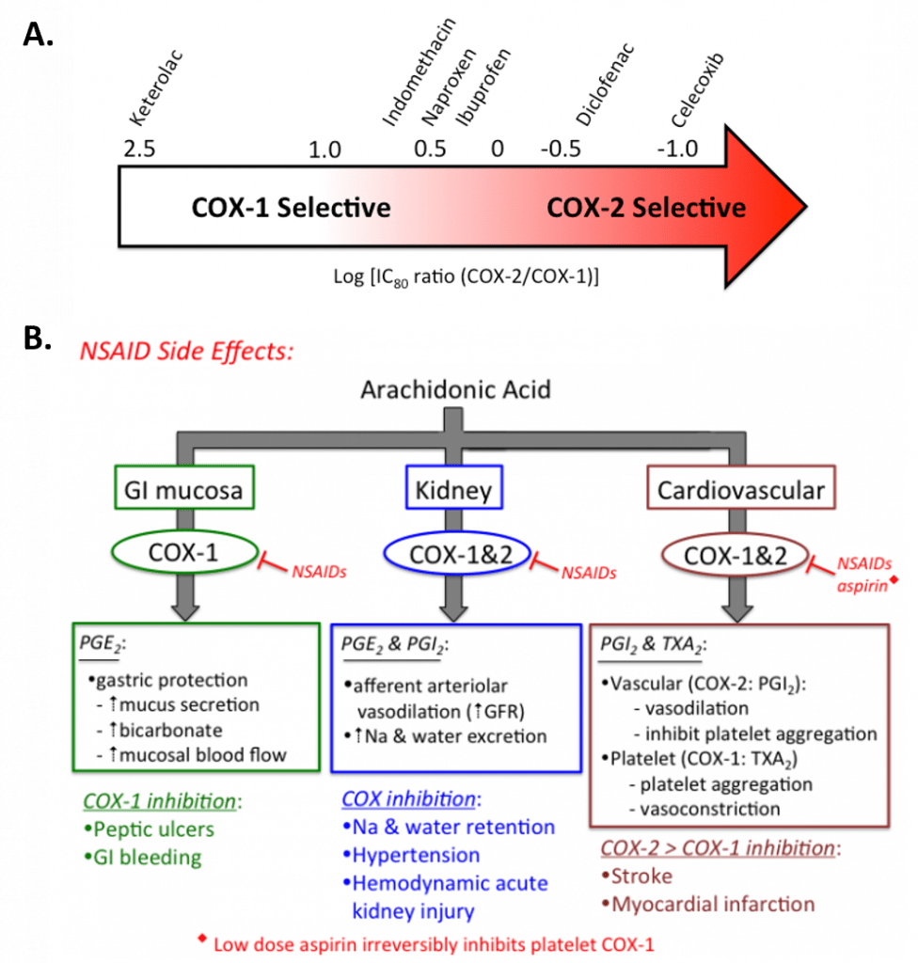
NSAID Selectivity
Notes:
Here is a diagram showing some of the selectivity of current NSAIDS. Notice that standard over the counter NSAIDS are pretty much in the middle and will equally inhibit Cox-1 and Cox-2. Note that aspirin also works to inibit Cox-1 and Cox-2 and displays activity similar to ibuprofen.

Slide 10
Notes:
So it turns out that the inhibition of Cox-1 and Cox-2 becomes complicated in vivo and affects many different systems. Cox-1 in the GI system is normally involved with increasing mucus secretion, increasing bicarbonate production (which aids in pH stabilization) and increases mucosal flow. Thus, if you inhibit Cox-1, this can lead to the development of peptic ulcers and GI bleeding. Long term inhibition of Cox-1 and Cox-2 can also negatively impact the kidney, which is another reason that Cox-2 selective inhibitors were sought. However, Cox-2 is also involved in vasodilation and inhibits platelet aggregation in the blood, acting as a blood thinner. However, notice that Cox-1 activity is the opposite of that of Cox-2 when it comes to the cardiovascular system. Cox-1 is involved in vasoconstriction and platelet aggregation. Thus, low dose aspirin is actually protective against heart attacks and strokes as it inhibits Cox-1 at low dose a little bit more than Cox-2. However, if you have selective Cox-2 inhibitors and end up inhibiting Cox-2 a lot more than Cox-1, you reduce inflammation and get rid of the GI tract side effects, but you increase platelet aggregation and vasoconstriction in the cardiovascular system, which increases the chance of heart attacks and strokes. Thus, most of the Cox-2 specific inhibitors have been removed from the market due to this concern. Overall, this story highlights the importance of differential product formation in different locations in the body by isozymes.

Slide 11
Chapter 8: Protein Regulation and Degradation
8.2 Post-Translational Modifications
Notes:
In this section, we will have an introduction into some of the most common types of post-translational modifications that are used to regulate enzyme activity. Note that there are many different types of modifications that can happen to proteins. Thus, this is a very complicated topic and we will only have a limited introduction here, which I’m sure will seem quite complicated, nonetheless.

Slide 12
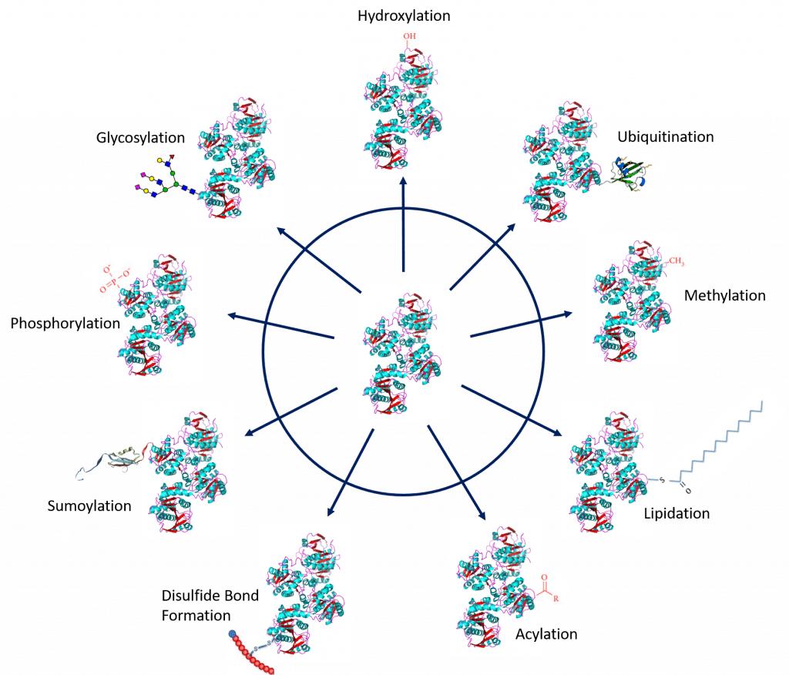
Post-Translational Modifications
Notes:
Within the body, it is very important for cells to be able to quickly fine-tune the regulation of enzyme or protein activity, to help relay messages and provide necessary chemical components in a quick and timely manner. Thus, it is important that proteins can be regulated after they have been made. Ie if you are suffering a DNA damage event, it is good to have repair enzymes in place and ready to go, and not have to wait four hours to increase their transcription and translation. This is where post-translational protein modifications play an important role! The major modifications that we will become familiar with, include disulfide bond formation (which you’ve already seen), or the addition of small chemical groups such as Phosphorylation, Hydroxylation, Methylation, and Acylation. The addition of larger groups can also include the addition of lipids through Lipidation, the addition of sugars through Glycosylation, or the attachment of small proteins through Ubiquitination and Sumoylation. Let’s start with a look at the smaller chemical modifications.

Slide 13
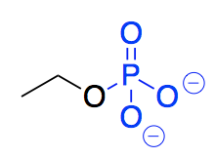
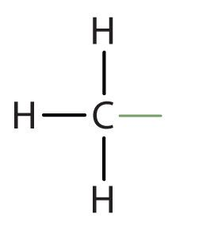
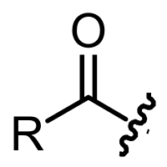
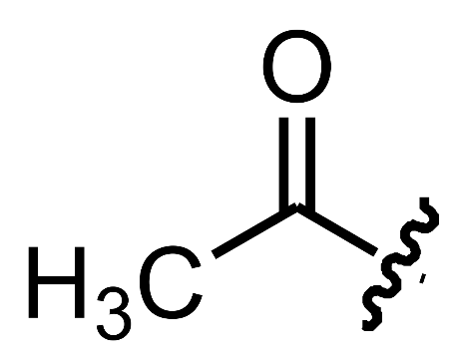
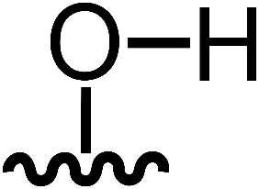
Small Chemical Modifications
Methylation
Phosphorylation
Acylation
(with Acetylation being the simplest)
Hydroxylation
Notes:
Here is a closer look at the four major types of small molecule changes that you will need to be familiar with. You have phosphorylation, which is likely the most commonly studied, followed by methylation, hydroxylation, and acylation. Note that acetylation is the simplest and most common acyl group that is added.

Slide 14

Phosphorylation
Phosphorylation
Kinase Enzymes
P
P
P
Phosphatase Enzymes
Notes:
Let’s look at phosphorylation in a little more detail. Separate enzymes are used to mediate the phosphorylation and dephosphorylation of a protein molecule. Enzymes that use ATP as a phosphate donor to phosphorylate their protein targets are called kinases. A separate enzyme is required to mediate the removal of a phosphate group. These enzymes are called phosphatases.

Slide 15
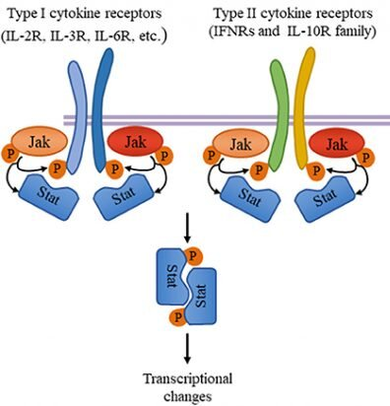
Two Major Families of Kinases
Serine/Threonine Kinases
Tyrosine Kinases
Notes:
Phosphorylation is a common mechanism for the activation and/or inhibition of cell signaling molecules. Signaling pathways can be highly dependent of phosphorylation cascades with the activation and/or inhibition of multiple proteins using phosphorylation as a modifier. The kinase enzymes that mediate phosphorylation typically fall into two major classes based on their substrate target. Serine-Threonine protein kinases will phosphorylate specific serines or threonines within their target, whereas tyrosine kinases preferentially phosphorylate tyrosine residues, within their targets. Note that not all serines or threonines will be phosphorylated by a single kinase enzyme. Kinases have high specificity for their target molecule, and more specifically for a small subset of residues on their target molecule. Phosphatase enzymes, on the otherhand, show less substrate specificity than kinases do…suggesting that dephosphorylation returns the cell to baseline and is always turned on to some extent, whereas kinases become active for short bursts of time to mediate their effect within the system.

Slide 16
Small Chemical Modifications
Acylation
(with Acetylation being the simplest)
Notes:
Let’s take a look at acylation with a focus on acetylation.

Slide 17
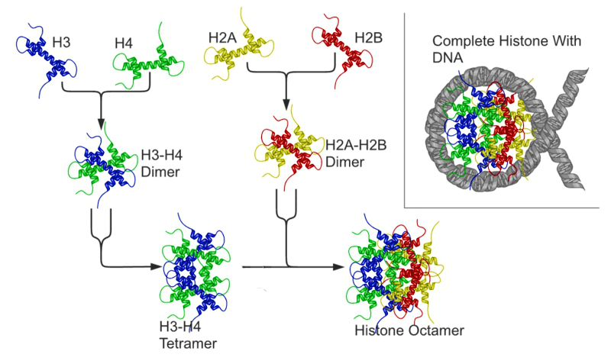
Histones and the Nucleosome
Notes:
One example, where protein acetylation plays an important role is in the acetylation of the histone proteins. Recall that histone proteins form the core structure used to create the nucleosome core in the formation of the chromosome. The nucleosome, however, needs to be released for gene transcription to occur. This is facilitated by the acetylation of the histones, which disrupts the DNA binding with the histone core.

Slide 18
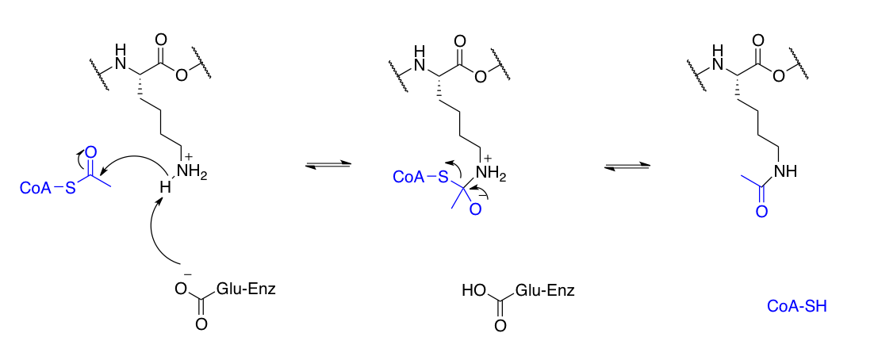
Acetylation of Lysine Residues
Notes:
Lysine often serves as the location for acetylation. The cofactor, coenzyme-A often serves as the source of the acetyl group, and acid-base catalysis helps to activate the amine functional group of lysine. Lysine can then act as a nucleophile and attack the carbonyl carbon, forming an oxyanion intermediate. The Coenzyme-A then serves as the leaving group.

Slide 19
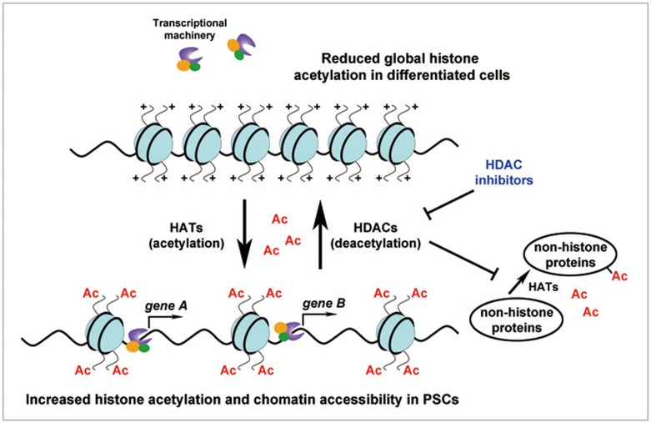
HATs and HDACs
Notes:
With histones, histone acetyl transferases (HATs) are involved in the acetylation of the histones, opening them up so that gene transcription can occur, whereas histone deacetylases (HDACs) remove the acetyl groups and restore nucleosome structure.

Slide 20
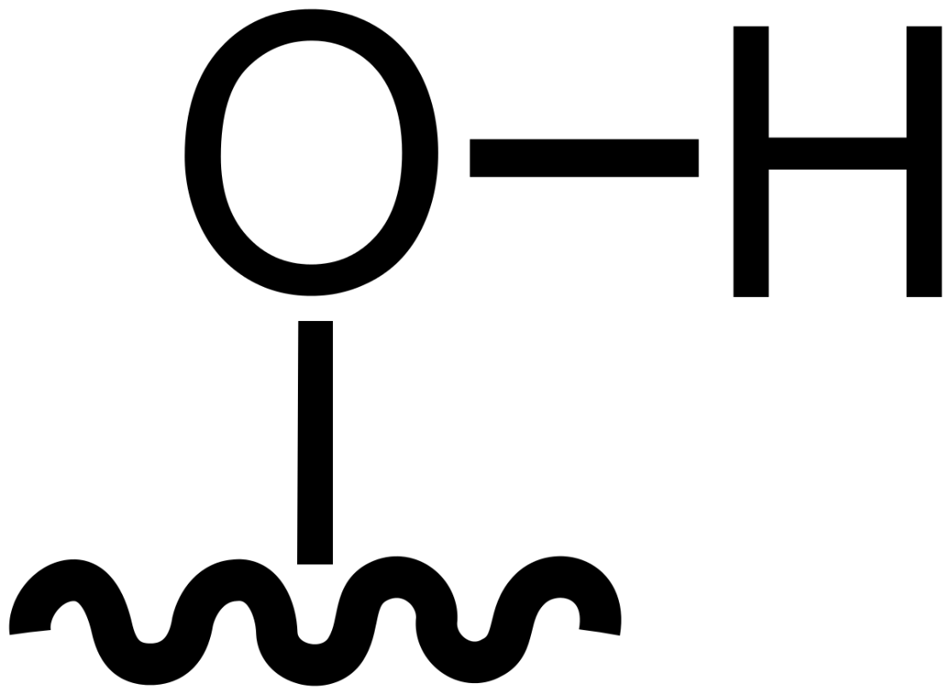
Small Chemical Modifications
Oxidation
Hydroxylation
Notes:
Another small molecule modification is oxidation, which commonly occurs as hydroxylation.

Slide 21
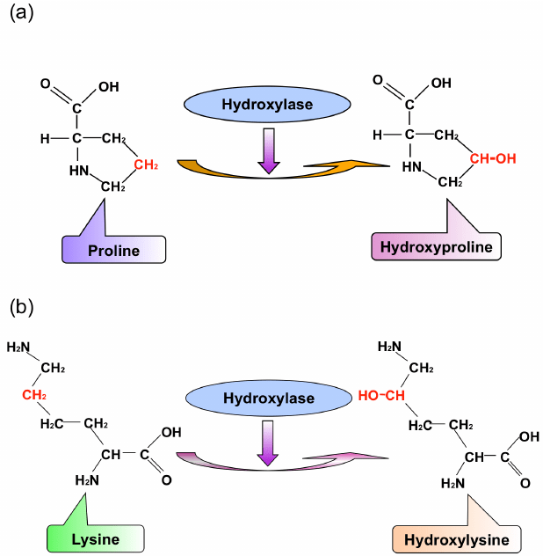
Hydroxylase Enzymes
Notes:
Hydroxylation occurs most often on proline and lysine residues, as we have already seen with important proteins such as collagen. Hydroxyproline makes up about 13.5% of the residues within the mammalian collagen family of proteins. Recall that collagen is the main protein of the connective tissue and represents about one-fourth of the total protein content in many animals. Hydroxyproline contributes to the stability of the triple helix and also aids in cross-linking between collagen fibers to form larger macromolecular complexes.

Slide 22
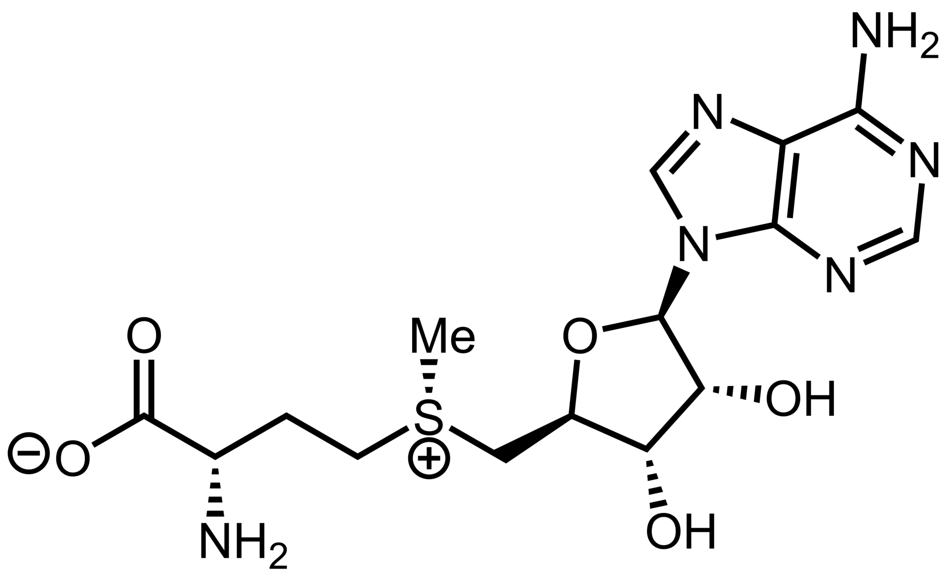
Small Chemical Modifications
Methylation
S-Adenosylmethionine (SAM)
Notes:
And the last small chemical modification that we will consider here is methylation. S-adenosylmethionine (SAM) is a common methyl donor used for methylation reactions. The structure of this is a combination of the amino acid methionine with the ribonucleoside adenosine, hopefully the structure is looking familiar to you. This is one example of common building blocks within the cell being used in alternate ways. This is a common feature for many macromolecule building blocks.

Slide 23
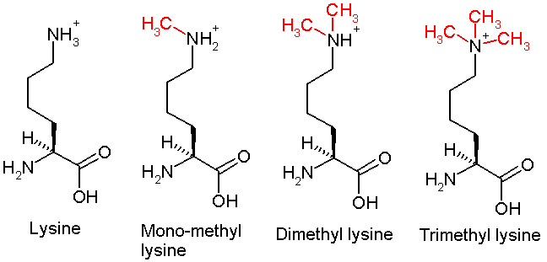
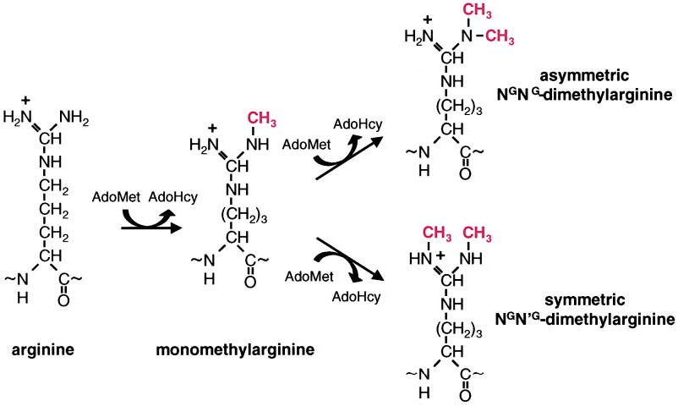
Protein Methylation
Notes:
Lysine and Arginine are amino acids that are commonly modified by methylation.

Slide 24
Larger Scale Modifications
Ubiquitination
Sumoylation
Glycosylation
Lipidation
Notes:
Small scale modifications are often routinely incorporated and removed during a protein’s lifespan and have a large influence on the regulation of protein activity, either causing an increase or decrease in activity. Larger scale modifications such as glycosylation and lipidation are usually more permanent alterations of the protein structure that are required for the protein to retain the active conformation.

Slide 25
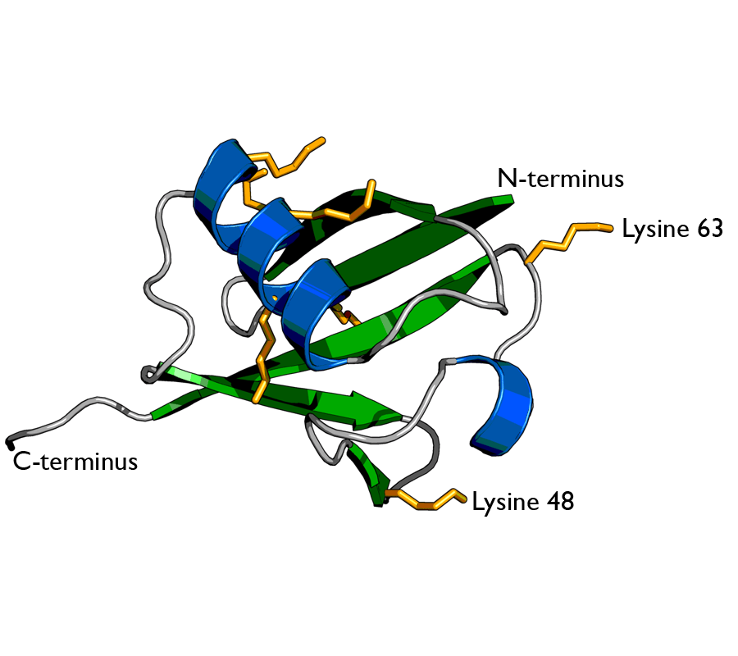
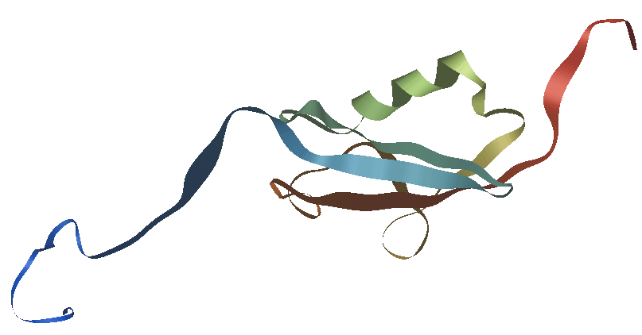
Ubiquitination and Sumoylation
Ubiquitin
SUMO
Notes:
Sometimes, small proteins or peptides can be added onto proteins to change their function or even target them for degradation. Two of the most common types of small peptides that serve this function are the ubiquitin protein and the SUMO protein. Note that the ubiquitin protein contains a lot of lysine residues and is a fairly basic peptide. Attaching a single ubiquitin peptide onto a histone protein can cause it to release the DNA, similar to the process of acetylation. Thus, this method can be used to increase gene transcription as well. However, when proteins have many ubiquitins attached and become polyubiquinated, this is typically a signal that the protein will be degraded. We will focus on this process in greater detail in section 8.5. The SUMO peptide is attached to proteins via lysine residues and appears to play a role in nuclear functions. It also may play a role in neuronal processes as well.

Slide 26
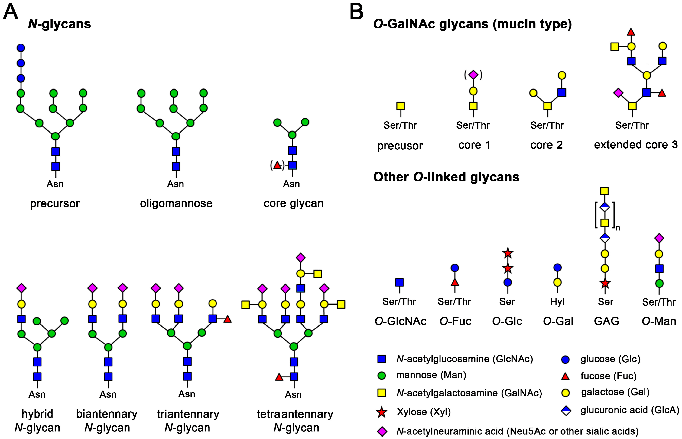
Glycosylation
Notes:
Let’s focus on glycosylation first. The incorporation of sugar residues onto a protein core is called glycosylation. Glycosylation can occur as N-linked or O-linked additions to a protein structure and sometimes directly to carbon. Asn usually serves as the sugar acceptor for N-linked glycosylation, whereas serine or threonine typically serve as the acceptor for O-linked glycosylation. C-linked glycosylation occurs most often on tryptophan residues.l Sugar addition can be fairly small only containing one or a few sugar residues, or it can be quite extensive, forming highly branched sugar appendages. More than half of mammalian proteins are believed to be glycosylated. The conglomerate of the sugar moieties that are linked to proteins is often referred to as the glycome. Inappropriate glycosylation or lack of glycosylation can lead to genetic disorders and contribute to disease states such as cancer.

Slide 27
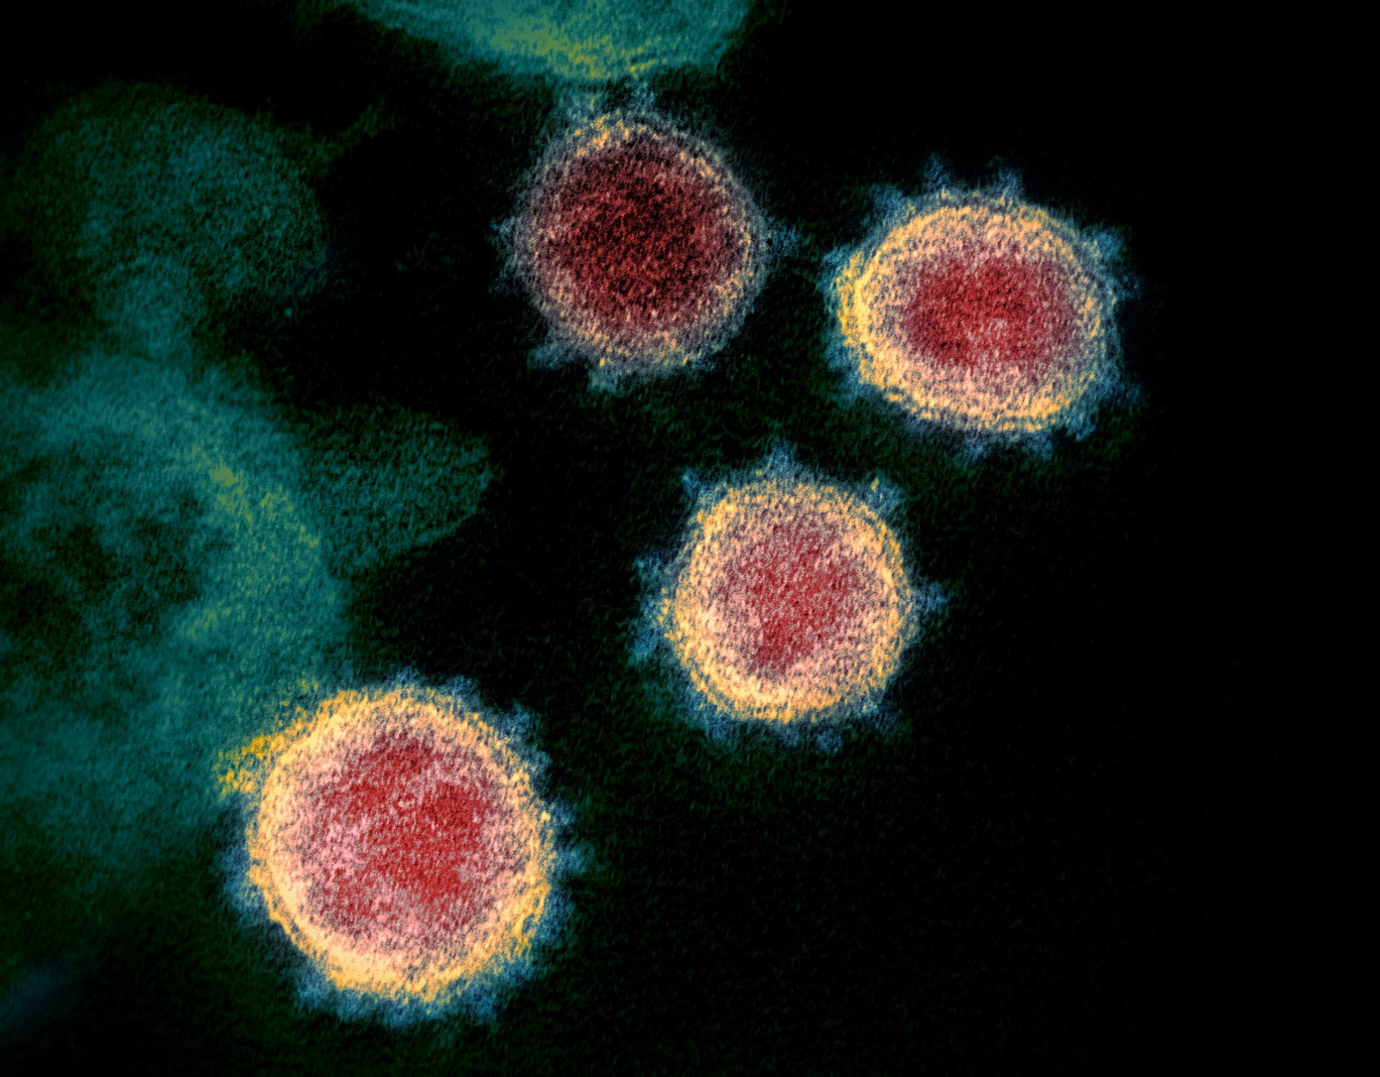
SARS-CoV-2 Virus
Photo from NIAID
Notes:
Interestingly, the SARS-CoV-2 Virus that causes COVID, infects cells through the interaction of a surface protein known as the Spike Protein. Antibody therapies and vaccine strategies have centered on the development of immunity towards this spike protein.

Slide 28
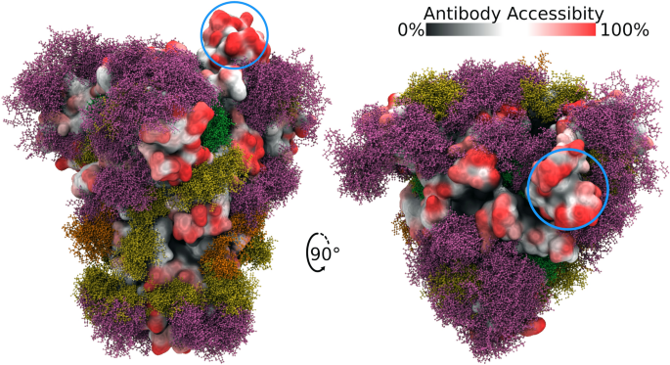
SARS CoV-2 Spike Protein is Highly Glycosylated
Figure from Grant, O.C., et. al. (2020) Scientific Reports 10:14991
Notes:
This hasn’t been a simple matter, as the Spike Protein is highly glycosylated. Here is a recent Cryo-EM structure of the Spike Protein demonstrates that approximately 40% of the surface of the Spike Protein is shielded by the glycan modifications (shown in purple, gold and rust colors on the diagram), and the nature of the sugar appendages can vary according to the individual that is infected with the virus. Fortunately, 60% of the protein surface is accessible and there are a number of highly accessible regions that are shown in red on the diagram. The spikey bit that is circled in blue is the main epitope that binds with the ACE2 receptor and mediates infection.

Slide 29
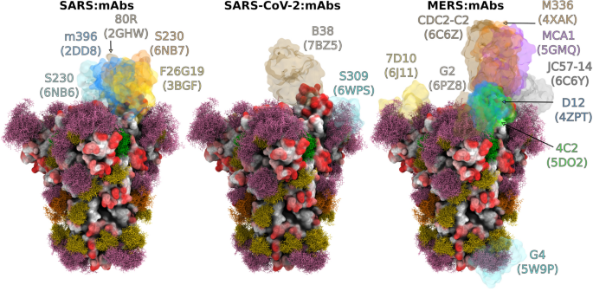
Antibody Binding
Figure from Grant, O.C., et. al. (2020) Scientific Reports 10:14991
Notes:
This same region is also antigenic. Antibodies isolated from sera from recently infected individuals show that people do generate an antibody response to SARS-CoV-2 and the other two related viruses, SARS and MERS, which both have highly similar Spike protein structures. This suggests that people can develop adaptive immunity to the virus, and that the antibodies interfere with the viruses ability to infect the host. However, the high amount of glycosylation does make this more difficult as antigen presenting cells within the immune system have a harder time presenting peptide fragments that are highly glycosylated. Thus, adaptive immunity may take longer to develop. Plus, the virus cannot shield this epitope and still remain as highly infective, because this region of the protein is required for entry into the host cell. Thus, developing a vaccine to this epitope is a good strategy.

Slide 30
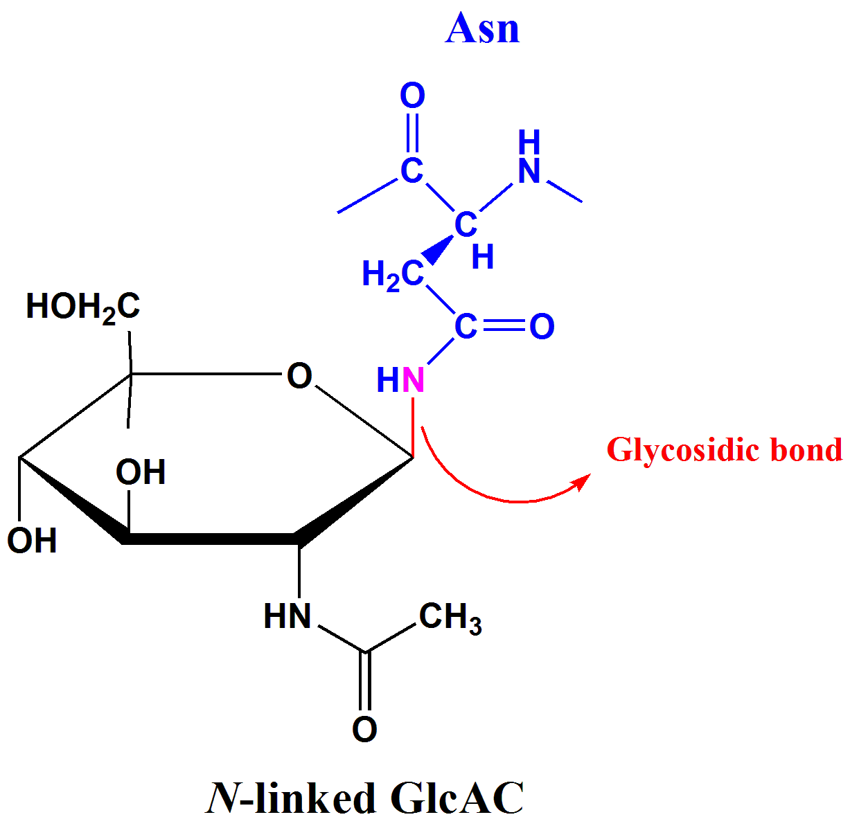
N-linked Glycosylation
Notes:
Here is a closer look at an N-linked residue. Compared with he Spike Protein in the last slide, this is super simplistic, and shows only a single sugar. We will explore more of the functions of glycosylated proteins in cell-cell recognition and communication, as well as in joint cushioning and extracellular matrix networks next term.

Slide 31
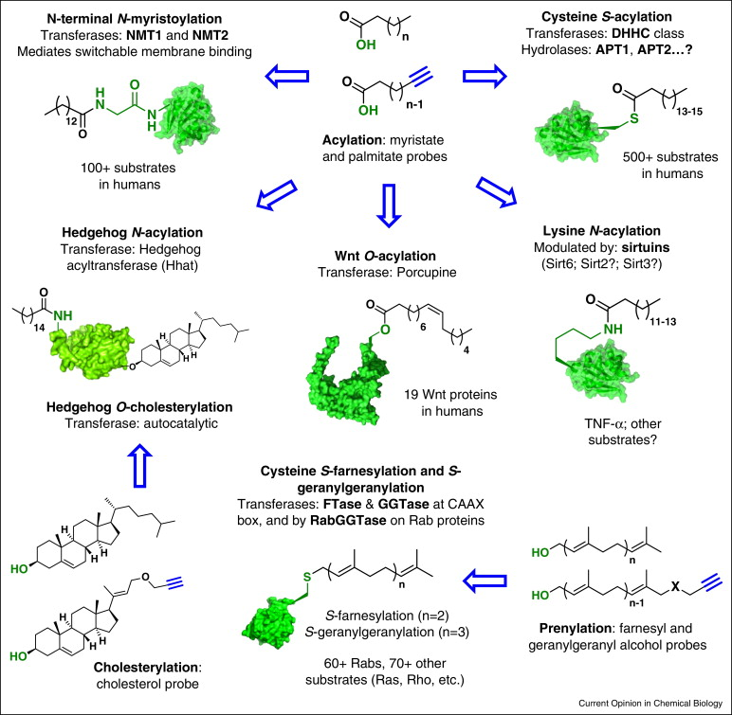
Lipidation
Figure from Tate, E.W., et al. (2014) Curr Op Chem Biol 24: 10.016
Notes:
Proteins can also be modified with lipid structures through the process of lipidation. In general, lipid structures are often added to proteins that will end up being docked onto or into a lipid bilayer membrane. They can be linked to a wide array of different amino acid residues forming amides with basic residues like lysine, thioesters with cysteine residues and esters with serine or threonine residues. We will cover lipidation in more detail next term as well and won’t spend a lot of time on it here. In the next section, we will learn more about the allosteric regulation of enzymes.

Slide 32
Chapter 8: Protein Regulation and Degradation
8.3 Allosteric Regulation
Notes:
In this section, we will look at allosteric protein regulation and zymogens.

Slide 33
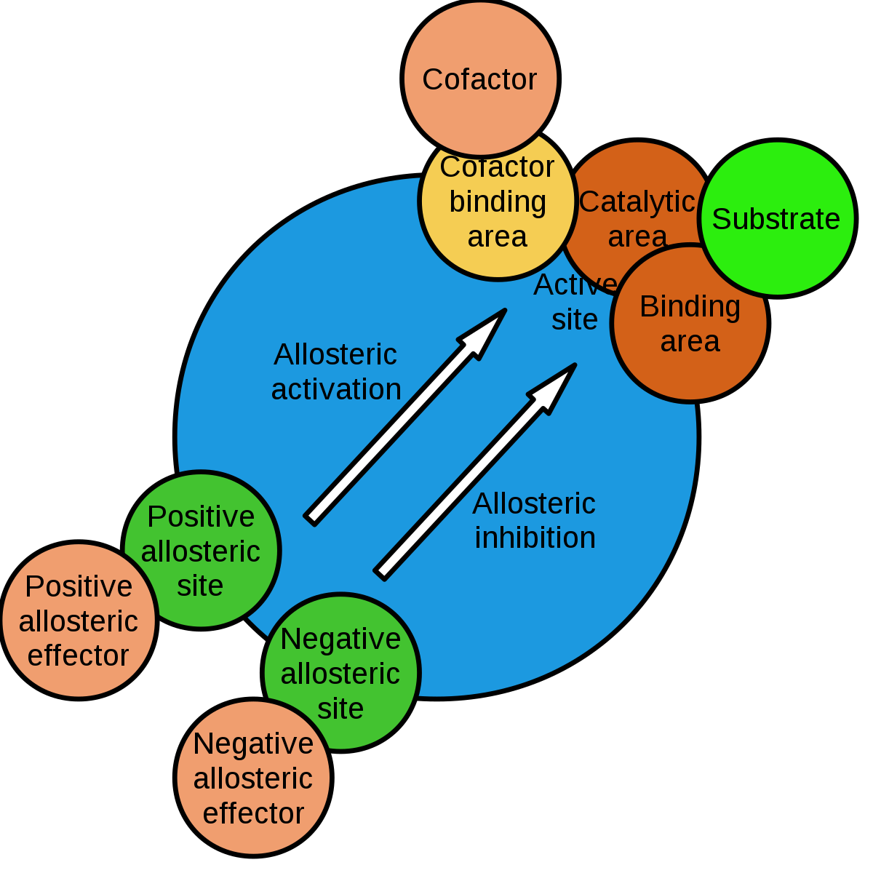
Allosteric Enzymes and Proteins
Notes:
Allosteric regulation fine-tunes most biological processes, including signal transduction, enzyme activity, metabolism and transport. Allostery, an intrinsic property of a protein, is referred to as the regulation of activity at one site (also known as an orthosteric site) in a protein by a topographically and spatially distant site; the latter is designated as an allosteric site. Allosteric regulation occurs through binding of a modulator (e.g., small molecule or protein) at an allosteric site to engender a conformational change that affects function at the orthosteric site. This effect may cause the re-distribution of the conformational ensemble by either stabilizing an active conformation (allosteric activation) or destabilizing an inactive conformation (allosteric inhibition) in response to allosteric effectors. Allosteric protein regulation is very common and we will focus on this aspect of enzyme regulation a lot next term when we discuss carbohydrate metabolism.

Slide 34
Chapter 8: Protein Regulation and Degradation
8.4 Zymogen Activation
Notes:
A zymogen also called a proenzyme, is an inactive precursor of an enzyme. A zymogen requires a biochemical change (such as a hydrolysis reaction revealing the active site, or changing the configuration to reveal the active site) for it to become an active enzyme.

Slide 35
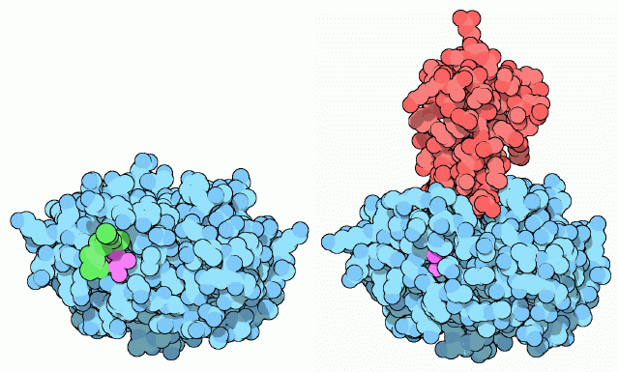
Trypsinogen and Trypsin
Notes:
An example of enzymes that are initially synthesized as zymogens are the protease enzymes secreted by the pancreas. The pancreas secretes zymogens to help prevent the enzymes from inappropriately digesting proteins in the pancreatic cells in which they are synthesised. Enzymes like Trypsin are synthesized as proenzymes. For typsin, trypsinogen is an inactive precursor that is translated in the rough endoplasmic reticulum and transported to the Golgi apparatus for sorting. In this diagram, typsinogen is shown on the right. The green portion of the protein is the fragment that is cleaved to open up the active site area shown in pink. Trypsinogen is always co-synthesized and packed with a pancreatic secretory trypsin inhibitor (PSTI), shown here in red, that inhibits its premature activation. Thus, there are two mechanisms in place to maintain the inactivity of the protease within the pancreas: (1) synthesis of the zymogen or proenzyme form, and (2) co-expression of a trypsin inhibitor protein that will bind and inhibit any prematurely cleaved trypsin until it has reached the small intestine.

Slide 36
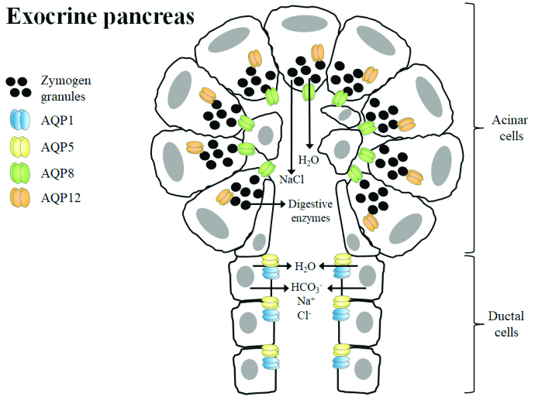
Zymogen granules
Figure from: Mendez-Gimenez, L. et al (2018) Frontiers in Chemistry 6:99
Notes:
During packaging within the Golgi system, the trypsinogen and other digestive enzymes condense into core particles and are packed in zymogen granules. The condensed enzymes are stable and minimal activation happens within the zymogen granules. Once the pancreatic cells receive secretory stimulus, these zymogen granules are released in to the lumen of pancreatic duct, which carries the digestive enzymes into the duodenum.

Slide 37
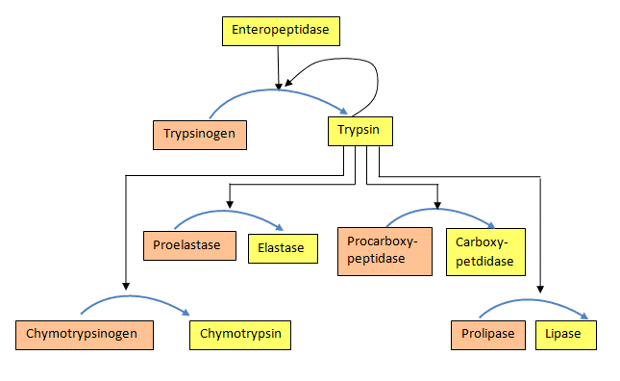
Cleavage Cascade
Notes:
Once in duodenum, enteropeptidase activates trypsinogen by removing 7-10 amino acid from N-terminal region known as trypsinogen activation peptide (TAP). Removal of TAP induces conformational change resulting in active trypsin. Once activated, trypsin will cleave and activate other zymogen proteases and lipases present in the duodenum. These include the activation of elastase, chymotrypsin, carboxypeptidase, and lipase. Zymogen cascades like this are found within other systems in the body, including the process of programmed cell death or apoptosis, and the blood clotting cascade to name a few.

