Slide 1
Chapter 9: DNA Replication
9.3 Replication of Extrachromosomal Elements
Notes:
In section 9.3 we will look at one strategy used to replication extrachromosomal materials in prokaryotic organisms. Due to the circular nature of plasmids and the circularization of some viral genomes on infection, rolling circle replication is a common strategy that is used. Other methods can be seen as well, but we will only focus on this one here.

Slide 2
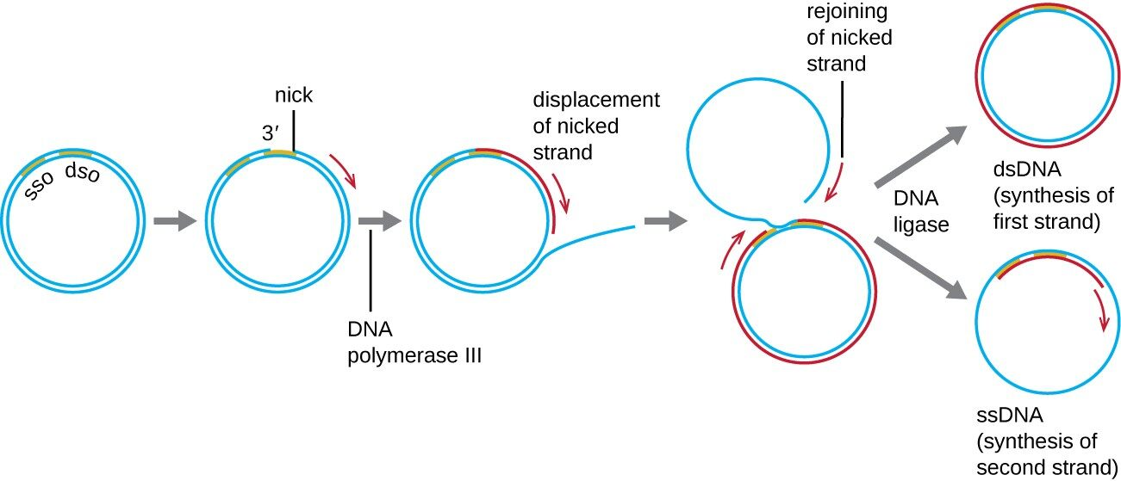
Plasmids Typically Use Rolling Circle Replication
Notes:
Rolling circle replication begins with the enzymatic nicking of one strand of the double-stranded circular molecule at the double-stranded origin (dso) site. In bacteria, DNA polymerase III binds to the 3′-OH group of the nicked strand and begins to unidirectionally replicate the DNA using the un-nicked strand as a template, displacing the nicked strand as it does so. Completion of DNA replication at the site of the original nick results in full displacement of the nicked strand, which may then recircularize into a single-stranded DNA molecule. RNA primase then synthesizes a primer to initiate DNA replication at the single-stranded origin (sso) site of the single-stranded DNA (ssDNA) molecule, resulting in a double-stranded DNA (dsDNA) molecule identical to the other circular DNA molecule.

Slide 3
Chapter 9: DNA Replication
9.4 DNA Replication in Eukaryotes
Part 1: The Cell Cycle
Notes:
In section 9.4, we will visit DNA replication in eukaryotic organisms and discuss key differences from that of prokaryotic organisms. In this first part, we will focus on the importance of the cell cycle.

Slide 4
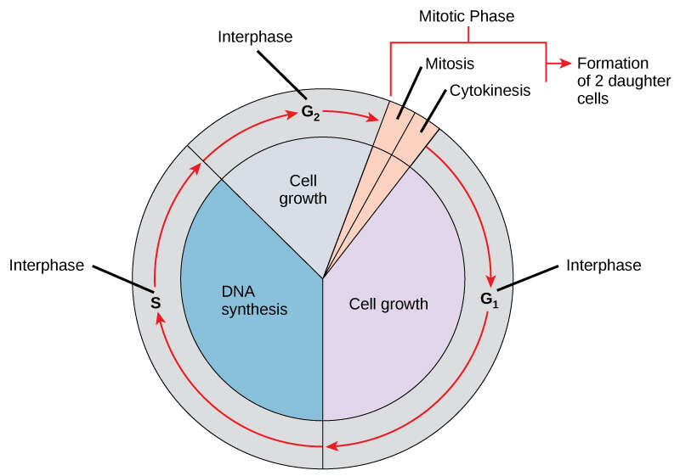
The Cell Cycle
Notes:
The cell cycle is an ordered series of events involving cell growth and cell division that produces two new daughter cells. The cell cycle has two major phases: interphase and the mitotic phase. During interphase, the cell grows and DNA is replicated. During the mitotic phase, the replicated DNA and cytoplasmic contents are separated and the cell divides. During interphase, G₁ involves cell growth and protein synthesis, the S phase involves DNA replication and the replication of the centrosome, and G₂ involves further growth and protein synthesis. The mitotic phase follows interphase, and consists of mitosis, where the genetic material is separated to two different poles within the cell, and then cytokinesis, where the cytoplasm is split and the two separate daughter cells are formed.

Slide 5
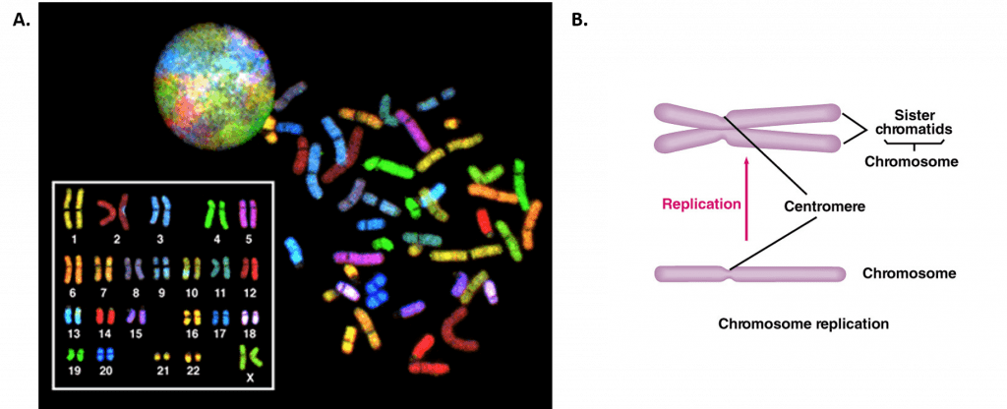
DNA Replication
Notes:
In contrast to prokaryotes, eukaryotes typically have multiple linear chromosomes that make up their genetic material. Recall that these linear chromosomes will have a centromere that hold the two arms of the chromosome together and provide an attachment site for the mitotic spindle. This will allow the replicated chromosomes to be separated from one another after replication. DNA replication occurs during the S-phase, or synthesis phase, of interphase, and will lead to the production of sister chromatids, which are identical copies of one another. This is not to be confused with homologous chromosomes that carry different alleles of the same gene sets. One set of homologous chromosomes comes from the mother and one set from the father. You can see the karyotype from a human here, with the homologous chromosomes free floating around here. The matching homologous chromosome pairs have been aligned in the left corner. Each chromosome is in the linear form and has NOT been replicated (ie no sister chromatids are present). Sister chromatids will have an X-shape to them, as both arms of the chromosome have been replicated and both chromatids are held together at the centromere.

Slide 6
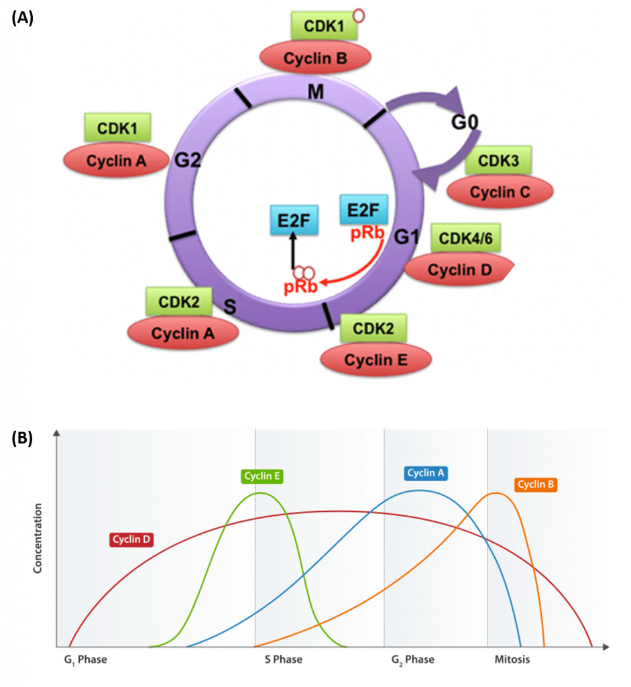
Cyclin/CDK Complexes
Notes:
Progression of cells through the cell cycle requires the coordinated actions of specific protein kinases, known as cyclin-dependent kinases. Cyclin-dependent kinases are usually abbreviated as CDK or CDC proteins. CDK/CDC proteins require the binding of a regulatory cyclin protein to become activated (Figure 9.17). The major cyclin proteins that drive the cell cycle in the forward direction, are expressed only at discrete times during the cell cycle. When activated by a cyclin counterpart, CDK/CDC enzymes phosphorylate downstream targets involved with cell cycle progression. For example, the primary cyclin-CDK complex involved in the initiation of DNA replication during S-phase is the CyclinE-CDK2 complex. CDK2 is activated by the expression and binding of Cyclin E during late G1 phase. This causes CDK2 to phosphorylate downstream targets, including the retinoblastoma tumor suppressor protein, pRb. pRB normally binds and inhibits the the activity of transcription factors from the E2F family. Following the release of E2F transcription factors from pRb, E2Fs activate the transcription of genes involved in DNA replication and the leads to the progression of cells into S-phase.

Slide 7
Cyclin Expression Patterns
Notes:
We can also look at the expression of cyclin levels graphically over time (in this case over the progression through the different phases of the cell cycle). What you see is that the expression of the different cyclins are required for the cell to be able traverse through the different phases of the cell cycle. For example, increases in cyclin D are needed for the cell to enter into the cell cycle and they will remain at high levels throughout the remainder of the cycle. Increases in Cyclin E are required for the cell to move into S-phase and increased Cyclin-A levels are correlated with the G2 phase. Cyclin B expression is then key for the cells to shift from interphase into mitosis and cell division. Notice here that cyclin D levels are not always high within the cell, and that cells do not always have to be traversing the cell cycle.

Slide 8
Cyclin/CDK Complexes
Notes:
If cells are not actively undergoing cells cycle and cell division, they can be in a state of quiescence known as G knot. If cells enter G₀ permanently, they are said to have entered a stage of replicative senescence and will no longer be maintained for long term viability within the organism. Depending on cell type and location within the body, different cells will be in different states.

Slide 9
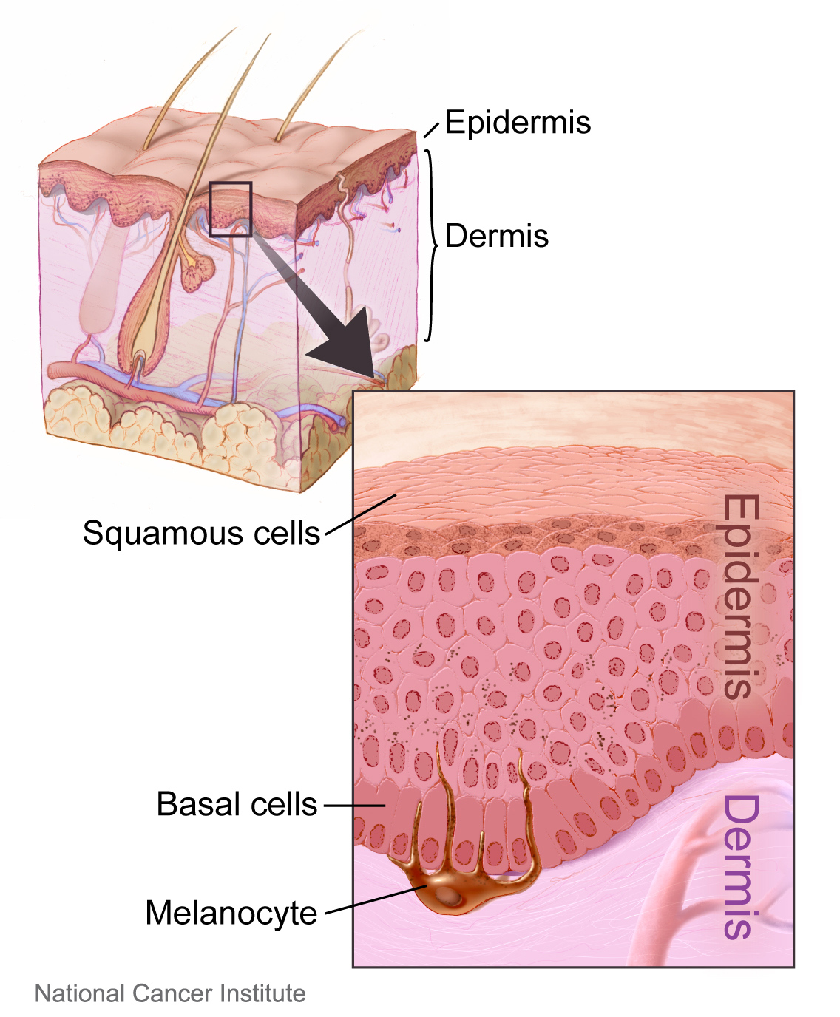
Skin Cells
Notes:
For example, if you look at a layer of skin cells in the epidermis, what you will see is that there is a set of basal cells that are consistently going through the cell cycle to produce more keratinocyte cells (the most common type of cell within the skin tissue). As these newly made cells move away from the basal layer, they enter into replicative senescence and then the very outer layer of epidermal cells are actually cells that have died and provide a protective sheath between the living cells and the environment. In the next section, we will look more closely at the process of eukaryotic DNA replication during S-phase.

Slide 10
Chapter 9: DNA Replication
9.4 DNA Replication in Eukaryotes
Part 2: S-Phase & DNA Replication
Notes:
In part 2 of section 9.4, we will focus on some of the key dynamics of eukaryotic DNA replication that differ from prokaryotic systems.

Slide 11
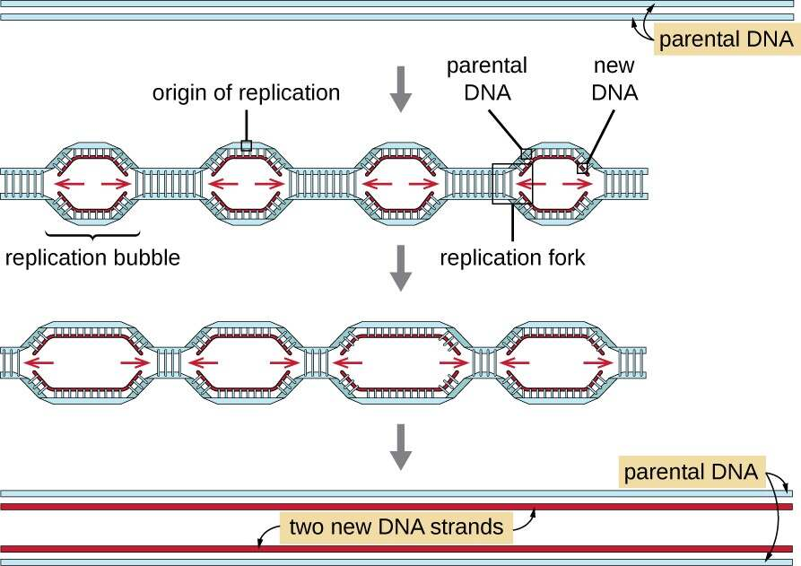
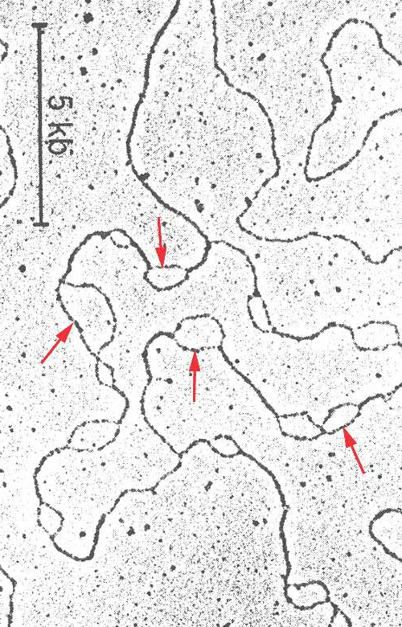
Replication Initiation
Notes:
Eukaryotic chromosomes tend to be quite a bit longer than prokaryotic ones and are linear in nature. Thus, one key major difference is that they tend to have multiple origins of replication that lead to the generation of the two new daughter stands. This electron micrograph picture showns the formation of multiple replication bubbles along the chromosome during S-phase. The replication machinery will fall off when two sytems run into eachother forming a larger bubble until replication is complete.

Slide 12
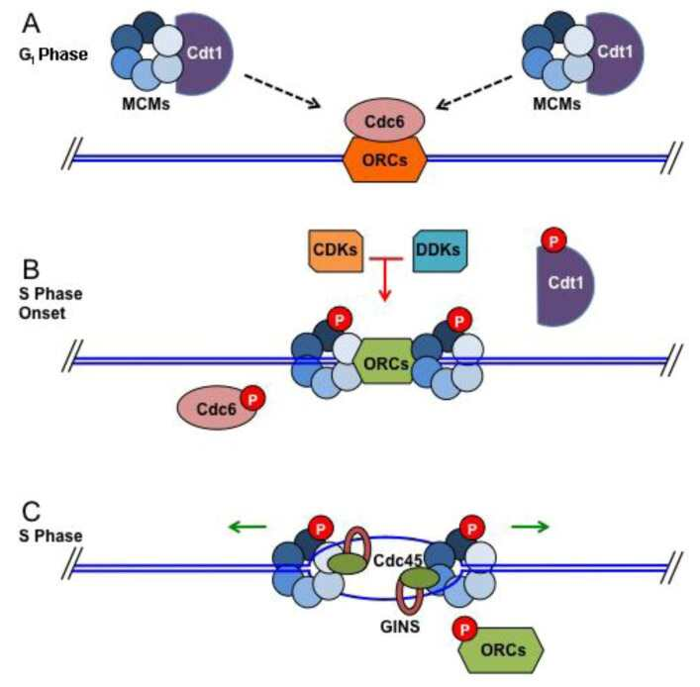
Origin Loading and Origin Firing
Notes:
Interestingly, in eukaryotic systems, the helicase enzymes (MCM complexes) are preloaded onto the chromosome at the replication origins (ORCs), in a process known as origin loading. This will occur whether or not the cell is preparing for cell division.

Slide 13
Origin Loading and Origin Firing
Notes:
Origin firing will then occur as cell cycle signals develop during late G1 of interphase. Note that in addition to the helicase MCM complexes, that Cdc6 (a cyclin dependent kinase) is also associated with the replication origins.

Slide 14
Origin Loading and Origin Firing
Notes:
Thus, as cyclins begin to accumulate, they will activate a Cyclin/CDK cascade, that causes the initiation of origin firing. This will occur at about 10 – 20% of the loaded origins and is sufficient for replication to begin. Note that the phosphorylation of Cdc6 and Cdt1 cause them to dissociate from the helicase complex (which is also phosphorylated in the process).

Slide 15
Origin Loading and Origin Firing
Notes:
Other proteins associated with cell cycle such as GINS and Cdc45, aid the helicase complex in unwinding the double stranded DNA so that the replication fork can be assembled.

Slide 16
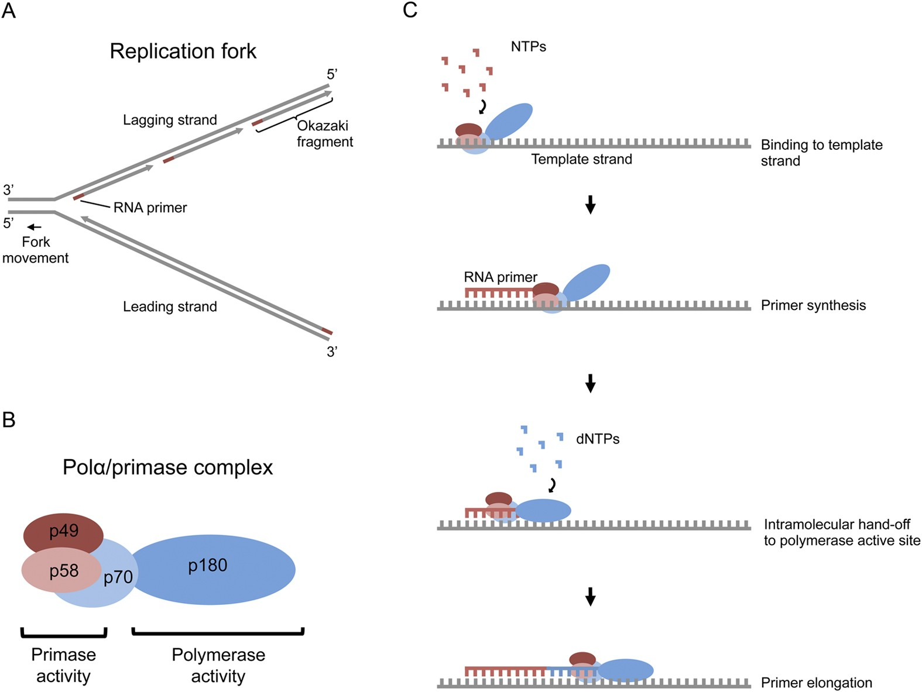
Eukaryotic DNA Polymerases
Figure from: Coloma, J., et al. (2016) Scientific Reports 6:23784
Notes:
Eukaryotic DNA polymerases are more complex than their prokaryotic counterparts, but essentially serve very similar functions during the replication process. Three distinct replicative polymerase complexes contribute to canonical DNA replication: α, δ, and ε. These three polymerases are essential for viability of the cell. Because DNA polymerases require a primer on which to begin DNA synthesis, first, polymerase α (Pol α) acts as a replicative primase. Pol α is associated with an RNA primase and this complex accomplishes the priming task by synthesizing a primer that contains a short ~10-nucleotide RNA stretch

Slide 17
Eukaryotic DNA Polymerases
Figure from: Coloma, J., et al. (2016) Scientific Reports 6:23784
Notes:
This is followed by 10 to 20 DNA bases that is extended by pol alpha. Importantly, this priming action occurs at replication initiation at origins to begin leading-strand synthesis and also at the 5′ end of each Okazaki fragment on the lagging strand.

Slide 18
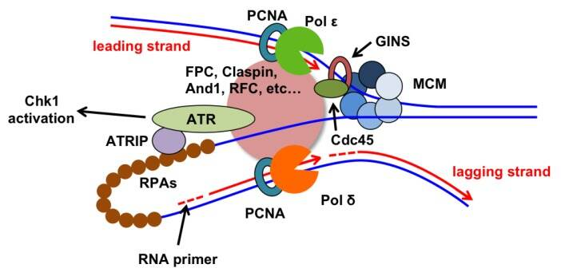
Replication Fork
Notes:
DNA replication must then be “handed off” to another polymerase to continue synthesis. The polymerase switching requires clamp loaders which are shown in this larger pink circle here and include things like Fork Protection Complex (FPC), Claspin, and the Replication Factor C clamp loader (RFC). Mutational studies has revealed that Pol epsilon is used for leading-strand synthesis and Pol delta for lagging strand synthesis. In eukaryotes, ssDNA stabilization is maintained by the heterotrimeric complex known as replication protein A (RPA). The proliferating cell nuclear antigen (PCNA), forms a ring structure that interacts with DNA polymerases and tethers them securely to DNA. PCNA acts as a sliding clamp during the replication process. As a side note, The ATR-Chk1 proteins are involved in cell monitoring. In the case of DNA damage, this system will become active and will inhibit origin firing and also stall active replication fork progression. This allows time for DNA repair process to occur prior to DNA synthesis, reducing the possibility of genetic mutations.

Slide 19
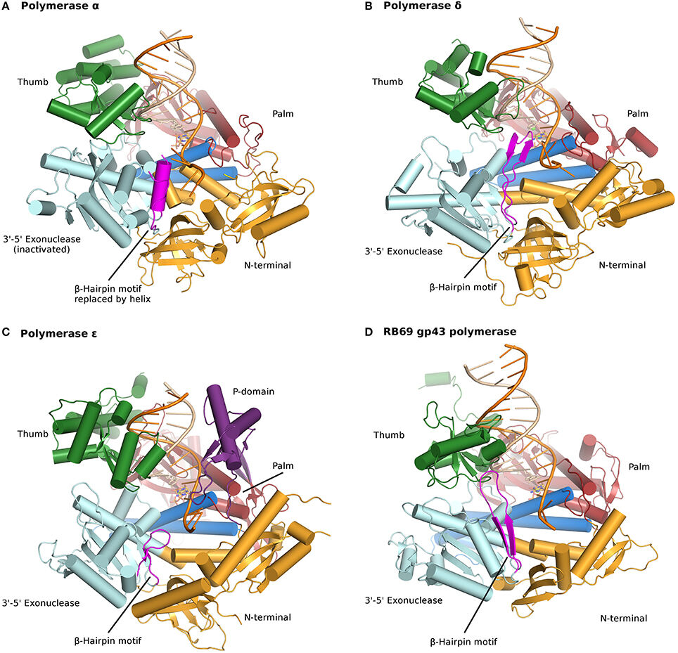
Nuclear Polymerases are
Type B-family Members
Notes:
In eukaryotes, DNA polymerases are grouped into seven families (A, B, C, D, X, Y, and RT). Crystal structures of the three nuclear replicative DNA polymerases demonstrate that they belong to the B family. All three replicative DNA polymerases are multi-subunit enzymes. The thumb and palm are critical for 5’ to 3’ polymerase activity, whereas the 3’-5’ exonuclease activity (proofreading) is controlled by the region in cyan. Note that the proofreading domain is inactivated in Pol alpha.

Slide 20
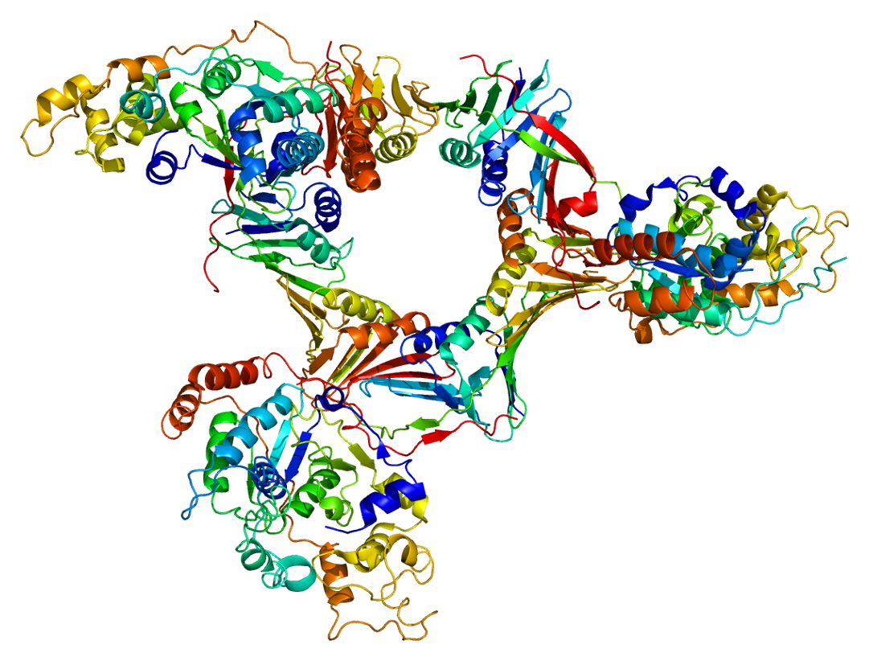
Flap Endonuclease (FEN1)
Figure from: Emw
Notes:
You may have noticed in the last slide that I didn’t mention any domains in the three key polymerases that have 5’ to 3’ endonuclease activity. So, Pol alpha, epsilon, and delta are NOT able to remove the primer sequences used during replication. The Flap Endonuclease, FEN1, is largely involved in this process with DNA Ligase being used to seal the sugar-phosphate backbone.

Slide 21
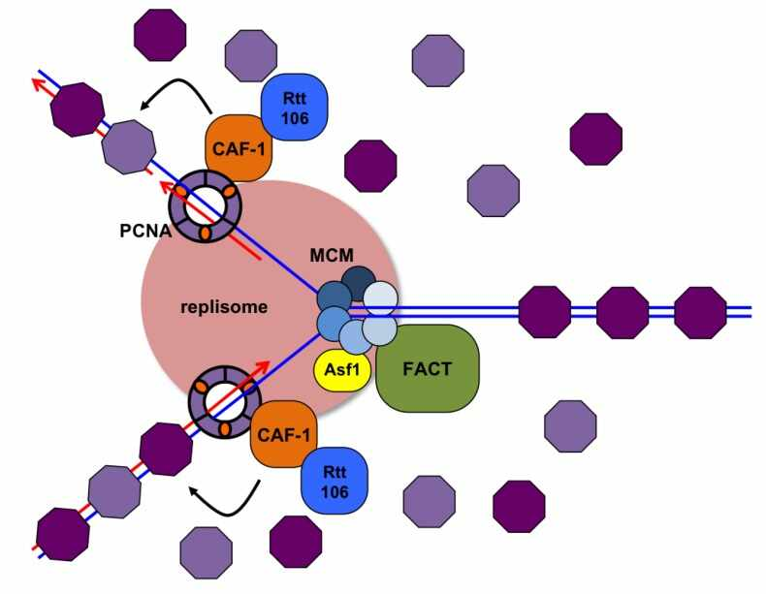
Histone Remodeling Required
Notes:
Eukaryotic DNA replication is also further complicated by the higher order chromosome structure, especially the nucleosome core structures. Nucleosomes must be displaced and then repositioned following the flow of the replisome. Several histone chaperones are known to be involved in replication-coupled nucleosome assembly, including the FACT complex. The FACT complex components were originally identified as proteins that greatly stimulate transcription by RNA polymerase II. The FACT complex is a heterodimer that does not hydrolyze ATP, but facilitates the “loosening” of histones in nucleosomes

Slide 22
Replication Termination
Notes:
Unlike prokaryotic systems that use the Tus-Ter systems to terminate replication in a distinct region of the chromosome, eukaryotic termination differs. Replication termination typically occurs by the collision of two replication forks anywhere between two active replication origins. The location of the collision can vary based on the replication rate of each of the forks and the timing of origin firing. Often, if a replication fork is stalled or collapsed at a specific site, replication of the site can be rescued when a replisome traveling in the opposite direction completes copying the region. Other more complex replication fork barriers also exist within the genome, but we will not go into detail about those here.

Slide 23
Chapter 9: DNA Replication
9.5 Replication of Mitochondrial DNA
Notes:
In this section, we will take a look at mitochondrial DNA replication.

Slide 24
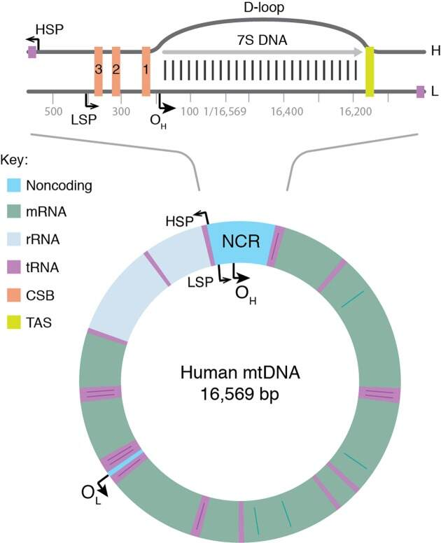
Mitochondrial Genome
Notes:
Mammalian mitochondria contain multiple copies of a circular, double-stranded DNA genome approximately 16.6 kb in length. The two strands of mtDNA differ in their base composition, with one being rich in guanines, making it possible to separate a heavy (H) and a light (L) strand by density centrifugation. The mtDNA contains one longer noncoding region (NCR) also referred to as the control region. In the NCR, there are promoters for polycistronic transcription, one for each mtDNA strand; the light strand promoter (LSP) and the heavy strand promoter (HSP). The NCR also harbors the origin for H-strand DNA replication (O_{H}). A second origin for L-strand DNA replication (O_{L}) is located outside the NCR, within a tRNA cluster.

Slide 25
Mitochondrial Genome
Notes:
Mammalian mtDNA is replicated by proteins distinct from those used for nuclear DNA replication and many are related to replication factors identified in bacteriophages. DNA polymerase γ (POLγ) is the main replicative polymerase in mitochondria. The helicase used in the process is known as TWINKLE and the primase is POLRMT complex

Slide 26
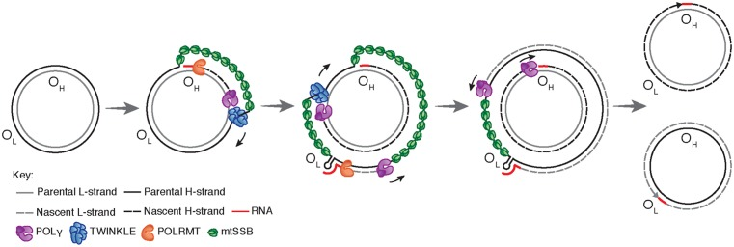
Mitochondrial DNA Replication
Notes:
Mitochondrial DNA replication is initiated at O_{H} and proceeds unidirectionally to produce the full-length nascent H-strand. mtSSB binds and protects the exposed, parental H-strand. When the replisome passes O_{L}, a stem–loop structure is formed that blocks mtSSB binding, presenting a single-stranded loop-region from which POLRMT can initiate primer synthesis. The transition to L-strand DNA synthesis takes place after about 25 nt, when POLγ replaces POLRMT at the 3′-end of the primer. Synthesis of the two strands proceeds in a continuous manner until two full, double-stranded DNA molecules have been formed.

Slide 27
Mitochondrial Genome
Notes:
Curiously, not all replication events initiated at O_{H} continue to full circle. Instead, 95% are terminated after about the first 650 nucleotides at a sequence known as the termination associated sequences (TAS). This creates a short DNA fragment known as the 7S DNA, that remains bound to the parental L-strand, while the parental H-strand is displaced. As a result, a triple-stranded displacement loop structure, a D-loop, is formed. The functional importance of the D-loop structure is unclear and how replication is terminated at TAS is also not known.

Slide 28
Chapter 9: DNA Replication
9.6 Telomeres and Replicative Senescence
Notes:
In this final section of Chapter 9, we will look at how the replication machinery deals with the ends of the linear chromosomes and a potential clue regarding replicative senescence.

Slide 29
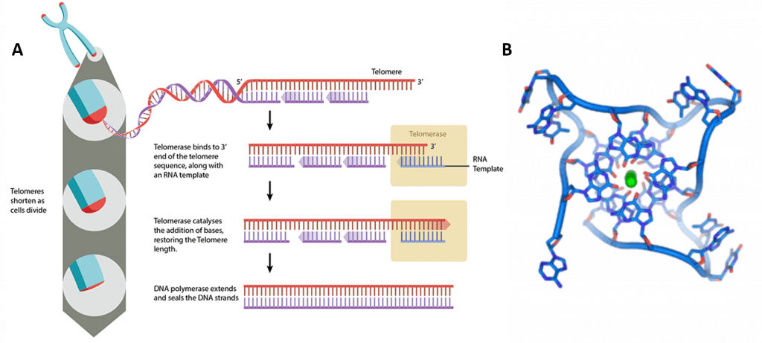
Telomere Structures
Notes:
In chapter 4, you learned about the telomere structures that are present at the ends of linear chromosomes. Recall, that these are repeating TTAGGG sequences at the ends of chromosomes. There can be hundreds to thousands of copies of this sequence repeated at the ends of the chromosome. Telomeres also form a unique tertiary structure that differs from the normal alpha helix. This is known as T-loop formation, and it protects the ends of the DNA from degradation.

Slide 30
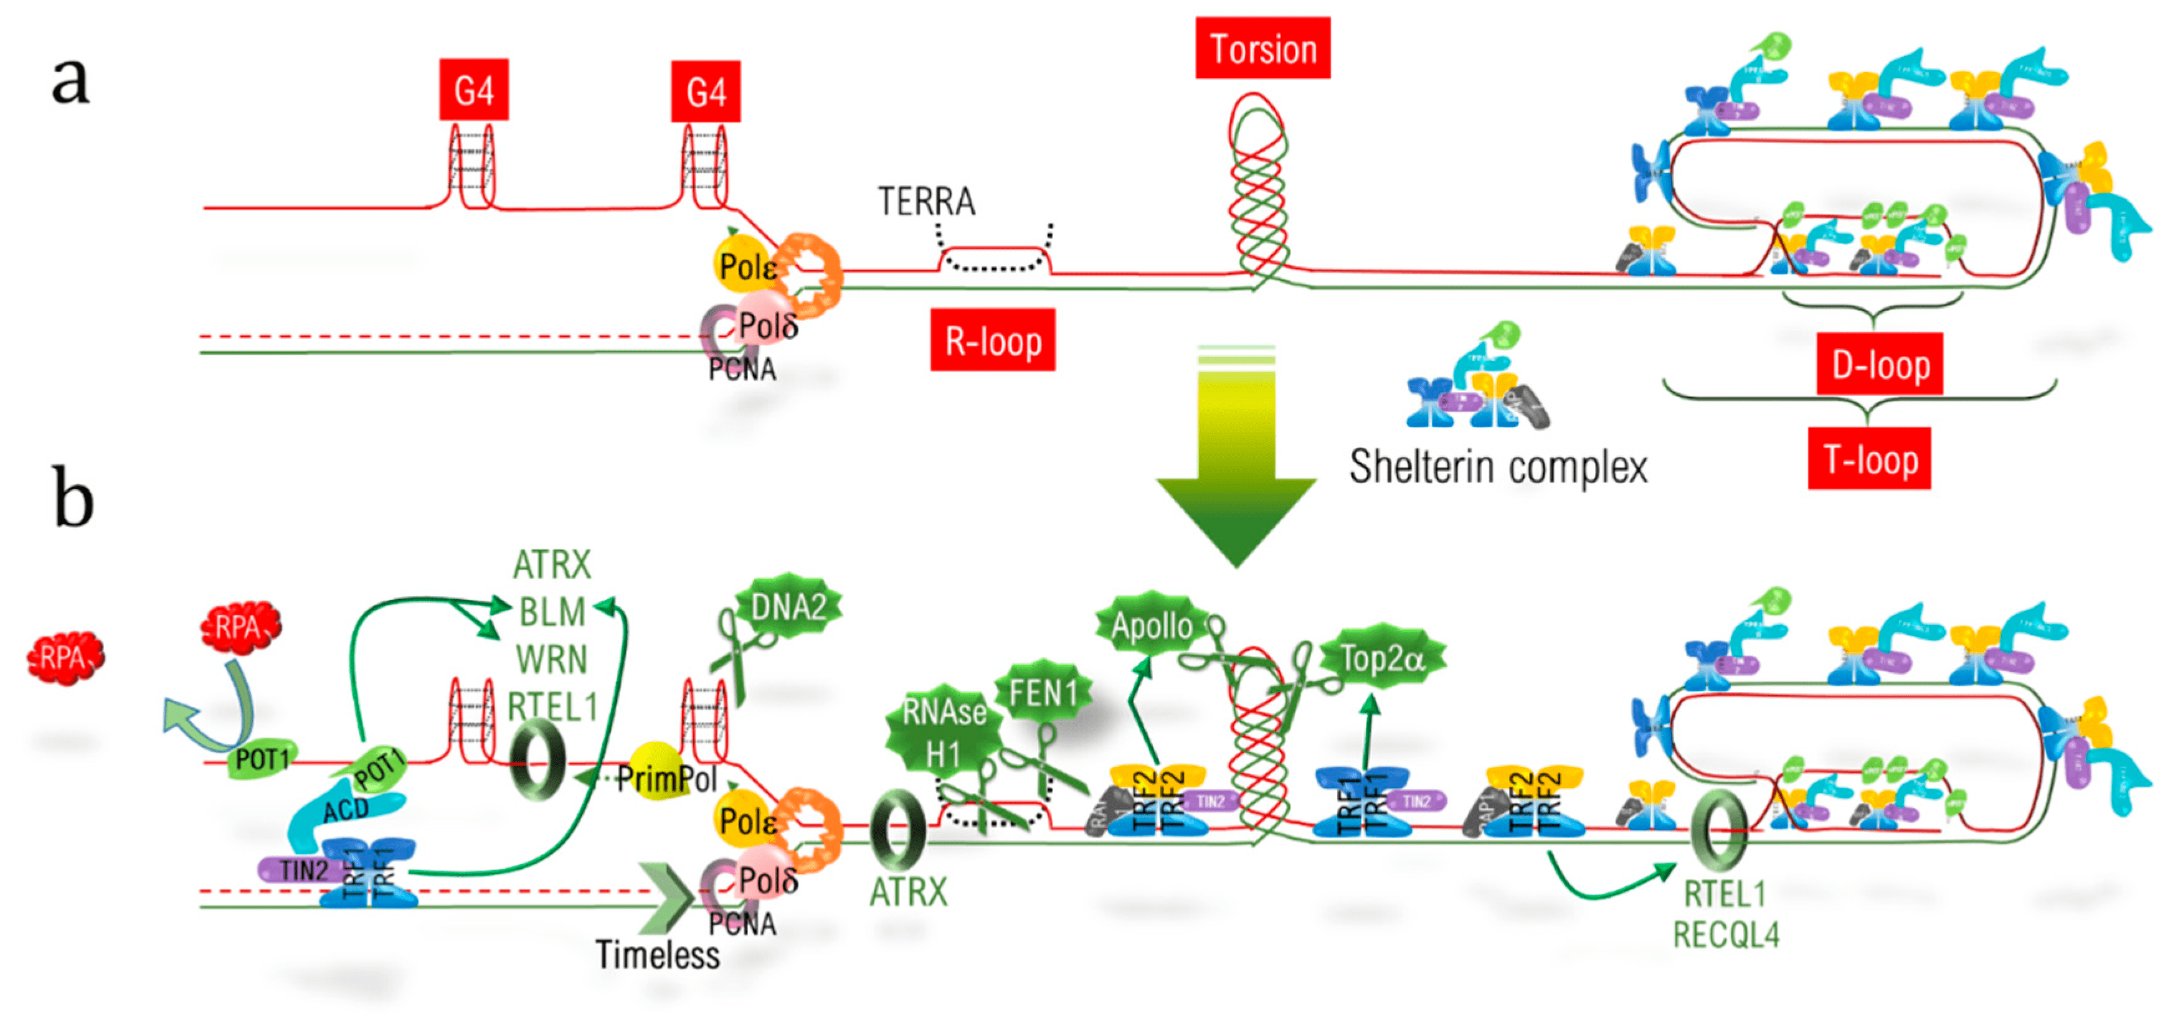
Obstacles of Telomere Replication
Notes:
The replication of telomeric DNA (telDNA) is a real challenge due to the different structural features of telomeres. Firstly, the nucleotidic sequence itself consists of an hexanucleotidic motif (TTAGGG) repeated over kilobases, with the 5′-3′ strand named the “G-strand” due to its high content in guanine. During the progression of the replication fork, the lagging strand, corresponding to the G-strand, forms G-quadruplex (G4) structures, which have to be resolved to allow fork progression and to complete replication. Secondly, R-loops corresponding to highly stable RNA:DNA hybrids, involving the long non-coding telomeric transcript TERRA (telomeric repeat-containing RNA) also have to be dissociated. Thirdly, the extremity of telomeres adopts a specific loop structure, the T-loop, which forms with a complex of shelterin proteins. This has to be unraveled. This is the loop that hides the double strand end from the DNA damage sensors, and is locked by the hybridization of the 3′ single strand overhang extremity with the above 3′-5′ strand, thereby displacing the corresponding 5′-3′ strand to form a D-loop (displacement loop) structure. Lastly, replication also has to deal with barriers encountered elsewhere in the genome, such as torsions and a condensed heterochromatic environment. So there are a huge assortment of DNA replication helping proteins that are enlisted to help resolve these structural barriers and enable replication to proceed. These are shown in green in the lower diagram. You do not need to memorize any of these helper proteins.

Slide 31
Telomere Structures
Notes:
In addition to these structural challenges, the ends of the linear chromosomes have a problem being synthesized during DNA replication. At the very ends, there will be an RNA primed region that was used by the DNA polymerase to start replication. However, when this primer is removed, there is no upstream primer to serve as a docking place for the DNA polymerase to replace the missing nucleotides. Thus, the ends of the chromosome will be shortened within this primer region every round of synthesis. Thus, it is thought that each cell has an inherent mitotic clock, or a maximal amount of times that the cell can enter into DNA replication before it is forced to enter into replicative senescence due to chromosome shortening. This is known as the Hayflick limit.

Slide 32
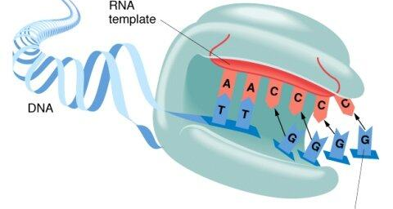
Telomerase Activity
Notes:
There is a way around the Hayflick Limit. This is through the activity of the telomerase enzyme. The human telomerase enzyme is responsible for maintaining and elongating telomeres and consists of an RNA component (TERC) and a reverse transcriptase (TERT), that serves as the catalytic component (Figure 9.26). The TERT uses the TERC as a template to synthesize new telomeric DNA repeats at a single-stranded overhang to maintain telomere length (Figure 9.26). Some cells such as germ cells, stem cells, hematopoietic progenitor cells, activated lymphocytes, and most cancer cells constitutively express telomerase and maintain telomerase activity to overcome telomere shortening and cellular senescence. However, most other somatic cells generally have a low or undetectable level of telomerase activity and concomitantly limited longevity. Interestingly, overall telomerase activity decreases with age, but increases markedly in response to injury, suggesting a role for telomerase in cellular regeneration during wound healing.

Slide 33
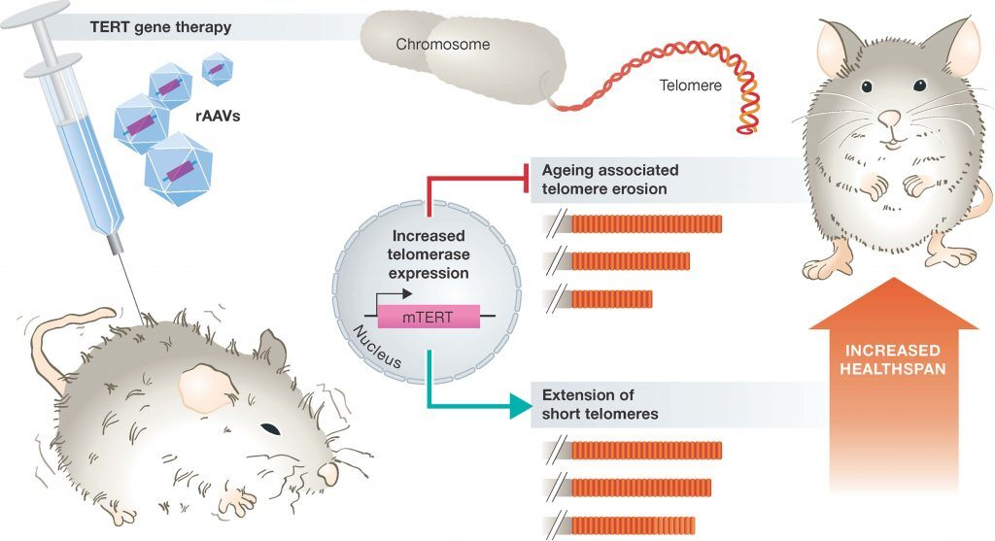
Healthspan and Telomere Length
Notes:
healthy lifespan in humans is positively correlated with longer telomere length and patients suffering from age-related diseases and premature aging have shorter telomeres compared with healthy individuals. An accumulation of unrepaired damage within telomeric regions has also been shown to accumulate in aging mice and non-human primates, suggesting that damage of telomeres with age may also be contributing to age-driven disease states and reduced healthspan.
Thus, one could argue that the activation and expression of telomerase may be a way of reducing age-related diseases and increasing overall longevity. However, the constitutive expression of telomerase, unfortunately, is a characteristic of almost all cancer cells. It is therefore, no surprise that transgenic animals over-expressiong the catalytic subunit of telomerase (mTERT), develop cancers earlier in life. However, overexpression of telomerase in mice that are highly resistant to cancers has shown large increases in median lifespan and significantly reduced age-associated disorders. Since humans are not highly resistant to cancer, this is not a feasible option for humans. However, additional studies in mice, where constitutive expression of telomerase is only introduced into a small percentage of host cells using adenovirus gene therapy techniques has yielded more promising results.

