Slide 1
Foundations of Biochemistry
1.2 Physical Foundations
Notes:
In the second section of Chapter 1, we will focus on key elements of physical chemistry that provide a foundation understanding cellular reactions and enzyme kinetics.

Slide 2
1.2 Physical Foundations
Reactions and Energy Changes
Reversible Reactions
Irreversible Reactions
Reaction Equilibrium
Change in Free Energy
Notes:
These include the major types of chemical reactions and the energy changes inherent within them.

Slide 3
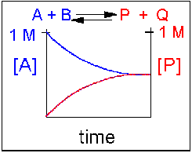
Reversible Reactions
Reactions and Energy Changes
Consider the reaction: A + B P + Q
Scenario 1: Reversible reaction in which the reactants and products are equally favored
Notes:
First let’s take a look at reversible reactions. If we consider the reaction: A + B being converted to the products, P + Q over time, we can imagine a few different scenarios. In the first scenario, shown here, this is a reversible reaction, where the reactants and products are equally favored. Shown on the graph is the concentration of one of the reactants [A] and one of the products [P]. You can see that overtime, as the reaction proceeds, that the concentration of the reactants decreases and the concentration of the products increases, until they reach the same level and stabilize at equilibrium. Recall, that at equilibrium the reaction is still proceeding and dynamic…there is just no net gain or loss in reactants or products as the rate of the forward and reverse reactions is the same.

Slide 4
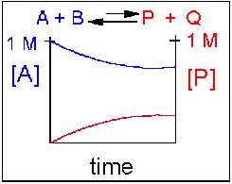
1.2 Physical Foundations
Reactions and Energy Changes
Consider the reaction: A + B P + Q
Scenario 2: Reversible reaction in which the reactants are favored (reverse reaction is favored…
Notes:
In scenario 2, the reverse reaction is favored over the forward reaction, causing an accumulation of reactants over time. This is seen in the reaction graph showing that some product is formed, but that when equilibrium is reached, the concentrations of reactant are higher than that of the product, and

Slide 5
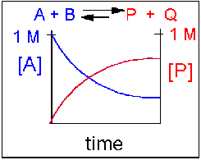
1.2 Physical Foundations
Reactions and Energy Changes
Consider the reaction: A + B P + Q
Scenario 3: Reversible reaction in which the products are favored (forward reaction is favored…
Notes:
In scenario 3, the forward reaction is favored causing an accumulation of more product than reactant at the point that equilibrium is reached.

Slide 6
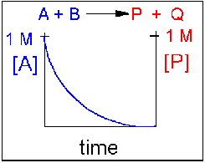
1.2 Physical Foundations
Reactions and Energy Changes
Consider the reaction: A + B P + Q
Scenario 3: Irreversible reaction where the reaction is driven to completion (forward products are not shown on the graph)
Notes:
We will also find that some reactions are irreversible in nature and are driven to completion. Note that forward products are not shown on this graph, only the complete consumption of the reactants during the reaction.

Slide 7
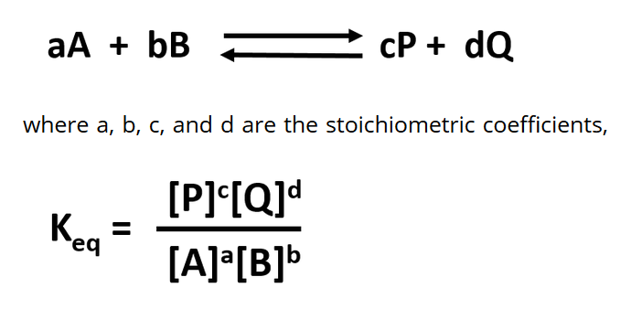
Equilibrium Constants
Equilibrium Constants (K_{eq}), as its name implies, is constant and independent of the concentration of the reactants and products.
A K_{eq} > 1 implies that the products are favored.
A K_{eq} < 1 implies that reactants are favored.
When K_{eq} = 1, both reactants and products are equally favored.
Notes:
For reactions that are reversible and reach an equilibrium state, they can be defined mathematically by an equilibrium constant called K-eq or K-equilibrium, due to the stability and nature of the equilibrium state. For this, we need to also take into account a fully balanced equation where the correct molar equivalents are shown. This is indicated in our equation here by the lower case letters in front of the reactants and products, such that we can now define Keq as the concentration of the products (raised to the power of the molar equivalent) over the concentration of the reactants (also raised to the power of the molar equivalent). This helps us define the dynamic nature of the reaction and the static nature of equilibrium. Regardless of whether we perturb the system by adding in more reactants or more products (or do the opposite! Remove products or remove reactants), there must be a shift in the concentration of the other amounts, such that they maintain the equilibrium state at the characteristic constant level. Because Keq is defined by the products in the numerator and the reactants in the denominator, a Keq that is > 1 indicates that the products are favored, whereas a Keq that is < 1 implied that the reactants are favored. If it is exactly 1, then the products and reactants are equally favored.

Slide 8
Change in Gibbs Free Energy (ΔG)
Controls the extent of a reaction
Two different pairs of factors influence the ΔG
One pair is concentration and inherent reactivity of reactants compared to products
The other pair is enthalpy and entropy changes
Notes:
Recall from general chemistry lessons, that the spontaneity of a reaction is measured by the change in the Gibbs Free Energy (termed Delta G). Delta G in influenced by two different pairs of factors. The first pair is the concentration of reactants and products and the inherent reactivity of the reactants compared to the products (these are the chemical characteristics of the compounds themselves). The second pair of factors include enthalpy and entropy changes.

Slide 9
HCl(aq) + H₂O(l) –> H₃O⁺(aq) + Cl–(aq)
CH₃CO₂H(aq) + H₂O(l) –> H₃O⁺(aq) + CH₃CO₂–(aq)
Notes:
For example, consider the two reactions shown. The top reaction showing hydrochloric acid reacting with water and the lower reaction showing acetic acid reacting with water. At t=0, there will be no product formed yet, and we will just be placing 0.1 moles of each acid into the water. When equilibrium is reached, there is essentially no HCl left in solution. This reaction has gone to completion. Whereas, 99% of the acetic acid remains. Why is that? All we can say is that there is something about the structure of HCl that makes it intrinsically less stable in water than the acetic acid. This is reflected in the Keq for each reaction ( >>1 for HCl and <<1 for acetic acid). Thus, intrinsic stability of the molecule is one factor that contributes to Δελτα G. The other factor in the first pair is concentration. For example, if we added 0.25 mol/L of acetic acid to a solution of water, this solution will not conduct electricity, suggesting that very little ionization of the acid has occurred. However, if we add more concentrated acid to the solution, this will drive the formation of more product and the solution will conduct electricity. This is an example of Le Chatelier’s Principle, which states that if a reaction at equilibrium is perturbed, the reaction will be driven in the direction that will relieve the perturbation.

Slide 10
Effects of Le Chatelier’s Principle
if more reactant is added, the reaction shifts to form more products
if more product is added, the reaction shifts to form more reactants
if products are selectively removed (by distillation, crystallization, or further reaction to produce another species), the reaction shifts to form more product.
if reactants are removed (as above), the reaction shifts to form more reactants.
if heat is added to an exothermic reaction, the reaction shifts to get rid of the excess heat by shifting to form more reactants. (opposite for an endothermic reaction).
Notes:
So, conlcusions we can make from Le Chatlier’s Principle are:

Slide 11


Change in Gibbs Free Energy (ΔG)
Notes:
So we can think about this first pair of factors in a more mathematical way to help us define Delta G of the reaction. We can first say that it is equal to the change in free energy associated with the intrinsic stability of the reactants, as well as the change in free energy associated with the concentrations of reactants present. Delta G knot is used to reflect the contribution from the intrinsic stability of the reactants and products (and differentiate it from the overall delta G of the rection). The component of delta G that is dependent on the concentration of reactants and products can be further defined by RTlnQrx, where R is the gas constant, T is temperature in Kelvin, and Qrx is the reaction quotient (which reflects the concentrations of the products over the reactants.

Slide 12

Change in Gibbs Free Energy (ΔG)
if ΔG < 0, the reaction goes toward products P and Q
The reaction is EXERGONIC (Spontaneous)
if ΔG = 0, the reaction is at equilibrium and no further
change occurs in the concentration of reactants and
products.
The reaction is at EQUILIBRIUM
if ΔG > 0, the reaction goes toward reactants A and B.
The reaction is ENDERGONIC (Not Spontaneous)
Notes:
Thus the change in Gibbs Free Energy can be simplified to this equation. Recall that if delta G is < 0, the reaction is spontaneous (or Exergonic). If delta G is 0, the reaction is at equilibrium, and if delta G is > 0, the reaction is Endergonic or Not spontaneous.

Slide 13
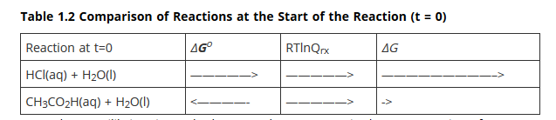
HCl(aq) + H₂O(l) –> H₃O⁺(aq) + Cl–(aq)
CH₃CO₂H(aq) + H₂O(l) –> H₃O⁺(aq) + CH₃CO₂–(aq)
Notes:
So if we look at our two acids from our previous reactions, we can characterize the reactions according to these following characteristics. We know that for HCl that the intrinsic stability of the molecule favors the products, whereas for acetic acid, it favors the reactants. For both reactions starting at time = 0, there will be a shift in the reaction such that the reaction will move to the right towards the formation of the products (as no products will have been formed yet at t=0; thus, products will form until equilibrium is established). The combination of these two factors, leads to the overall delta G of the reaction, which in the case of HCl is much larger than 1, and in the case of acetic acid is much smaller than 1.

Slide 14
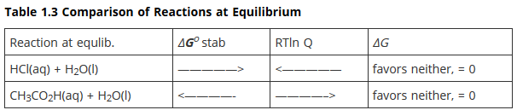
HCl(aq) + H₂O(l) –> H₃O⁺(aq) + Cl–(aq)
CH₃CO₂H(aq) + H₂O(l) –> H₃O⁺(aq) + CH₃CO₂–(aq)
Notes:
Once equilibrium is reached, you can see that the two pairs of factors have reached equivalency, such that neither factor favors a shift to the reactant or product side (they essentially cancel eachother out and the reaction remains at equilibrium).

Slide 15
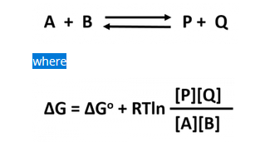
What is the significance of ΔGº?
Notes:
So what is the significance of delta G knot? One thing that we know, is that it is independent of concentration and does not change…

Slide 16
What is the significance of ΔGº?
Think of the reaction at equilibrium
Notes:
Think about the reaction at equilibrium….What do we know about the value of Delta G at equilibrium? It is zero, right?

Slide 17
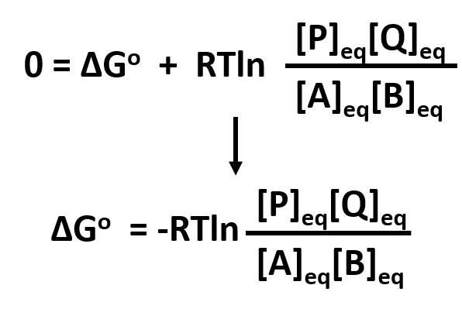
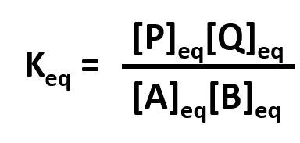
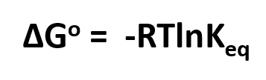
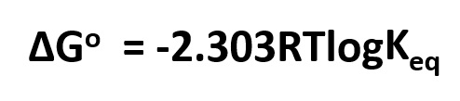
What is the significance of ΔGº?
Think of the reaction at equilibrium
Conclusions?
Notes:
At equilibrium, delta G knot will equal the negative RTln[P][Q]/[A][B]. We then know that this reaction is at equilibrium and can substitute in Keq. Thus, our equation reduces to delta G knot equals negative RT, natural log Keq. And we can convert this to a standard log equation if needed. Thus, depending on a given problem, we can potentially calculate a value for delta G knot that can help us further evaluate the delta G of a reaction under different conditions (ie not at equilibrium).

Slide 18
What is the significance of ΔGº?
Think of the reaction at standard state (all concentrations are at 1 M)
Notes:
What happens if in our equation, all of the concentrations are at 1 M?

Slide 19
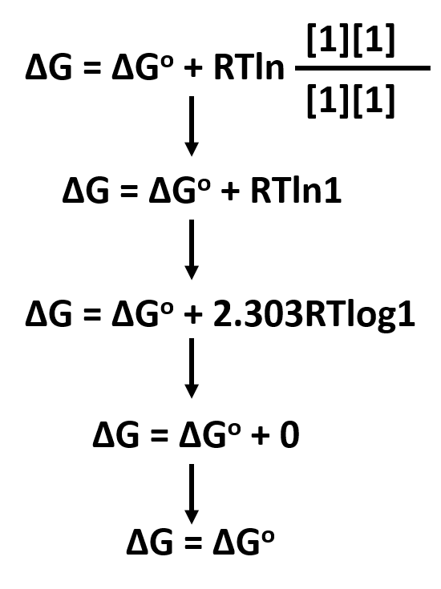
What is the significance of ΔGº?
Notes:
Well…the concentration factor reduces to zero, and we find that under this circumstance that the delta G of the reaction will be equal to the delta G knot value (ie the reaction will be independent of concentration and only be affected by the intrinsic reactivity of the molecules. This is defined as the standard state…when the delta G of the reaction equals delta G knot.

Slide 20
New symbol = ΔGº’
when all reactants are at this concentration, defined as the standard state (1 M for solutes), the ΔG at that particular moment just happens to equal the ΔGº for the reaction.
The ΔG^{o’}(delta G naught prime) is defined as the free energy change of a reaction under standard conditions. Note that standard conditions also define temperature and pressure constraints for the system. The following are true for ΔG^{o’}:
all the reactants and products are at an initial concentration of 1.0 M
Pressure is at 1.0 atm
Temperature is at 25ºC
Notes:
So at this point, we will introduce a new symbol for the steady state which is delta G knot prime. Standard conditions also define the temperature and pressure conditions of the reaction to a pressure of 1.0 atm and a tempterature of 25 degrees C.

Slide 21
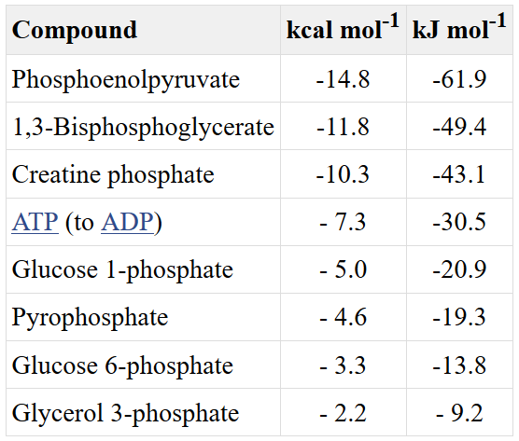
So What?
Energy flow. What is the direction of each of the following reactions when the reactants are initially present in equimolar amounts? Use the data given in the table
ΔG^{o’}
Notes:
This helps us to evaluate energy flow within a system. For example, if we look at reaction (a), we can see that conversion of ATP to ADP is going to yield a delta G knot prime of -7.3 kcal/mol (that is in the forward direction for our reaction). If we look at our table, we can also see that the breakdown of creatine phosphate will yield -10.3 kcal/mol (that is in the reverse direction for our equation). So for the forward reaction of creatine to creatine phosphate, our delta G knot prime will be +10.3 kcal/mol. Thus our overall delta G knot prime will be a sum of these values going in the forward direction or (-7.3) + (+10.3) = +3.0. So we know that reaction (a) under steady state conditions is Not Spontaneous!

Slide 22
So What?
Energy flow. What is the direction of each of the following reactions when the reactants are initially present in equimolar amounts? Use the data given in the table
ΔG^{o’}
The overall ΔG^{o’}
for the reactions above can be taken as the sum/difference
of those listed in the table for the individual hydrolysis steps
Notes:
Practice calculating delta G knot prime for reactions (b) – (d). What did you get for (c)? [ -7.3 for the ATP → ADP & +14.8 for the pyruvate → phosphoenolpyruvate = +7.5 for the overall reaction and Non spontaneous].

Slide 23
Calculate ΔG°′ and K′_{eq} at 25°C for this reaction, by using the data given in the table
ΔG^{o’}
R = 0.0019872 kcal/mol*K
Notes:
We calculated delta G knot prime on the last slide…can you use that information to calculate the Keq?? [Hint: Think about the reaction at equilibrium]

Slide 24
Solving the Problem….
Fill in the values (make sure units match!) and isolate the log.
Then exponentiate the equation to solve for Keq
+7.5 kcal/mol = -2.303(0.0019872 kcal/mol*K)(25+273K)logKeq
+7.5 kcal/mol = (-1.364kcal/mol)logKeq
-5.94 = logKeq
10^{-5.94} = Keq
0.000001148 or 1.1 x 10⁻⁶ = Keq
Notes:
Did you use this equation to come up with your final answer? First fill in the known values, checking to be sure that your units all match and will cancel out. Solve the problem down to the log, and then exponentiate. Once in exponential form, you can solve for Keq. This number turns out to be much << 1 indicating that the reaction favors the reactant side. Note that reactions in the body are not typically at equilibrium or at the steady state. These are conditions that we use in the lab to help us understand the nature of a reaction. The two fluctuating components then, in the reaction are temperature and the concentration of the reactants and the products. In vivo, it is not likely that you can vary the temperature very much to significantly impact the rate of reaction. In vivo, the main driver will be concentration of the reactants and products. Thus, if you have a highly unfavorable reaction, such as the one that we’ve been discussing, removing the product from the area as it is formed can drive the reaction in the forward direction (ie Le Chatelier’s Principle is important in vivo!!).

Slide 25
What about Enthalpy and Entropy??
Enthalpy relates to the heat of the reaction
Entropy relates to the state of order/disorder in a reaction
What is the equation that relates ΔG to these terms?
Notes:
Enthalpy and Entropy are also important components that can affect the overall change in Gibb’s free energy within a reaction. Do you remember the equation that relates these terms from general chemistry?

Slide 26
What about Enthalpy and Entropy??
Enthalpy relates to the heat of the reaction
Entropy relates to the state of order/disorder in a reaction
What is the equation that relates ΔG to these terms?
ΔG = ΔH – TΔS
Notes:
Yes, the change in Gibb’s free energy is equal to the change in enthalpy within the system minus the temperature (in Kelvin) times the change in entropy. This equation is more useful in the lab when we are studying isolated systems.

Slide 27
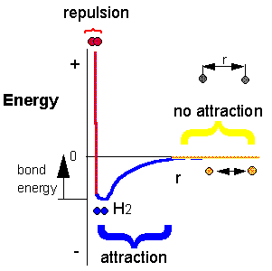
- Breaking Bonds Requires Energy - Forming New Bonds Releases Energy
Notes:
The final concept that I want to remind you of before we begin our journey into biochemistry, is that bonded elements that are sharing electrons exist in an optimal energy state and are highly attracted to each other. Thus, it always takes energy to break a bond, or pull the atoms apart from one another. When new bonds form, it releases energy. This amount of energy is called the bond energy, and it will be different for different atoms pairs involved in the bond and depending on what type of bond is formed (ie a sigma bond vs a pi bond or a hybridized mixture of the two).

Slide 28
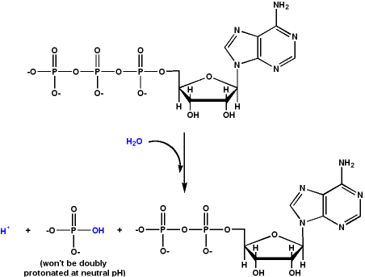
ATP Hydolysis
Notes:
A good example of where this concept is often misused or misunderstood is the hydrolysis of ATP. Many people erroneously state that breaking the high energy phosphate bond in ATP releases lots of energy. This is an incorrect way of thinking about this reaction. It is the formation of the hydrolysis product (the inorganic phosphate) that releases the energy! We will see that this mechanism is used over and over again to create energy for biological reactions in vivo.

