Slide 1
Foundations of Biochemistry
1.4 Genetic Foundations
Notes:
In this section, we will review key features of genetics that provide additional foundation for understanding biochemistry.

Slide 2
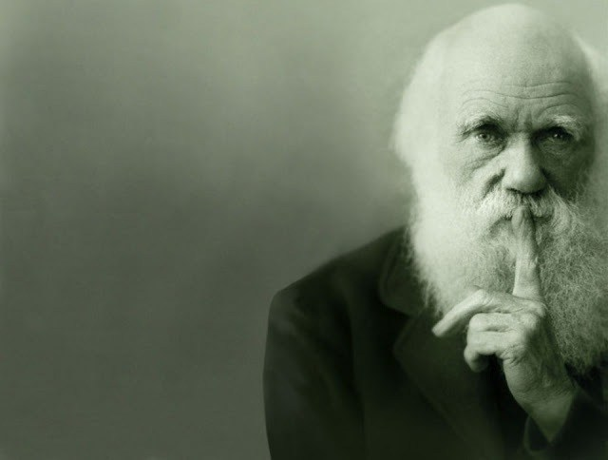
Evolution
Decent with Modification
Natural Selection Mechanism
Because resources are limited in nature, organisms with heritable traits that favor survival and reproduction will tend to leave more offspring than their peers, causing the traits to increase in frequency within a population over generations.
Notes:
Genetics provides the mechanistic basis for a key process, called evolution, that has given rise to the complexity of biological organisms on the planet. The mechanism of Natural Selection is quite simplistic, however, it gives rise to such complexity in all the kingdoms of life. Natural selection states that organisms with heritable traits that favor survival and reproduction will tend to leave more offspring than their peers, causing the traits to increase in frequency within a population over generations.

Slide 3
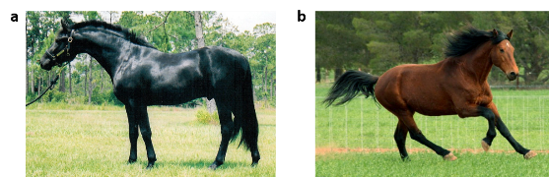
Phenotype
Natural Selection acts on an organism’s phenotype, or physical characteristics
Notes:
These traits within a population are known as a phenotype, or the physical characteristics of an organism.

Slide 4
Phenotype
Is determined by a combination of two features:
The organism’s genetic make-up (Genotype)
The environment in which the organism lives
Notes:
A phenotype is dependent on two key features of the organism:
The genotype or genetic make-up of the organism, and
The environment that the organism or that the organisms, parents have or are living in

Slide 5
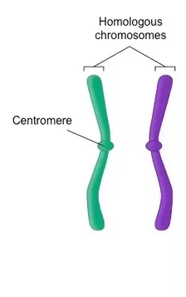
Genotype
Humans have two copies of each gene within our genomes that are housed on chromosomes. One set is derived from the father’s DNA and one from the mother’s DNA (i.e. Paternal vs Maternal Genes). These
Paternal and maternal chromosomes that contain genes for the same traits are called Homologous Chromosomes
Paternal
Maternal
Notes:
Let’s talk just a little more about the genotype of an organism. In humans, we have a total of 46 chromosomes (or 23 pairs). These pairs come from our mother and our father. Each chromosome of a pair are called a homologous chromosome. Homologous chromosomes contain the same sets of genes, in the same order. In humans this is true for all of the chromosome pairs except for the sex chromosome pair. For women, these are true homologs, as women contain two X chromosomes. Men, however, contain one X and one Y chromosome that do not have a homologous complement of genes present.

Slide 6
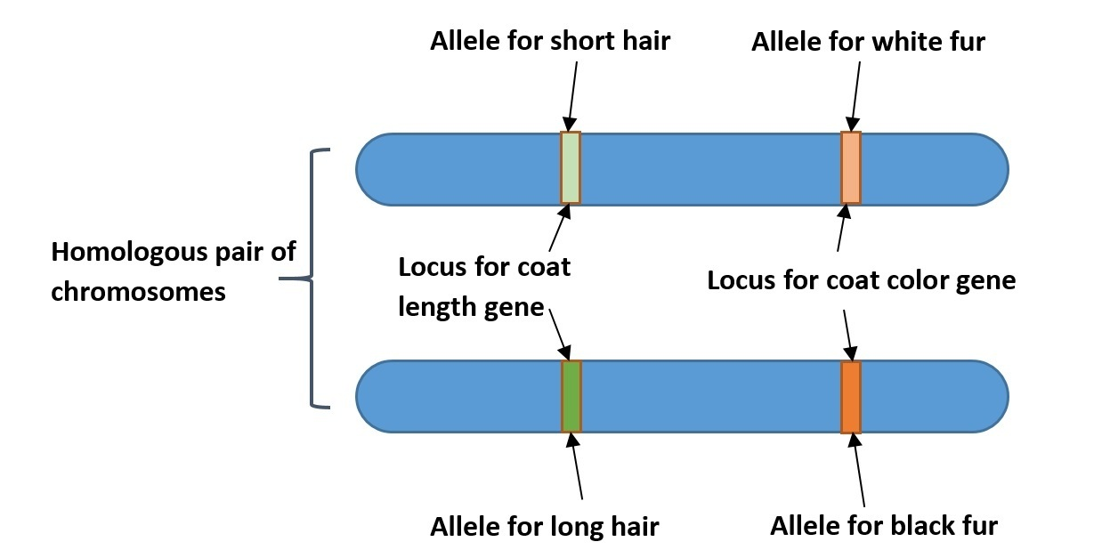
Genotype
When different organisms in a population possess different versions of a gene for a certain trait, each of these versions is known as an allele.
Notes:
While homologous chromosomes contain the same genes, in the same order, they don’t necessarily have the same traits. Each gene can have variations of a trait. These different variations for a trait are known as alleles of a gene. For example, you might have a gene that determines hair length. One allele may give short hair, and the other may give you long hair.

Slide 7
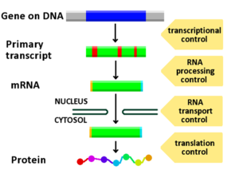
Phenotype is Dependent on Gene Expression….
Notes:
The phenotype of an organism is dependent on the genotype, but it is also dependent on the expression of those genes. And this can be influenced by the organisms environment, or even the environment of the organism’s parents. Genes encode the sequence of proteins. To express a gene, the gene is first transcribed into an RNA primary transcript. This transcript is processed, and in eukaryotic cells, transported into the cytoplasm from the nucleus, where it can be translated by the ribosome into the final protein structure.

Slide 8
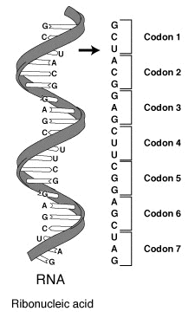
Protein Production (Translation)
RNA is ‘read and translated’ in groups of three bases known as codons
These codons in turn specify a single amino acid that is incorporated into the nacent peptide/protein
Notes:
The conversion of RNA to protein structure is read in units of 3 nucleotides called a codon. Each codon encodes for a specific amino acid within the protein sequence.

Slide 9
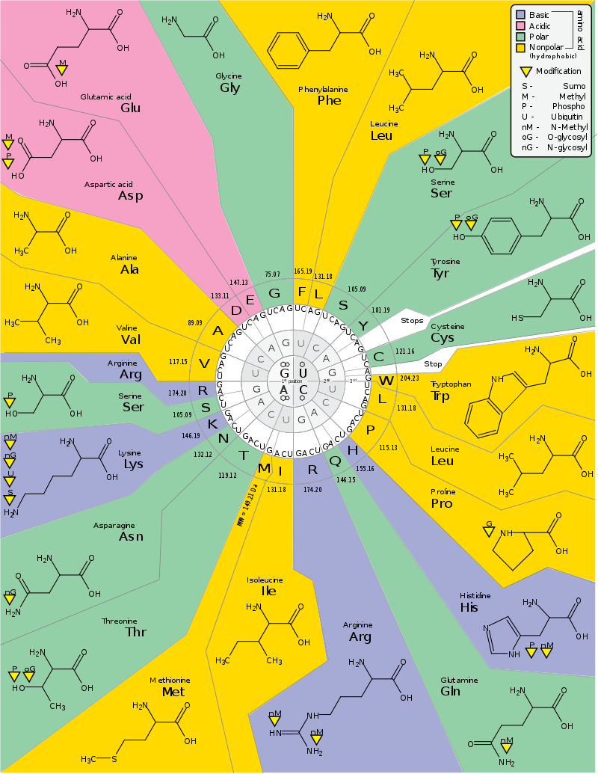
Codon Chart
Each codon determines a specific amino acid building block that will be incorporated into the protein structures
There are 20 amino acids commonly used for protein synthesis
These are defined by full name, three letter code, and single letter code
Notes:
Within proteins, there are 20 amino acids that can be incorporated into the protein structure. These amino acids have three letter and one letter codes that make it easier to work with sequences. You will need to know both the three letter and one letter codes for these amino acids.

Slide 10
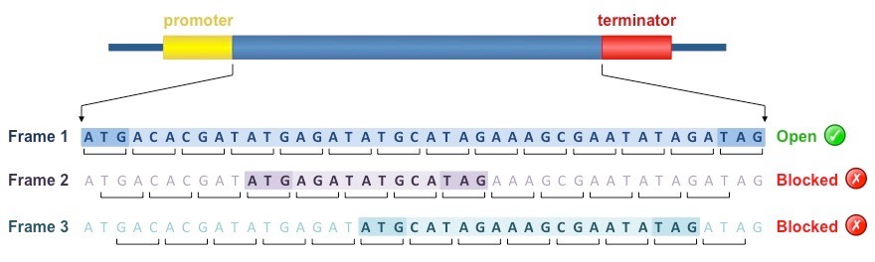
Open Reading Frame (ORF)
The ORF of a gene can be predicted using bioinformatics
For each strand of DNA, there are three potential ORFs depending on where you start evaluating the codons.
In the example below, Frame 1 contains the longest ORF, and would be predicted to contain correct reading frame of the gene sequence.
Notes:
When looking at the sequence of chromosomal DNA, it is possible to use bioinformatics to predict where gene sequences are located. These are known as Open Reading Frames or ORFs. ORFs are reading frame specific and non-overlapping. In the diagram you can see each of the possible DNA reading frames. We will spend a lot of time this term learning how DNA ORFs are recognized by cellular transcription factors, transcribed, and translated.

Slide 11
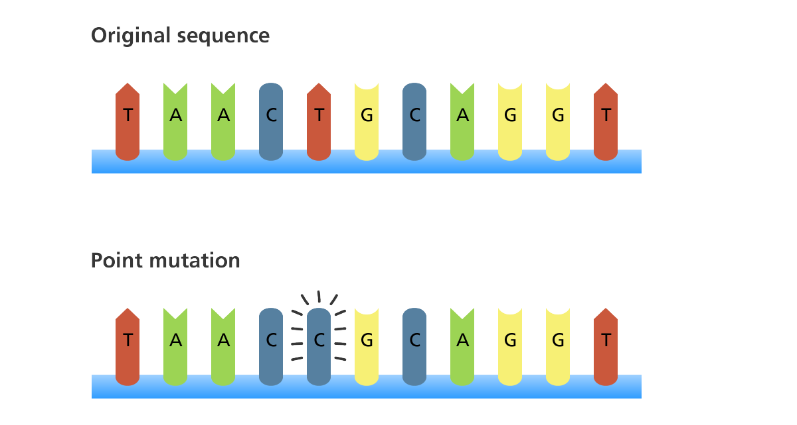
DNA Mutations
Notes:
The genetic mechanism for Evolution that enables Natural Selection to be possible is the mutation of DNA. Note that mutations are random.
Selection occurs at the level of the organism (ie does the environment favor the survival of an animal with the new mutant trait or the original one?)

Slide 12
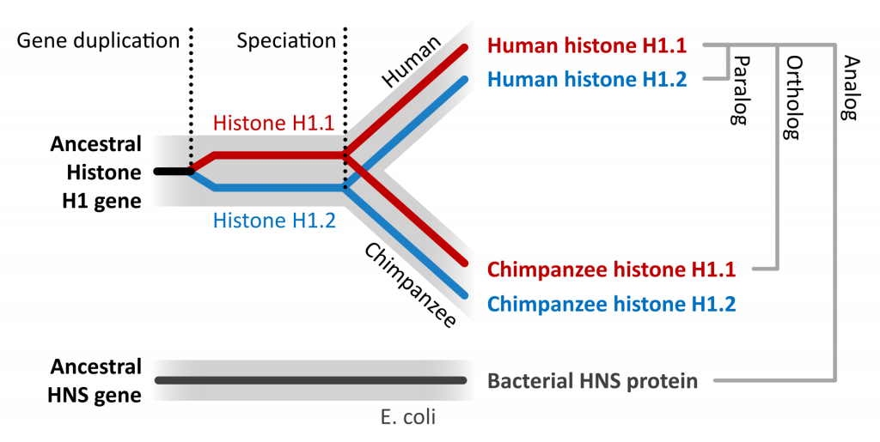
Genes Evolve
Notes:
Over time genes evolve due to random mutations that accumulate and can include gene duplication events. This is where entire genes may be duplicated producing a second or third copy.

Slide 13
Paralogs
Notes:
When a gene duplication event happens within a single species and evolves to create two different genes, they are called Paralogs

Slide 14
Orthologs
Notes:
When a speciation event occurs, the genes in each species begin to diverge from one another due to random mutation. The genes that encode proteins with the same function in each of the species are called Orthologs

Slide 15
Analogs
Notes:
Unrelated genes that have separate evolutionary origins, but that each encode proteins that have similar functions are called Analogs

Slide 16
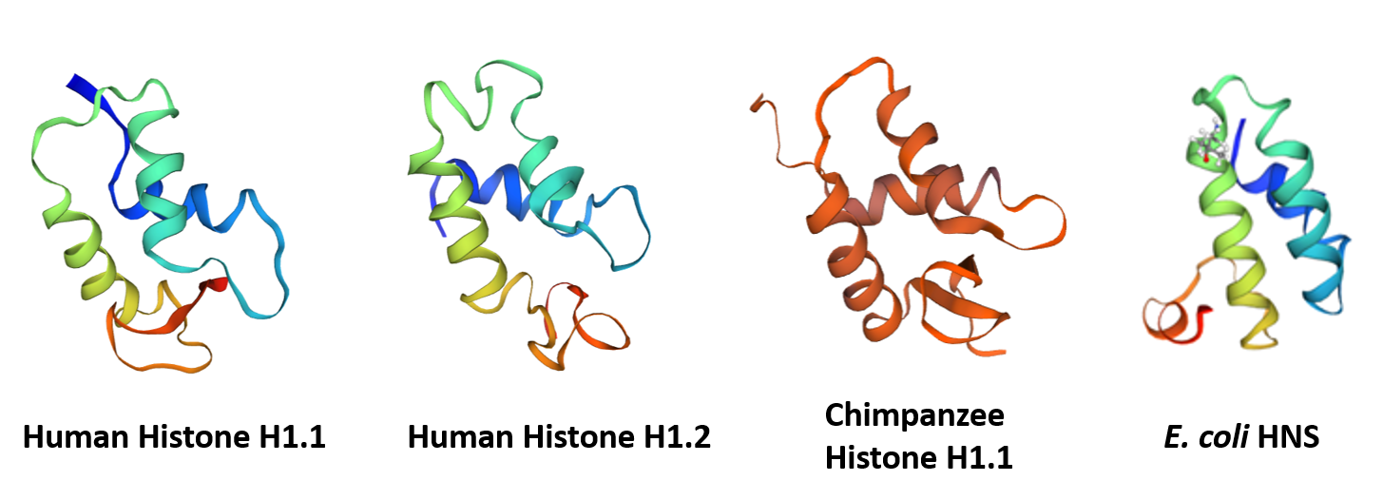
Shape Determines Function
Protein shapes are similar for paralogs, orthologs, and analogs
Notes:
The resulting shapes of the proteins are similar for paralogs, orthologs and analogs. This is important as the shape of the protein determines its function. All of the proteins shown on this slide are important for binding to DNA and share the same type of helix-loop-helix conformation.

Slide 17
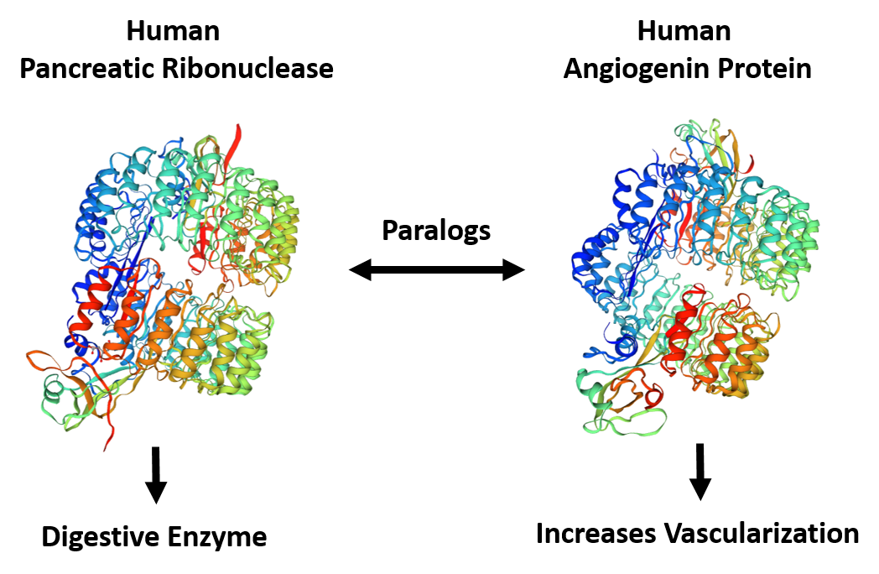
Paralogs can Evolve Different Functions!
Notes:
Similar shape, however, does not necessarily mean similar function. This is especially true for paralogs. Once the gene has been duplicated within a species, it can start to diverge from its original purpose, as the original gene is still serving in this function. For example, the human pancreatic ribonuclease enzyme and the human angiogenin protein are paralogs and share similar protein structure. However, the ribonuclease enzyme functions in digestion, whereas angiogenin functions as a hormone that helps increase vascularization. Overall, chapter 1 has aimed to provide an overview of key foundational concepts that we will now build upon through our exploration of Protein and DNA structure and function throughout this term.

