Slide 1
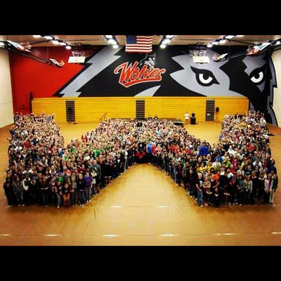




WOU Undergraduate Learning Outcomes
Liberal Education & America’s Promise

Slide 2
Committee Charge
Faculty Senate approved the LEAP outcomes for WOU undergraduate students
Which outcomes are most appropriate for General Education

Slide 3
WOU Undergrad Learning Outcomes
WOU students prepare for twenty-first-century challenges by gaining:
Knowledge of Human Cultures and the Physical and Natural World
  Through focused study in the sciences and mathematics, social sciences, humanities, histories, languages, and the arts, and by engagement with big questions, both contemporary and enduring

Slide 4

WOU Undergrad Learning Outcomes
Intellectual and Practical Skills, Including
Inquiry and analysis
Critical thinking
Creative thinking and practice
Written and oral/signed communication
Quantitative literacy
Information literacy
Teamwork and problem solving
Practiced extensively, across the curriculum using appropriate technology, in the context of progressively more challenging problems, projects, and standards for performance

Slide 5
WOU Undergrad Learning Outcomes
Personal and Social Responsibility, Including
Civic knowledge and engagement—local and global
Intercultural knowledge and competence
Ethical reasoning and action
Foundations and skills for lifelong learning
Anchored through active involvement with diverse communities, real-world challenges, and healthy life course decisions

Slide 6
WOU Undergrad Learning Outcomes
Integrative and Applied Learning, Including
Synthesis and advanced accomplishment across general and specialized studies
Demonstrated through the application of knowledge, skills, and responsibilities to new settings and complex problems

Slide 7
Recommendation
In the short term, use all of the approved Undergraduate Learning Outcomes (ULOs) as General Education Learning Outcomes (GELOs)

Slide 8
Recommendation
Over the next 3 years, gather assessment data on general education
  MUST.HAVE.DATA!
Spring 2018 revisit GELOs based on assessment data

Slide 9
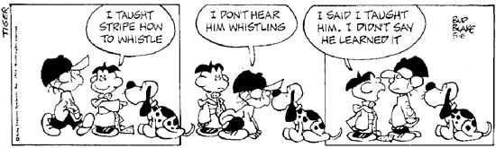
FOCUS: Learning outcomes for students

Slide 10
Additional Recommendation
Faculty senate designate a committee to oversee the initial assessment of GELOs and identify next steps for the university.

