Slide 1
Academic Affairs
Challenges and Opportunities

Slide 2
Condition of Higher Education
More people than ever are seeking post-secondary education
Public colleges and universities are drawing from the same tax dollars as human and social services (state support is lowest in 25 years)
None of those institutions is able to reduce services proportionately to need – need typically is larger than supply of service

Slide 3
Condition of Higher Education
Public colleges and universities are limited by market and government to small fee increases
Much of the infrastructure cannot be changed and some will have unpredictable cost increases (e.g., utilities)
Delivery of educational experiences has few efficiencies (e.g., number of credits required for degree)
Institutions face an “income gap” or “cost/revenue gap”

Slide 4
Options for closing the gap
Increase “revenue streams” (i.e., degree or certificate programs)
Increase capacity (i.e., enlarge class capacity)
Reduce cost of delivery
-pedagogy
-instructors
Modify programs
End delivery of programs

Slide 5
What can be done?
Beginning new programs requires “up-front” investment (e.g., new motion arts degree) and deferred return
Increasing capacity is more effective in some classes vs. others (e.g., chemistry lab compared to lecture in World Civilization)
Some modes of delivery (on-line or hybrid) can effectively reach new groups of students
Modifying programs can reduce scope of a student’s options and therefore costs associated with degree

Slide 6
Reducing cost of delivery includes a range of options
-melding lower enrolled classes
-increasing class size
-delivery of content in hybridized format
  Indecision is like a stepchild: if he does not wash his hands, he is called dirty, if he does, he is wasting water. African Proverb
  What's called a difficult decision is a difficult decision because either way you go there are penalties. Elia Kazan
  It's not hard to make decisions when you know what your values are. Roy Disney

Slide 7
WOU Preamble
Western Oregon University offers exemplary undergraduate and graduate programs in a supportive and rigorous learning environment. Oregon’s oldest public university, WOU works to ensure the success of students and the advancement of knowledge as a service to Oregon and the region. The University works in partnership with PK-12 schools, community colleges, higher education institutions, government, and local and global communities.

Slide 8
WOU Mission
Western Oregon University is a comprehensive public university, operating for the public good, which:
-Provides effective learning opportunities that prepare students for a fulfilling life in a global society;
-Supports an accessible and diverse campus community; and,
-Improves continuously the educational, financial, and environmental sustainability.

Slide 9
Core Themes
Effective Learning
Supports Diversity
Sustainable Institution

Slide 10
Strategic Priorities and Options Committee (SPOC)
The group will take options from faculty, staff and members of the campus community to determine:
Are the WOU mission and core themes upheld?
Is the option feasible?
Will the option make a measurable difference in reducing costs or increasing revenue
How quickly can the option be operational?
Who can take leadership in operationalizing?
Are there other options?

Slide 11
Strategic Priorities and Options Committee
SPOC
Academic Deans
Registrar
Associate Provost, SPOC Chair
Director of Academic Advising and Learning Center
President of Faculty Senate
Chair, Senate Curriculum Committee
Director of Budget

Slide 12
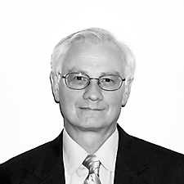
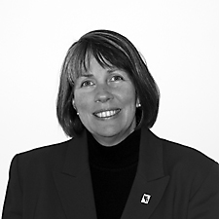
SPOC members
Academic Deans
Steve Scheck
Hilda Rosselli

Slide 13
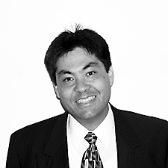
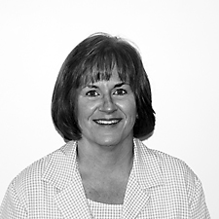
SPOC members
Associate Provost Registrar
Dave McDonald
Nancy France

Slide 14
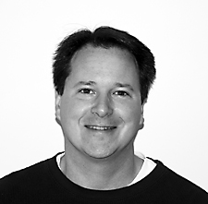
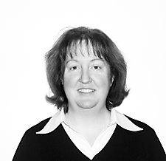
SPOC members
President Faculty Senate Director, AALC
Gavin Keulks
Karen Sullivan-Vance

Slide 15

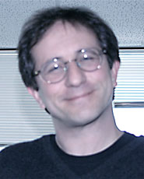
SPOC members
Director of Budget Chair, Faculty Senate
and Payroll Curriculum Committee
Eric Yahnke
Tad Shannon

Slide 16
Sample Questions/Options
Can lower division LACC classes be increased to large lecture format with break out discussion sessions?
-Could Peer Led Team Learning be utilized?
-Could Teaching Education pre-service majors be utilized as teaching assistants?
Can schedules be reconfigured to economize space and to accommodate above?
Can the total credits for a bachelor’s degree be amended?
Can we reduce the number of electives choices?
What other ideas come up during consideration.

