Slide 1

Strategic Planning and Options Committee (SPOC):
First Report to WOU Faculty Senate
February 14, 2012

Slide 2
A Fiscal Imperative
Since 2008 state appropriations to WOU have decreased by $4.5 Million per year or 25%.
It is likely that appropriations will continue to decline or fail to keep pace with inflation.
Costs to operate WOU will continue to increase without operational changes
  PEBB and PERS
  Salary adjustments
  Inflation

Slide 3
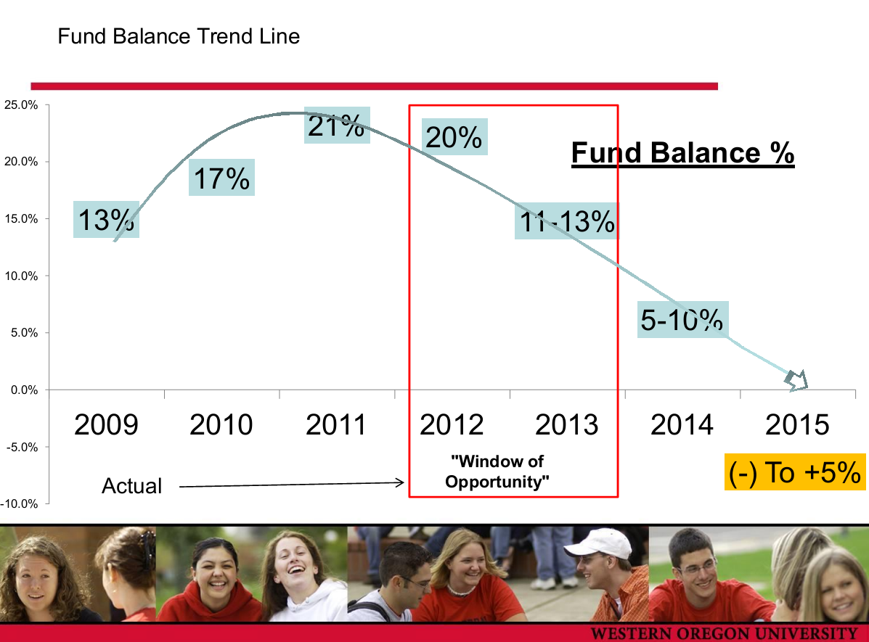

Slide 4
Fiscal Goal for WOU
As a university, create through new and sustained revenues or reduced expenses:
2013-14: $1.5 Million annually
2014-15: $1.5 Million annually in addition to the first $1.5 Million
The entire university will contribute to meeting this fiscal goal.

Slide 5
Purpose
Created in September 2012 by Provost Neely. Charged with review of original ideas posed by Provost Neely and identify new ideas generated by the committee.
    Increase revenue streams
    Increase capacity
    Reduce cost of delivery
    Modify academic programs
    End delivery of academic programs
Review and implementation of ideas will follow established campus process including Faculty Senate committees.

Slide 6
Academic Affairs Principle
In a time of significant financial strain, WOU
Academic Affairs will remain fully committed to
the institutional mission and will acknowledge and
support:
  Our dedicated/conscientious faculty and staff
  Our record of achieving effective student learning, especially among first-generation and underrepresented populations

Slide 7
Academic Affairs Principle
(Continued)
and now will rededicate ourselves to reconfigure
practices to be as effective as we have been and yet more
efficient.
  We all will look for opportunities for change
  We all will be committed to act to make change occur
  We all will celebrate our collective successes and encourage others’ efforts

Slide 8
SPOC Membership
Name | Organization/Group | Role
Farmer, Jonathan | ASWOU President | Student
France, Nancy | Registrar | Registrar
Hautala, Bob | Health and PE (COE) | Faculty Senate (alternate)
Keulks, Gavin | Literature (LAS) | Faculty Senate
Landreth, Jessica | ASWOU Exec Member | Student (alternate)
LeJeune, Marie | Teacher Education (COE) | Graduate Committee
McDonald, David | Associate Provost | Chair of SPOC
Palmer, Tina | Study Abroad/Advising | Staff to SPOC
Scheck, Steve | Liberal Arts and Sciences | Dean
Shannon, Tad | Theatre/Dance (LAS) | Curriculum Committee
Smiles, Tracy | Teacher Education (COE) | Graduate Committee (alternate)
Rosselli, Hilda | Education | Dean
Yahnke, Eric | Budget and Payroll Director | Budget
LeRoy, JoNan | Division Extended Programs | Ex-officio (distance education)
Stonecipher, Linda | Graduate Studies Director | Ex-officio (graduate programs)
Vickers, Bruce | Senior Research Analyst | Ex-officio (data and research)

Slide 9

SPOC Process
Committee held weekly meetings (initial report due 12/12/11)
  Sharing and use of WOU Mission Statement as a guide for discussion and committee work
  Reliance on data to make informed decisions
  On-going process
    Need to receive and review ideas generated from WOU community
    Continued campus-wide input of ideas

Slide 10
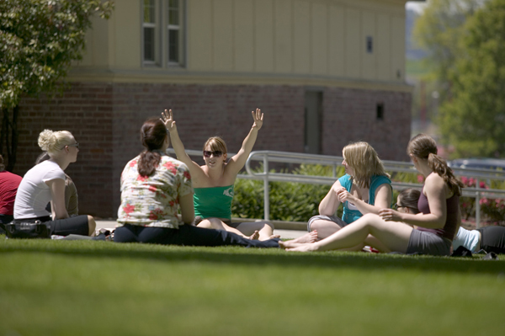
Examples of New Revenue Ideas
MA in Interpreting Studies—adding 2nd cohort and increasing tuition to market rates
Non-credit health care initiatives such as the medical interpreting with Salem Hospital
Applied Baccalaureate Programs
Increased offering of new online courses to new markets and summer session

Slide 11
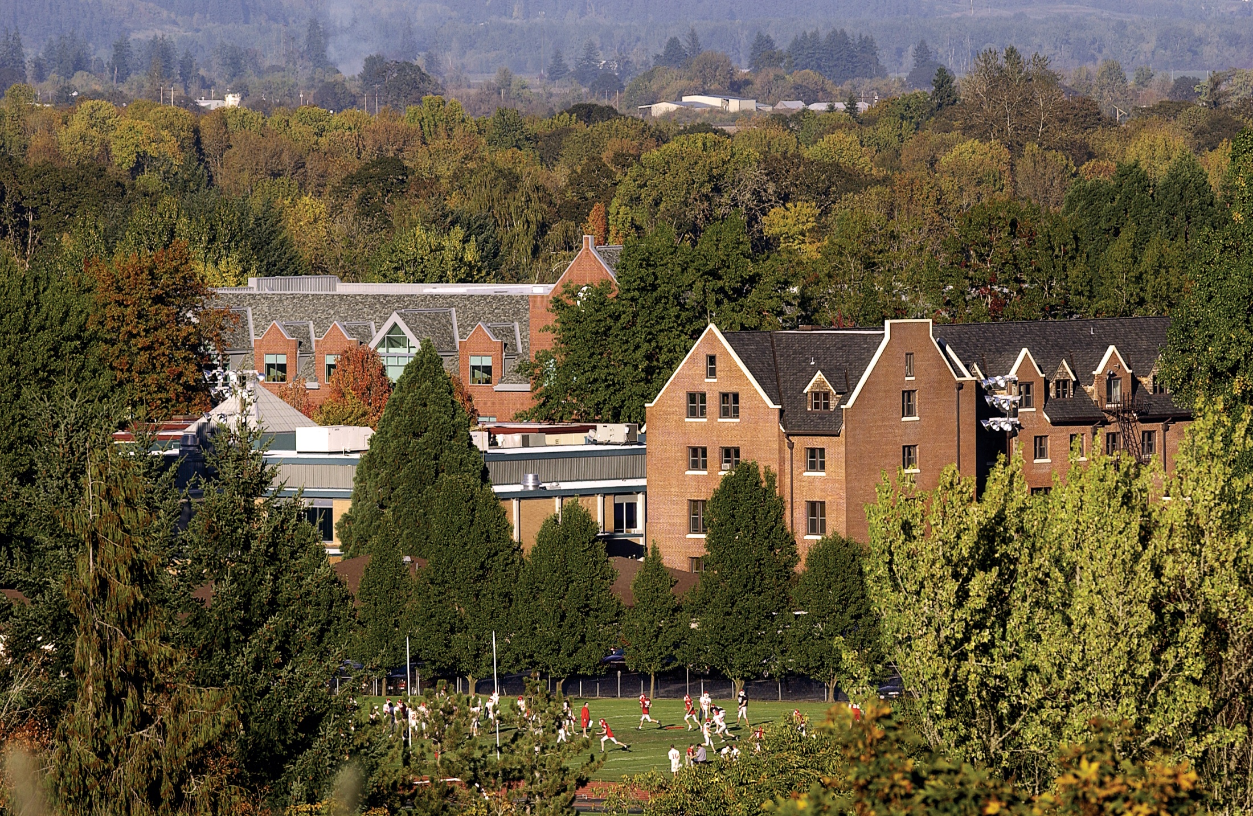
Examples of Cost Saving Ideas
Reduced number of routine enrollment forms
Reduction of electives and teaching assignments
Decrease of S&S expenses

Slide 12
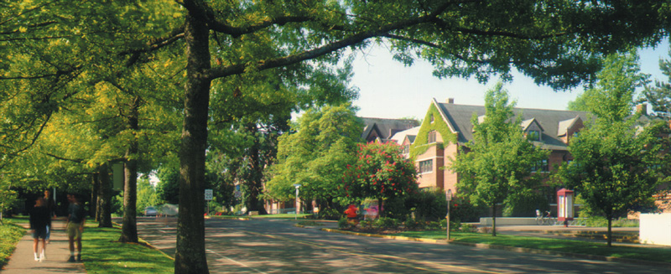
Examples of Efficiency Improvement Ideas
Streamline articulation of transfer credits such as the Diversity courses
Streamline and automate course substitution process
Improve the Registration Holds process

Slide 13


Role of President’s Staff
Review and prioritize all campus ideas to meet fiscal objectives.
Coordinate campus-wide efforts to maximize effectiveness and efficiency of process
Keep scorecard to monitor campus progress towards fiscal goals

Slide 14
Campus Input and Ideas
Faculty Senate and faculty representatives in SPOC
Meetings
  Faculty Senate
  Campus Conversation 2/23 at 3:30 in Columbia Room
SPOC Website
  Anonymous
  Linked to Faculty Senate web page
  Ideas/comments will be distributed to appropriate campus work groups
Your input and ideas are critical

Slide 15
Next Steps for SPOC
Committee will meet every two weeks until work is completed or until committee is dissolved by Provost
Initial report reviewed and endorsed by President’s Staff
Presentation to Faculty Senate and academic divisions
Campus-conversations
Continued gathering and refinement of ideas
**Implementation of feasible ideas will be by appropriate campus process and entities, not SPOC**

Slide 16



Additional Resources
WOU Office of President web page
  Contemplations and Musings
  http://www.wou.edu/president/contemplation.php
Education Advisory Board (EAB)
  Resource and source of demonstrated best practices across the country. WOU membership entitles all WOU employees to have full access to reports and studies
  http://www.educationadvisoryboard.com/

