Slide 1
Tobacco-free Wou Fall 2015
Savannah Phillips
Mackenzie Lafferty
Elizabeth Perez
Stephanie Delker

Slide 2
Who we are
Seniors
Community Health Education Majors
Program planning course
Community and Family Health Organization

Slide 3
introduction
Hundreds of individuals on campus
currently use tobacco products
despite well-known adverse health effects.
Tobacco claims more lives in the U.S then HIV, illegal drugs, alcohol, motor vehicle injuries, suicides and murders combined. (healthypeople.gov)

Slide 4

The average smoker in the U.S will smoke roughly 51,000 cigarettes in their lifetime… (cdc.gov)
That is enough smoke polluted air to fill 300 latex balloons.

Slide 5
As of 2015 nationwide…
1,514 campuses are smoke-free
2/3 of which are fully tobacco-free
(no-smoke.org)
In 2012…
OSU became smoke-free
AND U of O became tobacco-free

Slide 6
benefits
A tobacco-free environment helps create a safer, healthier place to study and work.
Students, staff and faculty who have serious medical reactions (asthma, allergies) to smoke will not be exposed to it at school/work.
Tobacco users who want to quit may have more of a reason to do so and will feel supported at school & work.
Students, faculty & staff may be less likely to miss classes or work due to tobacco-related illnesses.
Maintenance costs go down when tobacco, smoke, matches, and cigarette butts are taken out of campus outdoor facilities.

Slide 7
Goals
Work toward creating a tobacco-free campus policy
Gain student, faculty and staff support for the tobacco-free initiative
Continue to provide education and awareness regarding a tobacco-free campus

Slide 8
campus support 2011-2014

Slide 9
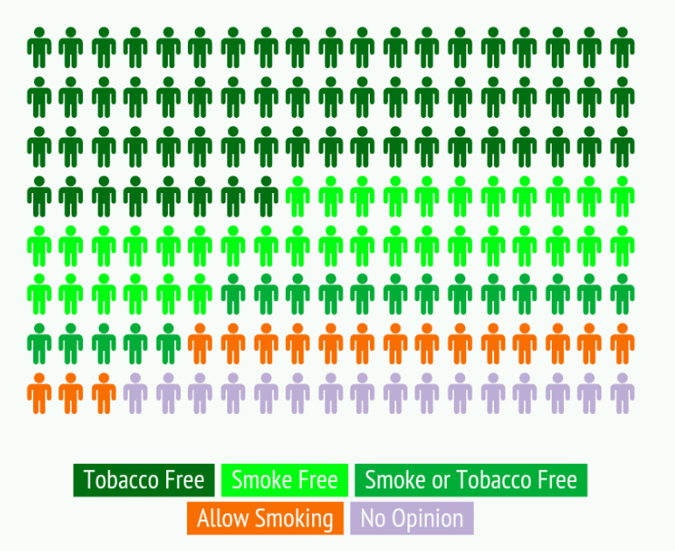
Current Campus Support
549 Respondents
79%
(Stevenson, M. Tobacco Prevention and Education Program Coordinator)
11%
10%

Slide 10
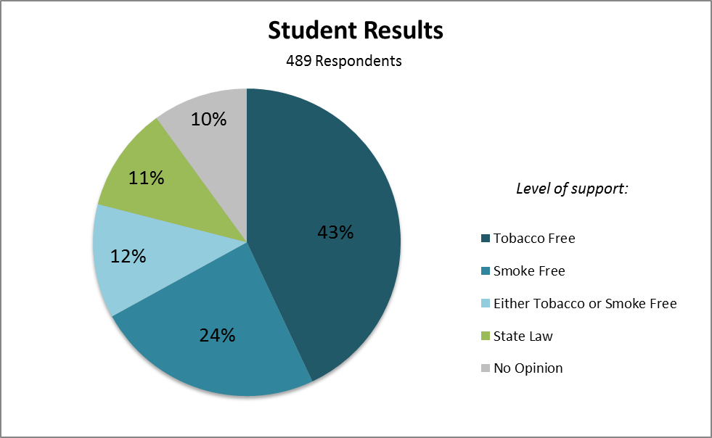
Current Student Support

Slide 11
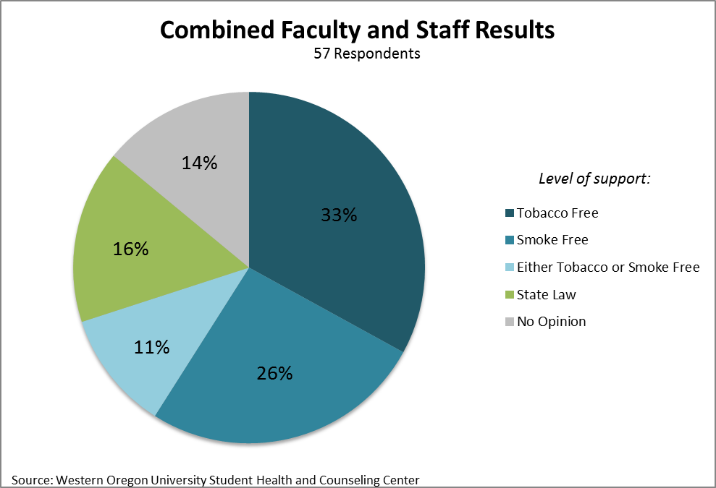
Current Faculty & Staff support

Slide 12
Current Policies
Oregon State Law
Prohibits smoking in any public building and within 10 feet of any entrance, exit, accessibility ramp, window, and ventilation intake.
Western Oregon University
Prohibits smoking in any campus owned or operated building and within 10 feet of entrances, exits, windows that open, and ventilation intakes of any owned or operated building.

Slide 13
Proposed Policy
Tobacco-free
The use of all tobacco products including cigarettes, smokeless tobacco and unregulated nicotine products will be prohibited anywhere on campus grounds.
Interior buildings
Outdoor areas
Green spaces
Sidewalks
Parking lots & Vehicles
Residential housing
Who does this apply to?
Students
Employees
Visitors
Contractors

Slide 14
enforcement
First year:
Policy enforced for faculty and staff
Educational awareness for students
Social norm changes
Information cards
Starting the second year: Non-compliant faculty & staff Supervisor
Non-compliant students Student Counsel
Non-compliant visitors Public safety

Slide 15
Previous Concerns
What will happen to current smoking areas?
Doesn’t this infringe on rights to use tobacco?
Will a tobacco-free campus affect student enrollment?
Does the initiative have a plan to address culturally diverse student concerns?

Slide 16
Future steps…
Winter 2015 Campus awareness and education
Gain support
Spring 2015 Present to Presidential Board
Prepare educational material & campus notices
Fall 2015 Policy enactment
Policy enforcement for employees
Fall 2015-2016 Student education
Begin enforcement
Resources:
Faculty HR benefits
Support groups
Medical assistance
Free “quit packs”
Website

Slide 17
Tobacco-Free wou

Slide 18
References
Cigarette Consumption Per Capita. (n.d.). Retrieved from The Tobacco Atlas website: http://www.tobaccoatlas.org/products/cigarette_consumption/annual_cigare tte_consumption/
Colleges and Universities. (n.d.). Retrieved February 26, 2015, from http://no smoke.org/goingsmokefree.php?id=447
Current Cigarette Smoking Among Adults in the United States. (2015, January 23). Retrieved March 2, 2015, from http://www.cdc.gov/tobacco/data_statistics/fact_sheets/adult_data/cig_smoking/
The Cigarette is a Major Source of Pollution. (n.d.). Retrieved 2011, from Tobacco Smoke: Scientific Information about Exposure website:http://tobaccosmoke.exposurescience.org/abcs-of-shs/the-cigarette-is-a- major- source-of-pollution
Human Resources. (n.d.). Retrieved March 03, 2015, from https://www.wou.edu/admin/hr/benefitsoverview.php
Oregon. (n.d.). Retrieved March 03, 2015, from http://www.no- smoke.org/goingsmokefree.php?id=160.
Stevenson, M. (n.d.). Infographic: 2015: What Should WOU's Tobacco Policy Be? | Infogram. Retrieved from https://infogr.am/2015_what_should_wous_tobacco_policy_be
Smoke-free OSU. (n.d.). Retrieved March 03, 2015, from http://oregonstate.edu/smokefree/
Tobacco. (n.d.). Retrieved March 03, 2015, from https://www.healthypeople.gov/2020/leading- health-indicators/2020-lhi-topics/Tobacco
UO becomes a smoke- and tobacco-free university Sept. 1. (n.d.). Retrieved March 03, 2015, from http://uonews.uoregon.edu/archive/news-release/2012/8/uo-becomes-smoke- and-tobacco-free-university-sept-1
WOU Policies & Procedures. (n.d.). Retrieved March 03, 2015, from http://ezproxy.wou.edu:6177/pls/wou2/policy.woupolicy.main

Slide 19
Questions???

