Slide 1
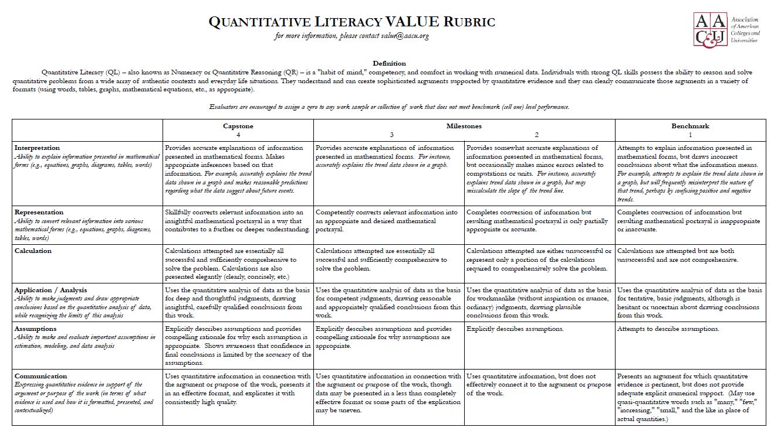
(Q) Quantitative Literacy
Course Designation

Slide 2
Quantitative Literacy (QL) is a 'habit of mind' competency, and comfort in working with numerical data. Individuals with strong QL skills possess the ability to reason and solve quantitative problems from a wide array of contexts. They understand and can create sophisticated arguments supported by quantitative evidence and they can clearly communicate those arguments in a variety of formats (using words, tables, graphs, mathematical equations, algorithms, etc., as appropriate). (adapted from AACU)

Slide 3
Key Changes in Language:
Old: The goal of Quantitative Literacy (Q) courses at WOU is to expose students
to the wide range of applications of mathematics and/or statistics in various
disciplines
New: The goal of Quantitative Literacy (Q) courses at WOU is to expose students
to the wide range of applications of quantitative literacy in various
disciplines

Slide 4
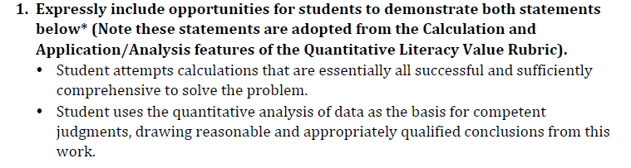
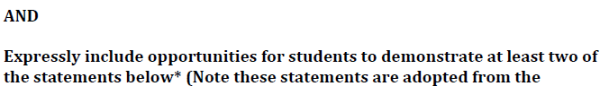
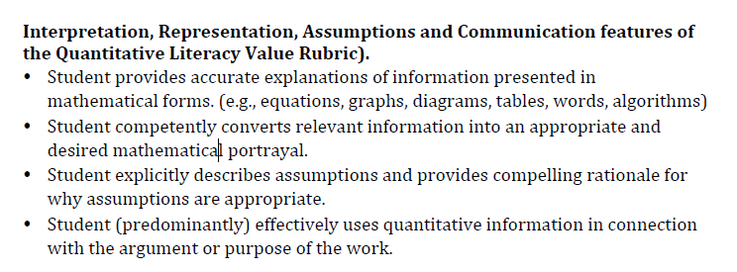

Slide 6
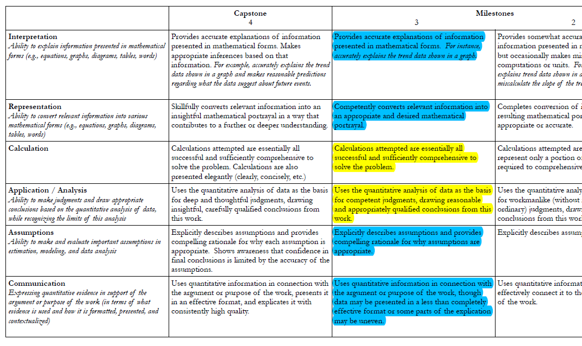

Slide 7
