Slide 1
Leap and gen ed
ASFC recommendation to the provost
And informational item to faculty senate

Slide 2
How did we get here?

Slide 3
How does this improve institutional effectiveness?
Initiate (or continue) Department conversations about Gen Ed course offerings
Provide information to Gen Ed Committee to help fulfill their charge
Identify LEAP outcomes aligned to Gen Ed
Define Q, W, D, and LACC designations
Inform work of WOU Team attending AAC&U General Education and Assessment Institute (Boston University, June ’16)

Slide 4
Preliminary Data Collection: by June 1, 2016
Do you have an assignment that gives students an opportunity to demonstrate achievement of any one of the LEAP Value rubrics in your General Education Course?
Courses with multiple sections may decide on a common assignment, if deemed appropriate by the department
Indicate how the assignment matches one LEAP rubric
LEAP rubric
Feature
Levels of competency that represent acceptable performance
Who is a contact person for follow-up?
Could be a course instructor, coordinator, department head

Slide 5
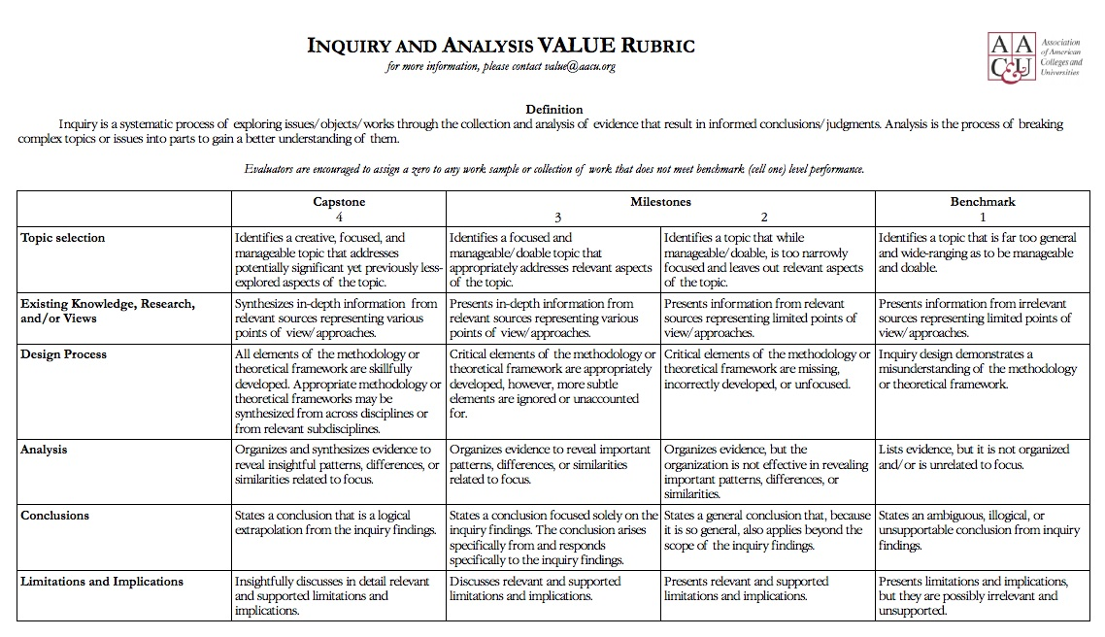
Biology 101, 102, 103
Lab writeup
Inquiry – Analysis (3) Conclusions (2) Limitations (1)
Contact: Erin Baumgartner, 100 series coordinator

Slide 6
What if I want help?
Access learning outcomes and value rubrics online:
http://www.wou.edu/las/files/2015/05/WOUs-Undergraduate-Learning-Outcomes.pdf
http://www.wou.edu/cai/files/2016/All_Rubrics-LEAP.pdf
Campus Conversations
Center for Academic Innovation
Assessment Facilitation Steering Committee
Erin Baumgartner (LAS/Chair)
Paul Disney (LAS/Vice-Chair)
Susanne Monahan (Dean/LAS)
Mark Girod (Dean, COE)
Dan Clark (CAI)
Adry Clark (SLCD)
Gay Timken (COE)
Carol Harding (LAS)
Alicia Wenzel (COE)
Stephanie Hoover (LAS)

