Slide 1
Supporting First-Generation, Low-Income Students through Graduation
Observations from the Student Enrichment Program

Slide 2

Today
5 minutes of SEP Info
5 minutes of Discussion, with opportunity for more after the meeting wraps

Slide 3
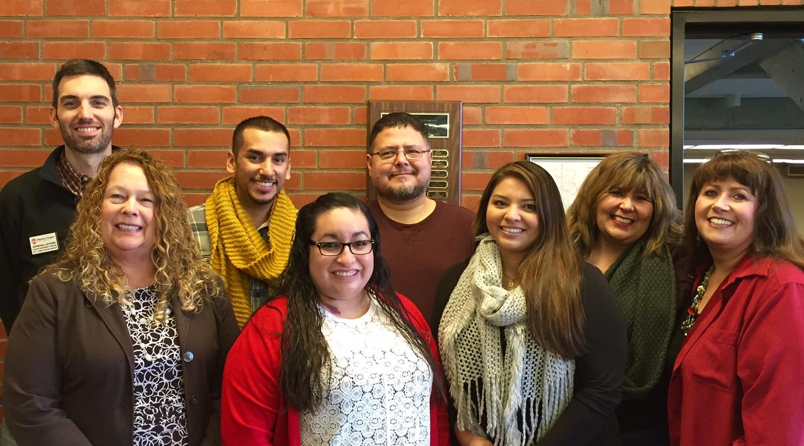
SEP: A Quick Overview
Serve students who are First-Gen, Low-Income, or have Disabilities
8 FTE: Advisors, Instructors, and Support Staff
Approximately 50% Funded by a Federal TRIO Grant
APSC 201, Ground Level by Honors
Left to Right: Marshall Guthrie, Beth Doughman, Emmanuel Macias, Adriana Carrillo, Chris Solario, Alicia Monrroy, Sheree Solario, Letitia Erckenbrack

Slide 4

SEP Core Services
General Advising
Credit-Bearing Coursework (Transition, Study Skills, Financial Literacy)
Textbook/Equipment Lending Resources

Slide 5
Coursework: The SEP First Year Experience
The Reason:
More Complete and Timely Information
Consistent Scheduling
The Plan:
120 students, 3 terms/1 year, Low-Cost/Open Source Textbooks
Potential overlap for faculty:
In 2 years: Is this a model that could/should be institution-wide?
Assist with text development

Slide 6
Micro-Assessments and Pre/Post
Textbooks: Most commonly purchased online (62%), 45% have not purchased a required book.
Technology: 14% lack 24-hour access to computing resources, 8% don’t have a smartphone
Social Media: 82% use Facebook 1/week, 40% FB is the Social Network they use most often

Slide 7

Discussion Points
What are faculty seeing?
What role should all of us, the institution and community, be playing in students lives?
What can SEP do for you?

