Slide 1
Career Mentoring Program
Annie Friedman
Mentoring Program Coordinator

Slide 2
What is it?
SB 860 – a grant-funded project managed by the Higher Education Coordinating Commission (HECC), awarded Jan. 2016
Designed to align advising, career services and alumni relations – focus on underrepresented students
The Career Mentoring Program connects current students with alumni mentors to help them prepare for life after WOU by developing career readiness through:
Exploration
Skill building
Networking

Slide 3
By the numbers
Needs assessment
72% interested in meeting with a WOU graduate in a career that interests them
42% one time per month
78.3% face-to-face, 1-on-1, 69% email, 45% texting
Fall term
86 students
19 alumni
Winter term
30 students
64 alumni in the mentor database

Slide 4
Pilots
FALL
Classroom
Student Enrichment Program First-Year experience class
In-person networking events
World After WOU
Public Service Career Connect
Group (in-person and virtually)
BA 484: International Management
WINTER
Formal one-on-one program
BA 474: Business Leadership
Classroom
Student Enrichment Program First-Year Experience class
In-person networking event – March 2
SPRING
Formal one-on-one program
Classroom
In-person networking event

Slide 5
Program goals
Expose students to mentoring that provides career development information and resources in order to support their exploration of futures beyond graduation
Help students develop networking skills and build professional networks in order to effectively pursue their career goals

Slide 6
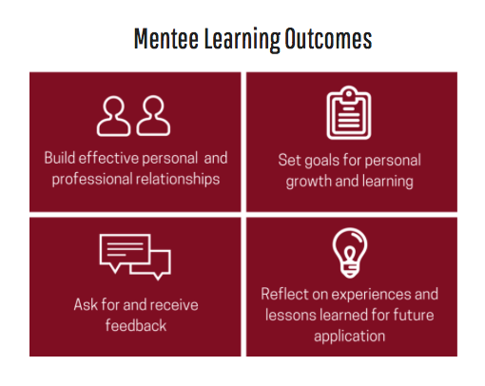
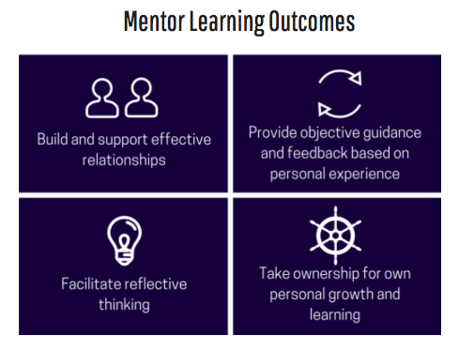
Learning Outcomes

Slide 7
How can you help?
Share ideas and feedback
Recommend alumni
Promote to students

Slide 8
Thank You!
Questions, Ideas, Feedback –
friedmana@wou.edu
503-838-8304

