Slide 1
Organizational Leadership Program
Western Oregon University Leadership Consortium

Slide 2
Need for Organizational Leadership
Companies see the need for leadership at all levels, in all geographies, and across all functional areas.
This continuous need for new and better leaders has accelerated.
  In a world where knowledge doubles every year and skills have a half-life of 2.5 to 5 years, leaders need constant development.
  This ongoing need to develop leaders is also driven by
    the changing expectations of the workforce
    the evolving challenges businesses are facing, including two major themes underlying this year’s trends:
      globalization
      the speed and extent of technological change and innovation.

Slide 3
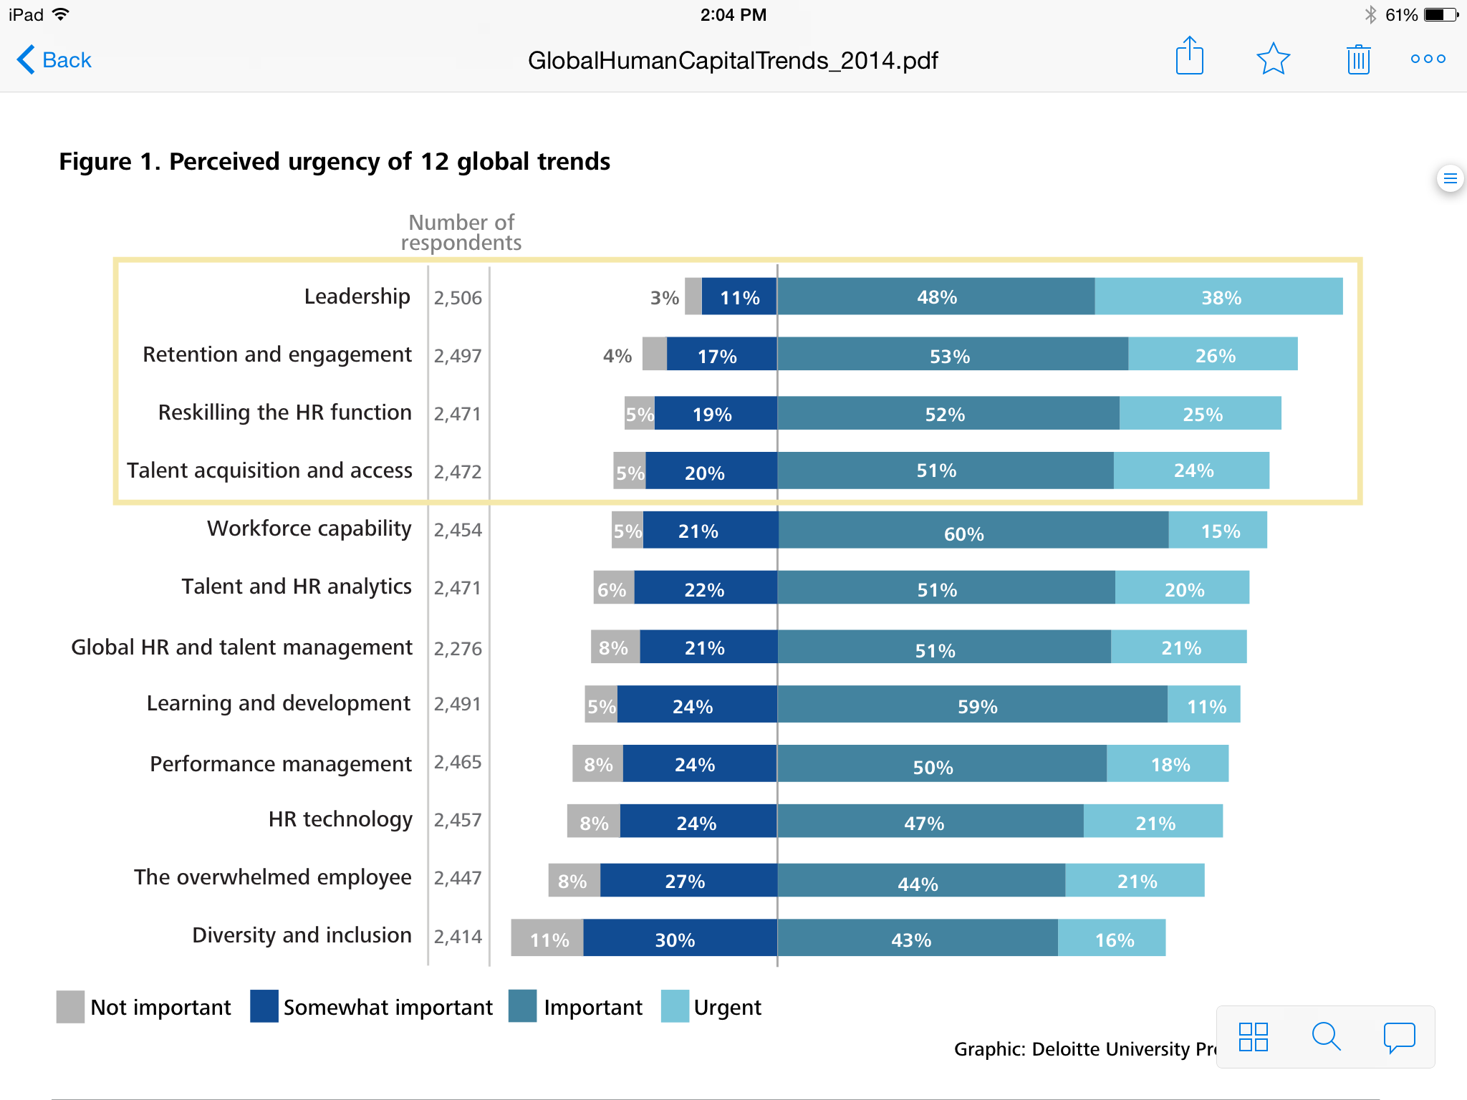
Need for Organizational Leadership
Companies surveyed indicated that leadership was their most urgent need.

Slide 4
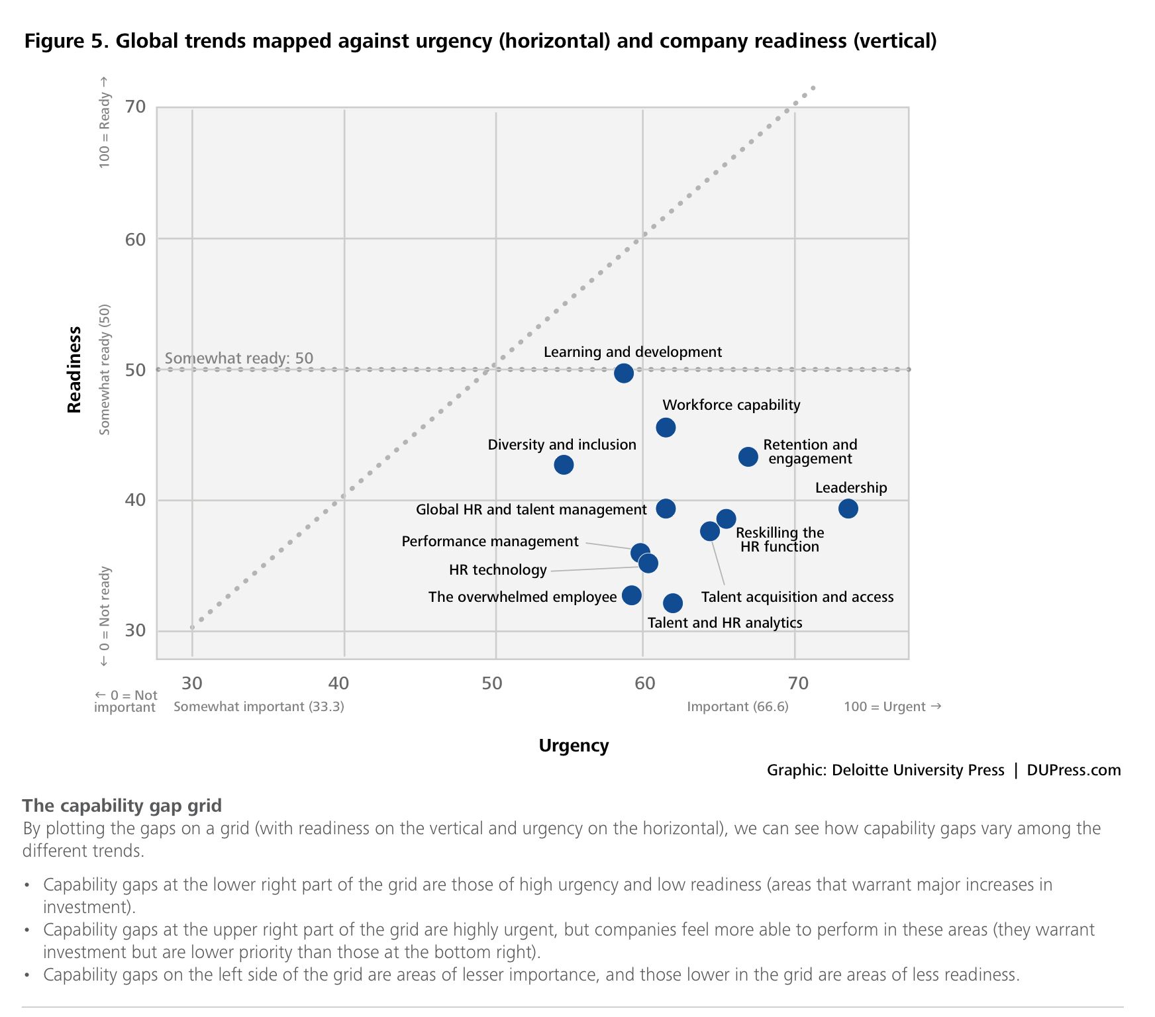
Need for Organizational Leadership
Companies surveyed indicated that leadership was their most urgent need.
At the same time, companies indicated a lack of readiness to meet this need.

Slide 5
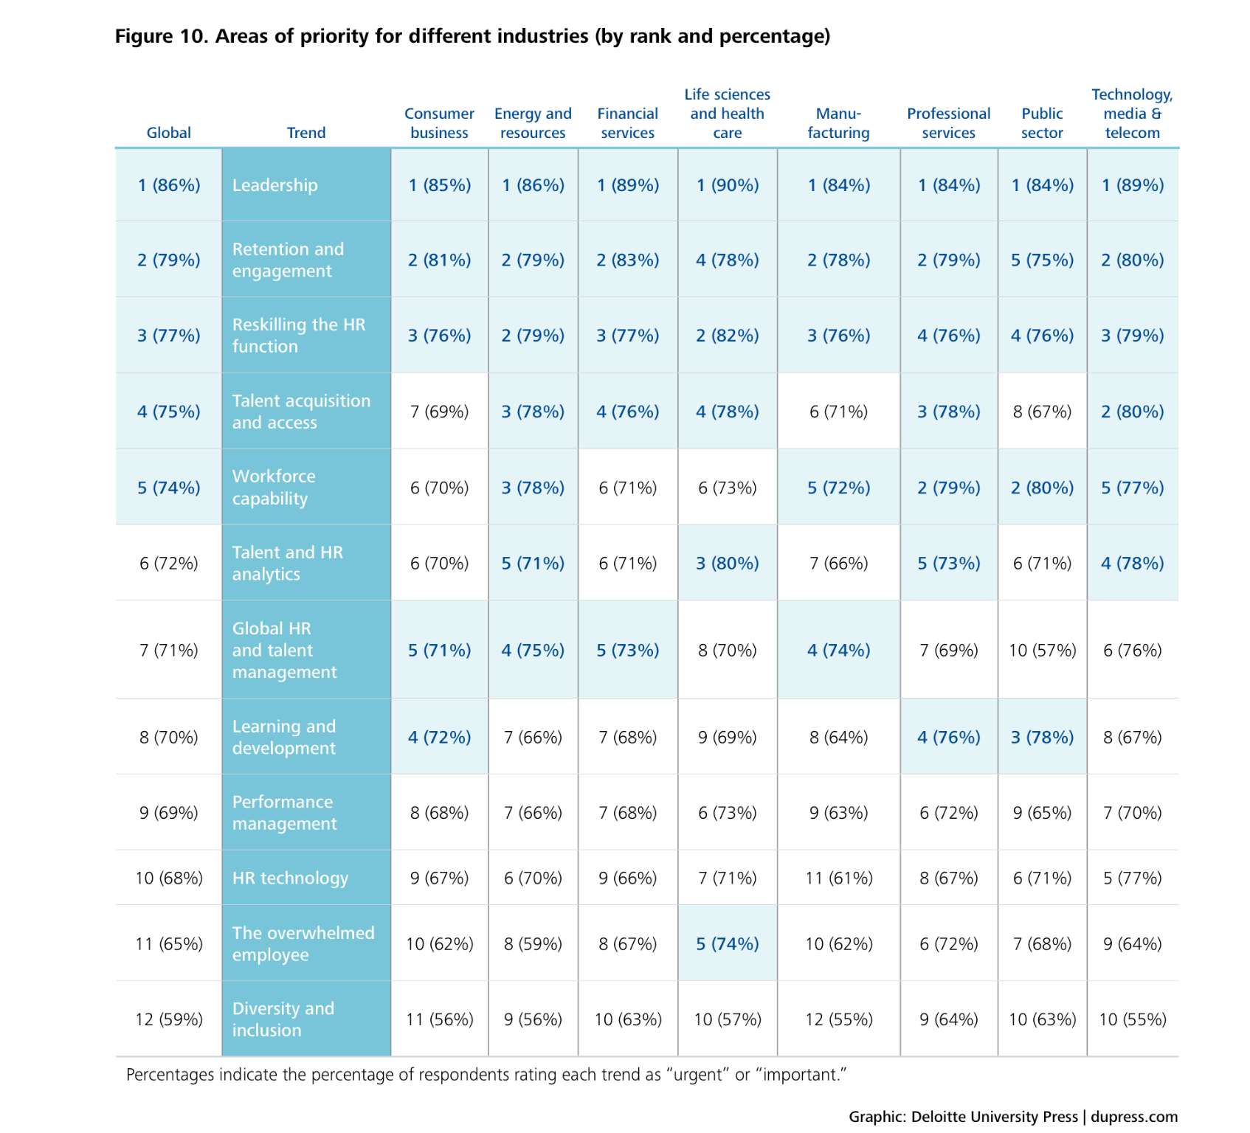
Developmental Priorities

Slide 6
Organizational Leadership Program
Terminate with UG OL Certificate
3 years or more professional work experience
Bachelors degree
+ 5-7 years or more professional work experience
Operational Leadership Certificate
Executive Leadership Certificate
Masters Degree in Organizational Leadership
Bachelors degree
Terminate with G OL Certificate
Terminate with G EL Certificate
Notes:
Level 1 (Operational Level)
400 level classes – for entry must have at least 3 years of professional work experience (3 years is just a placeholder number).
500 level classes – for entry must have bachelors degree. Do we want to require any work experience?
Level 2 (Executive Level)
Must have completed the 500 level classes for the operational leadership certificate.
Or
Bachelors degree with at least 5-7 years experience (need Bachelors degree since Level 2 course will be 600 level.
What do we do with people who complete the 400 level classes, then get bachelor’s degree, then want to complete masters degree or level 2 (executive leadership)

Slide 7
Proposed Curriculum
Requirements (45 Credits)
Core (36 Credits)
OL 491/591 Fundamentals of Leadership (3)
OL 492/592 Building Effective Teams (3)
OL 493/593 Communication in Organizations (3)
OL 494/594 Leading Across Cultures (3)
OL 611 Ethics in Leadership (3)
OL 612 Conflict Management (3)
OL 613 Human Behavior in Organizations (3)
OL 614 Leading for Creativity and Innovation (3)
OL 615 Strategic Leadership (3)
OL 619 Leading Organizational Change and Development (3)
OL 616. Leadership Work Action Project (3)
OL 617. Leadership Work Action Project Culmination (3)
Electives (9 Credits)
OL 607 Special Topics (3)
OL 618 Advanced Leadership (3)
OL 622 Critical Thinking for Leaders (3)
OL 624 Talent Management (3)
OL 625 Executive Coaching (3)
OL 626 Leading Sustainably (3)
OL 627 Leadership: Keys to Mental and Physical Health (3)
OL 628 Leadership and Work-Family Balance (3)
Operational Leadership Certificate Requirements
Culminating Experience for Masters Degree

Slide 8
Delivery Prototype
OL 491/591
OL 492/592
OL 493/593
OL 494/594
OL 491/591
OL 492/592
OL 493/593
OL 494/594
OL 611 -
OL 619 -
OL 612
OL 615
OL 613
OL 618
OL 614
OL 607
Fall Term
Winter Term
Spring Term
Summer Term
OL 622
OL 624
OL 625
OL 628
OL 626
OL 627
OL XXX
OL XXX
OL 616/617
OL 616/617
OL 616/617
OL 616/617

Slide 9
Identified Faculty
David Foster, Ph.D (Psychological Science)
Paul Disney, MA (Business/Economics)
Nick Backus, Ph.D (Communication Studies)
Jennifer Yang MA (Business/Economics)
John Morris MA (Business/Economics)
Debi Brannan , Ph.D (Psychological Science)
Weiwei Zhang, Ph.D (CAI)
Kristin Mauro, Ph.D (AALC)
Earlene Camarillo, Ph.D (Political Science)
Bojan Ilievski, Ph.D (Business/Economics)

