Slide 1
Quantitative Literacy at WOU
Findings from the 2016-17 QL PLC

Slide 2
What is quantitative literacy?
“a 'habit of mind' competency, and comfort in working with numerical data.
Individuals with strong QL skills possess the ability to reason and solve quantitative problems from a wide array of authentic contexts and everyday life situations.
They understand and can create sophisticated arguments supported by quantitative evidence and they can clearly communicate those arguments in a variety of formats (using words, tables, graphs, mathematical equations, algorithms, etc., as appropriate)”
(American Association of Colleges & Universities)

Slide 3
Features of QL
Interpretation – Ability to explain information in mathematical forms (e.g., equations, graphs, diagrams, tables, words)
Representation – Ability to convert relevant information into various mathematical forms (e.g., equations, graphs, diagrams, tables, words)
Calculation
Application/Analysis – Ability to make judgments and draw appropriate conclusions based on the quantitative analysis of data, while recognizing the limitations of this analysis
Assumptions – Ability to make and evaluate important assumptions in estimation, modeling and data analysis
Communication – Expressing quantitative evidence in support of the argument or purpose of the work (in terms of what evidence is and how it is formatted, presented, and contextualized)

Slide 4
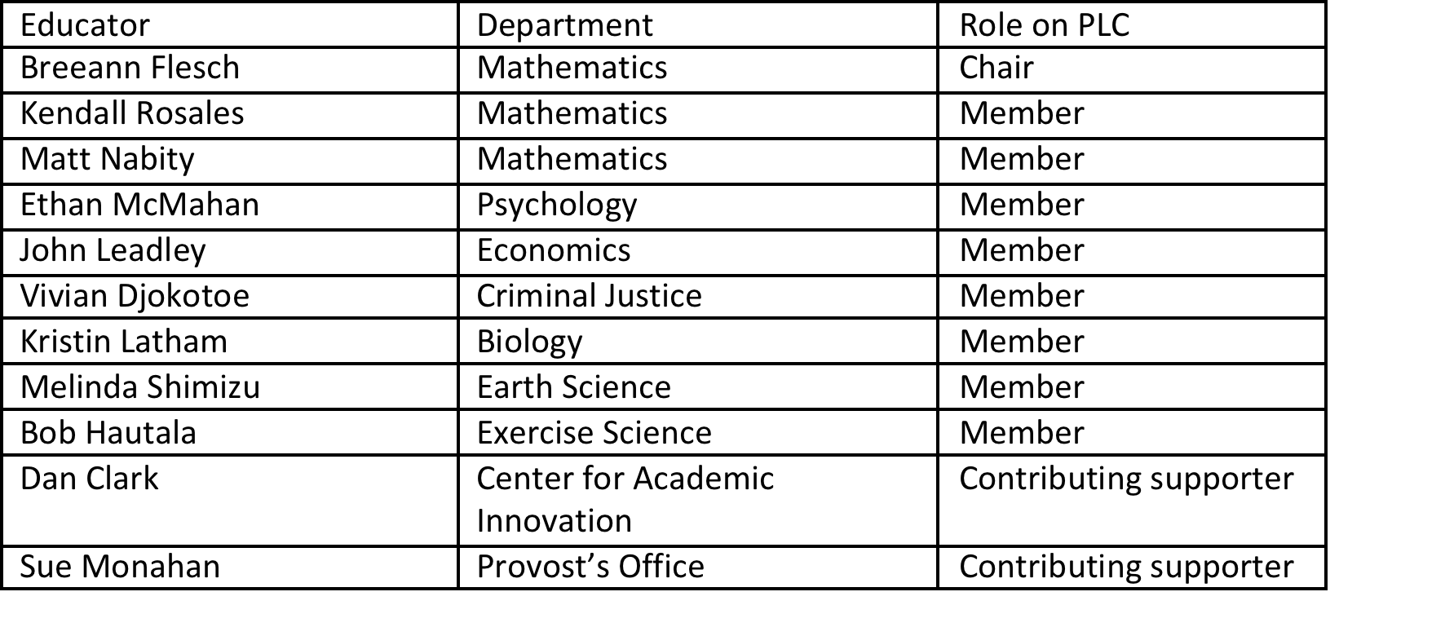
2016-17 Quantitative Literacy Professional Learning Community (PLC)

Slide 5
PLC Goals
Alignment and assessment: Examine the level of WOU undergraduate quantitative literacy by collaboratively reviewing student work in courses aligned with the Quantitative Literacy outcome. In its first consideration of our curriculum and its support of QL, the PLC considered these broad questions:
  What opportunities do we provide WOU students to demonstrate quantitative literacy and its component parts?
  What level of achievement do faculty who teach quantitative literacy courses expect of students?
  Do students meet faculty expectations?
PLC Process Design and Refinement: Pilot the PLC process for the assessment of undergraduate learning outcomes.

Slide 6
PLC Process
Identify courses and instructors (AE)
Call for assignment and student work (Chair)
Upload assignment and student work (Instructors)
Review of student work (PLC)
Discussion of non-concurrence (PLC)
Aggregation of data from reviews (AE)
Discussion and recommendations to Gen Ed, AFSC, campus(PLC)

Slide 7
Data Collection
We identified 42 QL-aligned courses that satisfy general education. We received samples from 27 of these courses. (64% course compliance)
We expected 64 student samples from instructors, and received 45. (70% instructor compliance)
We also received 3 samples from 2 different QL-aligned courses that submitted.

Slide 13
Recommendations related to PLC Process for Assessment of ULO’s
We found a process where instructors submit one assignment with one piece of typical student work, along with a report of the instructor’s expectations, to be sufficient.
In the future, it would be helpful to have instructors highlight, on the student work, the features they believe are prominent and where they are. This allows the PLC to more easily see from the perspective of the instructor.
We recommend retaining a process for “opting out” of review, when the material to be reviewed is too far outside the expertise of the reviewer for the reviewer to feel comfortable reviewing.
We found that, after reviewing and discussing some initial student work, the process of focusing discussion on assignments where there was confusion or a lack of concurrence to be a productive use of time.
The process of submitting the work electronically worked well for submitters and reviewers. Moving to electronic review of the work would facilitate data aggregation and reporting, however.

Slide 14
Recommendations related to Quantitative Literacy for the General Education Committee, the Assessment Facilitation Steering Committee and the broader WOU community
We encourage further development of high quality disciplinary courses where students have the opportunity to demonstrate quantitative literacy. The strongest examples of quantitative literacy were deeply rooted in real world examples.
More focus in QL-courses on assumptions, interpretation and communication may be warranted given the paucity of examples of assumptions in assignments and student work, and the divergence between overall WOU faculty expectations regarding Quantitative Literacy and individual instructor expectations of students.
Most Q-designated courses drew more heavily on material from MTH 243 rather MTH 111. We wonder if it might be possible to get more students taking MTH 243 and/or look to MTH 110, which has some basic statistics, for the BS requirement for some programs.

Slide 15
The End
Thank you for your time!
Questions?

