Slide 1

Doctorate of Physical Therapy
Faculty Senate Presentation
May 22, 2018

Slide 2

Background
Identified by Stamats as a high potential program (2016)
Student demand exceeds supply of available seats
Near 100% job placement for graduates
Aligned with WOU Strategic Mission

Slide 3

Key Data
2 DPT programs in Oregon (Pacific and George Fox)
  Number of qualified applicants 2016: >1,000
  Number of spaces for new students: 100
Exam pass rate
  National Average 2016: 96.3%
Job placement rate at 6 months
  National Average 2016: 99.4%
Median Oregon salary $81-85 K (depending on source)
TOGETHER WE SUCCEED

Slide 4
Graduate Headcount Enrollment
for students seeking degrees, certificates, endorsements
GR enrollment
Data: A. Deets, end of term, SZRGREN

Slide 5

Graduate Enrollment Possibilities
Doctor of Physical Therapy Program: 120-150 students
Occupational Therapy Doctorate Program: 100+ students
TOGETHER WE SUCCEED

Slide 6
WOU Undergraduate Student Fall Headcount (2012-17)

Slide 7
Undergraduate Enrollment
“Nursing Effect” creating an increase in Biology, Exercise Science, Health, and Gerontology
Possible new Health Science Major
Increase in high GPA students
Possible 2+2 agreements with LCC and MHCC
Retention pressure
Increased and changed overall academic footprint
TOGETHER WE SUCCEED

Slide 8

Aligned with WOU Strategic Plan

Slide 9
Areas of alignment
Student Success
  Campus environment that enhances learning
  Curricular innovation and accountability
Academic Excellence
  Create opportunities for undergraduate and graduate programs to include high impact activities
  Programs that demonstrate excellence
Community Engagement
  High impact practices
  Community service
  Improve connections with surrounding communities
Accountability
  Develop research capacity
  Promote a culture of evidence-based decision-making
Sustainability
  Enhance financial sustainability through enrollment
  Support new academic programs and innovative degrees
TOGETHER WE SUCCEED

Slide 10

Recent Progress

Slide 11
Campus Meetings
Faculty Senate Executive Committee
Health and Exercise Science Faculty
Biology Faculty
Behavioral Science Faculty
Graduate Studies Committee
Created Faculty Advisory Taskforce
TOGETHER WE SUCCEED

Slide 12
Faculty Advisory Taskforce
Bryan Dutton, Biology
Tom Kelly, Exercise Science
Mike LeMaster, Biology
Ethan McMahan, Behavioral Sciences
Linda Stonecipher, Graduate Studies
Rob Winningham, Behavioral Sciences
TOGETHER WE SUCCEED

Slide 13

Off-campus Meetings
George Fox University
Corvallis Clinic
Infinity Rehab
University of Missouri
Marysville University
St. Louis University
University of North Dakota
University of South Dakota
Salem Hospital
Northwest Rehabilitation Associates
TOGETHER WE SUCCEED

Slide 14

Key Positives
Enthusiastic support from faculty
Questions and suggestions about how to serve WOU undergraduates
Excitement around the added academic depth of a professional doctorate program and a 3rd college
Good dialogue about academic connections and research collaborations
Possible new undergraduate majors and enrollment
Net Revenue: $4-5M annually
TOGETHER WE
SUCCEED

Slide 15
Projected DPT Annual Net Revenues

Slide 16
Key questions
Costs
  Start-up
  Facility
  Technology support
Ability to align competitive admissions with WOU mission and students served
Salary level of DPT faculty
TOGETHER WE SUCCEED

Slide 17
Primary Concerns
Timing and ability to meet 2022 start.
  Multiple steps that require prompt action
  Grad Studies Comm. >>> FS >>> BOT >>> HECC >>> NWCCU >>> CAPTE
Interest by other universities
  Oregon Tech—Invested 200K in 2015, but current level of interest low
  OSU Cascades—Actively investigating a DPT program
  Western University (Lebanon)—Professional Hybrid Program beginning soon; possible DPT beginning as soon as 2020.
TOGETHER WE SUCCEED

Slide 18
Next Steps for 2022 Launch
Renderings of building by July 1, 2018
Complete curriculum draft by July 1, 2018
Approvals Required
    Graduate Studies Committee
    Faculty Senate
    WOU Administration
    WOU Board of Trustees
    Public Universities Provost Council
    Higher Ed Coordinating Commission (HECC)
    Northwest Commission on Colleges and Universities (NWCCU)
    Commission on Accreditation in Physical Therapy Education (CAPTE)
Secure funding
  Facility construction ~ $20-30 M
  Start-up costs
Expand external support network
TOGETHER WE SUCCEED

Slide 19
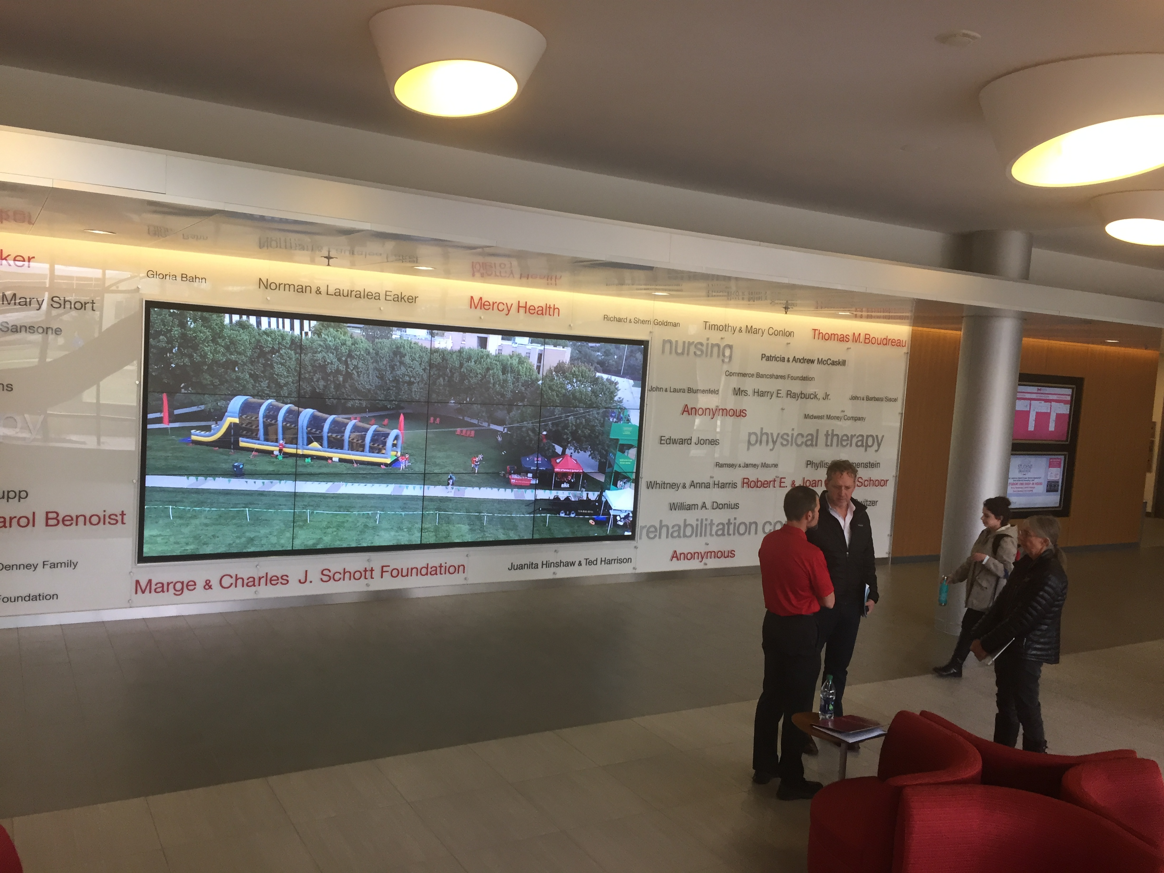
Questions and Comments
Maryville University: Walker College of Health Professions

