Slide 1
International Student Academic Support
Director, Rob Troyer
Report to Faculty Senate May 2018

Slide 2
Provost, VP Academic Affairs
Dean, COE
Dean, LAS
Dean, Library
Graduate
Programs
Assoc. Provost, Susan Monahan
INTL Ed & Dev, Neng Yang
Academic Affairs
Registrar
CAI
ROTC
Research Institute
Policing Institute
Advising
Honors
Writing Center
INTL Academic Support, Rob Troyer

Slide 3
Assoc. Provost, Susan Monahan
INTL Ed & Dev, Neng Yang
Office of International Education and Development
Director + 5 full-time staff, Maaske Hall
International Students
  Recruiting and INTL Agreement Programs
  Admissions
  Immigration
  Initial Orientation
  International Advising
  International Club, Saudi Club, Chinese Students and Scholars Association
Study Abroad
Visiting Scholars
INTL Academic Support, Rob Troyer
Office of International Student
Academic Support
Director (.5 fte) + 1 full-time staff, APS 501
Coordinate Courses
  ICS 110: First Year Exp for INTL Students
  WR 115 and 122 for INTL Students
  LING 136: Academic Discourse for INTL Students
English Tutoring Center
Conversation Partners
Educational Advising
Technology & Test Proctoring
Consultation with Faculty

Slide 4
English Tutoring Center: Reading Comprehension, Speaking, Listening, Grammar, Paraphrasing
32 hours per week (Mon-Thurs: 12-5pm APS 501, 7-10pm Library 228)
Tutors are students in the Teaching English as a Foreign Language Certificate Program

Slide 5
English Tutoring Center: Reading Comprehension, Speaking, Listening, Grammar, Paraphrasing
32 hours per week (Mon-Thurs: 12-5pm APS 501, 7-10pm Library 228)
Tutors are students in the Teaching English as a Foreign Language Certificate Program

Slide 6
Conversation Partners: Weekly informal 1-on-1 or small group conversation (once/week, apprx 1 hr)
Weeks 1-2: sign-up, Week 3: First Meeting Welcome Party
Weeks 4-Finals: weekly meetings

Slide 7
Educational Advising
Qin Ma
Primary instructor of ICS 110
Tracks INTL student academic standing
  proactively engages with struggling students
  coordinates with Student Success team
Academic advising, Registration, and Acculturation assistance
Assists with coordination and promotion of
  Conversation Partners, English Tutoring Center, Test proctoring, Technology
Listening

Slide 8
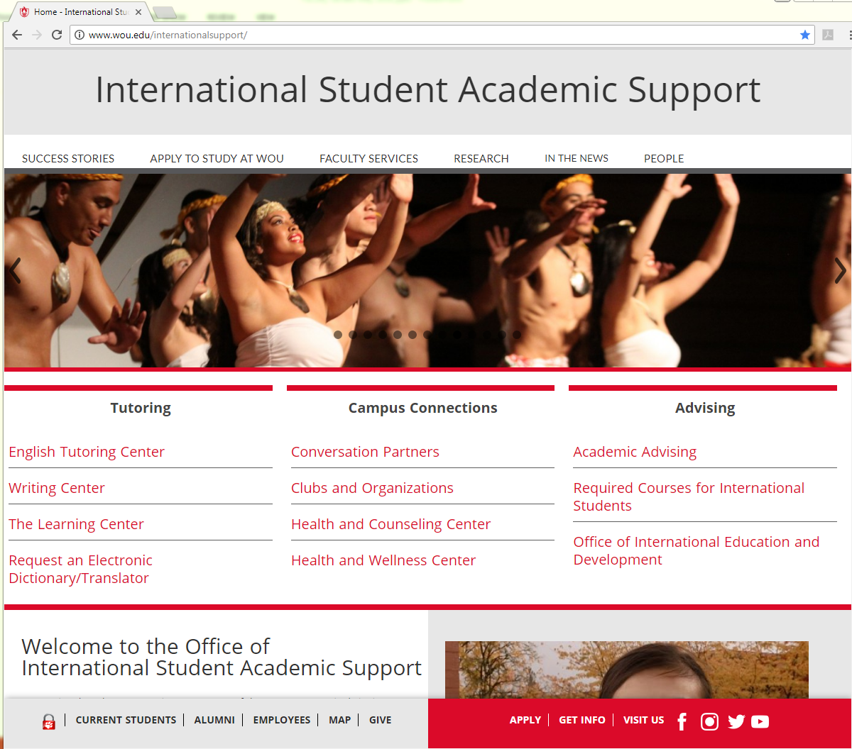
Our student services

Slide 9
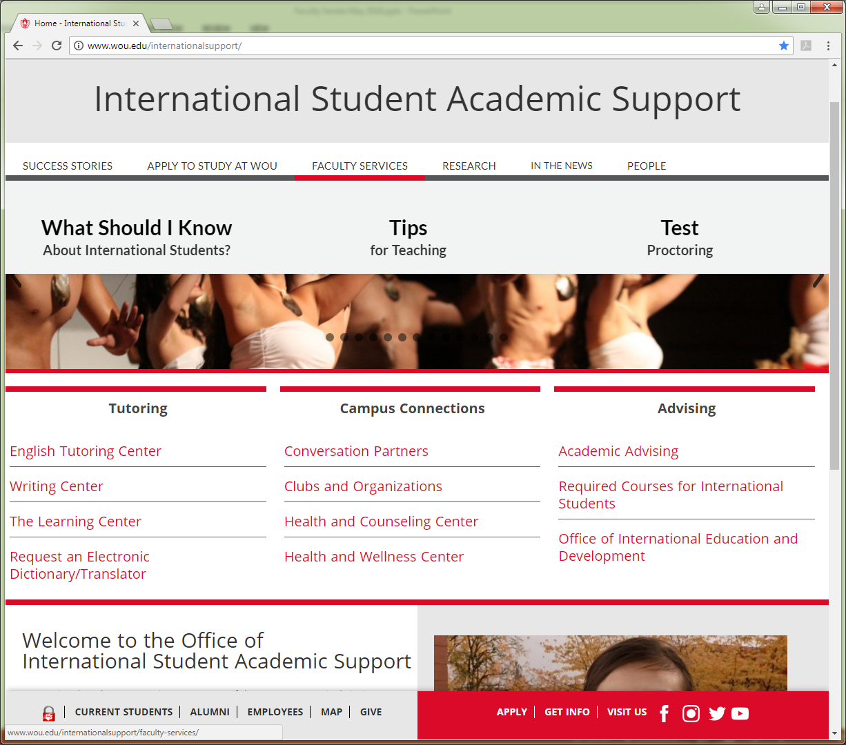

Slide 10
Technology
Electronic Dictionaries
Available for 4-hour check-out from the Library
No internet connection
No internal storage
Smartpens
Available for term check-out
Record lectures with audio synched to handwritten notes
Being replaced with mobile apps with similar functionality

Slide 11
Consultation with Faculty
Individual
Email, phone, face to face
Questions regarding language and intercultural communication
Student focus and/or Instructor focus
with Students
Facilitate meetings between instructor and one or more students
Clarification of coursework and behavioral expectations
Consultation with Students

