Slide 1
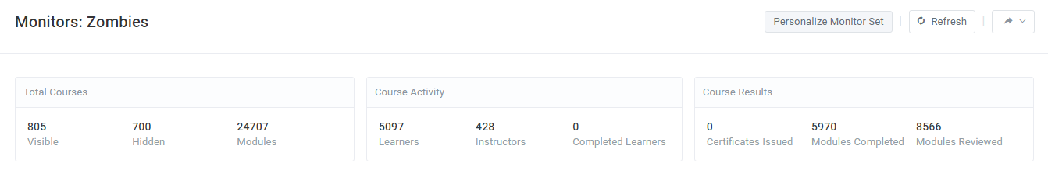
[Site monitor view 1]

Slide 2
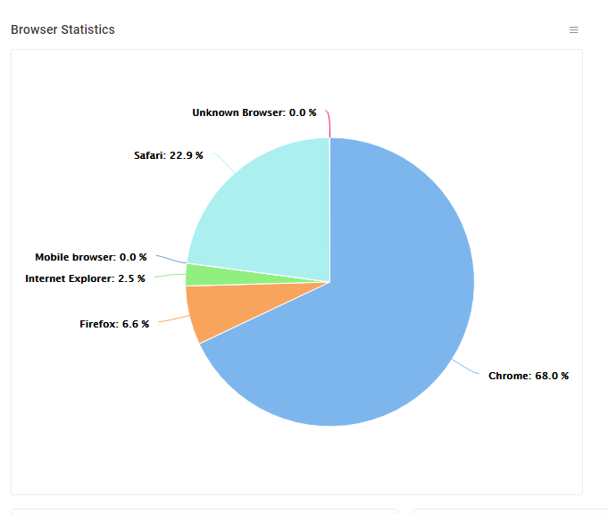
[Site monitor view 2]

Slide 3
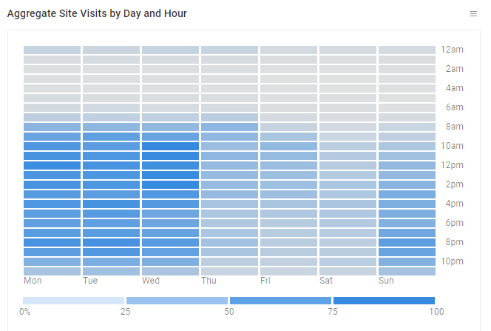
[Site monitor view 3]

Slide 4
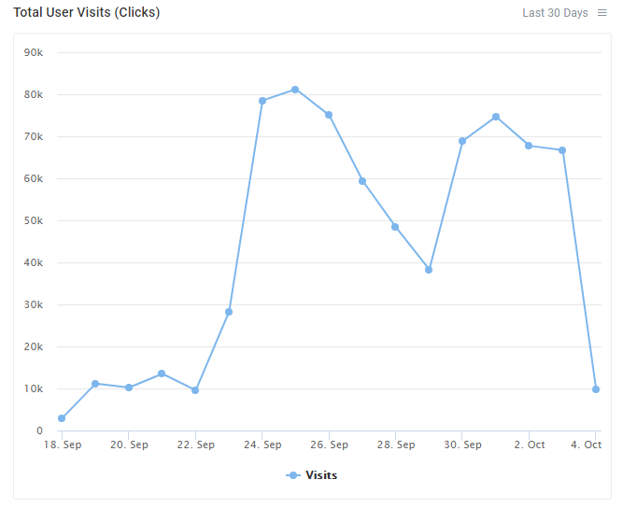
[Site monitor view 4]

Slide 5
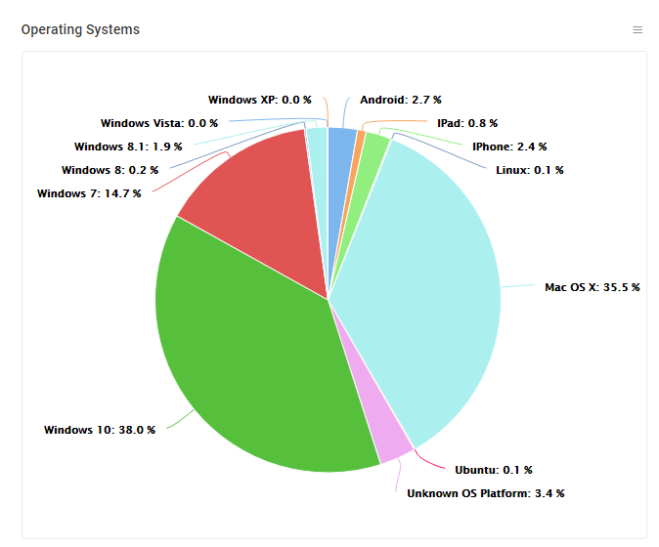
[Site monitor view 5]

Slide 6
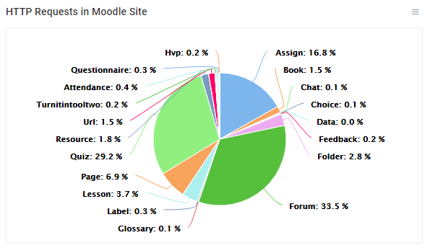
[Site monitor view 6]

Slide 7
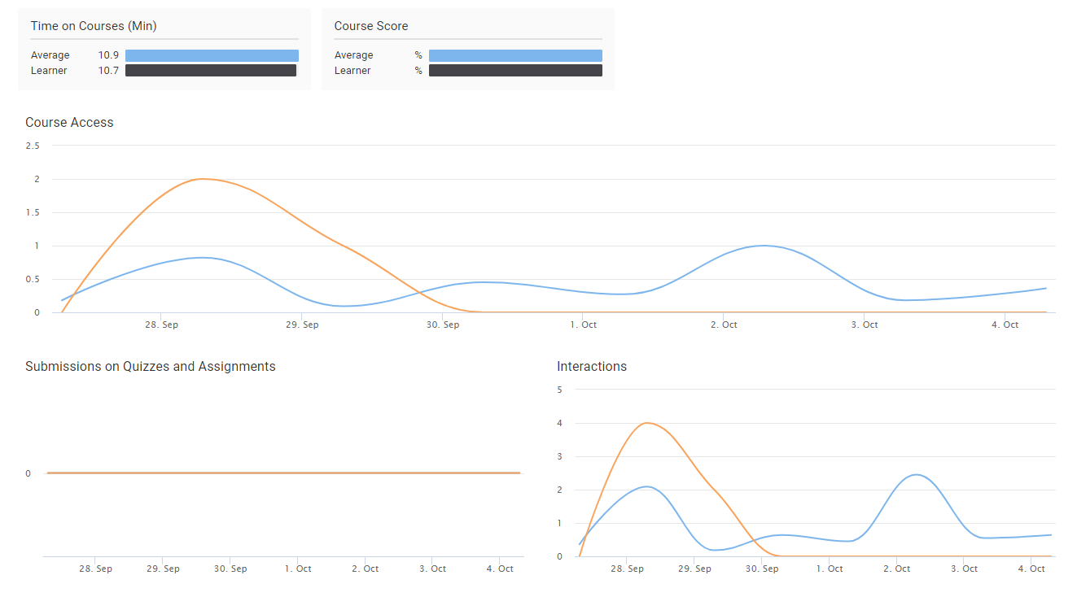
[Course level view 1]

Slide 8
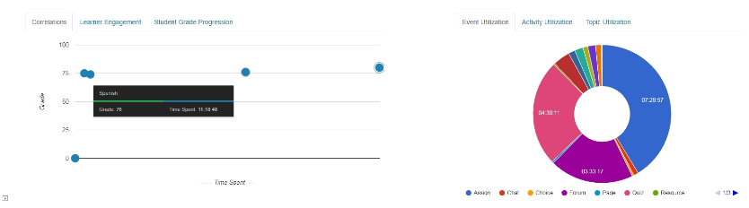
[Course level view 2]

