Slide 1

Designing an Experiential Learning Environment at WOU

Slide 2
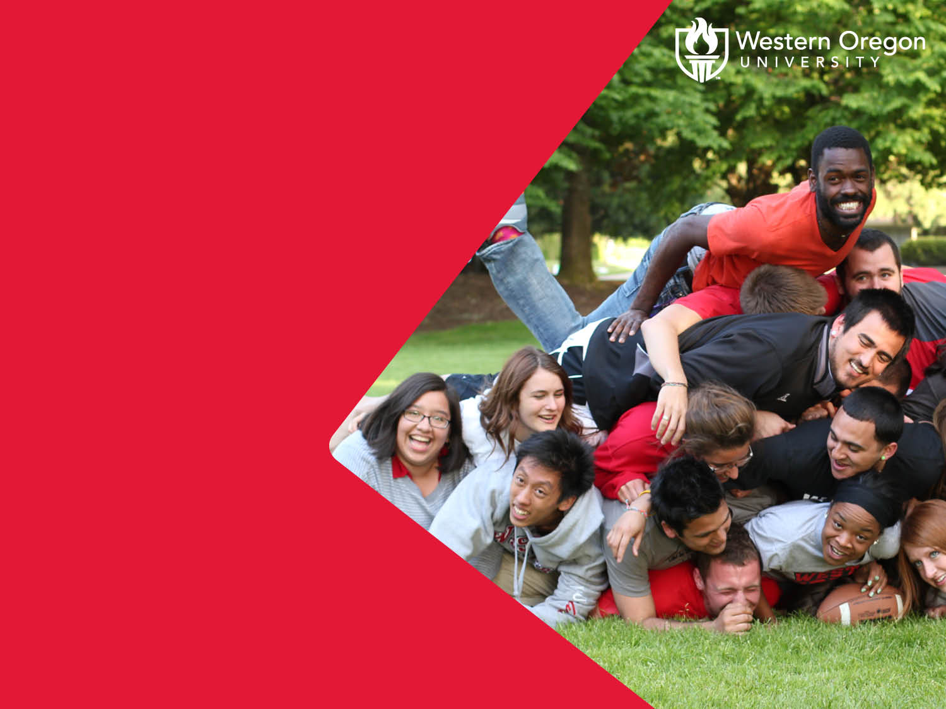
“Connecting students with communities through engagement in service, experiential learning, creative problem-solving opportunities and co-curricular collaborations.”
(Forward Together, page 2)

Slide 3
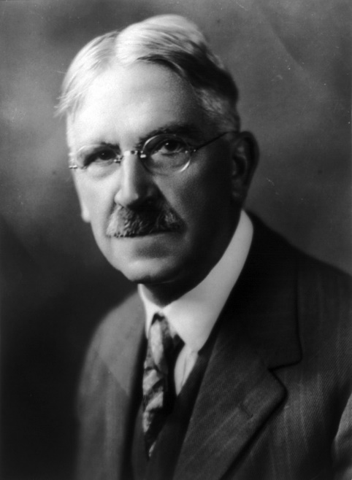
Designing Experiences
A connection between learning and active engagement in society is fundamental to democracy.
“we never educate directly, but only indirectly by means of the environment. Whether we permit chance environments to do the work, or whether we design environments for the purpose, makes a great difference”. (John Dewey , 1916)

Slide 4
Experiential Learning (el)
The best forms of experiential learning are framed by guidelines that serve all the parties involved, but that put learning first
As experiential educators we are informed and guided by a body of knowledge, research and pedagogical practices recognized by and specific to the field of experiential education, including reflection, self-authorship, assessment and evaluation, civic engagement, and the development of personal and social responsibility. (National Society for Experiential Education, Guiding Principles)
“Experiential learning is being able to demonstrate the intentionality in the way a student approaches the experience, how they learn by meeting objectives, document, describe what they would do different next time, and formally work through all the processes they are presented (Patrick Clarke, SUU)

Slide 5
Strategic Initiative
WOU’s mission is clear in its commitment to personalized and transformative learning; experiential learning epitomizes this mission
All pillars in the strategic plan support the creation of an EL program, but the most prominent are
Community Engagement (1.1 – 1.3, 2.1 – 2.6)
Student Success (1.1 – 1.3, 3.1 – 3.3, 4.4)
Academic Excellence (1.2, 2.2, 2.4, 4.3, 4.4, 4.5, 5.1-5.4).

Slide 6
Current el practices at WOU
Great examples, but sporadic
Uneven student access and benefit
Students vary in their preparation and social capital that informs their ability to seek out and engage in EL.
Our programs vary in diversity and availability of offerings
To design an equitable, accessible and optimum environment for WOU students, our community needs to band together, informed by best practice and training to thoughtfully build our EL capacity together

Slide 7
The Time is right – Expressed interest
A recent survey revealed
High level of interest in employing experiential learning pedagogy and practices
Large gaps in knowledge and shared understanding about what kinds of experiences and environments constitute EL
Faculty also reported lacking time and know-how when it comes to aspects of EL, such as creating community connections, pedagogy, and logistics
Faculty reported wanting training, resources and support.

Slide 8
The Time is Right – initiatives underway
Strategic Action Team
Current members faculty and staff (David Foster, Ava Howard, Adry Clark, Kathryn Plummer, Maureen Dolan, Lars Soderlund, Ermie Buncal)
General Education
First Year Experience Courses
Upper division
Integrative Learning PLC
Center for Academic Excellence
Focus on capacity building and pedagogy
Focus on community engagement

Slide 9
Planned steps
Strategic Action Team on Experiential Learning meets to coordinate trainings and conversations, beginning October, 2018 (formerly ad hoc group of enthusiasts)
Receive administrative backing and funding to bring experts to WOU for training and consultation to inform campus wide conversations and planning, November 30, 2018
Design conversations, showcases and workshops to develop initiatives and programs, Winter and Spring terms, 2019.
Send a small group of faculty and staff to an Experiential Learning Leadership Institute in Utah in June, 2019
Create pilot programs for Fall, 2019 (pending budget proposal approval)

Slide 10
November 30 – EL experts on campus Dr. Patrick Clarke and Dr. Todd Peterson, SUU
9:00 Meet with Experiential Learning Strategic Action Team.
Are you interested in joining the Experiential Learning Strategic Action Team? Please complete this interest form
10:00 “Integrated Learning” Learning Outcome, PLC
10:45 Departmental Consultation. Consultants will help two pre-identified departments/programs solve EL design problems and build a road map for implementation of EL framework within their specific curricula. To nominate your department, please complete this form
1:30 General Session - EL Overview to provide the community of WOU a clear and working understanding of EL, what it is and how it benefits our students and programs.
3:30 Open workshop for individual consultation/conversation
For more information, visit wou.edu/slcd/experiential-learning

Slide 11
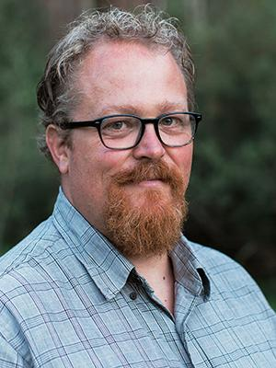
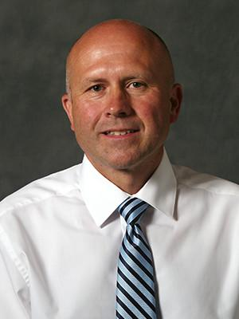
Experts from Southern Utah University Nationally recognized Experiential Learning program National Society of Experiential Education, Academy Faculty
Todd Petersen Assoc Chair/Dir, Project Based Learning; Professor, English
Specializing in experiential learning, visual narrative theory and film adaptation
Patrick Clarke Dean, Integrative and Engaged Learning; Asst Prof, Education
Founder, The Experiential Learning Leadership Institute (ELLI)

Slide 12
How you can get involved. . .
Attend November 30 training – General Overview, at 1:30 – 2:30 PM
Consider having your department be one of two to work with trainers to develop/improve an Experiential Learning related program, course(s), or activities. Examples:
Develop high impact First Year Seminar curriculum
Design project based assignments
Improve access and practices for service learning/study abroad/undergraduate research/internships
Adopt best practice for incorporating community engagement into course/program
Join the EL Strategic Action Team and meet the trainers for strategic planning – 9:00 AM
Bring a question, idea, project to drop-in workshop, 3:30-4:30 PM

Slide 13
What could an experiential learning environment look like at WOU?
What we will create as a community will be unique to WOU and our population. Here are examples from other institutions:
A “center” where students can access opportunities in a transparent fashion.
EL is integrated into the curriculum; at least one course in each program meets guidelines and is approved for an EL designation. EL course development funds and expertise available to faculty wanting to develop an EL designated course.
Faculty can incorporate service learning into a course and work with EL center staff to develop opportunities. The center staff manages contracts and logistics.
EL center helps match faculty to students interested in research

