Slide 1

RRCD (est.1973)
March 12, 2019

Slide 2

We are a nationally recognized Center.

Slide 3

Current Mission Statement
The mission of the Western Oregon University Regional Resource Center on Deafness is to prepare professionals in the Northwest to be qualified to serve the unique communication, rehabilitation, and educational needs of deaf and hard of hearing children and adults. To that end, the Center offers:
graduate and undergraduate degree programs for professionals entering fields that serve people who are deaf or hard of hearing,
continuing education opportunities for currently practicing professionals, and
consultation and community service activities designed to enhance the quality of life for all citizens who are hard of hearing or deaf.

Slide 4
Proposed Mission Statement
The RRCD supports Deaf, DeafBlind, and Hard of Hearing individuals by engaging students, professionals, and other stakeholders in innovative research, practices, training, and advocacy.

Slide 5
Name Change
Summer 2019

Slide 6

RRCD Grant Activity
Summary as of January 24, 2019
In the last 25 years, we have been awarded:
Over $23 million in US DOE grants,
Over $2 million in sub-contracts,
Over $210,000 in State of Oregon contracts,
and over $63,000 in sponsored training.

Slide 7
RRCD Grant Activity
OVER
$27,000,000
Summary as of January 24, 2019
In the last 25 years, we have received
Over $23 million in US DOE grants,
Over $2 million in sub-contracts,
Over $210,000 in State of Oregon contracts,
and over $63,000 in sponsored training

Slide 8
RRCD Grants
65%
Over $23 million in US DOE grants,
Over $2 million in sub-contracts,
Over $210,000 in State of Oregon contracts,
and over $63,000 in sponsored training.
At least 65% of the funding for the personnel preparation awards fund the students in the form of tuition fee remission and stipends.
Notes:
Emphasize that not less than 65% of the funding for the personnel preparation fund the students. We provide a percentage based upon their tuition rate. This funding supports students who may otherwise be unable to attend the university.
The vast majority of grants we get are to support students in professional preparation programs. These grants provide funding for the students to offset the cost of attending university. Even the DBI grant has funding to support students by providing student worker positions and specialized training.
4/5 current grants and most of the grants over the past decades provide funding for students.

Slide 9
Current RRCD Grants
Summary of current grants
DBI (3 of 5) • $2M ($1.2M remain)
Project Hive (1 of 5) • $1.25M ($1M remain)
RMHC ‘15 (4 of 5) • $1M ($200k remain)
RCDHHA (5 of 5) • $750k
RCE ‘14 (5 of 5) • $1M

Slide 10
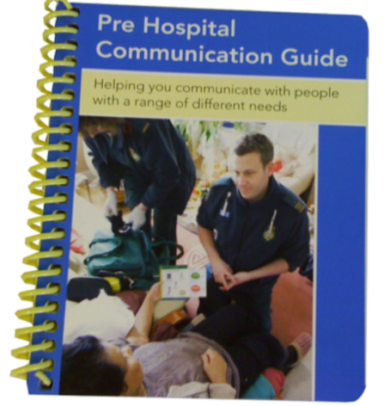
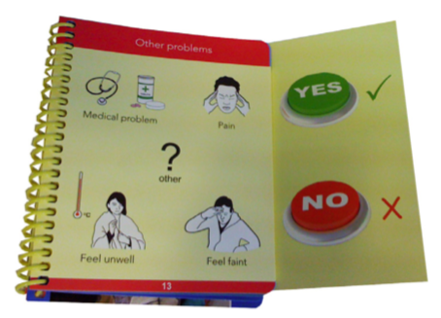

Pending RRCD Grants
Pending grant decision
FEMA (submitted 12/20/18) • $500K
Future 5 year grant proposals
RCDHHA • $750K (est.)
RCE Long Term Rehab • $1M (est.)
DHHE • $1.25M (est.)
Deaf Leadership Academy • $500K+ (est.)
National Research Deaf Suicide Prevention • $1M+ (est.)

Slide 11
Current RRCD Projects
Summary on all active RRCD projects
Refine our goal statement
Rejuvenate RRCD’s web page
Enhance RRCD’s Endowment and Foundation
Increase RRCD’s Fundraising Plan for our Endowment Fund
Seek $12K funding for ASL Language & Communication Assessment
Host 2 workshops for interpreter and ASL educators, students, and interpreters (April 2019)
Plan 3rd Biennial Deaf Interpreter Conference (DIC3) (June 2019)
Provide DBII Interpreter’s 2nd and 3rd Cohort training (July 2019)
Organize 10th Annual ASL Silent Weekend (July 2019)

Slide 12
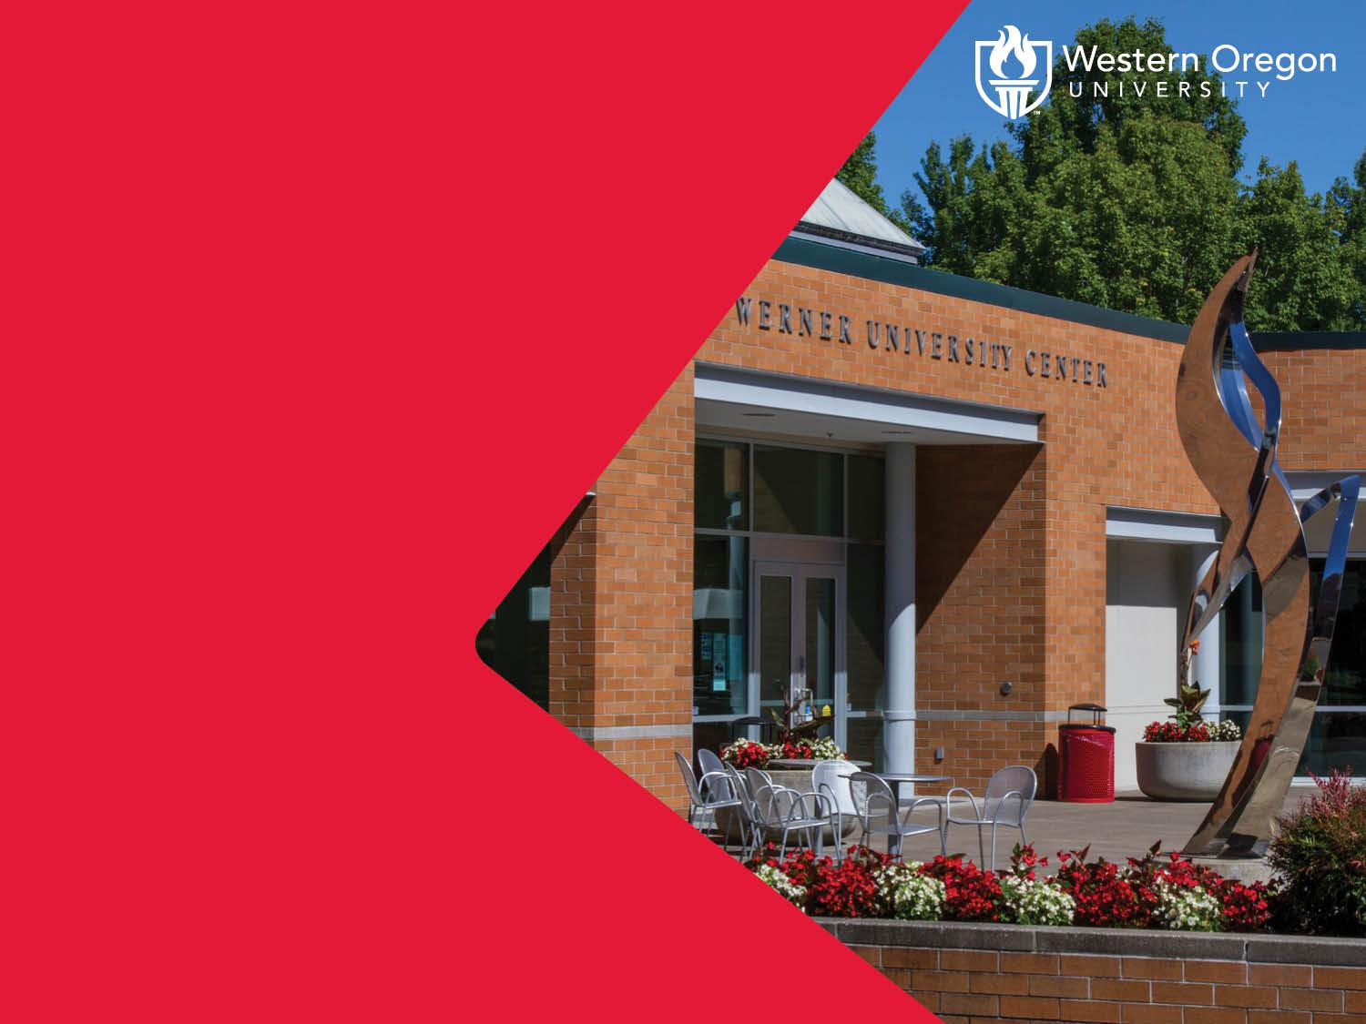
Save the Date!
1st Annual
Kick Off Forum
October 23, 2019 3 - 5pm

Slide 13
Question / Answer

Slide 14
For more information about current and future projects,
please view next three slides or contact me at
ludwigc@wou.edu.

Slide 15

RRCD supports Deaf, DeafBlind, and Hard of Hearing individuals by engaging students, professionals, and stakeholders in innovative research, practices, training and advocacy.
RRCD
Research and Resource Center with Deaf community
Research and Resource Center of the Deaf
Research, Resources and Communication with Deaf community
RRCD: deaf research and resource center
RRCD: Research and Resource Center supporting Deaf*
Research and Resource Center of the Deaf, DeafBlind, and Hard of Hearing (keep abbreviation to RRCD)
Research and Resource Connected with DSPS
Research, Resources and Communication with DSPS
Research and Resource Center of DSPS

Slide 16
Review all Ideas
Ideas List (con’t)
GED Program for D/DB/HH
Federal or State dollars to support students success in academic
Online Classes for
Parents
Government employees
Professional Seminar for
TOD
Interpreters
Professional to provide service
Language Deprivation Study
Implement resource program for Parents
Program for POC families and children
Certification program in Advocacy and Services with the Deaf Community
Video PSA about RRCD thru Social Media
Create LinkedIN account about RRCD
more?
Ideas List
USAID grant in Ghana
Study Abroad
Deaf Interpreter Track
Deaf Seniors • Chestnut Lane
Specific service geared to Deaf POC
Training for Foster Care & Child Welfare
Caseworkers
Families
Collaborate with other country to provide training and/or implement
DHHE opportunity
Interpreting
Services
Host Conference, Symposium or Summit
Educational
Advocacy
Deaf Interpreter

Slide 17

More Ideas
Ideas List (con’t)
Increase research skills and evidence based research: training on CNA
Get deaf researcher on board
Mental health interpreting: certification program?
Investigate resource on international Deaf education
International interpreting ie: ghana, kenya
Demand Control Schema in different country
Create apps: Clerc Center and RIT does app development.
Each Grant to include community outreach
Cultural Studies
Advocacy on Language Deprivation
Innovation online education (fipse grant)
Research Center and how to apply
Oregon high school has three different diploma. Language Deprivation on modified diploma and after graduation
Gallaudet Prep program and SVP (jumpstart) similar to WOU’s SEP
Partner with HSDC to do a “Parent Needs Assessment” similar to CNA.
Ideas List
ASL Corpus (lyra)
Get grant before the DIC3
Stop fingerspelling, ASL (ASL Corpus)
Training SSPs
Training ASL specialists
DB language deprivation
Summercamp - DB mentoring with youth
Vouch for Tactile Communications contract w/ VR to expand their businesses with VR clients
TSPC ASL teaching endorsement
Evaluate K-12 terp in education setting
Grant: develop evaluation instrument materials
NDEC partner with Clerc Center and WOU on Professional Seminar training
Give 3-4 Deaf full ride thru WOU? Pipeline to Success. Start here instead at CCC.
President office waive the tuition to limited pool of students, perhaps 1-2 deaf students?

