Slide 1

STRATEGIC SCORECARD
Faculty Senate | 11/12/19
Laurie Burton, Strategic Plan co-chair

Slide 2
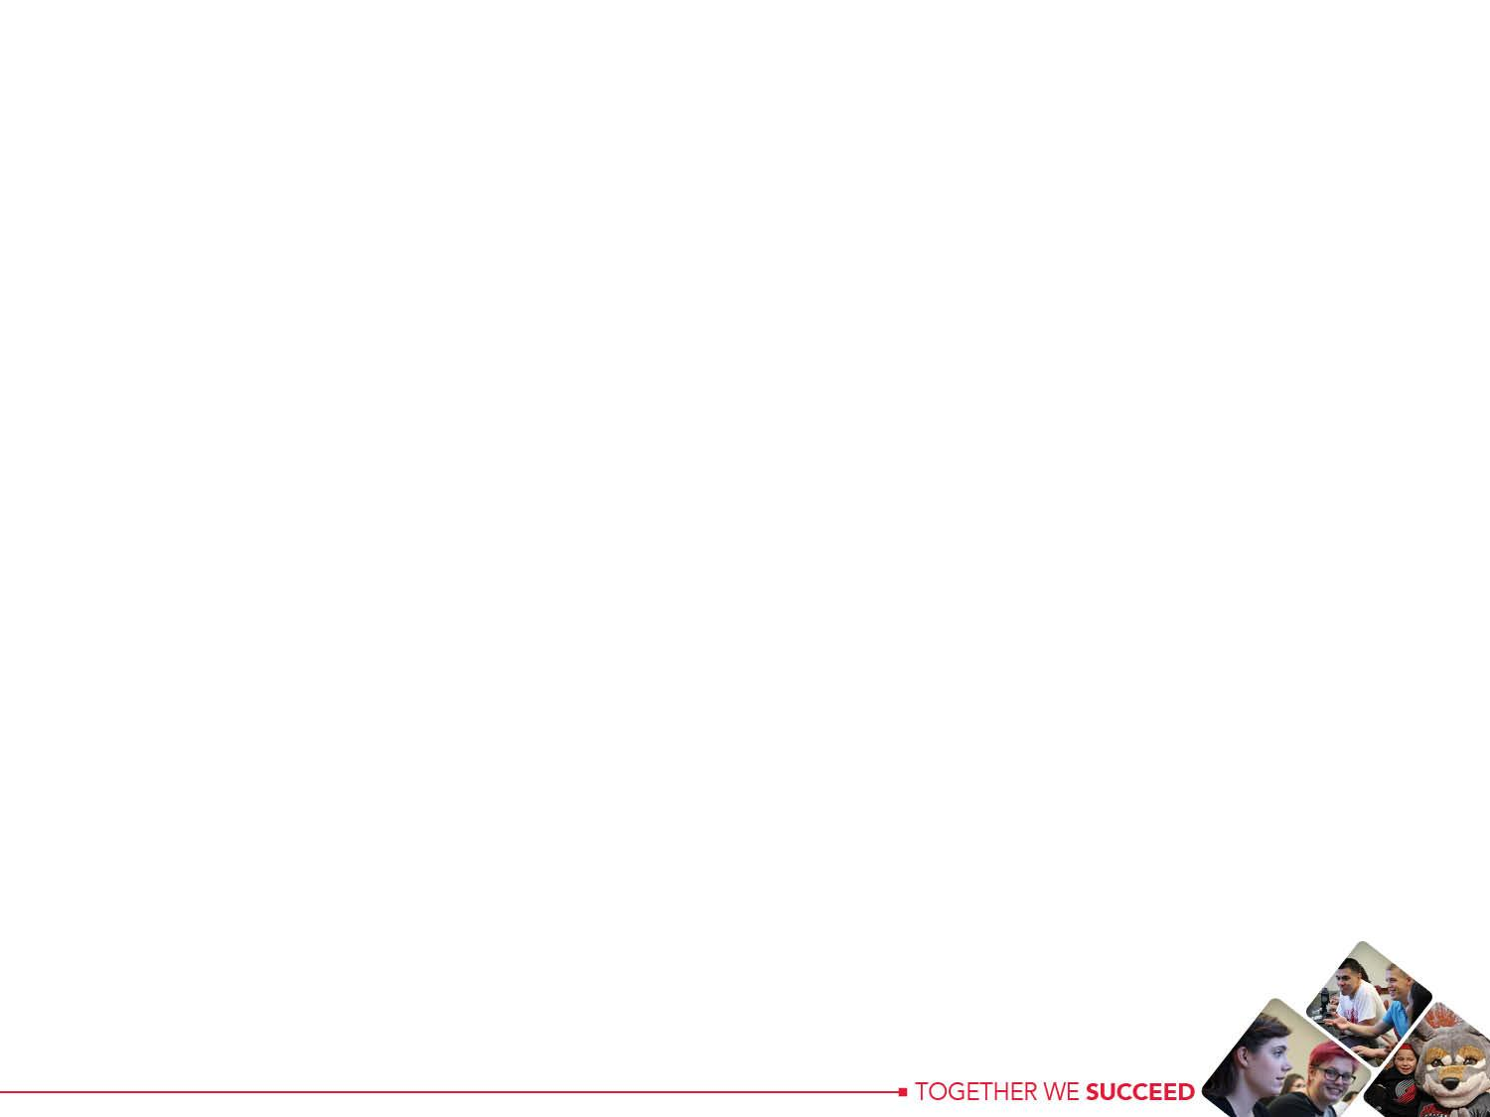

Background: First there was the
Strategic Plan

Slide 3

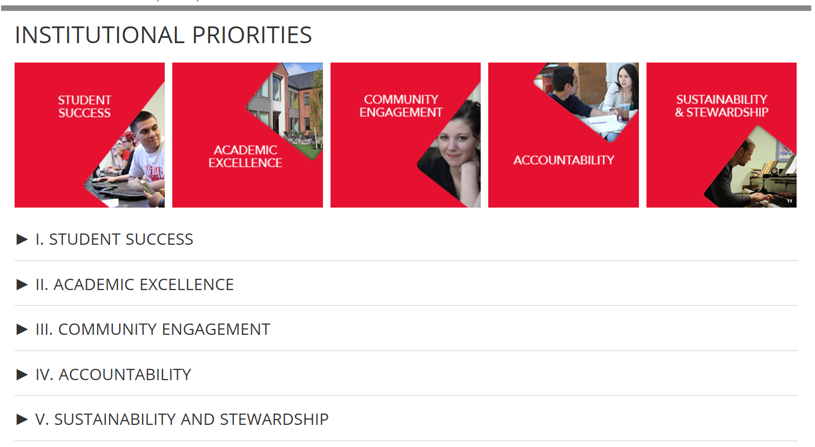
Strategic Plan Site & Campus
The Strategic Planning site, wou.edu/planning was created to help share our plan with the WOU community.

Slide 4

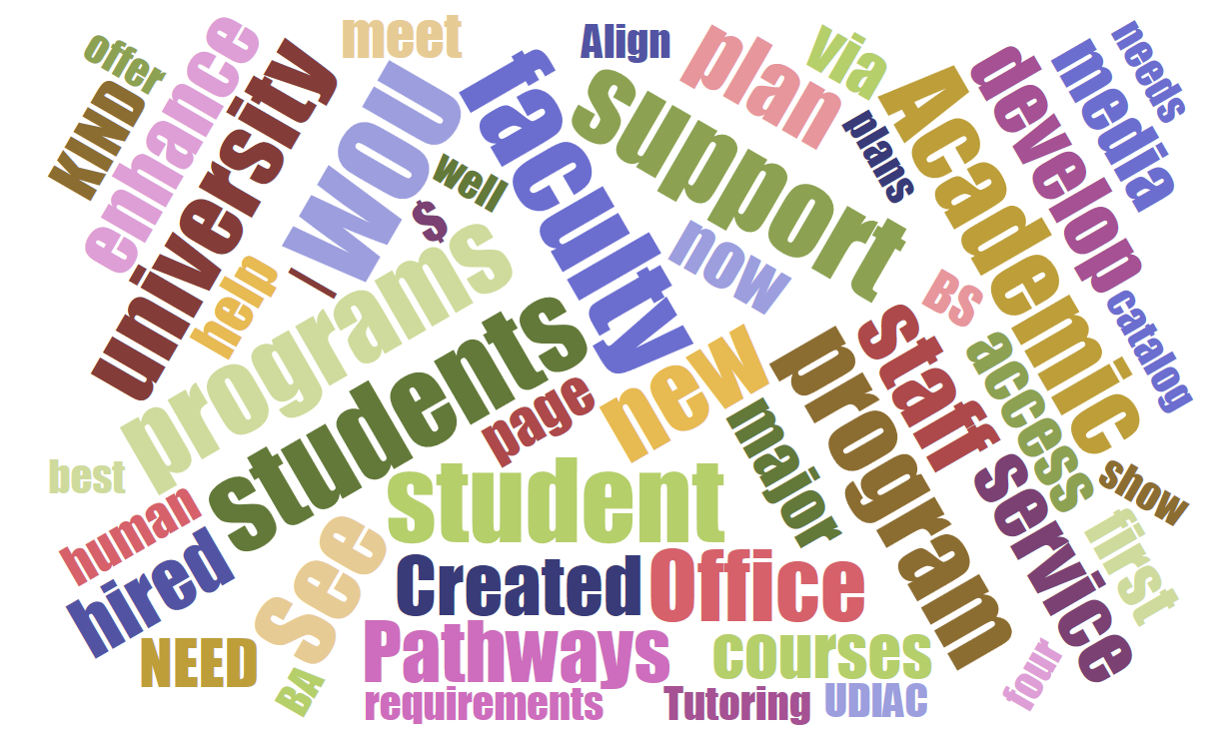
Then the real work began

Slide 5

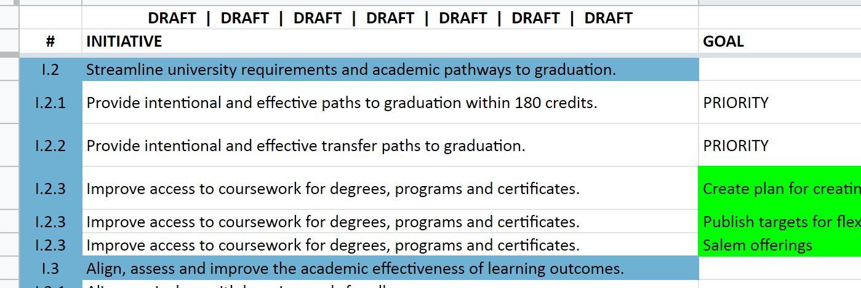
Strategic Initiatives Tracking 17 - 18
University Council members began tracking our progress in the spring of 2018.
We contributed to a spreadsheet of notes on achieving strategic initiatives.

Slide 6

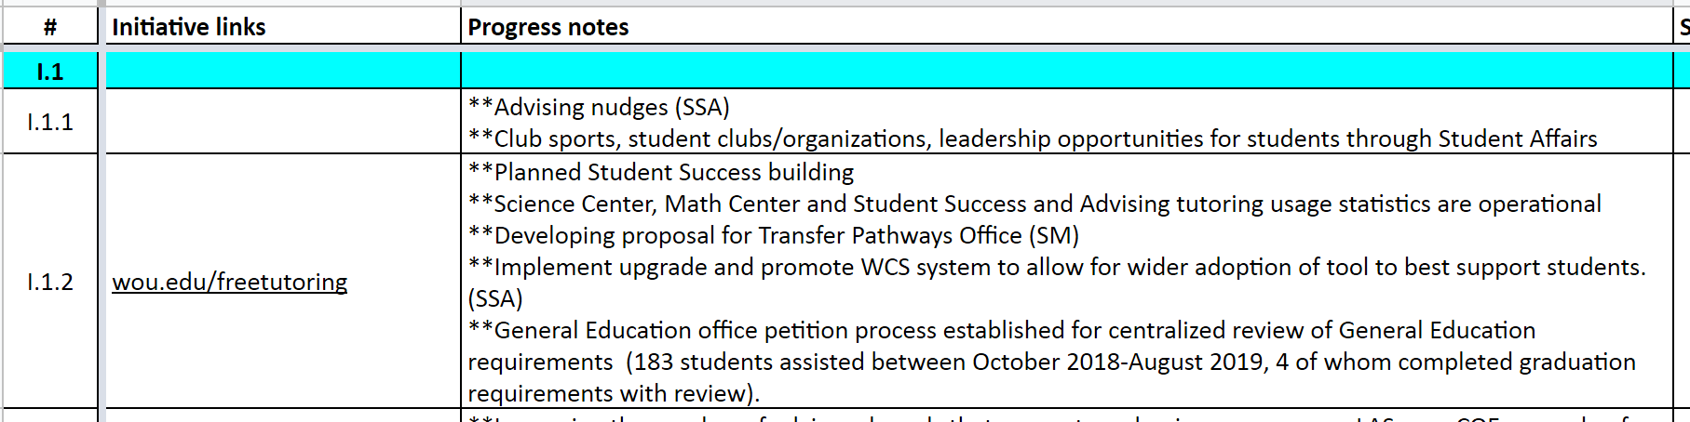
Strategic Initiatives Tracking 18 - 19
Spring – fall 2019 we collected far more information.
Our Strategic Initiatives Score Card 2019 tracking spreadsheet started to fill in.

Slide 7
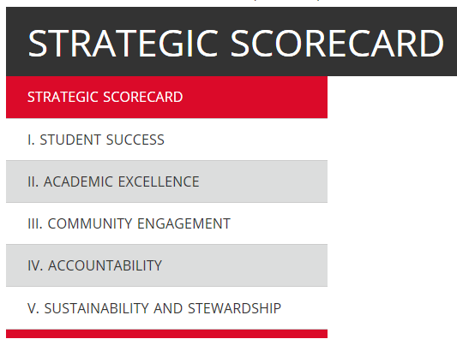
Strategic Scorecard webpage
The University Council members notes have been integrated into a Strategic Scorecard webpage to share with campus.

Slide 8
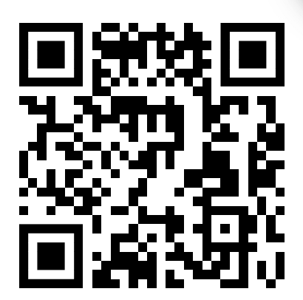
Strategic Scorecard webpage
wou.edu/planning/strategic-scorecard/

Slide 9

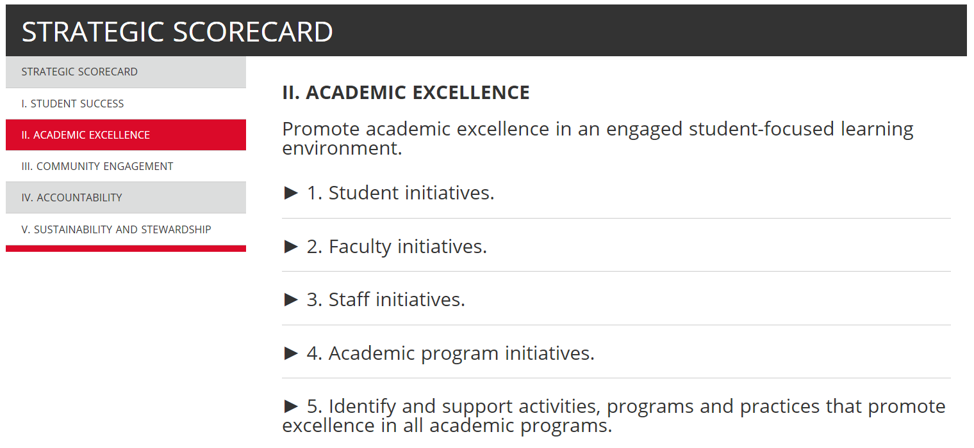
Strategic Scorecard webpage
When you click into the scorecard menu, you’ll find each Institutional Priority stepped out.

Slide 10

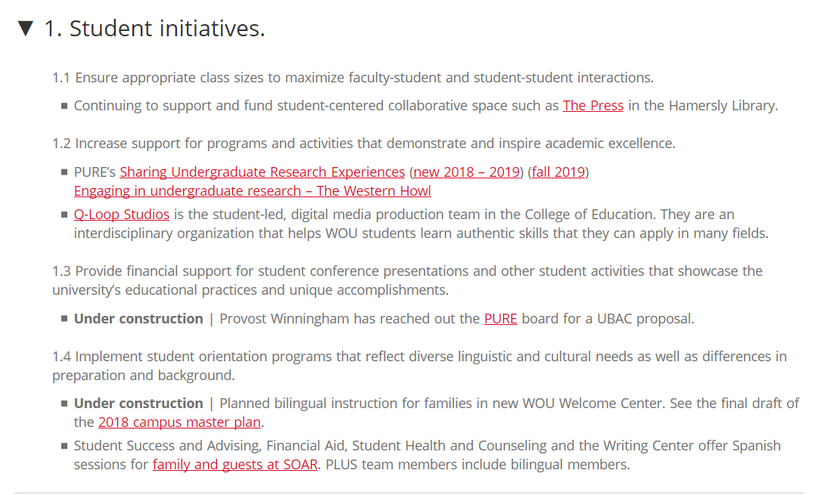
Strategic Scorecard webpage
And for each strategic initiative, you’ll find a list of accomplishments that we’ve noted - SO FAR

Slide 11

Strategic Scorecard - Your ideas
We didn't catch everything!
We’d like your input to capture more of what campus has done.

Slide 12

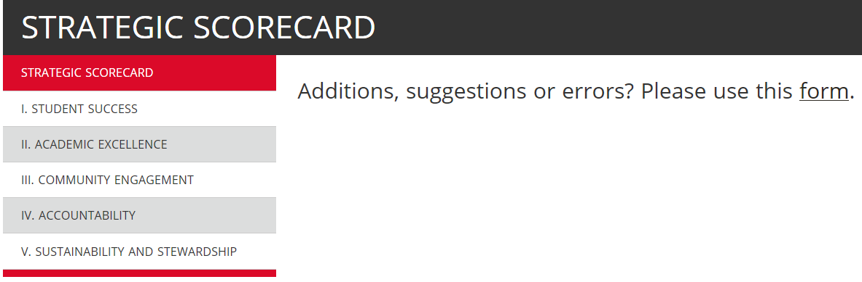
Strategic Scorecard - Your ideas
Allfacstaff sent out tomorrow.
There is a form linked to the page.

Slide 13



Strategic Scorecard

